Slide 1
Package and Access Specifiers

Slide 2
Module Introduction
Introduction to Packages.
Access Control keywords
Field and Method Modifiers

Slide 3

#1 - Packages
Java allows you to group classes in a collection called a package.
Packages are convenient for:
Organizing your work
Separating your work from code libraries provided by others.
The main reason for using packages is to guarantee the uniqueness of class names.
Use your company's Internet domain name written in reverse to guarantee a unique package name
eiu.edu.vn
vn.edu.eiu

Slide 4
Features of Java Packages
A package can have sub packages
A package cannot have two members with the same name.
If a class or interface is bundled inside a package, it must be referenced using it fully qualified name, which is the name of the Java class including its package name.
Package names are written in lowercase

Slide 5
Type of Java packages
Predefined packages
Packages in the Java class libraries, begin with “java.” or “javax.”
User-defined packages
Create by developer.
Java application or applet has accessed by default to the core package “java.lang”

Slide 6
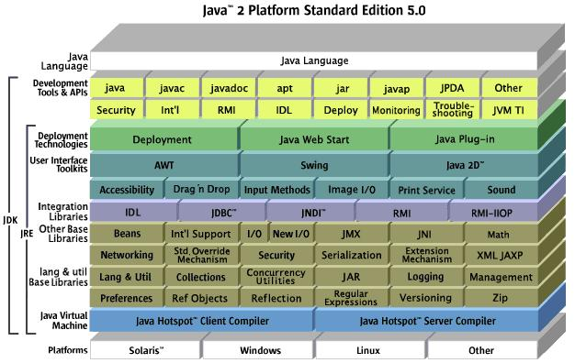
Predefined packages, J2SE Class Libraries

Slide 7
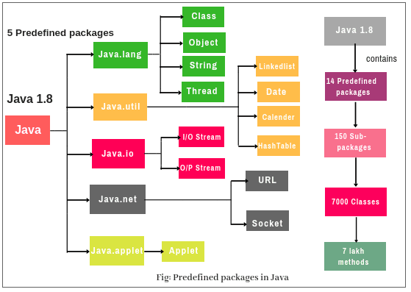
Predefined packages, J2SE Class Libraries

Slide 8
Creating a Package
Choose a name for the package.
Create a folder with the same name as the package.
The naming structure for a package is hierarchical.
Place the source file in the folder created for the package
Put a “package” statement with that name at the top of every source file.
Compile and execute the application.
Use “javac” with “–d” option

Slide 9
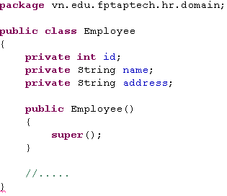
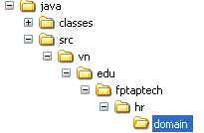
Creating a Package Demo
javac -d classes src/vn/edu/fptaptech/hr/domain/*.java

Slide 10
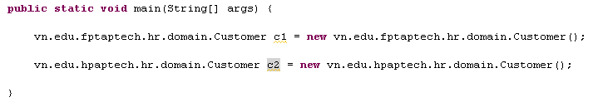
Points to be considered
Classes that are intended to be used outside the package within other programs must be declared public.
If two or more packages define a class with the same name and a program happens to import both packages, then the full name of the class with the package name must be used to avoid conflict.

Slide 11
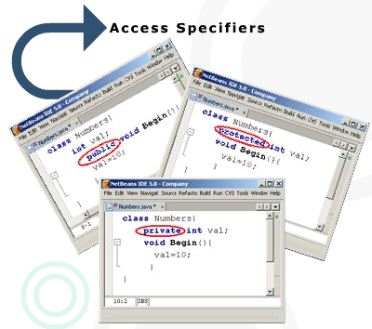
#2 – Access Specifier (Modifiers)
Use to control the access of classes and class members.
Determine whether classes and the members of the classes can be invoked by the other classes or interfaces.
Help to prevent misuse of class details as well as hides the implementation details.

Slide 12
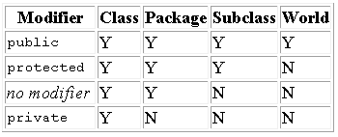
Levels of Access Specifier
Class level.
“public”
class can be accessible everywhere.
“package-private” (default access modifier)
Class can be accessible only by other class in the same package.
Class members (data members, methods and constructors)

Slide 13
Tips on Choosing an Access Level
Use the most restrictive access level that makes sense for a particular member.
Use private unless you have a good reason not to.
Avoid public fields except for constants.
Public fields tend to link you to a particular implementation and limit your flexibility in changing your code.

Slide 14
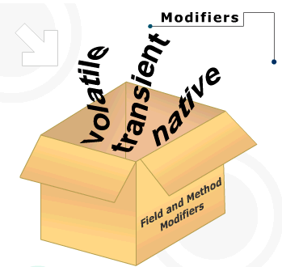
Field and Method Modifiers
Use to identify fields and methods that need to be declare for controlling access to users.

Slide 15
“volatile” Modifier
Only applied to data members.
Allows the content of a variable to be synchronized across all running threads.
When the value of the variable changes or is updated, all threads will reflect the same change.
This modifier is not frequently used.

Slide 16
“native” Modifier
Used only with methods
Indicates that the implementation of the method is in a language other than in Java.
Constructors, fields, classes and interfaces cannot have this modifier.

Slide 17
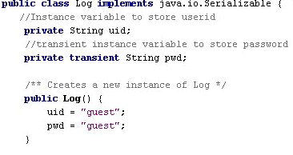
“transient” Modifier
Use to declare fields that are not saved or restored as a part of the state of the object.
“Serialization” in Java converts an object’s internal state into a binary stream of bytes. This stream can be written to a disk or stored in memory

Slide 18
That’s about all for today!
Introduction to Packages.
Access Control keywords
public
private
protected
default
Field and Method Modifiers
volatile
native
transient
Thank you all for your attention and patient!

