Slide 1
Inheritance, Interfaces and Polymorphism
One of the most important concepts of OOP

Slide 2
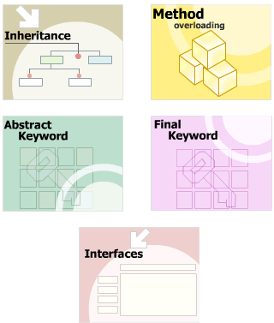
Module Introduction
Inheritance
Constructor Inheritance
Overriding Methods
Overloading of methods
“abstract” class
Using “final” keyword
Interfaces
Polymorphism

Slide 3
#1 - Inheritance
Explain the concept of inheritance
State the purpose of method overriding
State the use of a “super” keyword.

Slide 4
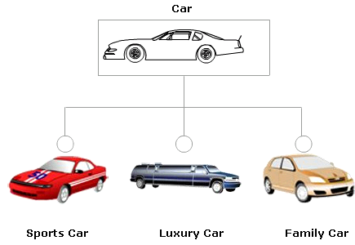
What is Inheritance?
Create a new class from the existing class.
reuse the fields and methods

Slide 5
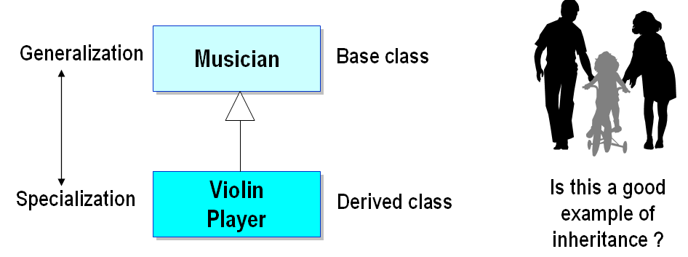
Basic concepts of Inheritance
Superclass
The class from which the subclass is derived is called a
Base class or parent class.
Subclass
Class that is derived from another class
Derived class, extended class, or child class

Slide 6
Inheritance basic concepts cont…
Use “extends” keyword to create a subclass.
A class can be directly derived from only one class (single inheritance)
If a class does not have any superclass, then it is implicitly derived from Object class.
Object class is parent of all Java classes
A subclass can inherit all the “protected” members of its superclass.
Constructors are not inherited by subclasses
The constructor of the superclass can be invoked from the subclass.

Slide 7
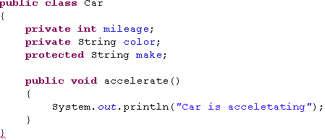

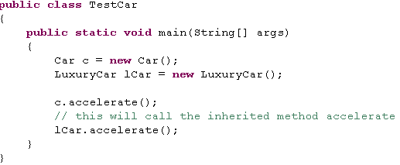

Example of Inheritance

Slide 8
“super” keyword
Use to access superclass’s members and constructors from subclass

Slide 9
#2 - Constructor Inheritance
Describe Constructor Inheritance
Constructor Chaining
Rules for Constructors
Explicitly invoke the base class constructor

Slide 10
Constructor Inheritance
In Java, cannot inherit constructors like inherit methods.
The instance of the derived class will always first invoke the constructor of the base class followed by the constructor of the derived class.
Can explicitly invoke the base class constructor by using the super keyword in the derived class constructor declaration

Slide 11
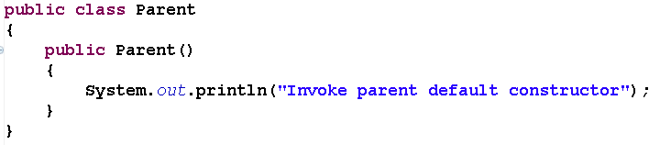
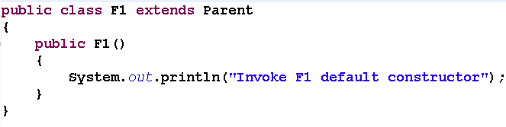
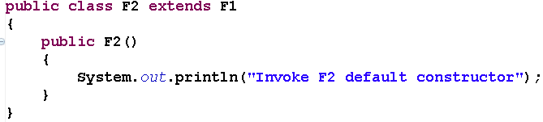
Constructor Chaining
Parent
F1
F2

Slide 12

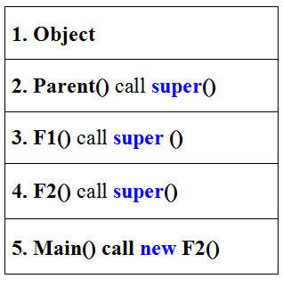
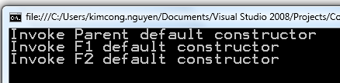
Constructor Chaining
The instance of the derived class will always first invoke the constructor of the base class followed by the constructor of the derived class

Slide 13
Rules for Constructors (MUST be clear and remember)
A default constructor will be automatically generated by the compiler if no constructor is specified within the class.
The default constructor is ALWAYS a no-arg constructor.
If there is a constructor defined in the class, the default constructor is no longer used.
If you don’t explicitly call a base class constructor in a derived class constructor, the compiler attempts to silently insert a call to the base class’s default constructor before executing the code in the derived class constructor

Slide 14
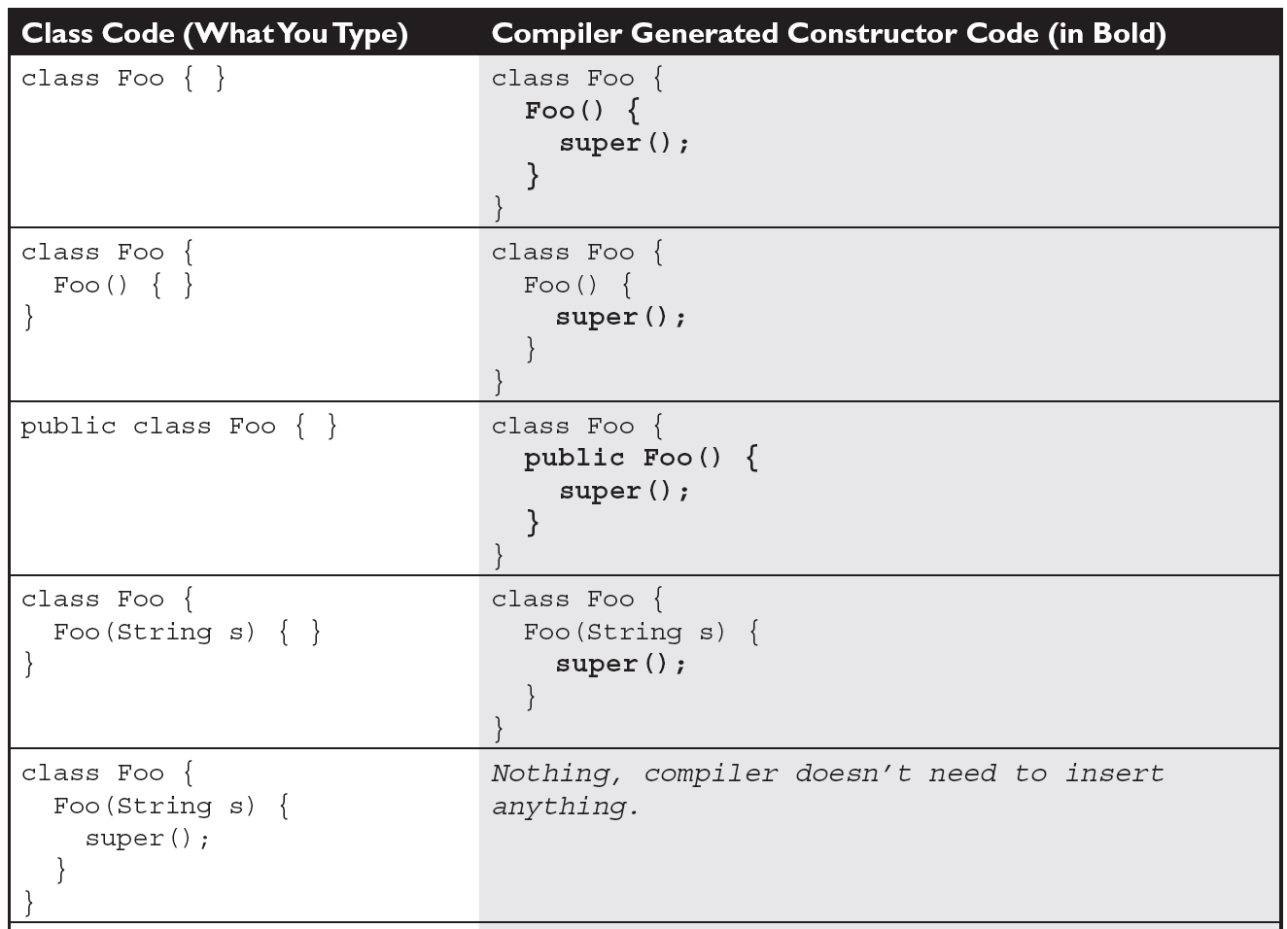
Compiler-Generated Constructor Code

Slide 15
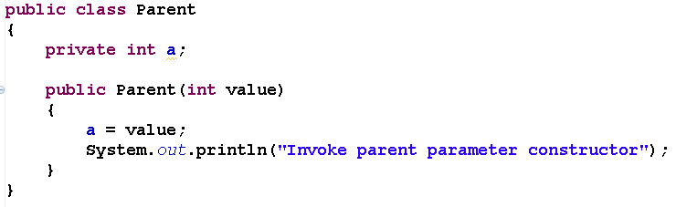
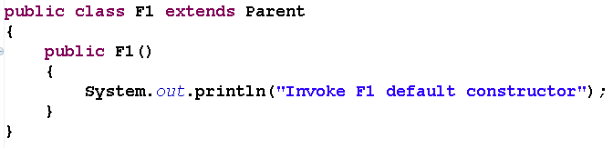
Can you see any bug?

Slide 16
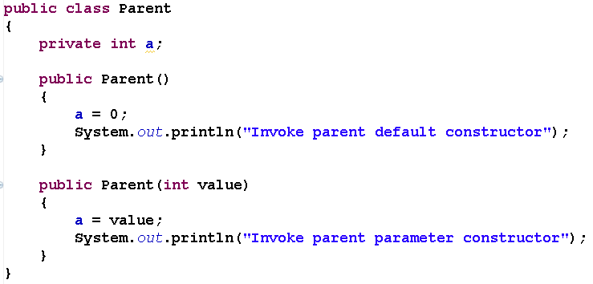
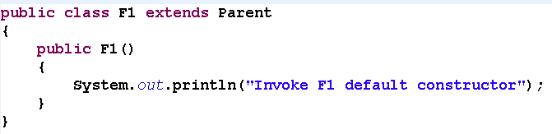
How to fixed?

Slide 17
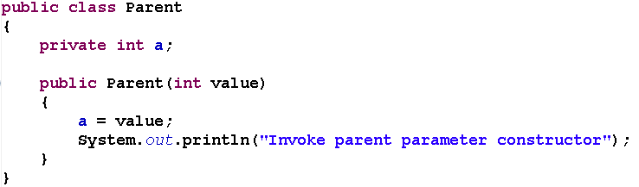
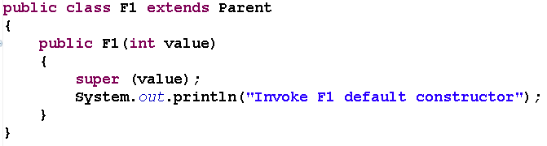
Explicitly invoke the base class constructor

Slide 18
#3 - Overriding Methods
Method Signatures
Define method overriding.

Slide 19
Method Signatures
Method has a signature comprises of:
The number of parameters
The data types of parameters
The order in which the parameters are written.
The return type of a method is not a part of its signature
The signature of the method is written in parentheses next to the method name.

Slide 20
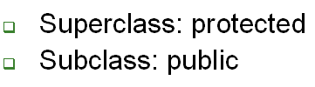


Overriding Methods
Subclass define new method with the same signature as the superclass method.
Overridden method cannot have a weaker “access specifier” than the “access specifier” of the method it overrides.

Slide 21
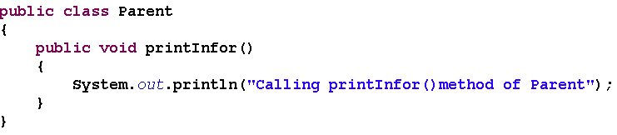
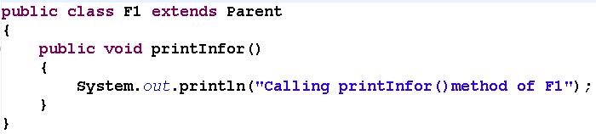
Example of Overriding Methods

Slide 22
“super” keyword
Use to access superclass’s members and constructors from subclass

Slide 23
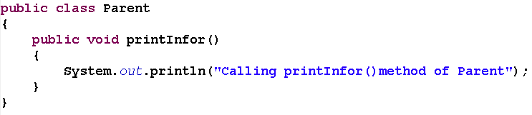
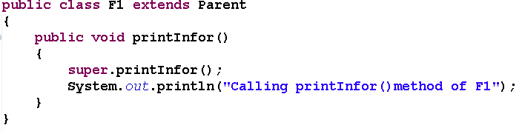
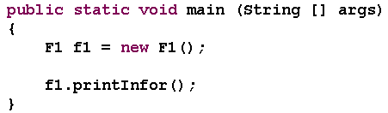

Example of Using “super” keyword

Slide 24
#4 – Overloading Methods
Method Signatures
Describe method overloading
State and explain the “this” keyword.

Slide 25
Method Signatures (review)
Method has a signature comprises of:
The number of parameters
The data types of parameters
The order in which the parameters are written.
The return type of a method is not a part of its signature
The signature of the method is written in parentheses next to the method name.

Slide 26
Overloading Methods
Declaring more than one method with the same method name but different signatures
Constructor overloading
Allows multiple ways of creating instances

Slide 27
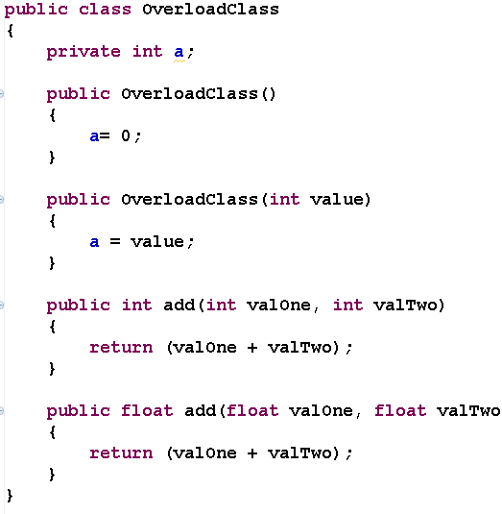
Example of Overloading Methods

Slide 28
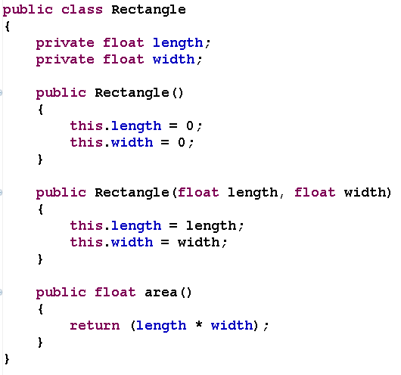
"this" keyword
Refer to the current object of the class.
Used to resolve conflicts between variables having same names and to pass the current object as a parameter
Cannot use the “this” keyword with static variables and methods,

Slide 29
#5 - Abstract Classes
Define abstract classes
Describe how to implement abstract classes
Define abstract methods

Slide 30
“abstract” Classes
To serve as a framework that provides certain behavior for other classes.
Contain zero or more abstract methods
Cannot be instantiated.
Can be inherited.
The subclass must implement “abstract methods” declared in base class
Otherwise it must be declared as abstract.
Declare an abstract class by using the keyword abstract precede class keyword

Slide 31
“abstract” Methods
Method has only declaration and no implementation
Is prefixed with the “abstract” keyword.
The declaration does not contain any braces and is terminated by a semicolon.
An abstract method is only a contract that the subclass will provide its implementation
If a class includes abstract methods, the class itself must be declared abstract

Slide 32
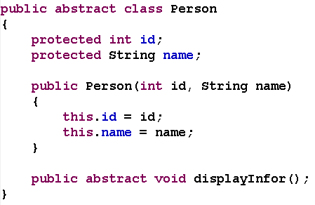
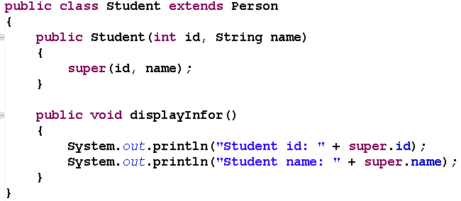
Example of “abstract” Classes and “abstract” Methods

Slide 33
#6 - Final Variables, Methods, Classes
Final Variables
Final Methods
Final Classes

Slide 34
Final Variables
“final’ keyword is used with variables to indicate that they are constant identifiers.
Constant variables are assigned a value at the time of declaration and will not change anytime later.

Slide 35

Final Methods
To prevent a method from being overridden or hidden in a Java subclass.
If a change in implementation of method effects the consistent state of the object
Method that are declared private or part of the final class are implicitly final.
The final method cannot declared as abstract.

Slide 36

Final Classes
A class that cannot be subclassed.
May or may not have final methods.
Final classes can be instantiated

Slide 37
#7 - Interfaces
Introduction to Interfaces
Implementing Multiple Interfaces

Slide 38
What is an Interface?
An interface is defined as a reference type
Has only final variables, abstract methods signatures.
Interface Methods Do Not Contain Method Bodies
Cannot be instantiated.
Can only be inherited by classes or other interfaces.
A class that implements an interface is required to provide implementations for all the methods of the interface or else should be declared abstract.

Slide 39
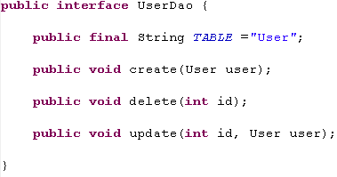
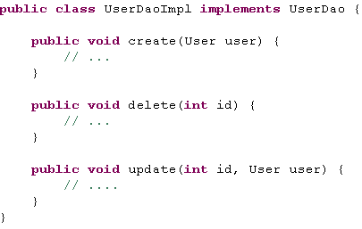
Example of Interface

Slide 40
Implementing Multiple Interfaces
An interface can extend zero or more interfaces
Multiple interfaces can be implemented in a single class.
This implementation provides the functionality of multiple inheritance.
Implement multiple interfaces by placing commas between the interface names when implementing them in a class.
A class must implement all inherited interface methods

Slide 41


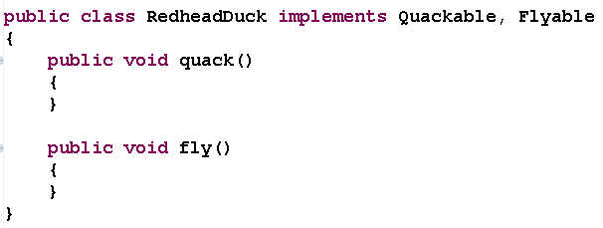
Example of Implementing Multiple Interfaces

Slide 42
Polymorphism
Define polymorphism in Java
Explain how to implement polymorphism
Describe compile and run-time polymorphism

Slide 43
Define polymorphism in Java
Polymorphism means existing in multiple forms.
The ability of an entity to behave differently in different situations
Polymorphism allows methods to function differently based on the parameters and their data types
Implement polymorphism in Java through:
Method overloading (Compile-time Polymorphism)
Method overriding (Run-time Polymorphism)

Slide 44
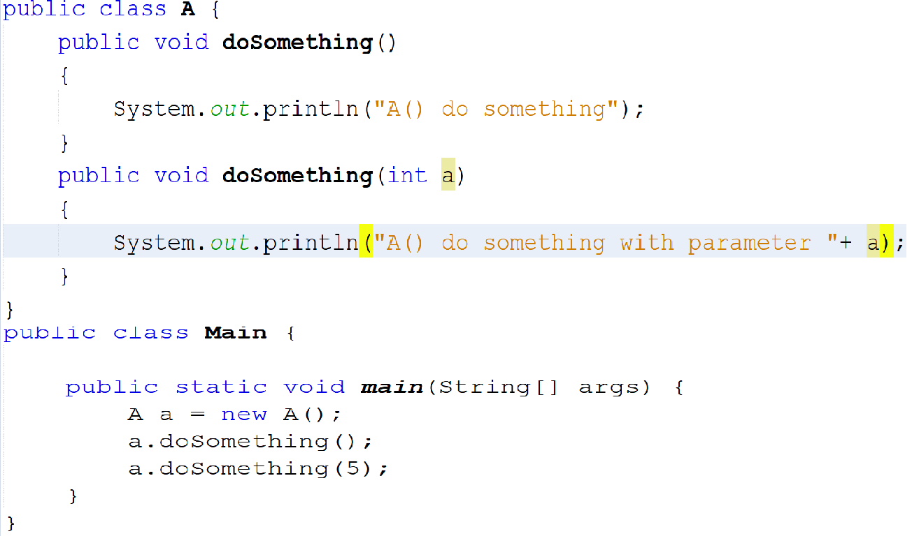

Example of polymorphism in Java (Compile-Time)

Slide 45
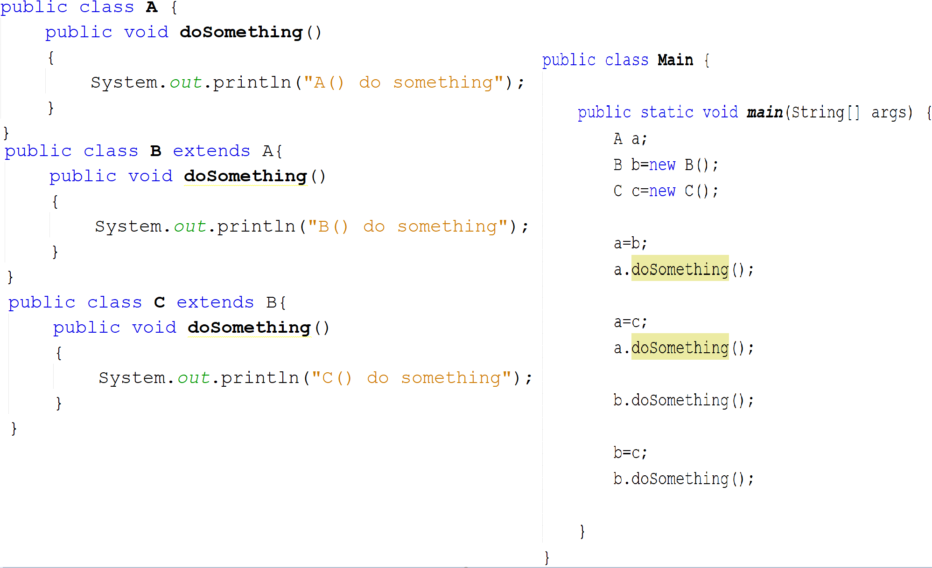
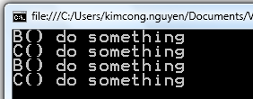
Example of polymorphism in Java (Run-Time)
A
B
C

Slide 46
Compile-time and Run-time Polymorphism
Compile-time Polymorphism
Implemented through method overloading
Executed at the compile-time
Referred to as static polymorphism
Run-time Polymorphism
Implemented through method overriding
Executed at run-time
Referred to as dynamic polymorphism

Slide 47
That’s about all for today!
Inheritance
Constructor Inheritance
Overriding Methods
Overloading of methods
“abstract” class
Using “final” keyword
Interfaces
Polymorphism
Thank you all for your attention and patient !

