Slide 1
Automated Multi-Level
Parking Management System

Slide 2
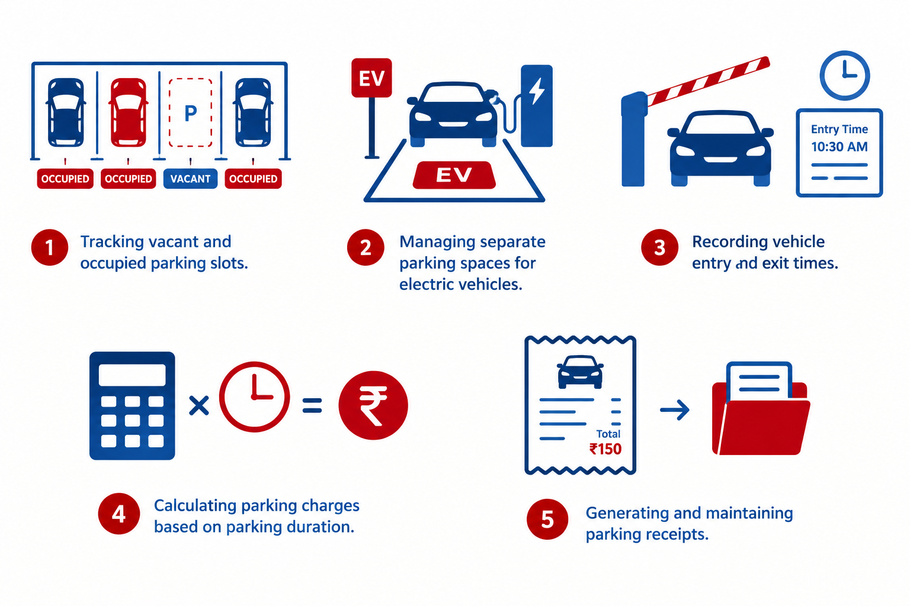
The 5 Manual Problems

Slide 3
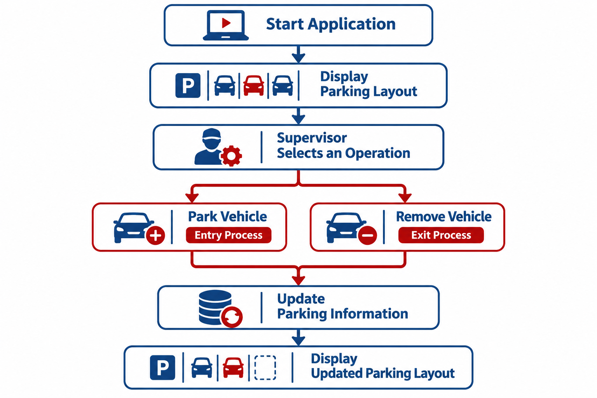
How a Supervisor uses the Application

Slide 4
How does the Application represent Multiple Floors and Parking Slots?

Slide 5
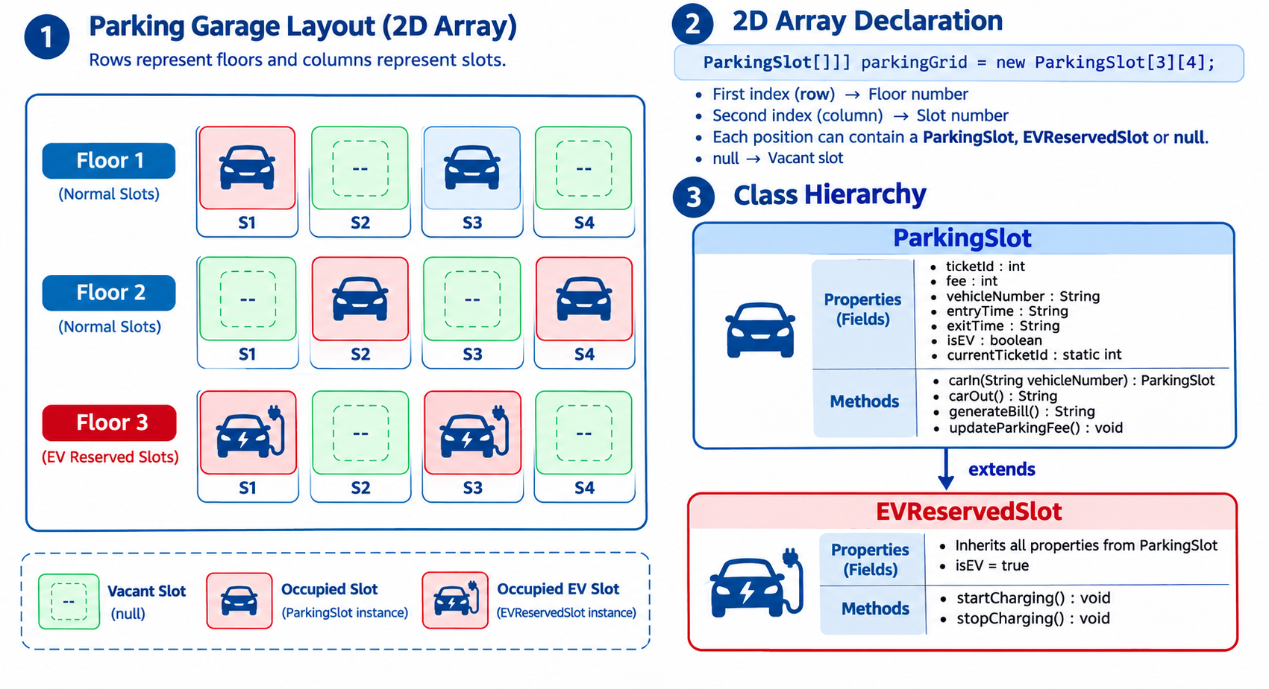
Representing Floors and Parking Slots

Slide 6
What Happens When a Vehicle Enters or Exits the Garage?

Slide 7
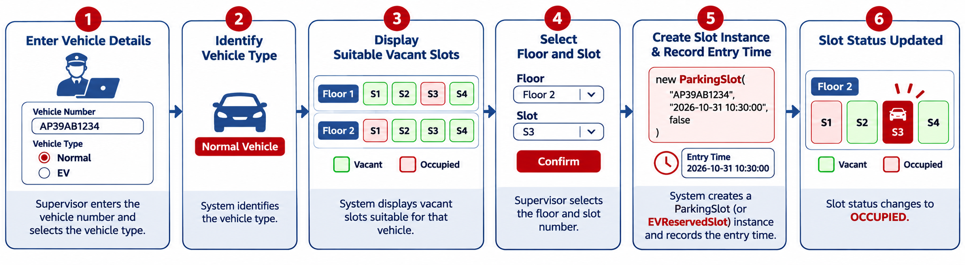
What happens when Car Enters?

Slide 8
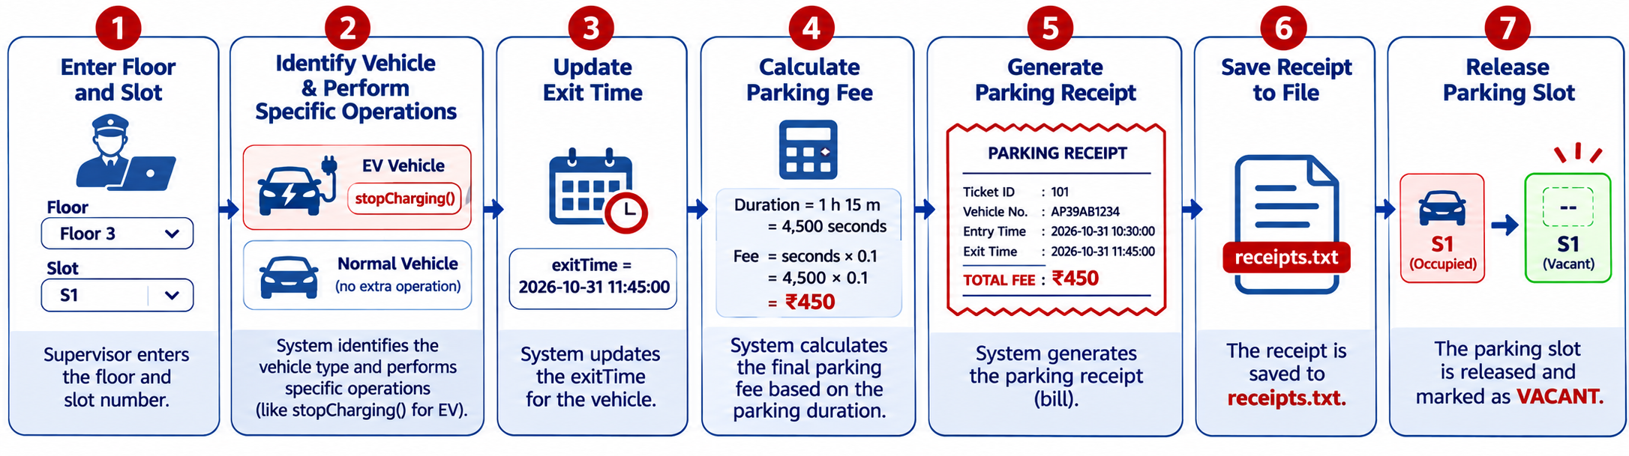
What happens when Car Exits?

Slide 9
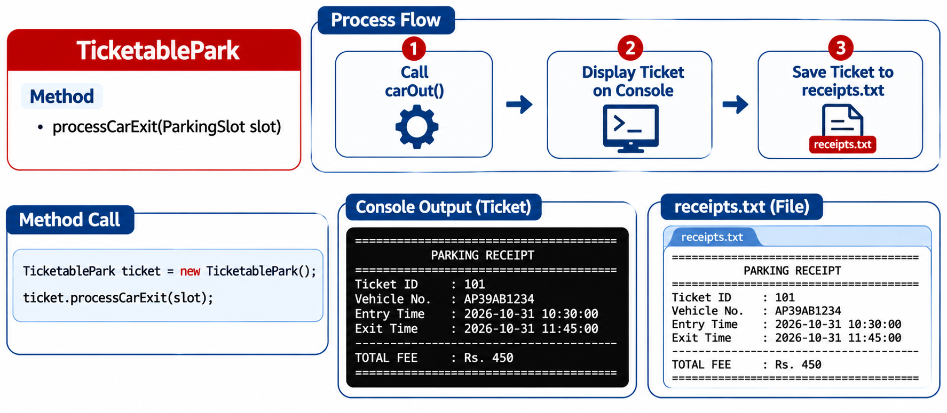
Ticket Generation & File Saving

Slide 10
How does the System continuously update the Fees for Parked Vehicles?

Slide 11
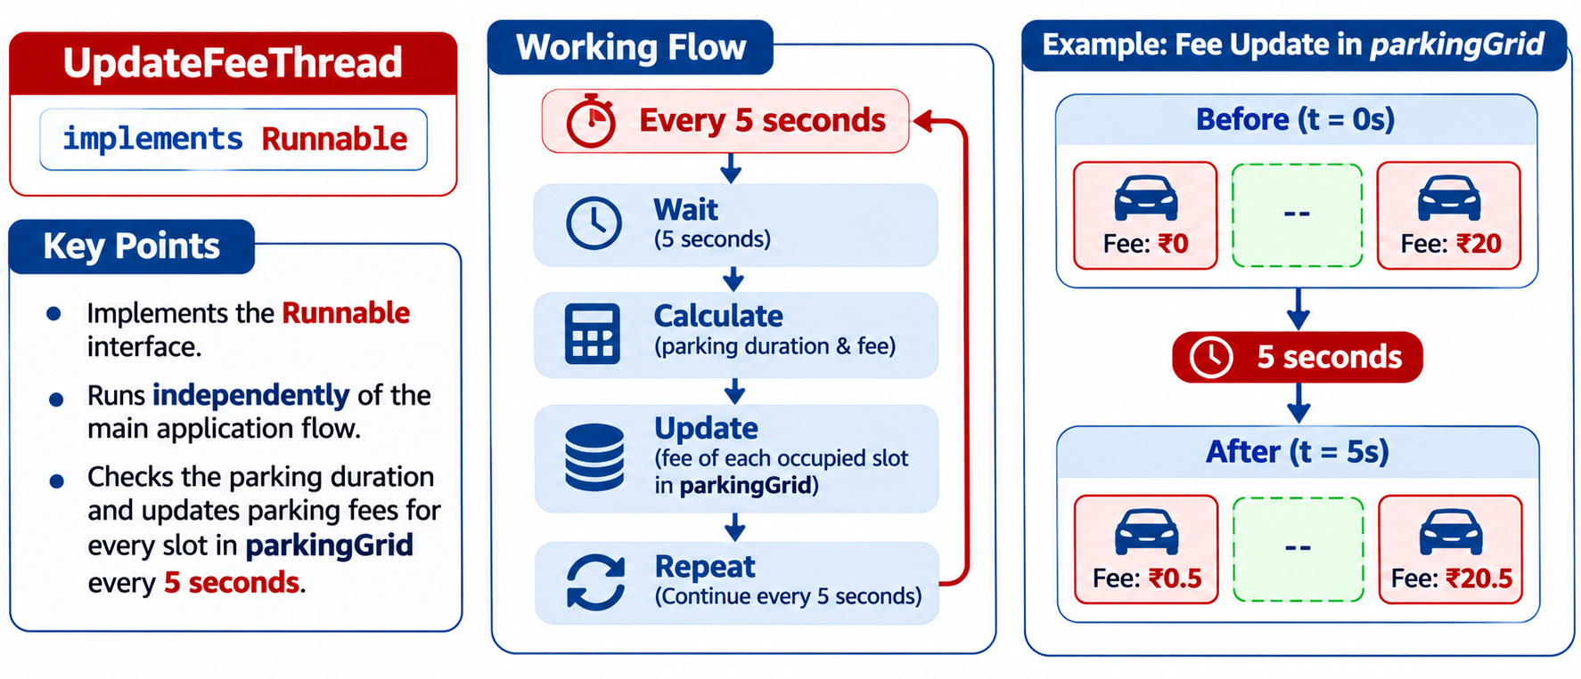
Update Fee Thread

Slide 12
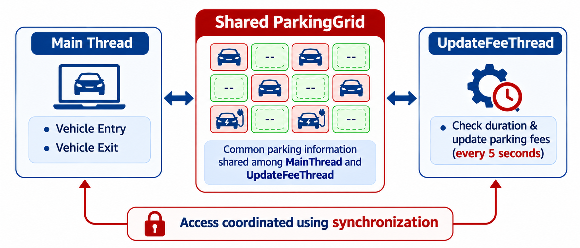
Synchronization of Parking Grid

Slide 13
What happens if a New Vehicle arrives when all Parking Slots are Occupied?

Slide 14
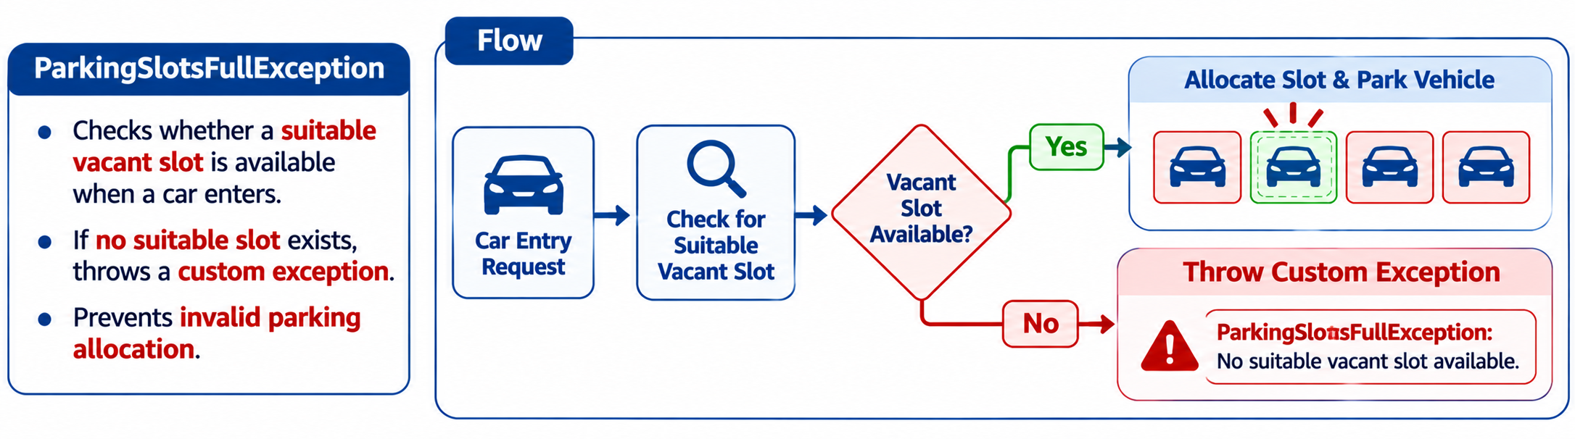
Handling Garage Full Conditions

Slide 15
Let’s see the
Project Demonstration!

