Slide 1
Web程式設計
JavaScript 2
授課教師:陳錫民
Email: hsiminc@fcu.edu.tw

Slide 2
JavaScript Where To
The <script> Tag
In HTML, JavaScript code must be inserted between <script> and </script> tags.
<!DOCTYPE html>
<html>
<body>
<h2>JavaScript in Body</h2>
<p id="demo"></p>
<script>
document.getElementById("demo").innerHTML = "My First JavaScript";
</script>
</body>
</html>

Slide 3
JavaScript Where To
JavaScript in <head> or <body>
You can place any number of scripts in an HTML document.
Scripts can be placed in the <body>, or in the <head> section of an HTML page, or in both.
Placing scripts at the bottom of the <body> element improves the display speed, because script compilation slows down the display.
<!DOCTYPE html> <html> <body> <h1>A Web Page</h1> <p id="demo">A Paragraph</p> <button type="button" onclick="myFunction()">Try it</button> <script> function myFunction() { document.getElementById("demo").innerHTML = "Paragraph changed."; } </script> </body> </html>

Slide 4
JavaScript Where To
External JavaScript
Scripts can also be placed in external files
External scripts are practical when the same code is used in many different web pages.
JavaScript files have the file extension .js.
To use an external script, put the name of the script file in the src (source) attribute of a <script> tag
<!DOCTYPE html> <html> <body> <script src="myScript.js"></script> </body> </html>

Slide 5
JavaScript Output
JavaScript can "display" data in different ways:
Writing into an HTML element, using innerHTML.
Writing into the HTML output using document.write().
Writing into an alert box, using window.alert().
Writing into the browser console, using console.log().

Slide 6
Using innerHTML
To access an HTML element, JavaScript can use the document.getElementById(id) method.
The id attribute defines the HTML element. The innerHTML property defines the HTML content
<!DOCTYPE html> <html> <body> <h1>My First Web Page</h1> <p>My First Paragraph</p> <p id="demo"></p> <script> document.getElementById("demo").innerHTML = 5 + 6; </script> </body> </html>

Slide 7
Using document.write()
<!DOCTYPE html> <html> <body> <h1>My First Web Page</h1> <p>My first paragraph.</p> <script> document.write(5 + 6); </script> </body> </html>
Using document.write() after an HTML document is fully loaded, will delete all existing HTML:
<!DOCTYPE html> <html> <body> <h1>My First Web Page</h1> <p>My first paragraph.</p> <button onclick="document.write(5 + 6)">Try it</button> </body> </html>

Slide 8
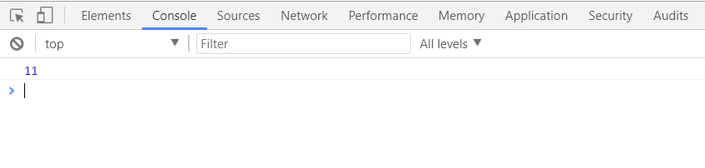
Using console.log()
For debugging purposes, you can use the console.log() method to display data.
<!DOCTYPE html> <html> <body> <script>
var i = 5 + 6; console.log(i); </script> </body> </html>

Slide 9
JavaScript Data Types
JavaScript variables can hold many data types:
numbers,
strings,
objects
and more:
var length = 16; // Number var lastName = "Johnson"; // String var x = {firstName:"John", lastName:"Doe"}; // Object

Slide 10
When adding a number and a string, JavaScript will treat the number as a string.
JavaScript evaluates expressions from left to right. Different sequences can produce different results:
<!DOCTYPE html>
<html>
<body>
<h2>JavaScript</h2>
<p id="demo1"></p>
<p id="demo2"></p>
<script>
var x = 16 + 4 + "Volvo";
var y = "Volvo"+16 + 4 +;
document.getElementById("demo1").innerHTML = x;
document.getElementById("demo2").innerHTML = y;
</script>
</body>
</html>

Slide 11
JavaScript Types are Dynamic
JavaScript has dynamic types. This means that the same variable can be used to hold different data types
The typeof Operator
You can use the JavaScript typeof operator to find the type of a JavaScript variable
var x; // Now x is undefined
var x = 5; // Now x is a Number
var x = "John"; // Now x is a String
typeof "John" // Returns "string“
typeof 3.14 // Returns "number"

Slide 12
Undefined, Empty and Null
In JavaScript, a variable without a value, has the value undefined. The typeof is also undefined.
var car; // Value is undefined, type is undefined
Empty Values
An empty string has both a legal value and a type.
var car = ""; // The value is "", the typeof is "string“
Null
In JavaScript null is "nothing". It is supposed to be something that doesn't exist.
var person = {firstName:"John", lastName:"Doe", age:50, eyeColor:"blue"};
person = null; // Now value is null, but type is still an object

Slide 13
Undefined, Empty and Null
Difference Between Undefined and Null
Undefined and null are equal in value but different in type:
typeof undefined // undefined typeof null // object null === undefined // false null == undefined // true

Slide 14
JavaScript Functions
A JavaScript function is defined with the function keyword, followed by a name, followed by parentheses ().
Function names can contain letters, digits, underscores, and dollar signs (same rules as variables).
The parentheses may include parameter names separated by commas:
(parameter1, parameter2, ...)
Function Return
When JavaScript reaches a return statement, the function will stop executing.
Functions often compute a return value. The return value is "returned" back to the "caller"

Slide 15
JavaScript Functions
<!DOCTYPE html>
<html>
<body>
<h2>JavaScript Functions</h2>
<p id="demo"></p>
<script>
function myFunction(a, b) {
return a * b;
}
document.getElementById("demo").innerHTML = myFunction(4, 3);
</script>
</body>
</html>

Slide 16
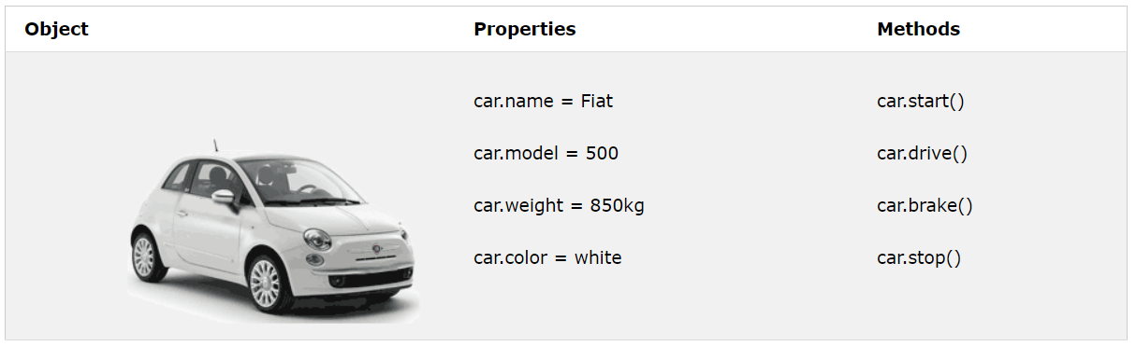
JavaScript Objects
Real Life Objects, Properties, and Methods
In real life, a car is an object.
A car has properties like weight and color, and methods like start and stop

Slide 17
JavaScript Objects
Objects are variables too. But objects can contain many values
The values are written as name:value pairs
The name:values pairs (in JavaScript objects) are called properties.
<!DOCTYPE html>
<html>
<body>
<p>Creating a JavaScript Object.</p>
<p id="demo"></p>
<script>
var car = {type:"Fiat", model:"500", color:"white"};
document.getElementById("demo").innerHTML = car.type;
</script>
</body>
</html>

Slide 18
Object Methods
Methods are actions that can be performed on objects.
Methods are stored in properties as function definitions.
<!DOCTYPE html>
<html>
<body>
<p id="demo"></p>
<script>
var person = {
firstName: "John",
lastName : "Doe",
id : 5566,
fullName : function() {
return this.firstName + " " + this.lastName;
}
};
document.getElementById("demo").innerHTML = person.fullName();
</script>
</body>
</html>
If you access the fullName method, without (), it will return the function definition:

Slide 19
JavaScript Scope
Scope determines the accessibility (visibility) of variables.
In JavaScript there are two types of scope:
Local scope
Global scope
JavaScript has function scope: Each function creates a new scope.
Variables defined inside a function are not accessible (visible) from outside the function.

Slide 20
Local JavaScript Variables
Variables declared within a JavaScript function, become LOCAL to the function.
Local variables have local scope: They can only be accessed within the function.
<!DOCTYPE html>
<html>
<body>
<p id="demo"></p>
<script>
myFunction();
document.getElementById("demo").innerHTML =
"The type of carName is " + typeof carName;
function myFunction() {
var carName = "Volvo";
}
</script>
</body>
</html>

Slide 21
Global JavaScript Variables
A variable declared outside a function, becomes GLOBAL.
A global variable has global scope: All scripts and functions on a web page can access it.
<!DOCTYPE html>
<html>
<body>
<p id="demo"></p>
<script>
var carName = "Volvo";
myFunction();
function myFunction() {
document.getElementById("demo").innerHTML =
"I can display " + carName;
}
</script>
</body>
</html>

Slide 22
Automatically Global
If you assign a value to a variable that has not been declared, it will automatically become a GLOBAL variable.
This code example will declare a global variable carName, even if the value is assigned inside a function.
<!DOCTYPE html>
<html>
<body>
<p id="demo"></p>
<script>
myFunction();
// code here can use carName as a global variable
document.getElementById("demo").innerHTML = "I can display " + carName;
function myFunction() {
carName = "Volvo";
}
</script>
</body>
</html>

Slide 23
JavaScript Events
HTML events are "things" that happen to HTML elements.
When JavaScript is used in HTML pages, JavaScript can "react" on these events.
An HTML event can be something the browser does, or something a user does.
Here are some examples of HTML events:
An HTML web page has finished loading
An HTML input field was changed
An HTML button was clicked
Often, when events happen, you may want to do something.
JavaScript lets you execute code when events are detected.

Slide 24
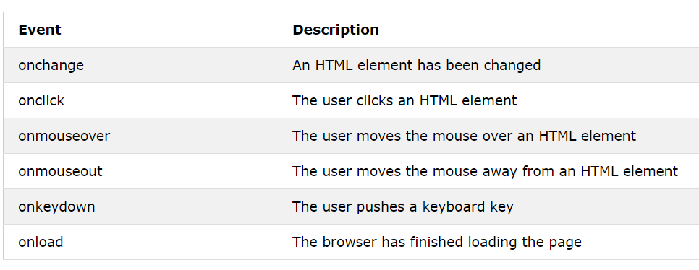
JavaScript Events
Common HTML Events

Slide 25
JavaScript Events
HTML allows event handler attributes, with JavaScript code, to be added to HTML elements.
<!DOCTYPE html>
<html>
<body>
<button onclick="document.getElementById('demo').innerHTML=Date()">The time is?</button>
<p id="demo"></p>
</body>
</html>
<!DOCTYPE html>
<html>
<body>
<button onclick="displayDate()">The time is?</button>
<script>
function displayDate() {
document.getElementById("demo").innerHTML = Date();
}
</script>
<p id="demo"></p>
</body>
</html>

Slide 26
JavaScript Strings
A JavaScript string simply stores a series of characters like "John Doe".
A string can be any text inside quotes. You can use single or double quotes:
String Length
The length of a string is found in the built in property length:
var carname = "Volvo XC60"; var carname = 'Volvo XC60';
var txt = "ABCDEFGHIJKLMNOPQRSTUVWXYZ"; var sln = txt.length;

Slide 27
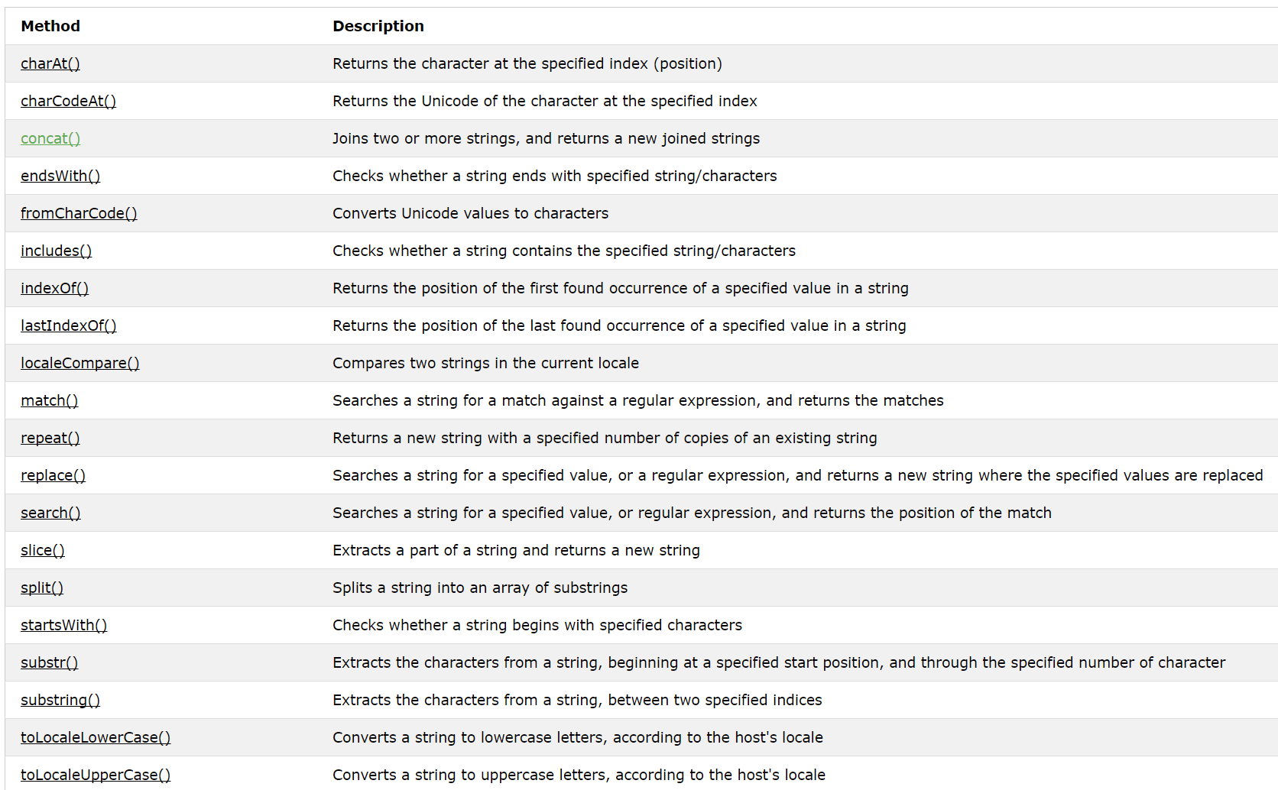
JavaScript Strings
JavaScript String Methods
Ref: https://www.w3schools.com/js/js_events.asp

Slide 28
JavaScript Strings
Example: Converting to Upper and Lower Case
<!DOCTYPE html>
<html>
<body>
<p>Convert string to upper case:</p>
<button onclick="myFunction()">Try it</button>
<p id="demo">Hello World!</p>
<script>
function myFunction() {
var text = document.getElementById("demo").innerHTML;
document.getElementById("demo").innerHTML = text.toUpperCase();
}
</script>
</body>
</html>

Slide 29
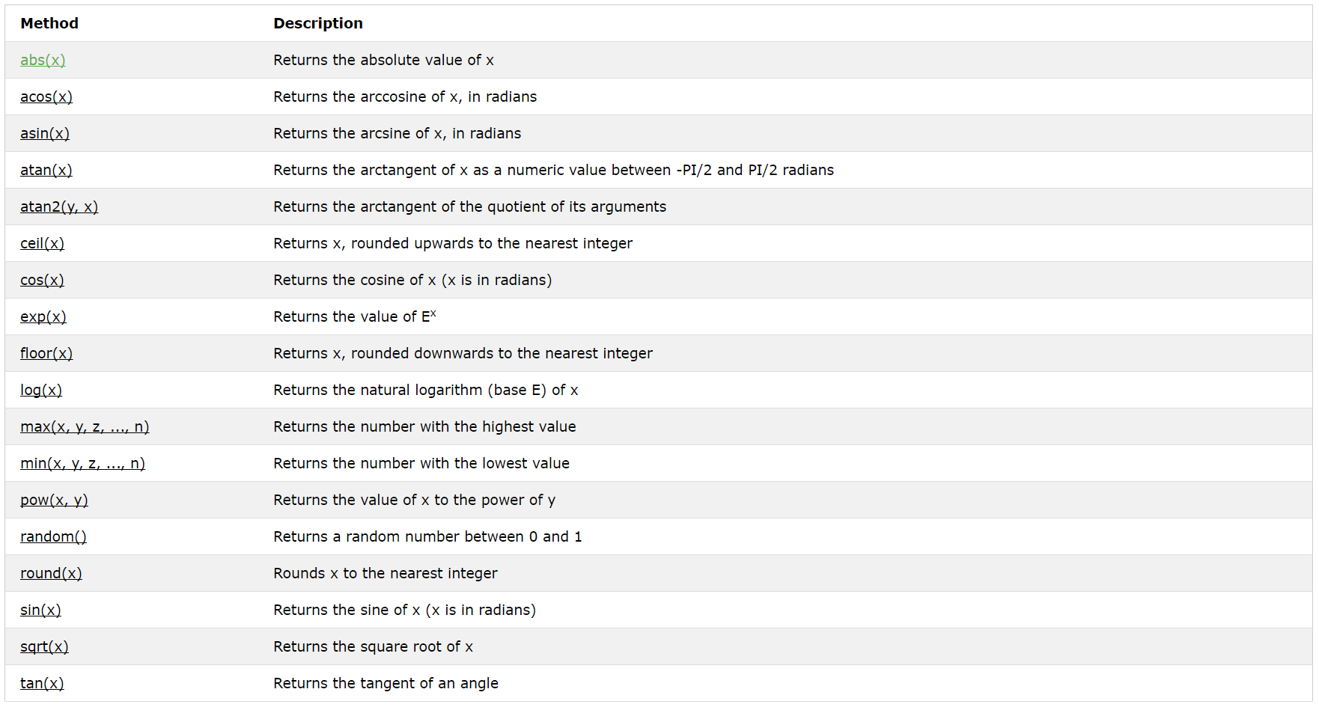
JavaScript Math Object
The JavaScript Math object allows you to perform mathematical tasks on numbers
Ref: https://www.w3schools.com/jsref/jsref_obj_math.asp

Slide 30
JavaScript Math Object
Example: JavaScript Math.round()
<!DOCTYPE html>
<html>
<body>
<h2>JavaScript Math.round()</h2>
<p id="demo"></p>
<script>
document.getElementById("demo").innerHTML = Math.round(4.4);
</script>
</body>
</html>

Slide 31
JavaScript Date Object
The Date object lets you work with dates (years, months, days, hours, minutes, seconds, and milliseconds)
A JavaScript date can be written as a string:
Tue Nov 28 2017 15:33:08 GMT+0800 (台北標準時間)
or as a number:
1511854388352
Dates written as numbers, specifiy the number of milliseconds since January 1, 1970, 00:00:00.

Slide 32
JavaScript Date Object
Displaying Dates
<!DOCTYPE html>
<html>
<body>
<p id="demo"></p>
<script>
document.getElementById("demo").innerHTML = Date();
</script>
</body>
</html>
<!DOCTYPE html>
<html>
<body>
<p id="demo"></p>
<script>
var d = new Date();
document.getElementById("demo").innerHTML = d;
</script>
</body>
</html>

Slide 33
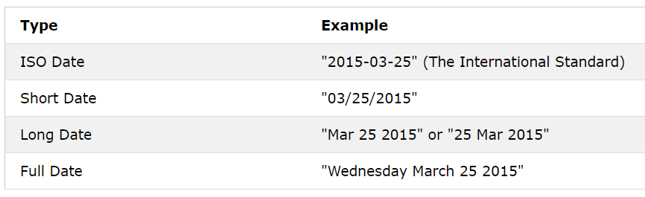
JavaScript Date Formats
There are generally 4 types of JavaScript date input formats

Slide 34
JavaScript Date Formats
Example: ISO Dates
<!DOCTYPE html>
<html>
<body>
<h2>JavaScript ISO Dates</h2>
<p id="demo"></p>
<script>
document.getElementById("demo").innerHTML = new Date("2015-03-25");
</script>
</body>
</html>

Slide 35
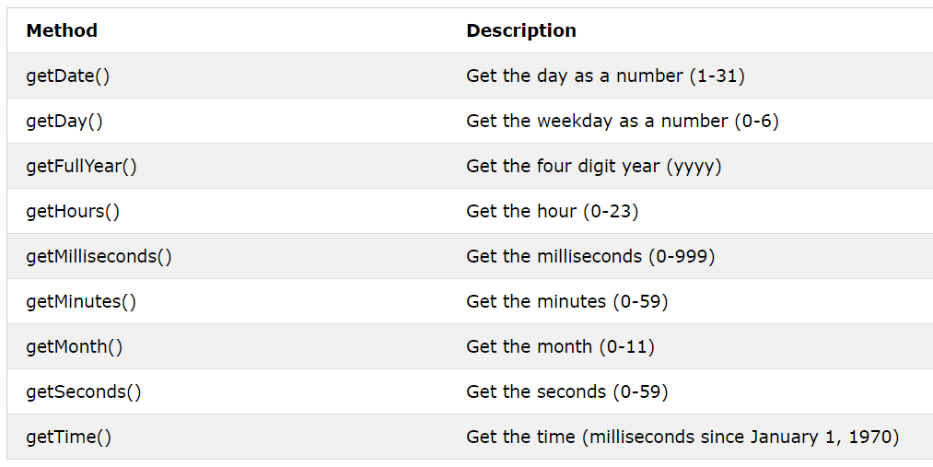
JavaScript Date Formats
JavaScript Date Methods
Get methods
Ref: https://www.w3schools.com/js/js_date_methods.asp

Slide 36
JavaScript Date Formats
Example: getFullYear()
<!DOCTYPE html>
<html>
<body>
<p>The getFullYear() method returns the full year of a date:</p>
<p id="demo"></p>
<script>
var d = new Date();
document.getElementById("demo").innerHTML = d.getFullYear();
</script>
</body>
</html>

Slide 37
JavaScript Arrays
JavaScript arrays are written with square brackets.
Array items are separated by commas.
<!DOCTYPE html>
<html>
<body>
<h2>JavaScript Arrays</h2>
<p id="demo"></p>
<script>
var cars = ["Saab","Volvo","BMW"];
document.getElementById("demo").innerHTML = cars[0];
</script>
</body>
</html>

Slide 38
Adding Array Elements
The easiest way to add a new element to an array is using the push method
<!DOCTYPE html>
<html>
<body>
<button onclick="myFunction()">Try it</button>
<p id="demo"></p>
<script>
var fruits = ["Banana", "Orange", "Apple", "Mango"];
document.getElementById("demo").innerHTML = fruits;
function myFunction() {
fruits.push("Lemon");
document.getElementById("demo").innerHTML = fruits;
}
</script>
</body>
</html>

Slide 39
JavaScript Arrays
Sorting an Array
The sort() method sorts an array alphabetically:
<!DOCTYPE html>
<html>
<body>
<button onclick="myFunction()">Try it</button>
<p id="demo"></p>
<script>
var fruits = ["Banana", "Orange", "Apple", "Mango"];
document.getElementById("demo").innerHTML = fruits;
function myFunction() {
fruits.sort();
document.getElementById("demo").innerHTML = fruits;
}
</script>
</body>
</html>

Slide 40

JavaScript HTML DOM
When a web page is loaded, the browser creates a DOM (Document Object Model) of the page.
With the HTML DOM, JavaScript can access and change all the elements of an HTML document.

Slide 41
JavaScript HTML DOM
With the object model, JavaScript gets all the power it needs to create dynamic HTML
JavaScript can change all the HTML elements in the page
JavaScript can change all the HTML attributes in the page
JavaScript can change all the CSS styles in the page
JavaScript can remove existing HTML elements and attributes
JavaScript can add new HTML elements and attributes
JavaScript can react to all existing HTML events in the page
JavaScript can create new HTML events in the page

Slide 42
JavaScript HTML DOM
What is the HTML DOM?
The HTML DOM is a standard object model and programming interface for HTML. It defines:
The HTML elements as objects
The properties of all HTML elements
The methods to access all HTML elements
The events for all HTML elements

Slide 43
HTML DOM Methods
HTML DOM methods are actions you can perform (on HTML Elements).
HTML DOM properties are values (of HTML Elements) that you can set or change.
<!DOCTYPE html>
<html>
<body>
<h2>My First Page</h2>
<p id="demo"></p>
<script>
document.getElementById("demo").innerHTML = "Hello World!";
</script>
</body>
</html>
getElementById is a method,
while innerHTML is a property.

Slide 44
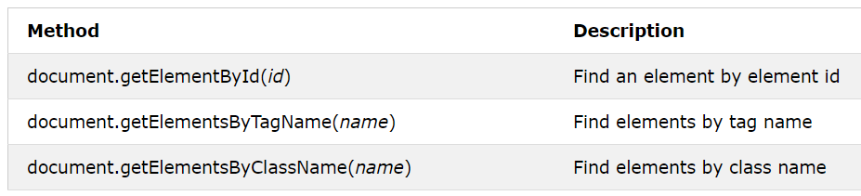
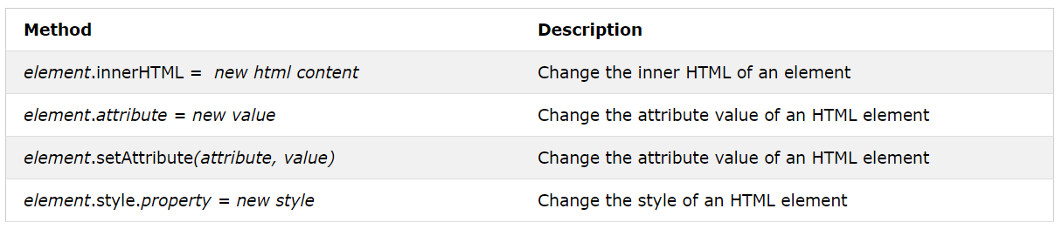
HTML DOM Document Object
Finding HTML Elements
Changing HTML Elements

Slide 45
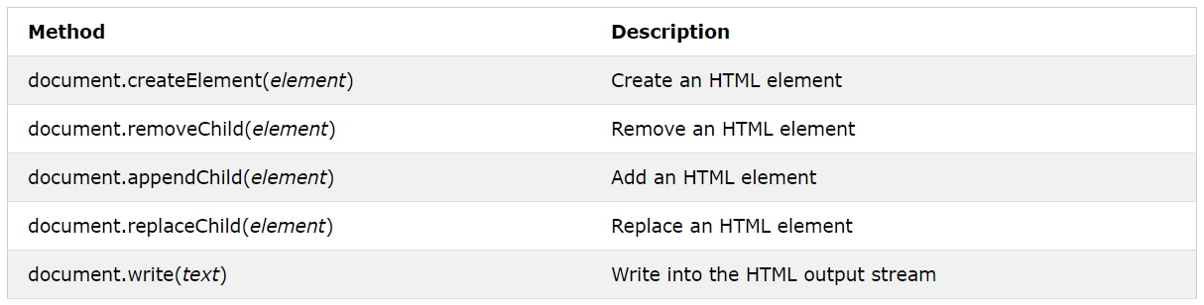
HTML DOM Document Object
Adding and Deleting Elements
Adding Events Handlers

Slide 46
HTML DOM Document Object
Example: Finding HTML Elements by Tag Name
<!DOCTYPE html>
<html>
<body>
<p>Hello World!</p>
<p>The DOM is very useful.</p>
<p>This example demonstrates the <b>getElementsByTagName</b> method</p>
<p id="demo"></p>
<script>
var x = document.getElementsByTagName("p");
document.getElementById("demo").innerHTML = 'The first paragraph (index 0) is: ' + x[0].innerHTML;
</script>
</body>
</html>

Slide 47
HTML DOM Document Object
Example: Changing the Value of an Attribute
<!DOCTYPE html>
<html>
<body>
<img id="image" src="smiley.gif" width="160" height="120">
<script>
document.getElementById("image").src = "landscape.jpg";
</script>
<p>The original image was smiley.gif, but the script changed it to landscape.jpg</p>
</body>
</html>

Slide 48
HTML DOM Document Object
Example: Changing HTML Style
<!DOCTYPE html>
<html>
<body>
<p id="p1">Hello World!</p>
<p id="p2">Hello World!</p>
<script>
document.getElementById("p2").style.color = "blue";
document.getElementById("p2").style.fontFamily = "Arial";
document.getElementById("p2").style.fontSize = "larger";
</script>
<p>The paragraph above was changed by a script.</p>
</body>
</html>

Slide 49
JavaScript HTML DOM Events
Examples of HTML events:
When a user clicks the mouse
When a web page has loaded
When an image has been loaded
When the mouse moves over an element
When an input field is changed
When an HTML form is submitted
When a user strokes a key

Slide 50
JavaScript HTML DOM Events
Example: HTML Event Attributes
<!DOCTYPE html>
<html>
<body>
<p>Click the button to display the date.</p>
<button onclick="displayDate()">The time is?</button>
<script>
function displayDate() {
document.getElementById("demo").innerHTML = Date();
}
</script>
<p id="demo"></p>
</body>
</html>

Slide 51
JavaScript HTML DOM Events
Example: Assign Events Using the HTML DOM
<!DOCTYPE html>
<html>
<body>
<p>Click "Try it" to execute the displayDate() function.</p>
<button id="myBtn">Try it</button>
<p id="demo"></p>
<script>
document.getElementById("myBtn").onclick = displayDate;
function displayDate() {
document.getElementById("demo").innerHTML = Date();
}
</script>
</body>
</html>

Slide 52
HTML DOM EventListener
The addEventListener() method attaches an event handler to the specified element.
<!DOCTYPE html>
<html>
<body>
<button id="myBtn">Try it</button>
<p id="demo"></p>
<script>
document.getElementById("myBtn").addEventListener("click", displayDate);
function displayDate() {
document.getElementById("demo").innerHTML = Date();
}
</script>
</body>
</html>

Slide 53
Add Many Event Handlers to the Same Element
<!DOCTYPE html>
<html>
<body>
<button id="myBtn">Try it</button>
<script>
var x = document.getElementById("myBtn");
x.addEventListener("click", myFunction);
x.addEventListener("click", someOtherFunction);
function myFunction() {
alert ("Hello World!");
}
function someOtherFunction() {
alert ("This function was also executed!");
}
</script>
</body>
</html>

Slide 54
JavaScript HTML DOM Elements (Nodes)
Creating New HTML Elements (Nodes)
To add a new element to the HTML DOM, you must create the element (element node) first, and then append it to an existing element.
<!DOCTYPE html>
<html>
<body>
<div id="div1">
<p id="p1">This is a paragraph.</p>
<p id="p2">This is another paragraph.</p>
</div>
<script>
var para = document.createElement("p");
var node = document.createTextNode("This is new.");
para.appendChild(node);
var element = document.getElementById("div1");
element.appendChild(para);
</script>
</body>
</html>

Slide 55
Removing Existing HTML Elements
To remove an HTML element, you must know the parent of the element:
<!DOCTYPE html>
<html>
<body>
<div id="div1">
<p id="p1">This is a paragraph.</p>
<p id="p2">This is another paragraph.</p>
</div>
<script>
var parent = document.getElementById("div1");
var child = document.getElementById("p1");
parent.removeChild(child);
</script>
</body>
</html>

