Slide 1
物件導向設計
Modifier
修飾子
授課教師:陳錫民
Email: hsiminc@fcu.edu.tw

Slide 2
Protected Access
If a method or instance variable is modified by protected (rather than public or private), then it can be accessed by name.
Inside its own class definition
Inside any class derived from it
In the definition of any class in the same package

Slide 3
Protected Access
The protected modifier provides very weak protection compared to the private modifier.
It allows direct access to any programmer who defines a suitable derived class.
Therefore, instance variables should normally not be marked protected.

Slide 4
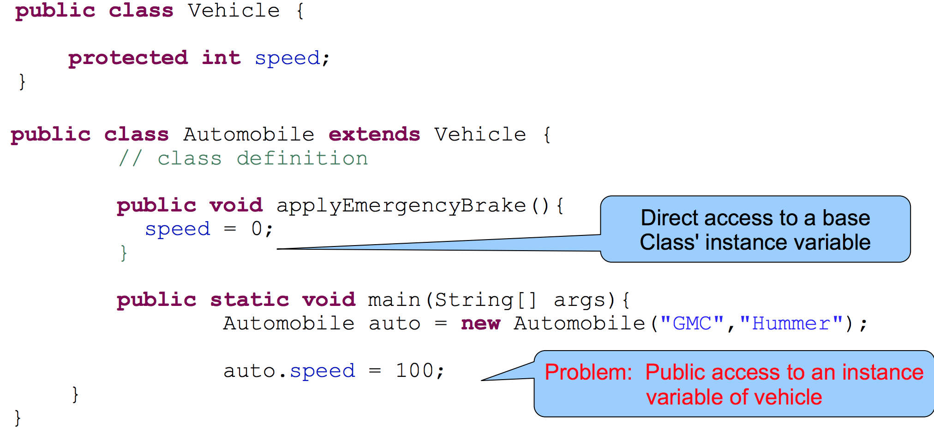
Protected Members
Derived classes can directly access inherited protected class members.

Slide 5
Package Access
If you don’t explicitly specify an access control modifier, Java defaults to package access.
Also known as “package-private” or “default”
Package visibility modifiers imply access rights that are unique to package.
All classes within the same package can access protected members as if they are public.

Slide 6
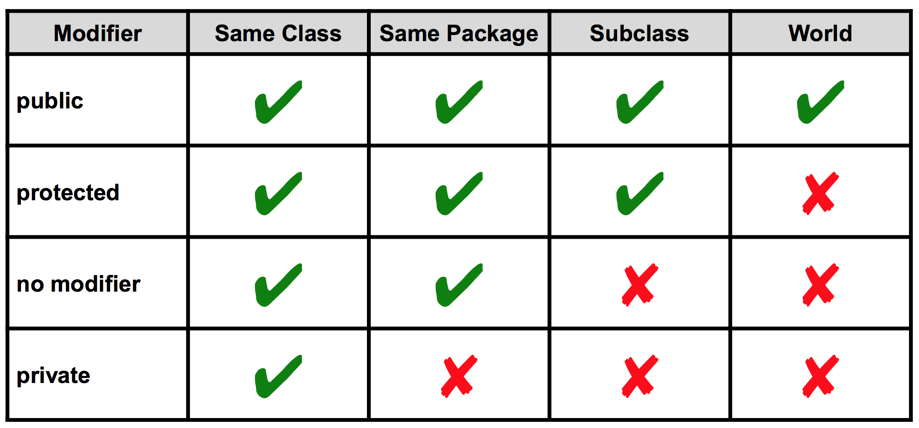
Access Levels

Slide 7
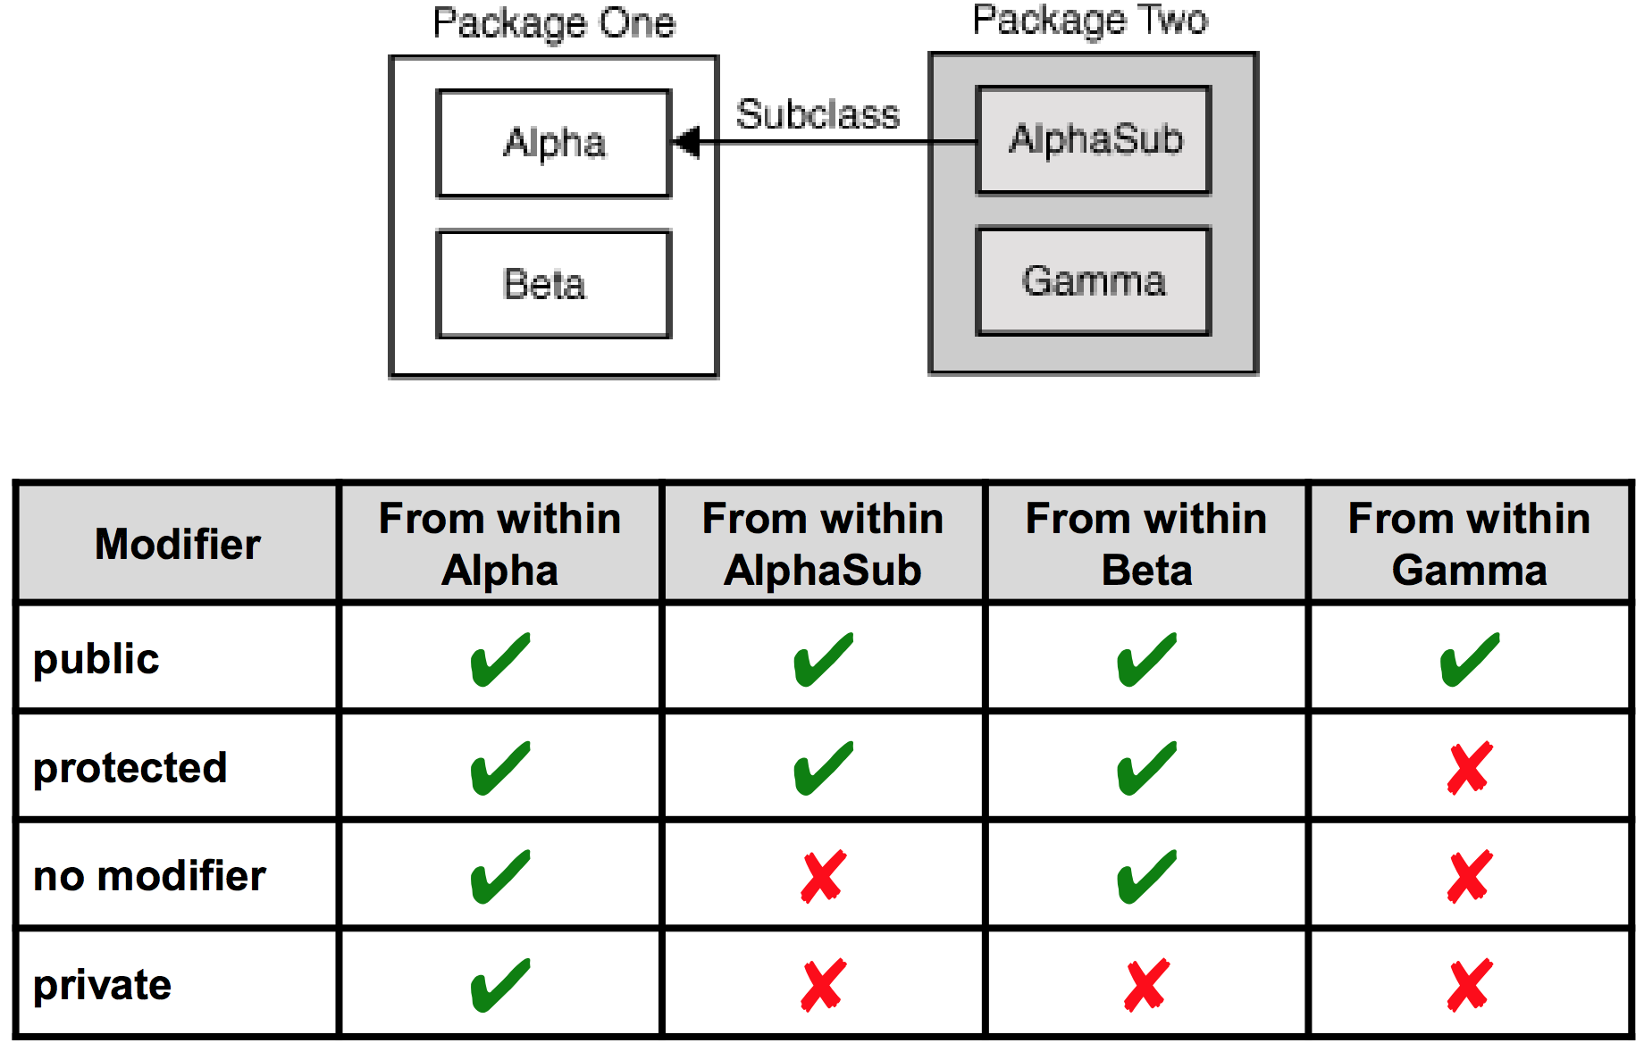
Visibility of Alpha’s Members

Slide 8
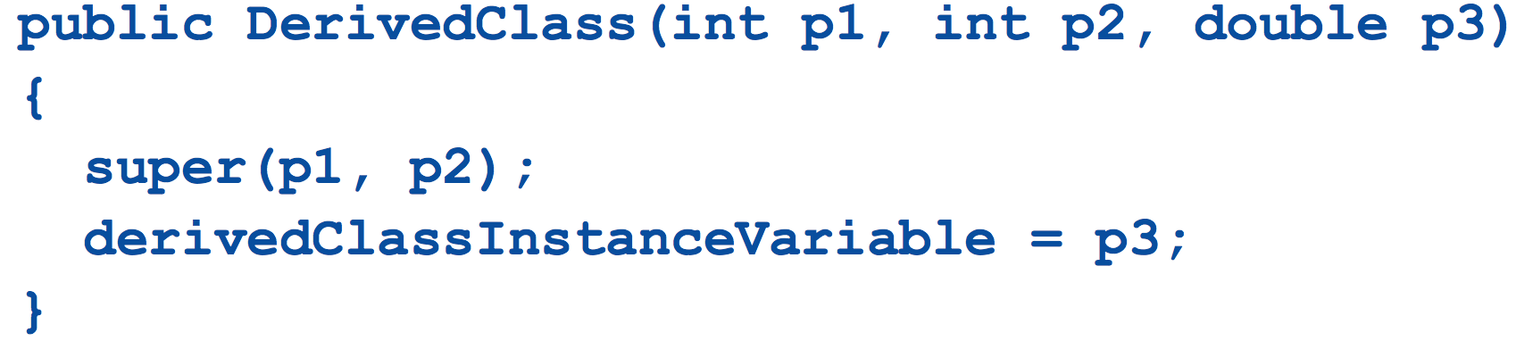
The super Constructor
A derived class uses a constructor from the base class to initialize all the data inherited from the base class.
In order to invoke a constructor from the base class, it uses a special syntax.
In the above example, super(p1, p2); is a call to the base class constructor.

Slide 9
The super Constructor
Calling the base class' constructor uses the keyword super().
A call to super must always be the first action taken in a constructor definition.
An instance variable CANNOT be used as an argument to super. Why not?

Slide 10
The super Constructor
If a derived class constructor does not include an invocation of super, then the no-argument constructor of the base class will automatically be invoked.
This can result in an error if the base class has not defined a no-argument constructor.

Slide 11
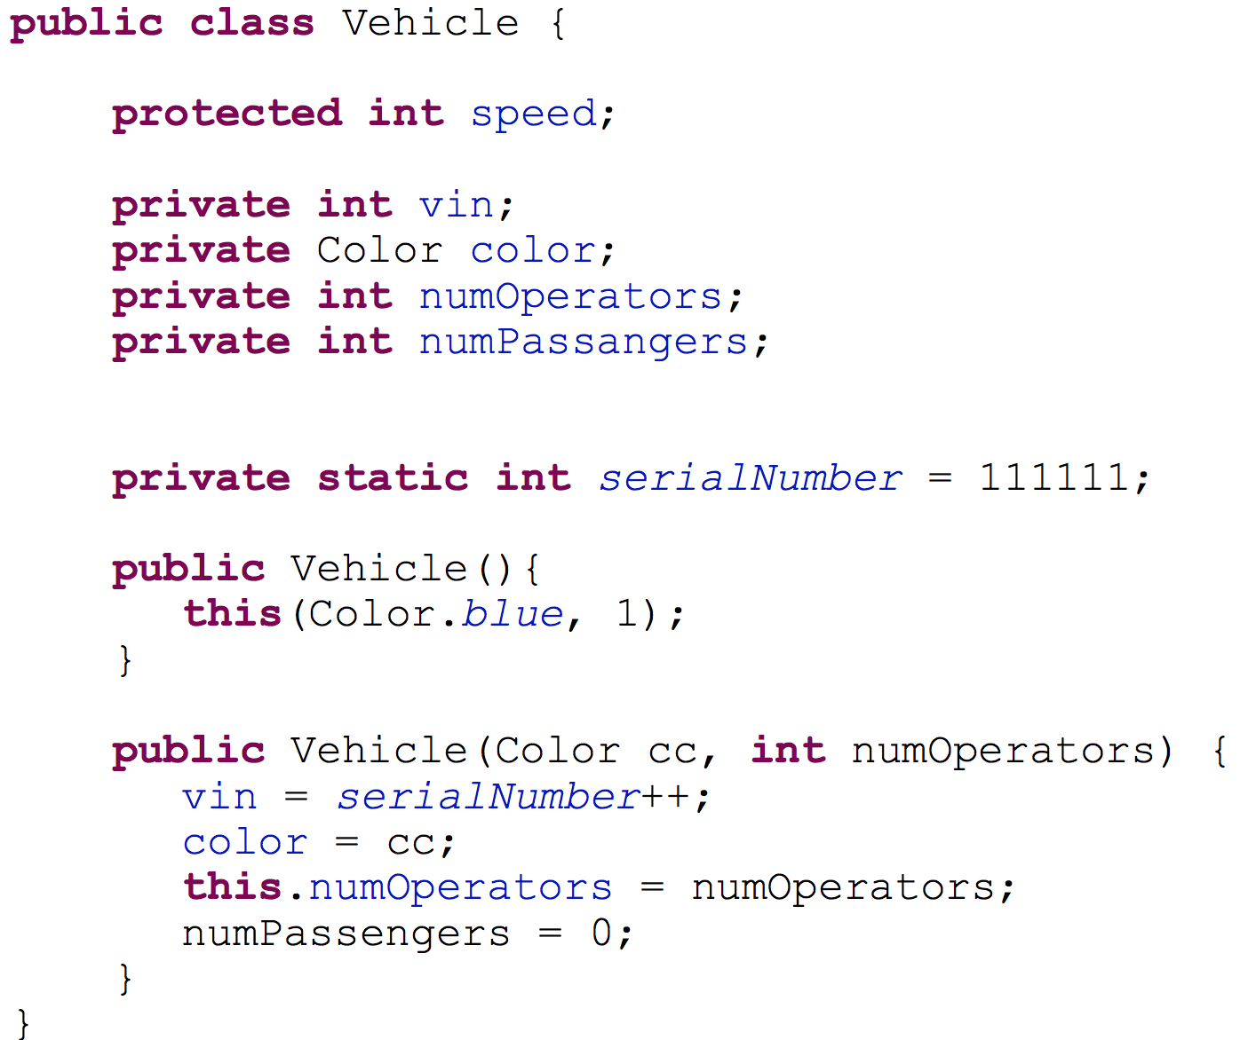
Vehicle Constructor

Slide 12
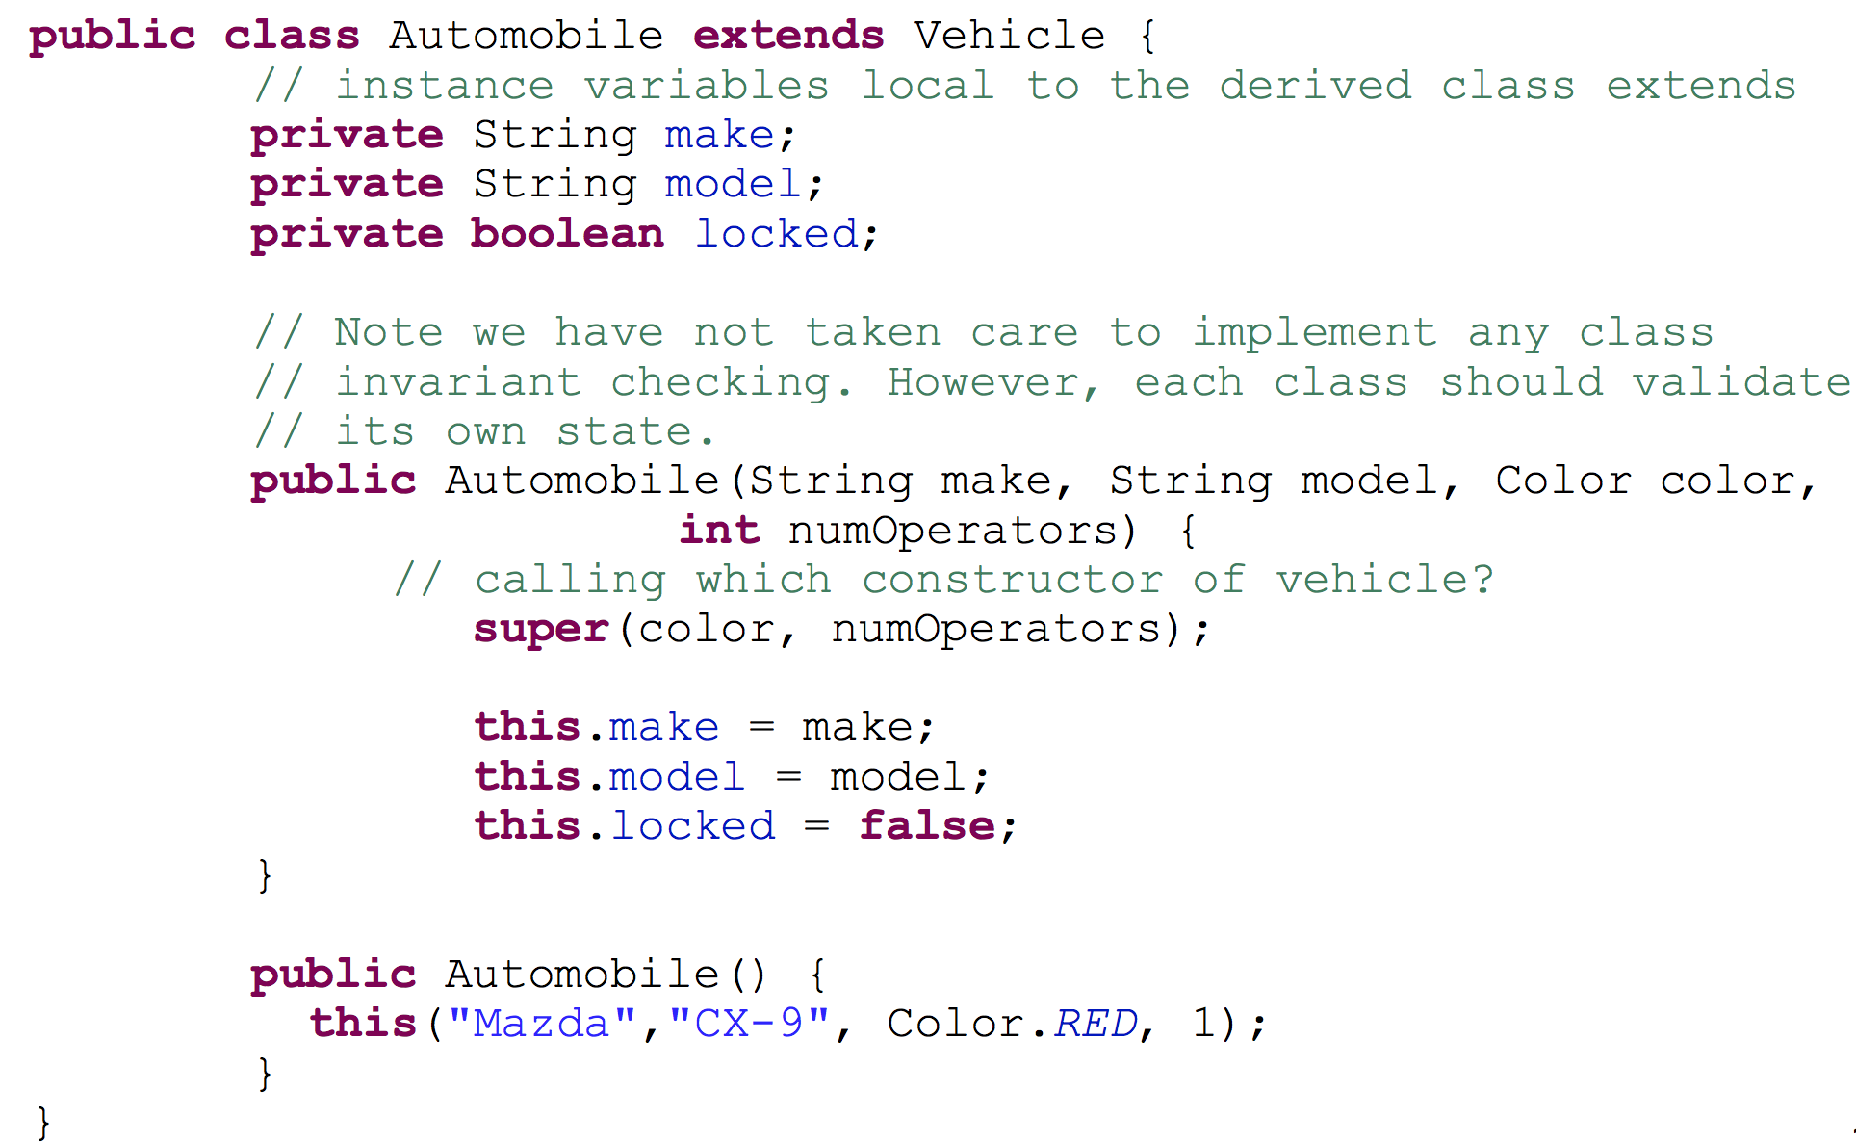
Automobile Constructor

Slide 13
You Cannot Use Multiple supers
It is only valid to use super to invoke a method from a direct parent.
Repeating super will not invoke a method from some other ancestor class.
For example,
if the Helicopter class were derived from the class Aircraft, and
the Aircraft class were derived form the class Vehicle,
You CANNOT use composition to accomplish that task.

Slide 14
An Object of a Derived Class Has More Than One Type
An object of a derived class has the type of the derived class, and it also has the type of the base class.
More generally, an object of a derived class has the type of every one of its ancestor classes.
Therefore, an object of a derived class can be assigned to a variable of any ancestor type.

Slide 15
An Object of a Derived Class Has More Than One Type
An object of a derived class can be plugged in as a parameter in place of any of its ancestor classes.
In fact, a derived class object can be used any place that an object of any of its ancestor types can be used.
Note, however, that this relationship does not go the other way.
An ancestor type can never be used in place of one of its derived types.

Slide 16
The Class Object
In Java, every class is a descendent of the class Object.
Every class has Object as its ancestor.
Every object of every class is of type Object, as well as being of the type of its own class.
If a class is defined that is not explicitly a derived class of another class, it is still automatically a derived class of the class Object.
The class Object is in the package java.lang, which is always imported automatically.

Slide 17
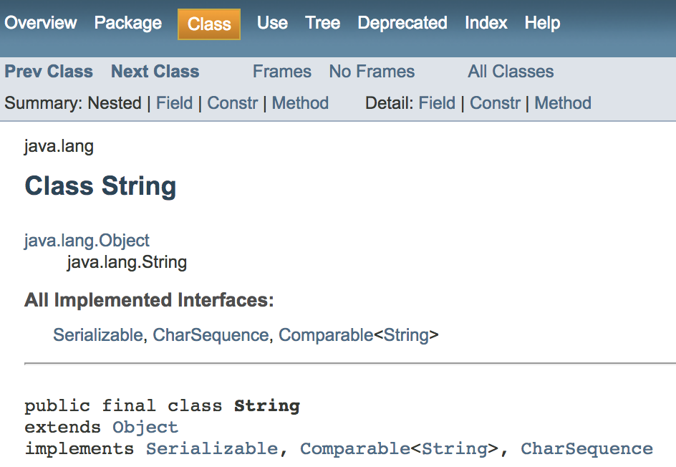
The Class Object

Slide 18
The Class Object
The class Object has some methods that every Java class inherits. • For example, the equals and toString methods
Every object inherits these methods from some ancestor class.

