Slide 1
物件導向設計
Interface
介面
授課教師:陳錫民
Email: hsiminc@fcu.edu.tw

Slide 2
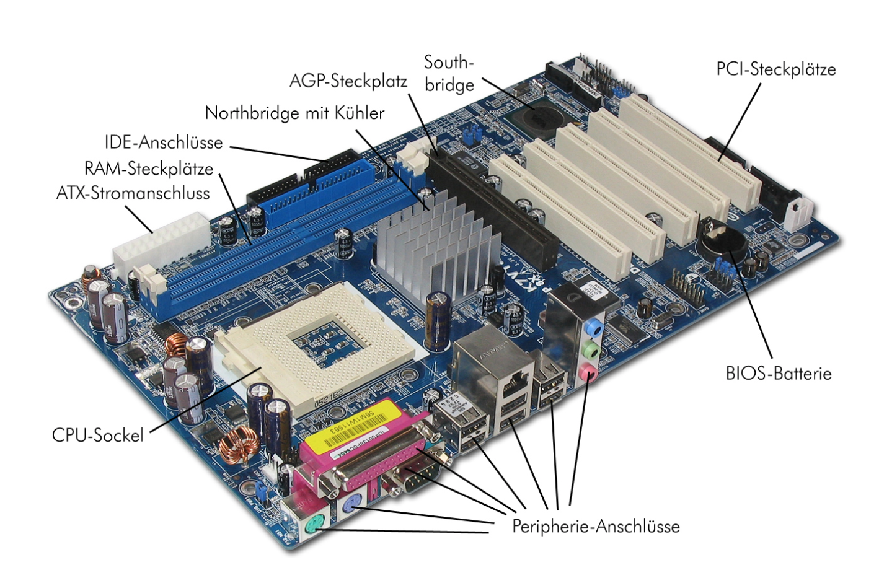
Interface

Slide 3
Public Interface
An interface is a group of related methods that multiple objects have in common, but might function slightly different.
For instance all Vehicles
Speed up
Slow down
Turn

Slide 4
Java Interfaces
Interfaces in Java are a set of behaviors that are common to multiple classes.
The implementation of an Interface is similar to a class, except that interfaces:
Use the keyword interface instead of class
Can only contain public methods, variables, and constants
Methods do not contain a body.
All methods are implicitly abstract.

Slide 5
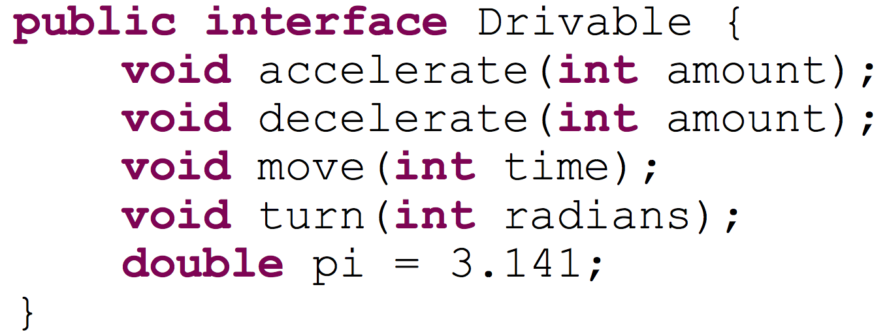
Java Interface
Each method defined in the interface does not have a body.
Interfaces can only have initialized variables.

Slide 6
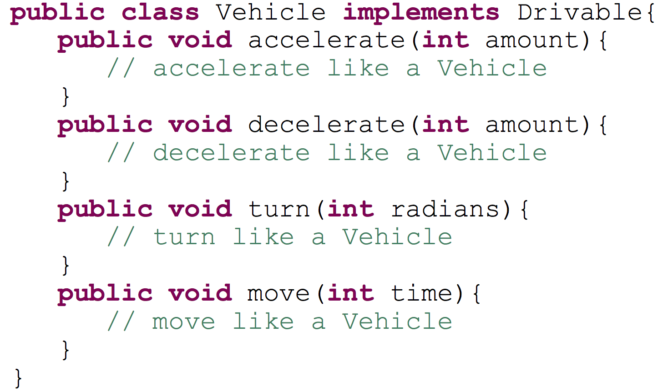
Implementing Interfaces
A class that implements an interface must
Use the keyword implements
Define all methods that are part of the interface

Slide 7
Interfaces
All methods are implicitly abstract.
A class that implements an interface must implement all methods defined in the interface in order to be concrete.
A class that does NOT implement all methods must be labeled as abstract when appropriate.
Interfaces can be used as a reference variable type.
All of the rules of polymorphism apply.

Slide 8
Comparable
Comparable is an interface defined in the Java API that is used to provide an ordering of objects of the same type.
A class that implements comparable must define the compareTo() method.
When invoked, a.compareTo(b) returns
a negative number if a < b
0 if a == b
a positive number if a > b

Slide 9
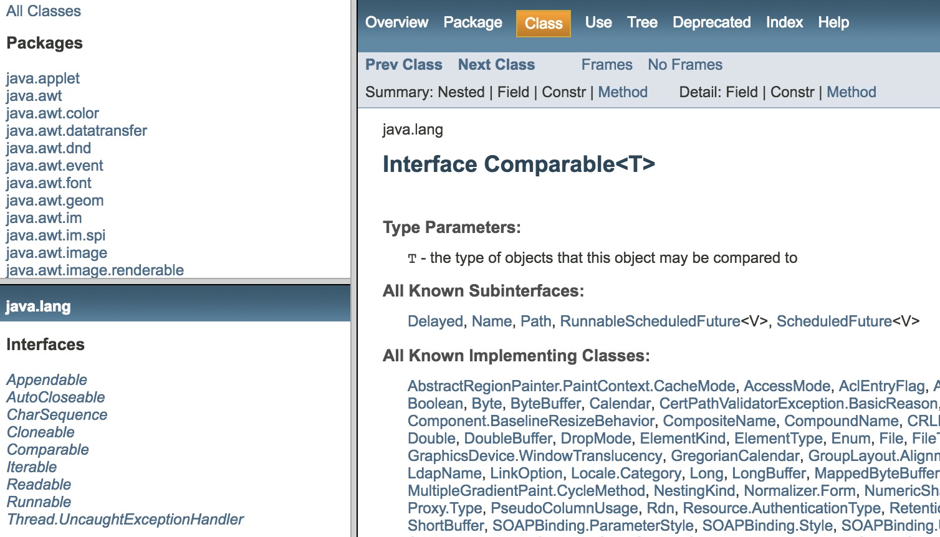
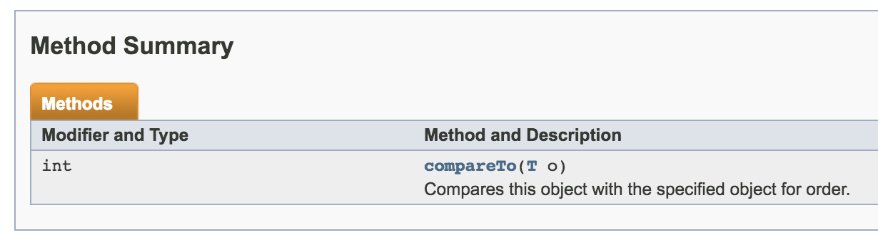

Slide 10
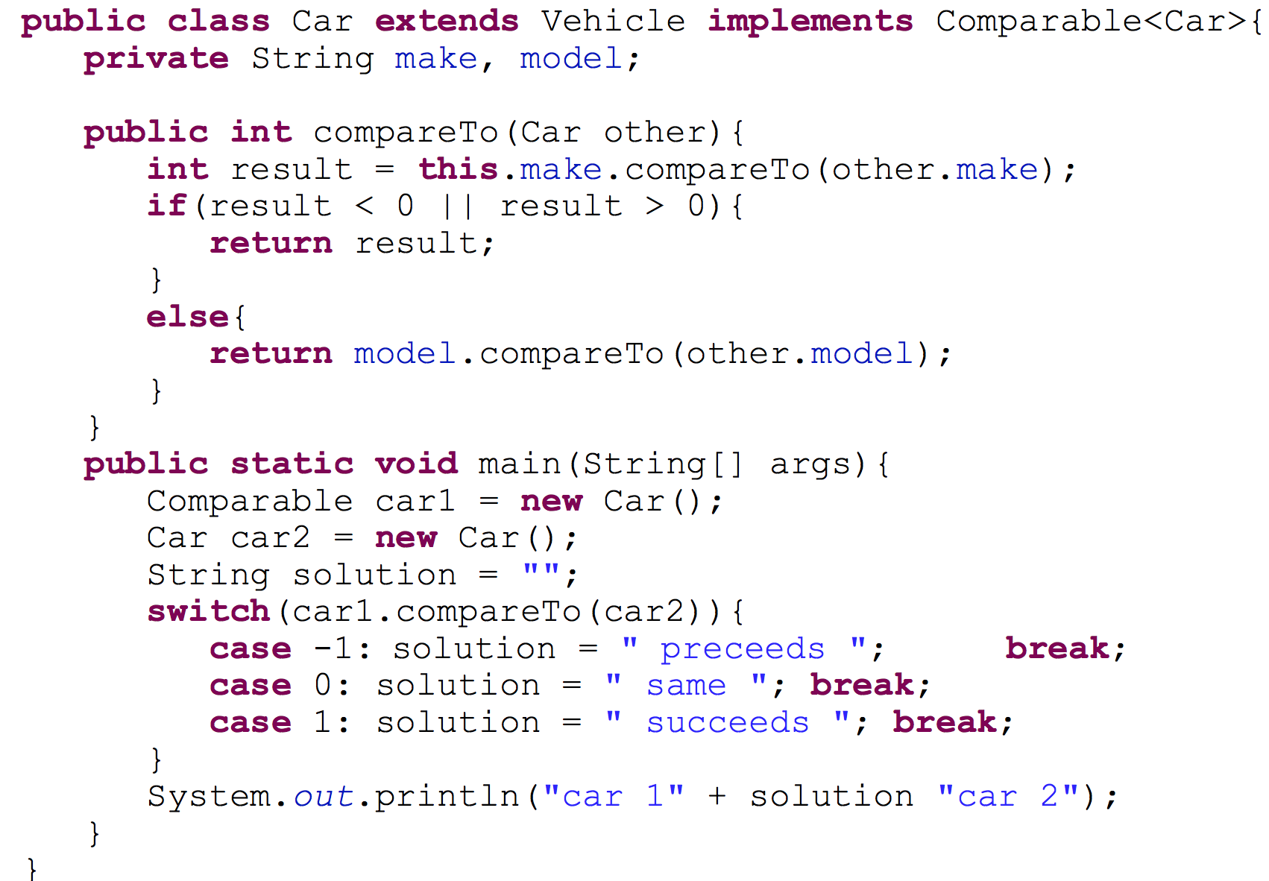
Comparable
Here, we are alphabetically ordering cars by their make and then their model

Slide 11
Interface Hierarchy
Interfaces can be used as the base “class” of other interfaces.
You can derive an interface from another interface using the keyword extends.
A derived interface inherits all the methods of the base interface.
To implement a derived interface, all methods must be implemented by the class.
Since interfaces can be used as reference variables, they can add to class hierarchies.

Slide 12
Class Hierarchy
<<interface>>
Drivable
Vehicle
Horse
Automobile
Aircraft
Car
Motorcycle
Plane
Holicoptar

Slide 13
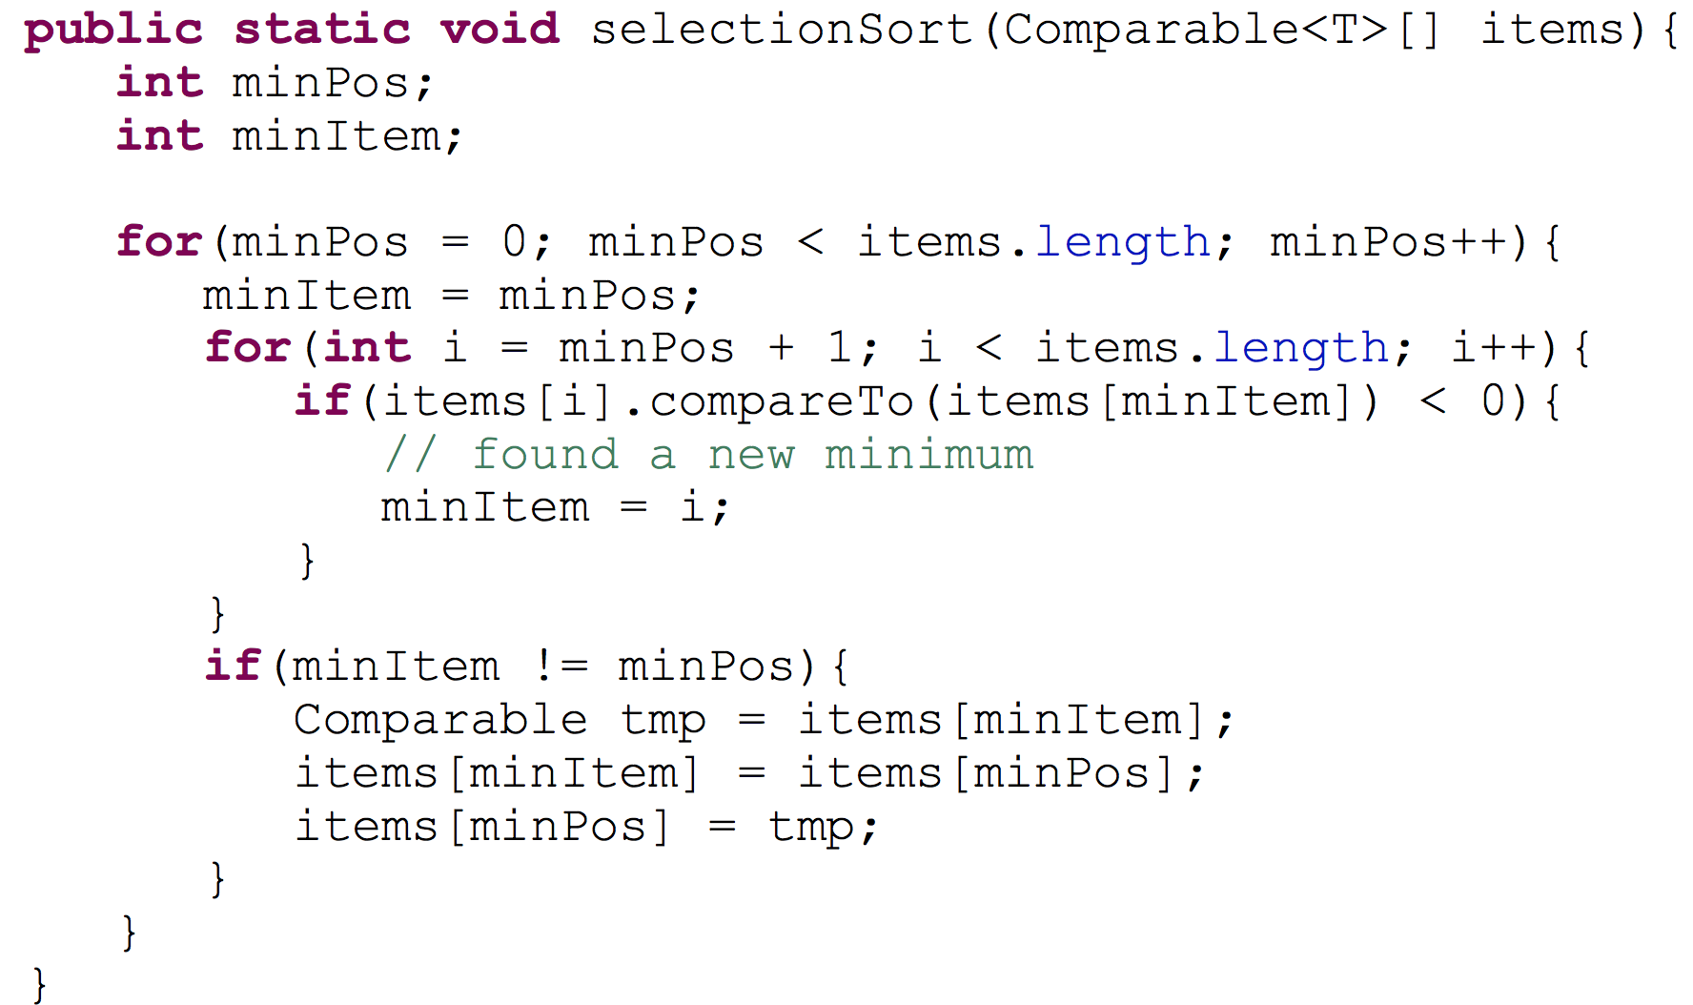
Interfaces and Polymorphism
We can use interfaces to increase the extensibility of our code.
We can write methods that require object to implement an interface instead of being a class.

Slide 14
Multiple Inheritance
Java does NOT support multiple inheritance with classes.
You can not say Class X extends X, Y
However, Java does allow a class to implement multiple interfaces.

Slide 15
Multiple Inheritance
<<interface>>
Lion
<<interface>>
Tiger
Liger
The class Liger must implement all methods in both Lion and Tiger.
Liger can now be referenced by either Lion or Tiger, but is limited to the interface defined in Lion or Tiger, respectively.

