Slide 1
物件導向設計
Array & Enumerated Types
授課教師:陳錫民
Email: hsiminc@fcu.edu.tw

Slide 2
Introduction to Arrays
An array is a data structure used to process a collection of data that is all of the same type
An array behaves like a numbered list of variables with a uniform naming mechanism
It has a part that does not change: the name of the array
It has a part that can change: an integer in square brackets
For example, given five scores:
score[0], score[1], score[2], score[3], score[4]

Slide 3
Declaring and Creating an Array
An array is declared and created in almost the same way that objects are declared and created:
BaseType[] ArrayName = new BaseType[size];
The size may be given as an expression that evaluates to a nonnegative integer, for example, an int variable
char[] line = new char[80];
double[] reading = new double[count];
Person[] specimen = new Person[100];

Slide 4
Referring to Arrays and Array Elements
Each array element can be used just like any other single variable by referring to it using an indexed expression: score[0]
The array itself (i.e., the entire collection of indexed variables) can be referred to using the array name (without any square brackets): score
An array index can be computed when a program is run
It may be represented by a variable: score[index]
It may be represented by an expression that evaluates to a suitable integer: score[next + 1]

Slide 5
Three Ways to Use Square Brackets [] with an Array Name
Square brackets can be used to create a type name:
double[] score;
Square brackets can be used with an integer value as part of the special syntax Java uses to create a new array:
score = new double[5];
Square brackets can be used to name an indexed variable of an array:
max = score[0];

Slide 6
The length Instance Variable
An array is considered to be an object
Since other objects can have instance variables, so can arrays
Every array has exactly one instance variable named length
When an array is created, the instance variable length is automatically set equal to its size
The value of length CANNOT be changed (other than by creating an entirely new array with new)
double[] score = new double[5];
Given score above, score.length has a value of 5

Slide 7
Pitfall: Array Index Out of Bounds
Array indices always start with 0, and always end with the integer that is one less than the size of the array
The most common programming error made when using arrays is attempting to use a nonexistent array index
When an index expression evaluates to some value other than those allowed by the array declaration, the index is said to be out of bounds
An out of bounds index will cause a program to terminate with a run-time error message

Slide 8
Initializing Arrays
An array can be initialized when it is declared
Values for the indexed variables are enclosed in braces, and separated by commas
The array size is automatically set to the number of values in the braces
int[] age = {2, 12, 1};
Given age above, age.length has a value of 3

Slide 9
Initializing Arrays
Another way of initializing an array is by using a for loop
double[] reading = new double[100];
int index;
for (index = 0;
index < reading.length; index++)
reading[index] = 42.0;
If the elements of an array are not initialized explicitly, they will automatically be initialized to the default value for their base type

Slide 10
Pitfall: An Array of Characters Is Not a String
An array of characters is conceptually a list of characters, and so is conceptually like a string
However, an array of characters is not an object of the class String
char[] a = {'A', 'B', 'C'};
String s = a; //Illegal!
An array of characters can be converted to an object of type String, however

Slide 11
Pitfall: An Array of Characters Is Not a String
The class String has a constructor that has a single parameter of type char[]
String s = new String(a);
The object s will have the same sequence of characters as the entire array a ("ABC"), but is an independent copy
Another String constructor uses a subrange of a character array instead
String s2 = new String(a,0,2);
Given a as before, the new string object is "AB"

Slide 12
Pitfall: Arrays with a Class Base Type
The base type of an array can be a class type
Date[] holidayList = new Date[20];
The above example creates 20 indexed variables of type Date
It does NOT create 20 objects of the class Date
Each of these indexed variables are automatically initialized to null
Any attempt to reference any them at this point would result in a "null pointer exception" error message

Slide 13
Pitfall: Arrays with a Class Base Type
Like any other object, each of the indexed variables requires a separate invocation of a constructor using new to create an object to reference
holidayList[0] = new Date();
. . .
holidayList[19] = new Date();
OR
for (int i = 0; i < holidayList.length; i++)
holidayList[i] = new Date();

Slide 14
Array Parameters
Both array indexed variables and entire arrays can be used as arguments to methods
An indexed variable can be an argument to a method in exactly the same way that any variable of the array base type can be an argument

Slide 15
Array Parameters
double n = 0.0;
double[] a = new double[10];//all elements
//are initialized to 0.0
int i = 3;
Given myMethod which takes one argument of type double, then all of the following are legal:
myMethod(n);//n evaluates to 0.0
myMethod(a[3]);//a[3] evaluates to 0.0
myMethod(a[i]);//i evaluates to 3,
//a[3] evaluates to 0.0

Slide 16
Array Parameters
The following method, doubleElements, specifies an array of double as its single argument:
public class SampleClass
{
public static void doubleElements(double[] a)
{
int i;
for (i = 0; i < a.length; i++)
a[i] = a[i]*2;
. . .
}
. . .
}
NOT specify the length of the array
double[] a = new double[10];
SampleClass.doubleElements(a);

Slide 17
Arguments for the Method main
The heading for the main method of a program has a parameter for an array of String
It is usually called args by convention
public static void main(String[] args)
Note that since args is a parameter, it could be replaced by any other non-keyword identifier
If a Java program is run without giving an argument to main, then a default empty array of strings is automatically provided

Slide 18
Arguments for the Method main
Here is a program that expects three string arguments:
public class SomeProgram
{
public static void main(String[] args)
{
System.out.println(args[0] + " " +
args[2] + args[1]);
}
}

Slide 19
Arguments for the Method main
java SomeProgram Hi ! there
This will set args[0] to "Hi", args[1] to "!", and args[2] to "there"
It will also set args.length to 3
When SomeProgram is run as shown, its output will be:
Hi there!

Slide 20
Methods That Return an Array
In Java, a method may also return an array
The return type is specified in the same way that an array parameter is specified
public static int[] incrementArray(int[] a, int increment){
int[] temp = new int[a.length];
int i;
for (i = 0; i < a.length; i++){
temp[i] = a[i] + increment;
}
return temp;
}

Slide 21
The "for each" Loop
There is a new kind of for loop, first available in Java 5.0, called a for-each loop or enhanced for loop
This kind of loop can cycle through each element in a collection even though the elements are not indexed
The general syntax for a for-each loop statement used with an array is
for (ArrayBaseType VariableName : ArrayName)
Statement

Slide 22
The "For-Each" Loop
The for-each loop can make code cleaner and less error prone
If the indexed variable in a for loop is used only as a way to cycle through the elements, then it would be preferable to change it to a for-each loop
For example:
for (int i = 0; i < a.length; i++)
a[i] = 0.0;
Can be changed to:
for (double element : a)
element = 0.0;

Slide 23
Methods with a Variable Number of Parameters
Starting with Java 5.0, methods can be defined that take any number of arguments
Such a method has as the last item on its parameter list a vararg specification of the form:
Type... ArrayName

Slide 24
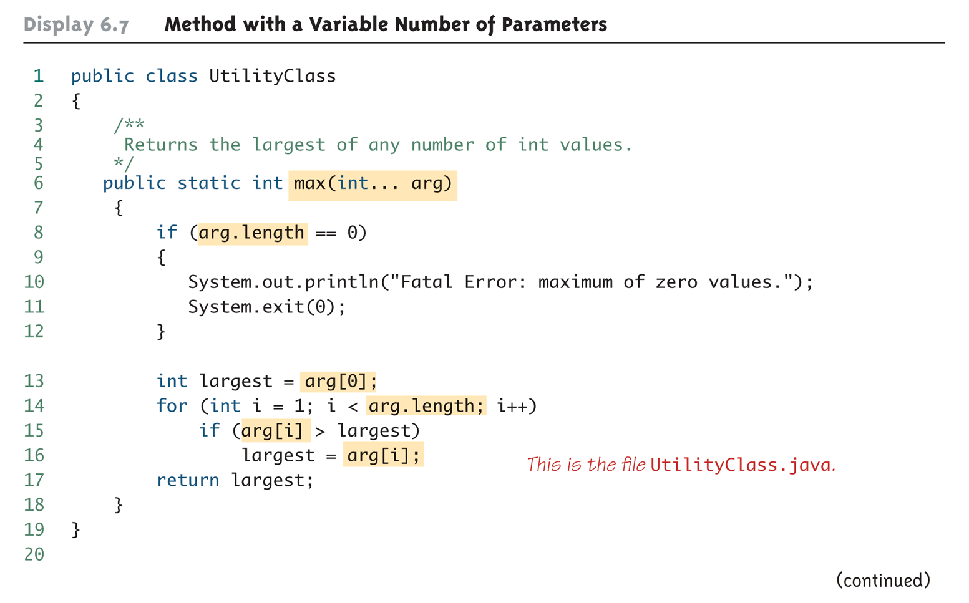
Method with a Variable Number of Parameters
UtilityClass.max(13, 8, 6, 25);

Slide 25
Privacy Leaks with Array Instance Variables
If an accessor(getter) method does return the contents of an array, special care must be taken
Just as when an accessor returns a reference to any private object
public double[] getArray()
{
return anArray;//BAD!
}
The example above will result in a privacy leak

Slide 26
Privacy Leaks with Array Instance Variables
The previous accessor method would simply return a reference to the array anArray itself
Instead, an accessor method should return a reference to a deep copy of the private array object
private double[] scores = new double[5];
public double[] getScores()
{
double[] temp = new double[scores.length];
for (int i = 0; i < count; i++)
temp[i] = a[i];
return temp
}

Slide 27
Privacy Leaks with Array Instance Variables
If a private instance variable is an array that has a class as its base type, then copies must be made of each class object in the array when the array is copied:
public ClassType[] getArray()
{
ClassType[] temp = new ClassType[count];
for (int i = 0; i < count; i++)
temp[i] = new ClassType(someArray[i]);
return temp;
}

Slide 28
Enumerated Types 列舉型態
Enumerated Values
Enumerated values(列舉值) are used to represent a set of named values (賦予名字的值).
Historically in Java (and other languages), these were often stored as constants(常數).
For example, in Java . . .
public static final int RED = 1;
public static final int YELLOW = 2;
public static final int GREEN = 3;

Slide 29
Representing a Set of Enumerated Values – 傳統作法
public class OldTrafficLight {
public static final int RED = 1;
public static final int ELLOW = 2;
public static final int GREEN = 3;
private int c = RED;
public int getColor() {
return c;
}
public void setColor(int newCol) {
if (newCol >= RED && newCol <= GREEN)
c = newCol;
}
}

Slide 30
Enumerated Types 列舉型態
Issues with this Approach
Acceptable values are not obvious
No type safety
Not printable

Slide 31
Acceptable Values Not Obvious 可接受的值不明顯
Since the values are just integers, it’s hard at a glance to tell what the possible values are.
Take this method from OldTrafficLight class
Any clue as to what the valid values are for the alignment parameter?
Have to resort to reading the documentation
public void setColor(int newCol)

Slide 32
No Type Safety 不具型態檢查
Since the values are just integers, the compiler will let you substitute any valid integer
For example, there’s nothing stopping one from passing in 1, -3, or 438523423 into the following method.
There’s no way to constrain to only “TrafficLight” ints.
public void setColor(int newCol)

Slide 33
Not Printable 沒有辦法印出
Since they are just integers, if we were to print out the values, they’d simply display their numerical value.
Similar problem as when reading the method parameters
Need to consult the documents to decipher values

Slide 34
Enumerated Types 列舉型態
Enums to the Rescue
Java 5 added an enum type to the language.
Declared using the enum keyword instead of class
In its simplest form, it contains a comma-separated list of names representing each of the possible options
public enum Colors { RED, YELLOW, GREEN }

Slide 35
Representing a Set of Enumerated Values – 採用列舉型態作法
public class TrafficLight {
public enum Colors {
RED, YELLOW, GREEN
}
private Colors c = Colors.RED;
public Colors getColor() {
return c;
}
public void setColor(Colors newCol) {
c = newCol;
}
}

Slide 36
Using Enum Types 使用列舉型態
public class Main {
public static void main(String[] args) {
TrafficLight tl1 = new TrafficLight();
tl1.setColor(TrafficLight.Colors.GREEN);
System.out.println(tl1.getColor());
}
}

Slide 37
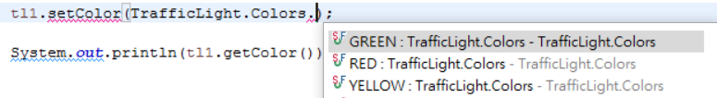

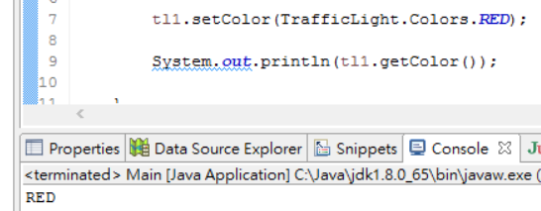
Enums Address These Issues
Acceptable values are now obvious — must choose one of the Traffic Light Color enumerated values…
Type safety — possible values are enforced by the compiler
Printing the enum value is actually readable

