Slide 1
物件導向設計
Inheritance
繼承
授課教師:陳錫民
Email: hsiminc@fcu.edu.tw

Slide 2
Object Relationships 物件關係
An object can be a specialized version of another object.
A Car is a Vehicle
A Motorcycle is a Vehicle
A Boat is a Vehicle
An Aircraft is a Vehicle
This kind of relationship is know as the “is-a” relationship.
In Object Oriented Programming, this relationship is modeled with a technique known as inheritance.
Inheritance creates new classes by “adding” code to a preexisting class, without actually modifying that class‘ definition.

Slide 3
Inheritance 繼承
Inheritance is one of the most important techniques used in OOP
Using inheritance
A very general class(一般化的類別) is first defined.
Vehicle, Fruit, Shape
Then, more specialized(特殊化) versions of the class are defined, such as Car, Boat, Aircraft (more specific versions of a Vehicle).
Adding instance variables and/or
Adding methods
The specialized classes are said to inherit the methods and instance variables of the general class.

Slide 4
Derived/Sub Classes
There is often a natural hierarchy when designing certain classes.
Example
In a record-keeping program for the vehicles on a military base, there are automobiles and aircraft.
Automobiles can be divided into Cars and Motorcycles.
Aircraft can be divided into Planes and Helicopters.

Slide 5
Derived/Sub Classes
All vehicles have certain characteristics in common
Vin number(車身號碼), color, number of operators, speed, number of passengers
The methods for setting and changing the vin, color, speed, number of passengers, and number of operators
Some vehicles have specialized characteristics
Move
Aircraft move on the ground and can move in the air
Automobiles move on the ground
Creating move methods for these two different groups would be different.

Slide 6
Inheritance and OOP
Inheritance is an abstraction for
sharing similarities among classes (e.g. vin, color, speed), and
preserving their differences (e.g. how they move).
Inheritance allows us to group classes into families of related types (Vehicles), allowing for the sharing of common operations and data.

Slide 7
General/Super Classes
A class called Vehicle can be defined that includes all Vehicles.
This class can then be used to define classes for Automobile and Aircraft.
The Automobile class can be used to define a Car class, and so forth.

Slide 8
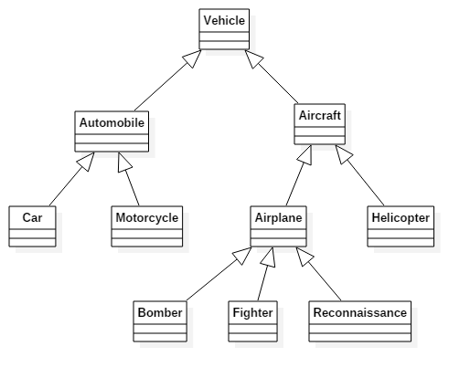
A Vehicle Class Hierarchy

Slide 9
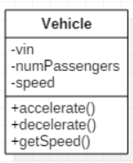
public class Vehicle {
private int vin;
private int numPassengers;
private int speed;
public Vehicle(){ /* code here */}
public Vehicle(Vehicle v){ /* code here */ }
public Vehicle(int vin, int numOperators) {/*code here */}
public void accelerate() { /* code here */ }
public void decelerate() { /* code here */ }
public int getSpeed() { /* code here */ }
}

Slide 10
Without Inheritance
public class Automobile {
private int vin;
private int numPassengers;
private int speed;
private String make;
private String model;
private boolean locked;
public Automobile() {/* code here */}
public Automobile(String make, String model) {/* code here */}
public void accelerate() { /* code here */ }
public void decelerate() { /* code here */ }
public int getSpeed() { /* code here */ }
public void isLocked() {/* code here */}
public void lock() {/* code here */}
public void unlock() {/* code here */}
}

Slide 11
Derived/Sub Classes
Since an Automobile “is-a” Vehicle, it is defined as a derived/sub class of the class Vehicle.
A derived class is defined by adding instance variables and/or methods to an existing class.
The class that the derived class is built upon is called the base class.
The phrase extends BaseClass must be added to the derived class definition.
public class Automobile extends Vehicle

Slide 12
Derived/Sub Class
The class derived from is called a base class or superclass.
The derived class inherits all of the following from the base class.
public methods
public and private instance variables
public and private static variables
The derived class can add more instance variables, static variables, and/or methods.

Slide 13
Inherited Members
Definitions for the inherited variables and methods do NOT appear in the derived/sub class.
The code is reused without having to explicitly copy it, unless the creator of the derived class redefines one or more of the base class methods.

Slide 14
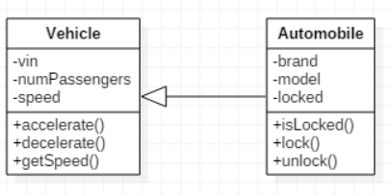
With Inheritance
public class Automobile extends Vehicle {
// instance variables local to the derived class
private String brand;
private String model;
private boolean locked;
public Automobile() {/* code here */}
public Automobile(String make, String model) {/* code here */}
// methods that are local to the derived class
public void isLocked() {/* code here */}
public void lock() {/* code here */}
public void unlock() {/* code here */}
}

Slide 15
Using Automobile & Inheritance
public static void main(String[] args){
Automobile auto = new Automobile("GMC", "Hummer");
auto.accelerate(); //Vehicle’s method
auto.lock();
}

Slide 16
Overriding a Method Definition
A derived class can change or override an inherited method.
In order to override an inherited method, a new method definition is placed in the derived class definition.
For example, let’s say automobiles decelerate and accelerate at a rate of 5 mph.
It would make sense to override Vehicle’s accelerate and decelerate methods by defining Automobile’s own accelerate and decelerate methods.

Slide 17
Overriding Example
public class Vehicle {
private int speed;
public void accelerate() {
speed ++;
}
public void decelerate() {
speed --;
}
public int getSpeed() {
return this.speed;
}
public void setSpeed(int speed) {
this.speed = speed;
}
}
public class Automobile extends Vehicle {
private String make;
private String model;
private boolean locked;
@Override
public void accelerate() {
int speed = super.getSpeed() + 5;
super.setSpeed(speed);
}
@Override
public void decelerate() {
int speed = super.getSpeed() + 5;
super.setSpeed(speed);
}
}
Now, this code
Automobile hummer = new Automobile( );
hummer.accelerate( );
invokes the overridden accelerate() method in the Automobile class rather than the accelerate() method in the Vehicle class.
To override a method in the derived class, the overriding method must have the same method signature as the base class method.

Slide 18
Overriding Versus Overloading
Do not confuse overriding a method in a derived class with overloading a method name.
When a method in a derived class has the same signature as the method in the base class, that is overriding.
When a method in a derived class or the same class has a different signature from the method in the base class or the same class, that is overloading.

Slide 19
The final Modifier
If the modifier final is placed before the definition of a method, then that method may NOT be overridden in a derived class.
It the modifier final is placed before the definition of a class, then that class may not be used as a base class from which to derive other classes.

Slide 20
Pitfall: Use of Private Instance Variables from a Base Class
An instance variable that is private in a base class is not accessible by name in a method definition of a derived class.
An object of the Automobile class cannot access the private instance variable speed by name, even though it is inherited from the Vehicle base class.
Instead, a private instance variable of the base class can only be accessed by the public accessor and mutator methods defined in that class.
An object of the Automobile class can use the getSpeed or accelerate/decelerate methods to access speed.

Slide 21
Encapsulation and Inheritance Pitfall: Use of Private Instance Variables from a Base Class
If private instance variables of a class were accessible in method definitions of a derived class,
then anytime someone wanted to access a private instance variable, they would only need to create a derived class, and access the variables in a method of that class.
This would allow private instance variables to be changed by mistake or in inappropriate ways.

Slide 22
Pitfall: Private Methods Are Effectively Not Inherited
The private methods of the base class are like private variables in terms of not being directly available.
A private method is completely unavailable, unless invoked indirectly.
This is possible only if an object of a derived class invokes a public method of the base class that happens to invoke the private method.
This should not be a problem because private methods should only be used as helper methods.
If a method is not just a helper method, then it should be public.

Slide 23
隨堂練習
假設有一校務系統，需要你/妳設計系統中類別的繼承(is-a)關係，系統的類別如下
教職員
老師
學生
大學生
研究生
博士生
職員
人
請畫出類別圖以及類別間的繼承關係

