Slide 1
物件導向設計
Polymorphism
多型
授課教師:陳錫民
Email: hsiminc@fcu.edu.tw

Slide 2
Polymorphism 多型
Object-oriented programming mechanisms
Encapsulation - data and methods together
Inheritance - extending a class for specialization
Polymorphism

Slide 3
Polymorphism 多型
Polymorphism
The ability to associate many meanings with one method name
Accomplished through a mechanism known as late binding or dynamic binding.

Slide 4
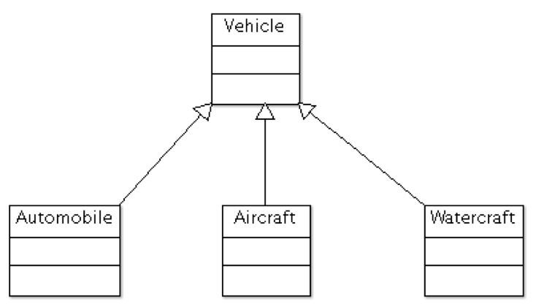
Vehicle Inheritance Hierarchy

Slide 5
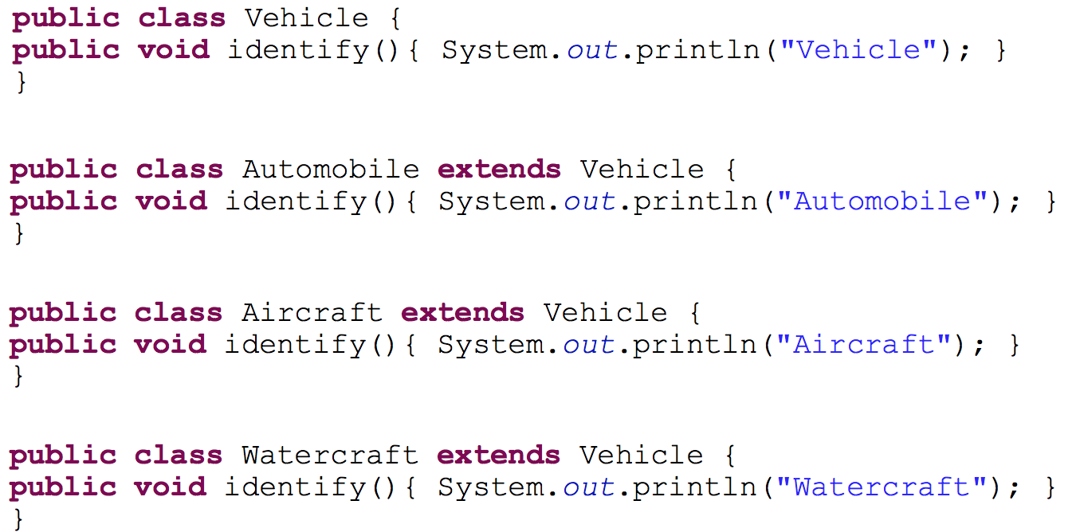
Identifying Classes of Vehicles

Slide 6
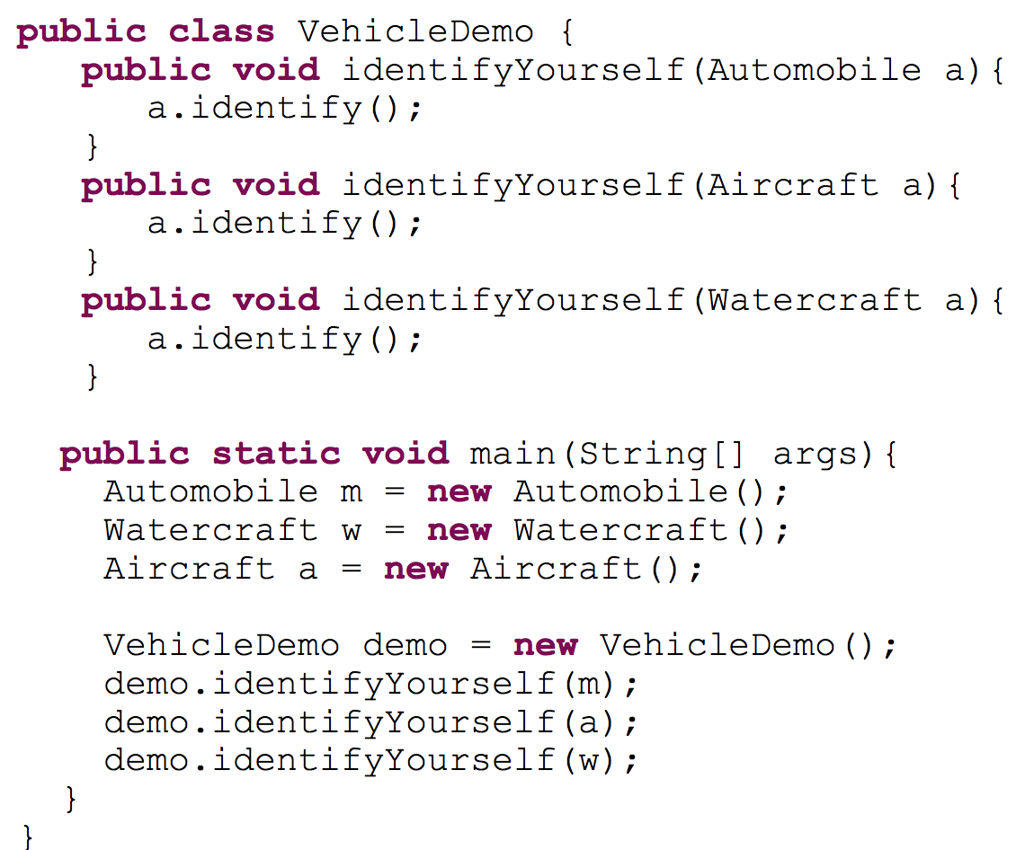
The Vehicle Classes
In the VehicleDemo, we ask each Vehicle to identify itself.
This is a poor example of OOP as we will see...
output
Automobile
Aircraft
Watercraft

Slide 7
Problems with VehicleDemo?
The VehicleDemo class contains a type specific version of identifyYourself for each type of Vehicle.
What if we add more types of Vehicles?
Wouldn’t it be nice to write just one identifyYourself method that works for all Vehicles?

Slide 8
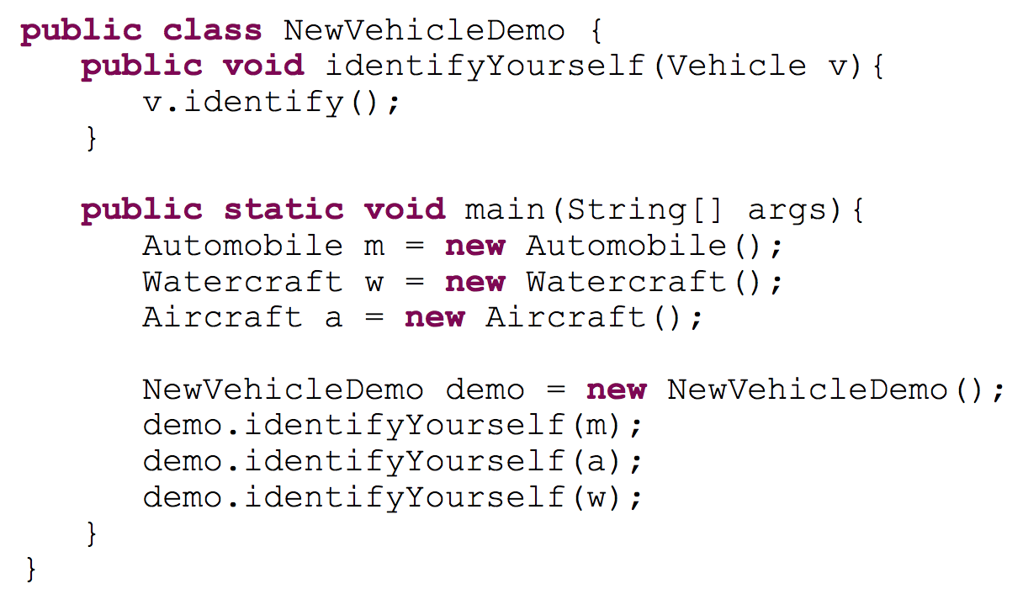
NewVehicleDemo
output
Automobile
Aircraft
Watercraft

Slide 9
Binding
Binding
Associating the appropriate method definition with the method invocation is known as binding.

Slide 10
Binding
Early binding occurs when the method definition is associated with its invocation when code is compiled.
Late binding or dynamic binding occurs when the method definition is associated with its invocation when the method is invoked (at run time)

Slide 11
Binding
Java uses late binding for all methods
except private, final, and static methods
Compiler knows that all such methods cannot be overridden
Because of late binding, a method can be written in a base class to perform a task, even if portions of that task aren't yet defined

Slide 12
The final Modifier
A method marked final indicates that it cannot be overridden with a new definition in a derived class.
If final, the compiler can use early binding with the method.
public final void someMethod() { . . . }
A class marked final indicates that it cannot be used as a base class from which to derive any other classes.

Slide 13
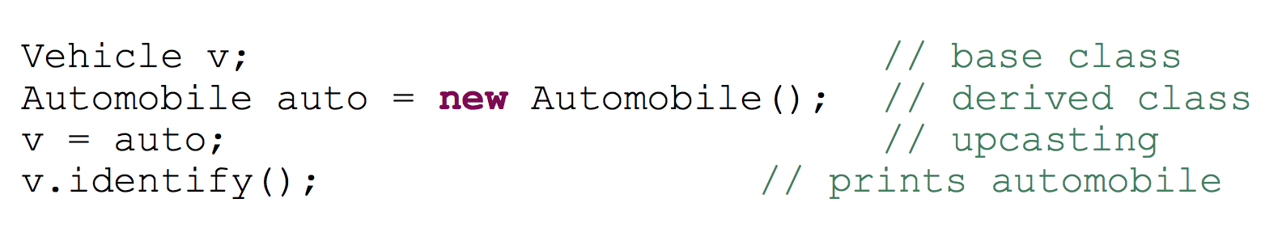
Upcasting and Downcasting
Upcasting occurs when an object of a derived class is assigned to a variable of a base class (or any ancestor class).
Or we could do something equivalent, such as
Because of late binding, identify() uses the definition of identify() given in the Automobile class.

Slide 14
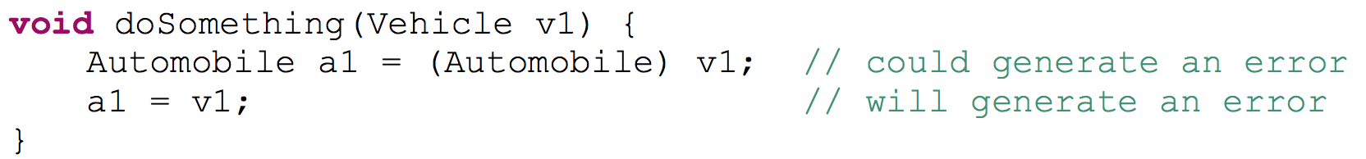
Upcasting and Downcasting
Downcasting occurs when a type cast is performed from a base class to a derived class (or from any ancestor class to any descendent class).
Downcasting must be done very carefully.
In many cases it doesn't make sense, or is illegal:

Slide 15
Constructors and Polymorphism
A constructor for the base class is automatically called during construction of a derived class.
This call propagates up the inheritance hierarchy until the constructor for every base class is called.

Slide 16
Why does this make sense?
The constructor’s job is to see that the object is completely built.
The derived class cannot have access to the base class’ private instance variables.
The base class constructor must be called to initialize its instance variables.
Therefore, all base class constructors must be called to fully initialize the entire derived class object.

Slide 17
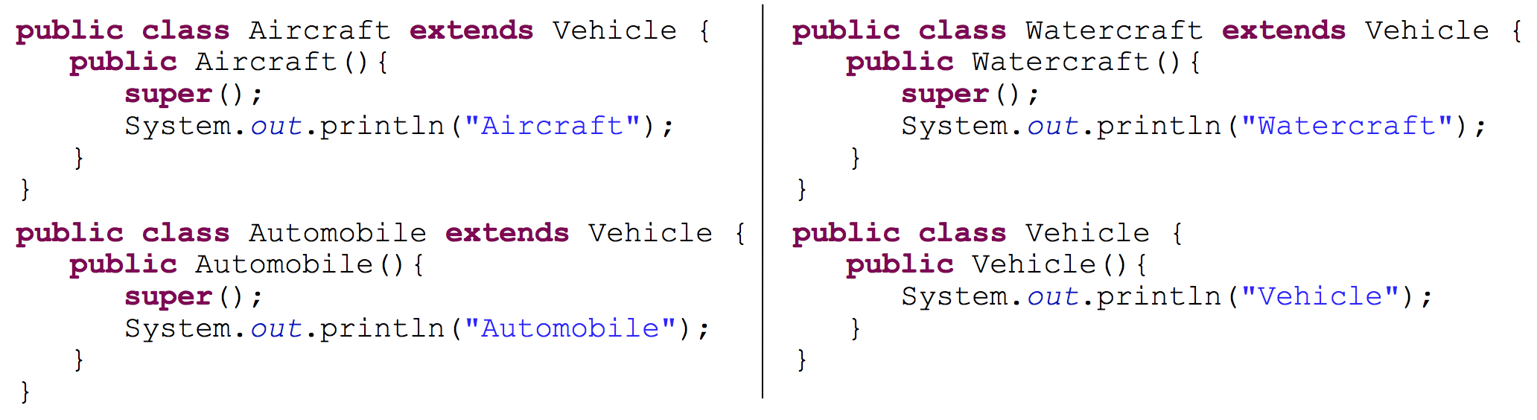
More Vehicles
In each constructor we are making explicit calls to base class constructors.

Slide 18
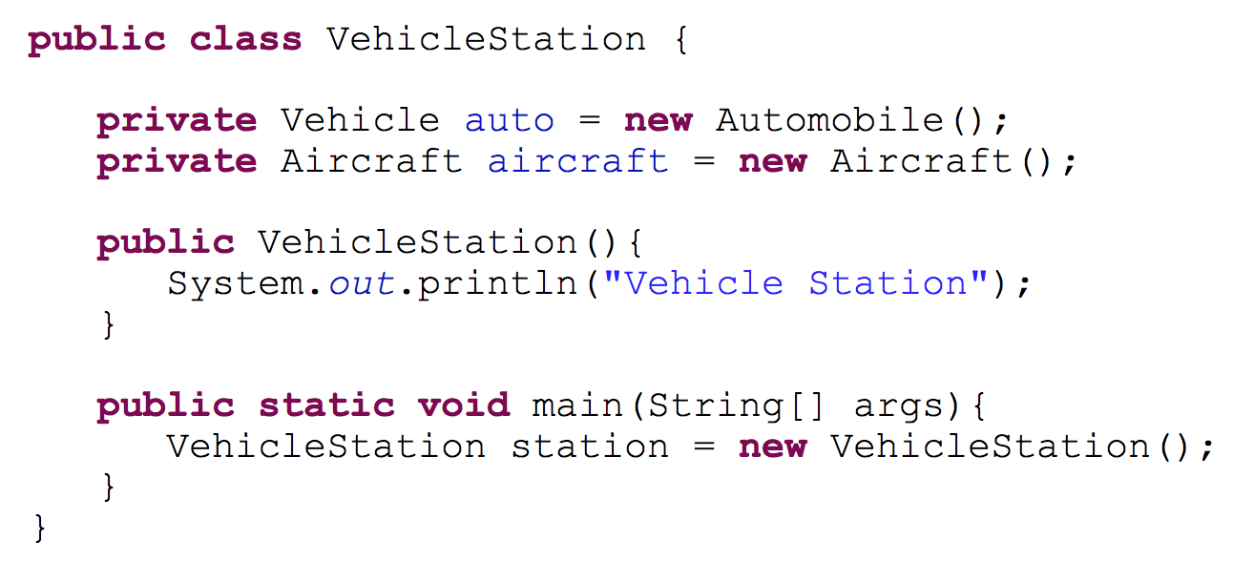
Vehicle Station
Which constructor is executed first?

Slide 19
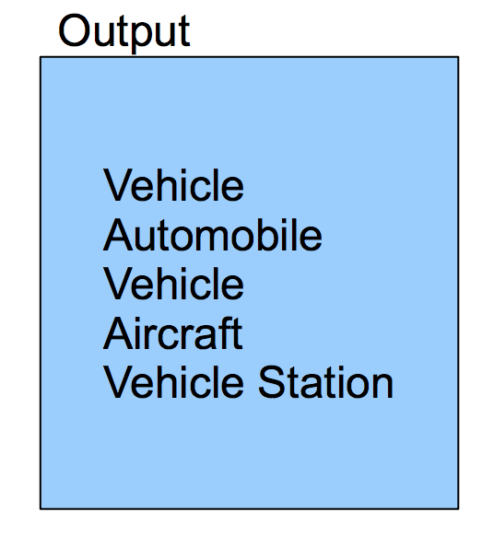
Vehicle Station
Which constructor is executed first?

Slide 20
Vehicle Station
Order of Construction
Note that base class constructors are called implicitly if there is no explicit call super( );
Base class constructors, recursively from the top of the hierarchy
Instance variables in order of declaration
The body of the derived class constructor

Slide 21
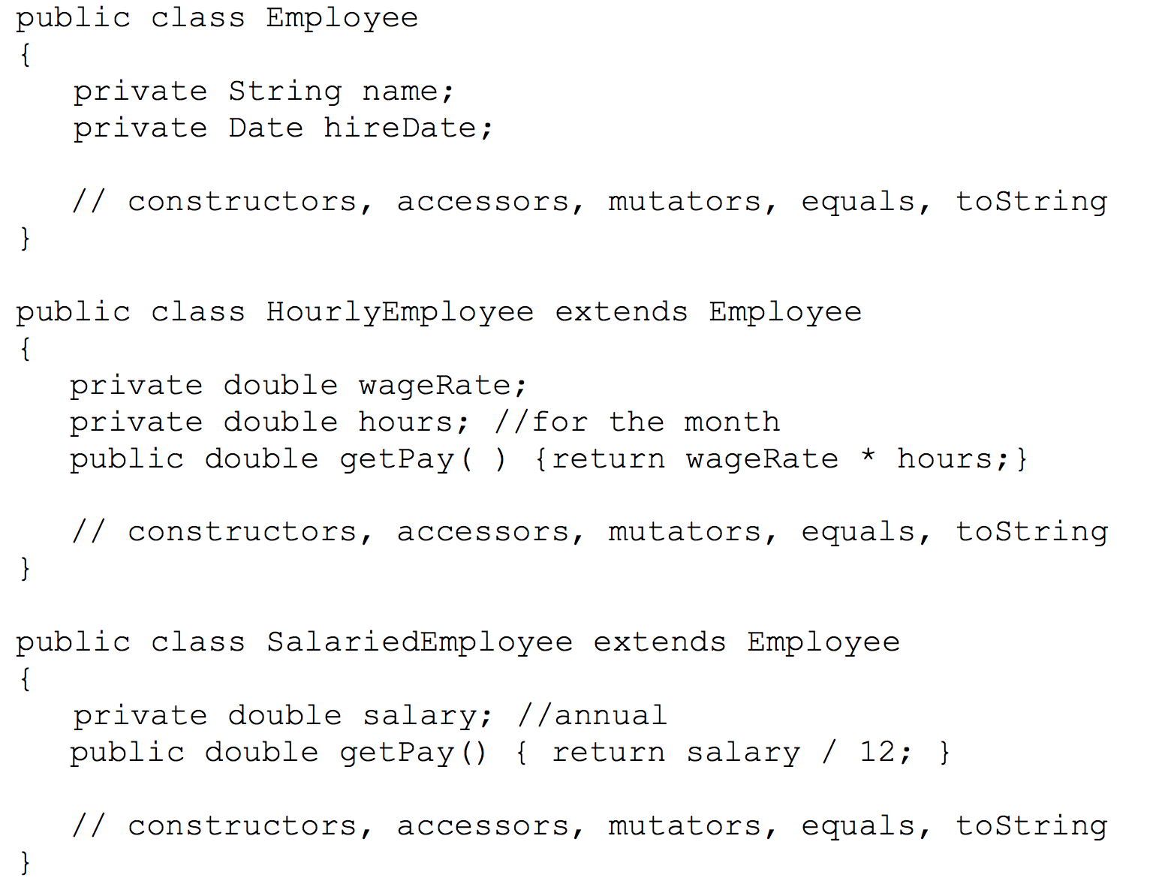
Abstract Classes

Slide 22
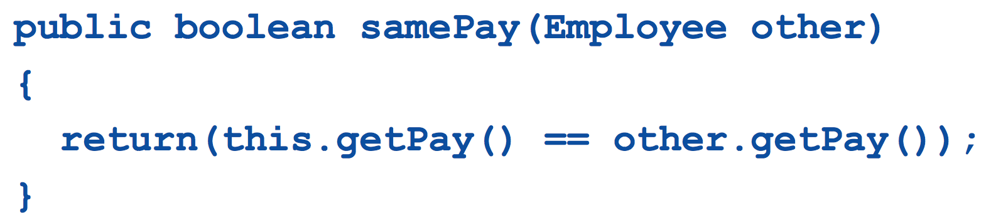
samePay
Suppose that we decide that it will often be necessary to determine if two Employees have the same pay.
We decide to implement a method named samePay in the Employee class.
This method should be able to compare the pays for any kinds of Employees

Slide 23
Problem with samePay
The method samePay calls getPay.
While getPay is defined for SalariedEmployees and HourlyEmployees, there is no meaningful implementation of getPay for a generic Employee.
We can’t implement getPay without knowing the type of Employee.

Slide 24
Problem with samePay
Solution:
Require that classes derived from Employee (who know what type they are) implement a suitable getPay method that can then be used from samePay.
Java provides this capability through the use of abstract methods.

Slide 25
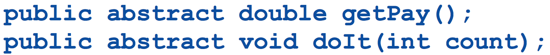
Abstract Classes
An abstract method is like a placeholder for a method that will be fully defined in a descendent class.
It postpones the definition of a method.
It has a complete method heading to which the modifier abstract has been added.
It cannot be private.
It has NO method body, and ends with a semicolon in place of its body.
The body of the method is defined in the derived classes.
The class that contains an abstract method is called an abstract class.

Slide 26
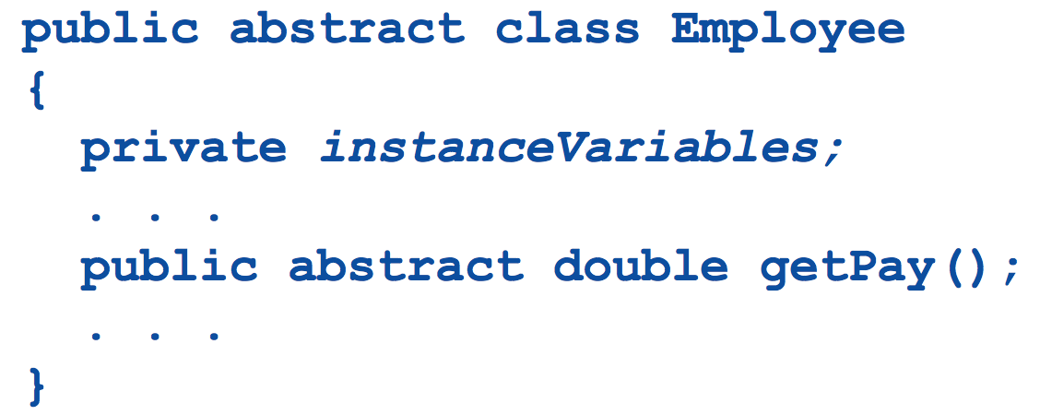
Abstract Class
If a class has at least one abstract method, it must be declared as an abstract class.
An abstract class must have the modifier abstract included in its class heading.

Slide 27
Abstract Class
An abstract class can have any number of abstract and/or fully defined methods.
If a derived class of an abstract class adds to or does not define all of the abstract methods,
it is abstract also, and
must add abstract to its modifier.
A class that is NOT abstract is called a concrete class.

Slide 28
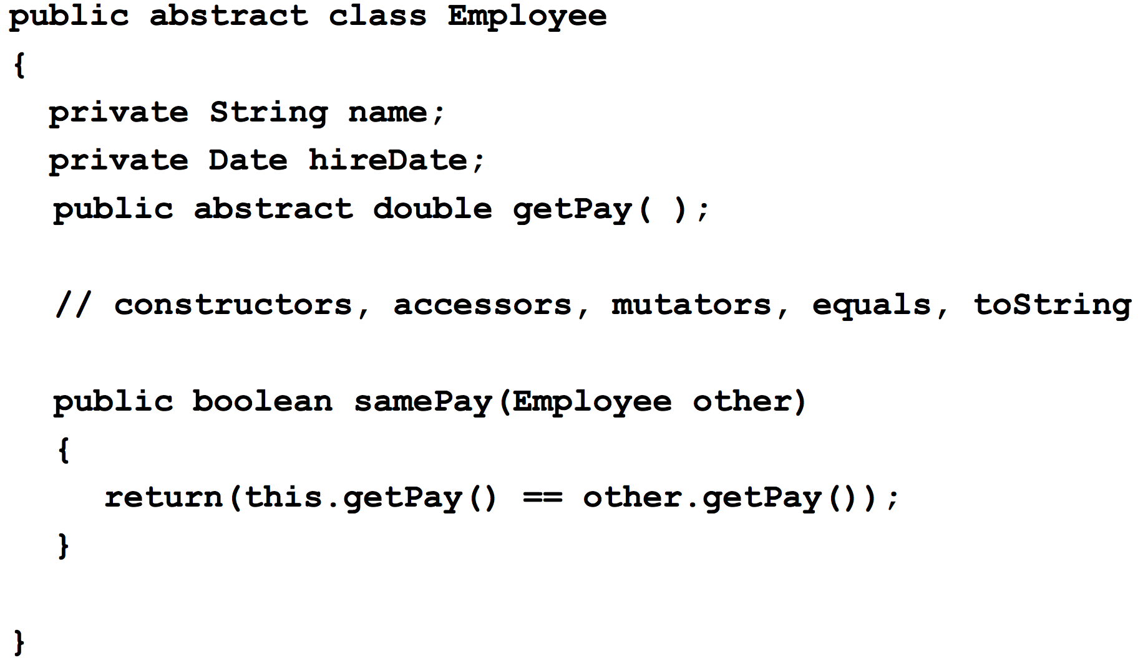
Abstract Employee Class

Slide 29
Abstract Class
You CANNOT create instances of an abstract class
An abstract class can only be used to derive more specialized classes.
While it may be useful to discuss employees in general, in reality an employee must be a salaried worker or an hourly worker.
An abstract class constructor CANNOT be used to create an object of the abstract class.
However, a derived class constructor will include an invocation of the abstract class constructor in the form of super.

Slide 30
An Abstract Class Is a Type
Although an object of an abstract class cannot be created, it is perfectly fine to have a parameter of an abstract class type.
This makes it possible to plug in an object of any of its descendent classes.
It is also fine to use a variable of an abstract class type, as long as it names objects of its concrete descendent classes only.

