Slide 1
AOV
資訊二甲

Slide 2
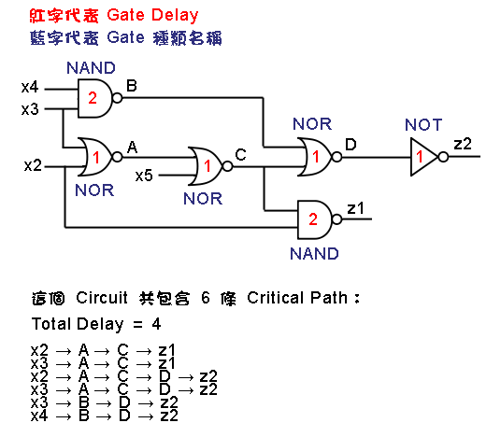
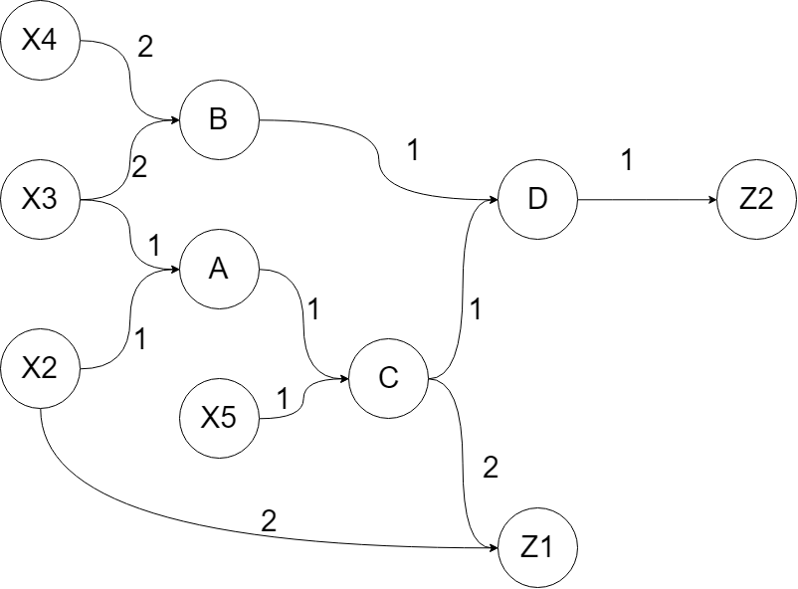
以老師提供的範例做講解
其實是長這樣，這樣看就是我們上課的圖論

Slide 3
Step 1： 標記每個節點，每個節點代表一個數字
X4 = 0
X3 = 1
X2 = 2
X5 = 3
B = 4
A = 5
C = 6
D = 7
Z1 = 8
Z2 =9

Slide 4
Step 2： 用連接點和取代名字的數字做一個陣列
 | 0 | 1 | 2 | 3 | 4 | 5 | 6 | 7 | 8 | 9
0 | 0 | 0 | 0 | 0 | 2 | 0 | 0 | 0 | 0 | 0
1 | 0 | 0 | 0 | 0 | 2 | 1 | 0 | 0 | 0 | 0
2 | 0 | 0 | 0 | 0 | 0 | 1 | 0 | 0 | 2 | 0
3 | 0 | 0 | 0 | 0 | 0 | 0 | 1 | 0 | 0 | 0
4 | 0 | 0 | 0 | 0 | 0 | 0 | 0 | 1 | 0 | 0
5 | 0 | 0 | 0 | 0 | 0 | 0 | 1 | 0 | 0 | 0
6 | 0 | 0 | 0 | 0 | 0 | 0 | 0 | 1 | 2 | 0
7 | 0 | 0 | 0 | 0 | 0 | 0 | 0 | 0 | 0 | 1
8 | 0 | 0 | 0 | 0 | 0 | 0 | 0 | 0 | 0 | 0
9 | 0 | 0 | 0 | 0 | 0 | 0 | 0 | 0 | 0 | 0
這邊記得計算連接點
0 | 0 | 0 | 0 | 2 | 2 | 2 | 2 | 2 | 1

Slide 5
Step 3： 用程式跑這個過程來計算最大delay
Earliest | [0] | [1] | [2] | [3] | [4] | [5] | [6] | [7] | [8] | [9] | Stack
開始 | 0 | 0 | 0 | 0 | 0 | 0 | 0 | 0 | 0 | 0 | []
X4=0 | 0 | 0 | 0 | 0 | 2 | 0 | 0 | 0 | 0 | 0 | []
X3=1 | 0 | 0 | 0 | 0 | 2 | 1 | 0 | 0 | 0 | 0 | [4]
4 out | 0 | 0 | 0 | 0 | 2 | 1 | 0 | 3 | 0 | 0 | []
X2=2 | 0 | 0 | 0 | 0 | 2 | 1 | 0 | 3 | 2 | 0 | [5]
5 out | 0 | 0 | 0 | 0 | 2 | 1 | 2 | 3 | 2 | 0 | []
X5=3 | 0 | 0 | 0 | 0 | 2 | 1 | 2 | 3 | 2 | 0 | [6]
6 out | 0 | 0 | 0 | 0 | 2 | 1 | 2 | 3 | 4 | 0 | [7,8]
8 out | 0 | 0 | 0 | 0 | 2 | 1 | 2 | 3 | 4 | 0 | [7]
7 out | 0 | 0 | 0 | 0 | 2 | 1 | 2 | 3 | 4 | 4 | [9]
9 out | 0 | 0 | 0 | 0 | 2 | 1 | 2 | 3 | 4 | 4 | []
 | 0 | 1 | 2 | 3 | 4 | 5 | 6 | 7 | 8 | 9
0 | 0 | 0 | 0 | 0 | 2 | 0 | 0 | 0 | 0 | 0
1 | 0 | 0 | 0 | 0 | 2 | 1 | 0 | 0 | 0 | 0
2 | 0 | 0 | 0 | 0 | 0 | 1 | 0 | 0 | 2 | 0
3 | 0 | 0 | 0 | 0 | 0 | 0 | 1 | 0 | 0 | 0
4 | 0 | 0 | 0 | 0 | 0 | 0 | 0 | 1 | 0 | 0
5 | 0 | 0 | 0 | 0 | 0 | 0 | 1 | 0 | 0 | 0
6 | 0 | 0 | 0 | 0 | 0 | 0 | 0 | 1 | 2 | 0
7 | 0 | 0 | 0 | 0 | 0 | 0 | 0 | 0 | 0 | 1
8 | 0 | 0 | 0 | 0 | 0 | 0 | 0 | 0 | 0 | 0
9 | 0 | 0 | 0 | 0 | 0 | 0 | 0 | 0 | 0 | 0
X4
X3
X2
X5
0 | 0 | 0 | 0 | 0 | 0 | 0 | 0 | 0 | 0

Slide 6
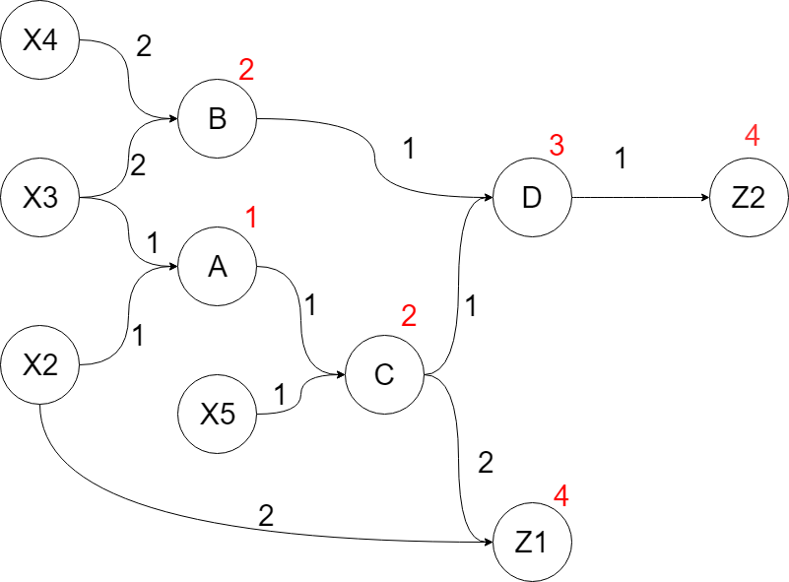
我們前面算這麽久就是要算去每一個點要多久
Earliest | [0] | [1] | [2] | [3] | [4] | [5] | [6] | [7] | [8] | [9] | Stack
開始 | 0 | 0 | 0 | 0 | 0 | 0 | 0 | 0 | 0 | 0 | []
X4=0 | 0 | 0 | 0 | 0 | 2 | 0 | 0 | 0 | 0 | 0 | []
X3=1 | 0 | 0 | 0 | 0 | 2 | 1 | 0 | 0 | 0 | 0 | [4]
4 out | 0 | 0 | 0 | 0 | 2 | 1 | 0 | 3 | 0 | 0 | []
X2=2 | 0 | 0 | 0 | 0 | 2 | 1 | 0 | 3 | 2 | 0 | [5]
5 out | 0 | 0 | 0 | 0 | 2 | 1 | 2 | 3 | 2 | 0 | []
X5=3 | 0 | 0 | 0 | 0 | 2 | 1 | 2 | 3 | 2 | 0 | [6]
6 out | 0 | 0 | 0 | 0 | 2 | 1 | 2 | 3 | 4 | 0 | [7,8]
8 out | 0 | 0 | 0 | 0 | 2 | 1 | 2 | 3 | 4 | 0 | [7]
7 out | 0 | 0 | 0 | 0 | 2 | 1 | 2 | 3 | 4 | 4 | [9]
9 out | 0 | 0 | 0 | 0 | 2 | 1 | 2 | 3 | 4 | 4 | []

Slide 7
我們用stack的概念（建議用遞回）
Step 4 輸出的部分(用之前算出來的4)
X2 | A
X2->A=1
X2 | A | C
X2->A->C=1+1=2
X2 | A | C | Z1
X2->A->C->Z1=1+1+2=4
這跑到4了，代表已經到達終點，輸出完之後，我們退回去上一個點，走其他路徑。

Slide 8
Step 4： 輸出的部分(用之前算出來的4)
我們用stack的概念（建議用遞回）
X2 | A
X2->A=1
X2 | A | C
X2->A->C=1+1=2
X2 | A | C | Z1
X2->A->C->Z1=1+1+2=4
這跑到4了，代表已經到達終點，輸出完之後，我們退回去上一個點，走其他路徑。

Slide 9
這邊最後會退到X2，然後放Z1， 失敗然後退回去主程式
X2 | A | C
X2->A->C=1+1=2
跑其他的節點
X2 | A | C | D
X2->A->C=1+1+1=3
X2 | A | C | D | Z2
X2->A->C=1+1+1+1=4

