Slide 1
資料結構實習

Slide 2
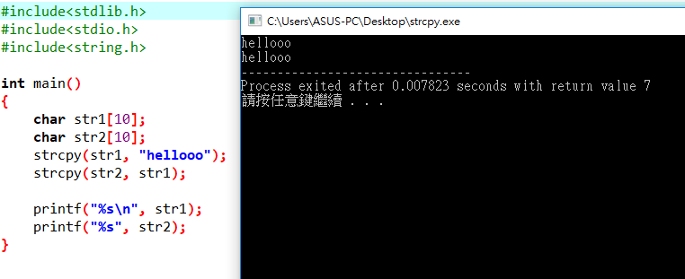
String
strcpy(char *dest, char *src)

Slide 3
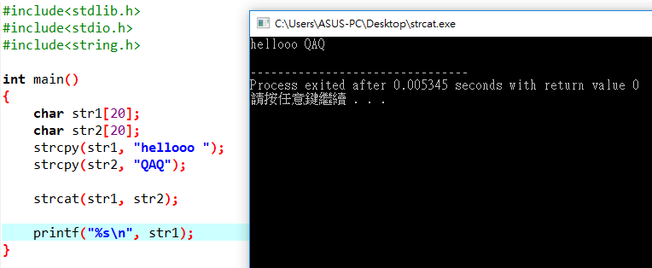
String
strcat(char *dest, char *src)

Slide 4
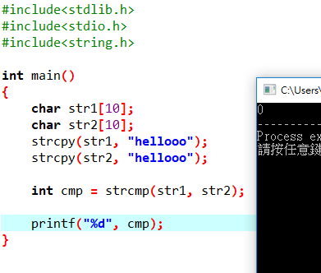
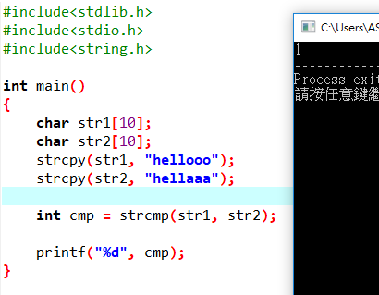
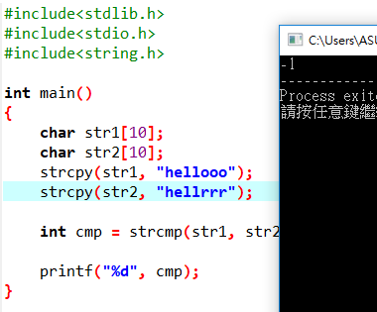
String
strcmp(char *str1, char *str2)

Slide 5
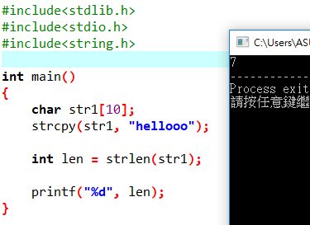
String
strlen(char *s)

Slide 6
Polynomial
多項式
如何儲存?
如何相加?
A(X) = 2X¹⁰⁰⁰ + 1
B(X) = X⁴ + 10X³ + 3X² + 1

Slide 7
Polynomial
4
2X
使用陣列來儲存
指數
底數

Slide 8
Polynomial
typedef struct {
int coef;
int expon;
} polynomial;
polynomial terms[100];
int avail = 0; //可以用的位址

Slide 9
Polynomial
int startA = 0;
int finishA = 3;
terms[0].coef = 1;
terms[0].expon = 4;
…
avail = 4;
X⁴ + 10X³ + 3X² + 1
startA
finishA
avail
1 | 10 | 3 | 1
4 | 3 | 2 | 0

Slide 10
Polynomial
多項式的相加
從最高次開始比
次方數一樣時相加

Slide 11
Polynomial
A(X) = X⁴ + 10X³ + 3X² + 1
B(X) = 2X¹⁰⁰⁰ + 1
startA
finishA
startB
finishB
avail
1 | 10 | 3 | 1 | 2 | 1
4 | 3 | 2 | 0 | 1000 | 0
startC
avail
startC

Slide 12
Polynomial
A(X) = X⁴ + 10X³ + 3X² + 1
B(X) = 2X¹⁰⁰⁰ + 1
startB
startA
finishA
finishB
avail
1 | 10 | 3 | 1 | 2 | 1 | 2
4 | 3 | 2 | 0 | 1000 | 0 | 1000
startC
avail
2
1000
startC

Slide 13
Polynomial
A(X) = X⁴ + 10X³ + 3X² + 1
B(X) = 2X¹⁰⁰⁰ + 1
startB
startA
finishA
finishB
1 | 10 | 3 | 1 | 2 | 1 | 2 | 1
4 | 3 | 2 | 0 | 1000 | 0 | 1000 | 4
startC
avail
2 | 1
1000 | 4
startC

Slide 14
Polynomial
A(X) = X⁴ + 10X³ + 3X² + 1
B(X) = 2X¹⁰⁰⁰ + 1
startB
startA
finishA
finishB
1 | 10 | 3 | 1 | 2 | 1 | 2 | 1
4 | 3 | 2 | 0 | 1000 | 0 | 1000 | 4
startC
avail
2 | 1 | 10
1000 | 4 | 3
startC

Slide 15
Polynomial
A(X) = X⁴ + 10X³ + 3X² + 1
B(X) = 2X¹⁰⁰⁰ + 1
startA
startB
finishA
finishB
1 | 10 | 3 | 1 | 2 | 1 | 2 | 1
4 | 3 | 2 | 0 | 1000 | 0 | 1000 | 4
startC
avail
2 | 1 | 10 | 3
1000 | 4 | 3 | 2
startC

Slide 16
Polynomial
A(X) = X⁴ + 10X³ + 3X² + 1
B(X) = 2X¹⁰⁰⁰ + 1
finishA
startA
finishB
startB
1 | 10 | 3 | 1 | 2 | 1 | 2 | 1
4 | 3 | 2 | 0 | 1000 | 0 | 1000 | 4
startC
avail
2 | 1 | 10 | 3 | 2
1000 | 4 | 3 | 2 | 0
startC
finishC

Slide 17
Polynomial
int startA = 0;
int finishA = 3;
int startB = 4;
int finishB = 5;
int startC;
int finishC;
int avail = 6;

Slide 18
Polynomial
startC = avail;
while(startA <= finishA && startB <= finishB)
{
if(terms[startA].expon > terms[startB].expon)
{
terms[avail].expon = terms[startA].expon;
terms[avail].coef = terms[startA].coef;
startA++;
}
else if(terms[startA].expon < terms[startB].expon)
{
…
}
else
{
terms[avail].coef = terms[startA].coef + terms[startB].coef;
startA++;
startB++;
}
avail++;
}

Slide 19
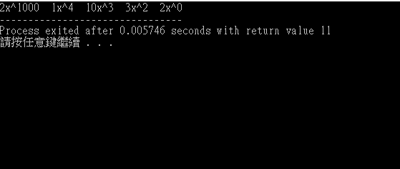
Polynomial
while(startA <= finishA)
{
terms[avail].expon = terms[startA].expon;
terms[avail].coef = terms[startA].coef;
startA++;
avail++;
}
while(startB <= finishB)
{
terms[avail].expon = terms[startB].expon;
terms[avail].coef = terms[startB].coef;
startB++;
avail++;
}
finishC = avail – 1;

Slide 20
Sparse Matrix
0 1 2 3 4 5
0
1
2
3
4
5
浪費儲存空間
6*6

Slide 21
Sparse Matrix
如何有效的儲存稀疏矩陣?
Row
Column
Value

Slide 22
Sparse Matrix
typedef struct {
int row;
int col;
int value;
} sparse;
sparse sp[101];

Slide 23
Sparse Matrix
第一個結構儲存矩陣的資訊
sp[0].row = 矩陣列數
sp[0].column = 矩陣行數
sp[0].value = 矩陣中的非0個數

Slide 24
Sparse Matrix
0 1 2 3 4 5
0
1
2
3
4
5
sp[0].row = 6;
sp[0].column = 6;
sp[0].value = 8;
6*6

Slide 25
Sparse Matrix
0 1 2 3 4 5
0
1
2
3
4
5
index = 1;
for(i = 0; i < sp[0].row; i++)
{
for(j = 0; j < sp[0].column; j++)
{
if(a[i][j] != 0)
{
sp[index].row = i;
sp[index].column = j;
sp[index].value = a[i][j];
index++;
}
}
}
6*6

Slide 26
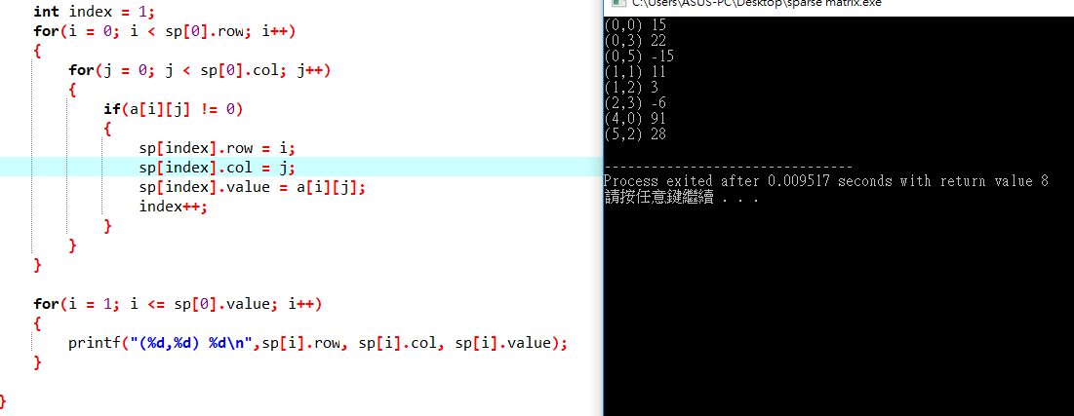
Sparse Matrix

Slide 27
Stack
First in last out
B
C
D
A
E

Slide 28
Stack
First in last out
(Push)
C
D
B
A
E

Slide 29
Stack
First in last out
C
D
B
A
E

Slide 30
Stack
First in last out
D
C
B
A
E

Slide 31
Stack
First in last out
E
D
C
B
A

Slide 32
Stack
E
First in last out
(Pop)
D
C
B
A

Slide 33
Stack
Function的呼叫
Factorial(5)
Fac(5)

Slide 34
Stack
Function的呼叫
Factorial(5)
Fac(4)
5*Fac(4)

Slide 35
Stack
Function的呼叫
Factorial(5)
Fac(3)
4*Fac(3)
5*Fac(4)

Slide 36
Stack
Function的呼叫
Factorial(5)
Fac(2)
3*Fac(2)
4*Fac(3)
5*Fac(4)

Slide 37
Stack
Function的呼叫
Factorial(5)
Fac(1) = 1
2*Fac(1)
3*Fac(2)
4*Fac(3)
5*Fac(4)

Slide 38
Stack
Function的呼叫
Factorial(5)
2
3*Fac(2)
4*Fac(3)
5*Fac(4)

Slide 39
Stack
Function的呼叫
Factorial(5)
6
4*Fac(3)
5*Fac(4)

Slide 40
Stack
Function的呼叫
Factorial(5)
24
5*Fac(4)

Slide 41
Stack
Function的呼叫
Factorial(5)
120

Slide 42
Stack
typedef struct{
int key; //模擬
} element;
element stack[100];
int top = -1; //用來記住最頂端的index

Slide 43
Stack
void push(element item){
if(top >= 99){
fprintf(stderr, “Stack is full, cannot add element”);
exit(EXIT_FAILURE);
}
stack[++top] = item;
}

Slide 44
Stack
element pop(){
if(top == -1){
fprintf(stderr, “Stack is empty”);
exit(EXIT_FAILURE);
}
return stack[top--];
}

Slide 45
Queue
First in first out
A
B
C
D
E

Slide 46
Queue
First in first out
(EnQueue)
B
A
C
D
E

Slide 47
Queue
First in first out
C
B
A
D
E

Slide 48
Queue
First in first out
(DeQueue)
C
B
A
D
E

Slide 49
Queue
100
0
typedef struct{
int key; //模擬
} element;
element queue[100];
int rear = -1; //index when enqueue
int front = -1 //index when dequeue
C
B
A
rear
front

Slide 50
Queue
void enqueue(element item){
if(rear == 99){
fprintf(stderr, “Queue is full, cannot add element”);
exit(EXIT_FAILURE);
}
queue[++rear] = item;
}

Slide 51
Queue
element dequeue(){
if(front == rear){
fprintf(stderr, “Queue is empty”);
exit(EXIT_FAILURE);
}
return queue[++front];
}

Slide 52
Stack & Queue
https://youtu.be/Pp8EkF_6WyE

Slide 53
練習1
請使用陣列結構儲存下面兩個多項式
輸出兩個多項式相加的結果
A(X) = 2X¹⁰ + 5X⁷ + 8X²
B(X) = 8X⁷ + 9X⁴ + 3X² + 2

Slide 54
練習2
請讀入sparse.txt內的數字，存進(8x8)二維陣列並輸出
將矩陣存入陣列結構中，並輸出格式如下：

Slide 55
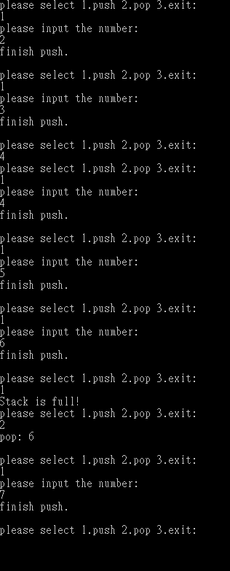
練習3
請實作一個容量為5的Stack
可讓使用者(push)整數，或者(pop)整數
Stack為空或者已滿須警告，程式不可崩潰
需有使用者介面

