Slide 1
資料結構實習

Slide 2
Queue
Front
First in first out
rear
-1
A
B
C
D
E
F

Slide 3
Queue
rear
Front
A
-1
B
C
D
E
F

Slide 4
Queue
rear
Front
B
A
-1
C
D
E
F

Slide 5
Queue
rear
Front
C
B
A
-1
D
E
F

Slide 6
Queue
rear
Front
D
C
B
A
-1
E
F

Slide 7
Queue
rear
Front
E
D
C
B
A
-1
F

Slide 8
Queue
rear
Front
E
D
C
B
A
-1
F

Slide 9
Queue
rear
Front
E
D
C
A
B
-1
F

Slide 10
Queue
rear
Front
E
D
C
A
B
-1
F

Slide 11
Queue
rear
Front
E
D
C
A
B
-1
F

Slide 12
Queue
rear
Front
D
E
C
A
B
-1
F
Queue為空但是無法新增

Slide 13
環狀Queue
3
4
Front=0
Rear=0
2
5
1
6
0
7

Slide 14
環狀Queue
3
4
Front=0
Rear=1
Rear =
(Rear+1)%Size;
queue[rear] = item;
2
5
A
1
6
0
7

Slide 15
環狀Queue
3
4
Front=0
Rear=2
2
5
B
A
1
6
0
7

Slide 16
環狀Queue
3
4
Front=0
Rear=7
C
D
2
5
B
E
A
F
1
6
G
0
7

Slide 17
環狀Queue
3
4
Front=0
Rear=0
Empty or Full?
C
D
2
5
B
E
A
F
1
6
H
G
0
7

Slide 18
環狀Queue
3
4
Front=0
Rear=7
Full
C
D
2
5
B
E
A
F
1
6
G
0
7

Slide 19
環狀Queue
3
4
Front=1
Rear=7
C
D
2
5
B
E
A
F
1
6
G
0
7

Slide 20
環狀Queue
3
4
Front=2
Rear=7
C
D
2
5
E
B
F
A
1
6
G
0
7

Slide 21
環狀Queue
當Rear的下一個為Front表示為Full
當Rear==Front表示為Empty
3
4
Front=7
Rear=7
Empty
2
5
G
1
6
0
7

Slide 22
環狀Queue
typedef struct{
int key; //模擬
} element;
element queue[100];
int rear = 0; //index when enqueue
int front = 0; //index when dequeue

Slide 23
環狀Queue
void enqueue(element item){ int new_rear = (rear +1) % queue_size; if(front == new_rear) //print queue is full
else{
queue[new_rear] = item;
rear = new_rear;
} }

Slide 24
環狀Queue
element dequeue(){ if(front == rear) //print queue is empty
else{
front = (front + 1) % queue_size;
return queue[front];
} }

Slide 25
Stack應用-Maze
1 1 1 1 1 1 1 1 1 1 1 1 1 1 1 1 1
entrance
1
1
1
1
1
1
1
1
1
1
1
0 1 0 0 0 1 1 0 0 0 1 1 1 1 1
1 0 0 0 1 1 0 1 1 1 0 0 1 1 1
0 1 1 0 0 0 0 1 1 1 1 0 0 1 1
1 1 0 1 1 1 1 0 1 1 0 1 1 0 0
1 1 0 1 0 0 1 0 1 1 1 1 1 1 1
0 0 1 1 0 1 1 1 0 1 0 0 1 0 1
0 1 1 1 1 0 0 1 1 1 1 1 1 1 1
0 0 1 1 0 1 1 0 1 1 1 1 1 0 1
1 1 0 0 0 1 1 0 1 1 0 0 0 0 0
0 0 1 1 1 1 1 0 0 0 1 1 1 1 0
0 1 0 0 1 1 1 1 1 0 1 1 1 1 0
1
1
1
1
1
1
1
1
1
1
1
exit
1 1 1 1 1 1 1 1 1 1 1 1 1 1 1 1 1

Slide 26
Stack應用-Maze
可以移動的方式：

Slide 27
Stack應用-Maze
使用結構、Stack紀錄路線
typedef struct{
short int row;
short int col;
short int from; //where you from
short int dir; //where you go
} element;
element stack[100];
int top = -1;

Slide 28
Stack應用-Maze
方向編碼(計算from的方式可用7減)
4 | 0 | 1
5 | X | 2
6 | 7 | 3

Slide 29
Stack應用-Maze
迷宮有可能為無解
搜尋時依編號遞增搜尋，from可跳過
邊搜尋邊push，遇到死路則pop往回走
已走過的點須紀錄，否則會形成cycle

Slide 30
Stack應用-Maze
印出路徑使用全1二維陣列，將pop出的位置改為0
1 | 1 | 1 | 1 | 1 | 1 | 1
1 | 0 | 1 | 1 | 1 | 1 | 1
1 | 1 | 0 | 1 | 1 | 1 | 1
1 | 1 | 0 | 1 | 1 | 1 | 1
1 | 1 | 1 | 0 | 0 | 1 | 1
1 | 1 | 1 | 1 | 1 | 0 | 1
1 | 1 | 1 | 1 | 1 | 1 | 1

Slide 31
Stack應用-Maze
起點
//current point
int row = 1;
int col = 1;
int dir = -1;
int from = 5;
//new point
int nrow;
int ncol;

Slide 32
Stack應用-Maze
迴圈
while(row != 10 || col != 10)
{
…
}

Slide 33
Stack應用-Maze
判斷新的點是否為0
switch(dir)
{
case 0:
nrow = row - 1;
break;
case 1:
nrow = row - 1;
ncol = col + 1;
break;
case 2:
ncol = col + 1;
break;
…
}

Slide 34
Stack應用-Maze
if(dir == 8) //this point has no path
{
if(top != -1)
{
//go back
element back_p = stack[top--];
row = back_p.row;
col = back_p.col;
dir = back_p.dir;
from = back_p.from;
}
else
//no path
}

Slide 35
Stack應用-Maze
if(maze[nrow][ncol] == 0 && maze_check[nrow][ncol] == 0) //find a new way
{
//push
…
//move to new point
…
}

Slide 36
Stack應用-中置式轉後置式
a / b - c + d * e - a * c

Slide 37
Stack應用-中置式轉後置式
((((a / b) – c) + (d * e)) – (a * c))

Slide 38
Stack應用-中置式轉後置式
((((a / b) – c) + (d * e)) – (a * c))

Slide 39
Stack應用-中置式轉後置式
a b / c – d e * + a c * –

Slide 40
Stack應用-中置式轉後置式
使用Stack完成
先乘除後加減
運算子 | + | - | * | /
優先度 | 1 | 1 | 2 | 2

Slide 41
Stack應用-中置式轉後置式
運算元直接輸出
運算子、左括號 進入堆疊：
Stack中的運算子優先度 >= 要進入的運算子則需先pop，才push
遇到右括號則pop至左括號(括號不輸出)
結束符號”\0”表示讀取完畢

Slide 42
Stack應用-中置式轉後置式
input | Stack | Output
a*(b+c)*d

Slide 43
Stack應用-中置式轉後置式
input | Stack | Output
a |  | a
a*(b+c)*d

Slide 44
Stack應用-中置式轉後置式
input | Stack | Output
a |  | a
* | * | a
a*(b+c)*d

Slide 45
Stack應用-中置式轉後置式
input | Stack | Output
a |  | a
* | * | a
( | *( | a
a*(b+c)*d

Slide 46
Stack應用-中置式轉後置式
input | Stack | Output
a |  | a
* | * | a
( | *( | a
b | *( | ab
a*(b+c)*d

Slide 47
Stack應用-中置式轉後置式
input | Stack | Output
a |  | a
* | * | a
( | *( | a
b | *( | ab
+ | *(+ | ab
a*(b+c)*d

Slide 48
Stack應用-中置式轉後置式
input | Stack | Output
a |  | a
* | * | a
( | *( | a
b | *( | ab
+ | *(+ | ab
c | *(+ | abc
a*(b+c)*d

Slide 49
Stack應用-中置式轉後置式
input | Stack | Output
a |  | a
* | * | a
( | *( | a
b | *( | ab
+ | *(+ | ab
c | *(+ | abc
) | * | abc+
a*(b+c)*d

Slide 50
Stack應用-中置式轉後置式
input | Stack | Output
a |  | a
* | * | a
( | *( | a
b | *( | ab
+ | *(+ | ab
c | *(+ | abc
) | * | abc+
* | * | abc+*
a*(b+c)*d

Slide 51
Stack應用-中置式轉後置式
input | Stack | Output
a |  | a
* | * | a
( | *( | a
b | *( | ab
+ | *(+ | ab
c | *(+ | abc
) | * | abc+
* | * | abc+*
d | * | abc+*d
a*(b+c)*d

Slide 52
Stack應用-中置式轉後置式
input | Stack | Output
a |  | a
* | * | a
( | *( | a
b | *( | ab
+ | *(+ | ab
c | *(+ | abc
) | * | abc+
* | * | abc+*
d | * | abc+*d
\0 |  | abc+*d*
a*(b+c)*d

Slide 53
Stack應用-中置式轉後置式
#define MAX 100
typedef struct{
char key;
} element;
element stack[MAX];

Slide 54
Stack應用-中置式轉後置式
int priority(char op) { //優先權
switch(op) {
case ‘+’: case ‘-’: return 1;
case ‘*’: case ‘/’: return 2;
default: return 0;
}
}

Slide 55
Stack應用-中置式轉後置式
Input: infix[], Output: postfix[]
int i, j, top;
for(i = 0, j = 0, top = -1; infix[i] != ‘\0’; i++)
switch(infix[i]) {
case ‘(’:
…
break;
case ‘+’: case ‘-’: case ‘*’: case ‘/’:
…
break;
case ‘)’:
…
break;
default: //直接輸出
…
}
while(top >= 0) {
postfix[j++] = stack[top--].key;
}

Slide 56
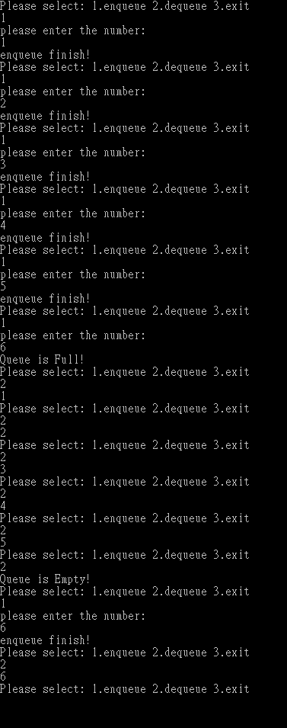
練習1
請實作一個容量為5的環狀Queue
可讓使用者(enqueue)整數，或者(dequeue)整數
Queue為空或者已滿須警告，程式不可崩潰
需有使用者介面

Slide 57
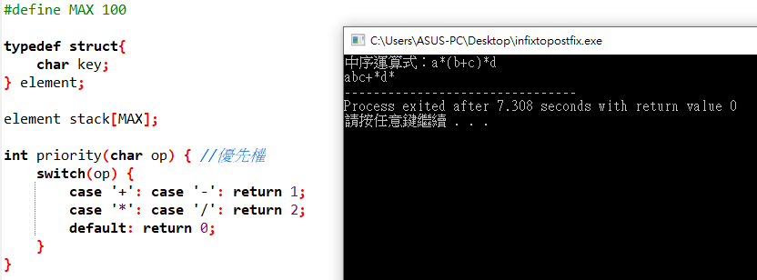
練習2
請讓使用者輸入一中置式，轉換為後置式並輸出

