Slide 1
Chapter 2 Arrays and Structures
Pointers and Dynamic Memory Allocation (from chap. 1)
Arrays
Dynamically Allocated Arrays
Structures and Unions
Polynomials
Sparse Matrices
Representation of Multi-D Arrays
Strings

Slide 2
Pointers
Any type T in C there is a corresponding type pointer-to-T
The actual value of a pointer type is an address of memory, two most important operators
& the address operator (位址運算子)
* the dereferencing (完全參考) operator，or indirection (間接) operator
A pointer is just a nonnegative integer number, C allows us to perform
Arithmetic operations
Relational operations
Convert pointers explicity to integers
2

Slide 3
Pointers
Declaration int i, *pi;
i is an integer variable and pi is a pointer to an integer
Statement pi = &i;
&i return the address of i and assigns it as the value of pi
To assign a value to i i = 10; or *pi = 10;
The null pointer points to no object or function, represented by the integer 0
NULL is defined to be constant 0
Test for the null pointer if (pi == NULL) or more simply: if (!pi)
3

Slide 4
Allocation and Deallocation of Memory (Prog. 1.1)
int i, *pi;
float f, *pf;
pi = (int *) malloc(sizeof(int));
pf = (float *) malloc(sizeof(float));
*pi = 1024;
*pf = 3.14;
printf (“an integer = %d, a float = %f\n”, *pi, *pf);
free (pi);
free (pf);

Slide 5
當記憶體不足
if ((pi = (int *) malloc(sizeof(int))) == NULL || (pf = (float *) malloc(sizeof(float))) == NULL)
{ fprintf (stderr, “Insufficient memory”); exit (EXIT_FAILURE);
}
if ( !(pi = (int *) malloc(sizeof(int))) || !(pf = (float *) malloc(sizeof(float))))
{ fprintf (stderr, “Insufficient memory”); exit (EXIT_FAILURE);
}
5

Slide 6
MALLOC
#define MALLOC (p, s) \ if (! ((p) = malloc (s))) {\ fprintf (stderr, “Insufficient memory”); \ exit (EXIT_FAILURE); \ }
/* int* pi = (int *) malloc (sizeof (int)) */ MALLOC (pi, sizeof (int));
/* float* pf= (float *) malloc (sizeof (float)) */ MALLOC (pf, sizeof (float));
6

Slide 7
Dangling Reference (懸浮參考)
int i, *pi;
float f, *pf;
/* pi = (int *) malloc(sizeof(int)); */
MALLOC (pi, sizeof (int));
/* pf = (float *) malloc(sizeof(float)); */
MALLOC (pf, sizeof (float));
*pi = 1024;
*pf = 3.14;
printf (“an integer = %d, a float = %f\n”, *pi, *pf);
MALLOC (pf, sizeof (float));
free (pi);
free (pf);
7

Slide 8
Pointer Can Be Dangerous
Set all pointer to NULL when they are not actually pointing to an object
Use explicit type casts when converting between pointer types
int *pi = NULL; float *pf = NULL; pi = malloc (sizeof (int)); pf = (float *) pi; /* casts an int pointer to a float pointer */

Slide 9
Arrays
C 陣列 (array) 是相同資料型態的集合，並用連續的記憶體來存放 ，透過索引 (index) 方式存取陣列各元素值 (value)。
An array is a set of <index, value>, for each index, there is a value associated with that index.
Correspondence or mapping
Implemented as a consecutive memory.
There standard operations
Create a new array
Retrieve a value
Store a value

Slide 10
Abstract Data Type Array
ADT Array is objects : A set of pairs <index, value> where for each value of index there is a value from the set item. Index is a finite ordered set of one or more dimensions, for example, {0, …, n-1} for one dimension, {(0, 0), (0, 1), (0, 2), (1, 0), (1, 1), (1, 2), (2, 0), (2,1), (2, 2)} for two dimensions, etc. functions : for all A ∈ Array, i ∈ index, x ∈ item, j, size ∈ integer Array Create (j, list) ::= return an array of j dimensions where list is a j-tuple whose ith element is the size of the ith dimension. Items are undefined. Item Retrieve (A, i) ::= if (i ∈ index) return the item associated with index value i in array A else return error Array Store (A, i, x) ::= if (i in index) return an array that is identical to array A except the new pair <i, x> has been inserted else return error
end Array

Slide 11
Arrays in C
陣列名稱可視為一唯讀的指標，陣列名稱是陣列在記憶體的起始位址，可透過指標方式存取陣列元素。
例如Month[5]，可撰寫為*(Month+5)。
陣列名稱並不是可修改的指標變數，故不可將之指向另一記憶體位址。
呼叫函式而必須傳遞陣列時，採用傳指標呼叫 (pass by pointer)，因為它使用了大量的連續記憶體空間，為了知道陣列的邊界在何處，同時也必須指定所傳遞陣列之大小。
int Month[12] = {0}; /* 將陣列的所有元素初始為0 */
int *ptr1 = Month; /* ptr1指標存放陣列的起始位址 */
int a = 10;
int *ptr2 = &a; /* ptr2指標存放a的記憶體位址 */
Month[6] = 100; /* 修改Month[6]的資料值 */
*(Month+3) = 200; /* 修改Month[3]的資料值 */
Month = ptr2; /* 不合法, Month不可指向其他處 */

Slide 12
1-D array accessed by index (Prog. 2.1)
#define MAX_SIZE 100
float sum(float [], int);
float input[MAX_SIZE], answer;
void main(void){
int i;
for (i = 0; i < MAX_SIZE; i++)
input[i] = i;
answer = sum(input, MAX_SIZE);
printf(“The sum is: %f\n”, answer);
}
float sum(float list[ ], int n){
int i;
float tempsum = 0;
for (i = 0; i < n; i++)
tempsum += list[i];
return tempsum;
}

Slide 13
Arrays in C
Declaration
int list[5], *plist[5];
Implementation of array list[5]
Variable Memory Address
list[0] base address : α
list[1] α + sizeof(int)
list[2] α + 2*sizeof(int)
list[3] α + 3*sizeof(int)
list[4] α + 4*sizeof(int)

Slide 14
Arrays in C
Compare int *list1 and int list2[5] in C.
Same：list1 and list2 are pointers.
Difference：list2 reserves five locations.
Notations:
list2 : a pointer to list2[0]
(list2 + i) : a pointer to list2[i] (i.e. &list2[i])
*(list2 + i) : list2[i]

Slide 15

Ex. 2.1: 1-D array addressing
int one[ ] = {0,1,2,3,4};
print1(one,5);
Prog. 2.2
void print1(int *ptr, int rows){
/* print out a one-dimensional array using a pointer */
int i;
printf(“Address Contents\n”);
for (i = 0; i < rows; i++)
printf(“%8u%5d\n”, ptr + i, *(ptr + i));
printf(“\n”);
}

Slide 16
Dynamically Allocated Arrays
Static vs. Dynamic
malloc(size), calloc(items, size), realloc(p, size), free(p)
1-D Arrays
int i, n, *list; printf (“Enter the number of numbers to generate : ”); scanf (“%d”, &n); if (n < 1) { fprintf (stderr, “Improper value of n\n”); exit (EXIT_FAILURE); } MALLOC (list, n * sizeof (int));

Slide 17
2-D Arrays
C uses array-of-arrays representation to represent a multidimensional arrays.
2-D array is represented as a 1-D array int x[3][5];
[0]
[1]
[2]
[3]
[4]
X[0]
X[1]
X[2]
Find the element x[i][j] : 1. accessing the pointer in x[i], (the address of the 0th element of row i). 2. adding j * sizeof (int) to this pointer, the address of the j^{th} element of row i.

Slide 18
Dynamically create a 2-D Array (Prog. 2.3)
int** make2darray (int rows, int cols){
/* create a 2-D rows × cols array */ int **x, i;
/* get memory for row pointers */ MALLOC (x, rows * sizeof (*x));
/* get memory for each row */ for (i = 0; i < rows; i++) MALLOC (x[i], cols * sizeof (**x)); return x;
}
int **myArray; myArray = make2darray(5, 10); myArray [2][4] = 6;

Slide 19
Memory Allocation
calloc and realloc are useful in context of dynamically allocated arrays.
Function calloc allocates a user-specified amount of memory.
initialized the allocated memory to 0 (i.e. all allocated bits are set to 0).
A pointer to the start of the allocated memory is returned.
Insufficient memory to make the allocation, the returned value is NULL.

Slide 20
CALLOC
Define a 1-D array of integer, the capacity is n, and x[0:n-1] are initially 0.
int *x; x = calloc (n, sizeof (int));
#define CALLOC (p, n, s) \ if (! ( (p) = calloc (n, s))) {\ fprintf (stderr, “Insufficient memory”); \ exit (EXIT_FAILURE); \ }

Slide 21
Memory Re-Allocation
Function realloc resizes memory previously allocated by either malloc or calloc
E.g., realloc (p, s)
Change size of the memory block pointed at by p to s
The contents of the first min{s, oldsize} bytes of the block are unchanged as result of resizing
When s > oldsize, the additional (s – oldsize) have an unspecified value
When s < oldsize, the rightmost (oldsize – s) bytes of the old block are freed
When realloc is able to do the resizing, it returns a pointer to the start of the new block, otherwise, the old block is unchanged and returned value is NULL

Slide 22
REALLOC
#define REALLOC (p, s) \ if (! ((p) = realloc (p, s))) {\ fprintf (stderr, “Insufficient memory”);\ exit (EXIT_FAILURE);\ }

Slide 23
Structures and Unions
結構 (structure)
可以是不同資料型態的集合。
可以將多種資料型態集合起來當作一種使用者自訂的新資料型態。
Structures in C
struct {
char name[10];
int age;
float salary;
} person;
strcpy(person.name, “james”);
person.age=10;
person.salary=35000.0;

Slide 24
Create structure data type
typedef struct humanBeing {
char name[10];
int age;
float salary;
};
or
typedef struct {
char name[10];
int age;
float salary
} humanBeing;
humanBeing person1, person2;

Slide 25
Check Equality of Structures (Prog. 2.3)
int humansEqual (humanBeing person1, humanBeing person2){
/* return TRUE if person1 and person2 are the same human being otherwise return FALSE */
if (strcmp(person1.name, person2.name))
return FALSE;
if (person1.age != person2.age)
return FALSE;
if (person1.salary != person2.salary)
return FALSE;
return TRUE;
}
if (humansEqual (person1, person2))
printf(“The two human beings are the same\n”);
else
printf(“The two human beings are not the same\n”);

Slide 26
Structure within a Structure
typedef struct {
int month;
int day;
int year;
} date;
typedef struct humanBeing{
char name[10];
int age;
float salary;
date dob;
};
humanBeing person1;
person1.dob.month = 2;
person1.dob.day = 11;
Person1.dob.year = 1944;

Slide 27
Structures in C
struct student
{
char stu_id[12]; /* 學號 */
int ScoreComputer; /* 計概成績 */
int ScoreMath; /* 數學成績 */
int ScoreEng; /* 英文成績 */
float ScoreAvg; /* 平均成績 */
};
當定義結構後，可將結構 student 視為一新的資料型態，包含了stu_id、ScoreComputer、ScoreMath、ScoreEng、ScoreAvg等 5 項資料變數，
以 student 結構體所宣告的變數，將會佔用 28-byte 空間。

Slide 28
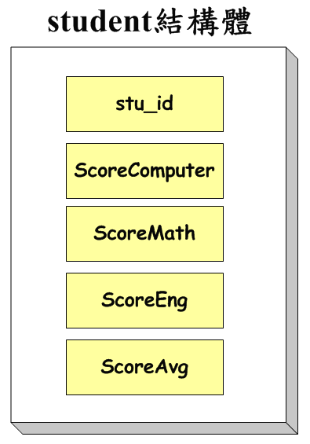
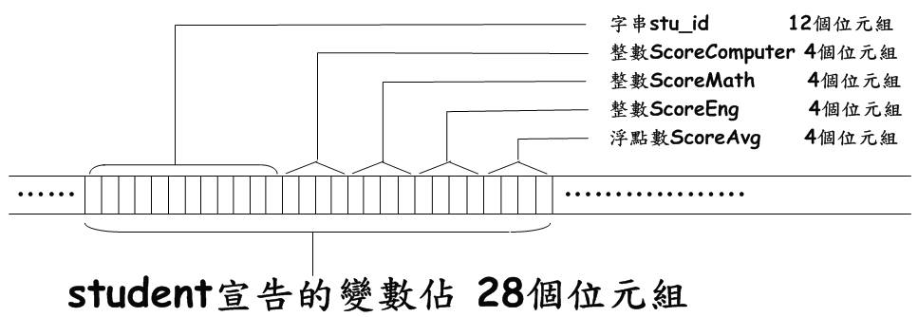
Structures in C

Slide 29
Structures in C
定義結構之後，除了可宣告結構變數外，也可以將結構與陣列結合，構成結構陣列。
例如：儲存全班 50 位學生的資料，可如下：
IM[50] 為擁有 50 個元素的陣列，每一個陣列元素的資料型態都是student 結構型態。
struct student John; /* 宣告一個結構變數John */
struct student IM[50]; /* 宣告一個結構陣列IM */

Slide 30
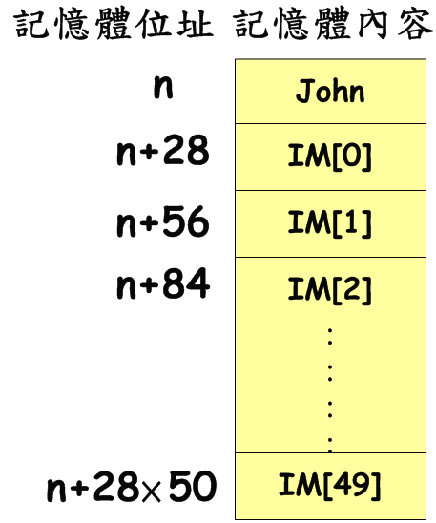
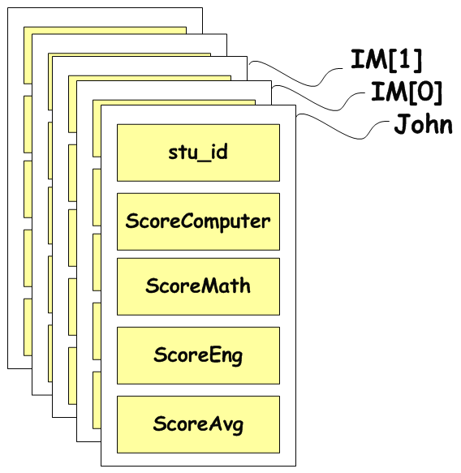
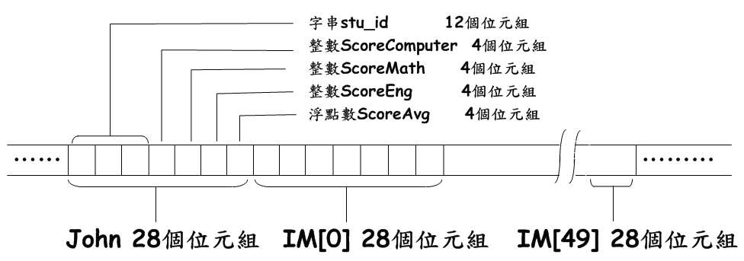
Structures in C

Slide 31
Structures in C
存取結構體變數某資料項，可用「.」與「->」符號。 兩種符號分別適用於不同時機如下：
「.」：結構體為普通結構體變數。
「->」：結構體為指向結構體的指標變數。
而在 C 語言中，必須使用型態別名 (typedef) 機制。
用 typedef 為 student 定義一個別名 stu。因此可直接使用 stu 來宣告變數John，而不用再加入 struct 關鍵字。
typedef struct student stu;
stu John;

Slide 32
Structures in C
一種更方便且具彈性的方式宣告結構 (無名稱)以及結構的別名，且該別名仍可用來宣告變數。
宣告了一個沒有名稱的結構，但已經為該結構取了一個別名stu (stu非結構變數名稱，而是結構別名)。
別名stu可直接用來宣告結構變數John與Mary。
typedef struct
{
char stu_id[12]; /* 學號 */
int ScoreComputer; /* 計概成績 */
int ScoreMath; /* 數學成績 */
int ScoreEng; /* 英文成績 */
float ScoreAvg; /* 平均成績 */
}stu;
stu John, Mary;

Slide 33
Structures in C
宣告結構時，可以不宣告結構名稱，但為了日後可以使用結構變數，因此必須在宣告結構時，同時指定一個以上的結構變數。
struct
{
char stu_id[12]; /* 學號 */
int ScoreComputer; /* 計概成績 */
int ScoreMath; /* 數學成績 */
int ScoreEng; /* 英文成績 */
float ScoreAvg; /* 平均成績 */
}John, Mary; /* John與Mary是結構變數 */

Slide 34
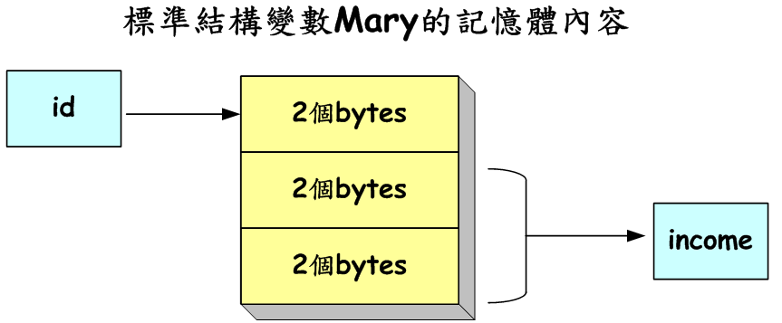
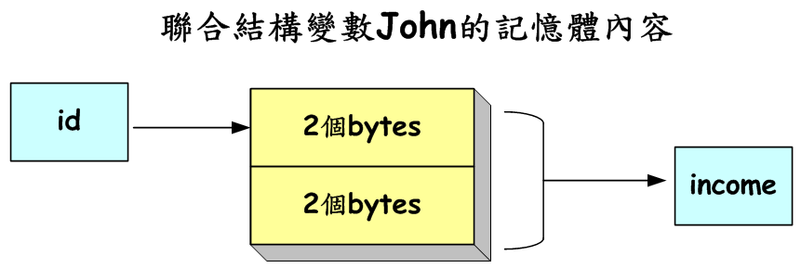
Unions in C
聯合 (union) 結構中的資料變數將會共同分享同一塊記憶體空間，因此，分享記憶體空間的總容量是『該結構中佔最多空間的資料變數』。
如下範例，struct 結構的 Mary 變數將會佔用(2 + 4) = 6 bytes。
但 union 聯合結構 John 變數則只會佔用 max(2,4) = 4 bytes。
struct s_member
{
short int id;
int income;
}Mary;
union u_member
{
short int id;
int income;
}John;

Slide 35
Unions in C
Similar to struct, but the fields of union must share their memory space, and only one field is active.
Example: Add fields for male and female.
typedef struct sexType {
enum tag_field {female, male} sex;
union {
int children;
int beard;
} u;
};
typedef struct humanBeing {
char name[10];
int age;
float salary;
date dob;
sexType sexInfo;
};
humanBeing person1, person2;
person1.sexInfo.sex=male;
person1.sexInfo.u.beard=FALSE;

Slide 36
Self-Referential Structures
One or more of its components is a pointer to itself.
typedef struct list {
char data;
list *link;
}
list item1, item2, item3;
item1.data=‘a’;
item2.data=‘b’;
item3.data=‘c’;
item1.link = item2.link = item3.link = NULL;
/* Construct a list with three nodes */
item1.link=&item2;
item2.link=&item3;
a
b
c

Slide 37
Ordered or Linear Lists
The ordered (有序) or linear list (線性串列)
(item₁, item₂, item₃, …, item_{n})
For Examples
(Sunday, Monday, Tuesday, Wednesday, Thursday, Friday, Saturday)
(甲, 乙, 丙, 丁)
Operations on lists
Finding the length
Reading the items
Retrieving the ith element
Replacing the ith element
Inserting a new element
Deleting the element
Implementation
sequential vs. nonsequential mapping

Slide 38
Polynomial
A(x) = 3x²⁰ + 2x⁵ + 4
A(x) = a_{i}x^{i}, where x is the variable, a_{i} is the coefficient, and i is the exponent
A(x) + B(x) = (a_{i} + b_{i})x^{i}
Representation I
#define MAX_DEGREE 101 /* Max degree of polynomial + 1 */
typedef struct {
int degree;
float coef[MAX_DEGREE];
} polynomial; polynomial a;
a.degree = n;
a.coef[i] = a_{n-i}, 0 ≦ i ≦ n

Slide 39
ADT Polynomial
ADT Polynomial is
objects： p(x) ＝ a₁x^{e1}＋ ... ＋a_{n}x^{en}; a set of ordered pairsof <e_{i}, a_{i}>，a_{i} in Coefficients, e_{i} in Exponents, e_{i} are integers >= 0
functions：
對於所有的 poly, poly1, poly2 ∈ Polynomial, coef ∈ Coefficients, expon ∈ Exponents
Polynomial Zero() | ::= | return the polynomial, p(x) = 0
Boolean IsZero(poly) | ::= | if (poly) return FALSE else return TRUE
Coefficient Coef(poly, expon) | ::= | if (expon ∈ poly) return its coefficient else return 0
Exponent LeadExp(poly) | ::= | return the largest exponent in poly
Polynomial Attach(poly, coef, expon) | ::= | if (expon ∈ poly) return error else return the poly with the term <coef,expon> inserted
Polynomial Remove(poly, expon) | ::= | if (expon ∈ poly) return the poly with expon is deleted else return error
Polynomial SingleMult(poly,coef,expon) | ::= | return the polynomial poly．coef．x^{expon}
Polynomial Add(poly1, poly2) | ::= | return the polynomial poly1＋poly2
Polynomial Mult(poly1, poly2) | ::= | return the polynomial poly1．poly2
end Polynomial

Slide 40
Polynomial
Representation II
MAX_TERMS 100 /* size of terms array */ typedef struct { float coef; int expon; } polynomial; polynomial terms[MAX_TERMS]; int avail = 0;

Slide 41
Polynomial
A(X) = 2X¹⁰⁰⁰ + 1
B(X) = X⁴ + 10X³ + 3X² + 1
startA finishA startB finishB avail
terms
2
1
1
10
3
1
coef
expon
1000
0
4
3
2
0
[0] [1] [2] [3] [4] [5] [6] [7] . . .

Slide 42
/* d =a + b, where a, b, and d are polynomials */ d = Zero( ) while (! IsZero(a) && ! IsZero(b)) do { switch COMPARE (LeadExp(a), LeadExp(b)) { case -1:
d = Attach(d, Coef (b, LeadExp(b)), LeadExp(b)); b = Remove(b, LeadExp(b)); break; case 0:
sum = Coef (a, LeadExp (a)) + Coef ( b, LeadExp(b)); if (sum) Attach (d, sum, LeadExp(a)); a = Remove(a , LeadExp(a)); b = Remove(b , LeadExp(b)); break;
case 1:
d = Attach(d, Coef (a, LeadExp(a)), LeadExp(a)); a = Remove(a, LeadExp(a)); } } insert any remaining terms of a or b into d
Prog. 2.5

Slide 43
Polynomial Addition (Prog. 2.6)
void padd (int starta, int finisha, int startb, int finishb, int * startd, int *finishd){
/* add A(x) and B(x) to obtain D(x) */ float coefficient; *startd = avail; while (starta <= finisha && startb <= finishb) switch (COMPARE(terms[starta].expon, terms[startb].expon)) { case -1: /* a expon < b expon */ attach(terms[startb].coef, terms[startb].expon); startb++; break;
case 0: /* equal exponents */ coefficient = terms[starta].coef + terms[startb].coef; if (coefficient) attach (coefficient, terms[starta].expon); starta++; startb++; break; case 1: /* a expon > b expon */ attach(terms[starta].coef, terms[starta].expon); starta++; }

Slide 44
Polynomial Addition (Prog. 2.6)
/* add in remaining terms of A(x) */ for( ; starta <= finisha; starta++) attach(terms[starta].coef, terms[starta].expon);
/* add in remaining terms of B(x) */ for( ; startb <= finishb; startb++) attach(terms[startb].coef, terms[startb].expon); *finishd = avail - 1; }
=> O(m+n), where m and n be the number of nonzero terms in A and B, respectively.

Slide 45
Add a New Term (Prog. 2.7)
void attach(float coefficient, int exponent){ /* add a new term to the polynomial */ if (avail >= MAX_TERMS) { fprintf(stderr, “Too many terms in the polynomial\n”); exit(1); } terms[avail].coef = coefficient; terms[avail++].expon = exponent; }

Slide 46
Sparse Matrix
0 1 2 3 4 5
0
1
2
3
4
5
6*6
1. Represented by a two-dimensional array.
➔ Sparse matrix wastes space.
2. Each element is characterized by <row, col, value>.

Slide 47
ADT SparseMatrix
ADT SparseMatrix is
objects：a set of triple , <row, column, value>，row and column are integers and from a unique combination, and value comes from the set item
functions：對於所有的 a、b ∈ SparseMatrix, x ∈item,
i、j、maxCol、maxRow ∈ index
SparseMatrix Create(maxRow, maxCol) | ::= | Return a SparseMatrix that can hold up to maxItems = maxRow × maxCol and maxRow 列 and maxCol 行
SparseMatrix Transpose(a) | ::= | Return the matrix produced by interchanging the row and column value of every triple
SparseMatrix Add(a,b) | ::= | if the dimensions of a and b are the same return 一個把相同的列和行的值相加過後的矩陣 else return error
SparseMatrix Multiply(a,b) end SparseMatrix | ::= | if a 的行數和 b 的列數相等 return 一個由以下公式產生的 a 乘 b 矩陣， d：d[i][j] = Σ(a[i][k]．b[k][j])，其中 d(i,j) 是第 (i,j) 個元素 else return 錯誤

Slide 48
Sparse Matrix
Sparse_matrix Create(max_row, max_col) ::= #define MAX_TERMS 101 /* maximum number of terms +1*/ typedef struct { int row; int col; int value; } term; term a[MAX_TERMS];

Slide 49
Sparse Matrix
 | row | col | value |  |  | row | col | value
a[0] | 6 | 6 | 8 |  | b[0] | 6 | 6 | 8
[1] | 0 | 0 | 15 |  | [1] | 0 | 0 | 15
[2] | 0 | 3 | 22 |  | [2] | 0 | 4 | 91
[3] | 0 | 5 | -15 |  | [3] | 1 | 1 | 11
[4] | 1 | 1 | 11 |  | [4] | 2 | 1 | 3
[5] | 1 | 2 | 3 |  | [5] | 2 | 5 | 28
[6] | 2 | 3 | -6 |  | [6] | 3 | 0 | 22
[7] | 4 | 0 | 91 |  | [7] | 3 | 2 | -6
[8] | 5 | 2 | 28 |  | [8] | 5 | 0 | -15
Row, column in ascending order.
a[0].row：the number of rows in array a. a[0].col：the number of cols in array a. a[0].value：the total number of nonzero terms in array a.

Slide 50
Transposing a Matrix
(1) For each row i, take element <i, j, value> and store it in element <j, i, value> of the transpose.
(0, 0, 15) => (0, 0, 15)
(0, 3, 22) => (3, 0, 22)
(0, 5, -15) => (5, 0, -15)
difficulty：where to put <j, i, value>？
(2) For all elements in column j,
place element <i, j, value> in element <j, i, value>
=>O(cols * elements)

Slide 51
Transposing a Matrix (prog. 2.8)
void transpose (term a[], termb[]){ /* b is set to the transpose of a */ int n,i,j,currentb; n = a[0].value; /* total number of elements */ b[0].row = a[0].col; /* rows in b = columns in a */ b[0].col = a[0].row; /* columns in b = rows in a */ b[0].value = n; if (n > 0) { /* non zero matrix */ currentb = 1; for (i = 0; i < a[0].col; i++) /* transpose by the columns in a */ for (j = 1; j<= n; j++) /* find elements from the current column */ if (a[j].col == i) { /* element is in current column, add it to b */ b[currentb].row = a[j].col; b[currentb].col = a[j].row; b[currentb].value = a[j].value; currentb++; } } }

Slide 52
Transposing a Sparse Matrix
Discussion: compared with 2-D array representation
O(cols * elements) vs. O(cols * rows)
elements => cols * rows when nonsparse
O(cols * elements) => O(cols² * rows)
Problem: Scan the array cols times.
Solution:
Step1：Determine the number of elements in each column of the original matrix.
Step2：Determine the starting positions of each row in the transpose matrix.

Slide 53
Transposing a Sparse Matrix
 | row | col | value |  |  | row | col | value
a[0] | 6 | 6 | 8 |  | b[0] | 6 | 6 | 8
[1] | 0 | 0 | 15 |  | [1] | 0 | 0 | 15
[2] | 0 | 3 | 22 |  | [2] | 0 | 4 | 91
[3] | 0 | 5 | -15 |  | [3] | 1 | 1 | 11
[4] | 1 | 1 | 11 |  | [4] | 2 | 1 | 3
[5] | 1 | 2 | 3 |  | [5] | 2 | 5 | 28
[6] | 2 | 3 | -6 |  | [6] | 3 | 0 | 22
[7] | 4 | 0 | 91 |  | [7] | 3 | 2 | -6
[8] | 5 | 2 | 28 |  | [8] | 5 | 0 | -15
[0] [1] [2] [3] [4] [5] rowTerms ： 2 1 2 2 0 1 startingPos ： 1 3 4 6 8 8

Slide 54
Fast transpose (Prog. 2.9)
void fast_transpose(term a[ ], term b[ ]){
/* the transpose of a is placed in b */ int rowTerms[MAX_COL], startingPos[MAX_COL]; int i, j, numCols = a[0].col, numTerms = a[0].value; b[0].row = numCols; b[0].col = a[0].row; b[0].value = numTerms; if (numTerms > 0){ /*nonzero matrix*/ for (i = 0; i < numCols; i++) rowTerms[i] = 0;
for (i = 1; i <= numTerms; i++) rowTerms[a[i].col]++;
startingPos[0] = 1; for (i =1; i < numCols; i++) startingPos[i]=startingPos[i-1] +rowTerms[i-1];

Slide 55
Fast transpose (Prog. 2.9)
for (i=1; i <= numTerms, i++) { j = startingPos[a[i].col]++; b[j].row = a[i].col; b[j].col = a[i].row; b[j].value = a[i].value; } } }
Compared with 2-D array representation
O(cols + elements) vs. O(cols * rows)
elements => cols * rows, when nonsparse
O(cols + elements) => O(cols * rows)

Slide 56
Representation of Multidimensional Arrays
Multi-D arrays represented
In C, using the array-of-arrays.
To map all elements into an ordered or linear list, stored in consecutive memory, just as a 1-D array.
If an array declared a[upper₀][upper₁]… [upper_{n-1}], then the number of elements in the array is：
Two common ways to represent multi-D arrays：
Row major order (列序) or column major order (行序)

Slide 57
Representation of 2-D Arrays
row major order vs. column major order
A[u₀][u₁] -- u₀ rows : row₀, row₁, …, row_{u0-1}, each row contains u₁ elements.
col₀ col₁ col_{u1-1}
row₀ A[0][0] A[0][1] . . . A[0][u₁-1]
row₁ A[1][0] A[1][1] . . . A[1][u₁-1]
. . .
row_{u0-1} A[u₀₋₁ ][0] A[u₀₋₁][1] . . . A[u₀₋₁][u₁-1]
α α + u₀ α+(u₁-1)* u₀
α + u₁
α+(u₀-1)*u₁

Slide 58
Representation of 2-D Arrays
Row major order A[i][j] : α + i*u₁ + j
Row # 1st element Address
row₀ A[0][0] α
row₁ A[1][0] α + u₁
row₂ A[2][0] α + 2*u₁
row_{i} A[i][0] α + i*u₁
row_{u0-1} A[u₀-1][0] α + (u₀-1)*u₁
Column major order A[i][j] : α + j*u₀ + i

Slide 59
Representation of 3-D Arrays (row major order)
3-D arrays a[u₀][u₁][u₂], 有u₀ 個 2-D arrays of dimension u₁* u₂。 為 a[i][j][k] 定址：
first, obtain α + i * u₁* u₂ as the address of a[i][0][0].
second, combining with 2-D addressing obtain α + i * u₁* u₂ + j * u₂ + k

Slide 60
Representation of n-D Arrays (row major order)
n-D arrays a[u₀][u₁]…[u_{n-1}], if α is the address for a[0][0]…[0]
The address of a[i₀][0]…[0] is α + i₀ * u₁* u₂ * … * u_{n-1}
The address of a[i₀][i₁]…[0] is α + i₀ * u₁* u₂ * … * u_{n-1} + i₁ * u₂* u₃ * … * u_{n-1}
Repeating in this way, the address for a[i₀][i₁]…[i_{n-1}] is α + i₀ * u₁* u₂ * … * u_{n-1} + i₁ * u₂* u₃ * … * u_{n-1} + i₂ * u₃* u₄ * … * u_{n-1} … + i_{n-2} * u_{n-1} + i_{n-1}

Slide 61
Ex1. One dimension array a, the address of a[5] is 1232, where is the address of a[23]?
Sol：The address of a[i] is α + i, when a[0] at α
∵ a[5] at 1232 =>α+ 5 = 1232 => α= 1227
∴ a[23] at α+ 23 => 1227+ 23 => 1250
Ex2. 2-D array a, a[2][3]的位址為1756, 且a[3][3]的位址為1760, 則a[5][1]在何處？
Sol：假設 a 為 m*n 的 2-D array
∵ 1760 – 1756 = 4 ∴ a為row major order, a[i][j]的位址為α+ i * n + j
∵ a[2][3]在α+ 2 * n + 3 = 1756 ..... (1)
a[3][3]在α+ 3 * n + 3 = 1760 ..... (2)
(2) – (1) 得 n = 4, 代入(1)得α= 1745
∴ a[5][1]的位址為1745 + 5 * 4 + 1 = 1766

Slide 62
Ex3. 2-D array a, a[0][0]在240, a[3][2]在255, 且a[1][1]在247, 則a[5][3]在何處？
Sol：假設 a 為 m*n 的2-D array, a[0][0]在240
(i) 若 a 為 row-major order：則a[i][j]在 240 + i * n + j
∵ a[3][2]在255 = 240 + 3 * n + 2, 得n = 13/3(非整數), 矛盾
(ii) 若 a 為column-major order：則a[i][j]在 240 + j * m + i
a[3][2]在255 = 240 + 2 * m + 3, ∴ m = 6
a[1][1]在247 = 240 + m + 1, ∴ m = 6
∴ a[5][3]在240 + 3 * 6 + 5 = 263

Slide 63
Ex4. 2-D array a, a[5][4]在160, 且a[3][1]在145, 則a[6][2]在何處？
Sol：假設 a 為 m*n 的2-D array
若a為row-major order，則a[i][j]在 a + i * n + j
∵ a[5][4]在160 = a + 5 * n + 4 ..... (1)
a[3][1]在145 = a + 3 * n + 1 ..... (2)
解聯立方程式(1)、(2), 得 n = 6, a = 126
∴ a[6][2]在126 + 6 * 6 + 2 = 164

Slide 64
Strings
define a string to have the form, S = s₀, s₁, …, s_{n-1}, where s_{i} are characters.
If n = 0, then S is an empty or null string.
Operations:
creating a new empty string.
reading a string or printing it out.
concatenation: appending two strings together.
copying a string.
comparing strings.
inserting a substring into a string.
removing a substring from a string.
finding a pattern in a string.

Slide 65
ADT String
ADT String is
objects：a finite set of zero or more characters.
functions：對於所有的 s, t ∈ String， i, j,m ∈non-negative integers.
String Null(m) | ::= | return a string whose maximum length in m characters. But is initially set to NULL。We write NULL as ””.
Integer Compare(s,t) | ::= | if s equals t return 0 else if s precedes t return -1 else return +1
Boolean IsNull(s) | ::= | if (Compare(s, NULL)) return FALSE else return TRUE
Integer Length(s) | ::= | if (Compare(s, NULL)) return the number of characters in s else return 0
String Concat(s, t) | ::= | if (Comare(t, NULL)) return a string whose elements are those of s followed by those of t else return s
String Substr(s, i, j) | ::= | if ((j＞0) && (i + j - 1) < Length(s)) return the string containing the characters of s at positions i, i+1,…, i+j-1 else return NULL

Slide 66
C string functions (Fig. 2.8)
函式 | 描述
char *strcat(char *dest, char *src) | 合併dest和src字串；回傳存在dest的結果
char *strncat(char *dest, char *src, int n) | 合併dest和src中的n個字元；回傳存在dest的結果
char *strcmp(char *str1, char *str2) | 比較兩個字串；如果str1＜str2則回傳＜0；如果str1＝str2則回傳0；如果str1＞str2則回傳＞0
char *strncmp(char *str1, char *str2, int n) | 比較前n個字元；如果str1＜str2則回傳＜0；如果str1＝str2則回傳0；如果str1＞str2則回傳＞0
char *strcpy(char *dest, char *src) | 把src複製到dest；回傳dest
char *strncpy(char *dest, char *src, int n) | 從src中複製n個字元到dest；回傳 dest
size_t strlen(char *s) | 回傳字串s的長度
char *strchr(char *s, int c) | 回傳指向字串s中的第一個c的指標；若找不到則回傳NULL
char *strrchr(char *s, int c) | 回傳指向字串s中的最後一個c的指標；若找不到則回傳NULL
char *strtok(char *s, char *delimiters) | 回傳s中的標記；標記包含在 delimiters裡
char *strstr(char *s, char *pat) | 回傳s中子字串pat的起使指標

Slide 67
Strings in C
Strings as character arrays terminated with the null character \0.
For instance, included array bounds. #define MAX_SIZE 100 /* maximum size of string */ char s[MAX_SIZE] = {“dog”}; char t[MAX_SIZE] = {“house”};
 | s[0] | s[1] | s[2] | s[3] |  | t[0] | t[1] | t[2] | t[3] | t[4] | t[5]
 | d | o | g | \0 |  | h | o | u | s | e | \0
Allocated just enough space to hold each word including the null character.
char s[] = {“dog”}; char t[] = {“house”};
What happens ? strcat(s, t);

Slide 68
#include <string.h>
#define MAX_SIZE 100 /*size of largest string*/
char string1[MAX_SIZE], *s = string1;
char string2[MAX_SIZE], *t = string2;
s | → | a | m | o | b | i | l | e | \0
t | → | u | t | o | \0
temp | → | \0
 |  | 起始
temp | → | a | \0
 |  | (a) after strncpy (temp,s,i)
temp | → | a | u | t | o | \0
 |  | (b) after strcat (temp,t)
temp | → | a | u | t | o | m | o | b | i | l | e | \0
 |  | (c) after strcat (temp,(s＋i))
insert t into s[1]

Slide 69
String Insertion (Prog. 2.12)
void strnins(char *s, char *t, int i){ /* 把字串 t 插入字串 s 中第 i 個位置 */ char string[MAX_SIZE], *temp = string; if (i < 0 && i > strlen(s)) { fprintf(stderr,”Position is out of bounds \n”); exit(EXIT_FAILURE); } if (!strlen(s)) strcpy(s,t); else if (strlen(t)){ strncpy(temp,s,i); strcat(temp,t); strcat(temp,(s+i)); strcpy(s,temp); } }

Slide 70
Pattern Matching
Sequential algorithm examines each character in string until it either finds the pattern or it reaches the end of the string.
KMP algorithm developed by Knuth, Morris and Pratt.
s = “ … a b c a b c a b c a c a b … ”
pat = “a b c a b c a c a b”

Slide 71
Pattern Matching by checking end indices first (Prog. 2.13)
int nfind(char *string, char *pat){ /* 先比對樣式的最後一個字元，再從頭開始比對 */ int i,j,start = 0; int lasts = strlen(string)-1; int lastp = strlen(pat)-1; int endmatch = lastp; for (i = 0; endmatch <= lasts; endmatch++, start++) { if (string[endmatch] == pat[lastp]) for ( j = 0, i = start; j < lastp && string[i] == pat[j]; i++,j++) ; if (j == lastp) return start; /* 成功比對 */ } return -1; }

Slide 72
Simulation of nfind
 |  |  |  | a |  | a |  | b
 |  |  |  | ↑ |  |  |  | ↑
 |  |  |  | j |  |  |  | lastp
 |  |  |  |  | (a) pattern
a | b | a | b |  | b |  | a |  | a |  | b |  | a | a
↑ |  | ↑ |  |  |  |  |  |  |  |  |  |  |  | ↑
start | endmatch |  |  |  |  |  |  |  |  |  |  |  |  | lasts
 |  |  |  |  | (b) no match
a | b | a | b |  | b |  | a |  | a |  | b |  | a | a
 | ↑ |  | ↑ |  |  |  |  |  |  |  |  |  |  | ↑
 | start | endmatch |  |  |  |  |  |  |  |  |  |  |  | lasts
 |  |  |  |  | (c) no match
a | b | a | b |  | b |  | a |  | a |  | b |  | a | a
 |  | ↑ |  |  | ↑ |  |  |  |  |  |  |  |  | ↑
 |  | start | endmatch |  |  |  |  |  |  |  |  |  |  | lasts
 |  |  |  |  | (d) no match

Slide 73
Simulation of nfind
a | b | a | b | b | a | a | b | a | a
 |  |  | ↑ |  | ↑ |  |  |  | ↑
 |  |  | start | endmatch |  |  |  |  | lasts
 |  |  |  | (e) no match
a | b | a | b | b | a | a | b | a | a
 |  |  |  | ↑ |  | ↑ |  |  | ↑
 |  |  |  | start | endmatch |  |  |  | lasts
 |  |  |  | (f) no match
a | b | a | b | b | a | a | b | a | a
 |  |  |  |  | ↑ |  | ↑ |  | ↑
 |  |  |  |  | start | endmatch |  |  | lasts
 |  |  |  | (g) match

Slide 74
Failure Function
Def: if p=p₀p₁…p_{n-1} is a pattern, then its failure function, f, is defined as
largest i < j such that p₀p₁…p_{i}= p_{j-i}p_{j-i+1}…p_{j}
f(j) if such an i >=0 exists
-1 otherwise
j 0 1 2 3 4 5 6 7 8 9
pat “a b c a b c a c a b”
f -1 -1 -1 0 1 2 3 -1 0 1

Slide 75
Computing th Failure Function (Prog. 2.15)
void fail(char *pat){ /* compute the pattern’s failure function */ int n = strlen(pat); failure[0] = -1; for (j = 1; j < n; j++) { i = failure[j-1]; while ((pat[j] != pat[i+1] && (i >= 0)) i = failure[i]; if (pat[j] == pat[i+1]) failure[j] = i+1; else failure[j] = -1; } }

Slide 76
Pattern Matching Rule
if a partial match is found such that s_{i-j}s_{i-j+1} …s_{i-1} = p₀p₁…p_{j-1} and s_{i} ≠ p_{j} then
matching may be resumed by comparing s_{i} and p_{f(j-1)+1} if j ≠ 0. If j = 0, then we may continue by comparing s_{i+1} and p₀.
s = “ … a b c a b c a b c a c a b … “
pat = “a b c a b c a c a b”
f = -1 -1 -1 0 1 2 3 -1 0 1
Compared with sequential algorithm
O(strlen(pat)+strlen(s)) vs. O(strlen(pat)*strlen(s))

Slide 77
KMP Pattern Matching Algorithm (Prog. 2.14)
int pmatch(char *string, char *pat){ /* Knuth, Morris, Pratt string matching algorithm */ int i = 0, j = 0; int lens = strlen(string); int lenp = strlen(pat); while (i < lens && j < lenp ) { if (string[i] == pat[j]) { i++; j++; } else if (j == 0) i++; else j = failure[j-1]+1; } return ( (j == lenp) ? (i-lenp) : -1); }

