Slide 1
Chapter 5
TREES
Introduction
Binary Trees
Binary Tree Traversals
Additional Binary Tree Operations
Threaded Binary Trees
Heaps
Binary Search Trees
Selection Trees
Forests
Counting Binary Trees

Slide 2







Trees
Notes:
Trees are a very useful data structure. Many different kinds of trees are used in Computer Science. We shall study just a few of these.

Slide 3
Nature Lover’s View Of A Tree
leaves
branches
root

Slide 4

Computer Scientist’s View
root
leaves
branches
nodes
Notes:
Branches meet at nodes.

Slide 5
Linear Lists And Trees
Linear lists are useful for serially ordered data.
(e₀, e₁, e₂, …, e_{n-1})
Days of week.
Months in a year.
Students in this class.
Trees are useful for hierarchically ordered data.
Employees of a corporation.
President, vice presidents, managers, and so on.
Genealogical charts (家譜表)
Pedigree chart (血統表) -- 呈現某人的祖先。
Lineal chart (直系表) -- 記載後代。

Slide 6
Hierarchical Data And Trees
The element at the top of the hierarchy is the root.
Elements next in the hierarchy are the children of the root.
Elements next in the hierarchy are the grandchildren of the root, and so on.
Elements that have no children are leaves.

Slide 7
Example Tree
root
President
children of root
VP1
VP2
VP3
grand children of root
Manager1
Manager2
Manager3
Manager4
great grand child of root
Worker Bee

Slide 8
Subtrees
root
President
VP1
VP2
VP3
Manager1
Manager2
Manager3
Manager4
Worker Bee

Slide 9
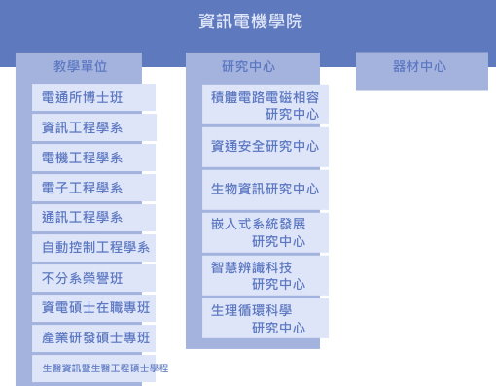
逢甲資電學院組織圖

Slide 10
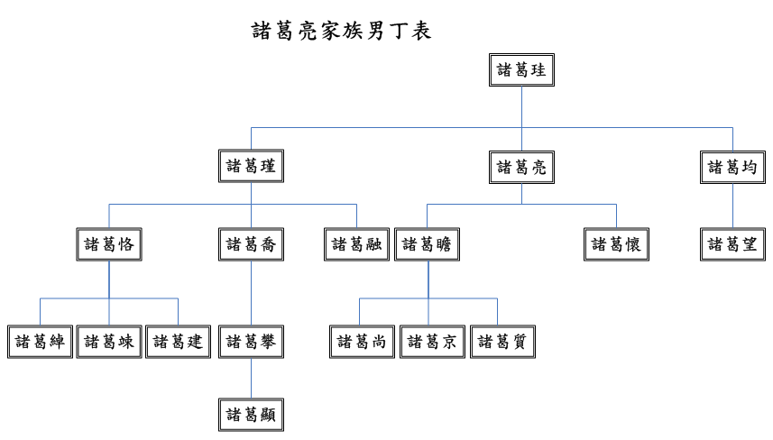
族譜關係

Slide 11
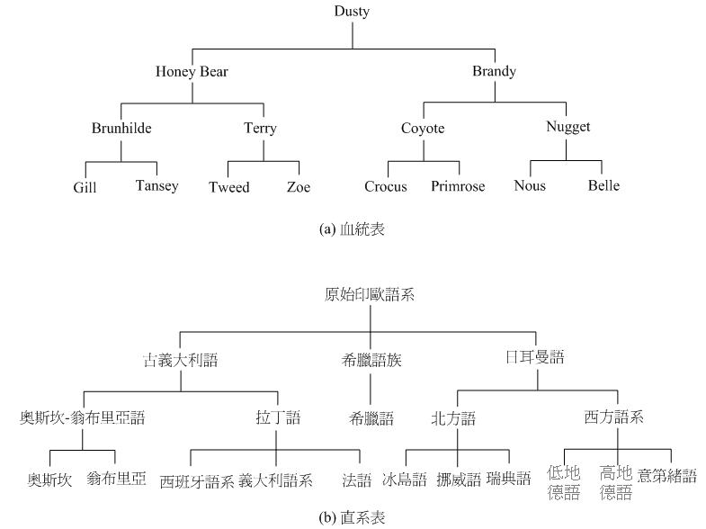
家譜表

Slide 12
2017 MLB 季後賽
2017 MLB 冠軍
(太空人)
4
3
美聯冠軍
(太空人)
國聯冠軍
(道奇)
3
4
4
1
區勝1
(洋基)
區勝2
(太空人)
區勝1
(道奇)
區勝2 (小熊)
3
2
3
1
0
3
2
3
外卡 (洋基)
區勝率1 (印地安人)
區勝率2 (太空人)
區勝率3 (紅襪)
外卡 (響尾蛇)
區勝率1 (道奇)
區勝率2 (國民)
區勝率3 (小熊)
1
0
0
1
洋基
雙城
洛磯
響尾蛇

Slide 13
Tree Definition
A tree is a finite set of one or more nodes such that
(1) There is a specially designated node called the root.
(2) The remaining nodes are partitioned into n ≥ 0 disjoint sets T₁, ..., T_{n}, where each of these sets is a tree. T₁, ..., T_{n} are called the subtrees of the root.
Recursive definition of Tree.

Slide 14
Terminology
A node (節點) stands for the item of information plus the branches to other nodes.
A is the root node.
The number of subtrees of a node is called its degree (分支度).
degree of node B is 2.
Nodes that have degree 0 are called leaf (葉節點) or terminal nodes (終端節點).
D, E, F, G, I are leaf nodes.
A, B, C, H are nonterminal nodes.
The roots of the subtrees of a node X are the children (子節點) of X. X is the parent (父節點) of its children.
D and E are the children of B.
B is the parent of D and E.
Grandparent (祖父節點) of I is C.
Level
A
1
B
C
2
D
E
F
G
H
3
I
4

Slide 15
Terminology
Children of the same parent are said to be siblings (兄弟).
F, G, and H are sibling.
The degree of a tree is the maximum of the degree of the nodes in the tree.
The ancestors (祖先) of a node are all nodes along the path from the root to that node.
Ancestors of I are A, C, H.
Descendants (後代) of node C are F, G, H, I.
The level (階層) of a node is defined by letting the root be at level 1.
if a node is at level i, then its children are at level i + 1. E is at level 3.
The height or depth of a tree is defined to be the maximum level of any node in the tree.
Level
Property: (# edges) = (#nodes) − 1
A
1
B
C
2
D
E
F
G
H
3
I
4

Slide 16
Representation of Trees
Level
A
1
List Representation (A (B (D, E), C (F, G, H (I))))
B
C
2
D
E
F
G
H
3
A
I
4
B
D
E
C
F
G
H
I
Possible node structure for a tree of degree k
Data Child 1 Child 2 … Child k
A k-way tree with n nodes, then n(k – 1) + 1 of the nk child fields are 0, n ≧ 1.

Slide 17
Representation of Trees
Left Child-Right Sibling (左子-右兄弟)
Level
A
1
A
B
C
2
B
C
D
E
F
G
H
3
D
E
F
G
H
I
4
I
A
Node structure
B
C
Data
Left child Right sibling
D
E
F
G
Representation as a Degree-Two Tree
H
I

Slide 18
Tree Representation
A
A
A
B
B
B
tree
left Child-right Sibling tree
binary tree
A
A
A
B
C
B
B
C
C

Slide 19
Binary Trees (二元樹)
A binary tree is a finite set of nodes that is either empty or consists of a root and two disjoint binary trees called the left subtree and the right subtree.
Recursive definition of binary tree.
Two different binary trees.
Viewed as binary trees, they are different.
Viewed as trees, they are the same.
A
A
B
B

Slide 20
Trees vs. Binary Trees
A binary tree may be empty; a tree cannot be empty.
No node in a binary tree may have a degree more than 2, whereas there is no limit on the degree of a node in a tree.
The subtrees of a binary tree are ordered; those of a tree are not ordered.

Slide 21
ADT Binary_Tree
structure Binary_Tree (abbreviated BinTree) is
objects: a finite set of nodes either empty or consisting of a root node, left Binary_Tree, and right Binary_Tree.
functions:
for all bt, bt1, bt2 ∈ BinTree, item ∈ element
Bintree Create() ::= creates an empty binary tree
Boolean IsEmpty(bt) ::= if (bt==empty binary tree)
return TRUE else return FALSE
BinTree MakeBT(bt1, item, bt2) ::= return a binary tree whose left
subtree is bt1, whose right
subtree is bt2, and whose root
node contains the data item
Bintree Lchild(bt) ::= if (IsEmpty(bt)) return error else
return the left subtree of bt
element Data(bt) ::= if (IsEmpty(bt)) return error else
return the data in the root node of bt
Bintree Rchild(bt) ::= if (IsEmpty(bt)) return error else
return the right subtree of bt

Slide 22
Properties of Binary Trees
The maximum number nodes on level i of a BT is 2^{i-1}, i ≥ 1.
The maximum number nodes in a BT of depth k is 2^{k}- 1, k ≥ 1.
Level
A
1
B
C
2
D
E
F
G
3
I
4

Slide 23
Properties of Binary Trees
For any nonempty binary tree, if n₀ is the number of leaf nodes and n₂ the number of nodes of degree-2, then n₀ = n₂ + 1.
Proof：Let n_{i} be the number of nodes of degree-i, and
n is the total number of nodes.
∵ all nodes are at most of degree 2,
∴ n = n₀ + n₁ + n₂ ----- (1)
We count the number of branched in a binary tree,
every node except the root has a branch leading into it.
If B is the number of branches, then n = B + 1.
All branches stem from a node of degree 1 and 2,
∴ B = n₁ + 2n₂ ➔ n = n₁ + 2n₂ + 1 ----- (2)
(1) – (2), get n₀ = n₂ + 1

Slide 24
Special types of Binary Trees
Level
A
A
A
1
B
B
C
B
C
2
D
D
E
F
G
D
E
F
G
3
H
H
I
4
Skewed Binary Tree
Complete Binary Tree
Full Binary Tree

Slide 25
Full BT vs. Complete BT
A full BT of depth k is a binary tree of depth k having 2^{k} -1 nodes, k ≥ 0.
Suppose we number the nodes in a BT starting with the root on level 1, continuing with the nodes on level 2, and so on.
Nodes on any level are numbered from left to right.
A binary tree with n nodes and depth k is complete iff its nodes correspond to the nodes numbered from 1 to n in the full binary tree of depth k.
The height of a complete BT with n nodes is .
Complete BT with 10 nodes
Full BT of depth 4

Slide 26
Binary Tree Representations
由上至下，
由左而右編號
Array Representation
waste space, but complete binary tree is ideal
Complete BT with n nodes (depth = ).
If i ≠ 1, parent(i) is at ⎣i/2⎦. If i=1, i is root and no parent.
If 2i ≦ n, leftChild(i) is at 2i. If 2i > n, no left child.
If 2i + 1 ≦ n, rightChild(i) is at 2i + 1. If 2i+1 > n, no right child.
A
1
[1]
[2]
[3]
[4]
[5]
[6]
[7]
B
2
C
3
A B C — D — E
Level 1
D
E
Level 2
Level 3
4
5
6
7

Slide 27
Representations of Binary Trees
Linked Representation
typedef struct node *treePointer;
typedef struct node {
int data;
treePointer leftChild, rightChild;
}
Where is parent？
A
NULL
B
NULL
C
D
NULL
E
NULL
NULL
NULL
leftChild
data
rightChild

Slide 28
Traversing Binary Trees
leftChild
data
rightChild
V
:
visiting
node
L: moving left
R: moving right
There are six possible combinations of traversal
LVR, LRV, VLR, VRL, RVL, RLV
Adopt convention that we traverse left before right, only 3 traversals remain
LVR, LRV, VLR
inorder, postorder, preorder

Slide 29
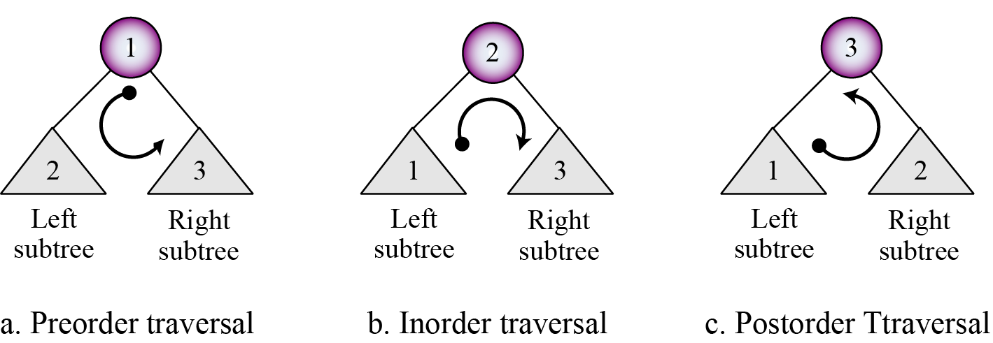
Depth-first Traversals

Slide 30
Inorder Traversal (Prog. 5.1)
void inorder(treePointer ptr){
/* inorder tree traversal */
if (ptr) {
L inorder(ptr->leftChild);
V printf(“%d”, ptr->data);
R indorder(ptr->rightChild);
}
}
+
*
E
*
D
/
C
A
B
A / B * C * D + E
⇔ infix expression ?
Binary tree with arithmetic expression

Slide 31
Preorder Traversal (Prog. 5.2)
void preorder(treePointer ptr){
/* preorder tree traversal */
if (ptr) {
V printf(“%d”, ptr->data);
L preorder(ptr->leftChild);
R predorder(ptr->rightChild);
}
}
+
*
E
*
D
/
C
+ * * / A B C D E
⇔ prefix expression !
A
B
Binary tree with arithmetic expression

Slide 32
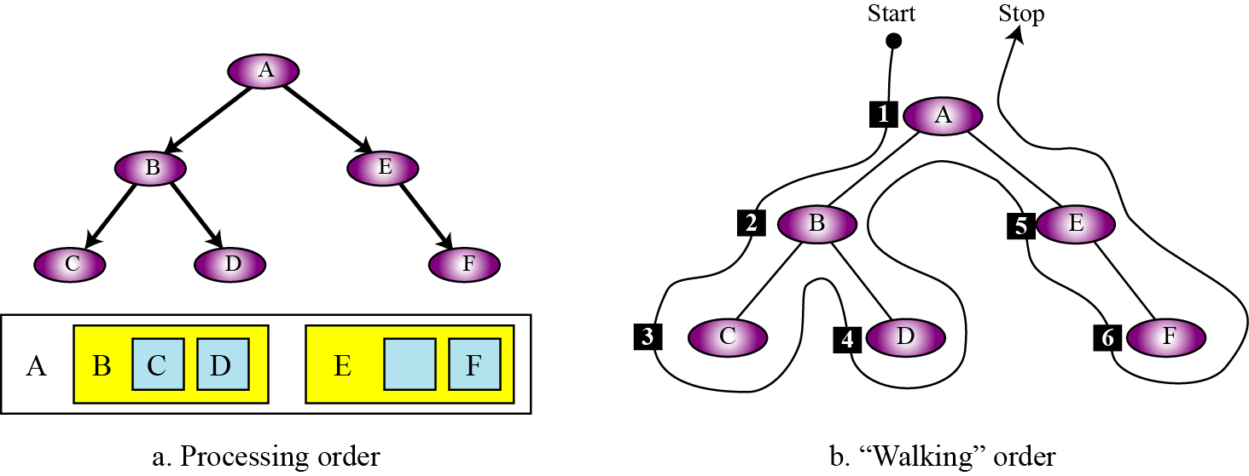
Preorder Traversal

Slide 33
Postorder Traversal (Prog. 5.3)
void postorder(treePointer ptr){
/* inorder traversal */
if (ptr) {
L postorder(ptr->leftChild);
R postdorder(ptr->rightChild);
V printf(“%d”, ptr->data); }
}
+
*
E
*
D
/
C
A B / C * D * E +
⇔ postfix expression !
A
B
Binary tree with arithmetic expression

Slide 34
Iterative Inorder Traversal (Prog. 5.4)
void iterInorder(treePointer node){
/* iterative inorder traversal */
int top = -1; /* initialize stack */
treePointer stack[MAX_STACK_SIZE];
for ( ; ; ) {
for (; node; node = node->leftChild)
add(&top, node); /* add to stack */
node = delete(&top); /* delete from stack */
if (!node) break; /* empty stack */
printf(“%d”, node->data);
node = node->rightChild;
}
}
L
V
R

Slide 35
Level Order Traversal (Prog. 5.5)
void levelOrder(treePointer ptr){
/* level order traversal */
int front = rear = 0;
treePointer queue[MAX_QUEUE_SIZE];
if (!ptr) return; /* empty queue */
addq(ptr);
+
*
E
*
D
/
C
+*E*D/CAB
A
B
Breadth-first traversals.
Binary tree with arithmetic expression

Slide 36
Level Order Traversal (Prog. 5.5)
for ( ; ; ) {
ptr = deleteq(&front, rear);
if (ptr) {
printf(“%d”, ptr->data);
if (ptr->leftChild)
addq(ptr->leftChild);
if (ptr->rightChild)
addq(ptr->rightChild);
}
else break;
}
}
FIFO

Slide 37
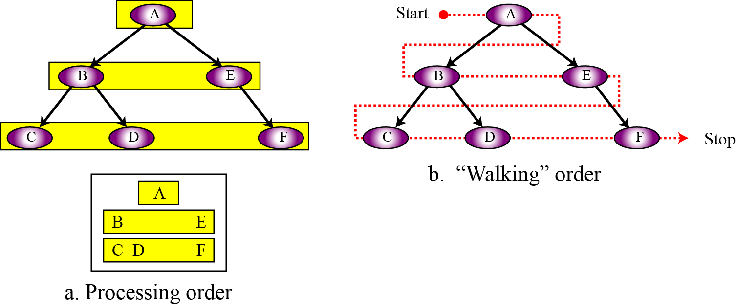
Breadth-first Traversals

Slide 38
Binary Expression Trees
二元運算樹 (binary expression tree)：使用二元樹來表示運算式。
給定一個運算式的中序、前序或後序表示式時，可由下列方式建立對應的二元運算樹：
加上適當的小括號 -- 考慮運算子的結合性與優先權。
從最內層的括號逐步化為二元樹 -- 運算子做為樹根，左邊運算元做為左子節點，右邊運算元做為右子節點。完成後，該括號將構成一棵子樹。做為外層括號的運算元。
重複上述步驟，直到處理完所有的運算子，最後處理的運算子將會是整棵樹的樹根。

Slide 39
Binary Expression Trees
請建立中序運算式 A+B/C-(D+E) 對應的二元運算樹。
解：
A + B / C - (D + E) ==> A + (B / C) - (D + E) ==> (A + (B / C)) - (D + E) ==> ( ( A + ( B / C ) ) - ( D + E ) )

Slide 40
Binary Expression Trees
建立後序運算式 FEAB-D+*/G- 對應的二元運算樹。
解：
F E A B - D + * / G - ==> F E (A B -) D + * / G - ==> F E ((A B -) D +) * / G – ==> F (E ((A B -) D +) *) / G – ==> (F (E ((A B -) D +) *) /) G – ==> ((F (E ((A B -) D +) *) /) G –)

Slide 41
Copying a Binary Tree (Prog. 5.6)
treePointer copy(treePointer original){
/* copying a binary tree */
treePointer temp;
if (original) {
MALLOC(temp, sizeof(*temp));
temp->leftChild = copy(original->leftChild);
temp->rightChild = copy(original->rightChild);
temp->data = original->data;
return temp;
}
return NULL;
}
拜訪的過程中順便copy
L
R
V

Slide 42
Testing for equality of binary trees (Prog. 5.7)
int equal(treePointer first, treePointer second){
/* function returns FALSE if the binary trees first and
second are not equal, Otherwise it returns TRUE */
return ((!first && !second) || (first && second &&
(first->data == second->data) &&
equal(first->leftChild, second->leftChild) &&
equal(first->rightChild, second->rightChild)))
}
V
L
R
拜訪的過程中順便compare

Slide 43
The Satisfiability Problem
Rules:
A variable is an expression.
If x and y are expressions, then ¬x, x∧y, x∨y are expressions.
Parentheses can be used to alter the normal order of evaluation, which is ¬ (not) before ∧ (and) before ∨ (or).
Example:
x₁ ∨ (x₂ ∧ ¬x₃)
Problem description:
Is there an assignment that cause the value of expression to be true?
Solution for the Example:
x₁ and x₃ are false and x₂ is true
==> false ∨ (true ∧ ¬false) ==> false ∨ true ==> true
test all possible combinations of true and false ? ( 2^{n})

Slide 44
Propositional formula in a binary tree
(x₁ ∧ ¬x₂) ∨ (¬ x₁ ∧ x₃) ∨ ¬x₃
postorder traversal
∨
data
∨
¬
value
∧
∧
X₃
X₁
¬
¬
X₃
X₂
X₁

Slide 45
Node Structure
leftChild data value rightChild
typedef emun {not, and, or, true, false } logical; typedef struct node *treePointer; typedef struct node { treePointer leftChild; logical data; short int value; treePointer rightChild; } ;

Slide 46
First Version of Satisfiability Algorithm (Prog. 5.8)
for (all 2^{n} possible combinations) {
generate the next combination;
replace the variables by their values;
evaluate root by traversing it in postorder;
if (root->value) {
printf(<combination>);
return;
}
}
printf(“No satisfiable combination\n”);

Slide 47
Satisfiability Algorithm (Prog. 5.9)
void postOrderEval(treePointer node){ /* modified postorder traversal to evaluate a propositional calculus tree */ if (node) { postOrderEval(node->leftChild); postOrderEval(node->rightChild); switch(node->data) { case not: node->value = !node->rightChild->value; break;
L
R
V

Slide 48
Satisfiability Algorithm (Prog. 5.9)
case and: node->value = node->rightChild->value && node->leftChild->value; break; case or: node->value = node->rightChild->value || node->leftChild->value; break; case true: node->value = TRUE; break; case false: node->value = FALSE; } } }

Slide 49
Threaded Binary Trees (引線二元樹)
Problem : Linked representation of any binary tree
more null links than actual points.
n+1 null links out of 2n total links.
2 n₀ + n₁ => n₀ + n₁ + n₂ + 1 => n + 1
Solution :
Replace these null links with some useful “threads”.

Slide 50
Threaded Binary Trees
Rules
(1) If (ptr->leftChild) is null, replace it with a pointer to the node that would be visited before ptr in an inorder traversal.
(2) If (ptr->rightChild) is null, replace it with a pointer to the node that would be visited after ptr in an inorder traversal.

Slide 51
A Threaded Binary Tree
root
A
t: true ⇒thread
f: false ⇒child
f
B
f
C
dangling
dangling
t
E
t
G
D
F
H
I
inorder traversal:
H, D, I, B, E, A, F, C, G

Slide 52
Memory representation of a Threaded Tree
root
f
—
f
A
dangling
dangling
f
B
f
C
D
t
E
t
F
G
t: true ⇒thread
f:false ⇒child
H
I

Slide 53
Node Structure
An empty threaded binary tree
typedef struct threadedTree *threadedPointer;
typedef struct threadedTree { short int leftThread; threadedPointer lftChild; char data; threadedPointer rightChild; short int rightThread;
};

Slide 54
Finding the Inorder Successor (Prog. 5.10)
threadedPointer insucc(threadedPointer tree){
threadedPointer temp;
temp = tree -> rightChild;
if (!tree -> rightThread)
while (!temp -> leftThread)
temp = temp -> leftChild;
return temp;
}
Inorder

Slide 55
Inorder Traversal of a Threaded BT (Prog. 5.11)
void tinorder(threadedPointer tree){
/* traverse the threaded binary tree inorder */
threadedPointer temp = tree;
for ( ; ; ) {
temp = insucc(temp); O(n)
if (temp == tree) break;
printf(“%3c”, temp -> data);
}
}

Slide 56
Insertion of Child as a Right Child of s
in a Threaded Binary Tree
root
root
A
s
A
s
(1)
B
B
(3)
C
X
r
C
X
r
(2)
root
root
A
s
s
A
B
B
r
(3)
C
D
C
X
(1)
(2)
E
F
(4)
D
r
X
E
F
successor

Slide 57
Right Insertion in a Threaded BT (Prog. 5.12)
void insertRight(threadedPointer s, threadedPointer r){ /* insert r as the right child of s */
threadedPointer temp;
r -> rightChild = s -> rightChild;
r -> rightThread = s -> rightThread;
r -> leftChild = s;
r -> leftThread = TRUE;
s -> rightChild = r;
s -> rightThread = FALSE;
if (!r -> rightThread) { temp = insucc(r);
temp -> leftChild = r;
}
}
(1)
(2)
(3)
(4)

Slide 58
Heaps (堆積)
A max(min) tree is a tree in which the key value in each node is no smaller(larger) than the key values in its children.
A max (min) heap is a complete binary tree that is also a max (min) tree.
Operations on heaps (refer to p.223 for ADT of Maxheap)
creation of an empty heap
insertion of a new element into the heap;
deletion of the largest element from the heap
detection of full or empty

Slide 59
Examples
max heap
[1]
14
[1]
9
[1]
30
[2]
12
[3]
7
[2]
6
[3]
3
[2]
25
[4]
[5]
[6]
[4]
10
8
6
5
min heap
[1]
2
[1]
10
[1]
11
[2]
7
[3]
4
[2]
20
[3]
83
[2]
21
[4]
[5]
[6]
[4]
10
8
6
50
Property
The root of max heap (min heap) contains the largest (smallest) element.

Slide 60
Application : priority queue
Queue in Chapter 3
FIFO
Priority Queue (優先權佇列)
delete the element with highest (lowest) priority
insert the element with arbitrary priority
Heaps is the only way to implement priority queue.

Slide 61
Insertion into a Max Heap
Insert 5 into heap
20
15
2
14
10
20
20
20
Parent
sink
15
2
15
2
15
5
14
10
14
10
5
Upheap
14
10
2
Complete BT
initial location of new node
insert 5 into heap

Slide 62
Insertion into a Max Heap (Prog. 5.13)
void push(element item, int *n){
/* insert item into a max heap of current size *n */
int i;
if (HEAP_FULL(*n)) {
fprintf(stderr, “the heap is full.\n”);
exit(1);
}
i = ++(*n);
while ((i != 1) && (item.key > heap[i/2].key)){
heap[i] = heap[i/2]; parent sink
i /= 2; item upheap
}
heap[i]= item;
}
O(log₂n)

Slide 63
Deletion from a Max Heap
Remove 20 from heap
20
15
2
20
14
10
downheap
10
15
Child up
15
2
15
2
14
2
14
10
14
10
Complete BT

Slide 64
Deletion from a Max Heap (Prog. 5.14)
element pop(int *n){
/* delete element with the highest key from the heap */
int parent, child;
element item, temp;
if (HEAP_EMPTY(*n)) {
fprintf(stderr, “The heap is empty\n”);
exit(1);
}
/* save value of the element with the highest key */
item = heap[1];
/* use last element in heap to adjust heap */
temp = heap[(*n)--];
parent = 1;
child = 2;

Slide 65
Deletion from a Max Heap (Prog. 5.14)
while (child <= *n){
/* find the larger child of the current parent */
if ((child < *n) && (heap[child].key < heap[child+1].key))
child++;
if (temp.key >= heap[child].key) break;
/* move to the next lower level */
heap[parent] = heap[child]; child up
parent = child;
child *= 2; item downheap
}
heap[parent] = temp;
return item;
}

Slide 66
Priority Queue Representations

Slide 67
Binary Search Trees
A binary search tree (二元搜尋樹) is a binary tree. It may be empty. If it is not empty then it satisfies the following properties :
Each node has exactly one key and the keys in the tree are distinct.
The keys in a nonempty left subtree (right subtree) are smaller (larger) than the key in the root of subtree.
The left and right subtrees are also binary search trees.

Slide 68
Examples of Binary Search Trees
20
30
60
12
25
5
40
70
10
15
32
2
65
80
中
小
大

Slide 69
Searching a Binary Search Tree
Search(25)
Search(76)
44
17
88
32
65
97
28
54
82
29
76
80

Slide 70
Recursive Search of a BST (Prog. 5.15)
element* search(treePointer root, int k){
/* return a pointer to the element whose key is k, if there is no such element, return NULL. */
if (!root) return NULL;
if (k == root->data.key)
return &(root->data);
if (k < root->data.key)
return search(root->leftChild, k);
return search(root->rightChild, k);
}

Slide 71
Iterative Searching Algorithm (Prog. 5.16)
element* search2(treePointer tree, int k){
/* return a pointer to the element whose key is k, if there is no such element, return NULL. */
while (tree){
if (k == tree->data.key)
return &(tree->data);
if (k < tree->data.key)
tree = tree->leftChild;
else tree = tree->rightChild;
}
return NULL;
}
O(h)

Slide 72
Insert Node in BST
Insert(25)
search(25)
before
after
44
44
17
88
17
88
32
65
97
32
65
97
28
54
82
28
54
82
29
76
25
29
76
80
80

Slide 73
void insert (treePointer *node, int k, iType theItem){
/* if k is in the tree pointed at by node do nothing; otherwise add a new node with data = (k, theItem) */
treePointer ptr, temp = modifiedSearch(*node, k);
if (temp || !(*node)) { /* k in not in the tree */
MALLOC (ptr, sizeof(*ptr));
ptr->data.key = k;
ptr->data.item = theItem;
ptr->leftChild = ptr->rightChild = NULL;
if (*node) /* insert as child of temp */
if (k < temp->data.key) temp->leftChild = ptr;
else temp->rightChild = ptr;
else *node = ptr;
}
}
Prog. 5.17
node
44
temp
...
...
28
29
ptr
25

Slide 74
Deletion from a BST
x
Max.
中
Min.
T1
T2
小
大

Slide 75
Deletion from a BST
44
17
x
88
32
65
97
28
54
82
29
76
before
80
78
Remove node x with an external child
44
17
88
after
65
28
97
29
54
82
76
80
78

Slide 76
Deletion from a BST
44
17
x
88
32
65
97
28
54
82
29
76
before
80
78
Remove node x whose children are both internal
44
17
x
88
after
28
76
97
29
54
82
80
78

Slide 77
Time Complexity
Searching, insertion, removal
O(h), where h is the height of the tree.
Worst case - skewed binary tree
O(n), where n is the # of internal nodes.
Prevent worst case
rebalancing scheme
AVL, 2-3, and Red-black tree.

Slide 78
Selection Trees
Problem: k ordered sequences, called runs, that are to be merged into a single ordered sequence.
Solution:
straightforward : k-1 comparison
selection tree : ⎡log₂k⎤+1

Slide 79
Winner Trees
Definition: A winner tree is a complete binary tree in which each node represents the smaller of its two children.
root node is the smallest node in the tree
a winner is the record with smaller key
Rules:
(1) tournament : between sibling nodes
(2) put X in the parent node ⇒ X tree where X = winner or loser

Slide 80
Winner tree
1
6
(8)
loser
2
3
6
(9)
8
(17)
4
5
6
7
9
(10)
6
(20)
8
(9)
17
(90)
8
9
10
11
12
13
14
15
10
9
20
6
8
9
90
17
15
20
20
15
15
11
100
18
16
38
30
25
50
16
110
20
28
run 1
run 2
run 3
run 4
run 5
run 6
run 7
run 8

Slide 81
Loser tree
0
Overall
winner
6
1
8
2
3
9
17
4
5
6
7
10
20
9
90
8
9
10
11
12
13
14
15
10
9
20
6
8
9
90
17
run 1
run 2
run 3
run 4
run 5
run 6
run 7
run 8

Slide 82
Replay : Winner tree
1
8
2
3
9
8
4
5
6
7
9
15
8
17
8
9
10
11
12
13
14
15
10
9
20
15
8
9
90
17
15
20
20
25
15
11
100
18
16
38
30
28
50
16
110
20
run 1
run 2
run 3
run 4
run 5
run 6
run 7
run 8

Slide 83
Complexity analysis of Selection Trees
k: # of runs
n: # of records
setup time: O(k)
# of levels: ⎡log₂k⎤ +1
restructure time: O(log₂k)
merge time: O(nlog₂k)
slight modification: tree of loser consider the parent node only (vs. sibling nodes)

Slide 84
Forest
A forest is a set of n ≥ 0 disjoint trees.
Forest
Binary tree
A
E
G
A
How ?
B
C
D
F
H
I
B
E
C
F
G
D
H
I

Slide 85
Transforming a forest into a binary tree
Definition:
if T₁, …, T_{n} is a forest of trees, then the binary tree corresponding to this forest by B(T₁, T₂, …, T_{n}).
(1) empty, if n = 0
(2) has root equal to root(T₁) - has left subtree equal to B(T₁₁,T₁₂,…,T_{1m}),
where T₁₁,T₁₂,…,T_{1m} are the subtree of root (T₁); - has right subtree equal to B(T₂,T₃,…,T_{n})

Slide 86
Transforming a forest into a binary tree
Rotate the tree clockwise by 45 degrees
Leftmost child
A
A
E
G
B
E
B
C
D
F
H
I
C
F
G
Right sibling
D
H
I

Slide 87
Counting Binary Trees
Problems :
The number of distinct binary trees having n nodes
The number of distinct permutations of the numbers of from 1 to n obtains by a stack
The number of distinct ways of multiplying n+1 matrices

Slide 88
Distinct Binary Trees
N = 2
N = 3

Slide 89
Distinct Binary Trees
Decomposing b_{n}
b_{n}
b_{i}
b_{n-i-1}
n = 1
b₁ = b₀ * b₀ = 1
n = 2
b₂ = b₀ * b₁ + b₁ * b₀ = 2
n = 3
b₃ = b₀ * b₂ + b₁ * b₁ + b₂ * b₀ = 5

Slide 90
Stack Permutations
1
1
1
1
1
2
2
2
3
2
2
3
3
3
3
Preorder ：
1, 2, 3 1, 2, 3 1, 2, 3 1, 2, 3 1, 2, 3
Inorder：
1, 2, 3 1, 3, 2 2, 1, 3 2, 3, 1 3, 2, 1
Postorder：
3, 2, 1 3, 2. 1 2, 3, 1 3, 2, 1 3, 2, 1

Slide 91
preorder: A B C D E F G H I inorder: B C A E D G H F I
A
A
B, C
E, D, G, H, F, I
B
D
preorder: A B C (D E F G H I) inorder: B C A (E D G H F I)
C
E
F
A
G
I
B
D
H
C
E
F, G, H, I

Slide 92
Matrix Multiplication
M₁*M₂*…*M_{n}
n=3 (M₁*M₂)*M₃ M₁*(M₂*M₃)
n=4 ((M₁*M₂)*M₃)*M₄ (M₁*(M₂*M₃))*M₄ M₁*((M₂*M₃)*M₄) M₁*(M₂(*M₃*M₄)) (M₁*M₂)*(M₃*M₄)

