Slide 1
Chapter 7
Sorting
Motivation
Sequential and Binary Search
List Verification
Selection Sort
Insertion Sort
Quick Sort
Merge Sort
Heap Sort
Sorting on Several Keys
List Sort
Table Sort
External Sorting

Slide 2
Motivation
We use the term list to mean a collection of records (記錄), each record having one or more fields. The field used to distinguish among the records are knows as keys (鍵值).
Sorting 是將 list 內記錄依鍵值 ascending 或 descending 排序，鍵值是每一記錄進行比對的依據。
例如，每筆學生的資料包含「學號」、「姓名」、「平均成績」等，可要求以「學號」做為鍵值升冪排序，或者以「平均成績」做為鍵值降冪排序。
在不同時機下，可能使用不同的鍵值做為排序依據。
例如，在列印名次時，會以「平均成績」做為鍵值。

Slide 3
Motivation
通常Sorting有其目的。
為了方便搜尋。
例如，英漢字典內的英文單字依字母 a ~ z 遞增排序，為日後找尋特定單字變得比較方便。
在資訊領域中，由於有些搜尋演算法要求資料必須是具順序的存放， 因此，排序時常與搜尋搭配使用。
為了比對資料。
例如，核對發票六獎，會以尾三碼進行排序，以便於比對。
假設有兩資料群，list1 = {1,6,4,2,….}及 list2 = {2,3,6,1,….}，在未排序的狀況下，雖然也可以進行資料的比對以判別 list1 是否與 list2 相等，但若經過排序，則可以使比對變得比較簡單。
No single sorting technique is the “best” for all initial orderings and sizes of the list being sorted.
We examine several techniques, indicating when one is superior to the others.

Slide 4
排序的種類
排序演算法的分類有許多種，依據的分類方式有所不同。
依據資料量的多寡分類。
內部排序 (internal sort)
排序的資料量較小，足以全部放入主記憶體內進行排序。
selection sort, insertion sort, quick sort, merge sort, heap sort, and radix sort.
外部排序 (external sort)
排序的資料量過大，無法完全載入主記憶體，而必須使用輔助記憶體來存放資料。
k-way merging.

Slide 5
排序的種類
依據每次比對資料的方式分類。
比較排序 (comparative sort)
以整個鍵值進行比較，做為排序依據。
分配排序 (distributive sort)
以鍵值的某一位數進行比較，做為排序分配方式。
此類排序最有名的為基底排序法 (radix sort)。
依據排序是否穩定分類。
例如，以學生資料而言，假設 A, B 學生的成績相同，要依據成績當鍵值排序，若排序前與排序後 A, B 學生資料的順序一樣，則為穩定排序法 (stable sorting)。

Slide 6
Stable Sorting
若原始 list 為 (R₁,R₂,…..,R_{n})，每筆記錄 R_{i} 的鍵值為 K_{i}。
則遞增排序是要找到一個排列為 (R_{σ(1)}, R_{σ(2)}, … R_{σ(n)})，使得 K_{σ(i)} ≦ K_{σ(i+1)}，1 ≦ i ≦ n-1。
當 list 內有多筆鍵值一樣時，排列 σ 就不是唯一的。
一 stable (穩定的) 排序演算法，可以找到一個唯一的排列 σ_{s}，σ_{s}滿足下列兩特性：
(1) sorted list = (R_{σ(1)}, R_{σ(2)}, … R_{σ(n)})， K_{σ(i)} ≦ K_{σ(i+1)}，1 ≦ i ≦ n-1。
(2) 在原始 list內, 若 i < j 且 K_{i} = K_{j}，則在 sorted list 內，R_{i} 必在 R_{j} 之前。
若演算法僅能保證滿足特性(1)，而無法保證滿足特性(2) (也就是有可能R_{i}位於R_{j}之後)，該排序演算法稱為 unstable (不穩定的) 排序演算法。
實際應用場合中，有時會要求必須使用穩定的排序，有時不要求。

Slide 7
Sequential Search
One way to search for a record with the specified key is to examine the list of records in left-to-right or right-to-left order, known as a sequential search.
Example: List has n records. 4, 15, 17, 26, 30, 46, 48, 56, 58, 82, 90, 95
unsuccessful search
n+1 ⇒ O(n)
average successful search
⇒ O(n)

Slide 8
Sequential Search
# define MAX_SIZE 1000 /* maximum size of list plus one */ typedef struct { int key; /* other fields */ } element; element list[MAX_SIZE];

Slide 9
Sequential Search (Prog. 7.1)
int seqSearch(element a[ ], int n, int k ){
/*在串列 a[1 : n] 中尋找最小的 i 值，使得 a[i].key = k
如果 k 在串列 a[1 : n] 中找不到，則回傳 0。 */ int i;
for(i = 1; i <= n && a[i].key != k; i++)
;
if (i > n) return 0;
return i;
}
int seqSearchSorted(element a[ ], int n, int k ){
/* 在已排序串列 a[1 : n] 中尋找最小的 i 值，使得 a[i].key = k
如果 k 在串列 a[1 : n] 中找不到，則回傳 0。 */ int i;
for(i = 1; i <= n && a[i].key < k; i++)
;
if (i > n || a[i].key != k) return 0;
return i;
}

Slide 10
Decision tree for binary search.
Binary Search
List：4, 15, 17, 26, 30, 46, 48, 56, 58, 82, 90, 95
[6]
46
[3]
[9]
17
58
[1]
[4]
[7]
[11]
4
26
48
90
[2]
[5]
[8]
[10]
[12]
15
30
56
82
95

Slide 11
int binsearch(element a[ ], int k, int n){ /* Search a[1] ≦ a[2] ≦…≦ a[n] for k. Return its position if found. Otherwise return -1 */ int left = 1, right = n, middle; while (left <= right) { middle = (left + right)/2; switch (COMPARE(a[middle].key, k)) { case -1: left = middle +1; break; case 0: return middle; case 1: right = middle - 1; } } return -1; }
Binary Search Algorithm

Slide 12
Binary Search
A full binary tree of depth k is a binary tree of depth k having 2^{k}-1 nodes, k >= 0.
Let n ∈[2^{k-1}, 2^{k}-1]
complexity

Slide 13
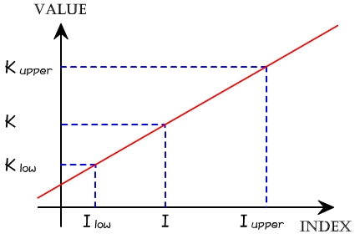
Interpolation Search
改良自binary search，也只能在資料已排序好的情況下進行搜尋。
若資料分布均勻時，其效率會比 binary search 好。
若是一串資料於索引值 I_{low} 與 I_{upper} 的值分別為 K_{low} 與 K_{upper}。 假設要找的目標值為 K，且 K 的索引值 I，則可以推得： (K_{upper} - K_{low}) / (I_{upper} - I_{low}) = (K - K_{low}) / (I - I_{low})
整理以上的算式，便可以得到公式： I = I_{low} + (I_{upper} - I_{low})(K - K_{low}) / (K_{upper} - K_{low})

Slide 14
Interpolation Search Algorithm
int interpolationSearch(element a[ ], int k, int n){
/* Search a[1] ≦ a[2] ≦…≦ a[n] for k. Return its position if found. Otherwise return -1 */
int left = 1, right = n, middle;
while (left <= right) {
middle = left + (right - left) * (k - a[left].key) / (a[right].key - a[left].key);
switch (COMPARE(a[middle].key, k)) { case -1: left = middle +1; break; case 0: return middle; case 1: right = middle - 1; }
}
return -1;
}

Slide 15
List Verification
Compare lists to verify that they are identical or identify the discrepancies.
example
International Revenue Service (e.g., employee vs. employer).
Reports three types of errors :
all records found in list1 but not in list2.
all records found in list2 but not in list1.
all records that are in list1 and list2 with the same key but have different values for different fields.

Slide 16
/* sequential search*/ void verify1(element list1[ ], element list2[ ], int n, int m){ /* compare two unordered lists list1[1 : n] and list2[1 : m] */ int i, j; int marked[MAX_SIZE]; /* for list2 */ for(i = 1; i <= m; i++) marked[i] = FALSE;
List Verification Algorithm (prog. 7.2)
for (i = 1; i <= n; i++) if ((j = seqSearch(list2, m, list1[i].key)) == 0) printf(“%d is not in list 2\n “, list1[i].key); else /* check each of the other fields from list1[i] and list2[j], and print out any discrepancies */ marked[j] = TRUE; for (i = 1; i <= m; i++) if (!marked[i]) printf(“%d is not in list1\n”, list2[i]key); }

Slide 17
void verify2(element list1[ ], element list2 [ ], int n, int m){ /* Same task as verify1, but list1 and list2 are sorted */ int i, j; sort(list1, n); sort(list2, m); i = j = 1; while (i <= n && j <= m)
Fast verification of two Sorted Lists (prog. 7.3)
if (list1[i].key < list2[j].key) { printf (“%d is not in list 2 \n”, list1[i].key); i++; } else if (list1[i].key == list2[j].key) { /* compare list1[i] and list2[j] on each of the other field and report any discrepancies */ i++; j++; } else { printf(“%d is not in list 1\n”, list2[j].key); j++; }

Slide 18
for(; i <= n; i++) printf (“%d is not in list 2\n”, list1[i].key); for(; j <= m; j++) printf(“%d is not in list 1\n”, list2[j].key); }
List Verification Algorithm (prog. 7.3)
Complexities
Prog. 7.2, random order lists：O(mn)
Prog. 7.3, sorted lists：O(t_{sort}(n) + t_{sort}(m) + m + n)
=> O(max{n log n, m log m})

Slide 19
Selection Sort
i [1] [2] [3] [4] [5]
- 30 10 50 40 20
1 10 30 50 40 20
2 10 20 50 40 30
3 10 20 30 40 50
4 10 20 30 40 50
From those integers that are currently unsorted, find the smallest and place it next in the sorted list.

Slide 20
Selection Sort Algorithm
For (i = 1; i ≦ n; i ++) {
Examine list[i] to list[n] and suppose that the smallest integer is at list[min]
Interchange list[i] and list[min]
}

Slide 21
Insertion Sort
Insert a record R_{i+1} into a sequence of ordered records, R₁, R₂, …. R_{i} in such a way that the resulting sequence of size i+1 is also ordered.
R₁ | R₂ | R₃ | R₄ | R₅ | R₆ | R₇ | R₈ | R₉ | R₁₀
26 | 5 | 77 | 1 | 61 | 11 | 59 | 15 | 48 | 19
5 | 26 | 77 | 1 | 61 | 11 | 59 | 15 | 48 | 19
1 | 5 | 26 | 77 | 61 | 11 | 59 | 15 | 48 | 19
1 | 5 | 26 | 61 | 77 | 11 | 59 | 15 | 48 | 19

Slide 22
Insertion Sort
R₁ | R₂ | R₃ | R₄ | R₅ | R₆ | R₇ | R₈ | R₉ | R₁₀
1 | 5 | 26 | 61 | 77 | 11 | 59 | 15 | 48 | 19
1 | 5 | 11 | 26 | 61 | 77 | 59 | 15 | 48 | 19
1 | 5 | 11 | 26 | 59 | 61 | 77 | 15 | 48 | 19
1 | 5 | 11 | 15 | 26 | 59 | 61 | 77 | 48 | 19
1 | 5 | 11 | 15 | 26 | 48 | 59 | 61 | 77 | 19

Slide 23
Insertion Sort
R₁ | R₂ | R₃ | R₄ | R₅ | R₆ | R₇ | R₈ | R₉ | R₁₀
1 | 5 | 11 | 15 | 26 | 48 | 59 | 61 | 77 | 19
1 | 5 | 11 | 15 | 19 | 26 | 48 | 59 | 61 | 77

Slide 24
Insertion Sort Algorithm (prog. 7.4 & 7.5)
void insert(element e, element a[ ], int i)
{/* 將 e 插入到一個已排序串列 a[1 : i] 中，並使得插入過後的串列 a[1: i+1] 仍依序排好。此陣列 a 至少必須分配到大小為 i + 2 個element */
a[0] = e;
while (e.key < a[i].key) { a[i+1] = a[i];
i--;
}
a[i+1] = e;
}
void insertionSort(element a[ ], int n){
/* sort a[1: n] into nondecreasing order */
int j;
for (j = 2; j <= n; j++) {
element temp = a[j];
insert(temp, a, j-1);
}
}
insert => O(i)
insertionSort : i = j-1 = 1, 2,…, n-1 call insert =>

Slide 25
Insertion Sort
Worst case
i [1] [2] [3] [4] [5]
- 5 4 3 2 1
2 4 5 3 2 1
3 3 4 5 2 1
4 2 3 4 5 1
5 1 2 3 4 5

Slide 26
Insertion Sort
Best case
i [1] [2] [3] [4] [5]
- 2 3 4 5 1
2 2 3 4 5 1
3 2 3 4 5 1
4 2 3 4 5 1
5 1 2 3 4 5

Slide 27
Insertion Sort Analysis
Definition: 左失序(Left out of order, LOO)
R_{i} is LOO iff R_{i} < max{R_{j}}
1 ≤ j <i
2 3 4 5 1
*
只有那些 LOO 的記錄才需要做插入的步驟
Computing time：O((k+1)n) = O(kn)
k: number of LOO records

Slide 28
Insertion Sort Analysis
Stable
best case : Ω(n)
worst case : O(n²)
average case : Θ(n²)
Make insertion sort a good sort.
Only a very few records are LOO (i.e., k << n)
for small lists, n <= 30

Slide 29
Insertion Sort Variations
二元插入排序法 (Binary Insertion Sort)
Replace the sequential search with binary search.
Reduce the number of comparisons.
The number of record moves remains unchanged.
鏈結插入排序法 (Linked Insertion Sort)
Replace array structure with linked list.
Must retain the sequential search.
The number of record moves becomes zeros (i.e. adjust link field).

Slide 30
Quick Sort
Developed by C. A. R. Hoare has the best average behavior among the sorting methods we shall be studying.
Given (R₁, R₂, …, R_{n}) and K_{i} is pivot key (基準鍵). if K_{i} is placed in S(i), then K_{j} ≤ K_{s(i)} for j < S(i), K_{j} ≥ K_{s(i)} for j > S(i).
=> R₁, …, R_{S(i)-1}, R_{S(i)}, R_{S(i)+1}, …, R_{S(n)}

Slide 31
In-Place Partitioning Example
6
6
2
8
8
5
11
10
4
1
9
7
3
3
6
6
2
3
5
11
11
10
4
1
1
9
7
8
6
6
2
3
5
1
10
10
4
4
11
9
7
8
6
6
2
3
5
1
4
4
10
10
11
9
7
8
bigElement is not to left of smallElement, terminate process. Swap pivot and smallElement.
4
2
3
5
1
4
6
6
10
11
9
7
8

Slide 32
Example for Quick Sort
i
j
R₁ | R₂ | R₃ | R₄ | R₅ | R₆ | R₇ | R₈ | R₉ | R₁₀ | left | right
[26 | 5 | 37 | 1 | 61 | 11 | 59 | 15 | 48 | 19] | 1 | 10
[26 | 5 | 19 | 1 | 61 | 11 | 59 | 15 | 48 | 37]
[26 | 5 | 19 | 1 | 15 | 11 | 59 | 61 | 48 | 37]
[11 | 5 | 19 | 1 | 15] | 26 | [59 | 61 | 48 | 37]

Slide 33
Example for Quick Sort
i
j
R₁ | R₂ | R₃ | R₄ | R₅ | left | right
[11 | 5 | 19 | 1 | 15] | 1 | 5
[11 | 5 | 1 | 19 | 15]
[11 | 5 | 1 | 19 | 15]
[1 | 5] | 11 | [19] | [15]

Slide 34
Quick Sort (prog. 7.6)
void quickSort(element a[], int left, int right)
{
int pivot, i, j;
element temp;
if (left < right) {
i = left; j = right+1;
pivot = a[left].key;
do {
do i++;
while (a[i].key < pivot);
do j--;
while (a[j].key > pivot);
if (i < j)
SWAP(a[i], a[j], temp);
} while (i < j);
SWAP(a[left], a[j], temp);
quicksort(a, left, j - 1);
quicksort(a, j + 1, right);
}
}

Slide 35
Analysis for Quick Sort
Assume that each time a record is correctly positioned, the list is divided into the rough same size of two parts.
Positioning a list with n elements needs O(n).
T(n) is the time taken to sort n elements T(n) ≦ cn + 2T(n/2) for some constant c ≦ cn + 2(cn/2+2T(n/4))
≦ 2cn + 4T(n/4) ... ≦ cnlog₂n + nT(1) = O(n log n)

Slide 36
Space for Quick Sort
Stack space complexity:
Average case and best case: O(log n) (maximum recursion depth)
Worst case: O(n)
The smaller of the two subarrays is always stored first. The maximum stack space is less than O(log n).

Slide 37
Time for Quick Sort
Time complexity:
Average case and best case: O(n log n)
Worst case: O(n²)
Best internal sorting method considering the average case.
Insertion can be used to speed up whenever size < 16.
Unstable.

Slide 38
Quick Sort
Variation:
Quicksort using a median of three.
pivot = median{K_{left}, K_{(left+right)/2}, K_{right}}
e.g. median {10, 5, 7} = 7
and {10, 7, 7} = 7

Slide 39
Merge Sort
Given two sorted lists (list[i], …, list[m]) (list[m + 1], …, list[n]) Generate a single sorted list (sorted[i], …, sorted[n])
Merged (2, 5, 7) and (1, 3, 6, 9) lists is (1, 2, 3. 5, 6, 7, 9).
Merging methods.
Iterative merge sort
Recursive merge sort
Natural merge sort

Slide 40
Merge Sort (prog. 7.7)
void merge(element initList[], element mergedList[], int i, int m, int n)
{/* the sorted lists initList[i : m] and initList[m+1 : n] are merged to obtain the sorted list mergedList[i : n] */
int j, k, t;
j = m + 1;
k = i;
while (i <= m && j <= n) {
if (initList[i].key <= initList[j].key)
mergedList[k++] = initList[i++];
else
mergedList[k++] = initList[j++];
}
if (i > m)
for (t = j; t <= n; t++)
mergedList[k+t-j] = initList[t];
else
for (t = i; t <= m; t++) mergedList[k+t-i] = list[t];
}

Slide 41
Analysis for Merge Sort
The total number of records added to the sorted list is n–i+1.
time complexity O(n-i+1)
addition space: O(n)
array vs. linked list representation (time required)
array: O(s*(n-i+1)), where s: record length for copy.
linked list representation: O(n-i+1) (n-i+1) linked fields

Slide 42
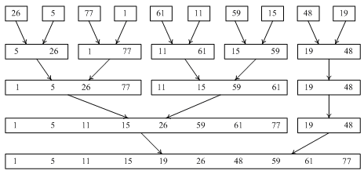
Iterative Merge Tree
Sort 26, 5, 77, 1, 61, 11, 59, 15, 48, 19
O(n log₂ n): ⎡log₂ n⎤ passes, O(n) for each pass

Slide 43
A Merge Pass (prog. 7.8)
void mergePass(element initList[], element mergedList[], int n, int s)
{/* 執行一回合的合併排序，將initList[]中兩兩相鄰的排序過的區段合併到mergedList[]。n 為串列中元素個數，s代表每一個區段大小。 */
int i, j;
for( i=1; i<= n – 2 * s + 1; i+= 2*s)
merge(initList, mergedList, i, i+s-1, i+2*s-1);
if ( i+s-1 < n)
merge(initList, mergedList, i, i+s-1, n);
else
for( j=i; j<=n; j++)
mergedList[j] = initList[j];
}

Slide 44
Merge Sort (prog. 7.9)
void mergeSort(element a[], int n)
{ /* 使用合併排序法將a[1:n]排序 */
int s =1; /* 現在區段大小 */
element extra[MAX_SIZE];
while(s<n) {
mergePass(a, extra, n, s);
s*=2;
mergePass(extra, a, n, s);
s*=2;
}
}

Slide 45
Recursive Merge Sort
Sort 26, 5, 77, 1, 61, 11, 59, 15, 48, 19
Sublist partitioning for a recursive merge sort.

Slide 46
Recursive Merge Sort (prog. 7.10)
int rmergeSort(element a[], int link[], int left, int right)
{ /* a[left:right]是要排序的陣列，link[i]所有i是一開始為0。
回傳排序好的鏈的第一個元素之索引值。 */
if(left >= right) return left;
int mid = (left + right) /2;
return listMerge(a, link,
rmergeSort(a, link, left, mid), /* 排序左半部 */
rmergeSort(a, link, mid+1, right) ); /* 排序右半部 */
}

Slide 47
Merging Sorted Chains (prog. 7.11)
int listMerge(element a[], int link[], int start1, int start2)
{ /* 兩個排序好的鏈分別從start1及start2開始，將它們合併；將link[0]當作一個暫時的標頭。回傳合併好的鏈的開頭。*/
int last1, last2, lastResult=0;
for(last1 = start1, last2 = start2; last1 && last2; )
if (a[last1] <= a[last2]) {
link[lastResult] = last1;
lastResult = last1; last1 = link[last1];
}
else{
link[lastResult2] = last2;
lastResult = last2; last2 = link[last2];
}
/* 將其餘的記錄附接至最後的鏈結*/
if(last1 == 0) link[lastResult] = last2;
else link[lastResult] = last1;
return link[0];
}

Slide 48
Natural Merge Sort
Sort 26, 5, 77, 1, 61, 11, 59, 15, 48, 19
Merge sort starting with sorted sublists.

Slide 49
Merge Sort
Average computing times for two sorting algorithms on random inputs.

Slide 50
Merge Sort
Worst-case computing times for two sorting algorithms on random inputs.

Slide 51
Array interpreted as a (complete) binary tree.
Heap Sort
Array
i | 1 | 2 | 3 | 4 | 5 | 6 | 7 | 8 | 9 | 10
key | 26 | 5 | 77 | 1 | 61 | 11 | 59 | 15 | 48 | 19
[1]
26
[2]
5
[3]
77
[4]
1
[5]
61
11
[6]
59
[7]
[8]
15
[9]
48
19
[10]

Slide 52
Max heap following first for loop of heapsort.
Heap Sort Example
[1]
26
[2]
5
[3]
77
[4]
1
[5]
61
11
[6]
59
[7]
[1]
77
[8]
15
[9]
48
19
[10]
[2]
61
[3]
59
[4]
48
[5]
19
11
[6]
26
[7]
[8]
15
[9]
1
5
[10]
initial heap

Slide 53
Heap Sort Example
[1]
77
[2]
61
[3]
59
[4]
48
[5]
19
11
[6]
26
[7]
[1]
61
[8]
15
[9]
1
5
[10]
[2]
48
[3]
59
adjusting
[4]
15
[5]
19
11
[6]
26
[7]
[8]
5
[9]
1
77
[10]
(a) Heap size = 9 Sorted = [77]

Slide 54
Heap Sort Example
[1]
61
[2]
48
[3]
59
[4]
15
[5]
19
11
[6]
26
[7]
5
[9]
1
77
[10]
[1]
59
(a) Heap size = 9 Sorted = [77]
[2]
48
[3]
26
adjusting
[4]
15
[5]
19
11
[6]
1
[7]
[8]
5
[9]
61
77
[10]
(b) Heap size = 8 Sorted = [61, 77]

Slide 55
Heap Sort Example
[1]
59
[2]
48
[3]
26
[4]
15
[5]
19
11
[6]
1
[7]
[8]
5
[9]
61
77
[10]
[1]
48
(b) Heap size = 8 Sorted = [61, 77]
[2]
19
[3]
26
adjusting
[4]
15
[5]
5
11
[6]
1
[7]
[8]
59
[9]
61
77
[10]
(c) Heap size = 7 Sorted = [59, 61, 77]

Slide 56
Heap Sort Example
[1]
48
[2]
19
[3]
26
[4]
15
[5]
5
11
[6]
1
[7]
[8]
59
[9]
61
77
[10]
[1]
26
(c) Heap size = 7 Sorted = [59, 61, 77]
[2]
19
[3]
11
[4]
15
[5]
5
1
[6]
48
[7]
adjusting
[8]
59
[9]
61
77
[10]
(d) Heap size = 6 Sorted = [48, 59, 61, 77]

Slide 57
Heap Sort Example
[1]
26
[2]
19
[3]
11
[4]
15
[5]
5
1
[6]
48
[7]
[8]
59
[9]
61
77
[10]
[1]
19
(d) Heap size = 6 Sorted = [48, 59, 61, 77]
15
11
[2]
[3]
[4]
1
[5]
5
26
[6]
48
[7]
adjusting
[8]
59
[9]
61
77
[10]
(e) Heap size = 5 Sorted = [26, 48, 59, 61, 77]

Slide 58
Heap Sort Example
[1]
19
[2]
15
[3]
11
[4]
1
[5]
5
26
[6]
48
[7]
[1]
15
[8]
59
[9]
61
77
[10]
[2]
5
[3]
11
(e) Heap size = 5 Sorted = [26, 48, 59, 61, 77]
[4]
15
[5]
19
26
[6]
48
[7]
adjusting
[8]
[9]
61
77
59
[10]
(f) Heap size = 4 Sorted = [19, 26, 48, 59, 61, 77]

Slide 59
Heap Sort Example
[1]
15
[2]
5
[3]
11
[4]
1
[5]
19
26
[6]
48
[7]
[8]
59
[9]
61
77
[10]
[1]
11
(f) Heap size = 4 Sorted = [19, 26, 48, 59, 61, 77]
5
1
[2]
[3]
[4]
15
[5]
19
26
[6]
48
[7]
adjusting
[8]
59
[9]
61
77
[10]
(g) Heap size = 3 Sorted = [15, 19, 26, 48, 59, 61, 77]

Slide 60
Heap Sort Example
[1]
11
[2]
5
[3]
1
[4]
15
[5]
19
26
[6]
48
[7]
[8]
59
[9]
61
77
[10]
[1]
5
(g) Heap size = 3 Sorted = [15, 19, 26, 48, 59, 61, 77]
1
11
[2]
[3]
[4]
15
[5]
19
26
[6]
48
[7]
adjusting
[8]
59
[9]
61
77
[10]
(h) Heap size = 2 Sorted = [11, 15, 19, 26, 48, 59, 61, 77]

Slide 61
Heap Sort Example
[1]
5
[2]
1
[3]
11
[4]
15
[5]
19
26
[6]
48
[7]
[8]
59
[9]
61
77
[10]
[1]
1
(h) Heap size = 2 Sorted = [11, 15, 19, 26, 48, 59, 61, 77]
[2]
5
[3]
11
[4]
15
[5]
19
26
[6]
48
[7]
adjusting
[8]
59
[9]
61
77
[10]
(i) Heap size = 1 Sorted = [5, 11, 15, 19, 26, 48, 59, 61, 77]

Slide 62
Adjusting a Max Heap (prog. 7.12)
void adjust(element a[], int root, int n)
{ /* 調整一二元樹來建立出堆積 */
int child, rootkey;
element temp;
temp = a[root];
rootkey = a[root].key;
child = 2*root; /*左子樹*/
while(child <= n) {
if ((child < n) && (a[child].key < a[child+1].key))
child++;
if(rootkey > a[child].key) /*比較樹根和最大子樹*/
break;
else {
a[child/2] = a[child]; /*移動成父節點*/
child*2;
}
}
a[child/2] = temp;
}

Slide 63
Heap Sort (prog. 7.13)
void heapSort(element a[], int n)
{ /* 在a[1:n]上執行堆積排序 */
int i, j;
element temp;
for( i = n/2; i > 0; i--)
adjust(a, i, n);
for( i = n - 1; i > 0; i--) {
SWAP(a[1], a[i+1], temp);
adjust(a, 1, i);
}
}

Slide 64
Heap Sort
Heap sort is unstable
Time complexity :
Best case : O(n log n)
Average case : O(n log n)
Worst case : O(n log n)

Slide 65
Radix Sort
Sorted by various keys (each record has several keys)
K⁰, K¹, …, K^{r-1}
Most significant
Least significant
R₁, R₂, …, R_{n} are said to be sorted with respect to the keys K¹, K², …, K^{r} iff
i < j
最重要位數優先 (Most significant digit (MSD) first)
sort on K¹, then K², ...
最不重要位數優先 (Least significant digit (LSD) first)
sort on K^{r}, then K^{r-1}, ...

Slide 66
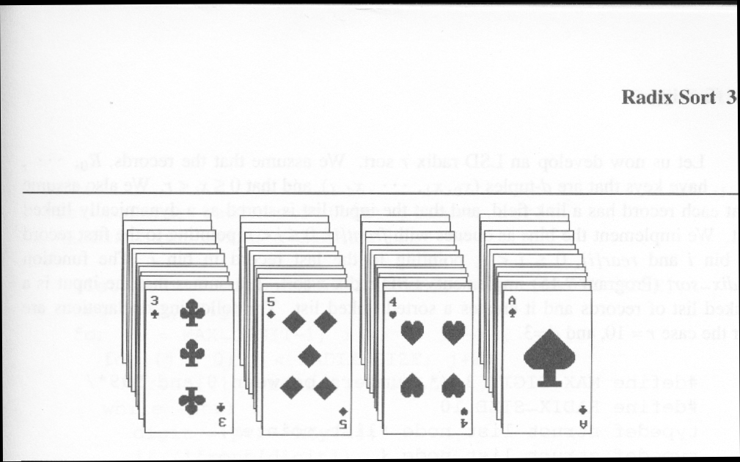
Arrangement of cards after first pass of an MSD sort.
Radix Sort
Suits: ♣ < ♦ < ♥ < ♠
Face values: 2 < 3 < 4 < … < J < Q < K < A
(1) MSD sort first, e.g., bin sort, four bins ♣ ♦ ♥ ♠
LSD sort second, e.g., insertion sort

Slide 67
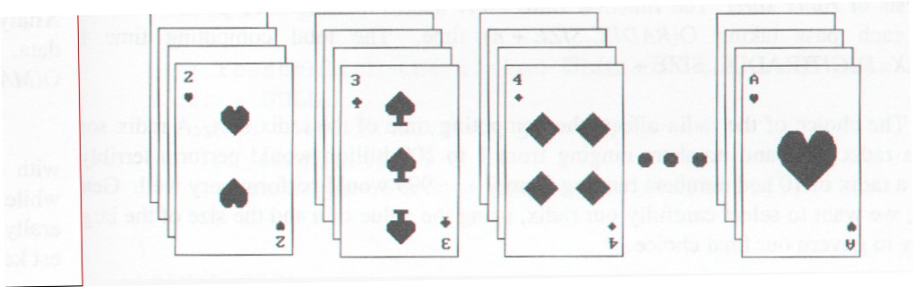
Arrangement of cards after first pass of LSD sort .
Radix Sort
Suits: ♣ < ♦ < ♥ < ♠
Face values: 2 < 3 < 4 < … < J < Q < K < A
(2) LSD sort first, e.g., bin sort, 13 bins
2, 3, 4, …, 10, J, Q, K, A
MSD sort, e.g., bin sort four bins ♣ ♦ ♥ ♠

Slide 68
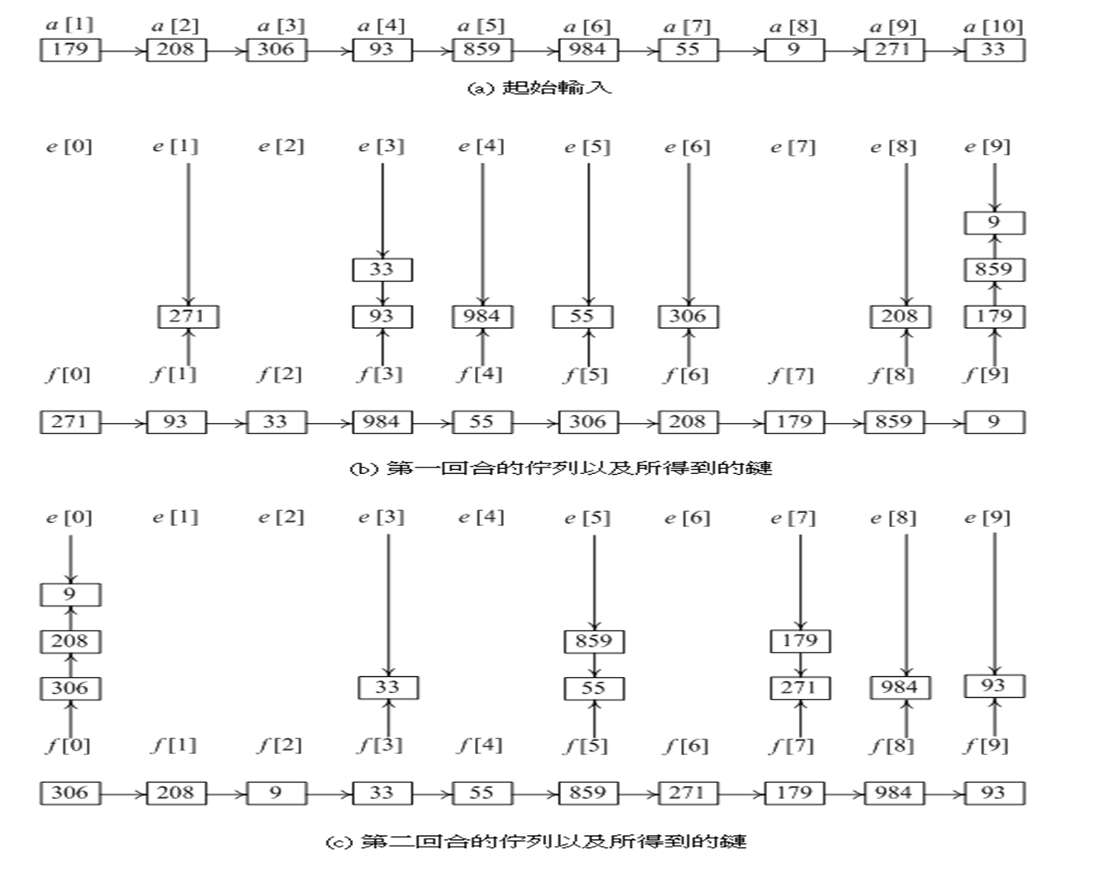
Example for LSD Radix Sort

Slide 69
Example for LSD Radix Sort
第一回合所得到的鏈

Slide 70
Example for LSD Radix Sort
第二回合所得到的鏈

Slide 71
Data Structures for LSD Radix Sort
Develop an LSD radix r sort,
R₁, R₂, ..., R_{n} have the keys that are d-tuples (x₁, x₂, ..., x_{d}), and that 0 <= x_{i} < r.
#define MAX_DIGIT 3
#define RADIX_SIZE 10
typedef struct list_node *list_pointer;
typedef struct list_node {
int key[MAX_DIGIT];
list_pointer link;
}

Slide 72
LSD Radix Sort (prog. 7.14)
int radixSort(element a[], int link[], int d, int r, int n)
{/* 利用一個d位數、基數r的基數排序法來排序a[1:n] digit(a[i], j, r) 回傳a[i]以r為基數的鍵值在第j個位數(從左邊)。每一個位數的範圍是[0, r)，同一個位數內的排序是使用容器排序法 */
int front[r], rear[r]; /*佇列的開頭和結尾指標*/
int i, bin, current, first, last;
/*建立一個從first開始的記錄起始鏈*/
first = 1;
for( i = 1; i < n; i++) link[i] = i+1;
link[n] = 0;
for( i = d-1; i>=0; i--)
{ /*根據第i位數來排序*/
/*將容器初始化成空的佇列*/
for(bin = 0; bin<r; bin++) front[bin] = 0;

Slide 73
LSD Radix Sort (prog. 7.14)
for(current = first; current; current = link[current])
{ /* 把記錄放到佇列/容器中 */
bin = digit(a[current], i, r);
if( front[bin] == 0) front[bin] = current;
else link[rear[bin]] = current;
rear[bin] = current;
}
/* 找出第一個非空的佇列/容器 */
for(bin = 0; !front[bin]; bin++) ;
first = front[bin]; last = rear[bin];
/* 連接其餘的佇列 */
for(bin++; bin < r; bin++)
if(front[bin])
{ link[last] =front[bin]; last = rear[bin];}
link[last] = 0;
}
return first;
}

Slide 74
Analysis of Radix Sort
radix-sort makes MAX_DIGIT passes
each pass taking O(RADIX_SIZE + n) time
Time complexity :
O(MAX_DIGIT(RADIX_SIZE+n)

Slide 75
List Sort
Apart from radix sort and recursive merge sort, all sorting algorithms require excessive data movement since we must physically move records following some comparisons.
If the records are large, this slows down the sorting process.
We can reduce data movement by using a linked list representation.
However, in some applications we must physically rearrange the records so that they are in the required order.
We can achieve considerable savings by first performing a linked list sort and then physically rearranging the records according to the order specified in the list.
This rearranging can be accomplished in linear time using some additional space.

Slide 76
List Sort
Practical Considerations for Internal Sorting.
Data movement
slow down sorting process.
insertion sort and merge sort --> linked file.
perform a linked list sort + rearrange records.

Slide 77
List Sorts
Sorted linked list , first = 4
i | R₁ | R₂ | R₃ | R₄ | R₅ | R₆ | R₇ | R₈ | R₉ | R₁₀
key | 26 | 5 | 77 | 1 | 61 | 11 | 59 | 15 | 48 | 19
link | 9 | 6 | 0 | 2 | 3 | 8 | 5 | 10 | 7 | 1
Sorted doubly linked list , first = 4
i | R₁ | R₂ | R₃ | R₄ | R₅ | R₆ | R₇ | R₈ | R₉ | R₁₀
key | 26 | 5 | 77 | 1 | 61 | 11 | 59 | 15 | 48 | 19
linka | 9 | 6 | 0 | 2 | 3 | 8 | 5 | 10 | 7 | 1
linkb | 10 | 4 | 5 | 0 | 7 | 2 | 9 | 6 | 1 | 8

Slide 78
Doubly Linked List
Sorted doubly linked list , first = 4
i | R₁ | R₂ | R₃ | R₄ | R₅ | R₆ | R₇ | R₈ | R₉ | R₁₀
key | 26 | 5 | 77 | 1 | 61 | 11 | 59 | 15 | 48 | 19
linka | 9 | 6 | 0 | 2 | 3 | 8 | 5 | 10 | 7 | 1
linkb | 10 | 4 | 5 | 0 | 7 | 2 | 9 | 6 | 1 | 8
first = 4, i = 1
i | R₁ | R₂ | R₃ | R₄ | R₅ | R₆ | R₇ | R₈ | R₉ | R₁₀
key | 1 | 5 | 77 | 26 | 61 | 11 | 59 | 15 | 48 | 19
linka | 2 | 6 | 0 | 9 | 3 | 8 | 5 | 10 | 7 | 4
linkb | 0 | 4 | 5 | 10 | 7 | 2 | 9 | 6 | 4 | 8

Slide 79
Doubly Linked List
first = 4, i = 1
i | R₁ | R₂ | R₃ | R₄ | R₅ | R₆ | R₇ | R₈ | R₉ | R₁₀
key | 1 | 5 | 77 | 26 | 61 | 11 | 59 | 15 | 48 | 19
linka | 2 | 6 | 0 | 9 | 3 | 8 | 5 | 10 | 7 | 4
linkb | 0 | 4 | 5 | 10 | 7 | 2 | 9 | 6 | 4 | 8
first = 2, i = 2
i | R₁ | R₂ | R₃ | R₄ | R₅ | R₆ | R₇ | R₈ | R₉ | R₁₀
key | 1 | 5 | 77 | 26 | 61 | 11 | 59 | 15 | 48 | 19
linka | 2 | 6 | 0 | 9 | 3 | 8 | 5 | 10 | 7 | 4
linkb | 0 | 4 | 5 | 10 | 7 | 2 | 9 | 6 | 4 | 8

Slide 80
Doubly Linked List
first = 2, i = 2
i | R₁ | R₂ | R₃ | R₄ | R₅ | R₆ | R₇ | R₈ | R₉ | R₁₀
key | 1 | 5 | 77 | 26 | 61 | 11 | 59 | 15 | 48 | 19
linka | 2 | 6 | 0 | 9 | 3 | 8 | 5 | 10 | 7 | 4
linkb | 0 | 4 | 5 | 10 | 7 | 2 | 9 | 6 | 4 | 8
first = 6, i = 3
i | R₁ | R₂ | R₃ | R₄ | R₅ | R₆ | R₇ | R₈ | R₉ | R₁₀
key | 1 | 5 | 11 | 26 | 61 | 77 | 59 | 15 | 48 | 19
linka | 2 | 6 | 8 | 9 | 6 | 0 | 5 | 10 | 7 | 4
linkb | 0 | 4 | 2 | 10 | 7 | 5 | 9 | 6 | 4 | 8

Slide 81
Doubly Linked List
first = 6, i = 3
i | R₁ | R₂ | R₃ | R₄ | R₅ | R₆ | R₇ | R₈ | R₉ | R₁₀
key | 1 | 5 | 11 | 26 | 61 | 77 | 59 | 15 | 48 | 19
linka | 2 | 6 | 8 | 9 | 6 | 0 | 5 | 10 | 7 | 4
linkb | 0 | 4 | 2 | 10 | 7 | 5 | 9 | 6 | 4 | 8
first = 8, i = 4
i | R₁ | R₂ | R₃ | R₄ | R₅ | R₆ | R₇ | R₈ | R₉ | R₁₀
key | 1 | 5 | 11 | 15 | 61 | 77 | 59 | 26 | 48 | 19
linka | 2 | 6 | 8 | 10 | 6 | 0 | 5 | 9 | 7 | 8
linkb | 0 | 4 | 2 | 6 | 7 | 5 | 9 | 10 | 8 | 8

Slide 82
Doubly Linked List
first = 8, i = 4
i | R₁ | R₂ | R₃ | R₄ | R₅ | R₆ | R₇ | R₈ | R₉ | R₁₀
key | 1 | 5 | 11 | 15 | 61 | 77 | 59 | 26 | 48 | 19
linka | 2 | 6 | 8 | 10 | 6 | 0 | 5 | 9 | 7 | 8
linkb | 0 | 4 | 2 | 6 | 7 | 5 | 9 | 10 | 8 | 8
first = 10, i = 5
i | R₁ | R₂ | R₃ | R₄ | R₅ | R₆ | R₇ | R₈ | R₉ | R₁₀
key | 1 | 5 | 11 | 15 | 19 | 77 | 59 | 26 | 48 | 61
linka | 2 | 6 | 8 | 10 | 8 | 0 | 10 | 9 | 7 | 6
linkb | 0 | 4 | 2 | 6 | 8 | 10 | 9 | 10 | 8 | 7

Slide 83
Doubly Linked List
first = 10, i = 5
i | R₁ | R₂ | R₃ | R₄ | R₅ | R₆ | R₇ | R₈ | R₉ | R₁₀
key | 1 | 5 | 11 | 15 | 19 | 77 | 59 | 26 | 48 | 61
linka | 2 | 6 | 8 | 10 | 8 | 0 | 10 | 9 | 7 | 6
linkb | 0 | 4 | 2 | 6 | 8 | 10 | 9 | 10 | 8 | 7
first = 8, i = 6
i | R₁ | R₂ | R₃ | R₄ | R₅ | R₆ | R₇ | R₈ | R₉ | R₁₀
key | 1 | 5 | 11 | 15 | 19 | 26 | 59 | 77 | 48 | 61
linka | 2 | 6 | 8 | 10 | 8 | 9 | 10 | 0 | 7 | 8
linkb | 0 | 4 | 2 | 6 | 8 | 10 | 9 | 10 | 8 | 7

Slide 84
Doubly Linked List
first = 8, i = 6
i | R₁ | R₂ | R₃ | R₄ | R₅ | R₆ | R₇ | R₈ | R₉ | R₁₀
key | 1 | 5 | 11 | 15 | 19 | 26 | 59 | 77 | 48 | 61
linka | 2 | 6 | 8 | 10 | 8 | 9 | 10 | 0 | 7 | 8
linkb | 0 | 4 | 2 | 6 | 8 | 10 | 9 | 10 | 8 | 7
first = 9, i = 7
i | R₁ | R₂ | R₃ | R₄ | R₅ | R₆ | R₇ | R₈ | R₉ | R₁₀
key | 1 | 5 | 11 | 15 | 19 | 26 | 48 | 77 | 59 | 61
linka | 2 | 6 | 8 | 10 | 8 | 9 | 9 | 0 | 10 | 8
linkb | 0 | 4 | 2 | 6 | 8 | 10 | 8 | 10 | 9 | 9

Slide 85
Doubly Linked List
first = 9, i = 7
i | R₁ | R₂ | R₃ | R₄ | R₅ | R₆ | R₇ | R₈ | R₉ | R₁₀
key | 1 | 5 | 11 | 15 | 19 | 26 | 48 | 77 | 59 | 61
linka | 2 | 6 | 8 | 10 | 8 | 9 | 9 | 0 | 10 | 8
linkb | 0 | 4 | 2 | 6 | 8 | 10 | 8 | 10 | 9 | 9
first = 9, i = 8
i | R₁ | R₂ | R₃ | R₄ | R₅ | R₆ | R₇ | R₈ | R₉ | R₁₀
key | 1 | 5 | 11 | 15 | 19 | 26 | 48 | 59 | 77 | 61
linka | 2 | 6 | 8 | 10 | 8 | 9 | 9 | 10 | 0 | 9
linkb | 0 | 4 | 2 | 6 | 8 | 10 | 8 | 9 | 10 | 9

Slide 86
Doubly Linked List
first = 9, i = 8
i | R₁ | R₂ | R₃ | R₄ | R₅ | R₆ | R₇ | R₈ | R₉ | R₁₀
key | 1 | 5 | 11 | 15 | 19 | 26 | 48 | 59 | 77 | 61
linka | 2 | 6 | 8 | 10 | 8 | 9 | 9 | 10 | 0 | 9
linkb | 0 | 4 | 2 | 6 | 8 | 10 | 8 | 9 | 10 | 9
first = 10, i = 9
i | R₁ | R₂ | R₃ | R₄ | R₅ | R₆ | R₇ | R₈ | R₉ | R₁₀
key | 1 | 5 | 11 | 15 | 19 | 26 | 48 | 59 | 61 | 77
linka | 2 | 6 | 8 | 10 | 8 | 9 | 9 | 10 | 10 | 0
linkb | 0 | 4 | 2 | 6 | 8 | 10 | 8 | 9 | 9 | 10

Slide 87
Doubly Linked List
first = 10, i = 9
i | R₁ | R₂ | R₃ | R₄ | R₅ | R₆ | R₇ | R₈ | R₉ | R₁₀
key | 1 | 5 | 11 | 15 | 19 | 26 | 48 | 59 | 61 | 77
linka | 2 | 6 | 8 | 10 | 8 | 9 | 9 | 10 | 10 | 0
linkb | 0 | 4 | 2 | 6 | 8 | 10 | 8 | 9 | 9 | 10
first = 10, i = 10
i | R₁ | R₂ | R₃ | R₄ | R₅ | R₆ | R₇ | R₈ | R₉ | R₁₀
key | 1 | 5 | 11 | 15 | 19 | 26 | 48 | 59 | 61 | 77
linka | 2 | 6 | 8 | 10 | 8 | 9 | 9 | 10 | 10 | 0
linkb | 0 | 4 | 2 | 6 | 8 | 10 | 8 | 9 | 9 | 10

Slide 88
Rearranging Records using a Doubly Linked List (prog. 7.15)
void listSort1(element a[], int linka[], int n, int first)
{ /* rearrange the sorted chain beginning at first so that the records a[1:n] are in sorted order */
int linkb[MAX_SIZE]; /* array for backward links */
int i, current, prev = 0;
element temp;
for (current = first; current; current = linka[current])
{ /* convert chain into a doubly linked list */
linkb[current] = prev;
prev = current;
}

Slide 89
Rearranging Records using a Doubly Linked List (prog. 7.15)
/* move a[first] to position i while maintaining the list */
for (i = 1; i < n ; i++) {
if (first != i) {
if (linka[i]) linkb[linka[i]] = first;
linka[linkb[i]] = first;
SWAP(a[first], a[i], temp);
SWAP(linka[first], linka[i], temp);
SWAP(linkb[first], linkb[i], temp);
}
first = linka[i];
}
}

Slide 90
Singly Linked List
(2)
first = 4
i | R₁ | R₂ | R₄ | R₄ | R₅ | R₆ | R₇ | R₈ | R₉ | R₁₀
key | 26 | 5 | 77 | 1 | 61 | 11 | 59 | 15 | 48 | 19
link | 9 | 6 | 0 | 2 | 3 | 8 | 5 | 10 | 7 | 1
(1)
first = 2, i=1
i | R₁ | R₂ | R₃ | R₄ | R₅ | R₆ | R₇ | R₈ | R₉ | R₁₀
key | 1 | 5 | 77 | 26 | 61 | 11 | 59 | 15 | 48 | 19
link | 4 | 6 | 0 | 9 | 3 | 8 | 5 | 10 | 7 | 1
first = 6, i=2

Slide 91
Singly Linked List
first = 6, i = 2
i | R₁ | R₂ | R₃ | R₄ | R₅ | R₆ | R₇ | R₈ | R₉ | R₁₀
key | 1 | 5 | 77 | 26 | 61 | 11 | 59 | 15 | 48 | 19
link | 4 | 6 | 0 | 9 | 3 | 8 | 5 | 10 | 7 | 1
first = 8, i = 3
i | R₁ | R₂ | R₃ | R₄ | R₅ | R₆ | R₇ | R₈ | R₉ | R₁₀
key | 1 | 5 | 11 | 26 | 61 | 77 | 59 | 15 | 48 | 19
link | 4 | 6 | 6 | 9 | 3 | 0 | 5 | 10 | 7 | 1
first = 10, i=4

Slide 92
Singly Linked List
first = 8, i = 3
i | R₁ | R₂ | R₃ | R₄ | R₅ | R₆ | R₇ | R₈ | R₉ | R₁₀
key | 1 | 5 | 11 | 26 | 61 | 77 | 59 | 15 | 48 | 19
link | 4 | 6 | 6 | 9 | 3 | 0 | 5 | 10 | 7 | 1
first = 10, i = 4
i | R₁ | R₂ | R₃ | R₄ | R₅ | R₆ | R₇ | R₈ | R₉ | R₁₀
key | 1 | 5 | 11 | 15 | 61 | 77 | 59 | 26 | 48 | 19
link | 4 | 6 | 6 | 8 | 3 | 0 | 5 | 9 | 7 | 1

Slide 93
Singly Linked List
first = 10, i = 4
i | R₁ | R₂ | R₃ | R₄ | R₅ | R₆ | R₇ | R₈ | R₉ | R₁₀
key | 1 | 5 | 11 | 15 | 61 | 77 | 59 | 15 | 48 | 19
link | 4 | 6 | 6 | 8 | 3 | 0 | 5 | 10 | 7 | 1
first = 1
first = 8, i = 5
i | R₁ | R₂ | R₃ | R₄ | R₅ | R₆ | R₇ | R₈ | R₉ | R₁₀
key | 1 | 5 | 11 | 15 | 19 | 77 | 59 | 26 | 48 | 61
link | 4 | 6 | 6 | 8 | 10 | 0 | 5 | 9 | 7 | 3

Slide 94
Singly Linked List
first = 8, i = 5
i | R₁ | R₂ | R₃ | R₄ | R₅ | R₆ | R₇ | R₈ | R₉ | R₁₀
key | 1 | 5 | 11 | 15 | 19 | 77 | 59 | 26 | 48 | 61
link | 4 | 6 | 6 | 8 | 10 | 0 | 5 | 9 | 7 | 3
first = 9, i = 6
i | R₁ | R₂ | R₃ | R₄ | R₅ | R₆ | R₇ | R₈ | R₉ | R₁₀
key | 1 | 5 | 11 | 15 | 19 | 26 | 59 | 77 | 48 | 61
link | 4 | 6 | 6 | 8 | 10 | 8 | 5 | 0 | 7 | 3

Slide 95
Singly Linked List
first = 9, i = 6
i | R₁ | R₂ | R₃ | R₄ | R₅ | R₆ | R₇ | R₈ | R₉ | R₁₀
key | 1 | 5 | 11 | 15 | 19 | 26 | 59 | 77 | 48 | 61
link | 4 | 6 | 6 | 8 | 10 | 8 | 5 | 0 | 7 | 3
first = 7
first = 9 , i = 7
i | R₁ | R₂ | R₃ | R₄ | R₅ | R₆ | R₇ | R₈ | R₉ | R₁₀
key | 1 | 5 | 11 | 15 | 19 | 26 | 48 | 77 | 59 | 61
link | 4 | 6 | 6 | 8 | 10 | 8 | 9 | 0 | 5 | 3

Slide 96
Singly Linked List
first = 9, i = 7
i | R₁ | R₂ | R₃ | R₄ | R₅ | R₆ | R₇ | R₈ | R₉ | R₁₀
key | 1 | 5 | 11 | 15 | 19 | 26 | 48 | 77 | 59 | 61
link | 4 | 6 | 6 | 8 | 10 | 8 | 9 | 0 | 5 | 3
first = 5
first = 10 , i = 8
i | R₁ | R₂ | R₃ | R₄ | R₅ | R₆ | R₇ | R₈ | R₉ | R₁₀
key | 1 | 5 | 11 | 15 | 19 | 26 | 48 | 59 | 77 | 61
link | 4 | 6 | 6 | 8 | 10 | 8 | 9 | 9 | 0 | 3

Slide 97
Singly Linked List
first = 10, i = 8
i | R₁ | R₂ | R₃ | R₄ | R₅ | R₆ | R₇ | R₈ | R₉ | R₁₀
key | 1 | 5 | 11 | 15 | 19 | 26 | 48 | 59 | 77 | 61
link | 4 | 6 | 6 | 8 | 10 | 8 | 9 | 9 | 0 | 3
first = 3
first = 10 , i = 9
i | R₁ | R₂ | R₃ | R₄ | R₅ | R₆ | R₇ | R₈ | R₉ | R₁₀
key | 1 | 5 | 11 | 15 | 19 | 26 | 48 | 59 | 61 | 77
link | 4 | 6 | 6 | 8 | 10 | 8 | 9 | 9 | 10 | 0

Slide 98
Rearranging Records using only one Link Field (prog. 7.16)
void listSort2(element a[], int linka[], int n, int first)
{ /* same function as list1 except that a second link array linkb is not required */
int i;
element temp;
for (i = 1; i < n ; i++)
{/*尋找在第i個位置上正確的記錄，它的索引值 ≥i因為在位置 1, 2, …, i-1位置上的記錄已經放在正確的位置上 */
while (first < i) first = link[first];
int q = link[first]; /* a[q] is next in sorted order */
if (first != i) {
/* a[first]的鍵值是第i小的，並將與a[i]互換以將鏈結值更新 */
SWAP(a[i], a[first], temp);
link[first] = link[i];
link[i] = first;
}
first = q;
}
}

Slide 99
Table Sort
Before
sort
Auxiliary
Table T
1 • 2 • 3 • 4 • 5 •
R₁
R₂
R₃
R₄
R₅
Key
50
9
11
8
3
After
sort
Auxiliary
Table T
4 • 3 • 1 • 2 • 0 •

Slide 100
Table Sort Example
temp
temp

Slide 101
Table Sort (prog. 7.17)
void tableSort2(element a[], int n, int t[])
{ /* rearrange a[1:n] to correspond to the sequence a[t[1]], …, a[t[n]] */
int i, current, next;
element temp;
for (i = 1; i < n ; i++)
if (t[i] != i) { /* 從i開始的非瑣碎迴路 */
temp = a[i]; current = i;
do {
next = t[current]; a[current] = a[next];
t[current] = current; current = next;
} while (t[current] != i);
a[current] = temp;
t[current] = current;
}
}

Slide 102
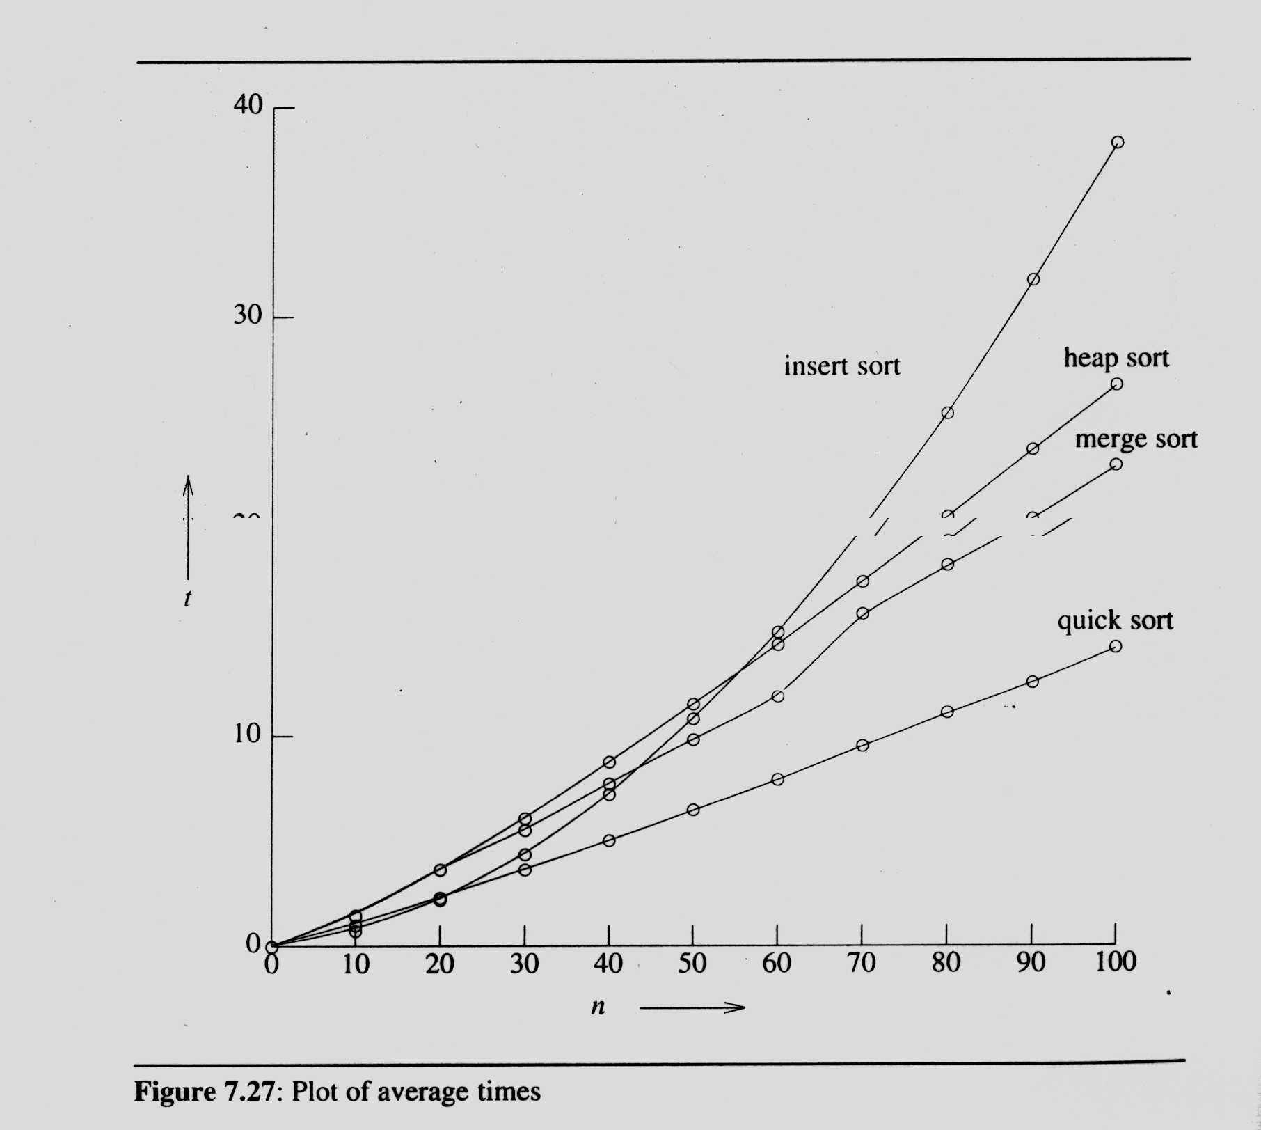
Summary of Internal Sorting

Slide 103
Summary of Internal Sorting
Method | Worst | Average
Insertion sort | n² | n²
Heap sort | n logn | n logn
Merge sort | n logn | n logn
Quick sort | n² | n logn
n < 20: insertion sort
20 ≤ n < 45: quick sort
n ≥ 45: merge sort
hybrid method:
merge sort + quick sort
merge sort + insertion sort

Slide 104
External Sorting
Very large files (overheads in disk access)
seek time: time take to position the read/write head to the correct track of the disk.
latency time:time until the right sector of the track is under the read/write head.
transmission time: time to transmit the data to/from the disk.

Slide 105
External Sorting
merge sort
phase 1 Segment the input file & sort the segments (runs).
phase 2 Merge the runs.

Slide 106
Example for External Sorting
File: 4500 records, A1, …, A4500
internal memory: 750 records (3 blocks)
block length: 250 records
input disk vs. scratch pad (disk)
(1) sort three blocks at a time and write them out onto scratch pad
(2) three blocks: two input buffers & one output buffer

Slide 107
Example for External Sorting
750 records
750 records
750 records
750 records
750 records
750 records
Run 1
Run 2
Run 3
1500 records
1500 records
1500 records
Run 1
3000 records
Run 1
4500 records

Slide 108
Time Complexity of External Sorting
input/output time
t_{s} = maximum seek time
t_{l} = maximum latency time
t_{rw} = time to read/write one block of 250 records
t_{IO} = t_{s} + t_{l} + t_{rw}
CPU processing time
t_{IS} = time to internally sort 750 records
nt_{m} = time to merge n records from input buffers to the output buffer

Slide 109
Time Complexity of External Sorting

Slide 110
Parallelism Consideration
Carry out the CPU operation and I/O operation in parallel
132 t_{IO} ≒ 12000 t_{m} + 6 t_{IS}
Two disks: 132 t_{IO} is reduced to 66 t_{IO}

Slide 111
k-way Merging
A 4-way merge on 16 runs.
1 2 3 4
1 2 3 4
1 2 3 4
1 2 3 4
2 passes (4-way) vs. 4 passes (2-way)

Slide 112
k-way Merging
A k-way merge
1 2 … k
k+1 … 2k
…( -1)k+1…m
...
levels
k

Slide 113
Analysis
⎡log_{k} m⎤ passes
1 pass: ⎡nlog₂ k⎤
O(nlog₂ k*log_{k} m)
I/O time vs. CPU time
reduction of the number of passes being made over the data.
efficient utilization of program buffers so that input, output and CPU processing is overlapped as much as possible.
run generation.
run merging.

