Slide 1
Chapter 8
Hashing
The Symbol Table Abstract Data Type
Hash Tables
Hash Functions
Overflow Handling

Slide 2
Symbol Table
A set of name-attribute pairs
Also called Dictionary
Operations on a symbol table
Determine if a particular name is in the table
Retrieve the attributes of the name
Modify the attributes of that name
Insert a new name and its attributes
Delete a name and its attributes
Three basic operations: search, insert, delete

Slide 3
The ADT of a Symbol Table
Objects
A set of name-attribute pairs, where the names are unique.
Functions
SymTab Create(max_size)
Boolean IsIn(symtab, name)
Attribute Find(symtab, name)
SymTab Insert(symtab, name, attr)
SymTab Delete(symtab, name)

Slide 4
Search Techniques
Search tree methods
Identifier comparisons
hashing methods
Hash functions
Worst-case time is O(size).
Expected time is O(1).
Types of hashing
static hashing
dynamic hashing

Slide 5
Static Hashing
Hash table
Store the identifiers in a fixed table
The hash table ht is stored in sequential memory locations that are partitioned into b buckets, ht[0], …, ht[b-1].
Each bucket is capable of holding s identifiers (or pointers to this many identifiers)
A bucket is consist of s slots, each slot being large enough to hold one identifier.

Slide 6
Hash function
Arithmetic function, f
To determine the address or location of an identifier, x, in the table, which maps keys into buckets.
For any key k, f(k) is
an integer : 0 ~ b-1
The hash or home address of k.
Under ideal conditions, identifiers are stored in their home buckets.
Hashing, key-to-address transformation
Identifier with k
Hash table, ht[0]…ht[b-1]
f
f(k)

Slide 7
Key density & Loading density
The key density of a hash table is the ratio n/T.
n : the number of identifiers in the table
T : the total number of possible keys.
The loading density or loading factor of a hash table is α= n/(sb).

Slide 8
Synonyms
Two identifiers, k₁ and k₂ are synonyms with respect to f, if f(k₁) = f(k₂).
We enter distinct synonyms into the same bucket as long as the bucket has slots available.

Slide 9
Synonyms (cont.)
Synonyms
Synonyms
Synonyms

Slide 10
Overflow and Collision
An overflow occurs when we hash a new identifier into a full bucket.
A collision occurs when we hash two non-identical identifiers into the same bucket.
When the bucket size is 1, collisions and overflows occur simultaneously.

Slide 11
Overflow and Collision (cont.)
clock
Overflow !!
Collision

Slide 12
Hash Functions
A hash function maps a key into the hash table.
Desired properties
easy to compute.
minimize the number of collisions.
Uniform hash function
a random key has an equal chance of hashing into any of the buckets.
The probability that f(k) = i to be 1/b for all buckets i.
Perfect hash function
no collisions.
Minimal perfect hash function
loading density is 1.
no collisions.

Slide 13
Hash Functions (cont.)
Mid-square
Division
Folding
Digit Analysis
Random method

Slide 14
Folding
Partition the identifier x into several parts.
All parts except for the last one have the same length.
Add the parts together to obtain the hash address.
Two possibilities
Shift folding
x1=123, x2=203, x3=241, x4=112, x5=20, ➔ address=699
Folding at the boundaries
x1=123, x2=302, x3=241, x4=211, x5=20, ➔ address=897
X = 12320324111220

Slide 15
Digit Analysis
Particularly useful in the case of a static file where all the keys in the table are know in advance.
Each key is interpreted as a number using some radix r. The same radix is used for all the keys in the table.
Using this radix, the digits of each key are examined.
Digits having the most skewed distributions are deleted.
Enough digits are deleted so that the number of remaining digits is small enough to give an address in the range of the hash table.

Slide 16
Data Structure for Hash Table
#define MAX_CHAR 10
#define TABLE_SIZE 13
typedef struct {
char key[MAX_CHAR];
/* other fields */
} element;
element ht[TABLE_SIZE];

Slide 17
Creation of a Hash Function
#define MAX_CHAR 10
#define TABLE_SIZE 13
typedef struct {
char key[MAX_CHAR];
/* other fields */
} element;
element ht[TABLE_SIZE];
void initTable(element ht[]){
int i;
for (i=0; i<TABLE_SIZE; i++)
ht[i].key[0]=NULL;
}
unsigned int stringToInt(char *key){
/* simple additive approach to create a natural number that is within the integer range */
int number = 0;
while (*key)
number += *key++;
return number;
}
int hash(char *key){
return (stringToInt(key) % TABLE_SIZE);
}

Slide 18
Alternative way to convert a string into a non-negative integer
unsigned int stringToInt(char *key){
/* alternative additive approach to create a natural number that is within the integer range */
int number = 0;
while (*key)
{
number += *key++;
if (*key)
number += ((int) *key++) << 8;
}
return number;
}

Slide 19
Additive transformation and Division

Slide 20
Overflow Handling
Linear probing (Linear open addressing)
Rehashing
Chaining (linked list)

Slide 21
Linear Probing
Identifier | Hash
for | 2
do | 3
while | 4
if | 12
else | 9
function | 12
[0] | function
[1]
[2] | for
[3] | do
[4] | while
[5]
[6]
[7]
[8]
[9] | else
[10]
[11]
[12] | if

Slide 22
Linear Probing (cont.)
element* search(int k){ /* search the linear probing hash table ht (each bucket has exactly one slot) for k, if a pair with key k is found, return a pointer to this pair; otherwise, return NULL */
int homeBucket, currentBucket;
homeBucket = hash(k);
for (currentBucket = homeBucket ; ht[currentBucket] && ht[currentBucket]→key != k;) { currentBucket = (currentBucket + 1 ) % b;
/* treat the table as circular */ if (currentBucket = = homeBucket ) return NULL;
/* back to start point */ }
if ( ht[currentBucket]→key = = k) return ht[currentBucket]; return NULL; }

Slide 23
Hash table with linear probing
bucket | x | Buckets search
0 | acos | 1
1 | atoi | 2
2 | char | 1
3 | define | 1
4 | exp | 1
5 | ceil | 4
6 | cos | 5
7 | float | 3
8 | atol | 9
9 | floor | 5
10 | ctime | 9
…
25
26 buckets, one slot per bucket

Slide 24
Rehashing
Reduce the clustering that occurs with linear probing.
Try f₁, f₂, …, f_{m} in sequence if collision occurs.
disadvantage
comparison of identifiers with different hash values.
use chain to resolve collisions.

Slide 25
Chaining
Maintained a list of synonyms for each bucket.
To insert a new element
Compute the hash address f(x).
Examine the identifiers in the list for f(x).

Slide 26
Chain search
element* search(int k){
/* search the chained hash table ht for k, if a pair with this key is found, return a pointer to this pair; otherwise return NULL */
nodePointer current;
int homeBucket = hash(k);
/* search the chain ht[homeBucket] */
for (current = hthomeBucket]; current; current = current -> link)
if (current -> data.key == k)
return &current -> data;
return NULL;
}

Slide 27
An Example of Hash Chaining
acos, atoi, char, define, exp, ceil, cos, float, atol, floor, ctime
f(x) = first character of x

Slide 28
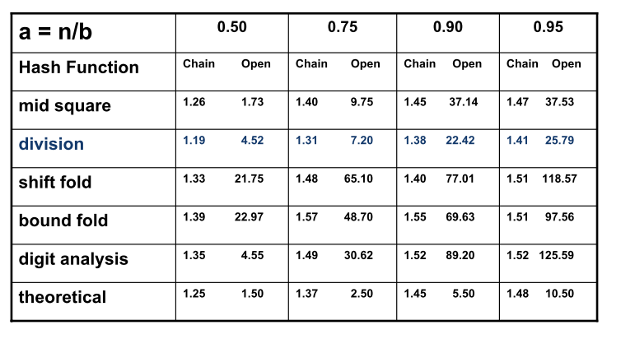
Average Number of Bucket Accesses Per Identifier Retrieved

