Slide 1

Chapter 1, Part I: Propositional Logic
With Question/Answer Animations

Slide 2
Chapter Summary
Propositional Logic
  The Language of Propositions
  Applications
  Logical Equivalences
Predicate Logic
  The Language of Quantifiers
  Logical Equivalences
  Nested Quantifiers
Proofs
  Rules of Inference
  Proof Methods
  Proof Strategy

Slide 3
Propositional Logic Summary
The Language of Propositions
  Connectives
  Truth Values
  Truth Tables
Applications
  Translating English Sentences
  System Specifications
  Logic Puzzles
Logical Equivalences
  Important Equivalences
  Showing Equivalence
  Satisfiability

Slide 4

Section 1.1

Slide 5
Section Summary
Propositions
Connectives
  Negation
  Conjunction
  Disjunction
  Implication; contrapositive, inverse, converse
  Biconditional
Truth Tables

Slide 6
Propositions
A proposition is a declarative sentence that is either true or false, but not both.
Examples of propositions:
  The Moon is made of green cheese.
  1 + 0 = 1
  0 + 0 = 2
Examples that are not propositions.
  Sit down!
  What time is it?
  x + 1 = 2
  x + y = z

Slide 7
Propositions
Examples of propositions:
  Washington, D. C. is the capital of the United States of America.
  1 + 1 = 2
  2 + 2 = 3
Examples that are not propositions.
  Read this carefully.

Slide 8
Propositional Logic
Constructing Propositions
  Propositional Variables: p, q, r, s, …
  The proposition that is always true is denoted by T and the proposition that is always false is denoted by F.
  Compound Propositions; constructed from logical connectives and other propositions
    Negation ¬
    Conjunction ∧
    Disjunction ∨
    Implication →
    Biconditional ↔

Slide 9
Compound Propositions: Negation
  The negation of a proposition p is denoted by ¬p and has this truth table:
Example1: If p denotes “The earth is round.”, then ¬p denotes “It is not the case that the earth is round,” or more simply “The earth is not round.”
p | ¬p
T | F
F | T

Slide 10
Conjunction
The conjunction of propositions p and q is denoted by p ∧ q and has this truth table:
Example: If p denotes “I am at home.” and q denotes “It is raining.” then p ∧q denotes “I am at home and it is raining.”
p | q | p ∧ q
T | T | T
T | F | F
F | T | F
F | F | F

Slide 11
Disjunction
The disjunction of propositions p and q is denoted by p ∨q and has this truth table:
Example: If p denotes “I am at home.” and q denotes “It is raining.” then p ∨q denotes “I am at home or it is raining.”
p | q | p ∨q
T | T | T
T | F | T
F | T | T
F | F | F

Slide 12
The Connective Or in English
In English “or” has two distinct meanings.
  “Inclusive Or” - In the sentence “Students who have taken CS202 or Math120 may take this class,” we assume that students need to have taken one of the prerequisites, but may have taken both. This is the meaning of disjunction. For p ∨q to be true, either one or both of p and q must be true.
  “Exclusive Or” - When reading the sentence “Soup or salad comes with this entrée,” we do not expect to be able to get both soup and salad. This is the meaning of Exclusive Or (Xor). In p ⊕ q , one of p and q must be true, but not both. The truth table for ⊕ is:

Slide 13
The Connective Or in English
  “Inclusive Or” - “Students who have taken calculus or computer science can take this class. ”
  “Exclusive Or” - “Students who have taken calculus or computer science , but not both, can enroll in this class. ”
p | q | p ⊕q
T | T | F
T | F | T
F | T | T
F | F | F

Slide 14
Implication
If p and q are propositions, then p →q is a conditional statement or implication which is read as “if p, then q ” and has this truth table:
Example: If p denotes “I am at home.” and q denotes “It is raining.” then p →q denotes “If I am at home then it is raining.”
In p →q , p is the hypothesis (antecedent or premise) and q is the conclusion (or consequence).
p | q | p →q
T | T | T
T | F | F
F | T | T
F | F | T

Slide 15
Understanding Implication
  In p →q there does not need to be any connection between the antecedent or the consequence. The “meaning” of p →q depends only on the truth values of p and q.
These implications are perfectly fine, but would not be used in ordinary English.
  “If the moon is made of green cheese, then I have more money than Bill Gates. ”
  “If 1 + 1 = 3, then all of you pass the course.”

Slide 16
Different Ways of Expressing p →q
if p, then q p implies q
if p, q p only if q
q unless ¬p q when p
q if p p is sufficient for q
q whenever p q is necessary for p
q follows from p
a necessary condition for p is q
a sufficient condition for q is p

Slide 17
Converse, Contrapositive, and Inverse
From p →q we can form new conditional statements .
  q →p is the converse of p →q
  ¬q → ¬ p is the contrapositive of p →q
  ¬ p → ¬ q is the inverse of p →q
Example: Find the converse, inverse, and contrapositive of “It raining is a sufficient condition for my not going to town.”
Solution:
  converse: If I do not go to town, then it is raining.
  inverse: If it is not raining, then I will go to town.
  contrapositive: If I go to town, then it is not raining.

Slide 18
Converse, Contrapositive, and Inverse
Example: Find the converse, inverse, and contrapositive statement of “The home team wins whenever it is raining.”
Solution:
  converse: If home team wins , then it is raining.
  inverse: If it is not raining, then home team does not win.
  contrapositive: If home team does not win , then it is not raining.

Slide 19
Biconditional
If p and q are propositions, then we can form the biconditional proposition p ↔q , read as “p if and only if q .” The biconditional p ↔q denotes the proposition with this truth table:
If p denotes “I am at home.” and q denotes “It is raining.” then p ↔q denotes “I am at home if and only if it is raining.”
If p denotes “You can take the flight.” and q denotes “You buy a ticket.” then p ↔q denotes “You can take the flight if and only if you buy a ticket.
p | q | p ↔q
T | T | T
T | F | F
F | T | F
F | F | T

Slide 20
Expressing the Biconditional
Some alternative ways “p if and only if q” is expressed in English:
  p is necessary and sufficient for q
  if p then q , and conversely
  p iff q

Slide 21
Truth Tables For Compound Propositions
Construction of a truth table:
Rows
  Need a row for every possible combination of values for the atomic propositions.
Columns
  Need a column for the compound proposition (usually at far right)
  Need a column for the truth value of each expression that occurs in the compound proposition as it is built up.
    This includes the atomic propositions

Slide 22
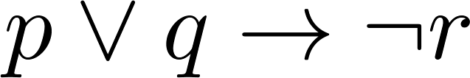
Example Truth Table
Construct a truth table for
p | q | r | ¬r | p ∨ q | p ∨ q → ¬r
T | T | T | F | T | F
T | T | F | T | T | T
T | F | T | F | T | F
T | F | F | T | T | T
F | T | T | F | T | F
F | T | F | T | T | T
F | F | T | F | F | T
F | F | F | T | F | T

Slide 23
Equivalent Propositions
Two propositions are equivalent if they always have the same truth value.
Example: Show using a truth table that the biconditional is equivalent to the contrapositive.
Solution:
p | q | ¬ p | ¬ q | p →q | ¬q → ¬ p
T | T | F | F | T | T
T | F | F | T | F | F
F | T | T | F | T | T
F | F | T | T | F | T

Slide 24
Using a Truth Table to Show Non-Equivalence
Example: Show using truth tables that neither the converse nor inverse of an implication are not equivalent to the implication.
Solution:
p | q | ¬ p | ¬ q | p →q | ¬ p →¬ q | q → p
T | T | F | F | T | T | T
T | F | F | T | F | T | T
F | T | T | F | T | F | F
F | F | T | T | F | T | T

Slide 25
Problem
How many rows are there in a truth table with n propositional variables?
Solution: 2^{n} We will see how to do this in Chapter 6.
Note that this means that with n propositional variables, we can construct 2^{n} distinct (i.e., not equivalent) propositions.

Slide 26
Precedence of Logical Operators
Operator | Precedence
¬ | 1
∧ ∨ | 2 3
→ ↔ | 4 5
p ∨q → ¬r is equivalent to (p ∨q) → ¬r
If the intended meaning is p ∨(q → ¬r )
then parentheses must be used.

Slide 27

Section 1.2

Slide 28
Applications of Propositional Logic: Summary
Translating English to Propositional Logic
System Specifications
Boolean Searching
Logic Puzzles

Slide 29
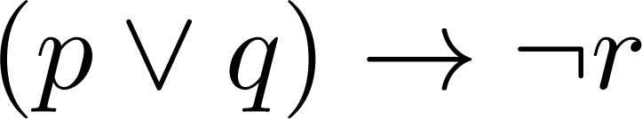
Translating English Sentences
Steps to convert an English sentence to a statement in propositional logic
  Identify atomic propositions and represent using propositional variables.
  Determine appropriate logical connectives
“If I go to sleep or to the country, I will not go shopping.”
  p: I go to sleep
  q: I go to the country.
  r: I will go shopping.
If p or q then not r.

Slide 30
Example
Problem: Translate the following sentence into propositional logic:
“You can access the Internet from campus only if you are a computer science major or you are not a freshman.”
One Solution: Let a, c, and f represent respectively “You can access the internet from campus,” “You are a computer science major,” and “You are a freshman.”
a→ (c ∨ ¬ f )

Slide 31
System Specifications
System and Software engineers take requirements in English and express them in a precise specification language based on logic.
Example: Express in propositional logic:
“The automated reply cannot be sent when the file system is full”
Solution: One possible solution: Let p denote “The automated reply can be sent” and q denote “The file system is full.”
q→ ¬ p

Slide 32
Consistent System Specifications
Definition: A list of propositions is consistent if it is possible to assign truth values to the proposition variables so that each proposition is true.

Slide 33
Consistent System Specifications
Exercise: Are these specifications consistent?
  “The diagnostic message is stored in the buffer or it is retransmitted.”
  “The diagnostic message is not stored in the buffer.”
  “If the diagnostic message is stored in the buffer, then it is retransmitted.”
Solution: Let p denote “The diagnostic message is not stored in the buffer.” Let q denote “The diagnostic message is retransmitted” The specification can be written as: p ∨ q, p→ q, ¬p. When p is false and q is true all three statements are true. So the specification is consistent.
  What if “The diagnostic message is not retransmitted is added.”
  Solution: Now we are adding ¬q and there is no satisfying assignment. So the specification is not consistent.

Slide 34
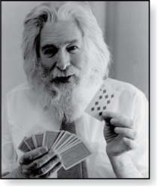
Logic Puzzles
Raymond Smullyan
(Born 1919)
An island has two kinds of inhabitants, knights, who always tell the truth, and knaves, who always lie.
You go to the island and meet A and B.
  A says “B is a knight.”
  B says “The two of us are of opposite types.”
Example: What are the types of A and B?
Solution: Let p and q be the statements that A is a knight and B is a knight, respectively. So, then ¬p represents the proposition that A is a knave and ¬q that B is a knave.
  If A is a knight, then p is true. Since knights tell the truth, q must also be true. Then (p ∧ ¬ q)∨ (¬ p ∧ q) would have to be true, but it is not. So, A is not a knight and therefore ¬p must be true.
  If A is a knave, then B must not be a knight since knaves always lie. So, then both ¬p and ¬q hold since both are knaves.

Slide 35

Section 1.3

Slide 36
Section Summary
Tautologies, Contradictions, and Contingencies.
Logical Equivalence
  Important Logical Equivalences
  Showing Logical Equivalence
Normal Forms (optional, covered in exercises in text)
  Disjunctive Normal Form
  Conjunctive Normal Form
Propositional Satisfiability
  Sudoku Example

Slide 37
Tautologies, Contradictions, and Contingencies
A tautology is a compound proposition which is always true.
  Example: p ∨¬p
A contradiction is a compound proposition which is always false.
  Example: p ∧¬p
A contingency is a proposition which is neither a tautology nor a contradiction, such as p
P | ¬p | p ∨¬p | p ∧¬p
T | F | T | F
F | T | T | F

Slide 38
Logically Equivalent
Two compound propositions p and q are logically equivalent if p↔q is a tautology.
We write this as p⇔q or as p≡q where p and q are logically equivalent.
Two compound propositions p and q are equivalent if and only if the columns in a truth table giving their truth values agree.
This truth table show ¬p ∨ q is equivalent to p → q.
p | q | ¬p | ¬p ∨ q | p→ q
T | T | F | T | T
T | F | F | F | F
F | T | T | T | T
F | F | T | T | T

Slide 39
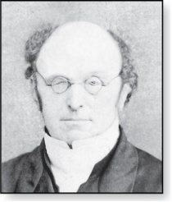
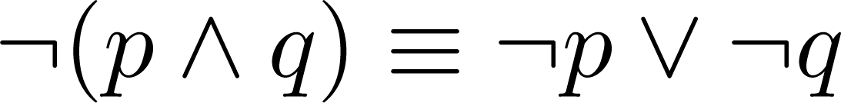
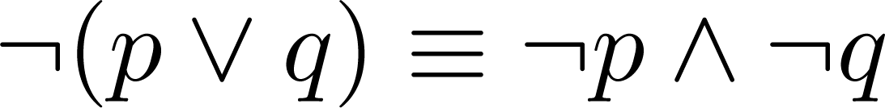
De Morgan’s Laws
Augustus De Morgan
1806-1871
This truth table shows that De Morgan’s Second Law holds.
p | q | ¬p | ¬q | (p∨q) | ¬(p∨q) | ¬p∧¬q
T | T | F | F | T | F | F
T | F | F | T | T | F | F
F | T | T | F | T | F | F
F | F | T | T | F | T | T

Slide 40
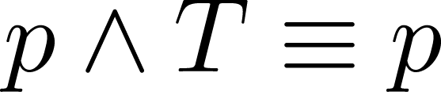
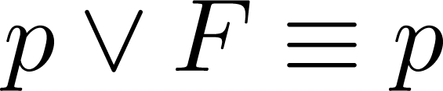
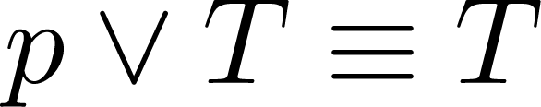
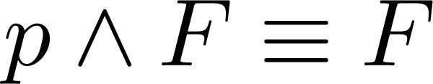
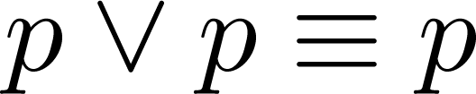
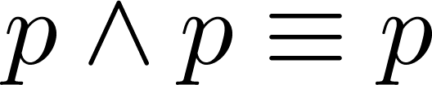
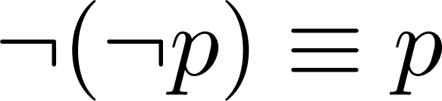
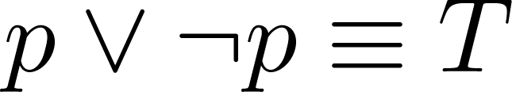
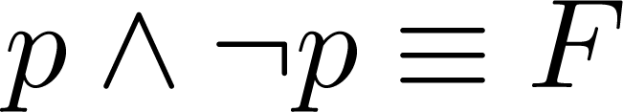
Key Logical Equivalences
Identity Laws: ,
Domination Laws: ,
Idempotent laws: ,
Double Negation Law:
Negation Laws: ,

Slide 41
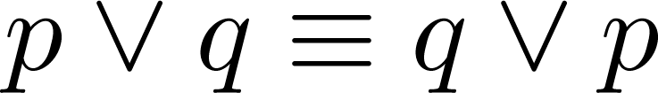
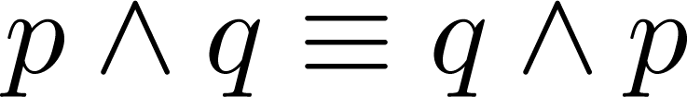
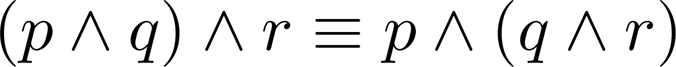
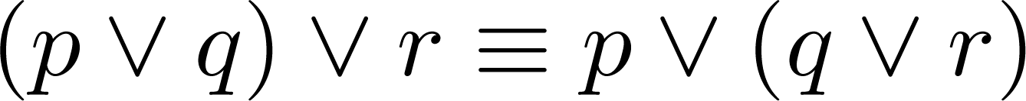
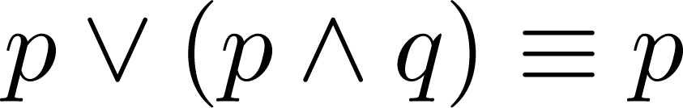
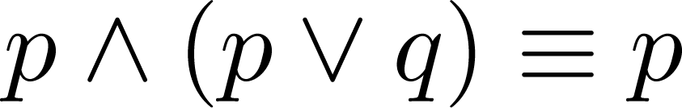
Key Logical Equivalences (cont)
Commutative Laws: ,
Associative Laws:
Distributive Laws:
Absorption Laws:

Slide 42
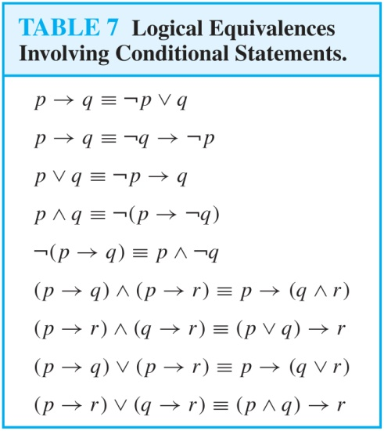
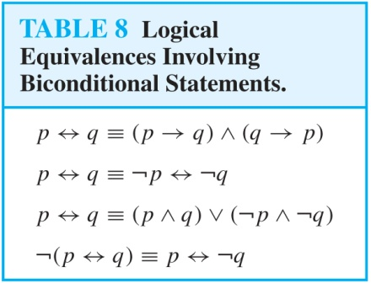
More Logical Equivalences

Slide 43



Constructing New Logical Equivalences
We can show that two expressions are logically equivalent by developing a series of logically equivalent statements.
To prove that we produce a series of equivalences beginning with A and ending with B.
Keep in mind that whenever a proposition (represented by a propositional variable) occurs in the equivalences listed earlier, it may be replaced by an arbitrarily complex compound proposition.

Slide 44
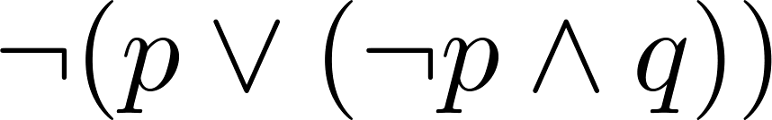
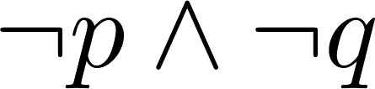
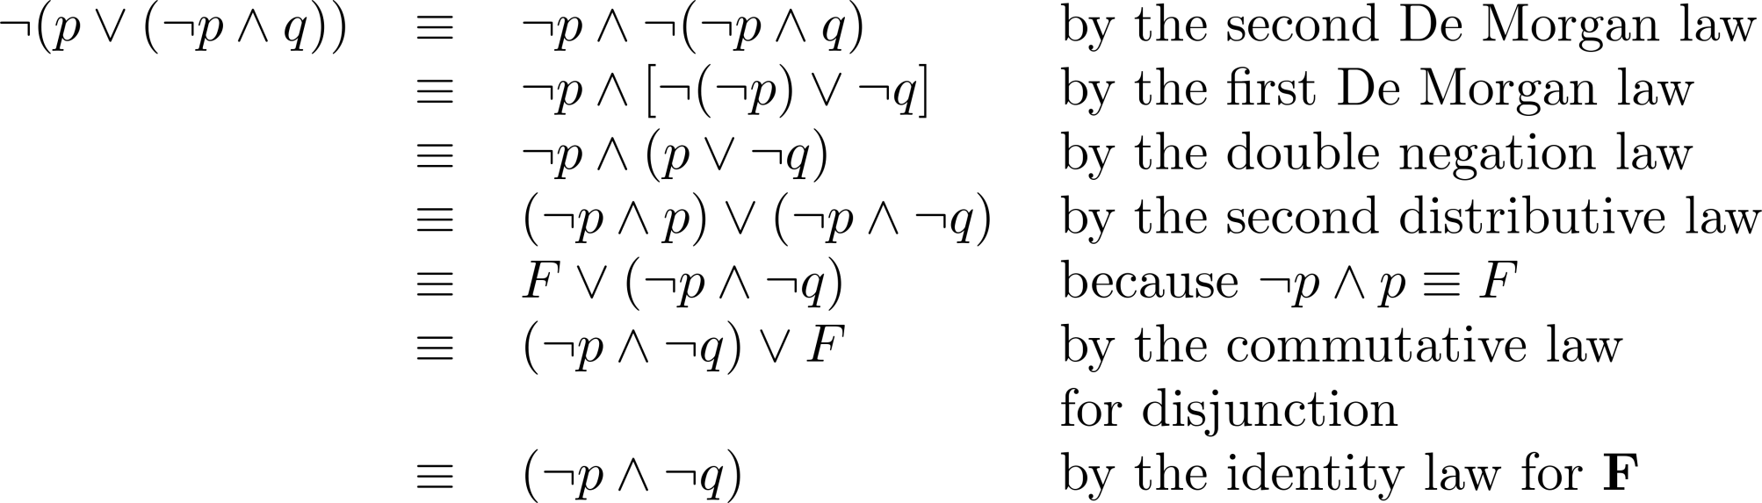
Equivalence Proofs
Example: Show that
is logically equivalent to
Solution:

Slide 45
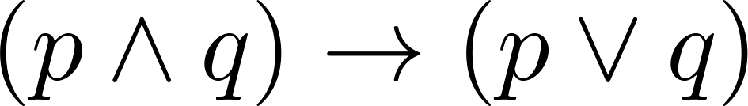
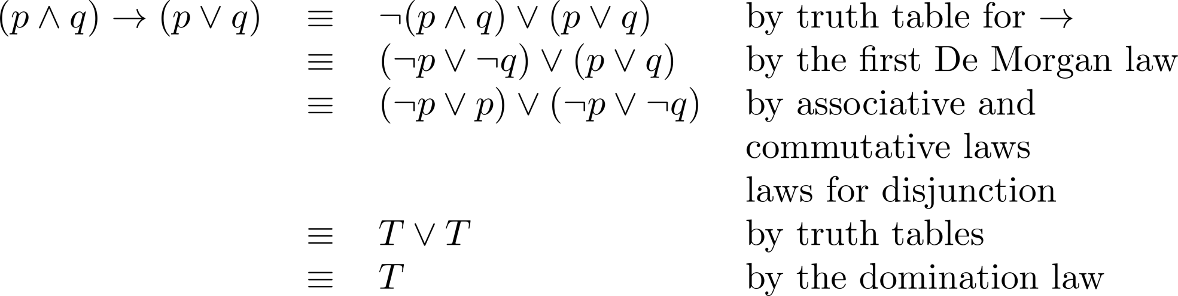
Equivalence Proofs
Example: Show that
is a tautology.
Solution:

Slide 46
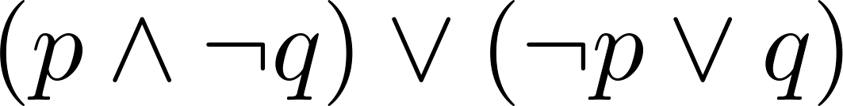
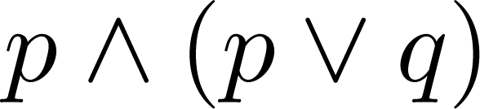
Disjunctive Normal Form (optional)
A propositional formula is in Disjunctive Normal Form if it consists of a disjunction of (1, … ,n) disjuncts where each disjunct consists of a conjunction of (1, …, m) atomic formulas or the negation of an atomic formula.
  Yes
  No
Every compound proposition can be put in disjunctive normal form.

Slide 47
Disjunctive Normal Form (optional)
Example: Find the Disjunctive Normal Form (DNF) of
(p∨q)→¬r
Solution: This proposition is true when r is false or when both p and q are false.
(¬ p∧ ¬ q) ∨ ¬r

Slide 48
Conjunctive Normal Form (optional)
A compound proposition is in Conjunctive Normal Form (CNF) if it is a conjunction of disjunctions.
Every proposition can be put in an equivalent CNF.

Slide 49
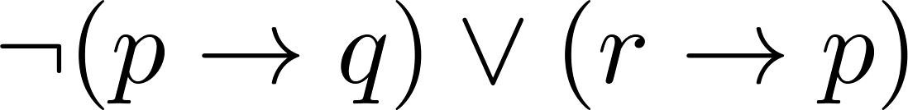
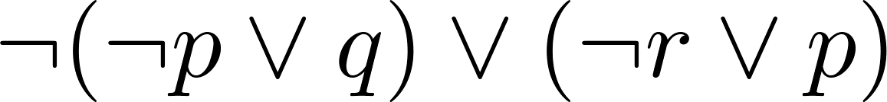
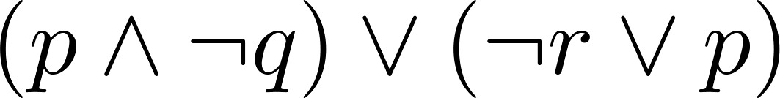
Conjunctive Normal Form (optional)
Example: Put the following into CNF:
Solution:
  Eliminate implication signs:
  Move negation inwards; eliminate double negation:
  Convert to CNF using associative/distributive laws

Slide 50
Propositional Satisfiability
A compound proposition is satisfiable if there is an assignment of truth values to its variables that make it true. When no such assignments exist, the compound proposition is unsatisfiable.
A compound proposition is unsatisfiable if and only if its negation is a tautology.

Slide 51
Questions on Propositional Satisfiability
Example: Determine the satisfiability of the following compound propositions:
Solution: Satisfiable. Assign T to p, q, and r.
Solution: Satisfiable. Assign T to p and F to q. (at least one of p, q, and r is true and at least one is false).
Solution: Not satisfiable. Check each possible assignment of truth values to the propositional variables and none will make the proposition true.

Slide 52
Notation

