Slide 1

Section 1.6

Slide 2
Revisiting the Socrates Example
We have the two premises:
  “All men are mortal.”
  “Socrates is a man.”
And the conclusion:
  “Socrates is mortal.”
How do we get the conclusion from the premises?

Slide 3
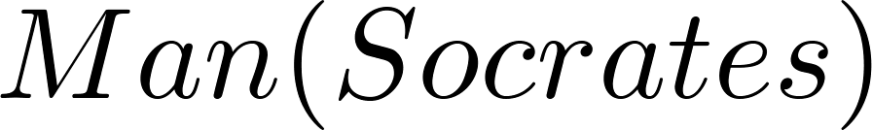
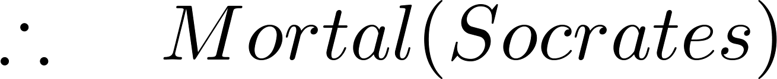
The Argument
We can express the premises (above the line) and the conclusion (below the line) in predicate logic as an argument:
We will see shortly that this is a valid argument.

Slide 4
Arguments in Propositional Logic
A argument in propositional logic is a sequence of propositions. All but the final proposition are called premises. The last statement is the conclusion.
The argument is valid if the premises imply the conclusion. An argument form is an argument that is valid no matter what propositions are substituted into its propositional variables.
If the premises are p₁ ,p₂, …,p_{n} and the conclusion is q then
(p₁ ∧ p₂ ∧ … ∧ p_{n} ) → q is a tautology.

Slide 5
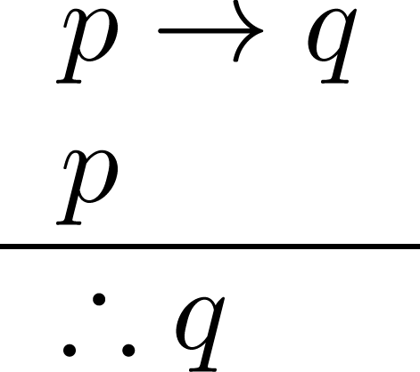
Rules of Inference for Propositional Logic: Modus Ponens
Corresponding Tautology:
(p ∧ (p →q)) → q
Example:
Let p be “It is snowing.”
Let q be “I will study discrete math.”
“If it is snowing, then I will study discrete math.”
“It is snowing.”
“Therefore , I will study discrete math.”
Example:
“If it snows today, then we will go skiing”
The hypothesis “ it snows today,” is true, then by modus ponens, “We will go skiing.” is true.

Slide 6
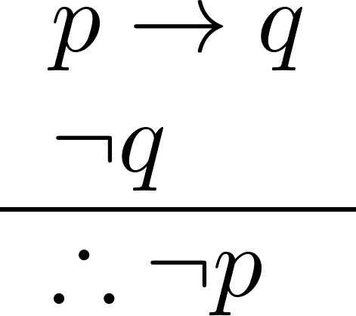
Modus Tollens
Corresponding Tautology:
(¬q∧(p →q))→¬p
Example:
Let p be “it is snowing.”
Let q be “I will study discrete math.”
“If it is snowing, then I will study discrete math.”
“I will not study discrete math.”
“Therefore , it is not snowing.”

Slide 7
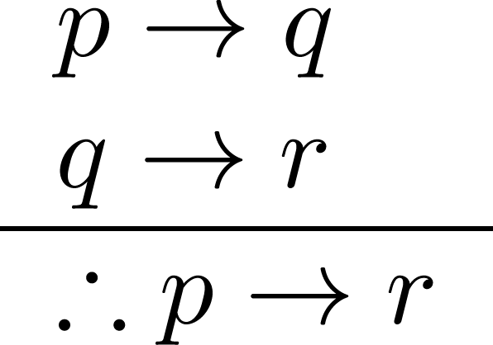
Hypothetical Syllogism
Corresponding Tautology:
((p →q) ∧ (q→r))→(p→ r)
Example:
Let p be “it snows.”
Let q be “I will study discrete math.”
Let r be “I will get an A.”
“If it snows, then I will study discrete math.”
“If I study discrete math, I will get an A.”
“Therefore , If it snows, I will get an A.”

Slide 8
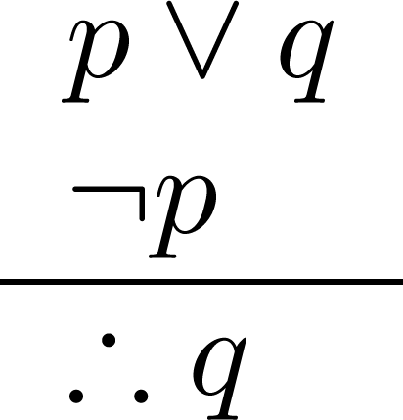
Disjunctive Syllogism
Corresponding Tautology:
(¬p∧(p ∨q))→q
Example:
Let p be “I will study discrete math.”
Let q be “I will study English literature.”
“I will study discrete math or I will study English literature.”
“I will not study discrete math.”
“Therefore , I will study English literature.”

Slide 9
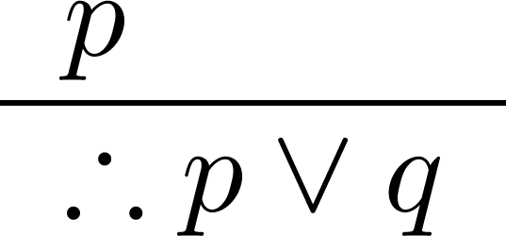
Addition
Corresponding Tautology:
p →(p ∨q)
Example:
Let p be “I will study discrete math.”
Let q be “I will visit Las Vegas.”
“I will study discrete math.”
“Therefore, I will study discrete math or I will visit
Las Vegas.”

Slide 10
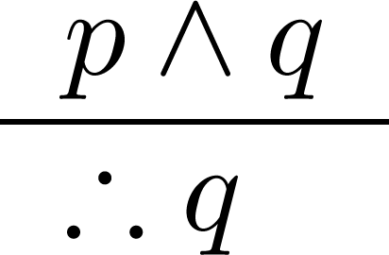
Simplification
Corresponding Tautology:
(p∧q) →p
Example:
Let p be “I will study discrete math.”
Let q be “I will study English literature.”
“I will study discrete math and English literature”
“Therefore, I will study discrete math.”

Slide 11
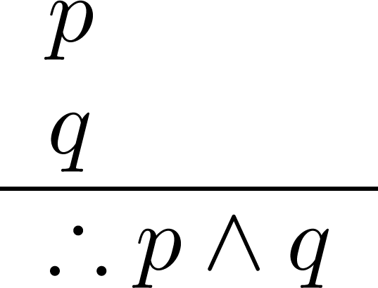
Conjunction
Corresponding Tautology:
((p) ∧ (q)) →(p ∧ q)

Slide 12
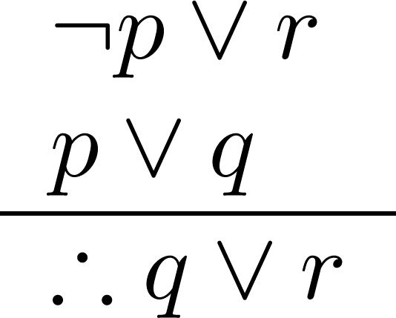
Resolution
Corresponding Tautology:
((¬p ∨ r ) ∧ (p ∨ q)) →(q ∨ r)
Example:
Let p be “I will study discrete math.”
Let r be “I will study English literature.”
Let q be “I will study databases.”
“I will not study discrete math or I will study English literature.”
“I will study discrete math or I will study databases.”
“Therefore, I will study databases or I will English literature.”

Slide 13
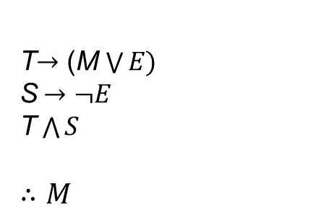
Example:
If today is Tuesday, I have a test in mathematics or Economics. If my Economics Professor is sick, I will not have a test in Economics. Today is Tuesday and my Economics Professor is sick. Therefore I have a test in Mathematics.
Let T denote “Today is Tuesday.”
M denote “I have a test in Mathematics.”
E denote “I have a test in Economics.”
S denote “My Economics Professor is sick.”

Slide 14

Using the Rules of Inference to Build Valid Arguments
A valid argument is a sequence of statements. Each statement is either a premise or follows from previous statements by rules of inference. The last statement is called conclusion.
A valid argument takes the following form:
S₁
S₂
.
.
.
S_{n}
C

Slide 15
Valid Arguments
Example 1:
With these hypotheses:
  “It is not sunny this afternoon and it is colder than yesterday.”
  “We will go swimming only if it is sunny.”
  “If we do not go swimming, then we will take a canoe trip.”
  “If we take a canoe trip, then we will be home by sunset.”
Using the inference rules, construct a valid argument for the conclusion:
  “We will be home by sunset.”
Continued on next slide →

Slide 16
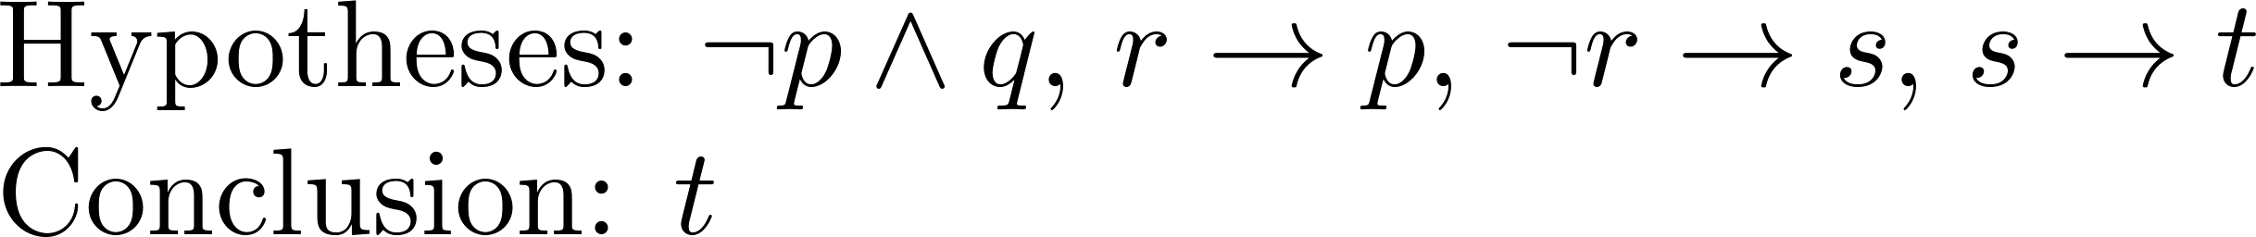
Valid Arguments
Solution:
Choose propositional variables:
  p : “It is sunny this afternoon.” r : “We will go swimming.” t : “We will be home by sunset.”
  q : “It is colder than yesterday.” s : “We will take a canoe trip.”
Translation into propositional logic:
Continued on next slide →

Slide 17
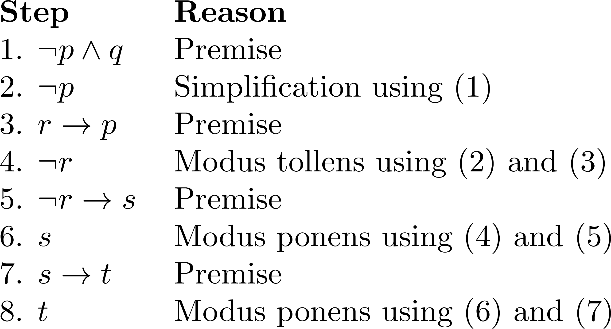
Valid Arguments
3. Construct the Valid Argument
Notes:
Note that a truth table would have 32 rows since we have 5 propositional variables.

Slide 18
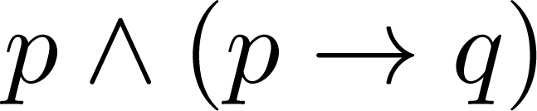
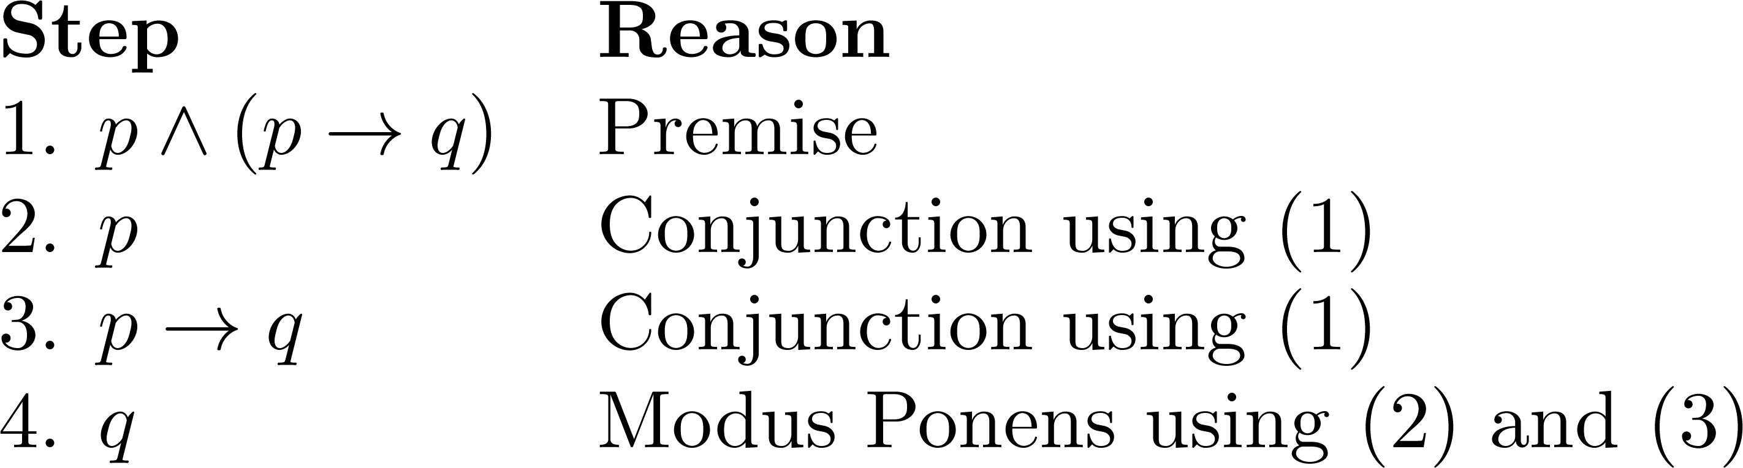
Valid Arguments
Example 2: From the single proposition
Show that q is a conclusion.
Solution:

Slide 19
Handling Quantified Statements
Valid arguments for quantified statements are a sequence of statements. Each statement is either a premise or follows from previous statements by rules of inference which include:
  Rules of Inference for Propositional Logic
  Rules of Inference for Quantified Statements
The rules of inference for quantified statements are introduced in the next several slides.

Slide 20
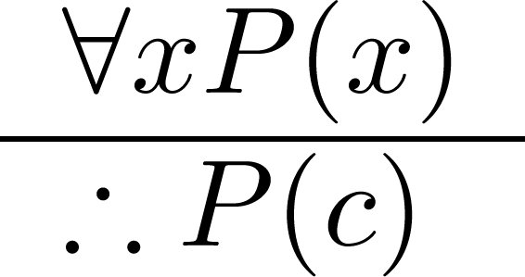
Rules of Inference for Quantified Statements Universal Instantiation (UI)
Example:
Our domain consists of all dogs and Fido is a dog.
“All dogs are cuddly.”
“Therefore, Fido is cuddly.”

Slide 21
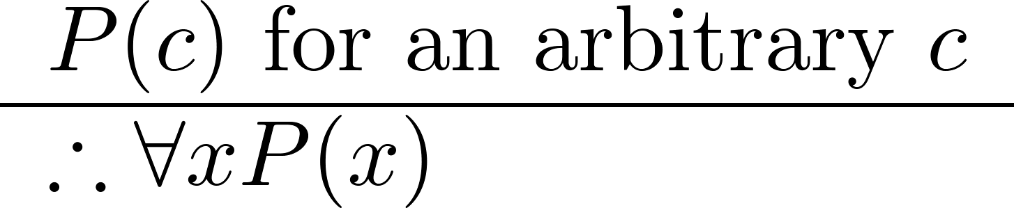
Universal Generalization (UG)
Used often implicitly in Mathematical Proofs.

Slide 22
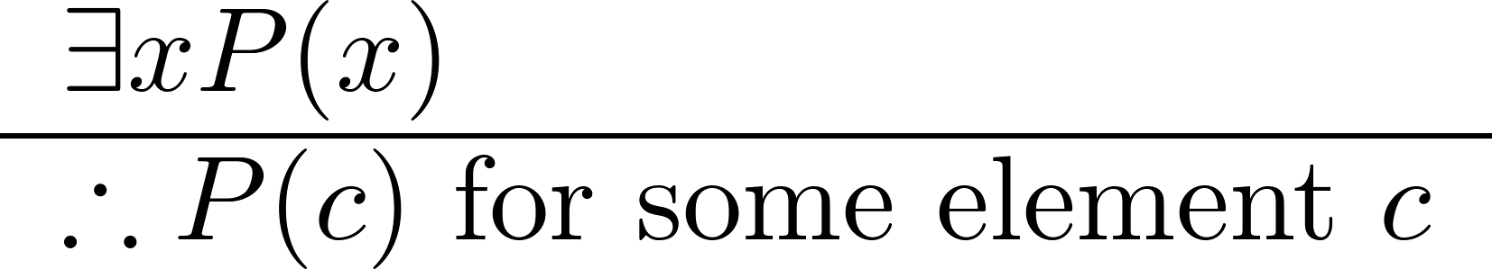
Existential Instantiation (EI)
Example:
“There is someone who got an A in the course.”
“Let’s call her a and say that a got an A”

Slide 23
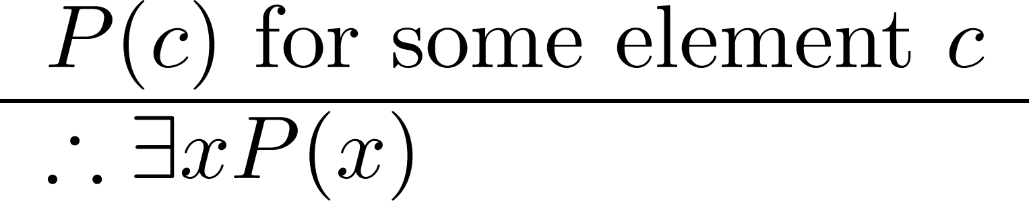
Existential Generalization (EG)
Example:
“Michelle got an A in the class.”
“Therefore, someone got an A in the class.”

Slide 24
Fallacies
Some fallacies, arise in incorrect arguments, resemble rules of inference, but are based on contingencies rather than tautologies.
Example: If you do every problem in this book, then you will learn discrete mathematics. You learned discrete mathematics. Therefore, you did every problem in this book.
Is this argument valid?
Solution: Let p be the proposition “you did every problem in this book.“ Let q be the proposition “You learned discrete mathematics.” Then this argument is of the form: if p q and q, then p.

Slide 25
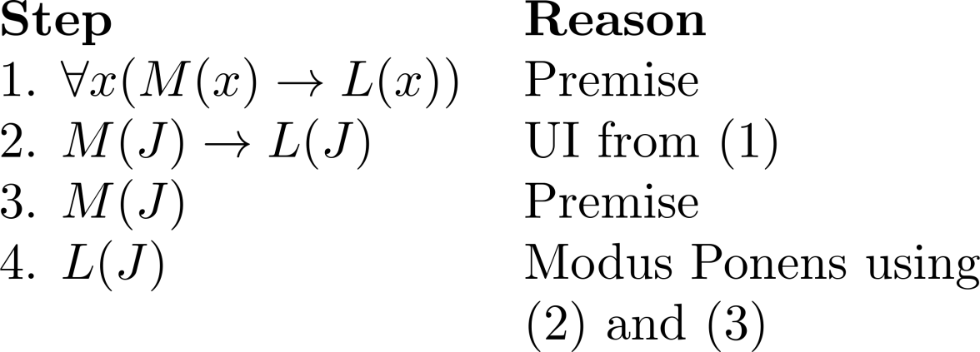
Using Rules of Inference
Example 1: Using the rules of inference, construct a valid argument to show that
  “John Smith has two legs”
is a consequence of the premises:
  “Every man has two legs.” “John Smith is a man.”
Solution: Let M(x) denote “x is a man” and L(x) “ x has two legs” and let John Smith be a member of the domain.
  Valid Argument:

Slide 26
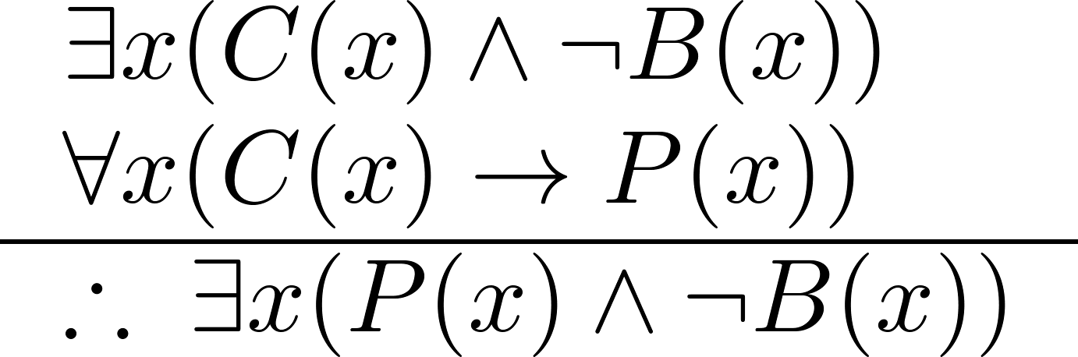
Using Rules of Inference
Example 2: Use the rules of inference to construct a valid argument showing that the conclusion
  “Someone who passed the first exam has not read the book.”
follows from the premises
  “A student in this class has not read the book.”
  “Everyone in this class passed the first exam.”
Solution: Let C(x) denote “x is in this class,” B(x) denote “ x has read the book,” and P(x) denote “x passed the first exam.”
  First we translate the
  premises and conclusion
  into symbolic form.
Continued on next slide →

Slide 27

Using Rules of Inference
Example 3: Show that the premises “Everyone in this discrete mathematics class has taken a course in computer science” and “Marla is a student in this class” imply the conclusion “Marla has taken a course in computer science.”
Solution: Let D(x) denote “x is in this discrete mathematics class ” and C(x) “ x has taken a course in computer science.” The premise are and the conclusion is C(Marla).

Slide 28




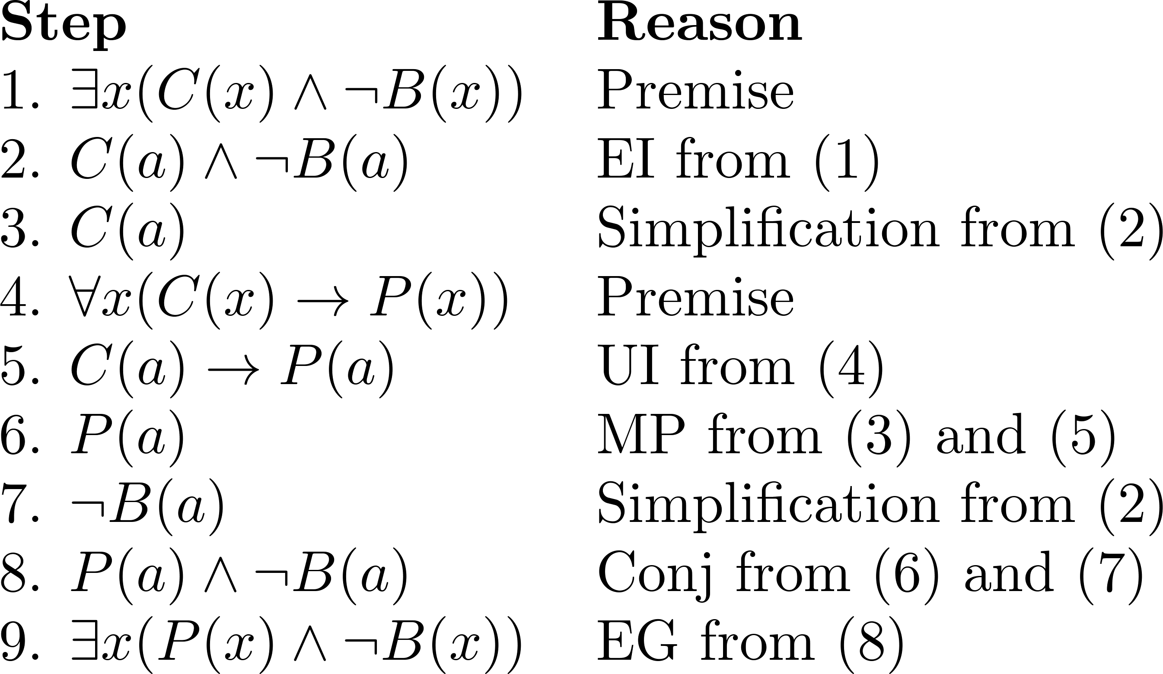
  Valid Argument:

Slide 29
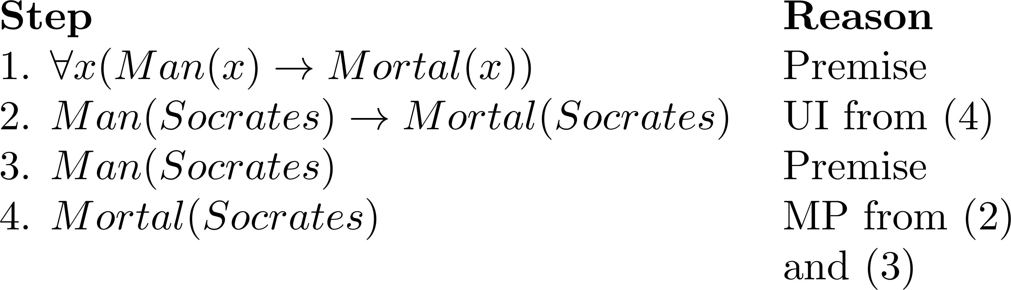
Valid Argument

Slide 30
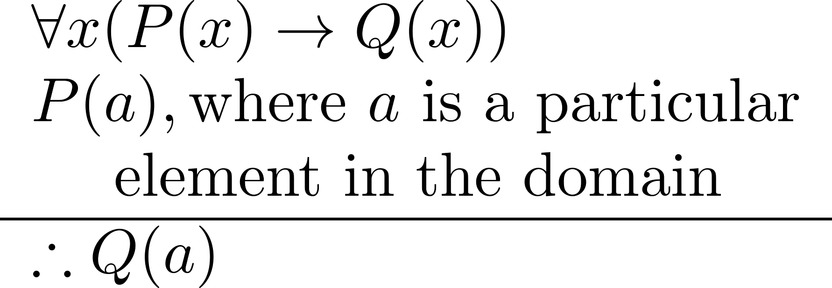
Universal Modus Ponens combines universal instantiation and modus ponens into one rule.
This rule could be used in the Socrates example.

Slide 31
Normal Forms
Section 1.7

Slide 32
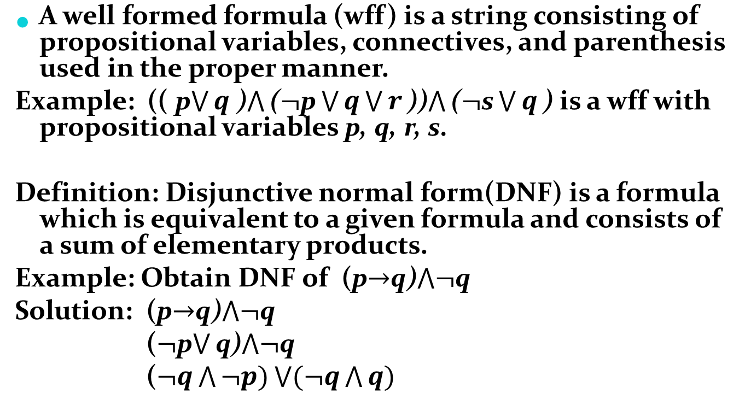
Disjunctive and Conjunctive Normal Form - DNF

Slide 33
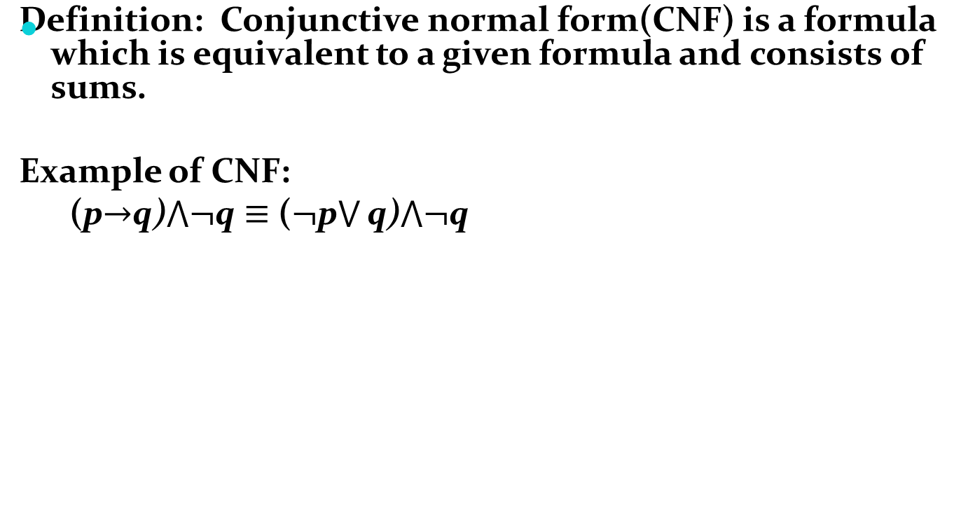
Disjunctive and Conjunctive Normal Form - CNF

Slide 34

Principle Conjunctive Normal Form
Definition: For a given formula, an equivalent formula consisting of conjunctions of maxterms only is known as its principal conjunctive normal form.
Example: Principle conjunctive normal form for
Solution:

Slide 35


Normal Forms for First Order Logic
Example: Transform the formula into prenex normal form
Solution:

