Slide 1
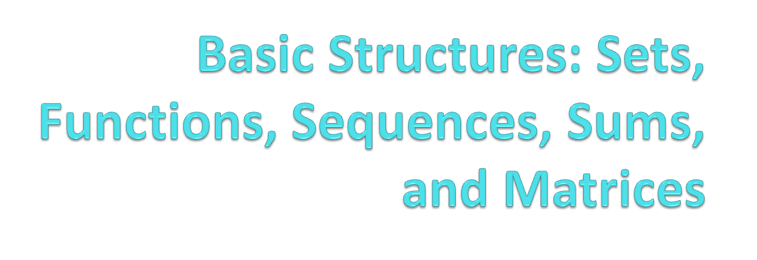
Chapter 2
With Question/Answer Animations

Slide 2

Section 2.1

Slide 3
Introduction
Sets are one of the basic building blocks for the types of objects considered in discrete mathematics.
  Important for counting.
  Programming languages have set operations.
Set theory is an important branch of mathematics.
  Many different systems of axioms have been used to develop set theory.
  Here we are not concerned with a formal set of axioms for set theory. Instead, we will use what is called naïve set theory.

Slide 4
Sets
A set is an unordered collection of objects.
  the students in this class
  the chairs in this room
The objects in a set are called the elements, or members of the set. A set is said to contain its elements.
The notation a ∈ A denotes that a is an element of the set A.
If a is not a member of A, write a ∉ A

Slide 5
Describing a Set: Roster Method
S = {a,b,c,d}
Order not important
S = {a,b,c,d} = {b,c,a,d}
Each distinct object is either a member or not; listing more than once does not change the set.
S = {a,b,c,d} = {a,b,c,b,c,d}
Ellipses (…) may be used to describe a set without listing all of the members when the pattern is clear.
S = {a,b,c,d, ……,z }

Slide 6
Roster Method
Set of all vowels in the English alphabet:
V = {a,e,i,o,u}
Set of all odd positive integers less than 10:
O = {1,3,5,7,9}
Set of all positive integers less than 100:
S = {1,2,3,……..,99}
Set of all integers less than 0:
S = {…., -3,-2,-1}

Slide 7
Some Important Sets
N = natural numbers = {0,1,2,3….}
Z = integers = {…,-3,-2,-1,0,1,2,3,…}
Z⁺ = positive integers = {1,2,3,…..}
R = set of real numbers
R⁺ = set of positive real numbers
C = set of complex numbers.
Q = set of rational numbers

Slide 8
Set-Builder Notation
Specify the property or properties that all members must satisfy:
S = {x | x is a positive integer less than 100}
O = {x | x is an odd positive integer less than 10}
O = {x ∈ Z⁺ | x is odd and x < 10}
A predicate may be used:
S = {x | P(x)}
Example: S = {x | Prime(x)}
Positive rational numbers:
Q⁺ = {x ∈ R | x = p/q, for some positive integers p,q}

Slide 9
Interval Notation
[a,b] = {x | a ≤ x ≤ b}
[a,b) = {x | a ≤ x < b}
(a,b] = {x | a < x ≤ b}
(a,b) = {x | a < x < b}
closed interval [a,b]
open interval (a,b)

Slide 10
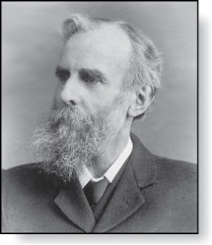
Universal Set and Empty Set
The universal set U is the set containing everything currently under consideration.
  Sometimes implicit
  Sometimes explicitly stated.
  Contents depend on the context.
The empty set is the set with no
elements. Symbolized ∅, but
{} also used.
Venn Diagram
U
V
a e i
o u
John Venn (1834-1923)
Cambridge, UK

Slide 11
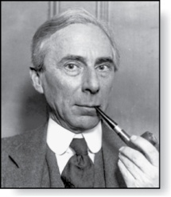
Russell’s Paradox
Let S be the set of all sets which are not members of themselves. A paradox results from trying to answer the question “Is S a member of itself?”
Related Paradox:
  Henry is a barber who shaves all people who do not shave themselves. A paradox results from trying to answer the question “Does Henry shave himself?”
Bertrand Russell (1872-1970)
Cambridge, UK
Nobel Prize Winner

Slide 12
Some things to remember
Sets can be elements of sets.
{{1,2,3},a, {b,c}}
{N,Z,Q,R}
The empty set is different from a set containing the empty set.
∅ ≠ { ∅ }

Slide 13
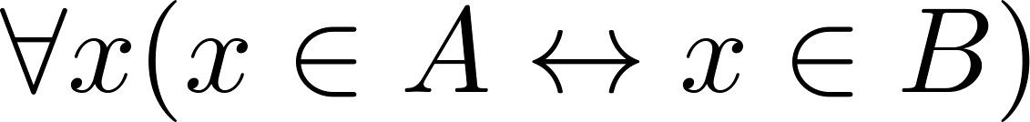
Set Equality
Definition: Two sets are equal if and only if they have the same elements.
  Therefore if A and B are sets, then A and B are equal if and only if .
  We write A = B if A and B are equal sets.
{1,3,5} = {3, 5, 1}
{1,5,5,5,3,3,1} = {1,3,5}

Slide 14
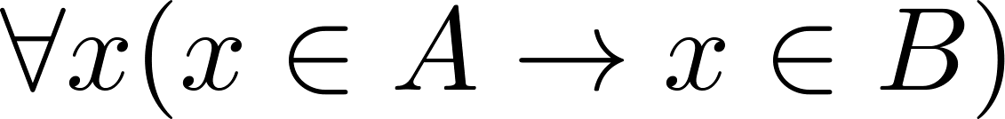
Subsets
Definition: The set A is a subset of B, if and only if every element of A is also an element of B.
  The notation A ⊆ B is used to indicate that A is a subset of the set B.
  A ⊆ B holds if and only if is true.
    Because a ∈ ∅ is always false, ∅ ⊆ S ,for every set S.
    Because a ∈ S → a ∈ S, S ⊆ S, for every set S.

Slide 15
Showing a Set is or is not a Subset of Another Set
Showing that A is a Subset of B: To show that A ⊆ B, show that if x belongs to A, then x also belongs to B.
Showing that A is not a Subset of B: To show that A is not a subset of B, A ⊈ B, find an element x ∈ A with x ∉ B. (Such an x is a counterexample to the claim that x ∈ A implies x ∈ B.)
Examples:
  The set of all computer science majors at your school is a subset of all students at your school.
  The set of integers with squares less than 100 is not a subset of the set of nonnegative integers.

Slide 16
Another look at Equality of Sets
Recall that two sets A and B are equal, denoted by A = B, if
Using logical equivalences we have that A = B if
This is equivalent to
A ⊆ B and B ⊆ A

Slide 17
Proper Subsets
Definition: If A ⊆ B, but A ≠B, then we say A is a proper subset of B, denoted by A ⊂ B. If A ⊂ B, then
is true.
Venn Diagram
U
B
A

Slide 18
The Size of a Set
Definition: If there are exactly n distinct elements in S where n is a nonnegative integer, we say that S is finite. Otherwise it is infinite.
Definition: The cardinality of a finite set A, denoted by |A|, is the number of (distinct) elements of A.
Examples:
|∅ | = 0
Let S be the letters of the English alphabet. Then |S| = 26
|{1,2,3}| = 3
|{ø}| = 1
The set of integers is infinite.

Slide 19
Power Sets
Definition: The set of all subsets of a set A, denoted P(A), is called the power set of A.
Example: If A = {a,b} then
P(A) = {ø, {a},{b},{a,b}}
If a set has n elements, then the cardinality of the power set is 2ⁿ. (In Chapters 5 and 6, we will discuss different ways to show this.)

Slide 20
Tuples
The ordered n-tuple (a₁,a₂,…..,a_{n}) is the ordered collection that has a₁ as its first element and a₂ as its second element and so on until a_{n} as its last element.
Two n-tuples are equal if and only if their corresponding elements are equal.
2-tuples are called ordered pairs.
The ordered pairs (a,b) and (c,d) are equal if and only if a = c and b = d.

Slide 21
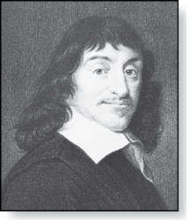
Cartesian Product
René Descartes (1596-1650)
Definition: The Cartesian Product of two sets A and B, denoted by A × B is the set of ordered pairs (a,b) where a ∈ A and b ∈ B .
Example:
A = {a,b} B = {1,2,3}
A × B = {(a,1),(a,2),(a,3), (b,1),(b,2),(b,3)}

Slide 22
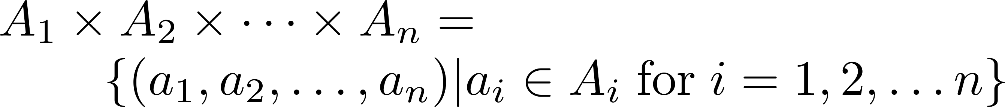
Cartesian Product
Definition: The cartesian products of the sets A₁,A₂,……,A_{n}, denoted by A₁ × A₂ × …… × A_{n} , is the set of ordered n-tuples (a₁,a₂,……,a_{n}) where a_{i} belongs to A_{i} for i = 1, … n.
Example: What is A × B × C where A = {0,1}, B = {1,2} and C = {0,1,2}
Solution: A × B × C = {(0,1,0), (0,1,1), (0,1,2),(0,2,0), (0,2,1), (0,2,2),(1,1,0), (1,1,1), (1,1,2), (1,2,0), (1,2,1), (1,2,2)}

Slide 23

Section 2.2

Slide 24
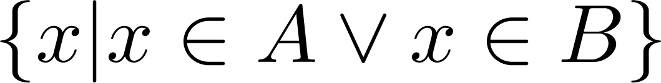

Union
Definition: Let A and B be sets. The union of the sets A and B, denoted by A ∪ B, is the set:
Example: What is {1,2,3} ∪ {3, 4, 5}?
Solution: {1,2,3,4,5}
Venn Diagram for A ∪ B
U
A
B

Slide 25
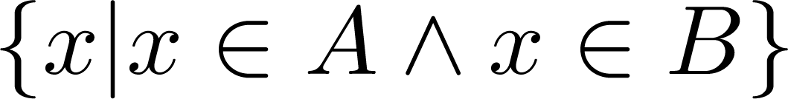
Intersection
Definition: The intersection of sets A and B, denoted by A ∩ B, is
Note if the intersection is empty, then A and B are said to be disjoint.
Example: What is? {1,2,3} ∩ {3,4,5} ?
Solution: {3}
Example:What is?
{1,2,3} ∩ {4,5,6} ?
Solution: ∅
Venn Diagram for A ∩B
U
A
B

Slide 26
Difference
Definition: Let A and B be sets. The difference of A and B, denoted by A – B, is the set containing the elements of A that are not in B. The difference of A and B is also called the complement of B with respect to A.
A – B = {x | x ∈ A ∧ x ∉ B} = A ∩‾B
U
Venn Diagram for A − B
A
B

Slide 27
Complement
Definition: If A is a set, then the complement of the A (with respect to U), denoted by Ā is the set U - A
Ā = {x ∈ U | x ∉ A}
(The complement of A is sometimes denoted by A^{c} .)
Example: If U is the positive integers less than 100, what is the complement of {x | x > 70}
Solution: {x | x ≤ 70}
Venn Diagram for Complement
U
Ā
A

Slide 28
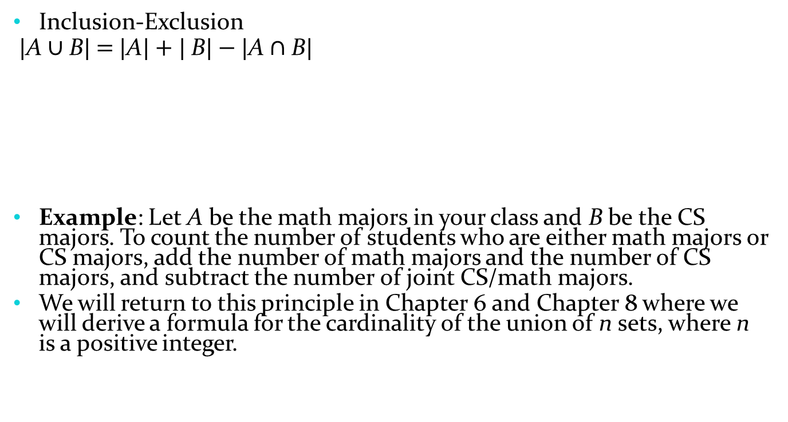
The Cardinality of the Union of Two Sets
U
A
B
Venn Diagram for A, B, A ∩ B, A ∪ B

Slide 29
Review Questions
Example: U = {0,1,2,3,4,5,6,7,8,9,10} A = {1,2,3,4,5}, B ={4,5,6,7,8}
  A ∪ B
    Solution: {1,2,3,4,5,6,7,8}
  A ∩ B
    Solution: {4,5}
  Ā
    Solution: {0,6,7,8,9,10}
    Solution: {0,1,2,3,9,10}
  A – B
    Solution: {1,2,3}
  B – A
    Solution: {6,7,8}

Slide 30

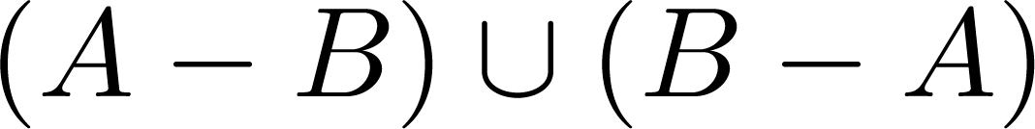
Symmetric Difference (optional)
Definition: The symmetric difference of A and B, denoted by is the set
Example:
  U = {0,1,2,3,4,5,6,7,8,9,10}
  A = {1,2,3,4,5} B ={4,5,6,7,8}
  What is:
  Solution: {1,2,3,6,7,8}
U
A
B
Venn Diagram

Slide 31



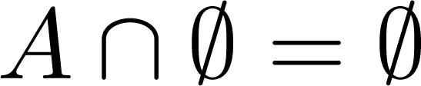


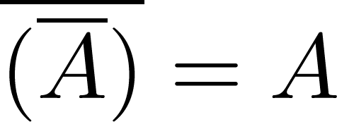
Set Identities
Identity laws
Domination laws
Idempotent laws
Complementation law
Continued on next slide →

Slide 32


Set Identities
Commutative laws
Associative laws
Distributive laws
Continued on next slide →

Slide 33


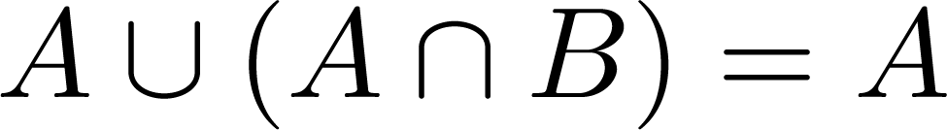
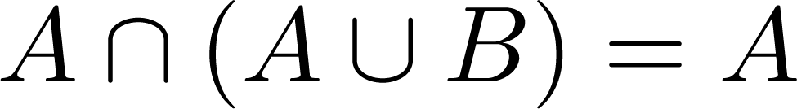

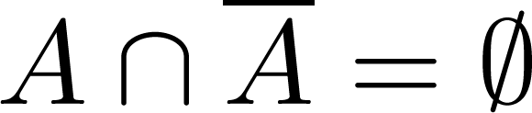
Set Identities
De Morgan’s laws
Absorption laws
Complement laws

Slide 34
Proving Set Identities
Different ways to prove set identities:
  Prove that each set (side of the identity) is a subset of the other.
  Use set builder notation and propositional logic.
  Membership Tables: Verify that elements in the same combination of sets always either belong or do not belong to the same side of the identity. Use 1 to indicate it is in the set and a 0 to indicate that it is not in the set.

Slide 35
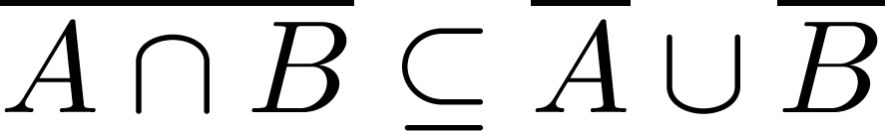

Proof of Second De Morgan Law
Example: Prove that
Solution: We prove this identity by showing that:
1) and
2)
Continued on next slide →

Slide 36
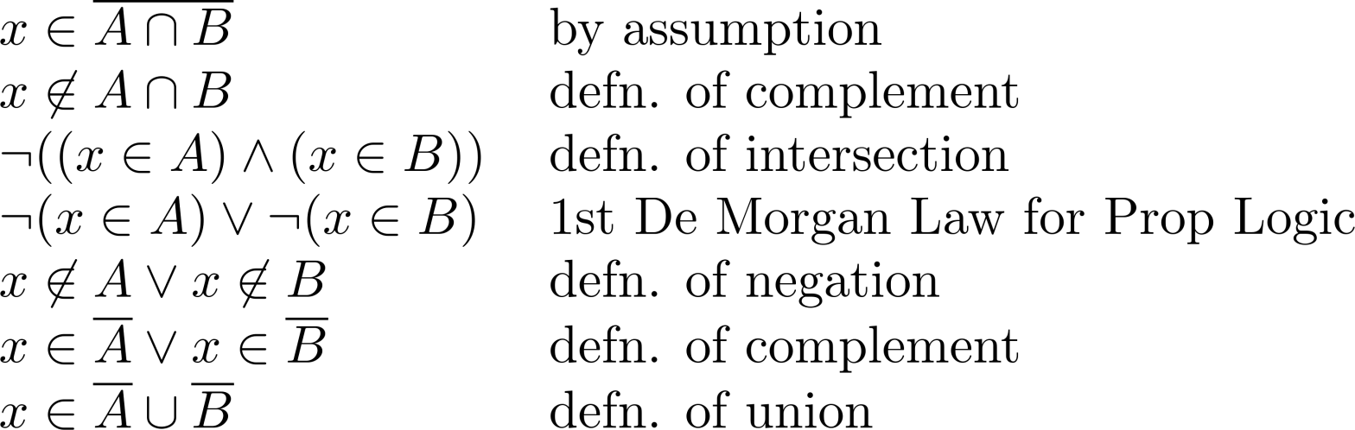
Proof of Second De Morgan Law
These steps show that:
Continued on next slide →

Slide 37
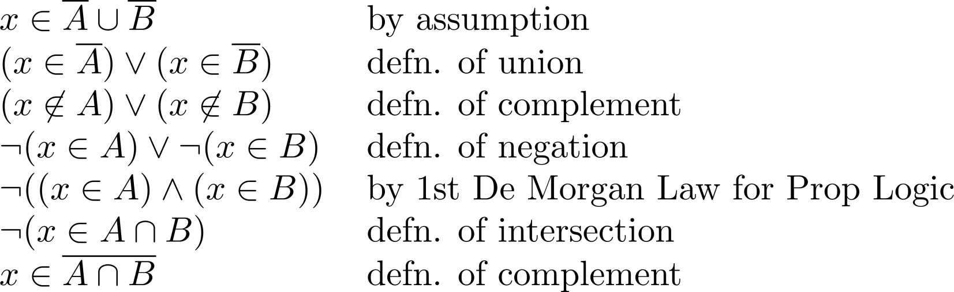
Proof of Second De Morgan Law
These steps show that:

Slide 38
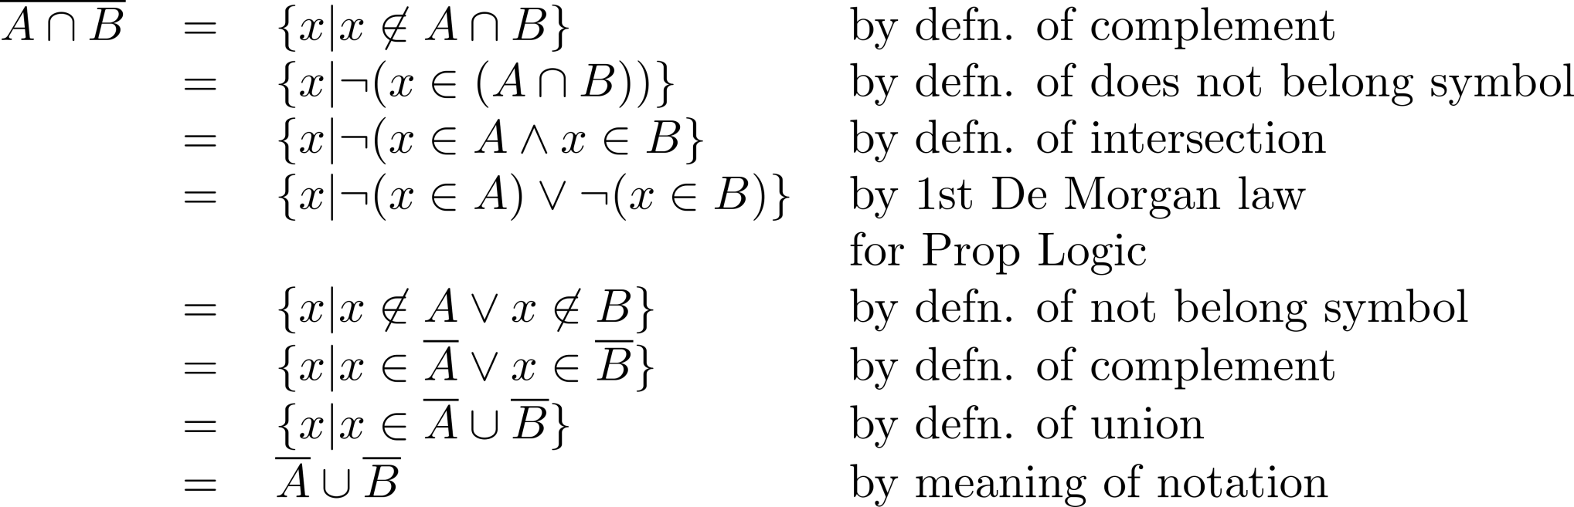
Set-Builder Notation: Second De Morgan Law

Slide 39





Membership Table
Example:
Construct a membership table to show that the distributive law holds.
Solution:
A | B | C
1 | 1 | 1 | 1 | 1 | 1 | 1 | 1
1 | 1 | 0 | 0 | 1 | 1 | 1 | 1
1 | 0 | 1 | 0 | 1 | 1 | 1 | 1
1 | 0 | 0 | 0 | 1 | 1 | 1 | 1
0 | 1 | 1 | 1 | 1 | 1 | 1 | 1
0 | 1 | 0 | 0 | 0 | 1 | 0 | 0
0 | 0 | 1 | 0 | 0 | 0 | 1 | 0
0 | 0 | 0 | 0 | 0 | 0 | 0 | 0

Slide 40
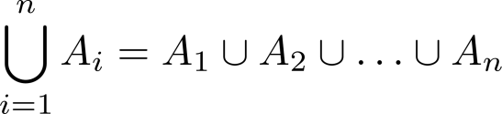
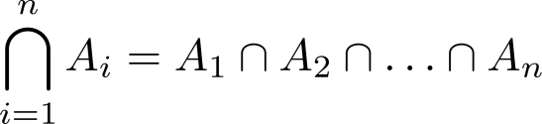
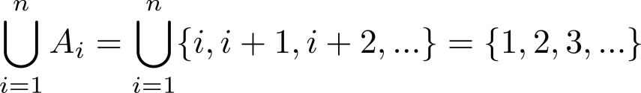
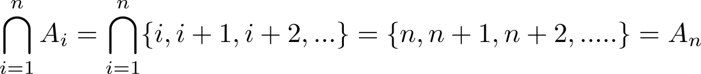
Generalized Unions and Intersections
Let A₁, A₂ ,…, A_{n} be an indexed collection of sets.
We define:
These are well defined, since union and intersection are associative.
For i = 1,2,…, let A_{i} = {i, i + 1, i + 2, ….}. Then,

