Slide 1

Chapter 4
With Question/Answer Animations

Slide 2

Section 4.1

Slide 3
Division
Definition: If a and b are integers with a ≠ 0, then a divides b if there exists an integer c such that b = ac.
  When a divides b we say that a is a factor or divisor of b and that b is a multiple of a.
  The notation a | b denotes that a divides b.
  If a | b, then b/a is an integer.
  If a does not divide b, we write a ∤ b.

Slide 4
Division
Example: Determine whether 3 | 7 and whether 3 | 12.
Solution: 3 ∤ 7 because7/3 is not an integer. 3 | 12 because12/3=4, which is an integer.

Slide 5
Properties of Divisibility
Theorem 1: Let a, b, and c be integers, where a ≠0.
  If a | b and a | c, then a | (b + c);
  If a | b, then a | bc for all integers c;
  If a | b and b | c, then a | c.
  Proof: (i) Suppose a | b and a | c, then it follows that there are integers s and t with b = as and c = at. Hence,
  b + c = as + at = a(s + t). Hence, a | (b + c)
(Exercises 3 and 4 ask for proofs of parts (ii) and (iii).) Corollary: If a, b, and c be integers, where a ≠0, such that a | b and a | c, then a | mb + nc whenever m and n are integers.
Can you show how it follows easily from from (ii) and (i) of Theorem 1?

Slide 6
Division Algorithm
When an integer is divided by a positive integer, there is a quotient and a remainder. This is traditionally called the “Division Algorithm,” but is really a theorem.
Division Algorithm: If a is an integer and d a positive integer, then there are unique integers q and r, with 0 ≤ r < d, such that a = dq + r (proved in Section 5.2).
    d is called the divisor.
    a is called the dividend.
    q is called the quotient.
    r is called the remainder.
Definitions of Functions div and mod
  q = a div d
  r = a mod d

Slide 7
Division Algorithm
Examples:
    What are the quotient and remainder when 101 is divided by 11?
    Solution: The quotient when 101 is divided by 11 is 9 = 101 div 11, and the remainder is 2 = 101 mod 11.
    What are the quotient and remainder when −11 is divided by 3?
    Solution: The quotient when −11 is divided by 3 is −4 = −11 div 3, and the remainder is 1 = −11 mod 3.

Slide 8
Congruence Relation
Definition: If a and b are integers and m is a positive integer, then a is congruent to b modulo m if m divides a – b.
  The notation a ≡ b (mod m) says that a is congruent to b modulo m.
  We say that a ≡ b (mod m) is a congruence and that m is its modulus.
  Two integers are congruent mod m if and only if they have the same remainder when divided by m.
  If a is not congruent to b modulo m, we write
  a ≢ b (mod m)

Slide 9
Congruence Relation
Example: Determine whether 17 is congruent to 5 modulo 6 and whether 24 and 14 are congruent modulo 6.
Solution:
    17 ≡ 5 (mod 6) because 6 divides 17 − 5 = 12.
    24 ≢ 14 (mod 6) since 6 divides 24 − 14 = 10 is not divisible by 6.

Slide 10
More on Congruences
Theorem 4: Let m be a positive integer. The integers a and b are congruent modulo m if and only if there is an integer k such that a = b + km.
Proof:
  If a ≡ b (mod m), then (by the definition of congruence) m | a – b. Hence, there is an integer k such that a – b = km and equivalently a = b + km.
  Conversely, if there is an integer k such that a = b + km, then km = a – b. Hence, m | a – b and a ≡ b (mod m).

Slide 11
The Relationship between (mod m) and mod m Notations
The use of “mod” in a ≡ b (mod m) and a mod m = b are different.
  a ≡ b (mod m) is a relation on the set of integers.
  In a mod m = b, the notation mod denotes a function.
The relationship between these notations is made clear in this theorem.
Theorem 3: Let a and b be integers, and let m be a positive integer. Then a ≡ b (mod m) if and only if a mod m = b mod m. (Proof in the exercises)

Slide 12
Congruences of Sums and Products
Theorem 5: Let m be a positive integer. If a ≡ b (mod m) and c ≡ d (mod m), then
a + c ≡ b + d (mod m) and ac ≡ bd (mod m)
Proof:
  Because a ≡ b (mod m) and c ≡ d (mod m), by Theorem 4 there are integers s and t with b = a + sm and d = c + tm.
  Therefore,
    b + d = (a + sm) + (c + tm) = (a + c) + m(s + t) and
    b d = (a + sm) (c + tm) = ac + m(at + cs + stm).
  Hence, a + c ≡ b + d (mod m) and ac ≡ bd (mod m).
Example: Because 7 ≡ 2 (mod 5) and 11 ≡ 1 (mod 5) , it follows from Theorem 5 that
    18 = 7 + 11 ≡ 2 + 1 = 3 (mod 5)
    77 = 7 11 ≡ 2 + 1 = 3 (mod 5)

Slide 13
Algebraic Manipulation of Congruences
Multiplying both sides of a valid congruence by an integer preserves validity.
  If a ≡ b (mod m) holds then c∙a ≡ c∙b (mod m), where c is any integer, holds by Theorem 5 with d = c.
Adding an integer to both sides of a valid congruence preserves validity.
  If a ≡ b (mod m) holds then c + a ≡ c + b (mod m), where c is any integer, holds by Theorem 5 with d = c.
Dividing a congruence by an integer does not always produce a valid congruence.
Example: The congruence 14≡ 8 (mod 6) holds. But dividing both sides by 2 does not produce a valid congruence since 14/2 = 7 and 8/2 = 4, but 7≢4 (mod 6).
See Section 4.3 for conditions when division is ok.

Slide 14
Computing the mod m Function of Products and Sums
We use the following corollary to Theorem 5 to compute the remainder of the product or sum of two integers when divided by m from the remainders when each is divided by m.
Corollary: Let m be a positive integer and let a and b be integers. Then
(a + b) (mod m) = ((a mod m) + (b mod m)) mod m
and
ab mod m = ((a mod m) (b mod m)) mod m.
(proof in text)

Slide 15
Arithmetic Modulo m
Definitions: Let Z_{m} be the set of nonnegative integers less than m: {0,1, …., m−1}
The operation +_{m} is defined as a +_{m} b = (a + b) mod m. This is addition modulo m.
The operation ∙_{m} is defined as a ∙_{m} b = (a + b) mod m. This is multiplication modulo m.
Using these operations is said to be doing arithmetic modulo m.
Example: Find 7 +₁₁ 9 and 7 ∙₁₁ 9.
Solution: Using the definitions above:
  7 +₁₁ 9 = (7 + 9) mod 11 = 16 mod 11 = 5
  7 ∙₁₁ 9 = (7 ∙ 9) mod 11 = 63 mod 11 = 8

Slide 16
Arithmetic Modulo m
The operations +_{m} and ∙_{m} satisfy many of the same properties of ordinary addition and multiplication of integers.
  Closure: If a and b belong to Z_{m} , then a +_{m} b and a ∙_{m} b belong to Z_{m} .
  Associativity: If a, b, and c belong to Z_{m} , then (a +_{m} b) +_{m} c = a +_{m} (b +_{m} c) and (a ∙_{m} b) ∙_{m} c = a ∙_{m} (b ∙_{m} c).
  Commutativity: If a and b belong to Z_{m} , then a +_{m} b = b +_{m} a and a ∙_{m} b = b ∙_{m} a.
  Identity elements: The elements 0 and 1 are identity elements for addition and multiplication modulo m, respectively.
    If a belongs to Z_{m} , then a +_{m} 0 = a and a ∙_{m} 1 = a.
continued →

Slide 17
Arithmetic Modulo m
  Additive inverses: If a≠ 0 belongs to Z_{m} , then m− a is the additive inverse of a modulo m and 0 is its own additive inverse.
    a +_{m} (m− a ) = 0 and 0 +_{m} 0 = 0
  Distributivity: If a, b, and c belong to Z_{m} , then
    a ．_{m} (b +_{m} c) = (a ． _{m} b) +_{m} (a ． _{m} c) and (a +_{m} b) ． _{m} c = (a ． _{m} c) +_{m} (b ． _{m} c).
Exercises 42-44 ask for proofs of these properties.
Multiplicatative inverses have not been included since they do not always exist. For example, there is no multiplicative inverse of 2 modulo 6.

Slide 18

Section 4.3

Slide 19
Primes
Definition: A positive integer p greater than 1 is called prime if the only positive factors of p are 1 and p. A positive integer that is greater than 1 and is not prime is called composite.
Example: The integer 7 is prime because its only positive factors are 1 and 7, but 9 is composite because it is divisible by 3.

Slide 20
The Fundamental Theorem of Arithmetic
Theorem: Every positive integer greater than 1 can be written uniquely as a prime or as the product of two or more primes where the prime factors are written in order of nondecreasing size.
Examples:
  100 = 2 ∙ 2 ∙ 5 ∙ 5 = 2² ∙ 5²
  641 = 641
  999 = 3 ∙ 3 ∙ 3 ∙ 37 = 3³ ∙ 37
  1024 = 2 ∙ 2 ∙ 2 ∙ 2 ∙ 2 ∙ 2 ∙ 2 ∙ 2 ∙ 2 ∙ 2 = 2¹⁰

Slide 21
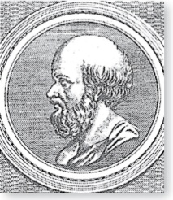
The Sieve of Erastosthenes
Erastothenes
(276-194 B.C.)
The Sieve of Erastosthenes can be used to find all primes not exceeding a specified positive integer. For example, begin with the list of integers between 1 and 100.
  Delete all the integers, other than 2, divisible by 2.
  Delete all the integers, other than 3, divisible by 3.
  Next, delete all the integers, other than 5, divisible by 5.
  Next, delete all the integers, other than 7, divisible by 7.
  Since all the remaining integers are not divisible by any of the previous integers, other than 1, the primes are:
{2,3,5,7,11,13, 17,19,23,29,31,37,41,43,47,53,59,61,67,71,73,79,83,89, 97}
continued →

Slide 22
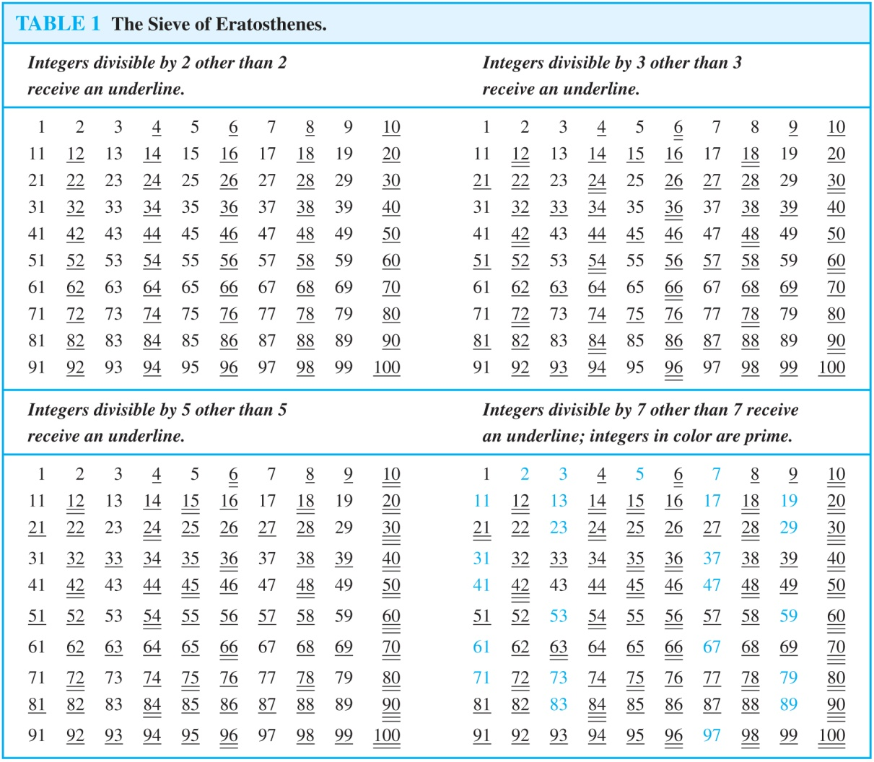
The Sieve of Erastosthenes
If an integer n is a composite integer, then it has a prime divisor less than or equal to √n.
To see this, note that if n = ab, then a ≤ √n or b ≤√n.
Trial division, a very inefficient method of determining if a number n is prime, is to try every integer i ≤√n and see if n is divisible by i.

Slide 23
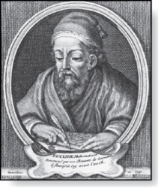
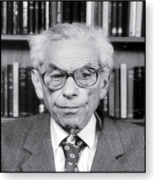
Infinitude of Primes
Euclid
(325 B.C.E. – 265 B.C.E.)
Theorem: There are infinitely many primes. (Euclid)
Proof: Assume finitely many primes: p₁, p₂, ….., p_{n}
  Let Q= p₁p₂∙∙∙ p_{n} + 1
  Either q is prime or by the fundamental theorem of arithmetic it is a product of primes.
    But none of the primes p_{j} divides Q since if p_{j} | Q , then p_{j} divides Q− p₁p₂∙∙∙ p_{n} = 1 .
    Hence, there is a prime not on the list p₁, p₂, ….., p_{n}. It is either q, or if q is composite, it is a prime factor of q. This contradicts the assumption that p₁, p₂, ….., p_{n} are all the primes.
  Consequently, there are infinitely many primes.
This proof was given by Euclid The Elements. The proof is considered to be one of the most beautiful in all mathematics. It is the first proof in The Book, inspired by the famous mathematician Paul Erdős’ imagined collection of perfect proofs maintained by God.
Paul Erdős
(1913-1996)

Slide 24
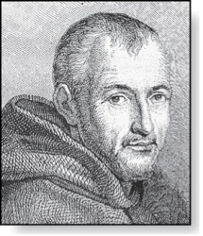
Mersenne Primes
Marin Mersenne
(1588-1648)
Definition: Prime numbers of the form 2^{p} − 1 , where p is prime, are called Mersenne primes.
  2² − 1 = 3, 2³ − 1 = 7, 2⁵ − 1 = 37 , and 2⁷ − 1 = 127 are Mersenne primes.
  2¹¹ − 1 = 2047 is not a Mersenne prime since 2047 = 23∙89.
  There is an efficient test for determining if 2^{p} − 1 is prime.
  The largest known prime numbers are Mersenne primes.
  As of mid 2014, 48 Mersenne primes were known, the largest is 2^{57,885,161} − 1, which has nearly 17 million decimal digits.
  The Great Internet Mersenne Prime Search (GIMPS) is a distributed computing project to search for new Mersenne Primes.
  http://www.mersenne.org/

Slide 25
Distribution of Primes
Mathematicians have been interested in the distribution of prime numbers among the positive integers. In the nineteenth century, the prime number theorem was proved which gives an asymptotic estimate for the number of primes not exceeding x.
Prime Number Theorem: The ratio of the number of primes not exceeding x and x/ln x approaches 1 as x grows without bound. (ln x is the natural logarithm of x)
  The theorem tells us that the number of primes not exceeding x, can be approximated by x/ln x.
  The odds that a randomly selected positive integer less than n is prime are approximately (n/ln n)/n = 1/ln n.

Slide 26
Generating Primes
The problem of generating large primes is of both theoretical and practical interest.
We will see (in Section 4.6) that finding large primes with hundreds of digits is important in cryptography.
So far, no useful closed formula that always produces primes has been found. There is no simple function f(n) such that f(n) is prime for all positive integers n.
But f(n) = n² − n + 41 is prime for all integers 1,2,…, 40. Because of this, we might conjecture that f(n) is prime for all positive integers n. But f(41) = 41² is not prime.
More generally, there is no polynomial with integer coefficients such that f(n) is prime for all positive integers n. (See supplementary Exercise 23.)
Fortunately, we can generate large integers which are almost certainly primes. See Chapter 7.

Slide 27
Conjectures about Primes
Even though primes have been studied extensively for centuries, many conjectures about them are unresolved, including:
Goldbach’s Conjecture: Every even integer n, n > 2, is the sum of two primes. It has been verified by computer for all positive even integers up to 1.6 ．10¹⁸. The conjecture is believed to be true by most mathematicians.
There are infinitely many primes of the form n² + 1, where n is a positive integer. But it has been shown that there are infinitely many primes of the form n² + 1, where n is a positive integer or the product of at most two primes.
The Twin Prime Conjecture: The twin prime conjecture is that there are infinitely many pairs of twin primes. Twin primes are pairs of primes that differ by 2. Examples are 3 and 5, 5 and 7, 11 and 13, etc. The current world’s record for twin primes (as of mid 2011) consists of numbers 65,516,468,355∙23^{33,333} ±1, which have 100,355 decimal digits.

Slide 28
Greatest Common Divisor
Definition: Let a and b be integers, not both zero. The largest integer d such that d | a and also d | b is called the greatest common divisor of a and b. The greatest common divisor of a and b is denoted by gcd(a,b).
One can find greatest common divisors of small numbers by inspection.
Example:What is the greatest common divisor of 24 and 36?
Solution: gcd(24,36) = 12
Example:What is the greatest common divisor of 17 and 22?
Solution: gcd(17,22) = 1

Slide 29
Greatest Common Divisor
Definition: The integers a and b are relatively prime if their greatest common divisor is 1.
Example: 17 and 22 are relatively prime because gcd(17, 22)=1.
Definition: The integers a₁, a₂, …, a_{n} are pairwise relatively prime if gcd(a_{i}, a_{j})= 1 whenever 1 ≤ i<j ≤n.
Example: Determine whether the integers 10, 17 and 21 are pairwise relatively prime.
Solution: Because gcd(10,17) = 1, gcd(10,21) = 1, and gcd(17,21) = 1, 10, 17, and 21 are pairwise relatively prime.
Example: Determine whether the integers 10, 19, and 24 are pairwise relatively prime.
Solution: Because gcd(10,24) = 2>1, so 10, 19, and 24 are not pairwise relatively prime.

Slide 30
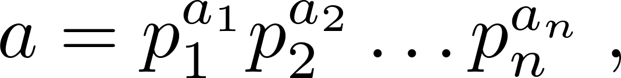
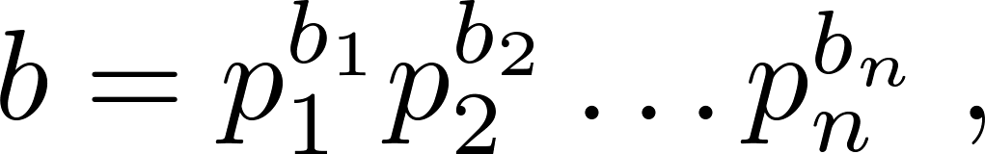
Finding the Greatest Common Divisor Using Prime Factorizations
Suppose the prime factorizations of a and b are:
where each exponent is a nonnegative integer, and where all primes occurring in either prime factorization are included in both. Then:
This formula is valid since the integer on the right (of the equals sign) divides both a and b. No larger integer can divide both a and b.
Example: 120 = 2³ ．3 ． 5 and 500 = 2² ． 5³
gcd(120,500) = 2^{min(3,2)} 3^{min(1,0)} 5^{min(1,3)} = 2² 3⁰ 5¹ = 20
Finding the gcd of two positive integers using their prime factorizations is not efficient because there is no efficient algorithm for finding the prime factorization of a positive integer.

Slide 31
Least Common Multiple
Definition: The least common multiple of the positive integers a and b is the smallest positive integer that is divisible by both a and b. It is denoted by lcm(a,b).
The least common multiple can also be computed from the prime factorizations.
This number is divided by both a and b and no smaller number is divided by a and b.
Example: lcm(2³3⁵7², 2⁴3³) = 2^{max(3,4)} 3^{max(5,3)} 7^{max(2,0)} = 2⁴ 3⁵ 7²
The greatest common divisor and the least common multiple of two integers are related by:
Theorem 5: Let a and b be positive integers. Then
ab = gcd(a,b) ∙lcm(a,b)
(proof is Exercise 31)

Slide 32
Euclidean Algorithm
Euclid
(325 B.C.E. – 265 B.C.E.)
The Euclidian algorithm is an efficient method for computing the greatest common divisor of two integers. It is based on the idea that gcd(a,b) is equal to gcd(a,c) when a > b and c is the remainder when a is divided by b.
Example: Find gcd(91, 287):
    287 = 91 ∙ 3 + 14
    91 = 14 ∙ 6 + 7
    14 = 7 ∙ 2 + 0
  gcd(287, 91) = gcd(91, 14) = gcd(14, 7) = 7
Divide 287 by 91
Divide 91 by 14
Divide 14 by 7
Stopping condition
continued →

Slide 33
Correctness of Euclidean Algorithm
Lemma 1: Let a = bq + r, where a, b, q, and r are integers. Then gcd(a,b) = gcd(b,r).
Proof:
  Suppose that d divides both a and b. Then d also divides a − bq = r (by Theorem 1 of Section 4.1). Hence, any common divisor of a and b must also be any common divisor of b and r.
  Suppose that d divides both b and r. Then d also divides bq + r = a. Hence, any common divisor of a and b must also be a common divisor of b and r.
  Therefore, gcd(a,b) = gcd(b,r).

Slide 34
Correctness of Euclidean Algorithm
r₀ = r₁q₁ + r₂ 0 ≤ r₂ < r₁,
r₁ = r₂q₂ + r₃ 0 ≤ r₃ < r₂,
∙
∙
∙
r_{n-2} = r_{n-1}q_{n-1} + r₂ 0 ≤ r_{n} < r_{n-1},
r_{n-1} = r_{n}q_{n} .
Suppose that a and b are positive
integers with a ≥ b.
Let r₀ = a and r₁ = b.
Successive applications of the division
algorithm yields:
Eventually, a remainder of zero occurs in the sequence of terms: a = r₀ > r₁ > r₂ > · · · ≥ 0. The sequence can’t contain more than a terms.
By Lemma 1
gcd(a,b) = gcd(r₀,r₁) = · · · = gcd(r_{n-1},r_{n}) = gcd(r_{n} , 0) = r_{n}.
Hence the greatest common divisor is the last nonzero remainder in the sequence of divisions.

Slide 35
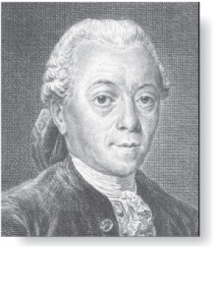
gcds as Linear Combinations
Étienne Bézout
(1730-1783)
Bézout’s Theorem: If a and b are positive integers, then there exist integers s and t such that gcd(a,b) = sa + tb.
(proof in exercises of Section 5.2)
Definition: If a and b are positive integers, then integers s and t such that gcd(a,b) = sa + tb are called Bézout coefficients of a and b. The equation gcd(a,b) = sa + tb is called Bézout’s identity.
By Bézout’s Theorem, the gcd of integers a and b can be expressed in the form sa + tb where s and t are integers. This is a linear combination with integer coefficients of a and b.
  gcd(6,14) = (−2)∙6 + 1∙14

Slide 36
Finding gcds as Linear Combinations
Example: Express gcd(252,198) = 18 as a linear combination of 252 and 198.
Solution: First use the Euclidean algorithm to show gcd(252,198) = 18
    252 = 1∙198 + 54
    198 = 3 ∙54 + 36
    54 = 1 ∙36 + 18
    36 = 2 ∙18
  Now working backwards, from iii and i above
    18 = 54 − 1 ∙36
    36 = 198 − 3 ∙54
  Substituting the 2nd equation into the 1st yields:
    18 = 54 − 1 ∙(198 − 3 ∙54 )= 4 ∙54 − 1 ∙198
  Substituting 54 = 252 − 1 ∙198 (from i)) yields:
    18 = 4 ∙(252 − 1 ∙198) − 1 ∙198 = 4 ∙252 − 5 ∙198
continued →

Slide 37
Finding gcds as Linear Combinations
This method illustrated above is a two pass method. It first uses the Euclidian algorithm to find the gcd and then works backwards to express the gcd as a linear combination of the original two integers. A one pass method, called the extended Euclidean algorithm, is developed in the exercises.

Slide 38
Consequences of Bézout’s Theorem
Lemma 2: If a, b, and c are positive integers such that gcd(a, b) = 1 and a | bc, then a | c.
Proof: Assume gcd(a, b) = 1 and a | bc
  Since gcd(a, b) = 1, by Bézout’s Theorem there are integers s and t such that
  sa + tb = 1.
  Multiplying both sides of the equation by c, yields sac + tbc = c.
  From Theorem 1 of Section 4.1:
    a | tbc (part ii) and a divides sac + tbc since a | sac and a|tbc (part i)
  We conclude a | c, since sac + tbc = c.

Slide 39
Consequences of Bézout’s Theorem
Lemma 3: If p is prime and p | a₁a₂∙∙∙a_{n}, then p | a_{i} for some i.
(proof uses mathematical induction; see Exercise 64 of Section 5.1)
Lemma 3 is crucial in the proof of the uniqueness of prime factorizations.

Slide 40


Uniqueness of Prime Factorization
We will prove that a prime factorization of a positive integer where the primes are in nondecreasing order is unique. (This part of the fundamental theorem of arithmetic. The other part, which asserts that every positive integer has a prime factorization into primes, will be proved in Section 5.2.)
Proof: (by contradiction) Suppose that the positive integer n can be written as a product of primes in two distinct ways:
n = p₁p₂ ∙∙∙ p_{s} and n = q₁q₂ ∙∙∙ p_{t}.
  Remove all common primes from the factorizations to get
  By Lemma 3, it follows that divides , for some k, contradicting the assumption that and are distinct primes.
  Hence, there can be at most one factorization of n into primes in nondecreasing order.

Slide 41
Dividing Congruences by an Integer
Dividing both sides of a valid congruence by an integer does not always produce a valid congruence (see Section 4.1).
But dividing by an integer relatively prime to the modulus does produce a valid congruence:
Theorem 7: Let m be a positive integer and let a, b, and c be integers. If ac ≡ bc (mod m) and gcd(c,m) = 1, then a ≡ b (mod m).
Proof: Since ac ≡ bc (mod m), m | ac − bc = c(a − b) by Lemma 2 and the fact that gcd(c,m) = 1, it follows that m | a − b. Hence, a ≡ b (mod m).

Slide 42

Section 4.4

Slide 43
Linear Congruences
Definition: A congruence of the form
ax ≡ b( mod m),
where m is a positive integer, a and b are integers, and x is a variable, is called a linear congruence.
The solutions to a linear congruence ax≡ b( mod m) are all integers x that satisfy the congruence.
Definition: An integer ā such that āa ≡ 1( mod m) is said to be an inverse of a modulo m.
Example: 5 is an inverse of 3 modulo 7 since 5∙3 = 15 ≡ 1(mod 7)
One method of solving linear congruences makes use of an inverse ā, if it exists. Although we can not divide both sides of the congruence by a, we can multiply by ā to solve for x.

Slide 44
Inverse of a modulo m
The following theorem guarantees that an inverse of a modulo m exists whenever a and m are relatively prime. Two integers a and b are relatively prime when gcd(a,b) = 1.
Theorem 1: If a and m are relatively prime integers and m > 1, then an inverse of a modulo m exists. Furthermore, this inverse is unique modulo m. (This means that there is a unique positive integer ā less than m that is an inverse of a modulo m and every other inverse of a modulo m is congruent to ā modulo m.)
Proof: Since gcd(a,m) = 1, by Theorem 6 of Section 4.3, there are integers s and t such that sa + tm = 1.
  Hence, sa + tm ≡ 1 ( mod m).
  Since tm ≡ 0 ( mod m), it follows that sa ≡ 1 ( mod m)
  Consequently, s is an inverse of a modulo m.
  The uniqueness of the inverse is Exercise 7.

Slide 45
Finding Inverses
The Euclidean algorithm and Bézout coefficients gives us a systematic approaches to finding inverses.
Example: Find an inverse of 3 modulo 7.
Solution: Because gcd(3,7) = 1, by Theorem 1, an inverse of 3 modulo 7 exists.
  Using the Euclidian algorithm: 7 = 2∙3 + 1.
  From this equation, we get −2∙3 + 1∙7 = 1, and see that −2 and 1 are Bézout coefficients of 3 and 7.
  Hence, −2 is an inverse of 3 modulo 7.
  Also every integer congruent to −2 modulo 7 is an inverse of 3 modulo 7, i.e., 5, −9, 12, etc.

Slide 46
Finding Inverses
Example: Find an inverse of 101 modulo 4620.
Solution: First use the Euclidian algorithm to show that gcd(101,4620) = 1.
Working Backwards:
  4620 = 45∙101 + 75
  101 = 1∙75 + 26
  75 = 2∙26 + 23
  26 = 1∙23 + 3
  23 = 7∙3 + 2
  3 = 1∙2 + 1
  2 = 2∙1
  1 = 3 − 1∙2
  1 = 3 − 1∙(23 − 7∙3) = − 1 ∙23 + 8∙3
  1 = −1∙23 + 8∙(26 − 1∙23) = 8∙26 − 9 ∙23
  1 = 8∙26 − 9 ∙(75 − 2∙26 )= 26∙26 − 9 ∙75
  1 = 26∙(101 − 1∙75) − 9 ∙75
  = 26∙101 − 35 ∙75
  1 = 26∙101 − 35 ∙(4620 − 45∙101)
  = − 35 ∙4620 + 1601∙101
Since the last nonzero
remainder is 1,
gcd(101,4260) = 1
1601 is an inverse of 101 modulo 4620
Bézout coefficients : − 35 and 1601

Slide 47
Using Inverses to Solve Congruences
We can solve the congruence ax≡ b( mod m) by multiplying both sides by ā.
Example: What are the solutions of the congruence 3x≡ 4( mod 7).
Solution: We found that −2 is an inverse of 3 modulo 7 (two slides back). We multiply both sides of the congruence by −2 giving
−2 ∙ 3x ≡ −2 ∙ 4(mod 7).
Because −6 ≡ 1 (mod 7) and −8 ≡ 6 (mod 7), it follows that if x is a solution, then x ≡ −8 ≡ 6 (mod 7)
We need to determine if every x with x ≡ 6 (mod 7) is a solution. Assume that x ≡ 6 (mod 7). By Theorem 5 of Section 4.1, it follows that 3x ≡ 3 ∙ 6 = 18 ≡ 4( mod 7) which shows that all such x satisfy the congruence.
The solutions are the integers x such that x ≡ 6 (mod 7), namely, 6,13,20 … and −1, − 8, − 15,…

Slide 48
The Chinese Remainder Theorem
In the first century, the Chinese mathematician Sun-Tsu asked:
  There are certain things whose number is unknown. When divided by 3, the remainder is 2; when divided by 5, the remainder is 3; when divided by 7, the remainder is 2. What will be the number of things?
This puzzle can be translated into the solution of the system of congruences:
  x ≡ 2 ( mod 3),
  x ≡ 3 ( mod 5),
  x ≡ 2 ( mod 7)?
We’ll see how the theorem that is known as the Chinese Remainder Theorem can be used to solve Sun-Tsu’s problem.

Slide 49
The Chinese Remainder Theorem
Theorem 2: (The Chinese Remainder Theorem) Let m₁,m₂,…,m_{n} be pairwise relatively prime positive integers greater than one and a₁,a₂,…,a_{n} arbitrary integers. Then the system
  x ≡ a₁ ( mod m₁)
  x ≡ a₂ ( mod m₂)
  ∙
  ∙
  ∙
  x ≡ a_{n} ( mod m_{n})
has a unique solution modulo m = m₁m₂ ∙ ∙ ∙ m_{n}.
(That is, there is a solution x with 0 ≤ x <m and all other solutions are congruent modulo m to this solution.)
Proof: We’ll show that a solution exists by describing a way to construct the solution. Showing that the solution is unique modulo m is Exercise 30.
continued →

Slide 50
The Chinese Remainder Theorem
To construct a solution first let M_{k}=m/m_{k} for k = 1,2,…,n and m = m₁m₂ ∙ ∙ ∙ m_{n}.
Since gcd(m_{k} ,M_{k} ) = 1, by Theorem 1, there is an integer y_{k} , an inverse of M_{k} modulo m_{k}, such that
  M_{k} y_{k} ≡ 1 ( mod m_{k} ).
  Form the sum
  x = a₁ M₁ y₁ + a₂ M₂ y₂ + ∙ ∙ ∙ + a_{n} M_{n} y_{n} .
  Note that because M_{j} ≡ 0 ( mod m_{k}) whenever j ≠k , all terms except the kth term in this sum are congruent to 0 modulo m_{k} .
  Because M_{k} y_{k} ≡ 1 ( mod m_{k} ), we see that x ≡ a_{k} M_{k} y_{k} ≡ a_{k}( mod m_{k}), for k = 1,2,…,n.
  Hence, x is a simultaneous solution to the n congruences.
  x ≡ a₁ ( mod m₁)
  x ≡ a₂ ( mod m₂)
  ∙
  ∙
  ∙
  x ≡ a_{n} ( mod m_{n})

Slide 51
The Chinese Remainder Theorem
Example: Consider the 3 congruences from Sun-Tsu’s problem:
x ≡ 2 ( mod 3), x ≡ 3 ( mod 5), x ≡ 2 ( mod 7).
  Let m = 3∙ 5 ∙ 7 = 105, M₁ = m/3 = 35, M₃ = m/5 = 21, M₃ = m/7 = 15.
  We see that
    2 is an inverse of M₁ = 35 modulo 3 since 35 ∙ 2 ≡ 2 ∙ 2 ≡ 1 (mod 3)
    1 is an inverse of M₂ = 21 modulo 5 since 21 ≡ 1 (mod 5)
    1 is an inverse of M₃ = 15 modulo 7 since 15 ≡ 1 (mod 7)
  Hence,
  x = a₁M₁y₁ + a₂M₂y₂ + a₃M₃y₃
  = 2 ∙ 35 ∙ 2 + 3 ∙ 21 ∙ 1 + 2 ∙ 15 ∙ 1 = 233 ≡ 23 (mod 105)
  We have shown that 23 is the smallest positive integer that is a simultaneous solution. Check it!

Slide 52
Back Substitution
We can also solve systems of linear congruences with pairwise relatively prime moduli by rewriting a congruences as an equality using Theorem 4 in Section 4.1, substituting the value for the variable into another congruence, and continuing the process until we have worked through all the congruences. This method is known as back substitution.
Example: Use the method of back substitution to find all integers x such that x ≡ 1 (mod 5), x ≡ 2 (mod 6), and x ≡ 3 (mod 7).

Slide 53
Back Substitution
Solution: By Theorem 4 in Section 4.1, the first congruence can be rewritten as x = 5t +1, where t is an integer.
  Substituting into the second congruence yields 5t +1 ≡ 2 (mod 6).
  Solving this tells us that t ≡ 5 (mod 6).
  Using Theorem 4 again gives t = 6u + 5 where u is an integer.
  Substituting this back into x = 5t +1, gives x = 5(6u + 5) +1 = 30u + 26.
  Inserting this into the third equation gives 30u + 26 ≡ 3 (mod 7).
  Solving this congruence tells us that u ≡ 6 (mod 7).
  By Theorem 4, u = 7v + 6, where v is an integer.
  Substituting this expression for u into x = 30u + 26, tells us that x = 30(7v + 6) + 26 = 210u + 206.
Translating this back into a congruence we find the solution x ≡ 206 (mod 210).

Slide 54
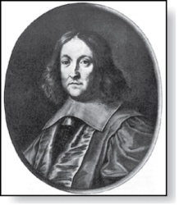
Fermat’s Little Theorem
Pierre de Fermat
(1601-1665)
Theorem 3: (Fermat’s Little Theorem) If p is prime and a is an integer not divisible by p, then a^{p-1} ≡ 1 (mod p)
Furthermore, for every integer a we have a^{p} ≡ a (mod p)
(proof outlined in Exercise 19)
Fermat’s little theorem is useful in computing the remainders modulo p of large powers of integers.
Example: Find 7²²² mod 11.
By Fermat’s little theorem, we know that 7¹⁰ ≡ 1 (mod 11), and so (7¹⁰ )^{k} ≡ 1 (mod 11), for every positive integer k. Therefore,
7²²² = 7^{22∙10 + 2} = (7¹⁰)²²7² ≡ (1)²² ∙49 ≡ 5 (mod 11).
Hence, 7²²² mod 11 = 5.

Slide 55
Pseudoprimes
By Fermat’s little theorem n > 2 is prime, where
2^{n-1} ≡ 1 (mod n).
But if this congruence holds, n may not be prime.
Composite integers n such that 2^{n-1} ≡ 1 (mod n) are called pseudoprimes to the base 2.
Example: The integer 341 is a pseudoprime to the base 2.
  341 = 11 ∙ 31
  2³⁴⁰ ≡ 1 (mod 341) (see in Exercise 37)
We can replace 2 by any integer b ≥ 2.
Definition: Let b be a positive integer. If n is a composite integer, and b^{n-1} ≡ 1 (mod n), then n is called a pseudoprime to the base b.

Slide 56
Pseudoprimes
Given a positive integer n, such that 2^{n-1} ≡ 1 (mod n):
  If n does not satisfy the congruence, it is composite.
  If n does satisfy the congruence, it is either prime or a pseudoprime to the base 2.
Doing similar tests with additional bases b, provides more evidence as to whether n is prime.
Among the positive integers not exceeding a positive real number x, compared to primes, there are relatively few pseudoprimes to the base b.
  For example, among the positive integers less than 10¹⁰ there are 455,052,512 primes, but only 14,884 pseudoprimes to the base 2.

