Slide 1

Chapter 6
With Question/Answer Animations

Slide 2

Section 6.1

Slide 3
The Product Rule
The Product Rule: A procedure can be broken down into a sequence of two tasks. There are n₁ ways to do the first task and n₂ ways to do the second task. Then there are n₁∙n₂ ways to do the procedure.
Example: How many bit strings of length seven are there?
Solution: Since each of the seven bits is either a 0 or a 1, the answer is 2⁷ = 128.

Slide 4
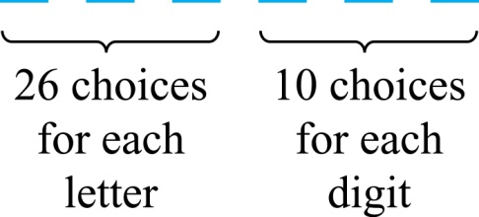
The Product Rule
Example: How many different license plates can be made if each plate contains a sequence of three uppercase English letters followed by three digits?
Solution: By the product rule,
there are 26 ∙ 26 ∙ 26 ∙ 10 ∙ 10 ∙ 10 = 17,576,000 different possible license plates.

Slide 5
Counting Functions
Counting Functions: How many functions are there from a set with m elements to a set with n elements?
Solution: Since a function represents a choice of one of the n elements of the codomain for each of the m elements in the domain, the product rule tells us that there are n ∙ n ∙ ∙ ∙ n = n^{m} such functions.
Counting One-to-One Functions: How many one-to-one functions are there from a set with m elements to one with n elements?
Solution: Suppose the elements in the domain are a₁, a₂,…, a_{m}. There are n ways to choose the value of a₁ and n−1 ways to choose a₂, etc. The product rule tells us that there are n(n−1) (n−2)∙∙∙(n−m +1) such functions.

Slide 6
Counting Subsets of a Finite Set
Counting Subsets of a Finite Set: Use the product rule to show that the number of different subsets of a finite set S is 2^{|S|}. (In Section 5.1, mathematical induction was used to prove this same result.)
Solution: When the elements of S are listed in an arbitrary order, there is a one-to-one correspondence between subsets of S and bit strings of length |S|. When the ith element is in the subset, the bit string has a 1 in the ith position and a 0 otherwise.
By the product rule, there are 2^{|S|} such bit strings, and therefore 2^{|S|} subsets.

Slide 7
The Sum Rule
The Sum Rule: If a task can be done either in one of n₁ ways or in one of n₂ ways to do the second task, where none of the set of n₁ ways is the same as any of the n₂ ways, then there are n₁ + n₂ ways to do the task.
Example: The mathematics department must choose either a student or a faculty member as a representative for a university committee. How many choices are there for this representative if there are 37 members of the mathematics faculty and 83 mathematics majors and no one is both a faculty member and a student.
Solution: By the sum rule it follows that there are 37 + 83 = 120 possible ways to pick a representative.

Slide 8
Combining the Sum and Product Rule
Example: Suppose statement labels in a programming language can be either a single letter or a letter followed by a digit. Find the number of possible labels.
Solution: Use the product rule.
26 + 26 ∙ 10 = 286

Slide 9

Subtraction Rule
Subtraction Rule: If a task can be done either in one of n₁ ways or in one of n₂ ways, then the total number of ways to do the task is n₁ + n₂ minus the number of ways to do the task that are common to the two different ways.
Also known as, the principle of inclusion-exclusion:
or expressed as

Slide 10
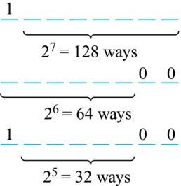
Counting Bit Strings
Example: How many bit strings of length eight either start with a 1 bit or end with the two bits 00?
Solution: Use the subtraction rule.
  Number of bit strings of length eight that start with a 1 bit: 2⁷ = 128
  Number of bit strings of length eight that start with bits 00: 2⁶ = 64
  Number of bit strings of length eight that start with a 1 bit and end with bits 00 : 2⁵ = 32
Hence, the number is 128 + 64 − 32 = 160.

Slide 11

Section 6.2

Slide 12
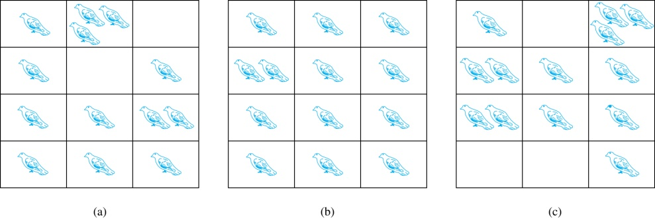
The Pigeonhole Principle
If a flock of 20 pigeons roosts in a set of 19 pigeonholes, one of the pigeonholes must have more than 1 pigeon.
Pigeonhole Principle: If k is a positive integer and k + 1 objects are placed into k boxes, then at least one box contains two or more objects.
Proof: We use a proof by contraposition. Suppose none of the k boxes has more than one object. Then the total number of objects would be at most k. This contradicts the statement that we have k + 1 objects.
Example: Among any group of 367 people, there must be at least two with the same birthday, because there are only 366 possible birthdays.

Slide 13
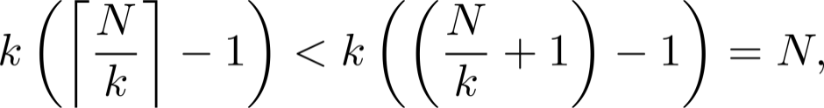
The Generalized Pigeonhole Principle
The Generalized Pigeonhole Principle: If N objects are placed into k boxes, then there is at least one box containing at least ⌈N/k⌉ objects.
Proof: We use a proof by contraposition. Suppose that none of the boxes contains more than ⌈N/k⌉ − 1 objects. Then the total number of objects is at most
where the inequality ⌈N/k⌉ < ⌈N/k⌉ + 1 has been used. This is a contradiction because there are a total of n objects.
Example: Among 100 people there are at least ⌈100/12⌉ = 9 who were born in the same month.

Slide 14
The Generalized Pigeonhole Principle
Example: a) How many cards must be selected from a standard deck of 52 cards to guarantee that at least three cards of the same suit are chosen?
b) How many must be selected to guarantee that at least three hearts are selected?
Solution: a) We assume four boxes; one for each suit. Using the generalized pigeonhole principle, at least one box contains at least ⌈N/4⌉ cards. At least three cards of one suit are selected if ⌈N/4⌉ ≥3. The smallest integer N such that ⌈N/4⌉ ≥3 is N = 2 ∙ 4 + 1 = 9.
b) A deck contains 13 hearts and 39 cards which are not hearts. So, if we select 41 cards, we may have 39 cards which are not hearts along with 2 hearts. However, when we select 42 cards, we must have at least three hearts. (Note that the generalized pigeonhole principle is not used here.)

Slide 15

Section 6.3

Slide 16
Permutations
Definition: A permutation of a set of distinct objects is an ordered arrangement of these objects. An ordered arrangement of r elements of a set is called an r-permuation.
Example: Let S = {1,2,3}.
  The ordered arrangement 3,1,2 is a permutation of S.
  The ordered arrangement 3,2 is a 2-permutation of S.
The number of r-permuatations of a set with n elements is denoted by P(n,r).
  The 2-permutations of S = {1,2,3} are 1,2; 1,3; 2,1; 2,3; 3,1; and 3,2. Hence, P(3,2) = 6.

Slide 17
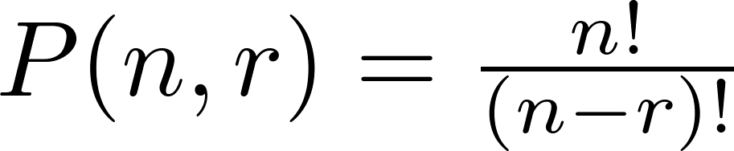
A Formula for the Number of Permutations
Theorem 1: If n is a positive integer and r is an integer with 1 ≤ r ≤ n, then there are
P(n, r) = n(n − 1)(n − 2) ∙∙∙ (n − r + 1)
r-permutations of a set with n distinct elements.
Proof: Use the product rule. The first element can be chosen in n ways. The second in n − 1 ways, and so on until there are (n − ( r − 1)) ways to choose the last element.
Note that P(n,0) = 1, since there is only one way to order zero elements.
Corollary 1: If n and r are integers with 1 ≤ r ≤ n, then

Slide 18
Solving Counting Problems by Counting Permutations
Example: How many ways are there to select a first-prize winner, a second prize winner, and a third-prize winner from 100 different people who have entered a contest?
Solution:
P(100,3) = 100 ∙ 99 ∙ 98 = 970,200

Slide 19
Solving Counting Problems by Counting Permutations (cont.)
Example: Suppose that a saleswoman has to visit eight different cities. She must begin her trip in a specified city, but she can visit the other seven cities in any order she wishes. How many possible orders can the saleswoman use when visiting these cities?
Solution: The first city is chosen, and the rest are ordered arbitrarily. Hence the orders are:
7! = 7 ∙ 6 ∙ 5 ∙ 4 ∙ 3 ∙ 2 ∙ 1 = 5040
If she wants to find the tour with the shortest path that visits all the cities, she must consider 5040 paths!

Slide 20
Solving Counting Problems by Counting Permutations (cont.)
Example: How many permutations of the letters ABCDEFGH contain the string ABC ?
Solution: We solve this problem by counting the permutations of six objects, ABC, D, E, F, G, and H.
6! = 6 ∙ 5 ∙ 4 ∙ 3 ∙ 2 ∙ 1 = 720

Slide 21

Combinations
Definition: An r-combination of elements of a set is an unordered selection of r elements from the set. Thus, an r-combination is simply a subset of the set with r elements.
The number of r-combinations of a set with n distinct elements is denoted by C(n, r). The notation is also used and is called a binomial coefficient. (We will see the notation again in the binomial theorem in Section 6.4.)
Example: Let S be the set {a, b, c, d}. Then {a, c, d} is a 3-combination from S. It is the same as {d, c, a} since the order listed does not matter.
C(4,2) = 6 because the 2-combinations of {a, b, c, d} are the six subsets {a, b}, {a, c}, {a, d}, {b, c}, {b, d}, and {c, d}.

Slide 22
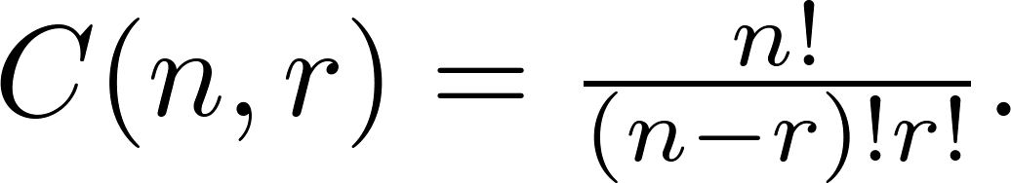
Combinations
Theorem 2: The number of r-combinations of a set with n elements, where n ≥ r ≥ 0, equals
Proof: By the product rule P(n, r) = C(n,r) ∙ P(r,r). Therefore,

Slide 23
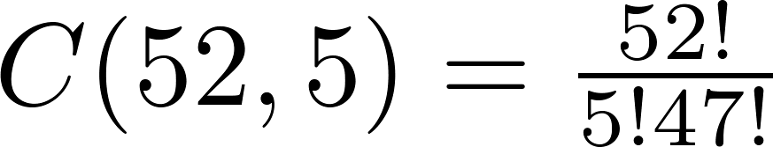
Combinations
Example: How many poker hands of five cards can be dealt from a standard deck of 52 cards? Also, how many ways are there to select 47 cards from a deck of 52 cards?
Solution: Since the order in which the cards are dealt does not matter, the number of five card hands is:
The different ways to select 47 cards from 52 is
This is a special case of a general result. →

Slide 24
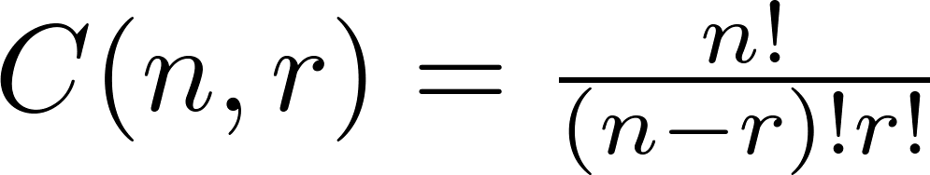
Combinations
Corollary 2: Let n and r be nonnegative integers with r ≤ n. Then C(n, r) = C(n, n − r).
Proof: From Theorem 2, it follows that
and
Hence, C(n, r) = C(n, n − r).
This result can be proved without using algebraic manipulation. →

Slide 25
Combinatorial Proofs
Definition 1: A combinatorial proof of an identity is a proof that uses one of the following methods.
  A double counting proof uses counting arguments to prove that both sides of an identity count the same objects, but in different ways.
  A bijective proof shows that there is a bijection between the sets of objects counted by the two sides of the identity.

Slide 26

Combinatorial Proofs
Here are two combinatorial proofs that
C(n, r) = C(n, n − r)
when r and n are nonnegative integers with r < n:
  Bijective Proof: Suppose that S is a set with n elements. The function that maps a subset A of S to is a bijection between the subsets of S with r elements and the subsets with n − r elements. Since there is a bijection between the two sets, they must have the same number of elements.
  Double Counting Proof: By definition the number of subsets of S with r elements is C(n, r). Each subset A of S can also be described by specifying which elements are not in A, i.e., those which are in . Since the complement of a subset of S with r elements has n − r elements, there are also C(n, n − r) subsets of S with r elements.

Slide 27
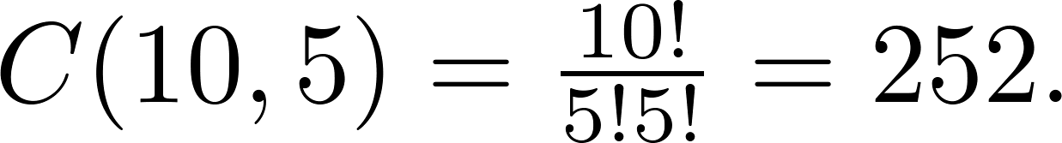
Combinations
Example: How many ways are there to select five players from a 10-member tennis team to make a trip to a match at another school.
Solution: By Theorem 2, the number of combinations is
Example: A group of 30 people have been trained as astronauts to go on the first mission to Mars. How many ways are there to select a crew of six people to go on this mission?
Solution: By Theorem 2, the number of possible crews is

Slide 28

Section 6.4

Slide 29


Powers of Binomial Expressions
Definition: A binomial expression is the sum of two terms, such as x + y. (More generally, these terms can be products of constants and variables.)
We can use counting principles to find the coefficients in the expansion of (x + y)^{n} where n is a positive integer.
To illustrate this idea, we first look at the process of expanding (x + y)³.
(x + y) (x + y) (x + y) expands into a sum of terms that are the product of a term from each of the three sums.
Terms of the form x³, x²y, x y², y³ arise. The question is what are the coefficients?
  To obtain x³ , an x must be chosen from each of the sums. There is only one way to do this. So, the coefficient of x³ is 1.
  To obtain x²y, an x must be chosen from two of the sums and a y from the other. There are ways to do this and so the coefficient of x²y is 3.
  To obtain xy², an x must be chosen from of the sums and a y from the other two . There are ways to do this and so the coefficient of xy² is 3.
  To obtain y³ , a y must be chosen from each of the sums. There is only one way to do this. So, the coefficient of y³ is 1.
We have used a counting argument to show that (x + y)³ = x³ + 3x²y + 3x y² + y³ .
Next we present the binomial theorem gives the coefficients of the terms in the expansion of (x + y)^{n} .

Slide 30


Binomial Theorem
Binomial Theorem: Let x and y be variables, and n a nonnegative integer. Then:
Proof: We use combinatorial reasoning . The terms in the expansion of (x + y)^{n} are of the form x^{n−j}y^{j} for j = 0,1,2,…,n. To form the term x^{n−j}y^{j}, it is necessary to choose n−j xs from the n sums. Therefore, the coefficient of x^{n−j}y^{j} is which equals .

Slide 31
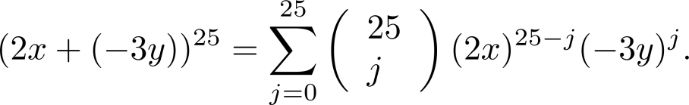
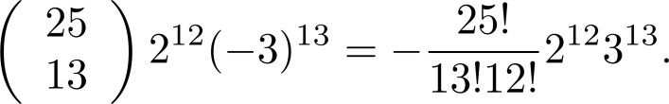
Using the Binomial Theorem
Example: What is the coefficient of x¹²y¹³ in the expansion of (2x − 3y)²⁵?
Solution: We view the expression as (2x +(−3y))²⁵. By the binomial theorem
Consequently, the coefficient of x¹²y¹³ in the expansion is obtained when j = 13.

Slide 32
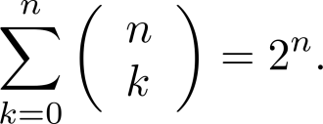
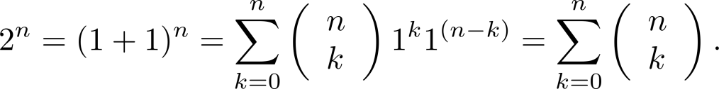




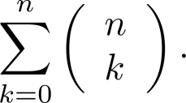
A Useful Identity
Corollary 1: With n ≥0,
Proof (using binomial theorem): With x = 1 and y = 1, from the binomial theorem we see that:
Proof (combinatorial): Consider the subsets of a set with n elements. There are subsets with zero elements, with one element, with two elements, …, and with n elements. Therefore the total is
Since, we know that a set with n elements has 2^{n} subsets, we conclude:

Slide 33
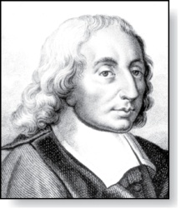
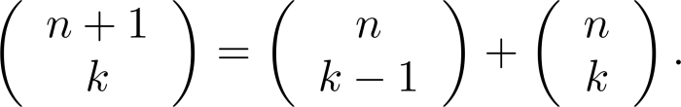



Pascal’s Identity
Blaise Pascal
(1623-1662)
Pascal’s Identity: If n and k are integers with n ≥ k ≥ 0, then
Proof (combinatorial): Let T be a set where |T| = n + 1, a ∊T, and S = T − {a}. There are subsets of T containing k elements. Each of these subsets either:
  contains a with k − 1 other elements, or
  contains k elements of S and not a.
There are
  subsets of k elements of T that contain a, since there are subsets of k − 1 elements of S,
  subsets of k elements of T that do not contain a, because there are subsets of k elements of S.
Hence,
See Exercise 11 for an algebraic proof.

Slide 34
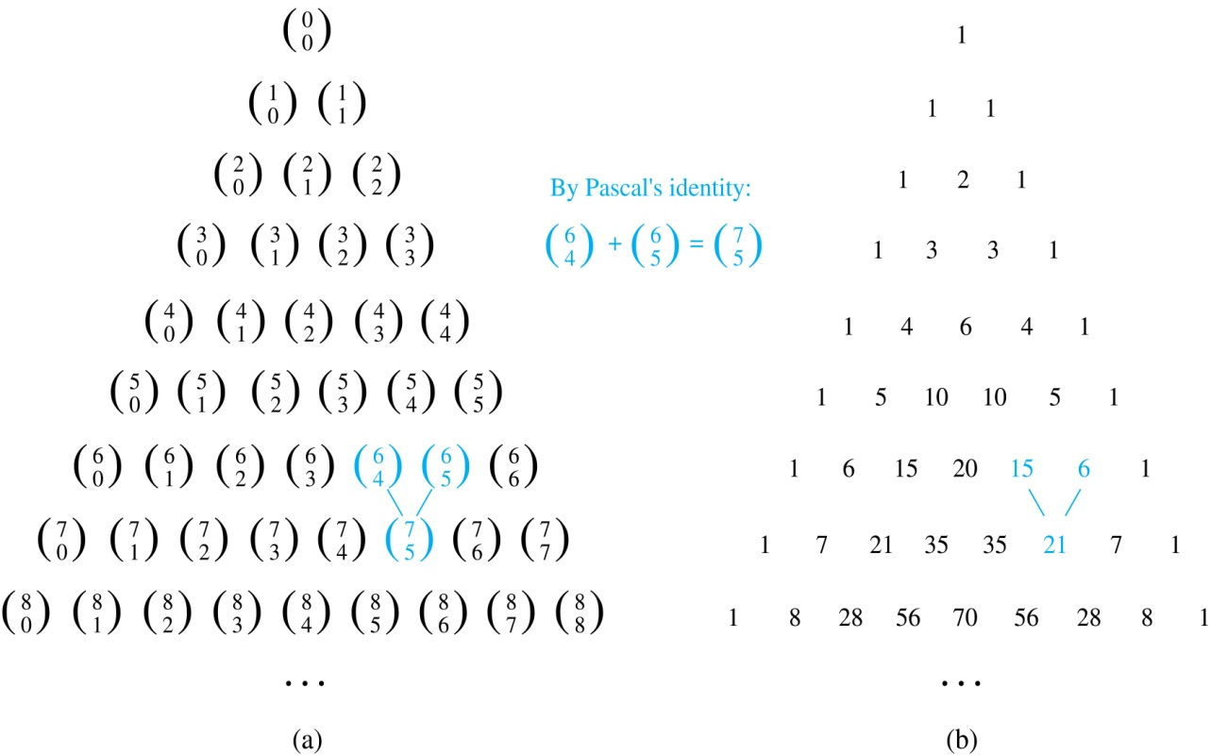
Pascal’s Triangle
The nth row in the triangle consists of the binomial coefficients ,
k = 0,1,….,n.
By Pascal’s identity, adding two adjacent bionomial coefficients results is the binomial coefficient in the next row between these two coefficients.

Slide 35

Section 6.5

Slide 36
Permutations with Repetition
Theorem 1: The number of r-permutations of a set of n objects with repetition allowed is n^{r}.
Proof: There are n ways to select an element of the set for each of the r positions in the r-permutation when repetition is allowed. Hence, by the product rule there are n^{r} r-permutations with repetition.
Example: How many strings of length r can be formed from the uppercase letters of the English alphabet?
Solution: The number of such strings is 26^{r}, which is the number of r-permutations of a set with 26 elements.

Slide 37
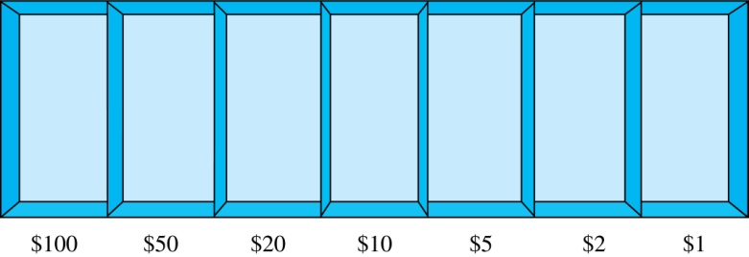
Combinations with Repetition
Example: How many ways are there to select five bills from a box containing at least five of each of the following denominations: $1, $2, $5, $10, $20, $50, and $100?
Solution: Place the selected bills in the appropriate position of a cash box illustrated below:
continued →

Slide 38
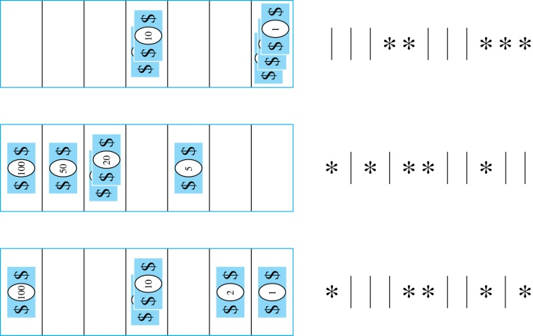

Combinations with Repetition
Some possible ways of
placing the five bills:
The number of ways to select five bills corresponds to the number of ways to arrange six bars and five stars in a row.
This is the number of unordered selections of 5 objects from a set of 11. Hence, there are
ways to choose five bills with seven types of bills.

Slide 39
Combinations with Repetition
Theorem 2: The number 0f r-combinations from a set with n elements when repetition of elements is allowed is
C(n + r – 1,r) = C(n + r – 1, n –1).
Proof: Each r-combination of a set with n elements with repetition allowed can be represented by a list of n –1 bars and r stars. The bars mark the n cells containing a star for each time the ith element of the set occurs in the combination.
The number of such lists is C(n + r – 1, r), because each list is a choice of the r positions to place the stars, from the total of n + r – 1 positions to place the stars and the bars. This is also equal to C(n + r – 1, n –1), which is the number of ways to place the n –1 bars.

Slide 40

Combinations with Repetition
Example: Suppose that a cookie shop has four different kinds of cookies. How many different ways can six cookies be chosen?
Solution: The number of ways to choose six cookies is the number of 6-combinations of a set with four elements. By Theorem 2
is the number of ways to choose six cookies from the four kinds.

Slide 41
Combinations with Repetition
Example: How many solutions does the equation
x₁ + x₂ + x₃ = 11
have, where x₁ , x₂ and x₃ are nonnegative integers?
Solution: Each solution corresponds to a way to select 11 items from a set with three elements; x₁ elements of type one, x₂ of type two, and x₃ of type three.
By Theorem 2 it follows that there are
solutions.

Slide 42
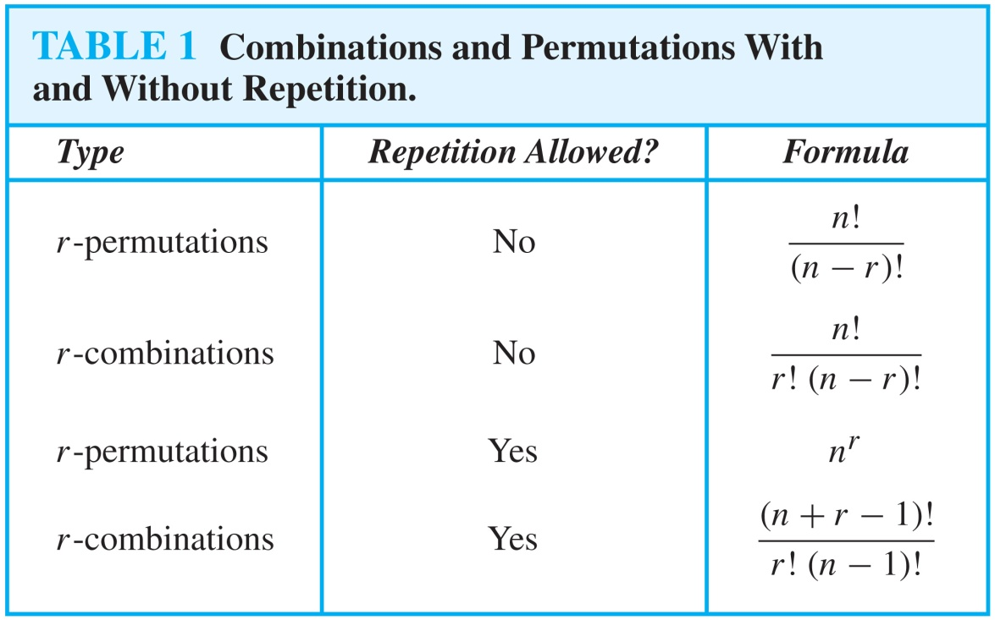
Summarizing the Formulas for Counting Permutations and Combinations with and without Repetition

Slide 43
Permutations with Indistinguishable Objects
Example: How many different strings can be made by reordering the letters of the word SUCCESS.
Solution: There are seven possible positions for the three Ss, two Cs, one U, and one E.
  The three Ss can be placed in C(7,3) different ways, leaving four positions free.
  The two Cs can be placed in C(4,2) different ways, leaving two positions free.
  The U can be placed in C(2,1) different ways, leaving one position free.
  The E can be placed in C(1,1) way.
By the product rule, the number of different strings is:
The reasoning can be generalized to the following theorem. →

Slide 44
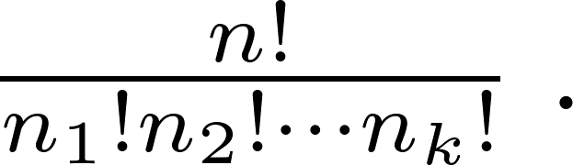
Permutations with Indistinguishable Objects
Theorem 3: The number of different permutations of n objects, where there are n₁ indistinguishable objects of type 1, n₂ indistinguishable objects of type 2, …., and n_{k} indistinguishable objects of type k, is:
Proof: By the product rule the total number of permutations is:
C(n, n₁ ) C(n − n₁, n₂ ) ∙∙∙ C(n − n₁ − n₂ − ∙∙∙ − n_{k}, n_{k}) since:
  The n₁ objects of type one can be placed in the n positions in C(n, n₁ ) ways, leaving n − n₁ positions.
  Then the n₂ objects of type two can be placed in the n − n₁ positions in C(n − n₁, n₂ ) ways, leaving n − n₁ − n₂ positions.
  Continue in this fashion, until n_{k} objects of type k are placed in C(n − n₁ − n₂ − ∙∙∙ − n_{k}, n_{k}) ways.
The product can be manipulated into the desired result as follows:

Slide 45
Distributing Objects into Boxes
Many counting problems can be solved by counting the ways objects can be placed in boxes.
  The objects may be either different from each other (distinguishable) or identical (indistinguishable).
  The boxes may be labeled (distinguishable) or unlabeled (indistinguishable).

Slide 46
Distributing Objects into Boxes
Distinguishable objects and distinguishable boxes.
  There are n!/(n₁!n₂! ∙∙∙n_{k}!) ways to distribute n distinguishable objects into k distinguishable boxes.
  (See Exercises 47 and 48 for two different proofs.)
  Example: There are 52!/(5!5!5!5!32!) ways to distribute hands of 5 cards each to four players.
Indistinguishable objects and distinguishable boxes.
  There are C(n + r − 1, n − 1) ways to place r indistinguishable objects into n distinguishable boxes.
  Proof based on one-to-one correspondence between n-combinations from a set with k-elements when repetition is allowed and the ways to place n indistinguishable objects into k distinguishable boxes.
  Example: There are C(8 + 10 − 1, 10) = C(17,10) = 19,448 ways to place 10 indistinguishable objects into 8 distinguishable boxes.

Slide 47
Distributing Objects into Boxes
Distinguishable objects and indistinguishable boxes.
  Example: There are 14 ways to put four employees into three indistinguishable offices (see Example 10).
  There is no simple closed formula for the number of ways to distribute n distinguishable objects into j indistinguishable boxes.
  See the text for a formula involving Stirling numbers of the second kind.
Indistinguishable objects and indistinguishable boxes.
  Example: There are 9 ways to pack six copies of the same book into four identical boxes (see Example 11).
  The number of ways of distributing n indistinguishable objects into k indistinguishable boxes equals p_{k}(n), the number of ways to write n as the sum of at most k positive integers in increasing order.
  No simple closed formula exists for this number.

