Slide 2
Light check and brightness regulation:
This branch of the system covers the topic of the illumination of the hospital, from checking if every lamp is operative to the adjustment of the brightness when needed. The system has the task: to warn if some lumination point is not working but also to adjust the brightness for each different place in the hospital (bedroom, toilet, surgeon room, corridor, etc.)according to the environment and other conditions (day, night, sunny day, foggy day, operation room, cabinet, toilets, number of patients and staff etc.) and at the same time to allow users (only in certain places, with specific requirement and in certain levels) to modify it.

Slide 3
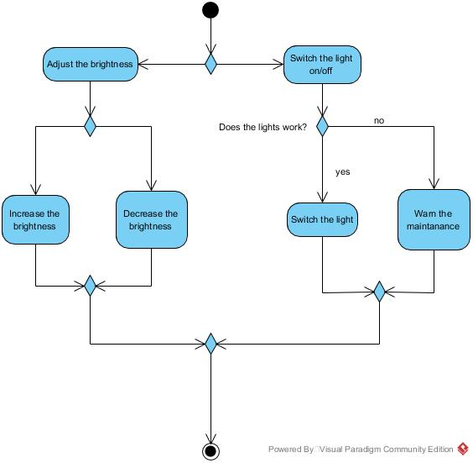

Slide 4
