Slide 1

Penguin Data Analysis: Predicting Body Mass and Species Classification
SDS 4392 Final Project
Xinyue Ha, MA Statistics
April 22, 2025

Slide 2

🐧 Part 1: Background and motivation
Data Source: The data were collected near Palmer Station in Antarctica, observing three penguin species: Adélie, Chinstrap, and Gentoo.
Scientific Background: The original study, led by Dr. Kristen Gorman, investigated sexual dimorphism and sex-specific foraging behavior under changing environmental conditions like sea ice.
Simplified Version: We use the penguins dataset (8 variables), — a cleaned, simplified version of the raw data (17 variables), keeping key body measurements and species traits for easy modeling.

Slide 3
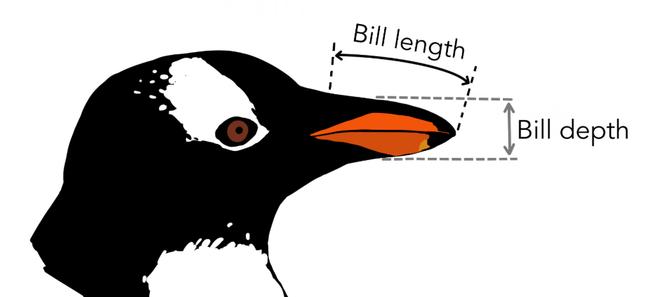
🐧 Part 2: Variables Introduction
library(palmerpenguins)
data(penguins) # 344 rows and 8 variables
colSums(is.na(penguins)) # 11 rows with missing values (3.2%)
penguins_clean <- na.omit(penguins) # 333 rows
Species Penguin species (Adélie, Chinstrap, Gentoo)
Island Island of observation (Biscoe, Dream, Torgersen)
Bill_length_mm Bill length in mm (numeric)
Bill_depth_mm Bill depth in mm (numeric)
Flipper_length_mm Flipper length in mm (integer)
Body_mass_g Body mass in grams (integer)
Sex Penguin sex (female, male) (factor)
Year Study year: 2007–2009 (factor)

Slide 4
🐧 Part 3: Problem statement
A. Predicting Body Mass
• Why? Body mass reflects a penguin’s overall health, how well it can find food, and how prepared it is for breeding — all of which are important in ecological research.
Methods:
• Linear Model (LM) to assess how body measurements like bill and flipper length relate to weight.
• Linear Mixed Model (LMM) to account for grouped data (year or island as random effects).
B. Species Classification
• Why? Accurate species identification helps scientist identify penguin species automatically, especially when working with large datasets or in places where it's hard to observe animals directly.
Methods:
• Generalized Linear Model (GLM): Multinomial logistic regression using body measurements.
• Non-parametric Regression

Slide 5
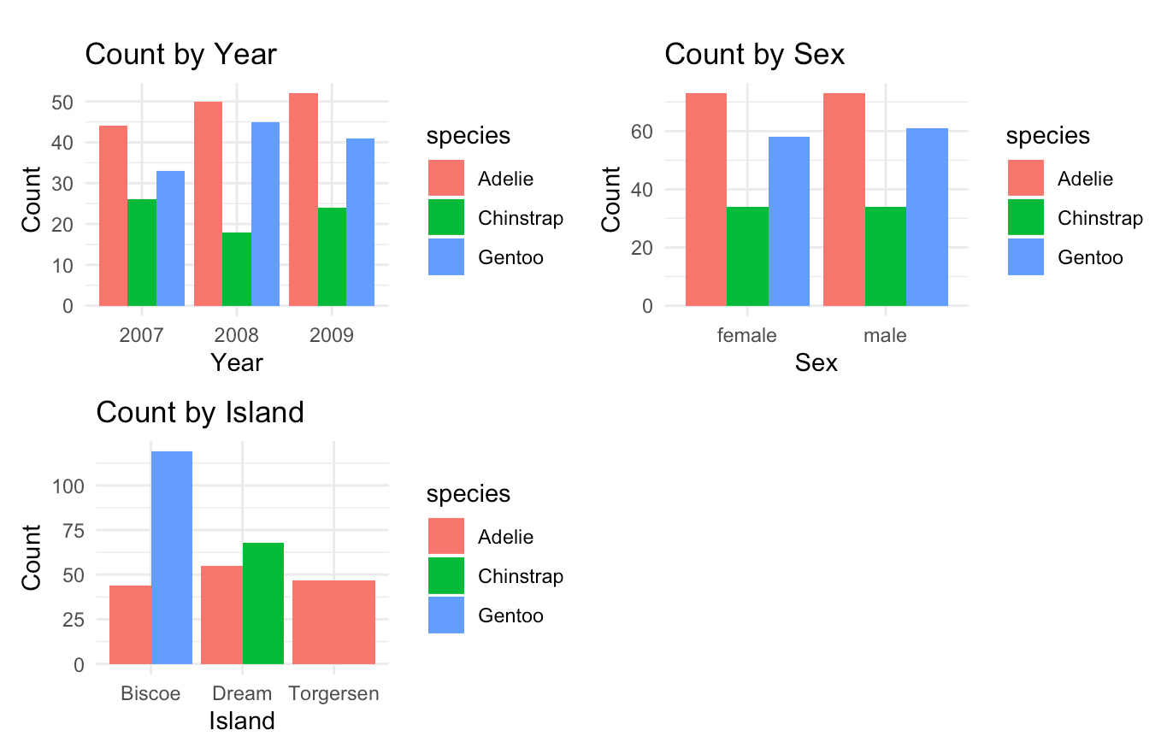
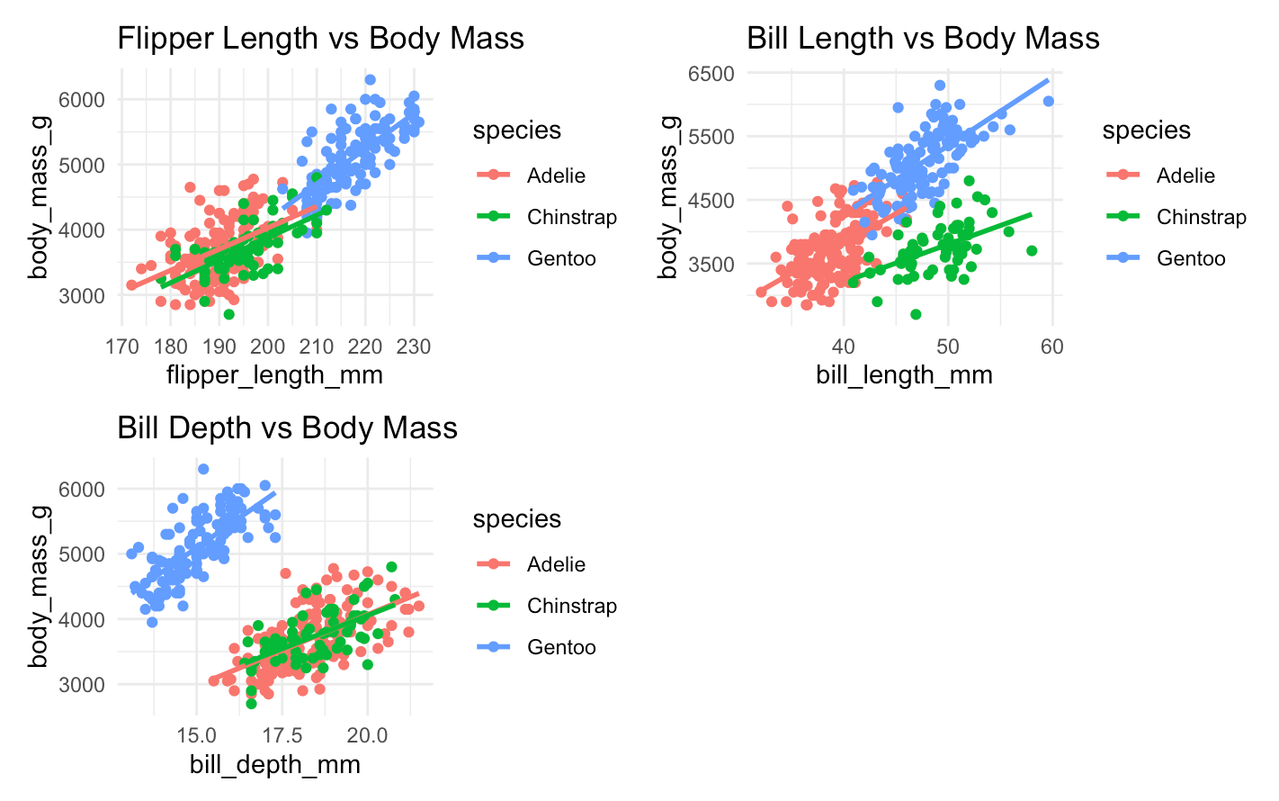
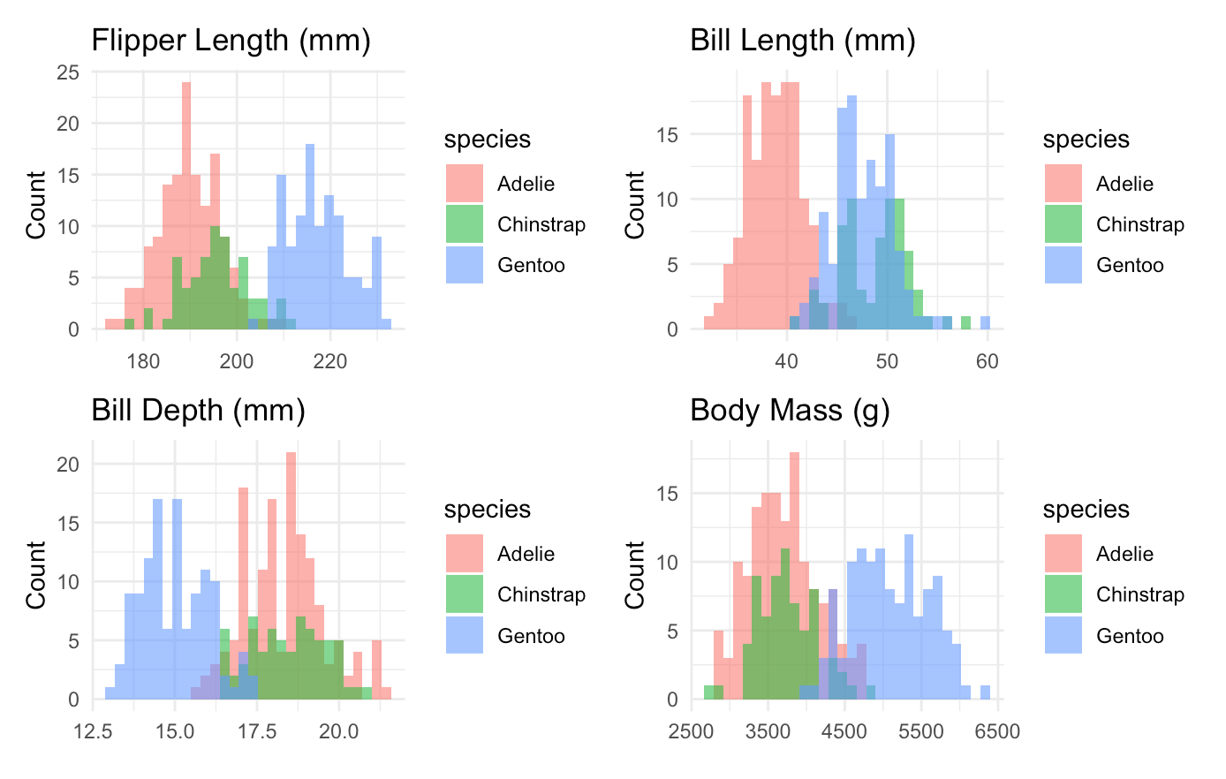
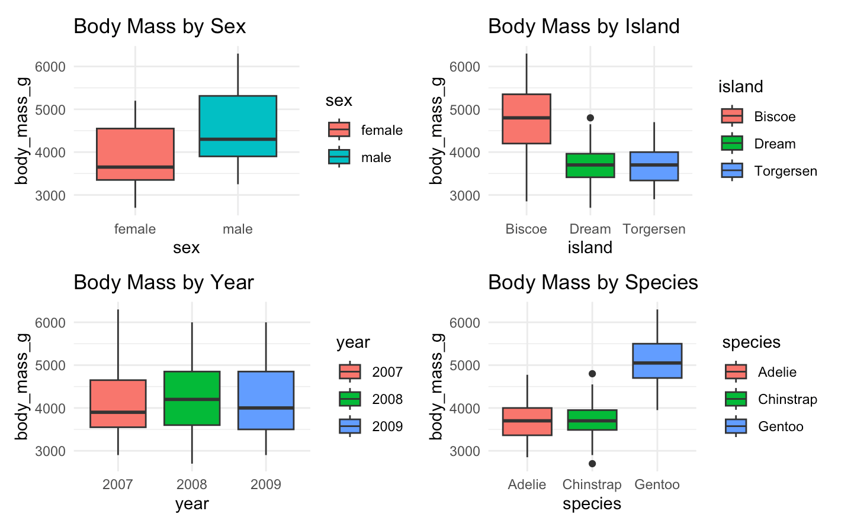
🐧 Part 4: About the Data

Slide 6
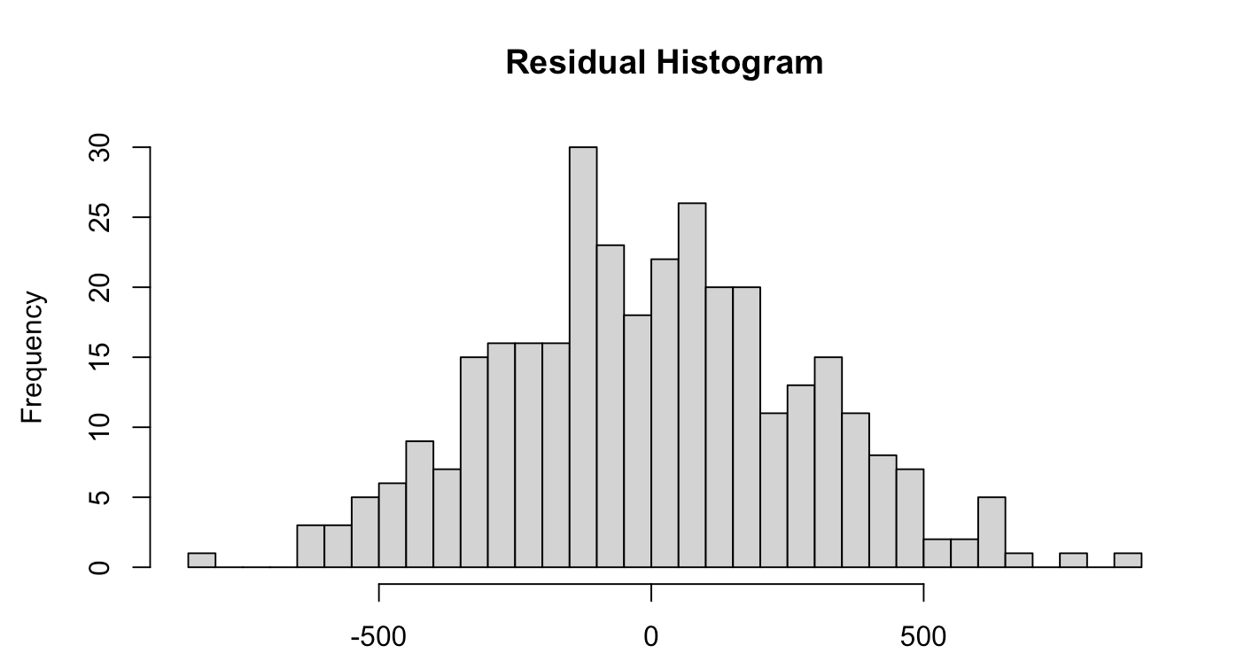
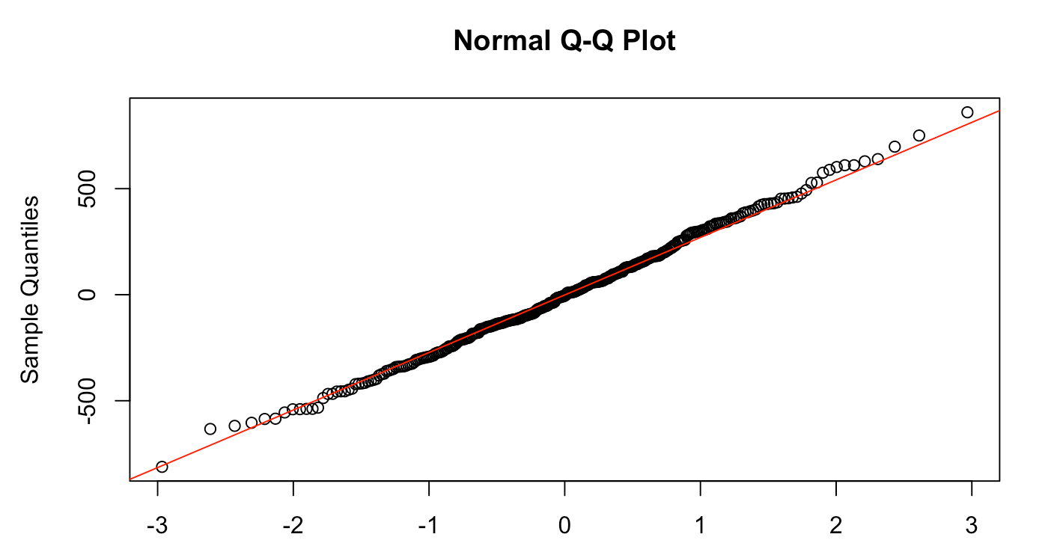
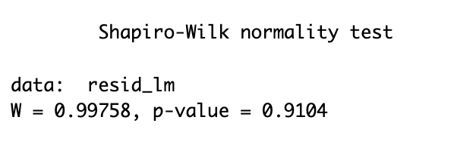
🐧 Part 5: Predicting Body Mass - LM
model_lm <- lm(body_mass_g ~ species + bill_length_mm + bill_depth_mm +
flipper_length_mm + island + sex + year, data = penguins_clean)
The linear model explained 87.3% of the variance in penguin body mass. Residuals showed no significant deviation from normality.

Slide 7
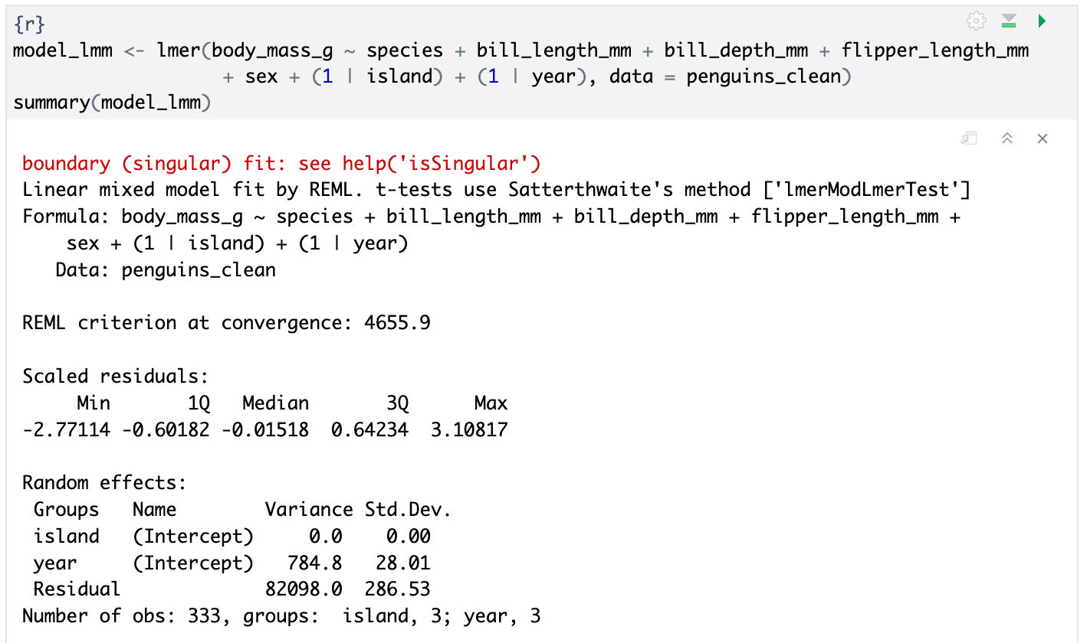
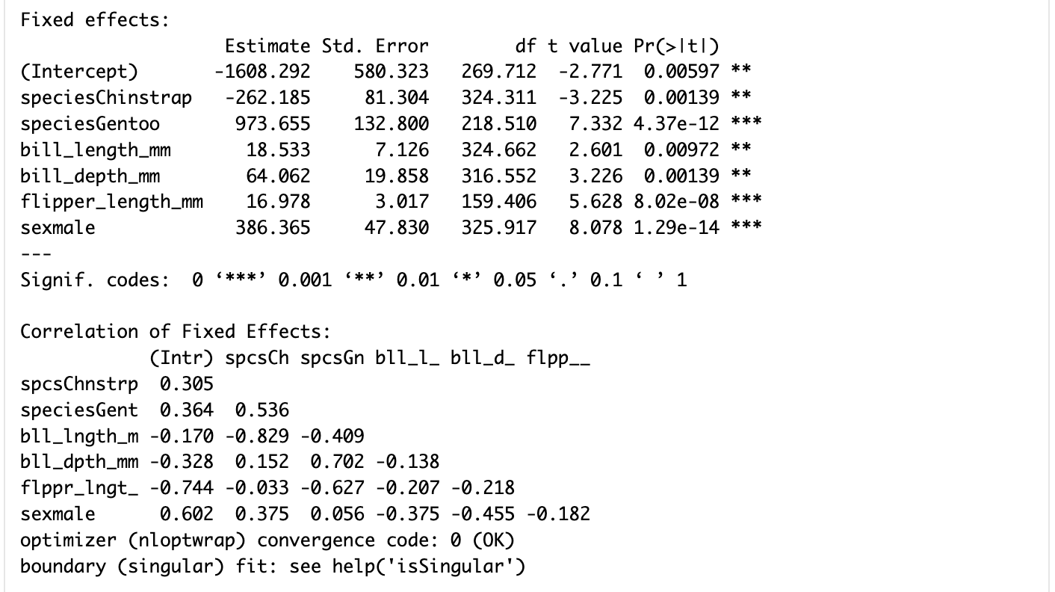
🐧 Part 5: Predicting Body Mass - LMM
Island showed zero variance, suggesting it may not meaningfully contribute as a random effect.
Species, bill dimensions, flipper length, and sex Significantly influence body mass.

Slide 8
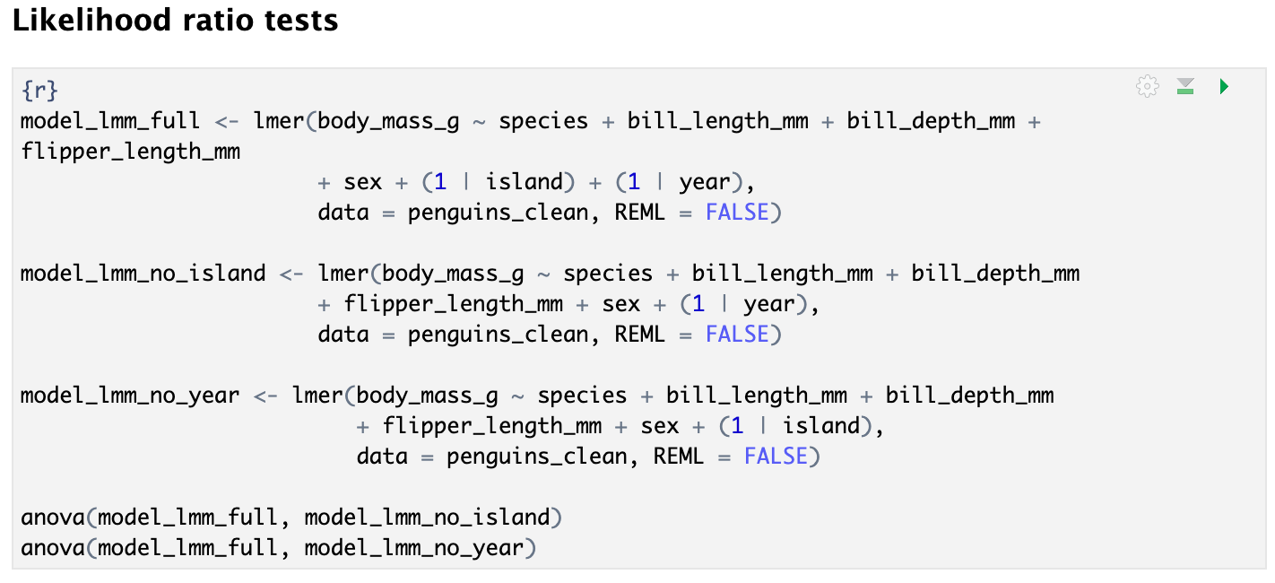
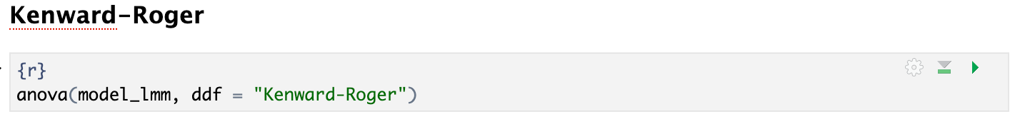
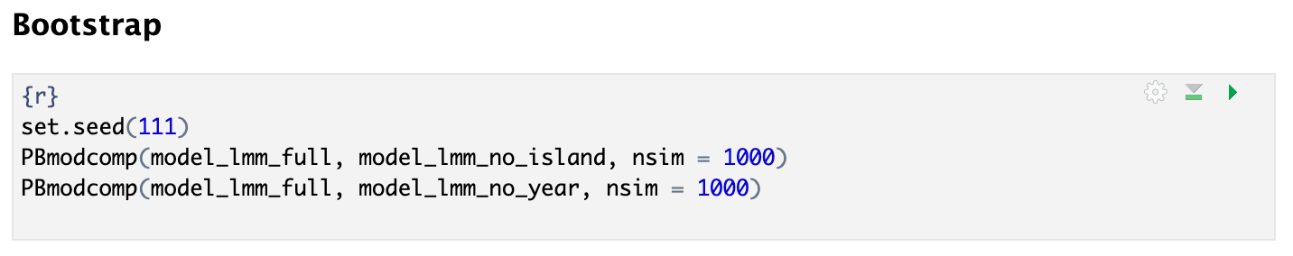

Slide 9
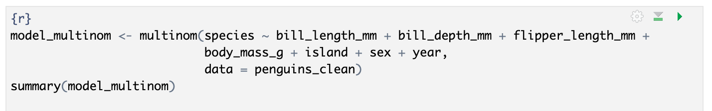
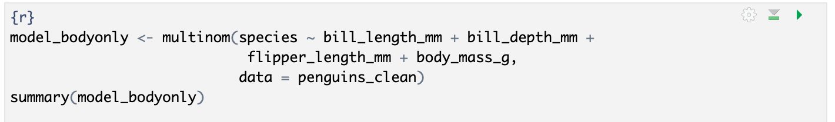
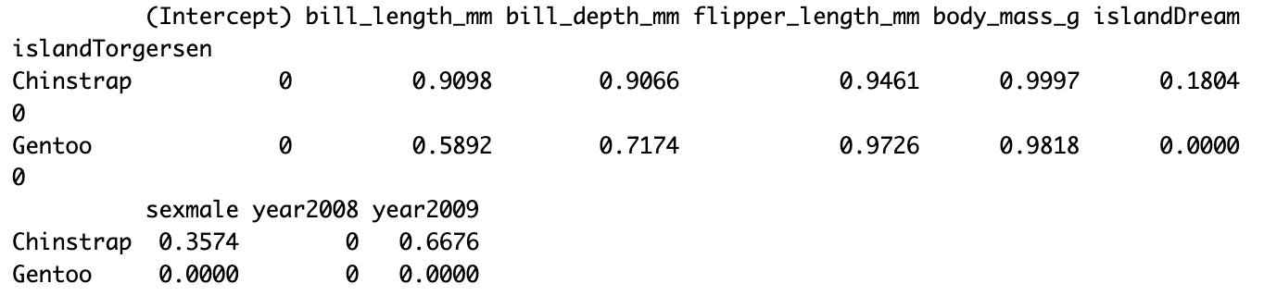
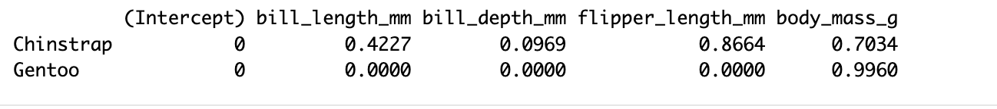
🐧 Part 6: Species Classification
Multinomial logistic regression was used to classify penguin species. Body features alone significantly distinguished Gentoo from Adelie, but not Chinstrap. We consider simplifying the task to a binary classification:
Gentoo vs. others.
More challenging than the body mass prediction task because we are now dealing with three classes.
Redefining the task as a binary classification is worth further exploration.

Slide 10
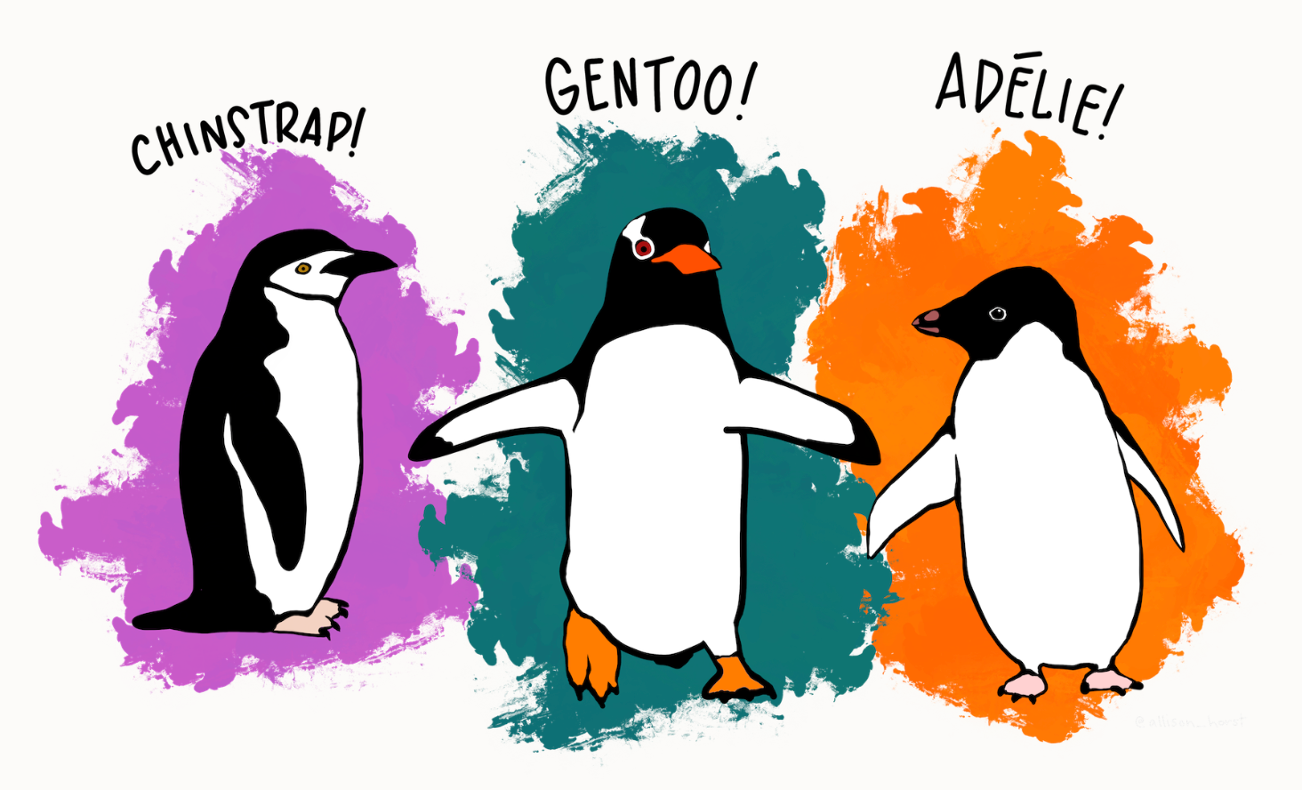
🐧 Part 7: Summary
For body mass prediction, a fixed-effect model without island/year performs well.
For species classification, I will explore extensions of GLMs to multiclass settings, and apply logistic regression with a binomial family for Gentoo vs. others. Try some non-parametric models to support classification.
Make some contributions to ecological monitoring and penguin conservation, especially for penguin health and species identity.

Slide 11
🐧 Part 8: Reference
Thanks for the data collected and made available by Dr. Kristen Gorman and the Palmer Station, Antarctica LTER, a member of the Long Term Ecological Research Network.
Thanks for beautiful artworks by @allison_horst .
Data originally published in:
Gorman KB, Williams TD, Fraser WR (2014). Ecological sexual dimorphism and environmental variability within a community of Antarctic penguins (genus Pygoscelis). PLoS ONE 9(3):e90081. https://doi.org/10.1371/journal.pone.0090081
Data citations:
Palmer Station Antarctica LTER and K. Gorman, 2020. Structural size measurements and isotopic signatures of foraging among adult male and female Adélie penguins (Pygoscelis adeliae) nesting along the Palmer Archipelago near Palmer Station, 2007-2009 ver 5. Environmental Data Initiative. https://doi.org/10.6073/pasta/98b16d7d563f265cb52372c8ca99e60f (Accessed 2020-06-08).

