Slide 1
Sentence Similarity on Quora Question Pairs
Okan Alan Ayça Meriç Çelik
Notes:
Hello everyone, I am Okan, today my friend Meriç and I are going to present our project. Our topic is the “Sentence Similarity”.

Slide 2
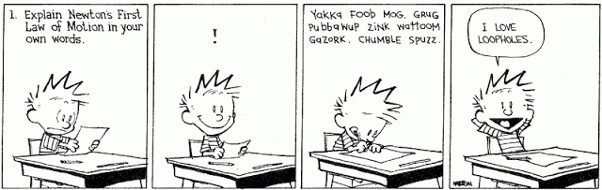
Sentence Similarity & Paraphrasing
Semantic Similarity: One of the most popular topics nowadays!
Paraphrasing: Same meaning but different word choice/structure.
Notes:
At the outset, let's look at main branch of our project subject. The first branch is semantic similarity that is the most popular NLP topics of recent years. Semantic similarity is a metric defined over a set of documents or terms, where the idea of the distance between items is based on the likeness of their meaning or semantic content as opposed to lexicographical similarity. The other branch is paraphrasing. Paraphrasing in computational linguistics is the natural language processing task of detecting and generating paraphrases.

Slide 3
Quora Question Pairs
Quora is one of the most popular question-answering platforms of our days
Different users ask the same question in different ways: Lots of duplicate questions!
Dataset released in 2017. We used the GLUE benchmark version:
train set: 363,192 rows (q_id_1, q_id_2, question1, question2, isDuplicate)
dev set: 40,372 rows (q_id_1, q_id_2, question1, question2, isDuplicate)
test set: 390,965 rows (question1, question2)
Notes:
Most people are not know how to use Google that’s why they are asking their questions on the question-answering platforms without any research. Our project is starting at this point. How can we detect duplicate questions? Our dataset was Quora Question Pairs and we focused on the subtask of semantic similarity task, named “Semantic Question Matching”. In 2017(two thousand seventeen), Quora released the dataset with more than 400,000(four hundred thousand) pairs of questions. Researchers, students had a great opportunity to work with organic data on semantic similarity tasks and compare the results with others easily.
For our research, we chosed the GLUE benchmark version of the dataset. It consists of three files as “train”, “dev”, and “test”. Train and dev sets have 5 columns representing the questions ids, the full text of the questions, and the label indicating whether the questions are duplicate or not. The test set only contains two columns representing the full texts of first and second questions

Slide 4
Related Work
Model | Accuracy(%) on Development Set
Feature Vector | 70.46
Tree Kernel | 74.05
CNN | 77.79
LSTM | 77.06
BiMPM | 88.69
ABCNN | 64.47
pt-DecAtt | 88.44
REGMAPR | 89.05
DIIN | 89.44
MwAN | 89.60
MFAE | 90.61
STILT-BERT | 91.50
Machine Learning Methods (SVM, Random forest, decision trees, logistic regression, etc)
Deep Learning Methods (RNN, LSTM, etc.)
Table 1: Comparison of related work results
Notes:
Considering the publication date of our data set, the growth rate of the natural language processing field had just begun to increase so we found a lot of works on this dataset. In the initial works, different machine learning models are used, such as SVM, decision tree, logistic regression, etc. In further researches, the deep learning based model such as FNN, LSTM, GRU are used. On the slide, you can see the other researcher’s results.

Slide 5
Our Experiments
Notes:
Let’s look at our experiment

Slide 6
Data Preparation
Dropped “qid1” and “qid2” columns in the train and dev set.
Converted all texts to lowercase. (We used uncased models for the training).
Expanded the English contractions: As an example, “couldn’t” becomes “could not”.
Punctuation isolation: We insert a space before and after each punctuation. We prefer to keep the punctuation marks since BERT performs better with them. Instead, we separated them from words to be correctly tokenized by BERT.
Notes:
What did we do on our dataset?
Firstly, we started dropping the questions ids’ because they are irrelevant to our task.
Then we converted all texts to lowercase
Next preprocess was expanding the English contractions
The last preparation step was punctuation isolation. We insert a space before and after each punctuation. We prefer to keep the punctuation marks since BERT that was our main model performs better with them.

Slide 7
Example From The Dataset
Question 1 | Question 2 | Duplicate?
How is air traffic controlled? | How do you become an air traffic controller? | No
Why doesn’t everyone I ask to answer a question-answer it on Quora? | Why doesn’t anyone here answer my questions? | Yes
Table2: The Raw Examples From The Dataset
Notes:
Now, you are looking at the raw data from our dataset.
---- in the rest of the presentation, my friend Meric will explain what we did after preprocessing.

Slide 8
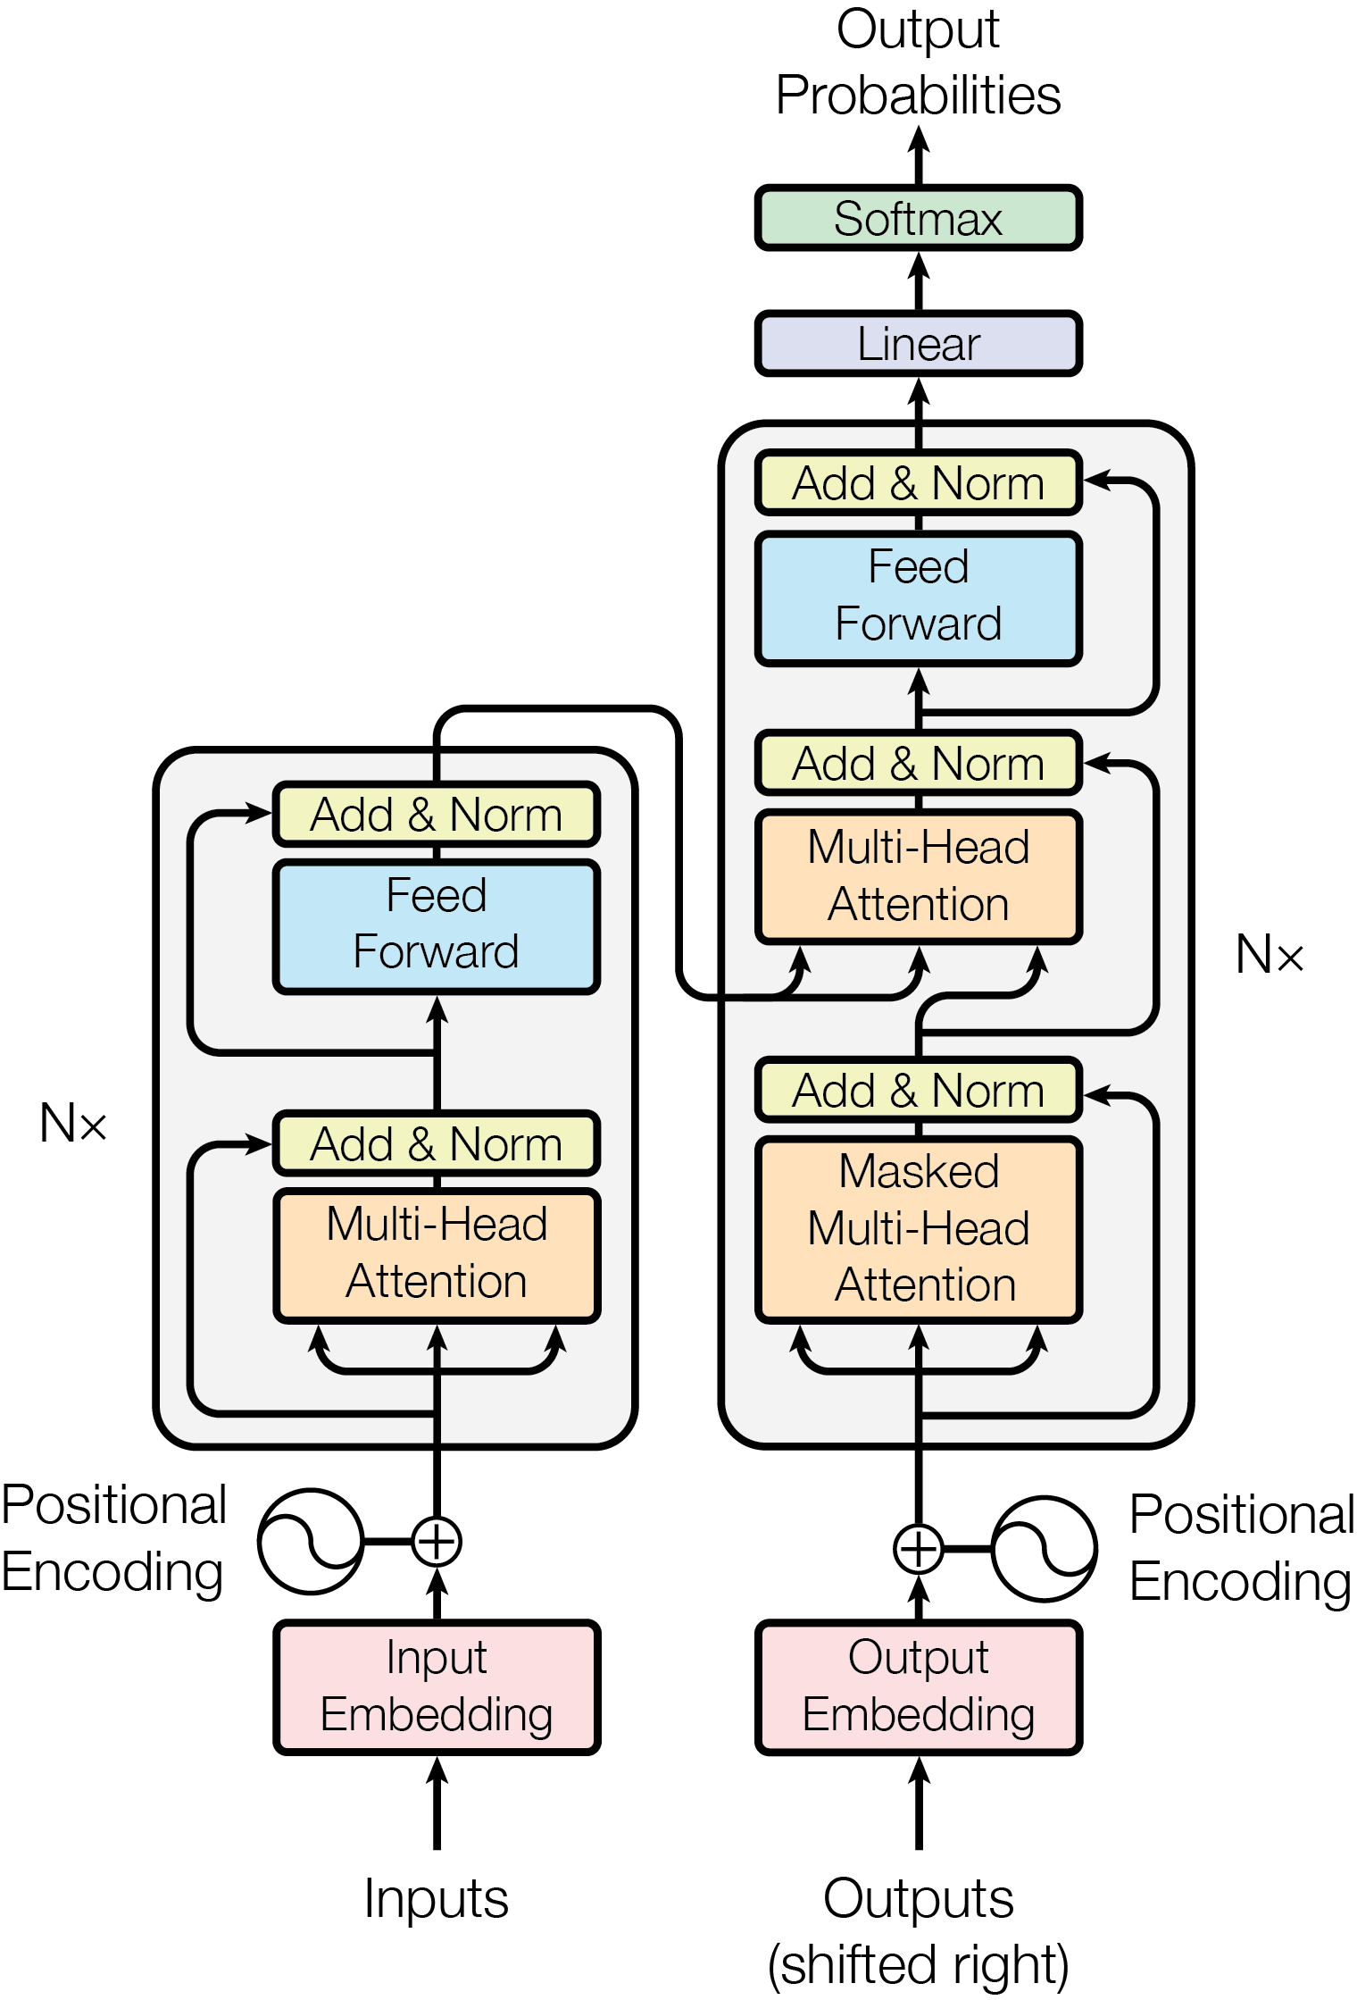
Transformer Model & BERT
"Attention is All You Need (2017)" changed the game! Hail to The Transformer!
Self-attention instead of long sequences.
Out-performed LSTM and RNN in various tasks.
BERT (Bidirectional Encoder Representations from Transformers):
Pretrain deep bidirectional representations from unlabeled text by jointly conditioning on both left and right context in all layers.
Fine-tuning is enough to obtain robust models.
Figure 1: The Transformer - model architecture.

Slide 9
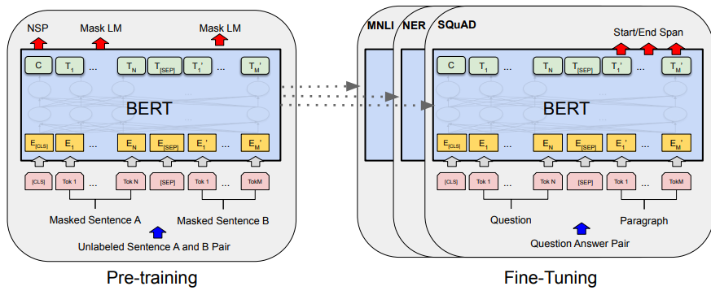
BERT
Figure 2: Overall pre-training and fine-tuning procedures for BERT.

Slide 10
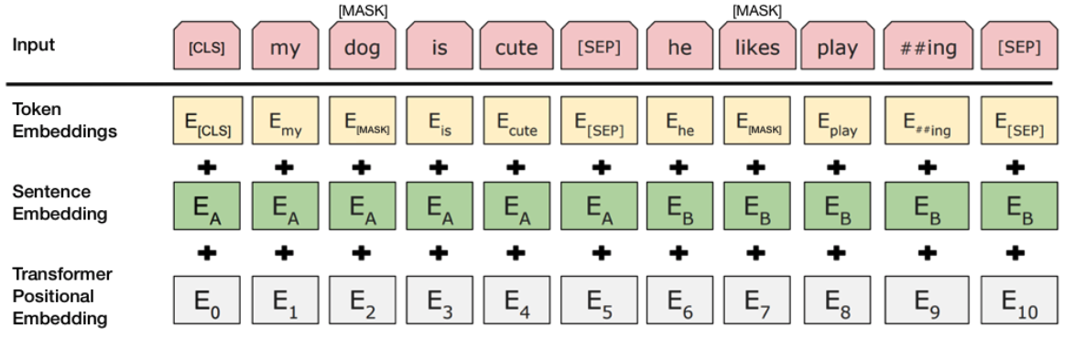
BERT
Figure 3: BERT input representation. The input embeddings are the sum of the token embeddings, the segmentation embeddings and the position embeddings.

Slide 11
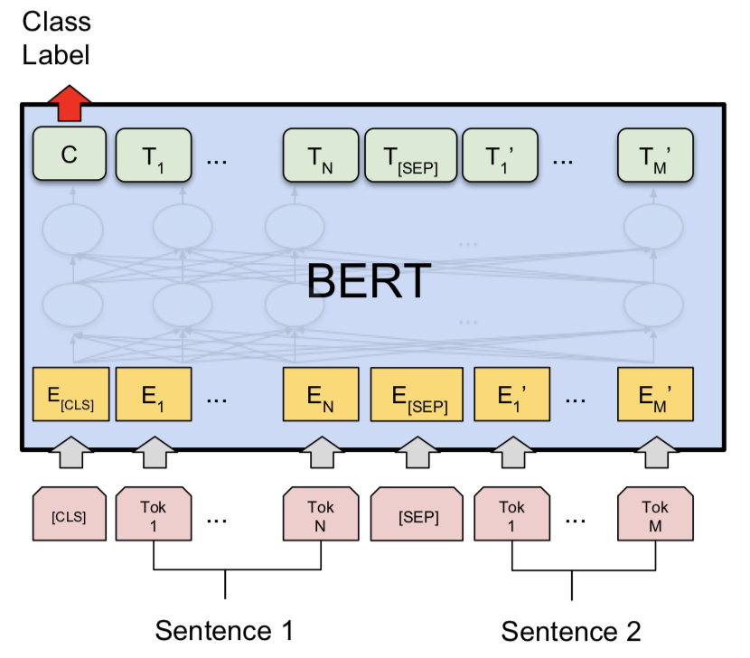
BERT
Albert: Only 12M parameters (89% less than BERT-base model), it is as robust as BERT!
SpanBERT: Extends BERT by masking contiguous random spans.
DistilBERT: Introduces a triple loss combining, language modeling, distillation and cosine-distance losses. (40% smaller, 60% faster than BERT).
Figure 4: Sentence Pair Classification Task on BERT

Slide 12
Approach #1: Thresholding Cosine Similarity of Sentence Vectors
Extracted BERT vector w/o fine-tuning.
No classification layer.
Threshold | Accuracy
0.70 | 0.624
0.75 | 0.668
0.80 | 0.704
0.85 | 0.728
0.90 | 0.728
0.95 | 0.697
Table 2: Threshold values and obtained accuracy

Slide 13
Evaluation of Approach #1
Question 1 | Question 2 | Similarty | Duplicate
why is my life getting so complicated ? | why is my life so complicated ? | 0.989 | No
why are african-americans so beautiful? | why are hispanics so beautiful? | 0.835 | No
Table 3: False Positive Examples
Question 1 | Question 2 | Similarty | Duplicate
what are your views about demonetisation in india? | what do you think about the ban on 500 and 1000 denomination notes in india? | 0.595 | Yes
how can i get rid of a bad habbit? | what are good strategies for getting rid of a bad habit? | 0.642 | Yes
Table 4: False Negative Examples

Slide 14
Approach #2: Fine-tuning BERT-Based Models
Fine-tuned BERT, ALBERT, DistilBERT and SpanBERT.
Trained on Google Colab (Tesla P100).
Larger ones (xlarge, xxlarge), did not fit into memory.
Got the best results with the parameters below:
Number of epochs: 3
Learning rate: 4e-5
Batch size: 16 (insufficient memory on larger models)
Larger models did not improved the accuracy!

Slide 15
Epoch | Method | Accuracy | Eval Loss
3 | bert-base-uncased | 0.837 | 0.650
3 | bert-large-uncased | 0.836 | 0.504
3 | albert-base-v2 | 0.830 | 0.427
3 | albert-large-v2 | 0.631 | 0.658
3 | spanbert-base-cased | 0.832 | 0.458
3 | distilbert-base-uncased | 0.814 | 0.489
Table 5: Evaluation Results of The Models Trained with only 10k Examples

Slide 16
Epoch | Method | Accuracy | Eval Loss
3 | albert-base-v2 | 0.908 | 0.278
3 | bert-base-uncased | 0.911 | 0.344
3 | spanbert-base-cased | 0.908 | 0.267
3 | distilbert-base-uncased | 0.903 | 0.293
Table 6: Evaluation Results of The Models Trained with FULL Train Set

Slide 17
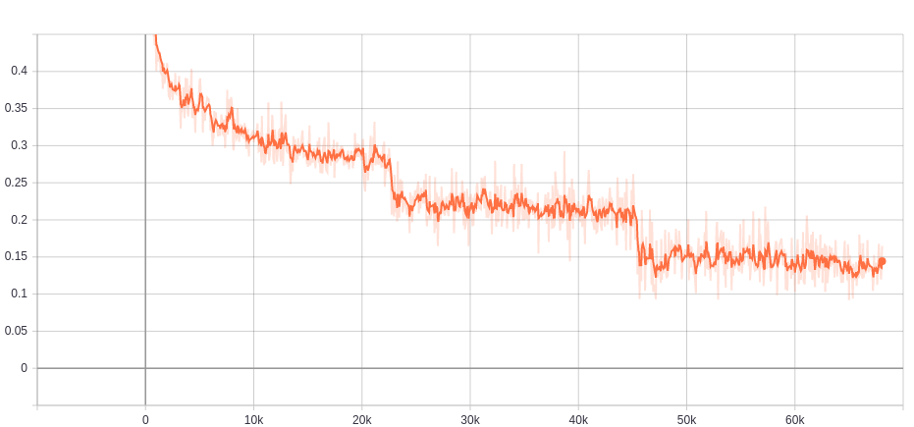
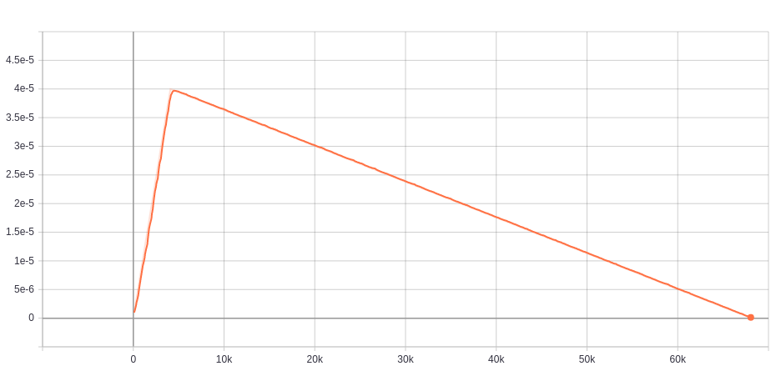
Approach #2: Fine-tuning BERT-Based Models
Figure 5 & 6: Loss & Learning Rate Graphs of BERT model on full training set.

Slide 18
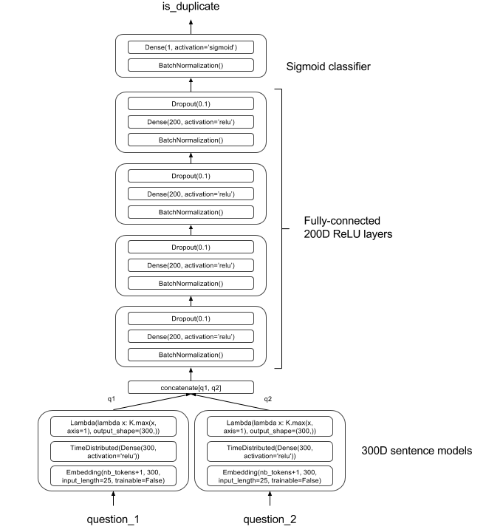
LSTM-Based Keras Model
Stanford Natural Language Inference benchmark
A dense layer with sigmoid activation instead of softmax.
Max of GloVe vectors instead of summation. (Glove.840B with 300-dim).
Cross-entropy loss, Adam optimizer.
Model parameters with the best results:
Dropout rate: 0.2
Batch size: 512.
Validation Ratio: 20%
Epoch | Method | Accuracy | Eval Loss
25 | Custom-SNLI | 0.671 | 2.404
100 | Custom-SNLI | 0.670 | 2.304
Table 7: Evaluation Results of the Custom SNLI Model With Different Epochs
Figure 7: Architecture of the model

Slide 19
Comparing The Results
Model | Accuracy(%) on Development Set
Feature Vector | 70.46
Tree Kernel | 74.05
CNN | 77.79
LSTM | 77.06
BiMPM | 88.69
ABCNN | 64.47
pt-DecAtt | 88.44
REGMAPR | 89.05
DIIN | 89.44
MwAN | 89.60
MFAE | 90.61
STILT-BERT | 91.50
ALBERT | 0.908
BERT | 0.911
SpanBERT | 0.908
DistilBERT | 0.903
Custom SNLI | 0.671

Slide 20
Thank you for listening.

