Slide 1
Air Quality Index Prediction
Machine Learning Internship at FTS
By,
Akshata Kotti
Shubham Urmaliya
Abhishek
Shreya Basu
Neha Kumari
Lokesh

Slide 2
Contents
Problem Statement
Data Visualisation before preprocessing
Data Visualisation on AQI
Data preprocessing
Missing value treatment
Air Quality Index(AQI) calculation
Outlier treatment
Data Visualisation after preprocessing
Model Making
XGBoost
Stacked LSTM

Slide 3
Problem Statement
To create a model which will predict the Air Quality Index (AQI).
We were given two datasets:
cities_by_day → day-wise information including the amount of various chemical substances present in different cities and the AQI information.
cities_by_hours → hours-wise information including the amount of various chemical substances present in different cities and the AQI information.
We have initially performed Exploratory Data Analysis including Data preprocessing, Outlier treatment and Data visualization to study the datasets.
We have then used certain algorithms like XGBoost and Stacked LSTM to create a model that will predict the AQI for any future reference using the input we are giving.

Slide 4
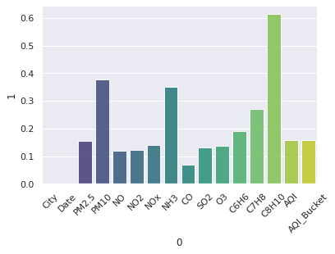
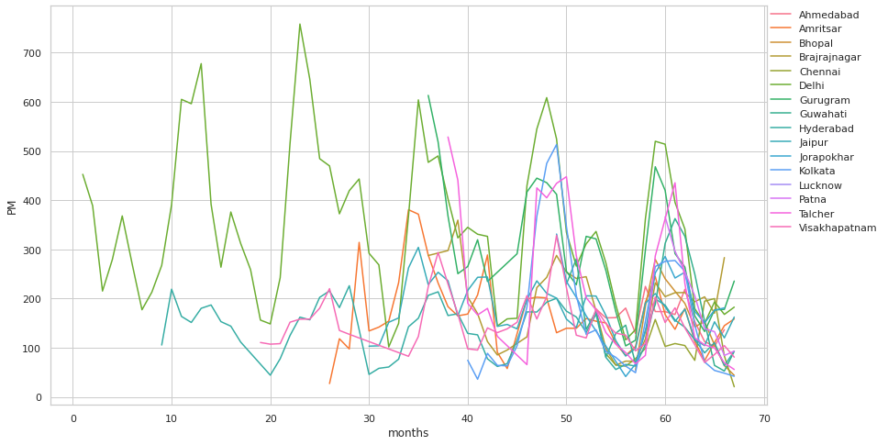
Data Visualisation before preprocessing
We used some visualisation techniques to understand the trends and relationships between different columns. The results are following.
There are a lot of missing values for xylene,PM2.5 and NH3. But after looking at correlations AQI is reasonably dependent on these gases. So it is not good to drop these columns.
The second image is a plot of PM(PM2.5 +PM10) with months. From this graph we can see that values are not missing at random they are missing for long periods of time from this we found that the imputation methods like linear interpolation will not give realistic results and we started thinking about methods like KNN imputation.

Slide 5
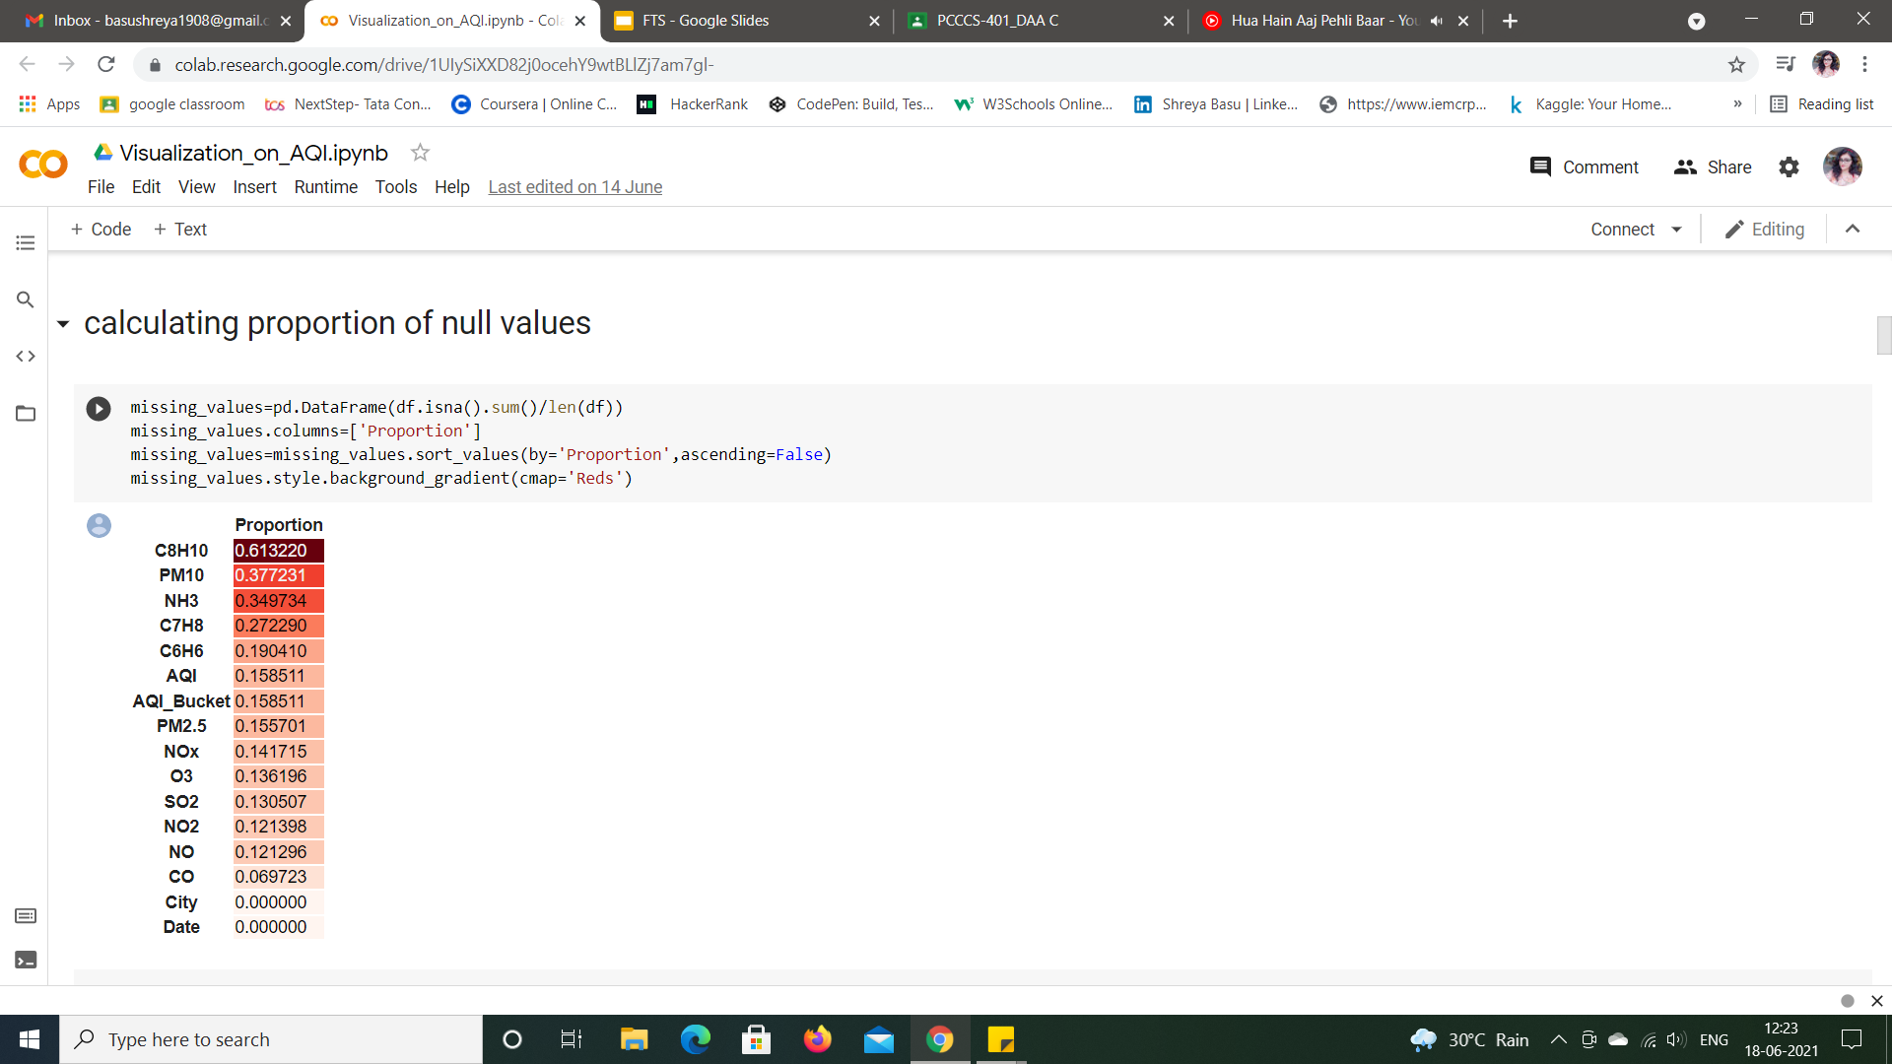
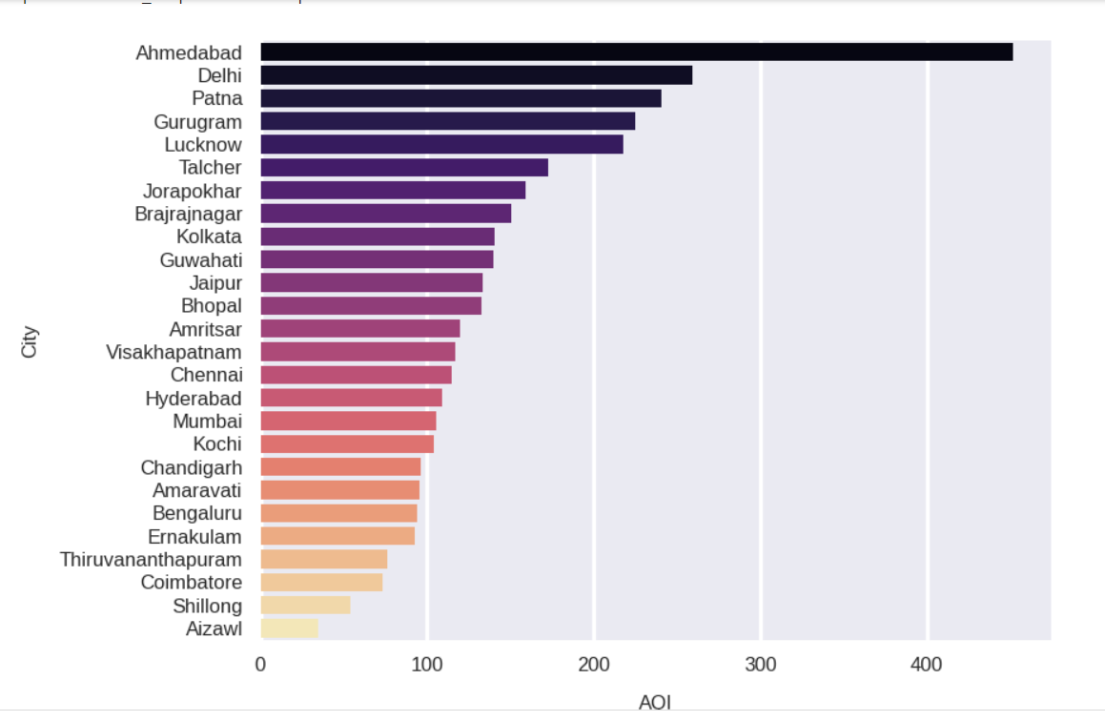
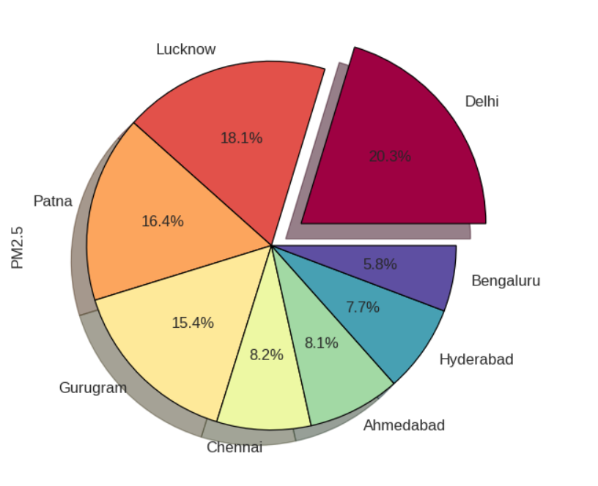
Data Visualisation on AQI
Data visualization is the graphical representation of information and data. We use different visual elements like charts, graphs, and maps, data visualization tools to provide an accessible way to see and understand trends, outliers, and patterns in data.
Visualization has been done on the dataset of cities_by_day to study certain trends. Some screenshots have been attached herewith. The link to the file has been given here: https://colab.research.google.com/drive/1UIySiXXD82j0ocehY9wtBLlZj7am7gl-#scrollTo=RHBP32Q3qcLu
Calculating the proportion
of missing values
Grouping the cities based on average AQI
Pie-chart showing distribution of pollutant in top polluted cities

Slide 6
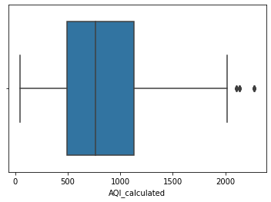
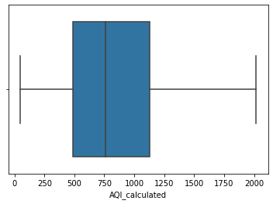
Data preprocessing
KNN Imputation
Outlier Detection Using Quantile Regression
def fun(dframe):
lis = []
for i in range(0, dframe.shape[1]):
if(dframe.iloc[:,i].dtypes == 'object'):
dframe.iloc[:,i] = pd.Categorical(dframe.iloc[:,i])
dframe.iloc[:,i] = dframe.iloc[:,i].cat.codes
dframe.iloc[:,i] = dframe.iloc[:,i].astype('object')
lis.append(dframe.columns[i])
KNN = KNNImputer(n_neighbors=3)
dframe = pd.DataFrame(KNN.fit_transform(dframe))
return dframe
Q1=df['AQI_calculated'].quantile(0.25)
Q3=df['AQI_calculated'].quantile(0.75)
IQR=Q3-Q1
print(Q1)
print(Q3)
print(IQR)
Lower_Whisker = Q1 - 1.5*IQR
Upper_Whisker = Q3 + 1.5*IQR
print(Lower_Whisker, Upper_Whisker)
df = df[df['AQI_calculated']< Upper_Whisker]

Slide 7
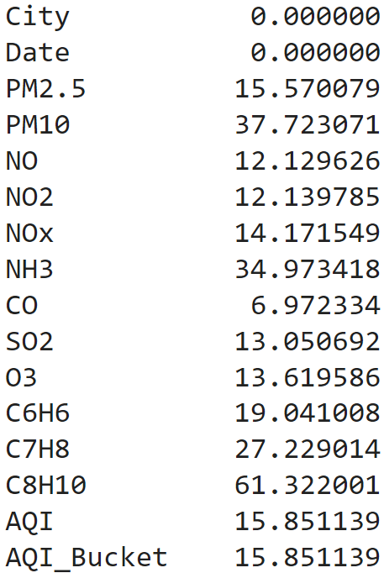
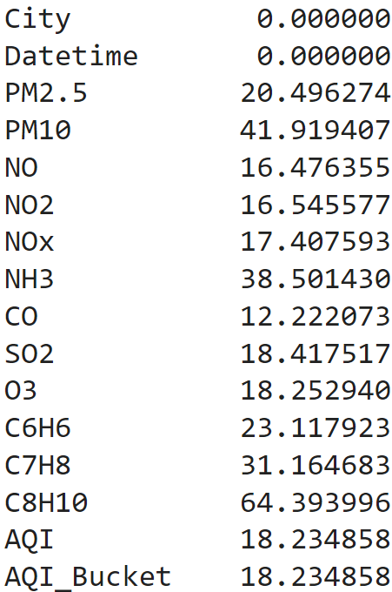
Data Preprocessing of Cities_by_day and Cities_by_hours dataset
1] Missing value treatment: Methods used to treat missing values are:
Citywise Mean imputation
Citywise Linear interpolation
Citywise K-Nearest Neighbors(KNN) imputation
2] AQI calculation: AQI is the maximum of sub-indices calculated for individual pollutants.
3] Outlier treatment: Outliers were detected and treated using Quantile Regression.
Percentage of missing Percentage of missing
values in cities_by_day: values in cities_by_hour:

Slide 8
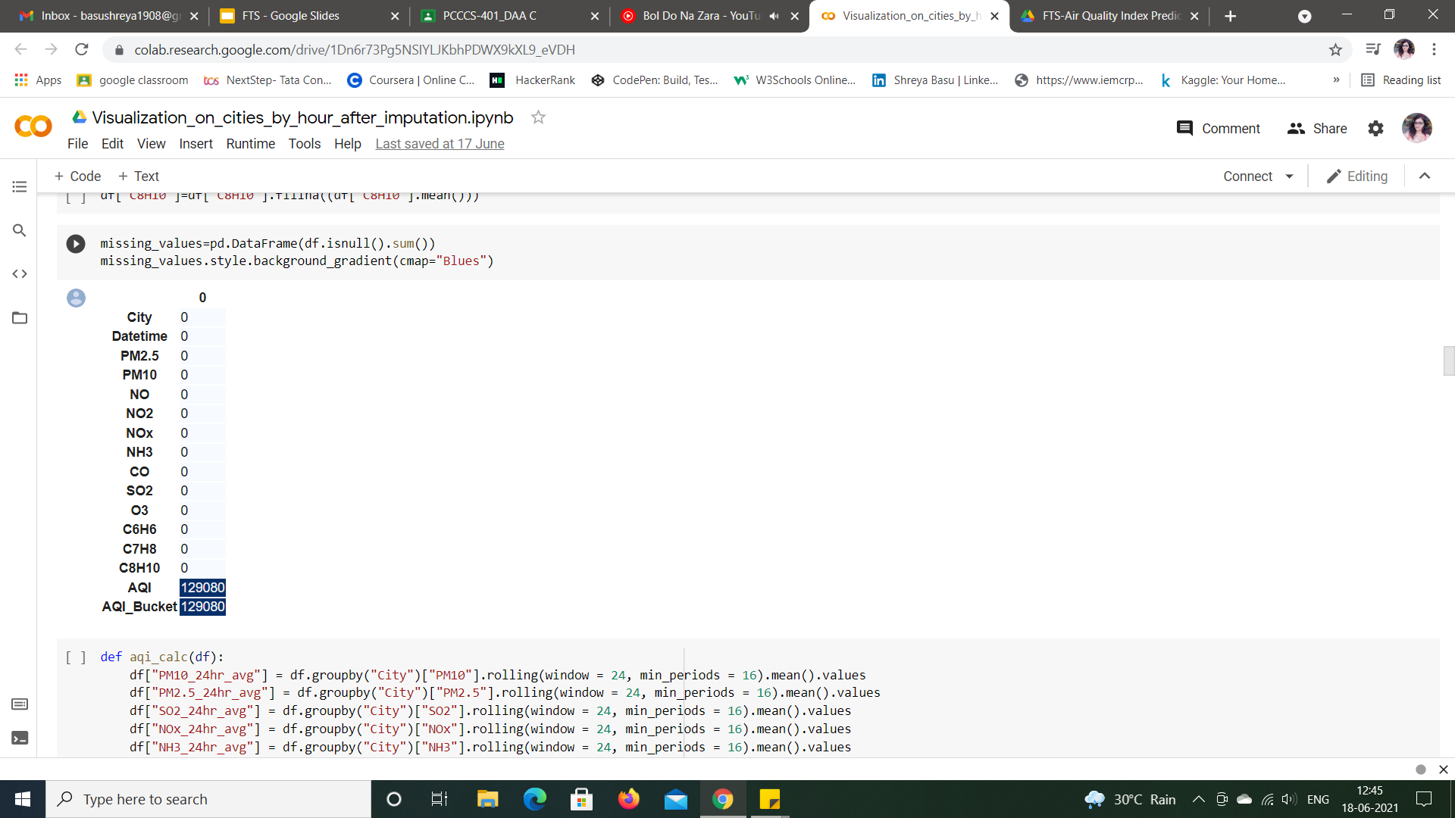
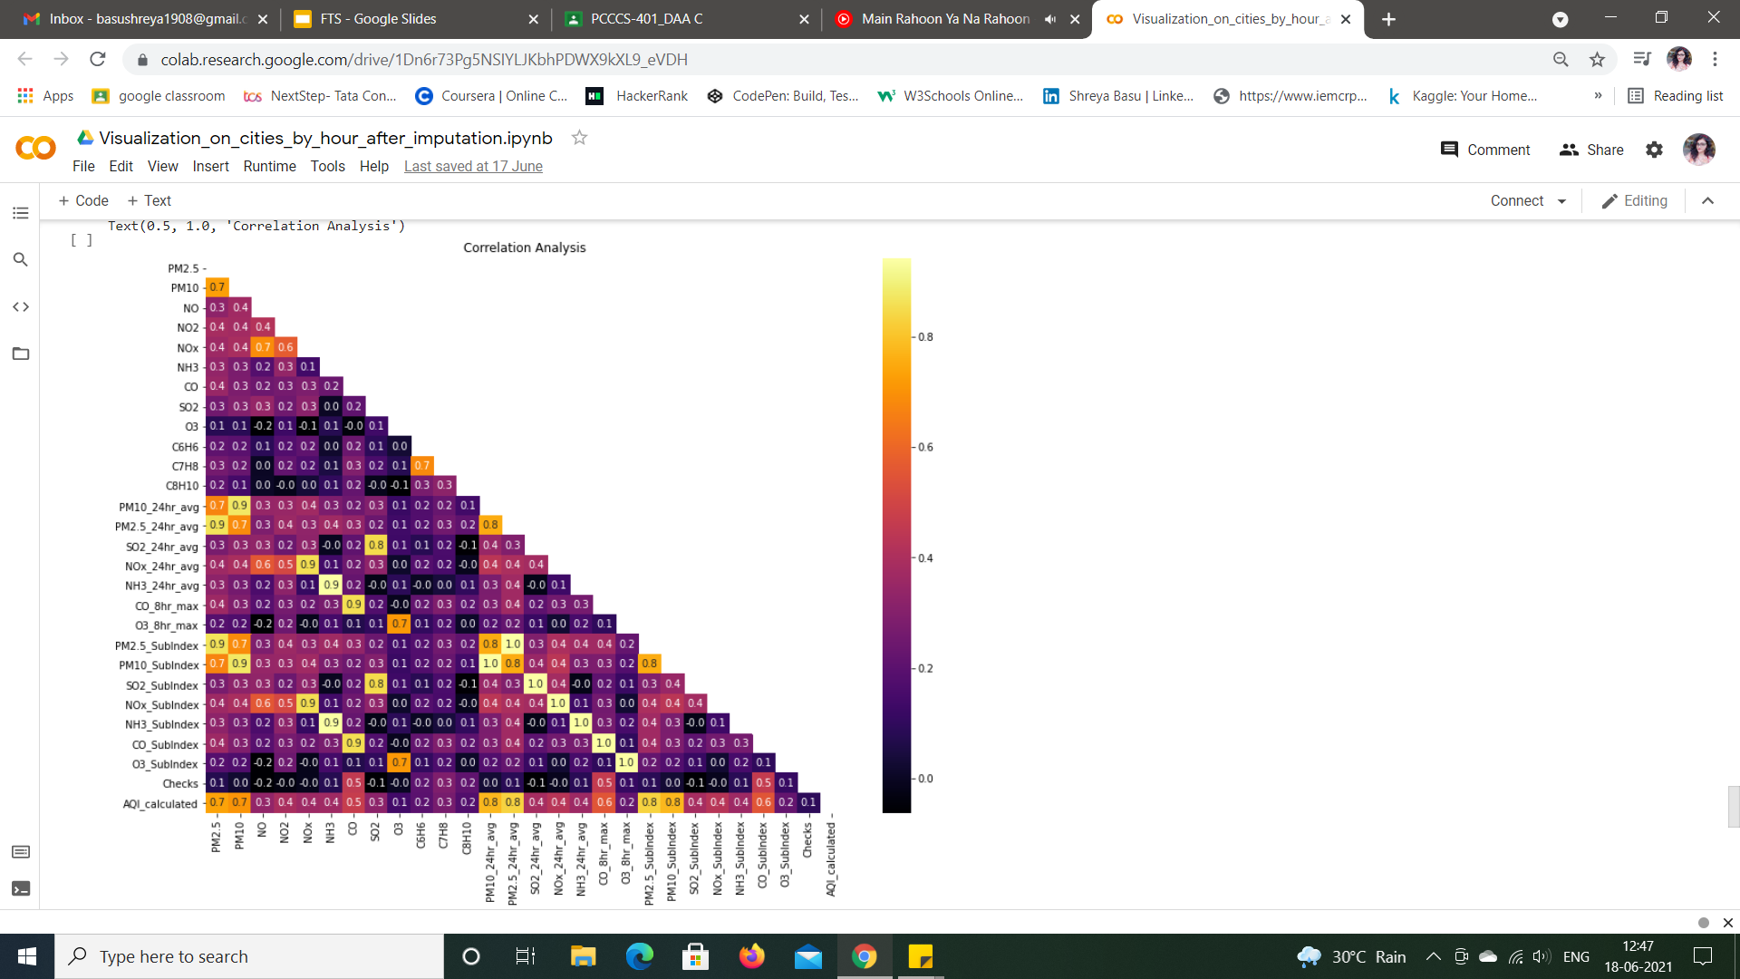
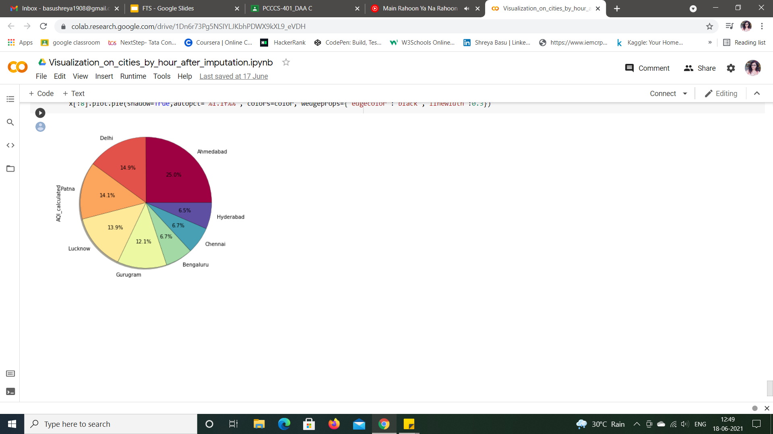
Data Visualisation after preprocessing
Visualization has also been performed after preprocessing the dataset cities_by_hours i.e., removing the missing values in the dataset.
Proportion of missing values has been reduced to zero
Pie-chart showing imputed AQI
values for top polluted cities
Correlation analysis

Slide 9
Model Making - (i) XGBoost Regressor
n_estimators = [int(x) for x in np.linspace(start=100, stop=1200, num=12)]
learning_rate = [0.05, 0.1, 0.2, 0.3, 0.4, 0.5, 0.6]
max_depth = [int(x) for x in np.linspace(5, 30, num=6)]
subsample = [0.7, 0.6, 0.8]
min_child_weight = list(range(3, 8))
objective = ['reg:squarederror']
params = {
'n_estimators': n_estimators,
'learning_rate': learning_rate,
'max_depth': max_depth,
'subsample': subsample,
'min_child_weight': min_child_weight,
'objective': objective
}
search = RandomizedSearchCV(xgb, params, scoring='neg_mean_squared_error',
cv=5, n_iter=100, random_state=43, n_jobs=-1, verbose=True)
search.fit(X,y)
search.best_params_
search.best_score_
pred = search.predict(X_test)
sns.distplot(y_test-pred)
pred = search.predict(X_test)
print(f"Mean Abs Error: {metrics.mean_absolute_error(y_test, pred)}")
print(f"Mean Sq Error: {metrics.mean_squared_error(y_test, pred)}")
print(f"Root Mean Error: {np.sqrt(metrics.mean_squared_error(y_test, pred))}")
def fun(Ahm):
Ahm.drop(['City'],axis=1,inplace = True)
Ahm.set_index('Date', inplace = True)
Ahm=Ahm.astype('float64')
Ahm=Ahm.resample(rule='MS').mean()
ax=Ahm[['AQI_calculated']].plot(figsize=(16,12),grid=True,lw=2,color='Red')
ax.autoscale(enable=True, axis='both', tight=True)
X = Ahm.iloc[:, :-1]
y = Ahm.iloc[:, -1]
X_train, X_test, y_train, y_test = train_test_split(X, y, test_size=0.3, random_state=43)
xgb = XGBRegressor()
xgb.fit(X_train, y_train)
f'Coefficient of determination R^2 on train set {xgb.score(X_train, y_train)}'
f'Coefficient of determination R^2 on test set {xgb.score(X_test, y_test)}'
score = cross_val_score(xgb, X, y, cv = 3)
score.mean()
pred = xgb.predict(X_test)
sns.distplot(y_test - pred)
Final Result
Mean Abs Error: 0.0033662200716981887
Mean Sq Error: 0.00011384331947930463
Root Mean Error: 0.010669738491608153

Slide 10
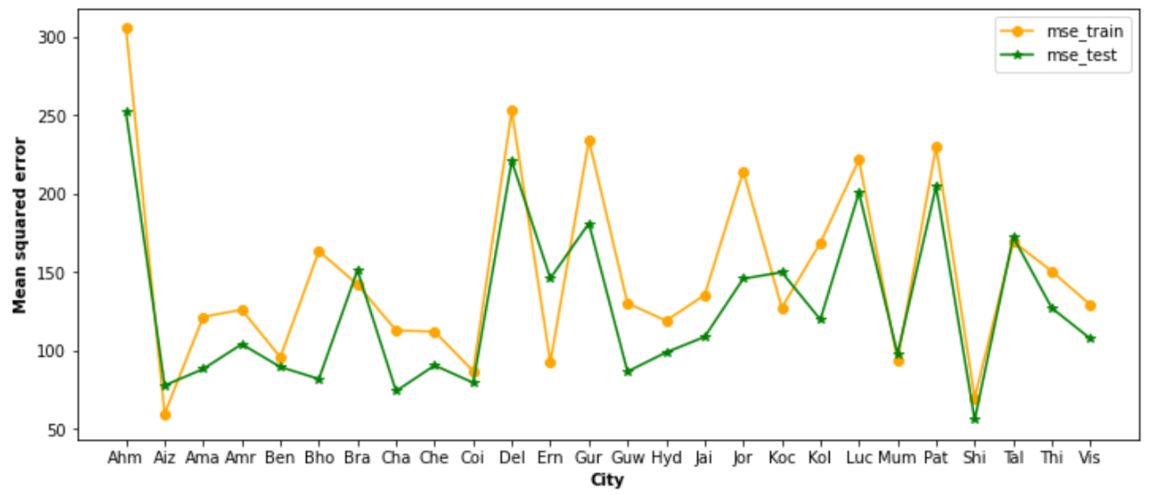
Citywise mean squared error
(ii) Stacked LSTM
LSTMs are widely used for sequence prediction problem. The stacked LSTM model was capable of forecasting future days AQI for different cities on basis of past AQI information available.
Citywise Mean Squared error

Slide 11
Thank You !
[Github link for our project]
https://github.com/Haaabs/FTS-Air-Quality-Index-Prediction
[Drive link for our project]
https://drive.google.com/drive/folders/1F2tTiHf2wsl7PRcYZBMs1Qb6jrForROg
[References]
https://www.researchgate.net/publication/341990700_AIR_QUALITY_INDEX_FORECASTING_USING_HYBRID_NEURAL_NETWORK_MODEL_WITH_LSTM_ON_AQI

