Slide 1
Outline
What is Machine Learning
Challenges
Types of machine learning
Role of data

Slide 2
Data in ML
We saw that data plays a central role in Machine Learning
Data needs preprocessing - some cleaning and human manipulation before they’re ready for consumption
This makes the data more workable
Typically involves modifying and removing incomplete, incorrectly formatted, irrelevant or duplicated data
Might also include converting text-based data to numeric values and the redesigning of features.
A very important step that demands time and effort

Slide 3
Preliminaries
Please ensure that you are up-to-date with basic statistics concepts
Min, max, range, mean, median, quartiles, mode, variance, standard deviation

Slide 4
Feature selection
Important to use judgement in selecting the variables in our model
Must discard features that don’t correlate strongly with the output value since this can affect the model’s accuracy adversely
Suppose we want to select variables that contribute to making a language endangered
Consider the following feature set
Language name in English
Language name in Spanish
Country name
Country Code
Number of speakers
Feature ii does not contribute to knowing if a language is endangered – remove
Features iii and iv give the same information, remove any one

Slide 5
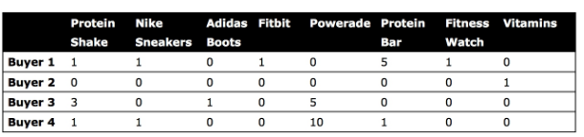
Feature selection
Another method to reduce the number of features is to combine multiple related features
Table shows fitness products
Can be combined to 3 columns instead of 8
Protien shake, Powerade, Vitamins, Protein bar - health foods
Nike sneakers, Adidas shoes – shoes
Fitbit, Fitness watch are - devices

Slide 6


Row compression
Suppose we have a table as above for classifying animals
We can compress rows and get a table as below

Slide 7
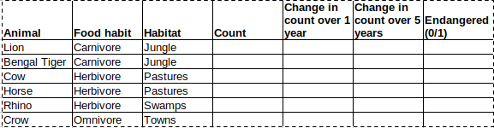
Numerical and categorical attributes
Most algorithms work with numbers
However, we often have categorical attributes – carnivore, herbivore, omnivore etc
One way to convert this to numbers is use “Label Encoding” – Carnivore: 1, Herbivore: 2, Omnivore: 3
However, ML algorithms may think labels closer to each other are more related
One hot encoding
Here each value in the category becomes a feature and the value of an instance for the feature is 0 or 1

Slide 8
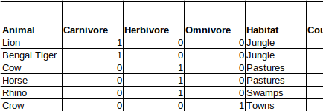
Numerical and categorical attributes
One hot encoding
Increase in number of columns/attributes

Slide 9
Binning
Converting continuous numeric values into multiple categorical features called bins or buckets according to their range of values
Useful because sometimes actual numerical values do not add much more value
For example, it may be sufficient to know a student’s grade (from A to E), rather than the actual percentage score

Slide 10
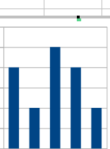
Equal width binning
Equal-width binning is simple often works well
Data is sorted in ascending order
The number of bins has to be specified
Height of each bin depends on number of values in that interval
Exampe: {1,3,6,6,7,11,12,13,14,15,16, 17,18,19,20,22,24}, # bins=5
Width of bin (w)= (24-1)/5 = 5
Intervals i1, i2, i3, i4, i5 are
min+w, min+2w,...min+5w
<=6, <=11, <=16,<=21<=26
1st bin has 4, 2nd has 2, 3rd has 5, 4th has 4, 5th has 2
Score distribution
1
2
3
4
5
6
7
8
9
10
11
12
13
14
15
16
17
18
19
20
21
22
23
24

Slide 11
Equal frequency binning
Equal-frequency binning is simple often works well
Data is sorted in ascending order
The number of bins has to be specified
Data is distributed into bins such that each bin has approx same number of values
{1,2,3,5,6,6,7,11,12,13,14,15,16, 17,18,19,20,22,24,25}, # bins=5
# values in each bin is 20/5 =4
b1 has 1,2,3,5; b2 has 6,7,11; b3 has 12,13,14,15; b4 has 16,17,18,19; b5 has 20, 22, 24, 25
1
2
3
4
5
6
7
8
9
10
11
12
13
14
15
16
17
18
19
20
21
22
23
24
25
14

Slide 12
Visualizing relationships between features
The scatter plot – very important tool in data visualization
Based on two axes: the horizontal axis represents one feature, and the vertical axis represents a second
Each instance in a dataset is represented by a point on the plot determined by the values for that instance of the two features being plotted
Scatter plot matrix (SPLOM) shows scatter plots for a whole collection of features arranged into a matrix

Slide 13
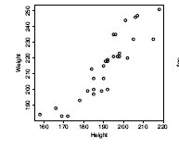
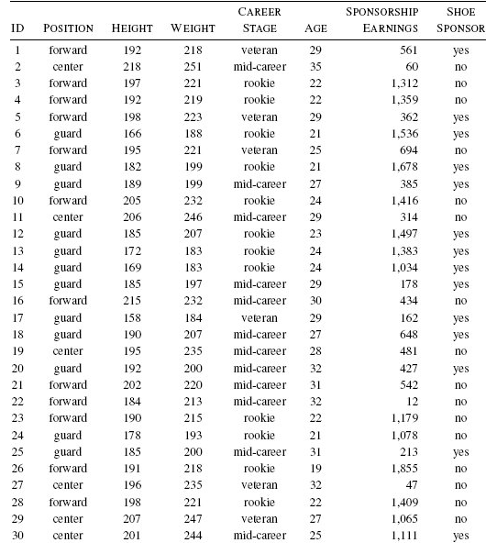
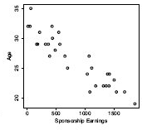
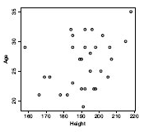
Example

Slide 14
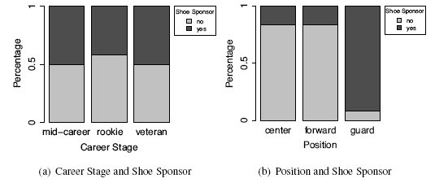
Visualizing relationships between categorical features
Stacked bar graphs

Slide 15
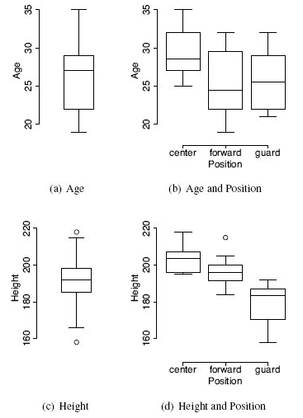
Visualizing relationships between continuous and categorical features
Density histograms
Box whisker plots

Slide 16


Covariance and correlation
Used to calculate formal measures of the relationship between two continuous features
For two features, a and b, in a dataset of n instances, the sample covariance between a and b is
where ai and bi are values of features for the ith instance in a dataset, and are the sample means of features a and b
Covariance values fall into the range [−∞, ∞] where negative values indicate a negative relationship, positive values indicate a positive relationship, and values near zero indicate that there is little or no relationship between the features

Slide 17
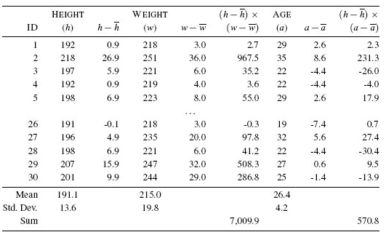
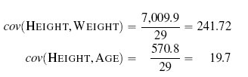
Covariance
Covariance numbers indicate that there is a strong positive relationship between the height and weight of a player, and a much smaller positive relationship between height and age.
This supports the relationships suggested by the scatter plots of these pairs of features shown earlier

Slide 18
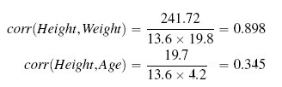
Correlation
Correlation is a normalized form of covariance that ranges between −1 and +1
Correlation between two features by dividing the covariance between the two features by the product of their standard deviations.

Slide 19
Data prep - Normalization
Sometimes different continuous features have very varying ranges – for eg., age can vary between 5 and 100, height in metres can vary from 1.524 to 1.9812, population can vary from 10,000 to 1,00,00,000
Normalization rescales the range of values for a given feature into a range with a prescribed minimum and maximum, such as [0, 1] or [−1, 1].
Helps to normalize the variance among the dataset’s features
Not recommended for rescaling features with an extreme range as the normalized range is too narrow to emphasize extremely high or low feature values

Slide 20
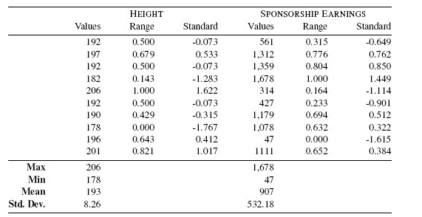

Data prep - Normalization
ai’ is the normalized feature value, ai is the original value, min(a) is the minimum value of feature a, max(a) is the maximum value of feature a, and low and high are the minimum and maximum values of the desired range. Typical ranges used for normalizing feature values are [0,1] and [−1,1].

Slide 21

Standardization
A better technique for emphasizing high or low feature values is standardization.
A standard score measures how many standard deviations a feature value is from the mean for that feature
To calculate a standard score, we compute the mean and standard deviation for the feature and normalize the feature values using the following equation
An extremely high or low value would be expressed as three or more standard deviations from the mean
is the normalized feature value, ai is the original value, is the mean for feature a,
and sd(a) is the standard deviation for a
Standardization assumes that data is normally distributed
If this assumption does not hold, then standardization may introduce some distortions

Slide 22
Missing data
Missing values unfortunately are a fact of life
Can minimize the negative impact of missing data.
One approach is to approximate missing values using the mode value.
This works best with categorical and binary variable types
The second approach is to approximate missing values using the median value
This works best with continuous variables
Last resort - remove the entire row if 1 or more attributes are missing
To be avoided if possible

