Slide 1
Back End Programming
Juha Hinkula and Jukka Juslin

Slide 2
Server Programming course
Introduction to the server side programming
See the course description in the moodle
Course contains
Lectures
Excercises
Project

Slide 3
Server Programming
Project
Individual server side programming project
Topic should be approved by the teacher
Project includes
Project proposal
Planning
Programming
Testing
Documentation & Code comments
Final review

Slide 4
Basics
Front-end vs Back-end
The difference is not always perfectly clear
The Front-end is everything what end users see
Common front-end jobs are web designer and user experience designer
The Back-end (server side) defines how the site works like updates, content management etc.
The Back-end development is required to get dynamic sites
During this course we mostly focus on back-end development

Slide 5
MVC design pattern
MVC = Model View Controller
MVC is software design pattern which is often used for web application development
The roles for different parts:
Model
Model is responsible for maintaining the application data
View
View is responsible for viewing data to end users
Controller
Controller handle user inputs and interact with model

Slide 6
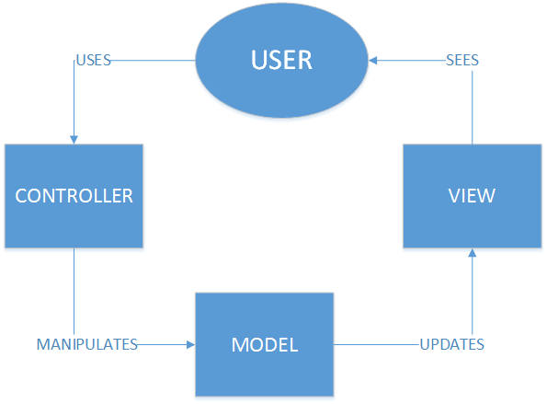
MVC

Slide 7
MVC
Popular MVC frameworks
Ruby on Rails
Django (Python)
ASP.NET MVC
Express (Node.js)
Spring MVC (Java)
Struts 2
backbone.js (JavaScript)
etc…

