Slide 1
Server Programming Spring Boot introduction
Juha Hinkula and Jukka Juslin
Updated Minna Pellikka 09.01.2025

Slide 2
Spring
Spring framework: https://spring.io/
Spring framework is an open source application framework for Java platform
The most popular framework for Java EE
First version was released under Apache 2.0 license in 2003
Spring is modular and it contains lot of extensions for different purposes

Slide 3
Spring
Material
Getting Started Guides: https://spring.io/guides
Tutorials: https://spring.io/guides#tutorials
Tutorialspoint: http://www.tutorialspoint.com/spring/

Slide 4
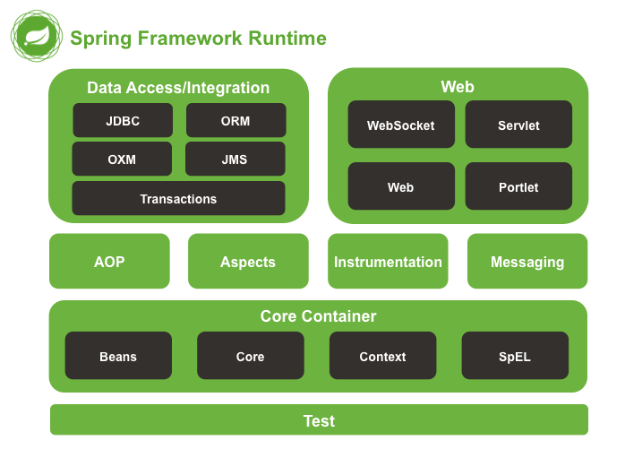

Slide 5
Dependency Injection (DI)
Web appliction typically contains object that have dependencies to each others
Dependency injection helps interaction between classes but same time keeping them independent

Slide 6
Dependency Injection (DI) example
Without DI
public class Vehicle {
private Owner owner;
public Vehicle() {
owner = new Owner();
}
}
With DI
public class Vehicle {
private Owner owner;
public Vehicle(Owner owner) {
this.owner = owner;
}
}

Slide 7
Spring Boot
Spring Boot helps to easily setup new Spring project
Create stand-alone Spring applications
Embedded application server
Starter POM’s for Maven configuration
Minimized the need of configuration

Slide 8
Maven
Apache Maven is a software project management and comprehension tool
https://maven.apache.org/
Maven objectives
Easy build process
Uniform build system
Transparent migration of new features
Guidelines for best practice development

Slide 9
Maven
Maven in 5 minutes: https://maven.apache.org/guides/getting-started/maven-in-five-minutes.html
The pom.xml file is the core of the project configuration in Maven
Single configuration file to build a project

Slide 10
POM.XML example
<?xml version="1.0" encoding="UTF-8"?>
<project xmlns="http://maven.apache.org/POM/4.0.0" xmlns:xsi="http://www.w3.org/2001/XMLSchema-instance"
xsi:schemaLocation="http://maven.apache.org/POM/4.0.0 http://maven.apache.org/xsd/maven-4.0.0.xsd">
<modelVersion>4.0.0</modelVersion>
<groupId>fi.haagahelia.course</groupId>
<artifactId>helloFormValidation</artifactId>
<version>0.0.1-SNAPSHOT</version>
<packaging>jar</packaging>
<name>helloFormValidation</name>
<description>Demo project for Spring Boot</description>
<parent>
<groupId>org.springframework.boot</groupId>
<artifactId>spring-boot-starter-parent</artifactId>
<version>3.4.1</version>
<relativePath/> <!-- lookup parent from repository -->
</parent>
<url />
<licenses>
<license />
</licenses>
<developers>
<developer />
</developers>
<scm>
<connection />
<developerConnection />
<tag />
<url />
</scm>
<properties>
<java.version>17</java.version>
</properties>
<dependencies>
<dependency>
<groupId>org.springframework.boot</groupId>
<artifactId>spring-boot-starter</artifactId>
</dependency>
<dependency>
<groupId>org.springframework.boot</groupId>
<artifactId>spring-boot-starter-web</artifactId>
</dependency> …..

Slide 11
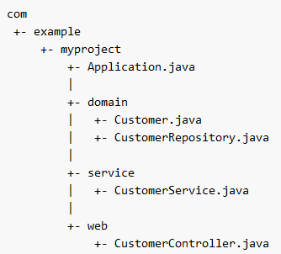
Spring Boot
Recommended project structure
NOTE! locate the main application class in a root package above other classes. Otherwise your application won’t work properly

Slide 12
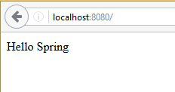
Spring Boot
First Spring Boot project
Create a new Spring Boot project according to instructions in course site
Add new controller class HelloController.java (code in next slide)
Run your project and browse to localhost:8080

Slide 13
Spring Boot
import org.springframework.stereotype.Controller;
import org.springframework.web.bind.annotation.RequestMapping;
import org.springframework.web.bind.annotation.ResponseBody;
@Controller
@ResponseBody
public class HelloController {
@RequestMapping("*")
public String hello() {
return "Hello Spring";
}
}

Slide 14
Spring Boot & Spring web MVC
Spring uses annotations (starts with ’@’-sign) for configuration
@Controller annotation
Marks class as a Spring web MVC controller
@ReponseBody annotation
Converts the return value and write it to http reponse
@RequestMapping annotation
Mapping URLs to controller methods

Slide 15
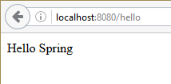
Spring Boot
@RequestMapping(”*”) means for any path in the application will excecute hello() method.
Change the code @RequestMapping(”/hello”)means that path address:port/hello excecutes hello() method.

Slide 16
Request parameters
HTTP GET request can contain parameters
Example
http://localhost:8080/hello?firstname=John&lastname=Doe
In HTTP POST request parameters are sent in the request body

Slide 17


Spring Boot
@RequestParam annotation binds the value of request parameter into name variable
@Controller
@ResponseBody
public class HelloController {
@RequestMapping("/hello")
public String hello(@RequestParam(name=“firstname") String firstName) {
return "Hello " + firstName;
}
}

Slide 18

Spring Boot
In the pevious example the parameter is mandatory. If it is not required you can use following parameters in @RequestParam annotation
public String hello(@RequestParam(name=“firstname", required=false, defaultValue="World") String firstName)
If the request does not contains parameter the default value is used

Slide 19
Spring Boot
Spring Boot packs everything to one executable JAR package
Excecution starts from the main application class (main() method)
package hello;
import org.springframework.boot.SpringApplication;
import org.springframework.boot.autoconfigure.SpringBootApplication;
@SpringBootApplication
public class Application {
public static void main(String[] args) {
SpringApplication.run(Application.class, args);
}
}

Slide 20
Spring Boot
@SpringBootApplication annotation adds following annotations
@Configuration tags the class as a source of bean definitions for the application context.
@EnableAutoConfiguration tells Spring Boot to start adding beans based on classpath .
@ComponentScan tells Spring to look for other components, configurations, and services in the package
@EnableWebMvc annotation flags the application as a web application and activates key behaviors such as setting up a DispatcherServlet

