Slide 1
Back End Programming Views & Model

Slide 2
Spring Boot
Thymeleaf is used for the views during this course
Thymeleaf is a modern server-side Java template engine for web and standalone environments
www.thymeleaf.org
How to start? Add dependency to pom.xml
<dependency>
<groupId>org.springframework.boot</groupId>
<artifactId>spring-boot-starter-thymeleaf</artifactId>
</dependency>

Slide 3

Spring Boot
Thymeleaf templates are HTML files that also work as static prototypes
With Spring Boot Thymeleaf templates are saved to resources/templates folder

Slide 4
Spring Boot
Thymeleaf template example
<!DOCTYPE html>
<html xmlns="http://www.w3.org/1999/xhtml" xmlns:th="http://www.thymeleaf.org">
<head>
<title>Server Programming</title>
<meta http-equiv="Content-Type" content="text/html; charset=UTF-8" />
</head>
<body>
<h1 th:text="'Hello ' + ${name}">Hello</h1>
</body>
</html>

Slide 5
Spring Boot
Accessing views
Controller handles request and returns the name of the View
Example below handels request for /index endpoint and returns view called ”index” (index.html Thymeleaf template)
Note! There is no @ResponseBody annotation when using Thymeleaf templates.
@Controller
public class MyController {
@RequestMapping("/index")
public String home() {
// do something
return "index";
}
}

Slide 6
Spring Boot
The value of a parameter can be added to the Model object that makes it accessible to the view
In a typical Spring application, Controller classes are responsible for preparing a model map with data and selecting a view to be rendered
...
import org.springframework.ui.Model;
@Controller
public class HelloController {
@RequestMapping("/hello")
public String greeting(@RequestParam(name="name") String name, Model model) {
model.addAttribute("name", name);
return "hello";
}
}

Slide 7
Spring Boot
In Thymeleaf, the model attributes can be accessed with the following syntax: ${attributeName}
Thymeleaf parses the template and evaluates th:text expression to render the value of the ${name} parameter
<!DOCTYPE HTML>
<html xmlns:th="http://www.thymeleaf.org">
<head>
<title>Server Programming with Spring Boot</title>
<meta http-equiv="Content-Type" content="text/html; charset=UTF-8" />
</head>
<body>
<p th:text="'Hello, ' + ${name} + '!'" />
</body>
</html>

Slide 8
Spring Boot
Model can contain the list of object which can be iterated and displayed as a table with Thymeleaf
In the following example messageRepository.findAll() method returns the list of message objects
@RequestMapping(”/message")
public String messages(Model model) {
model.addAttribute("messages", messageRepository.findAll());
return "messagelist”;
}

Slide 9
Spring Boot
Thymeleaf provides th:each attribute to iterate over the list of objects
<tr th:each="message : ${messages}">
<td th:text="${message.id}">1</td>
<td th:text="${message.text}">Text ...</td>
</tr>

Slide 10
Spring Boot
GET request
Values are sent in URL in URL’s query string
POST request
Values are sent in the request body
Typically used when sending a complete web form or uploading files
How to define request type in controller?
@RequestMapping(value="/greeting", method=RequestMethod.POST)
OR
@RequestMapping(value="/greeting", method=RequestMethod.GET)

Slide 11
Spring Boot
Instead of @RequestMapping annotation you can also use method specific shortcut annotations (@GetMapping, @PostMapping etc.)
@RequestMapping(value="/greeting", method=RequestMethod.POST)
EQUALS TO
@PostMapping("/greeting")

Slide 12
Spring Boot
Following mapping allows the controller to differentiate the requests to the /hello (GET and POST requests)
@Controller
public class HelloController {
@GetMapping("/hello")
public String greetingForm(Model model) {
model.addAttribute("message", new Message());
return "hello";
}
@PostMapping("/hello")
public String greetingSubmit(@ModelAttribute Message msg, Model model) {
model.addAttribute("message", msg);
return "result";
}
}

Slide 13
Spring Boot
HTML Forms are needed when you want to collect data from the application end users
A form will take input from the users and post it to a server
<form action="Script URL" method="GET|POST">
form elements like input, dropdowns...
</form>

Slide 14
Spring Boot: Form
Thymeleaf form example
<form action="#" th:action="@{/hello}" th:object="${message}“ method="post">
<p>Id: <input type="text" th:field="*{id}" /></p>
<p>Message: <input type="text" th:field="*{msg}" /></p>
<p><input type="submit" value="Submit" /></p>
</form>
th:action="@{/hello}" expression directs the form to POST to the /hello endpoint
th:object="${message}" expression is the model object used to collect data. We need to create Message class next.

Slide 15
Spring Boot: Form
Message class
public class Message {
private long id;
private String msg;
... getters an setters
}

Slide 16
Spring Boot: Form
Controller handles the form submit
The msgSubmit() method is mapped to POST
...
@PostMapping("/hello")
public String msgSubmit(@ModelAttribute Message msg, Model model) {
model.addAttribute("message", msg);
return "redirect:/result";
}
...
It is recommended to use redirect afer POST. That prevents duplicate form submissions (PostRedirectGet = PRG)

Slide 17
Spring Boot: Form
Finally we need Thymeleaf template for showing results (result.html)
<!DOCTYPE HTML>
<html xmlns:th="http://www.thymeleaf.org">
<head>
<title>Server Programming</title>
<meta http-equiv="Content-Type" content="text/html; charset=UTF-8" />
</head>
<body>
<p th:text="'id: ' + ${message.id}" />
<p th:text="'content: ' + ${message.msg}" />
<a href="/hello">Submit another message</a>
</body>
</html>

Slide 18
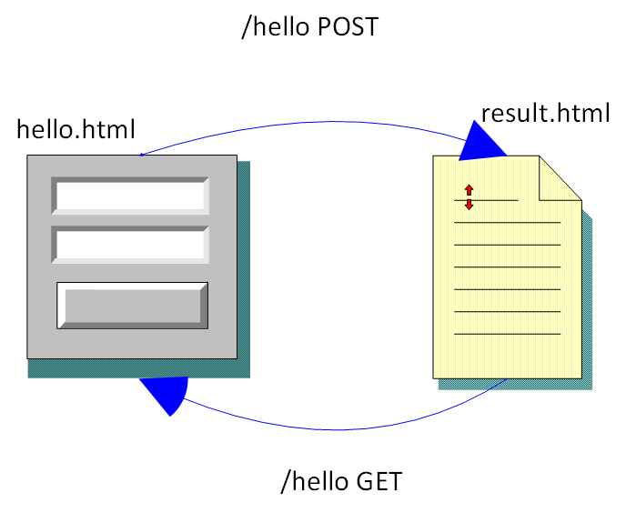
Spring Boot: Form
HelloForm example

Slide 19
Spring Boot: Form validation
Validation: Class attributes can be flagged with standard validation attributes (=Bean validation)
import jakarta.validation.constraints.Min;
import jakarta.validation.constraints.NotNull;
import jakarta.validation.constraints.Size;
public class Message {
@NotNull
private long id;
@Size(min=2, max=30)
private String name;
...getters & setters
}

Slide 20
Spring Boot: Form validation
POM.XML: insert validation depencency
<dependency>
<groupId>org.springframework.boot</groupId>
<artifactId>spring-boot-starter-validation</artifactId>
</dependency>
Controller: Add new arguments to controller request methdod. BindingResult object is used to check validation result. @Valid attribute gather attributes filled out in the form.
@RequestMapping(value="/hello", method=RequestMethod.POST)
public String greetingSubmit(@Valid Message msg, BindingResult bindingResult
, Model model) {
if (bindingResult.hasErrors()) {
return "hello";
}
model.addAttribute("message", msg);
return "result";
}

Slide 21
Spring Boot: Form validation
Thymeleaf provides validation function #fields.hasErrors() which can be used to check if field contains any validation errors
Example
<tr>
<td>Message: <input type="text" th:field="*{name}" /></td>
<td th:if="${#fields.hasErrors(’name')}" th:errors="*{name}">Error</td>
</tr>

Slide 22
Spring Boot
Demo codes
HelloForm
Simple form example
HelloFormValidation
Simple form example with validation
See ’How to run course demos’ instruction from the course Moodle site.

