Slide 1
Server Programming ORM/JPA, Databases
Minna Pellikka, Juha Hinkula and Jukka Juslin

Slide 2
Spring Boot: JPA
JPA (Java Persistence API) is a collection of classes to persistently store data into a database
JPA provides object – relational mapping for managing relational data in JAVA applications (ORM)
There is lot of implementations of the JPA (like Hibernate)
Dependency
<dependency>
<groupId>org.springframework.boot</groupId>
<artifactId>spring-boot-starter-data-jpa</artifactId>
</dependency>

Slide 3
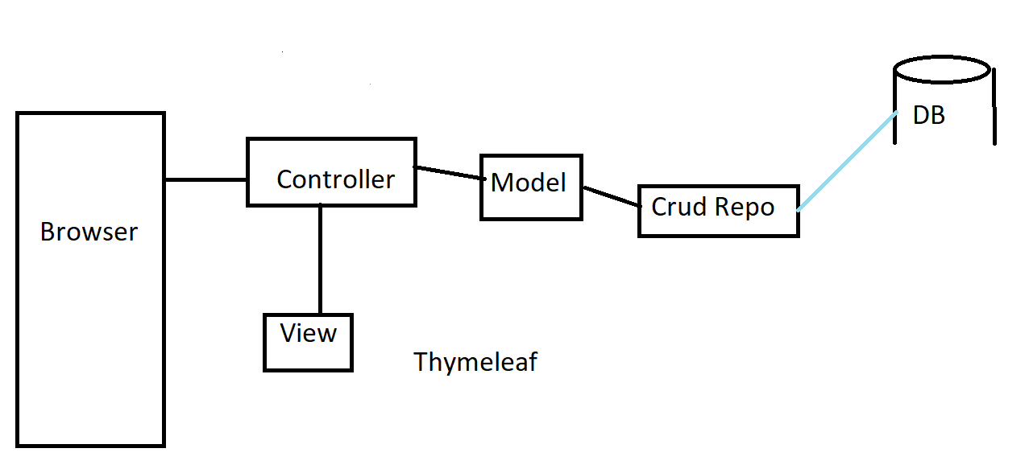
Architecture of this lesson setup

Slide 4
H2 database
H2 is open source Java based SQL database
www.h2database.com
Embedded and server modes: in-memory databases
Good database for prototyping, testing etc.
Dependency
<dependency>
<groupId>com.h2database</groupId>
<artifactId>h2</artifactId>
</dependency>

Slide 5
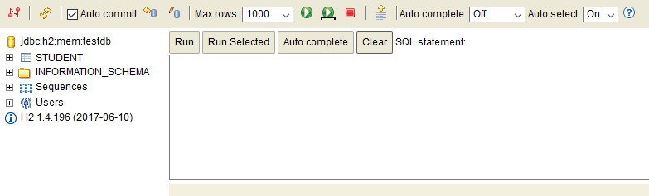
H2 database
H2 provides a web based console
Add following lines to the application.properties file
spring.h2.console.enabled=true
spring.h2.console.path=/h2-console
spring.datasource.url=jdbc:h2:mem:testdb
Navigate to localhost:8080/h2-console
JDBC URL = jdbc:h2:mem:testdb
Leave password field empty

Slide 6
Spring Boot: JPA
You can add following property to application.properties file. This enables the logging of SQL statements
spring.jpa.show-sql=true

Slide 7
Spring Boot: JPA
Entity
An entity represents a table in relational database
Entity class must be annotated with @Entity annotation (jakarta.persistence.Entity)
By default, the table name is the name of the entity class. It can be changed by using @Table annotation
import jakarta.persistence.Entity;
@Entity
public class Student {
// More code..

Slide 8
Spring Boot: JPA
@Id annotation is used for creating id column of the table
@GeneratedValue annotation generates automatically a unique primary key for every new entity object (GenerationType.Auto)
@Id
@GeneratedValue(strategy = GenerationType.AUTO)
private Long id;

Slide 9
Spring Boot: JPA
The other properties can be left unannotated. Then these properites are mapped to columns that share the same name as properties itself
@Column annotation can be used to specify mapped column. Example: @Column(name=”address”)
@Id
@GeneratedValue(strategy = GenerationType.AUTO)
private Long id;
private String firstName, lastName, email;
…getters and setters

Slide 10
Spring Boot: JPA
// Example Entity
@Entity
public class Student {
@Id
@GeneratedValue(strategy=GenerationType.AUTO)
private Long id;
private String firstName, lastName, email;
public Student() {}
public Student(String firstName, String lastName, String email) {
this.firstName = firstName;
this.lastName = lastName;
this.email = email;
}
@Override
public String toString() {
return "Student id=“ + id + “, firstName=“ + firstName + “,lastName=” + lastName;
}
}

Slide 11
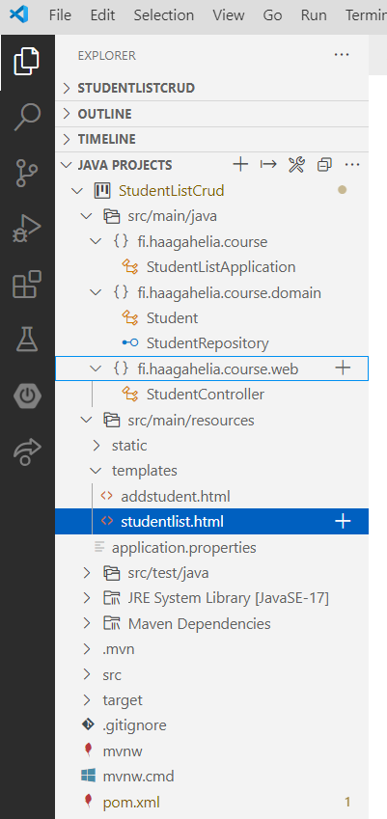
Wanted directory structure

Slide 12
Spring Boot: JPA
The CrudRepository provides CRUD functionality for the entity class that is being managed.
How to use repositories
Declare an interface extending Repository
Declare query methods on the interface
Get the repository instance injected and use it

Slide 13
Spring Boot: JPA
1. ) Declare an interface extending Repository (Create a new class which extends CrudRepository)
By extending CrudRepository the StudentRepository inherits methods for working with Student persistence, including methods for saving, deleting, and finding Student entities.
import org.springframework.data.repository.CrudRepository;
public interface StudentRepository extends CrudRepository<Student, Long> {
...
}

Slide 14
Spring Boot: JPA
2. ) Declare query methods on the interface
Note! In typical Java application you should write an class that implements StudentRepository. Spring Data JPA creates this automatically when you run the application.
import java.util.List;
import org.springframework.data.repository.CrudRepository;
public interface StudentRepository extends CrudRepository<Student, Long> {
List<Student> findByLastName(String lastName);
}

Slide 15
Spring Boot: JPA
3. ) Get the repository instance injected and use it
Constructor Injection annotation bring repository class into the context, and will inject an instance of the service into the YourAppClass class. Works only if there is only one constructor! Otherwise you need to use @Autowired annotation
@Controller
public class StudentController {
private StudentRepository repository;
// constructor injection. Can only be one constructor then.
public StudentController(StudentRepository repository) {
this.repository = repository;
}
@RequestMapping(value= {"/", "/studentlist"})
public String studentList(Model model) {
model.addAttribute("students", repository.findAll());
return "studentlist";
}
}

Slide 16
Spring Boot: JPA
Some useful CrudRepository methods
long count() | Returns the number of entities available.
void deleteById(ID id) | Deletes the entity with the given id
void delete(T Entity) | Deletes given entity
deleteAll() | Deletes all entities managed by the repository
Iterable<T> findAll() | Returns all entities
Optional<T> findById(ID id) | Retrieves an entity by its id
<S extends T> S save(S entity) | Saves a given entity

Slide 17
Spring Boot: CommandLineRunner
If you need to run some specific code when the SpringApplication has started, you can implement the CommandLineRunner interfaces. This is good place to add some demo data to your apllication
...
@Bean
public CommandLineRunner demo(StudentRepository repository) {
return (args) -> {
// Your code...add some demo data to db
};
}
...

Slide 18
Spring Boot: JPA
Adding List page to a Spring Boot application
1.) Create template for list page (studentlist.html).
<table class="table table-striped">
<tr>
<th>Name</th>
<th>Email</th>
</tr>
<tr th:each = "student : ${students}">
<td th:text="${student.firstName} + ' ' + ${student.lastName}"></td>
<td th:text="${student.email}"></td>
</tr>
</table>
…

Slide 19
Spring Boot: JPA
2.) Create method to your controller. All students are fetched from the database and added to the model attribute.
@Autowired
private StudentRepository repository;
…
@RequestMapping(value="/studentlist")
public String studentList(Model model) {
model.addAttribute("students", repository.findAll());
return "studentlist";
}
…

Slide 20
Spring Boot: JPA
Adding Create funtionality to a Spring Boot application
1.) Create template for adding new entity (in this example addstudent.html). Download source code from the course site.
…
<h1>Add student</h1>
<div>
<form th:object="${student}" th:action="@{save}" action="#" method="post">
<label for="fname">Firstname</label>
<input type="text" id="fname" th:field="*{firstName}" />
<label for="lname">Lastname</label>
<input type="text" id="lname" th:field="*{lastName}" />
<label for="email">Email</label>
<input type="text" th:field="*{email}" />
<input type="submit" value="Save"></input>
</form>
</div>
…

Slide 21
Spring Boot: JPA
2.) Create functionality to your controller
…
@RequestMapping(value = "/add")
public String addStudent(Model model){
model.addAttribute("student", new Student());
return "addstudent";
}
@RequestMapping(value = "/save", method = RequestMethod.POST)
public String save(Student student){
repository.save(student);
return "redirect:studentlist";
}
…
3.) Add link to create functionality
<a href="/add" class="btn btn-primary">Add Student</a>

Slide 22
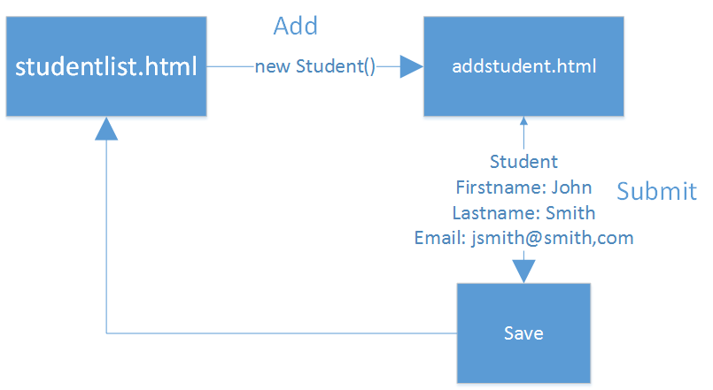

Slide 23
Spring Boot: JPA
Adding Delete funtionality to a Spring Boot application
1.) Create functionality to the controller
…
@RequestMapping(value = "/delete/{id}", method = RequestMethod.GET)
public String deleteStudent(@PathVariable("id") Long studentId, Model model) {
repository.deleteById(studentId);
return "redirect:../studentlist";
}
…
deleteStudent method listens /delete/studentid endpoint
By using @PathVariable annotation Spring extracts id from the URI
For example, request http://localhost:8080/delete/5, the @PathVariable studentId will be 5.

Slide 24
Spring Boot: JPA
2.) Add link to delete functionality (for example in the listpage row)
…
<a th:href="@{/delete/{id}(id=${student.id})}">Delete</a>
…

Slide 25
Spring Boot: CrudRepository
Query methods: CrudRepository can derive the query from the method name
Examples:
public interface StudentRepository extends CrudRepository<Student, Long> {
List<Student> findByLastName(String lastName);
List<Student> findByFirstNameAndLastName(String firstName, String lastName);
// Enabling ignoring case
List<Student> findByLastNameIgnoreCase(String lastName);
// Enabling ORDER BY for a query
List<Student> findByLastNameOrderByFirstNameAsc(String lastName);
}

Slide 26
Spring Boot: JPA
Relationships with JPA
One-to-Many
@OneToMany and @ManyToOne annotations defines a one-to-many and many-to-one relationship between two entities
@JoinColumn annotation defines the owner of the relationship
(Table has a column with a foreign key to the referenced table)

Slide 27
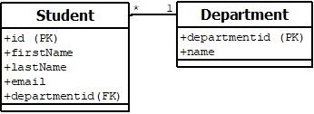
Spring Boot: JPA
Relationships with JPA
One-to-Many

Slide 28
Spring Boot: JPA
Student entity
Add new department attribute with @ManyToOne and @JoinColumn annotations
@ManyToOne
@JoinColumn(name = "departmentid")
private Department department;
Add getters and setters for department
Add department to constructor

Slide 29
Spring Boot: JPA
Department entity
Add new students attribute with @OneToMany annotation
@OneToMany(cascade = CascadeType.ALL,mappedBy = "department”)
private List<Student> students;
Add getters and setters

Slide 30
Spring Boot: JPA
Add CrudRepository for Department entity
import org.springframework.data.repository.CrudRepository;
public interface DepartmentRepository extends CrudRepository<Department, Long> {
...
}

Slide 31
Spring Boot: JPA
Add department dropdown list to student form
You have to add new model attribute to controller method which shows student creation form. You also have to inject department repository to controller
@Autowired
private StudentRepository repository;
@Autowired
private DepartmentRepository drepository;
// Add new student
@RequestMapping(value = "/add")
public String addStudent(Model model){
model.addAttribute("student", new Student());
model.addAttribute("departments", drepository.findAll());
return "addstudent";
}

Slide 32
Spring Boot: JPA
Add department dropdown list to student form
Departments can be now get from the model attribute in the template (departments attribute)
Select element shows department names (th:text) but the value will be departmentid (th:value)
<label for="deplist">Department</label>
<select id="deplist" th:field="*{department}" class="form-control">
<option th:each="department: ${departments}" th:value="${department.departmentid}"
th:text="${department.name}"></option>
</select>

Slide 33
Spring Boot: JPA
Show department name in the studentlist
<tr th:each = "student : ${students}">
<td th:text="${student.firstName} + ' ' + ${student.lastName}"></td>
<td th:text="${student.email}"></td>
<td th:text="${student.department.name}"></td>
<td><a th:href="@{/delete/{id}(id=${student.id})}">Delete</a></td>
</tr>

Slide 34
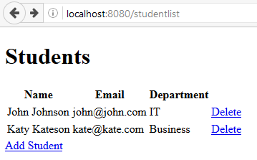
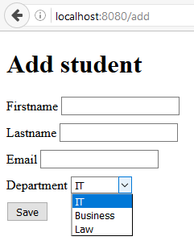
Spring Boot: JPA

Slide 35
Spring Boot: JPA
Edit functionality
Similar to Add functionality
Model contains now edited object instead of empty object (in the case of add)
// Edit student
@RequestMapping(value = "/edit/{id}")
public String showModStu(@PathVariable("id") Long studentId, Model model){
model.addAttribute("student", repository.findById(studentId);
model.addAttribute("departments", drepository.findAll());
return ”editstudent";
}

Slide 36
Spring Boot: JPA edit functionality continues
In thymeleaf need to be careful of proper syntax. For example modifystudent.html:
…
<body>
<h1>Modify student</h1>
<div>
<form th:object="${student}" th:action="@{../save}" action="#" method="post">
<label for="id"></label>
<input type="hidden" id="id" th:field="*{id}" readonly="readonly" />
<div style="clear: both; display: block; height: 10px;"></div>
<label for="studentNumber">Student number</label>
<input type="text" id="author" th:field="*{studentNumber}" />
<label for="catlist">Category</label>
<select id="catlist" th:field="*{category.categoryid}" class="form-control">
<option th:each="cat: ${categories}" th:value="${cat.categoryid}" th:text="${cat.name}"></option>
</select>
<div style="clear: both; display: block; height: 10px;"></div>
<input class="btn btn-success" type="submit" value="Save"></input>
</form>
</div>
</body>
</html>

Slide 37
Spring Boot: JPA
Edit functionality
Template for editing
Note! Id should be added otherwise new student is created
<form th:object="${student}" th:action="@{../save}" action="#" method="post">
<input type="hidden" th:field="*{id}" class="form-control"/>
<input type="text" th:field="*{firstName}" />
<input type="text" th:field="*{lastName}" />
<input type="text" th:field="*{email}" />
<input type="submit" class="btn btn-success" value="Save"></input>
</form>

Slide 38
Spring Boot: MariaDB
Switching database from H2 to MySQL/MariaDB
Remove H2 dependency from the pom.xml file
Add MySQL/MariaDB dependency to the pom.xml file
<dependency>
<groupId>mysql</groupId>
<artifactId>mysql-connector-java</artifactId>
<version>8.0.33</version>
</dependency> Add following database connection settings to the application.properties file:
spring.datasource.driver-class-name=com.mysql.cj.jdbc.Driver
spring.datasource.url=jdbc:mysql://localhost:3306/jusju?useUnicode=true&useJDBCCompliantTimezoneShift=true&useLegacyDatetimeCode=false&serverTimezone=UTC
spring.datasource.username=jusju
spring.datasource.password=YOUR_PASSWORD
spring.datasource.initialization-mode=always
spring.batch.initialize-schema=always

Slide 39
Spring Boot: MySQL/MariaDB
Switching database from H2 to MariaDB
For testing purposes you can install MariaDB locally and use localhost as server address. Change also password in the application.properties file (Password that you defined when installing MySQL/MariaDB).
Use HeidiSQL to create new database before running the application (see the next slide)
Set DB_NAME in the application.properties file to match name of the database you just created.
Run the application and check with HeidiSQL that database tables were created.

Slide 40
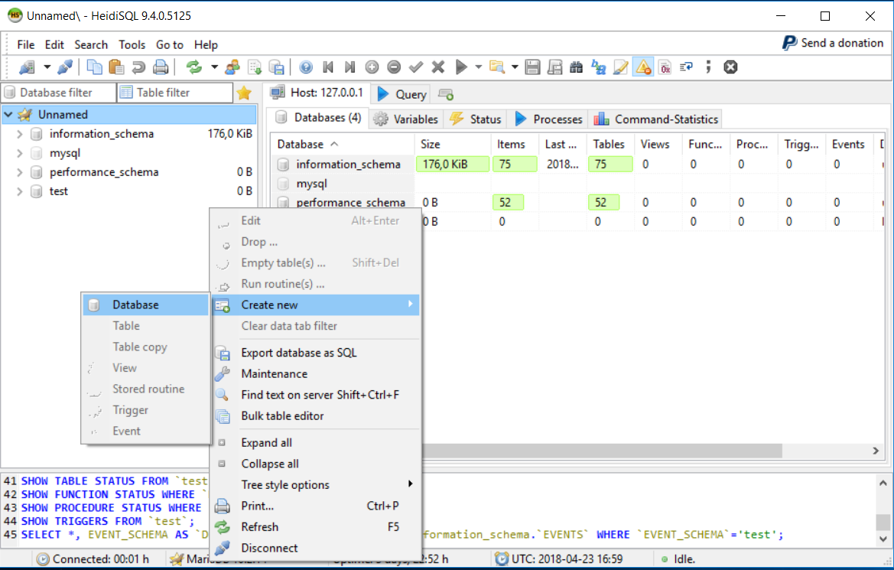
Spring Boot: MySQL/MariaDB

