Slide 1
Server Programming File upload
Juha Hinkula

Slide 2
Spring Boot – File upload
Add new controller for file uploading
@Controller
public class FileController {
}
Add method into controller that maps ’/’ – endpoint to upload.html thymeleaf template (GET method)
@GetMapping("/")
public String index() {
return "upload";
}

Slide 3
Spring Boot – File upload
Add upload.html thymeleaf template to resources/templates folder
enctype defines how data is encoded when sending to server. Use multipart/form-data in the case of file upload.
Form is posted to /upload endpoint
<!DOCTYPE html>
<html xmlns:th="http://www.thymeleaf.org">
<body>
<h1>File upload demo</h1>
<form method="POST" action="/upload" enctype="multipart/form-data">
<input type="file" name="file" /><br/>
<input type="submit" value="Submit" />
</form>
</body>
</html>

Slide 4
Spring Boot – File upload
Add method into controller for /upload endpoint (POST from the upload.html)
File can be accessed using RequestParam with id ’file’ (Name of the file input field in upload.html is file)
Spring MultipartFile can be used to temporarily store uploaded file.
@PostMapping("/upload")
public String fileUpload(@RequestParam("file") MultipartFile file, Model model) {
// File handling
}

Slide 5
Spring Boot – File upload
Check if the file is empty (no file has been chosen in upload form or file has no content) in fileUpload method. If it is empty move to uploadstatus thymeleaf template and add message to model attribute.
// In fileUpload method
if (file.isEmpty()) {
model.addAttribute("msg", "Upload failed");
return "uploadstatus";
}

Slide 6
Spring Boot – File upload
After empty file check we will add file handling that save uploaded file to upload folder.
Upload folder can be specified using application.properties file
Add following line to the application.properties file
upload.path=c:\\temp\\
You can read application.properties values using @Value(${propertyName}) annotation. Add following line at the beginning of your controller. It reads upload.path value from the application.properties file and save it to uploadFolder variable.
@Value("${upload.path}")
private String uploadFolder;

Slide 7
Spring Boot – File upload
// Note! Imports
import java.io.IOException;
import java.nio.file.Files;
import java.nio.file.Path;
import java.nio.file.Paths;
Add following file handling code after the empty file check in your controller. That save uploaded file to the upload folder defined in application.properties file.
try {
byte[] bytes = file.getBytes();
Path path = Paths.get(uploadFolder + file.getOriginalFilename());
Files.write(path, bytes);
model.addAttribute("msg", "File " + file.getOriginalFilename() + " uploaded");
} catch (IOException e) {
e.printStackTrace();
}
return "uploadstatus";

Slide 8
Spring Boot – File upload
Whole fileUpload method
@PostMapping("/upload")
public String fileUpload(@RequestParam("file") MultipartFile file, Model model) {
if (file.isEmpty()) {
model.addAttribute("msg", "Upload failed");
return "uploadstatus";
}
try {
byte[] bytes = file.getBytes();
Path path = Paths.get(uploadFolder + file.getOriginalFilename());
Files.write(path, bytes);
model.addAttribute("msg","File "+file.getOriginalFilename()+" uploaded");
} catch (IOException e) {
e.printStackTrace();
}
return "uploadstatus";
}

Slide 9
Spring Boot – File upload
Finally we will implement uploadstatus.html thymeleaf template that show the status of upload.
<!DOCTYPE html>
<html xmlns:th="http://www.thymeleaf.org">
<body>
<h3 th:text="${msg}" />
</body>
</html>

Slide 10
Spring Boot – File upload
We also have to enable multipart file upload. Add following line to the application.properties file
spring.servlet.multipart.enabled=true
Default max file size in Spring is 1MB. You can change this value with following settings in the application.properties file
spring.servlet.multipart.max-file-size=10MB
spring.servlet.multipart.max-request-size=10MB

Slide 11
Spring Boot – File upload
The whole source code can be found from course demos github (Filedemo)
https://github.com/juhahinkula/ServerProgramming.git

Slide 12
Spring Boot – File upload
How to save uploaded files to database?
Add database & JPA dependencies
Create model class for files. File content is saved to LOB (Large object) field.
@Entity
public class FileModel {
@Id
@GeneratedValue(strategy = GenerationType.AUTO)
private long id;
private String fileName, mimeType;
@Lob
private byte[] file;
...constructors, getters, setters

Slide 13
Spring Boot – File upload
Create repository class for file model class
public interface FileModelRepository extends CrudRepository<FileModel, Long> {
}

Slide 14
Spring Boot – File upload
In the file controller, create new FileModel entity and save it to a database.
try {
byte[] bytes = file.getBytes();
FileModel fileModel = new FileModel(file.getOriginalFilename(), file.getContentType(), bytes);
repository.save(fileModel);
model.addAttribute("msg", "File " + file.getOriginalFilename() + " uploaded");
} catch (IOException e) {
e.printStackTrace();
}

Slide 15
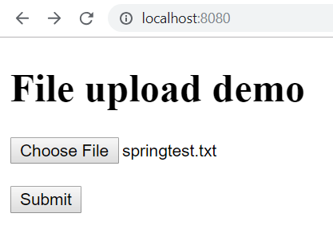
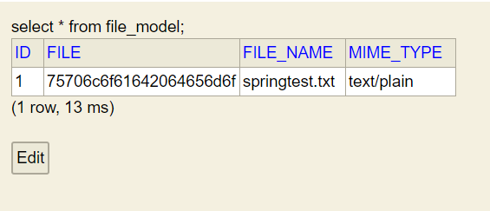
Spring Boot – File upload

Slide 16
Spring Boot – File upload
How to list uploaded files and add download functionality?
Add method to controller for fetching all files.
@GetMapping("/files")
public String fileList(Model model) {
model.addAttribute("files", repository.findAll());
return "filelist";
}

Slide 17
Spring Boot – File upload
Add filelist.html thymeleaf template to show files
...
<body>
<h1>Files</h1>
<table>
<tr>
<th>Name</th>
<th>Type</th>
</tr>
<tr th:each = "file : ${files}">
<td th:text="${file.fileName}"></td>
<td th:text="${file.mimeType}"></td>
</tr>
</table>
<a href="/">Upload</a>
</body>
…

Slide 18
Spring Boot – File upload
Add method to controller for file download. Spring ReponseEntity represents HTTP request or response. File content is added to the body of response. Content-Disposition header indicates that response contains attachment.
@GetMapping("/file/{id}")
public ResponseEntity<byte[]> getFile(@PathVariable Long id) {
Optional<FileModel> fileOptional = repository.findById(id);
if(fileOptional.isPresent()) {
FileModel file = fileOptional.get();
return ResponseEntity.ok()
.header(HttpHeaders.CONTENT_DISPOSITION, "attachment; filename=\"" + file.getFileName() + "\"")
.body(file.getFile());
}
return ResponseEntity.status(404).body(null);
}

Slide 19
Spring Boot – File upload
Add download link to filelist
...
<body>
<h1>Files</h1>
<table>
<tr>
<th>Name</th>
<th>Type</th>
</tr>
<tr th:each = "file : ${files}">
<td th:text="${file.fileName}"></td>
<td th:text="${file.mimeType}"></td>
<td><a th:href="@{/file/{id}(id=${file.id})}">Download</a></td>
</tr>
</table>
<a href="/">Upload</a>
</body>
…

Slide 20
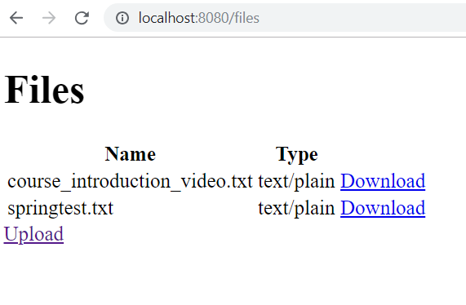
Spring Boot – File upload

Slide 21
Spring Boot – File upload
The whole source code can be found from course demos github (FiledemoDb)
https://github.com/juhahinkula/ServerProgramming.git

