Slide 1
Back End Programming
REST

Slide 2
Spring Boot: REST
REST (Representational State Transfer)
REST is an architectural style for designing distributed systems. It is not a standard but a set of constraints
Main principles
Resources expose easily understood directory structure URIs
Representations transfer JSON or XML to represent data objects and attributes
Messages use HTTP methods (POST, GET, PUT, DELETE)
PUT to modify and POST to add new
Stateless interactions store no client context on the server between requests

Slide 3
REST Endpoints
Http Method | Resource Endpoint | Actions
GET | /students | Get All Students
POST | /students | Add New Student
GET | /students/{id} | Get One Student
PUT | /students/{id} | Update One Student
DELETE | /students/{id} | Delete One Student
Etc.

Slide 4
Spring Boot: REST
In Spring framework’s approach to building RESTful web services, HTTP requests are handled by a controller
Controllers are identified by @RestController annotation
Difference between REST and MVC controller are that REST controller returns HTTP response body and MVC controller returns a view.
REST controller will write object data to the HTTP response as JSON format
Spring uses Jackson JSON processor to convert object data to JSON

Slide 5
Spring Boot: REST
Example
In the following example you have Message class with two attributes (id, text)
@RestController
public class MessageController {
private final AtomicLong counter = new AtomicLong();
@RequestMapping("/hello")
public Message greeting(@RequestParam(value="name", defaultValue="World") String name) {
return new Message(counter.incrementAndGet(),"Hello " + name);
}
}

Slide 6


Spring Boot: REST
Example
First GET request with request parameter
Second GET request without request parameter

Slide 7
Spring Boot: REST
You can also create RESTful service by using @Controller and @ResponseBody annotations
@Controller
public class MessageController {
private final AtomicLong counter = new AtomicLong();
@RequestMapping("/hello")
public @ResponseBody Message greeting(@RequestParam(value="name", defaultValue="World") String name) {
return new Message(counter.incrementAndGet(),"Hello " + name));
}
}

Slide 8
Spring Boot: REST
Example: Add REST service to student list application (Example project from ORM One-to-many chapter)
The first method returns students to Thymeleaf template. The second method returns as JSON format.
// Show all students in Thymeleaf template
@RequestMapping(value="/studentlist", method = RequestMethod.GET)
public String studentList(Model model) {
model.addAttribute("students", repository.findAll());
return "studentlist"; // studentlist.html
}
// RESTful service to get all students
@RequestMapping(value="/students", method = RequestMethod.GET)
public @ResponseBody List<Student> studentListRest() {
return (List<Student>) repository.findAll();
}

Slide 9
Spring Boot: REST
You have to configure one-to-many relationship from JSON by using @JsonIgnore or @JsonIgnoreProperties annotation. Otherwise entity relationship will cause endless loop (First student is serialized and it contains department which is then serialized which contains students which are then serialized….)
Next slide has the usage for this relationship
@ManyToOne
@JoinColumn(name = "departmentid")
private Department department;

Slide 10
Spring Boot: REST
Department class has
@JsonIgnoreProperties("department")
// ignoring ’department’ attribute for all students
@OneToMany(cascade = CascadeType.ALL, mappedBy = "department")
private List<Student> students;

Slide 11
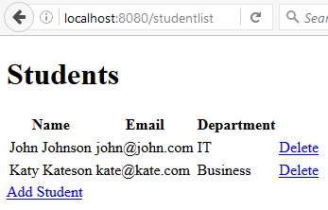
Spring Boot: REST
Now /students endpoint will return students in JSON
And /studentlist endpoint will return HTML page

Slide 12
Spring Boot: REST
RESTful service to find student by id using path variable
// RESTful service to get on student by id
@RequestMapping(value="/student/{id}", method = RequestMethod.GET)
public @ResponseBody Student findStudentRest(@PathVariable(”id”) Long studentId)
return repository.findById(studentId);
}

Slide 13
Spring Data REST
Spring Data REST builds on top of Spring Data repositories and automatically exports those as REST resources
Add dependency to get started with Spring Data REST
...
<dependency>
<groupId>org.springframework.boot</groupId>
<artifactId>spring-boot-starter-data-rest</artifactId>
</dependency>
...

Slide 14
Spring Data REST
Spring Data REST detects public repositories to determine if a repository will be exported as REST resource
You don't need to define any Controller
By default Spring Data REST serves REST resources in application root path ’/’.
Path can be changed in appliction.properties file
spring.data.rest.base-path=/api

Slide 15
Spring Data REST
If you have the following repository
public interface StudentRepository extends CrudRepository<Student, Long> { }
Spring Data REST will create REST service /students
Example: http://localhost:8080/api/students
The service path name is derived from the entity name (pluralized and uncapitalized)
Spring Data REST services contains also links to resources (using HAL format)

Slide 16
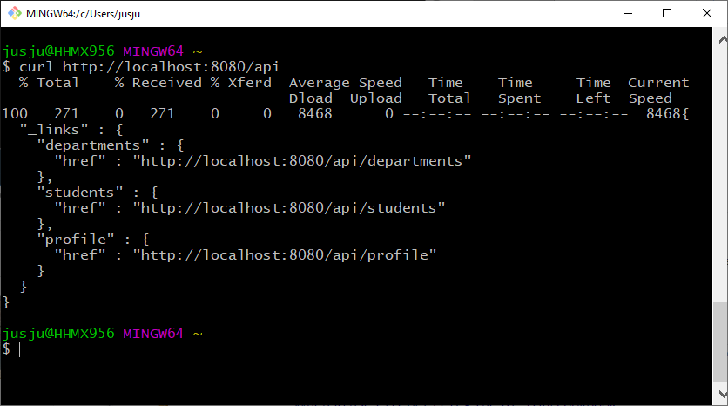
Spring Data REST
All available REST resources can be found with HTTP GET request to application root URL
Example: Student application

Slide 17
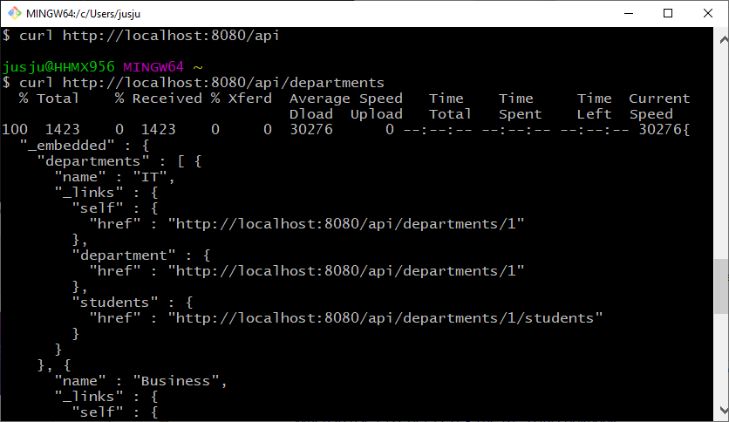
Spring Data REST
Departments REST service

Slide 18
Spring Data REST
curl -H "Content-Type: application/json" -X POST -d {\"username\":\"mkyong\",\"password\":\"abc\"} http://localhost:8080/api/login/
Services can be also used to add and delete items
Example:
Following POST request will add new student to database
curl -H "Content-Type: application/json" -X POST -d '{"firstName":"Jukka","lastName":"Juslin"}' http://localhost:8080/api/students
REST services can be also secured by using Spring Security (next lessons)

Slide 19
Spring Data REST
You can also use your queries from the CrudRepository by using Rest API
Example
@RepositoryRestResource
public interface StudentRepository extends CrudRepository<Student, Long> {
List<Student> findByEmail(@Param("email") String email);
}
Add @RepositoryRestResource annotation to your repository class and @Param annotation for your parameters
Now you can call your query by using following endpoint
http://localhost:8080/api/students/search/findByEmail?email=johnson@mail.com

Slide 20
DATA-REST HAL request
To add new student
{
"firstName": "Jukka",
"lastName": "Kateson",
"email": "kate@kate.com",
"department": "api/departments/1"
}

Slide 21
Example DATA REST commands with curl
$ curl -X PUT http://localhost:8080/api/students/6 -H 'Content-type:application/json' -d '{"firstName": "Samwise Gamgee", "lastName": "ring bearer"}'
$ curl -X DELETE http://localhost:8080/api/students/7

