Slide 1
Server Programming Testing
Juha Hinkula, Jukka Juslin, Tanja Bergius, Minna Pellikka

Slide 2
Spring Boot - Testing
Spring Boot provides a number of utilities and annotations to help when testing your application
When Spring boot project is created you can find from POM.XML test dependency
<dependency>
<groupId>org.springframework.boot</groupId>
<artifactId>spring-boot-starter-test</artifactId>
<scope>test</scope>
</dependency>
This dependency provides some libraries and tools for testing, for instance Junit.

Slide 3
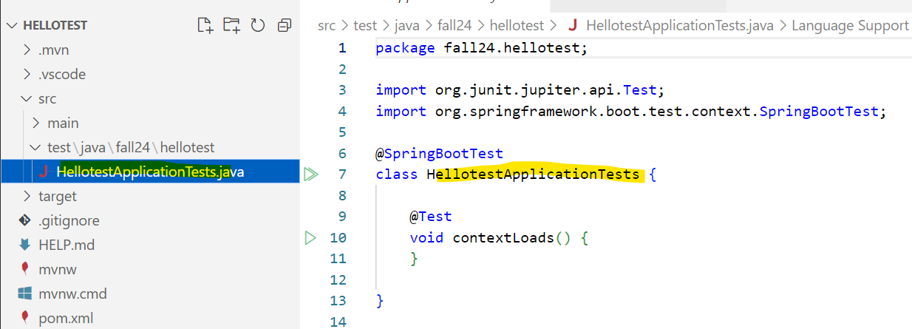
Spring Boot - Testing
Spring Boot will create automatically one test class for you

Slide 4
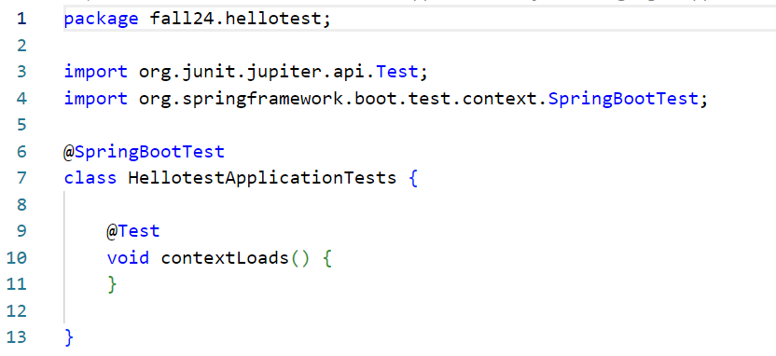
Spring Boot - Testing
@SpringBootTest annotation tells that entire application will be started so that it can be tested
@Test annotation defines a method to be tested
This is testing if application context is loaded without problems.

Slide 5
Spring Boot - Testing
Spring Boot test dependency will add AssertJ library for assertions (http://joel-costigliola.github.io/assertj/index.html)
Syntax
assertThat(objectToTest). // code completion -> assertions specific to objectToTest
Examples
assertThat(objectToTest).isNotNull();
assertThat(”Hello World”).contains(”Hello”);
assertThat(person.getName()).startsWith(”M”).endWith(”s”);

Slide 6
Spring Boot - Testing
Smoke testing
testing the major functions of software before carrying out formal testing
import static org.assertj.core.api.Assertions.assertThat;
import org.junit.jupiter.api.Test;
import org.springframework.beans.factory.annotation.Autowired;
import org.springframework.boot.test.context.SpringBootTest;
import fi.haagahelia.course.web.HelloController;
@SpringBootTest
public class HellotestApplicationTests {
@Autowired
private HelloController controller;
@Test
public void contexLoads() throws Exception {
assertThat(controller).isNotNull();
}
}

Slide 7
Spring Boot - Testing
Testing the web layer: Test will start the full Spring application context, but without the server by using Spring’s MockMvc.
@SpringBootTest
@AutoConfigureMockMvc
public class WebLayerTest {
@Autowired
private MockMvc mockMvc;
@Test
public void testDefaultMessage() throws Exception {
this.mockMvc.perform(get("/")).andDo(print()).andExpect(status().isOk())
.andExpect(content().string(containsString("Hello World")));
}
}

Slide 8
Testing the JPA repository / in-memory database
@DataJpaTest annotation will be used when testing in-memory database. It also turns on SQL logging
@DataJpaTest
public class StudentRepositoryTest {
@Autowired
private StudentRepository repository;
@Test
public void findByLastnameShouldReturnStudent() {
List<Student> students = repository.findByLastName("Johnson");
assertThat(students).hasSize(1);
assertThat(students.get(0).getFirstName()).isEqualTo("John");
}
@Test
public void createNewStudent() {
Department department = new Department("BITE");
drepository.save(department);
Student student = new Student("Mickey", "Mouse", "mm@mouse.com", department);
Student student = new Student("Mickey", "Mouse", "mm@mouse.com", new Department("BITE"));
repository.save(student);
assertThat(student.getId()).isNotNull();
}
}

Slide 9
JPA Testing on a real database (Postgres)
When testing with other than development database annotations change and the way to reference category
@SpringBootTest(classes = StudentListApplication.class)
@AutoConfigureTestDatabase(replace = AutoConfigureTestDatabase.Replace.NONE) //if you are using real db
public class StudentRepositoryTest {
@Autowired
private BookRepository repository;
@Autowired
private CategoryRepository crepository;
@Test
public void findByTitleShouldReturnAuthor() {
List<Book> books = repository.findByTitle("The Old Man And The Sea");
//assertThat(books).hasSize(1);
assertThat(books.get(0).getAuthor()).isEqualTo("Ernest Hemingway");
}
@Test
public void createNewBook() {
Book book = new Book("Paul Trembley", "A Head Full of Ghosts", 2015, 16.30, "ISBN434345621394", crepository.findByName("Classics").get(0));
repository.save(book);
assertThat(book.getId()).isNotNull();
}
}

