Slide 1


FINAL REPORT
INTERNSHIP BATCH 43
Mentor: Hồ Công Sơn
Conductor: Phạm Thế Bảo
Intern: Hà Thị Mai

Slide 2

CONTENT
REQUIREMENTS OF PROJECT
KEY DELIVERABLES
RESULTS ACHIEVED ACCORDING TO THE PROJECT REQUIREMENT
PROBLEMS AND SOLUTIONS
LESSONS LEARNT DURING INTERNSHIP

Slide 3

REQUIREMENTS OF PROJECT
sGAS is a management system for gas stations.
The system automates the process of retrieving data from pumps and transmitting it to the server for storage. Provides a website and mobile application that allows users to perform the following functions:

Slide 4
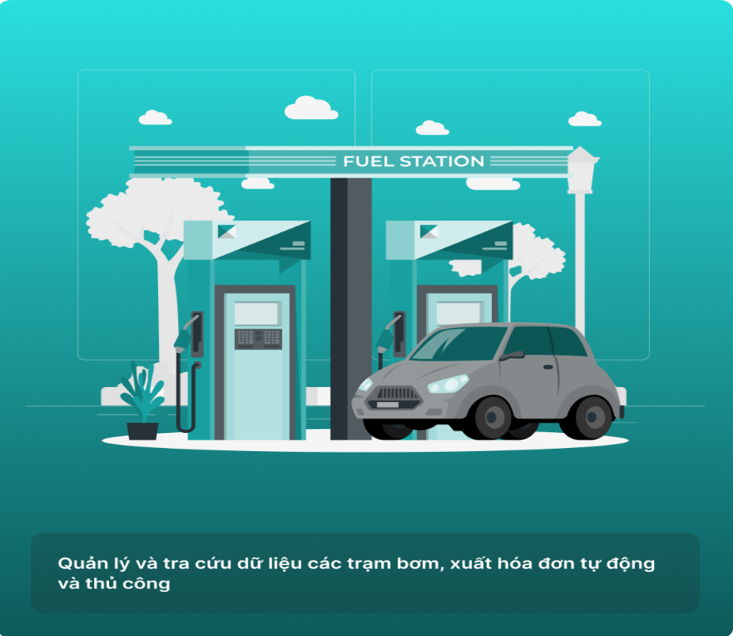
REQUIREMENTS OF PROJECT
01
02
03
Manage data and operations of remote pumps, manage shifts, open and close shifts, change prices.
Manage pumping times, issue invoices to send to the Tax Authority. Configure automatic retail invoice issuance.
Manage customers and debts of gas stations.
Manage drivers and automatically dispense gas and oil to drivers. Drivers scan the QR code at the gas station and fill up according to the provided configuration.

Slide 5

Learning and exploring about the software testing life cycle and tools used in testing
01
KEY DELIVERABLES
02
Build testcases
Tasks assigned during internship at the company
03
Executed testing on website
04
Report bug

Slide 6

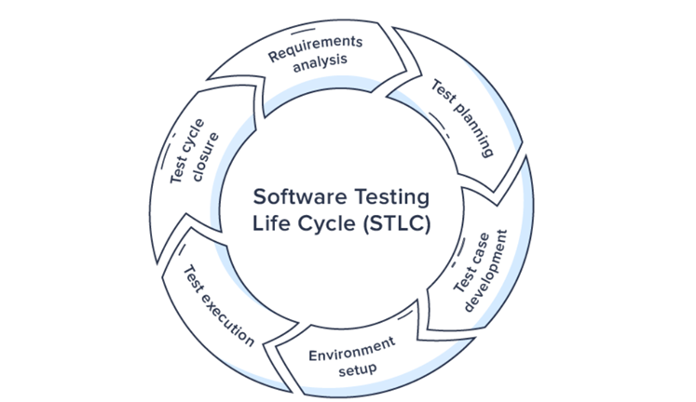

01
Learning and exploring about the software testing life cycle and tools used in testing

Slide 7
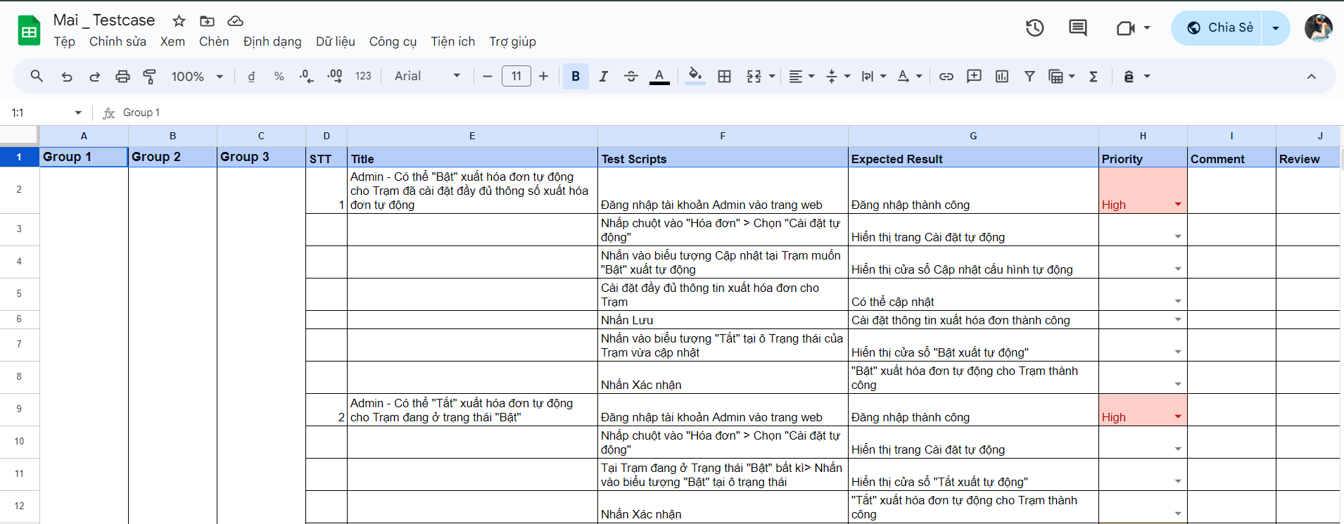
02
Build tescases

Slide 8
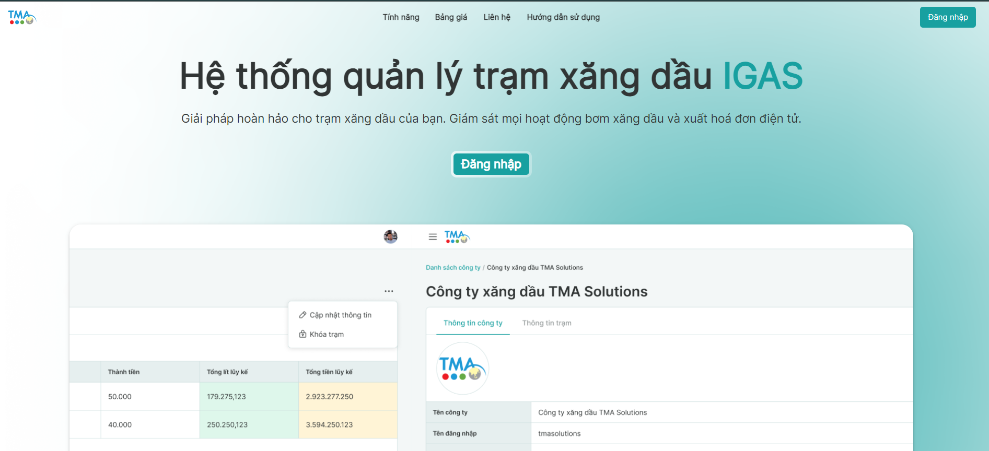
03
Executed Testcase on Website
Test Web’s UI

Slide 9
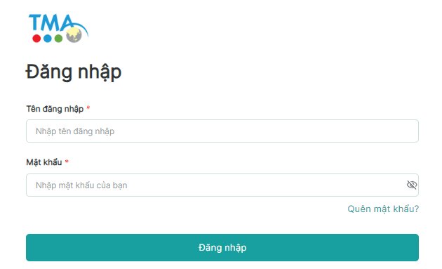
03
Executed Testcase on Website
Test Web’s Feature

Slide 10
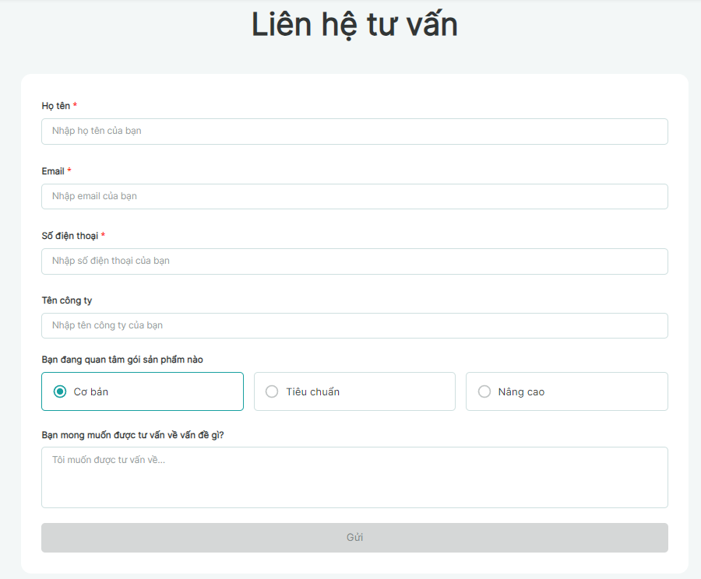
03
Executed Testcase on Website
Test Web’s Feature

Slide 11
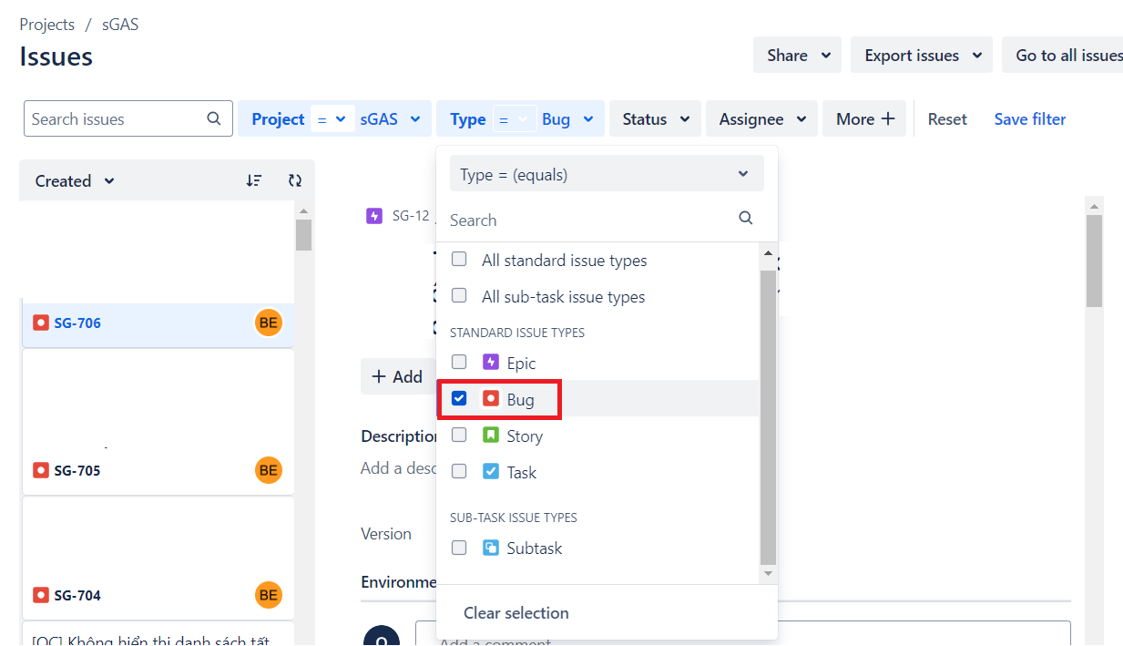
04
Report bug

Slide 12
PROBLEMS AND SOLUTIONS
Problems
Delays in testing and fixing
Small testing scopes can easily miss bugs
Bug reports do not fully describe the bug

Slide 13
PROBLEMS AND SOLUTIONS
Solutions
Expand the scope of test execution, test functions thoroughly, perform many exploratory tests
Report bugs accurately to mentor to cooperate with dev to quickly fix bugs
Thoroughly reviewed reported bugs

Slide 14
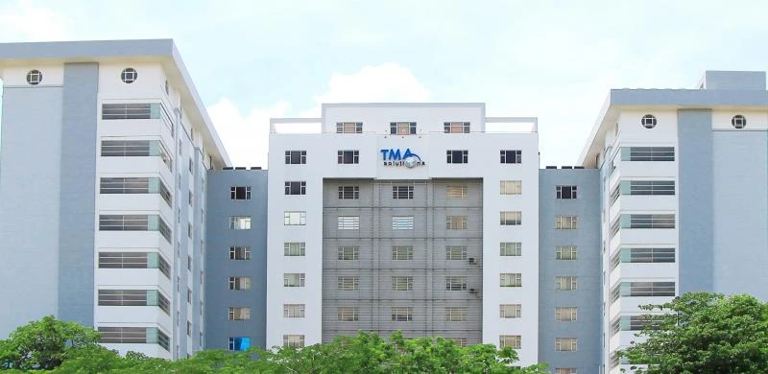
RESULTS ACHIEVED ACCORDING TO THE PROJECT REQUIREMENT
Understand the software development process
Complete test case writing with good evaluation
Complete project website test execution according to assigned tasks
Understand how to report/ comment bugs on jira

Slide 15

LESSONS LEARNT DURING INTERNSHIP
Technical Skill
Learned about manual testing
Learned how to build testccase and executed tescase
Learned about report bug on jira, how to using jira on project
Understand about software testing life cycle
knowledge of requirement analysis

Slide 16
LESSONS LEARNT DURING INTERNSHIP
Soft Skill
Reporting Skills: ability to Capture Information Concisely and Clearly
Communication skill: practice communication skills with colleagues and superiors at work
E-mail writing skill: cultivate professional email writing skills in a work environment
Teamwork skill: understand clearly about communication, work processes and management within a team
Work etiquette: learn how to behave and handle situations at work

Slide 17
THANK YOU!

