Slide 1
Optimizing Wastewater Pumping
Challenge for Junction 2025

Slide 2
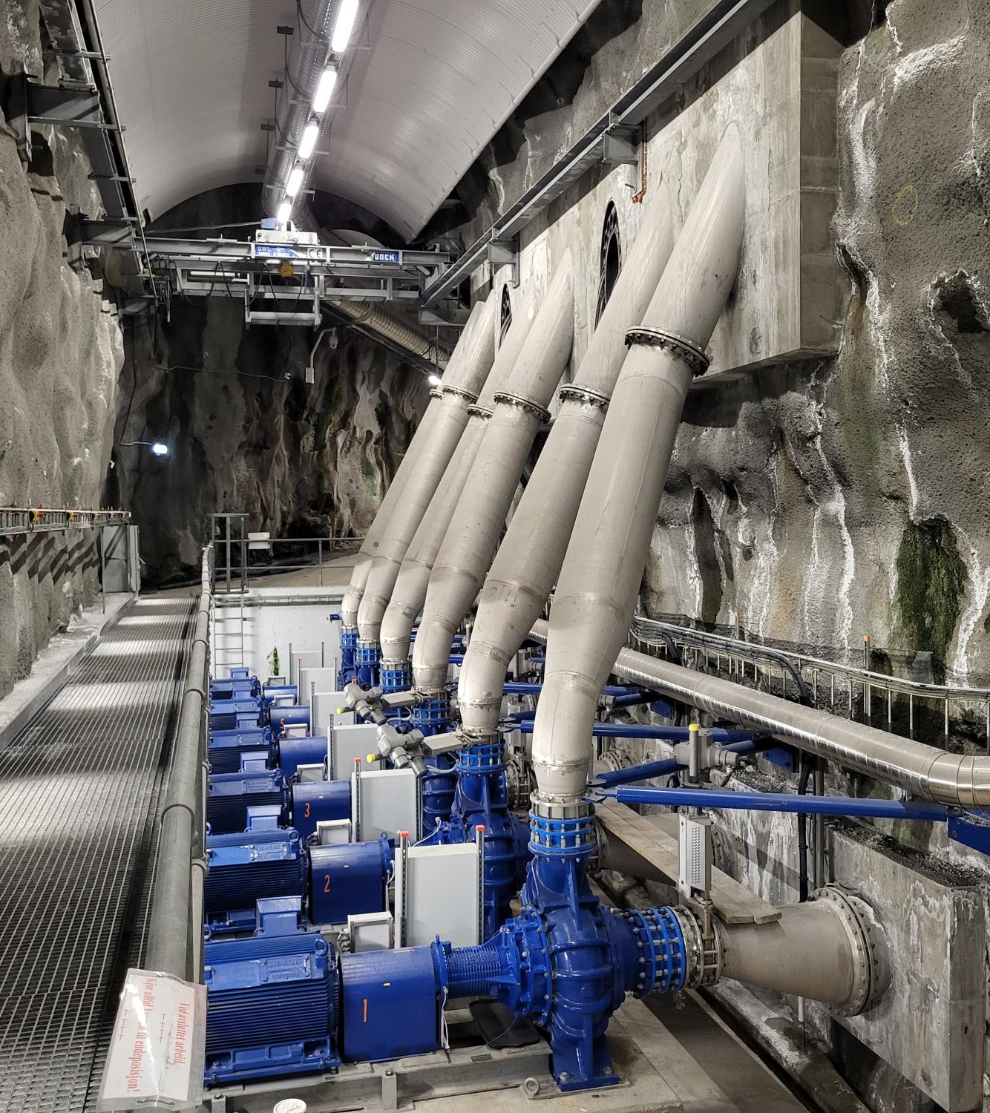
Task
Design a pump control scheme that minimizes energy costs while fulfilling certain boundary conditions

Slide 3
System Description
1.4
F2
L2
Wastewater is pumped from a collection tunnel to the head of the wastewater treatment plant (WWTP)
There are 6 big and 2 small pumps
Cost of pumping is determined by energy consumption and price of electricity
Energy requirement is determined by the
pumped flowrate
difference in elevation H (L2 – L1, m)
Pump efficiency η, %
Water level L2 at the WWTP (pump pressure side) is constant
Water level L1 in the tunnel (pump suction side) is determined by inflow from sewer network F1 and the flow pumped to the WWTP F2
1.3
1.2
1.1
2.4
2.3
2.2
L1
F1
2.1
V

Slide 4
Data
Data provided from a period of 14 days, dt 15 min
Inflow to tunnel F1
Suction level L1
Volume of water in tunnel V
Pumped flow per pump
Power intake per pump
Drive frequency per pump
Electricity price as two alternative time series
Other data
Formula for calculating V as function of L1
Pump curves showing dependency of pumped flow, H and η

Slide 5
Boundary conditions
Pump capacities (see pump curves and data)
Min and max limits for L1
L1min: 0 m
L1max: 8 m
L2: 30 m
Pumped flow to WWTP (F2) should be as close to constant as possible, with smooth changes
Pumping must not be stopped entirely
Pumps must not start and stop frequently (<2h)
Pumps to be operated at or close to full speed (>47,5 Hz)
Good pump efficiency is desirable
Tunnel must be emptied (L1 < 0,5 m) once every day during low inflow
Not necessary during rain events (high inflow)

Slide 6
Phenomena & Dynamics
Large tunnel volume = delay between pump activation and impact
Seasonality, daily usage cycle: morning & evening peaks, low night consumption
Storm rain effect: rapid, episodic increase in inflow

Slide 7
Technical Setup & Limitations
Dataset: 14 d
Data format: CSV / Excel
Simulation: Offline Python-based model
Optional: Feedforward control or multi-agent AI-based logic
Visualization: Cross-sectional view with topography, tanks, and pumps

Slide 8
Targeted Outcome
Data-driven, intelligent pump control algorithm
Accounts for delay, demand peaks, rainfall, and electricity price
Accounting for pump efficiency is a plus
Allows scenario testing in a simulation environment

Slide 9
Further Development Potential
Generic solution applicable to other waste water plants e.g. Viikinmäki (HSY), Sulkavuori (Tampereen keskuspuhdistamo), Kakola (Turun vesi) and others in Finland / globally
Potential for productization through collaboration
Possible integration with OPC UA/Digital Twin architecture

