Slide 1
Pic2Plate: "Turn Pictures into Plates"
By :
Harikrushna Chauhan
Enno: 2203396160046
Guided by:
Prof. Parth K Sharma

Slide 2
Problem Statement
In today's fast-paced world, many people struggle with deciding what to cook, especially when they have a limited number of ingredients at hand. Identifying ingredients and finding suitable recipes can be a time-consuming and daunting task, particularly for those with limited culinary experience.

Slide 3
Unique Idea Brief (Solution)
The goal of this project is to develop a solution that simplifies meal preparation by leveraging image recognition technology to identify ingredients from images and recommend recipes based on the detected ingredients. This tool aims to reduce food waste, save time, and help users make the most out of the ingredients they have available, ultimately making cooking more accessible and enjoyable.

Slide 4
Features Offered
1. Ingredient Identification:
Image Upload: Users can upload images of their ingredients using their device’s camera or from their gallery.
Ingredient Detection: The system accurately detects and identifies multiple ingredients within the uploaded image using advanced image recognition models.
2. Recipe Recommendation:
Recipe Matching: The system matches detected ingredients with a database of recipes and suggests dishes that can be prepared using the available ingredients.
Flexible Suggestions: Provides recipe suggestions even if not all required ingredients are present, offering alternatives or modifications.
3. User-Friendly Interface:
Simple Navigation: Intuitive interface for easy navigation and use, suitable for users of all technical backgrounds.
4. Additional Features:
Ingredient Substitution: Suggests alternative ingredients if certain items are not available or if users have dietary restrictions.
Favorites and History: Users can save favorite recipes and access their search history for future reference.
Customization: Users can customize recipes according to their preferences and save personalized versions.

Slide 5
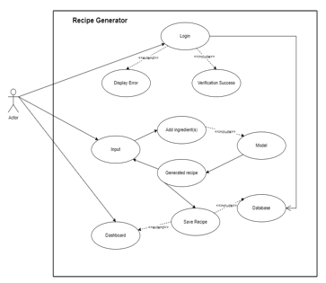
Process flow

Slide 6
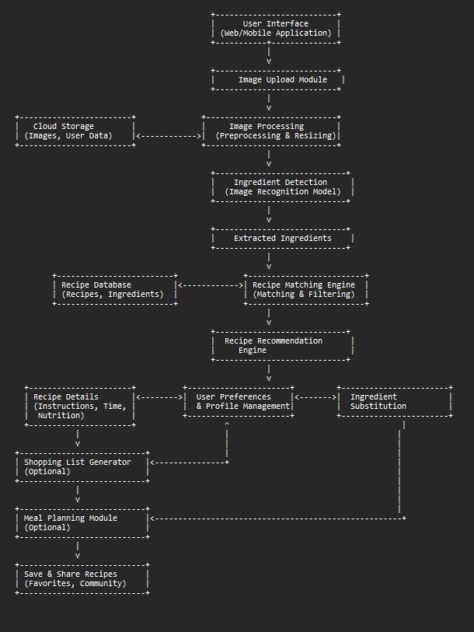
Architecture Diagram

Slide 7
Technologies used
Language : Python (Programming Language)
Modules Used:
Numpy
Scipy
Matplotlib
torch==0.4.1
torchvision==0.2.1
Nltk
Pillow
Tqdm
Lmdb
Tensorflow
tensorboardX
Streamlit

Slide 8
Future Scope
1. Integration with Smart Kitchen Devices:
Smart Appliances: Integrate with smart kitchen appliances (e.g., smart ovens, refrigerators) for automated cooking assistance.
IoT Integration: Use IoT sensors to automatically detect ingredients in the fridge or pantry.
2. Enhanced User Experience:
Voice Assistants: Integrate with voice assistants (e.g., Amazon Alexa, Google Assistant) for hands-free operation.
Augmented Reality (AR): Use AR to provide step-by-step cooking instructions overlayed on the user's view.
Social Features: Enhance social features, such as sharing recipes, cooking tips, and experiences within a community.
3.Integration with Health and Fitness Apps:
Diet Tracking: Integrate with diet and fitness apps to track calorie intake and nutritional information automatically.
Health Goals: Provide recipe recommendations based on health goals such as weight loss, muscle gain, or specific nutrient requirements.

Slide 9
Conclusion
The AI-powered recipe recommendation system represents a significant step forward in leveraging technology to enhance everyday cooking experiences. By integrating advanced image recognition and machine learning technologies, this project addresses the common challenge of deciding what to cook with available ingredients, offering a seamless and user-friendly solution.
the AI-powered recipe recommendation system successfully combines technology and culinary arts to create a valuable tool for home cooks. It simplifies the cooking decision process, encourages creativity in the kitchen, and supports healthier and more sustainable eating habits. With continuous innovation and user-centric enhancements, this project has the potential to become an indispensable part of daily life for people around the world.

