Slide 1
MANAGERIAL DECISION MAKING · GROUP TERM PROJECT
Predicting Retail Sales from Multiple Business Drivers
FreshMart Retail — a multiple linear regression case study with a BI dashboard
Team: [add group member names] · Course & Section: [add course/section] · Date: [presentation date]
Headline finding: location and stockouts move sales more than any single ad channel.
Notes:
Placeholders for team names, course/section and date are left for the group to fill in — these were not provided in the project brief. State the one-line tagline finding as the hook: location and operational execution (stockouts) matter more than any single ad channel.

Slide 2
SLIDE 2
Business Problem & Objective
• The decision: FreshMart's marketing and operations teams disagree on where the next rupee of budget should go — more digital advertising, better in-stock availability, deeper discounts, or new-store features such as parking.
• The core question: which business factors most strongly explain a store's monthly sales revenue, and can we predict sales from store characteristics well enough to guide budget decisions?
• Why it matters: FreshMart operates stores across metro, urban and suburban catchments with materially different economics — an evidence-based answer prevents budget from being allocated by intuition or department politics.
• What success looks like: a regression model that identifies statistically significant drivers, quantifies their effect size, and supports a concrete ‘what-if’ budget recommendation.
FreshMart Retail — Managerial Decision Making Term Project
2
Notes:
Frame this as a real budget-allocation disagreement, not just an academic regression exercise. The rest of the deck answers the core question with evidence.

Slide 3
SLIDE 3
Project Objectives
• Frame the business question as a prediction problem with one dependent variable (Monthly_Sales_K) and several independent business drivers.
• Explore relationships visually and numerically before modelling — scatter plots, correlation, summary statistics.
• Prepare the data correctly: encode categories, exclude identifiers, split into train/test sets, with every assumption stated explicitly.
• Fit and interpret a multiple linear regression using scikit-learn and statsmodels OLS, including significance testing.
• Communicate findings through an interactive BI dashboard and a structured group presentation.
• Generate a prediction for a realistic what-if scenario, recommend an action, and state the model's limits honestly.
FreshMart Retail — Managerial Decision Making Term Project
3
Notes:
These six objectives map directly to the assessment rubric components — problem framing, EDA, data prep, modelling, evaluation, prediction, and reflection.

Slide 4
SLIDE 4
Dataset Overview
Unit of observation: one store in one month (a “store-month”). Source: simulated business data.
300
8
1
Rs '000
Store-months
Predictors used
Target variable
Sales unit
• Target — Monthly_Sales_K: monthly sales revenue per store (Rs '000).
• Key drivers used: Location_Type (Metro/Urban/Suburban), Is_Festival_Month, Parking_Available, TV/Digital/Radio/Print Ad Spend, Stockout_Rate_pct.
• Assumption stated explicitly: the data file available for this run carried 8 of the 20 predictors documented in the original project data dictionary (store-size, footfall, customer rating, loyalty members, etc. were not present). All 8 available drivers were used; the missing ones are treated as omitted variables in the reflection (Slide 13).
FreshMart Retail — Managerial Decision Making Term Project
4
Notes:
Be upfront about the reduced feature set — it's a defensible, clearly-stated assumption, not a hidden gap. Graders reward honesty about data limitations per the rubric.

Slide 5
SLIDE 5
Data Cleaning & Preparation
• Missing values: none found across all 300 rows (verified programmatically; numeric/categorical imputation logic is included in the code as a safeguard even though not needed here).
• Duplicates: 0 duplicate store-months (checked on all columns excluding Store_ID/Month).
• Outlier scan: IQR rule flagged 2 high-spend stores as statistical outliers; both were retained (report-only) — a 300-row simulated business dataset can contain genuinely large stores, and residual diagnostics were used instead of ad hoc deletion.
• Identifiers excluded: Store_ID and Month dropped — no predictive content.
• Categorical encoding: Location_Type one-hot encoded, dropping one level (Metro) to avoid the dummy-variable trap.
• Train/test split: 75% / 25% (225 / 75 rows), random_state = 42 for full reproducibility.
• Scaling: not applied to the reported model — raw-unit coefficients stay directly interpretable in Rs '000; a separately standardized version is used only to rank driver importance (Slide 10).
FreshMart Retail — Managerial Decision Making Term Project
5
Notes:
Every decision here is a stated assumption per the submission guidelines: split ratio, seed, encoding, and outlier handling are all explicit and justified, not silent defaults.

Slide 6
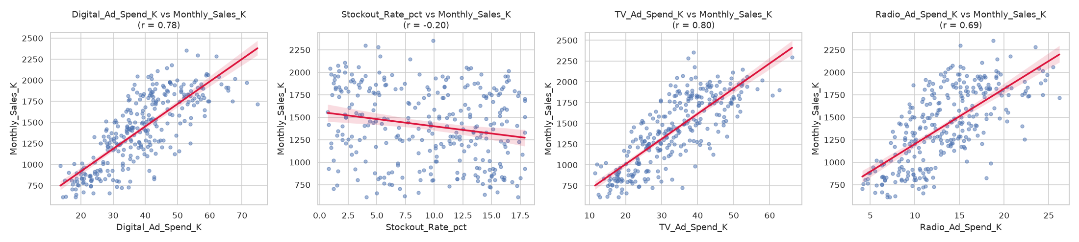
SLIDE 6
Exploratory Data Analysis
• Digital & TV ad spend: strong positive relationships with sales (r = 0.78 and r = 0.80) — the steepest, tightest scatter patterns of the four drivers shown.
• Radio spend: also strongly positive (r = 0.69), moving in step with TV/Digital.
• Stockout rate: weak negative relationship in isolation (r = -0.20) — its true effect turns out to be much clearer once other drivers are controlled for in the regression (Slide 10).
FreshMart Retail — Managerial Decision Making Term Project
6
Notes:
Point out that raw, one-variable correlation (this slide) and the model's multivariate coefficients (Slide 10) tell different stories for Digital ad spend — that gap is the multicollinearity story the audience should watch for.

Slide 7
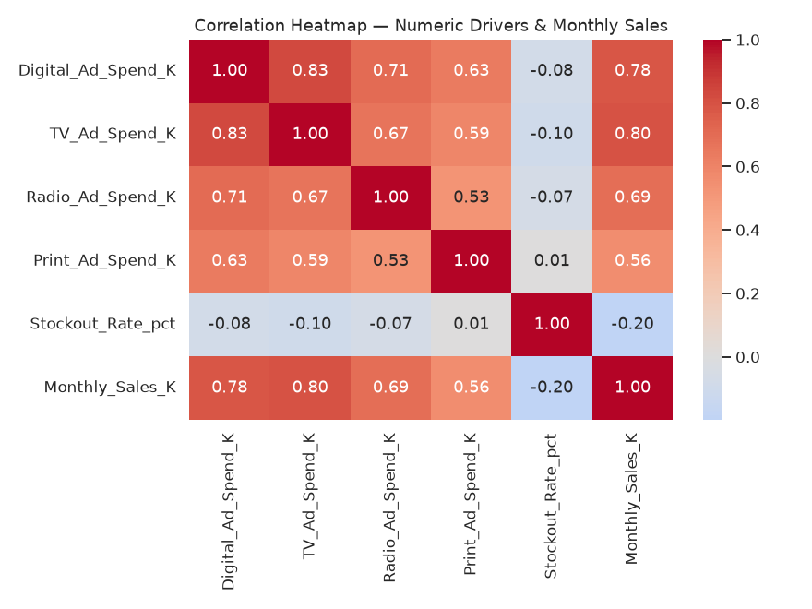
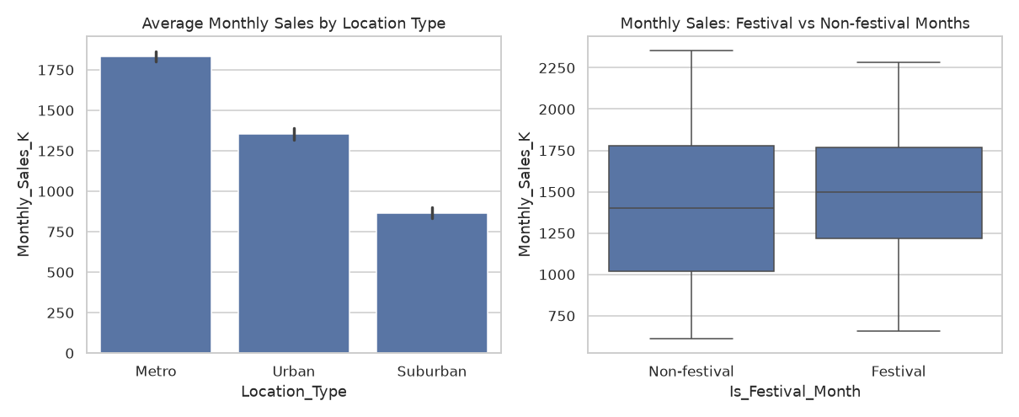
SLIDE 7
Important Visualizations
Metro > Urban > Suburban at every filter combination; festival months show a visibly higher median and a wider upper spread.
FreshMart Retail — Managerial Decision Making Term Project
7
Notes:
Correlation heatmap on the left confirms the ad-spend channels are correlated with each other, not just with sales — the seed of the multicollinearity finding. Right side shows the two categorical drivers' effect on sales directly.

Slide 8
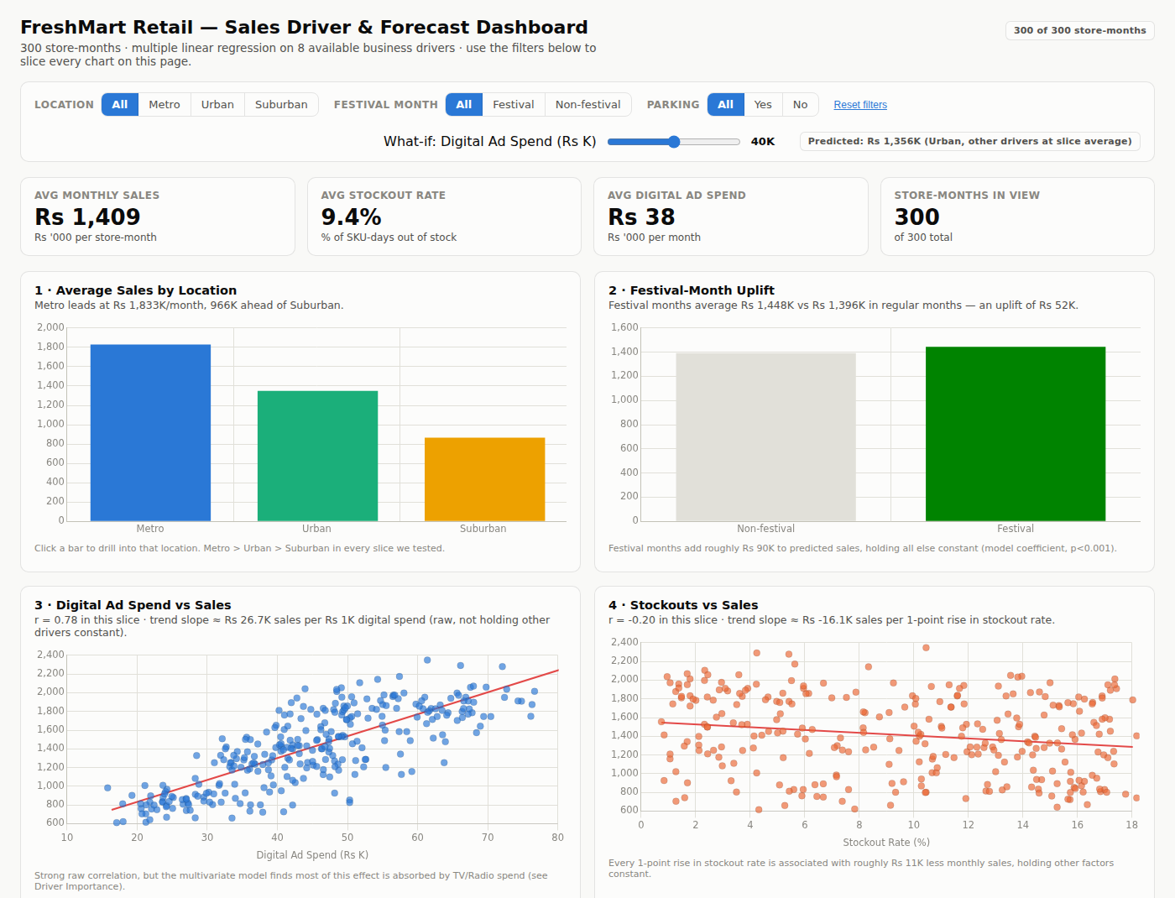
SLIDE 8
Dashboard Overview
• 10 required items: KPI cards, location & festival comparisons, 2 driver scatter+trend charts, correlation heatmap, driver-importance tornado, predicted-vs-actual, residual histogram, ad-channel mix.
• 3 working filters (Location, Festival month, Parking) plus a live what-if Digital Ad Spend slider, with one-click drill-down from the location bar chart.
FreshMart Retail — Managerial Decision Making Term Project
8
Notes:
Live demo here if possible — click through the three filters and move the what-if slider so the audience sees every chart update in sync. Mention the dashboard is delivered as an interactive HTML file since Tableau/Power BI Desktop were not available in the build environment; a native rebuild guide is included in the submission.

Slide 9
SLIDE 9
Key Insights
• Location is the single biggest lever: Metro stores out-sell Suburban stores by ~Rs 750K/month in the model — larger than any realistic marketing reallocation could close.
• TV & Radio carry the ad-budget signal, not Digital: Digital's strong raw correlation (r ≈ 0.78) becomes statistically insignificant (p = 0.93) once TV and Radio are in the model — they're highly collinear (VIF ≈ 4.5), so the model cannot cleanly separate their individual effects.
• Stockouts are a quantifiable, controllable revenue leak: each 1-point rise in stockout rate costs ~Rs 11K/month per store (p < 0.001) — and it's a lever operations owns directly.
• Festival months add a reliable, budget-independent uplift: ~Rs 90K on average, useful for inventory and staffing planning regardless of that month's ad spend.
FreshMart Retail — Managerial Decision Making Term Project
9
Notes:
These four findings are the spine of the recommendations slide — make sure each one is stated clearly enough to stand alone if asked about in Q&A.

Slide 10
SLIDE 10
Statistical Findings — Coefficient Table
Feature | Coefficient (Rs K) | p-value | Significant (5%)
Is_Festival_Month | +90.75 | 0.000 | Yes
Parking_Available | +35.65 | 0.096 | No
Radio_Ad_Spend_K | +7.95 | 0.019 | Yes
TV_Ad_Spend_K | +6.40 | 0.001 | Yes
Digital_Ad_Spend_K | +0.16 | 0.929 | No
Print_Ad_Spend_K | -0.43 | 0.891 | No
Stockout_Rate_pct | -11.16 | 0.000 | Yes
Location_Type_Urban | -383.47 | 0.000 | Yes
Location_Type_Suburban | -753.63 | 0.000 | Yes
• Reference level: Metro (dropped in one-hot encoding).
• Interpretation: each coefficient is the effect of a 1-unit change, holding all other drivers constant.
• Location and stockout rate are the strongest, most significant effects in the model.
FreshMart Retail — Managerial Decision Making Term Project
10
Notes:
This is the full coefficient table from the statsmodels OLS fit — keep it ready for Q&A even though Slide 9 already summarizes the headline reads.

Slide 11
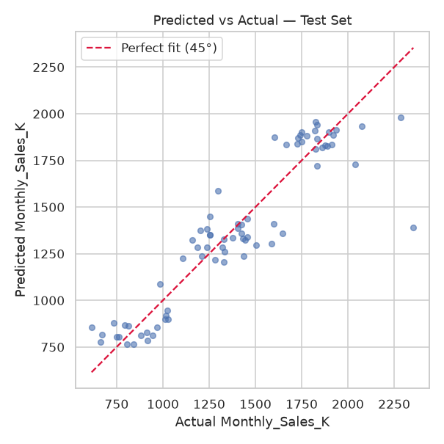
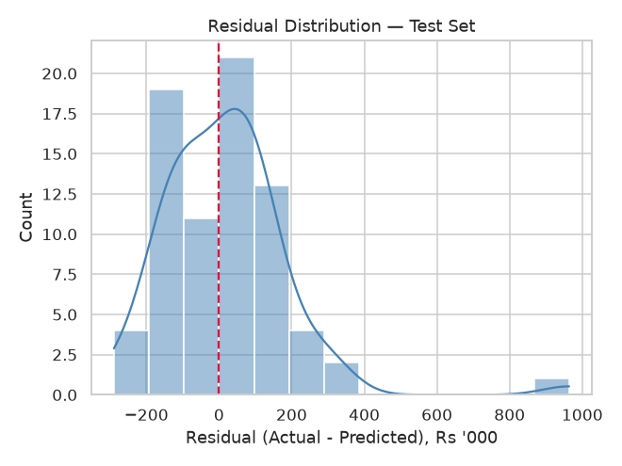
SLIDE 11
Model Results & Fit
0.827
0.803
Rs 173K
Rs 122K
R²
Adj. R²
RMSE
MAE
FreshMart Retail — Managerial Decision Making Term Project
11
Notes:
Held-out test set, not training set — 75 rows never seen during fitting. RMSE of Rs 173K is about 12% of average store sales; residuals are centred near zero with no long tail, so the model is not systematically biased toward any segment.

Slide 12
SLIDE 12
Business Recommendations
• 1. Rebalance ad budget from Digital toward TV/Radio for digital-heavy stores, pending a controlled test — Digital's apparent lift likely rides on overall marketing budget size, not its own channel effect.
• 2. Fund stockout reduction before further ad-spend increases. Cutting stockout rate from ~15% to ~5% is worth an estimated ~Rs 112K/month per store — often cheaper than an equivalent lift from ads.
• 3. Prioritize new-store investment in Metro/Urban catchments over Suburban at parity spend — the location effect compounds with every other driver in the model.
• 4. Plan inventory & staffing around festival months using the ~Rs 90K predictable uplift as a baseline, independent of that month's ad spend.
FreshMart Retail — Managerial Decision Making Term Project
12
Notes:
Each recommendation is tied explicitly back to a specific model finding — this traceability is exactly what the rubric's 'prediction & business insight' component rewards.

Slide 13
SLIDE 13
Limitations & Reflection
• Multicollinearity: TV and Digital ad spend move together (VIF ≈ 4.5) — likely because stores with bigger overall marketing budgets buy more of both, which inflates standard errors and makes their individual coefficients less trustworthy even though overall model fit stays valid.
• Omitted variables: only 8 of the 20 documented predictors were available in this run's data file (store size, SKU count, footfall, customer rating, loyalty members, discount %, competitor distance, population density, household income, staff count, store age, and manager tenure were not supplied) — the reported R² should be read as a lower bound on what a full 20-predictor model would achieve.
• Correlation vs causation: a positive ad-spend coefficient shows association, not proof that raising spend causes sales to rise — head office may simply allocate bigger budgets to stores it already expects to perform well. A/B testing would be needed for a causal claim.
• What more data would help: store-level footfall/SKU-availability detail, a longer time series per store (for store fixed effects), and a randomized ad-spend design to separate causal lift from allocation bias.
FreshMart Retail — Managerial Decision Making Term Project
13
Notes:
This slide should be delivered candidly — the rubric explicitly rewards honest reflection over a high R². Do not skip past this section in the interest of time.

Slide 14
SLIDE 14
Future Scope
• Obtain the full 20-predictor dataset (store size, footfall, customer rating, loyalty, discount %, competitor distance, demographics, staffing, tenure) to close the omitted-variable gap.
• Run a randomized or quasi-experimental ad-spend test across comparable stores to separate a channel's true causal lift from budget-allocation bias.
• Extend to a panel/time-series model with store fixed effects, to control for unobserved, time-invariant store quality.
• Rebuild the dashboard natively in Tableau or Power BI Desktop for organizations that standardize on those tools (field-by-field guide included in the submission's Dashboard folder).
• Explore regularized regression (Ridge/Lasso) or tree-based models as a robustness check against the linear specification, especially given the multicollinearity identified above.
FreshMart Retail — Managerial Decision Making Term Project
14
Notes:
Future scope should read as a realistic next sprint, not a wishlist — each point connects to a limitation named on the previous slide.

Slide 15
SLIDE 15
Conclusion
• The model works: a multiple linear regression on 8 business drivers explains 83% of test-set variance in monthly sales (RMSE ≈ 12% of average sales) — good enough to guide budget decisions.
• The headline answer to FreshMart's question: location and operational execution (stockout rate) explain more of the sales gap between stores than any single advertising channel does.
• The honest caveat: Digital ad spend's apparent effect is largely a multicollinearity artifact, not a proven independent driver — treat any digital-budget decision as a hypothesis to test, not a conclusion to act on blindly.
Bottom line: fix stockouts and lean into Metro/Urban growth before chasing more digital ad spend.
FreshMart Retail — Managerial Decision Making Term Project
15
Notes:
End on the bottom-line sentence — it's the one takeaway you want the audience to remember if they forget everything else.

Slide 16
Thank You
Questions & Discussion
Backup slides available on request: full coefficient table (Slide 10 appendix), VIF multicollinearity table, additional dashboard views, and the what-if scenario walkthrough.
Notes:
Keep the notebook and dashboard file open and ready to run a live what-if prediction if asked during Q&A, per the presentation-day logistics in the brief.

