Slide 1
API/HLR/LLR
Manjunatha / Dipesh
Notes:
Meeting objectives
Understand program framework
Understand your role in RTO program as site managers, ELT/SLT champions, and country people partners
Understand your next steps

Slide 2
I.
Introduction to RDS
II.
API Specifications
III.
HLR
IV.
LLR
V.
HLR & LLR example
VI.
Sample Test Scnarios
VII.
Q&A

Slide 3
Introduction to RDS
(Requirement and Design Standards)
It describes the content and format of software API specifications, software high-level requirements (HLR), software architecture, software design and software low-level requirements (LLR).
API Specifications provide the details of the publicly usable APIs published by the software (Definition from RDS)
HLRs describe the intended behavior of the software given a set of inputs, including any effects on the outputs (From RDS)
The low-level Requirements (LLR) describe the actions taken on inputs to generate the outputs of the software, with inputs from the HLRs and the architecture and design (From RDS)

Slide 4
API (Application Programming Interface)
Specification
The specification should be adequate to allow the user to use the API programmatically, similar to a user manual or a page from an operating system manual
The API Specifications consist of the following information:
Description
Function Prototype
Parameter List
Return Values
Globals

Slide 5
API (Application Programming Interface) Specification (Contd..)
Prototype Example:
LOCAL int vxbSpiFlashRead(FLASH_CHIP_ID pFlashChip, FLASH_ADDR_T uAddr, UINT32 uBufCount, FLASH_SIZE_T uBufLen, UINT8 **ppBuf, void *op)
Description Example:
This function returns [ERROR]:
when the address of flash chip [pFlashChip] is invalid
Parameters
Return Values
Parameter | Input/Output | Type | Range | Description
pFlashChip | Input | FLASH_CHIP_ID | [1 to [UINT64_MAX]] | The flash chip identifier.
Values | Description
[ERROR] | When the address of flash chip [pFlashChip] is invalid

Slide 6
API (Application Programming Interface) Specification (Contd..)
Why we need APIs?
Enables portability
Improves Maintainability
Allows Parallel Development (b/n HW and SW teams)

Slide 7
HLR (High Level Requirement)
HLR describes what the system should do from a user or system perspective.
It is abstract, not tied to implementation details.
An HLR consists of:
Identifier
Requirement statement
Example: [vxbSpiFlashRead_HLR_01]
[vxbSpiFlashRead] shall return [ERROR] when any of the following conditions are satisfied:
if the address of flash chip [pFlashChip] is invalid

Slide 8
LLR (Low Level Requirement)
LLR describes how each high-level requirement will be implemented.
It is detailed, technical, and specific.
The output/behavior should be mentioned first in a requirement, followed by the conditions under which that output/behavior occurs (From RDS)
Example: vxbSpiFlashRead_LLR_01
[vxbSpiFlashRead] shall validate the address of flash chip as follows:
if [pFlashChip] is equal to [NULL]
return [ERROR]

Slide 9
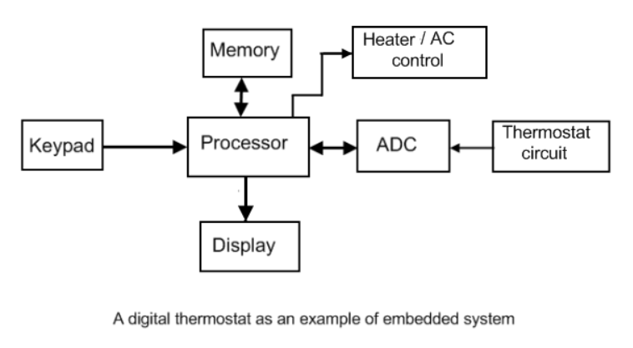
HLR and LLR – Example
High-Level Requirements (HLR)
HLR-1: The system shall measure ambient temperature.
HLR-2: The system shall maintain temperature within the user-defined range.
HLR-3: The system shall display current temperature.
HLR-4: The system shall activate heating or cooling as needed.
Low-Level Requirements (LLR)
LLR-1.1: The system shall read temperature from a digital sensor (I²C) every 500 ms.
LLR-2.1: If temperature < setpoint − 1°C, set GPIO_HEATER = HIGH.
LLR-2.2: If temperature > setpoint + 1°C, set GPIO_COOLER = HIGH.
LLR-3.1: The LCD shall be updated with current temperature value every 1 second.
LLR-4.1: Relay control shall use GPIO pin P2.3.

Slide 10
Sample Test Scenarios
Test 1:
Set setpoint to 25 degC.
Inject ambient temperature to 27 degC.
Expected Output is GPIO_COOLER is set to HIGH
Test 2:
Set setpoint to 29 degC.
Inject ambient temperature to 27 degC.
Expected Output is GPIO_HEATER is set to HIGH

Slide 11
Sample Test Scenarios (Contd ..)
Test 3:
Set setpoint to 25 degC.
Inject ambient temperature to 25 degC.
Expected Output is GPIO_COOLER/GPIO_HEATER are set to LOW
Test 4:
Monitor the LCD display for 5 seconds while heating/cooling.
Test 5:
Inject ambient temperature to 26.5 degC. Keep setpoint to a known value.
Expected Output is the LCD display shows 26.5 +/- display resolution.

Slide 12

Questions?

