Slide 1
Multistage Intrusion Detection System for Adversarial Attacks Based on RDLS Model in IoT
Team 5
Rhuthvika Dasi 2020103557
Sindhura M 2020103569
Sundaresan Haarini Amrutdha 2020103574
Under the Guidance of Dr.S.Bose

Slide 2
INTRODUCTION
ML based Intrusion Detection System helps detect attacks in IoT by distinguishing normal from malicious data packets.
Adversarial Machine Learning(AML) is an attack on ML models where attackers modify data to fool the model into misclassifying threats as normal.
AML makes it harder for ML models to detect attacks early, delaying response and increasing vulnerability.
ML models need testing against AML to ensure they're robust enough to handle real-world threats effectively.

Slide 3
OBJECTIVES
To Develop a hybrid ensemble model combining deep learning algorithms (DNN) with machine learning methods (Random Forest, SVM and Logistic Regression) for intrusion detection in IoT-based smart city applications.
To implement adversarial training techniques (FGSM, BIM, JSMA, PGD, DF) to enhance the robustness of models against adversarial attacks.
To propose method such as adversarial retraining to enhance IDS resilience against adversarial attacks, thereby improving robustness.
To understand the potential consequences of adversarial attacks on IoT-based smart city services to emphasize the importance of robust IDS solutions.

Slide 4
LITERATURE SURVEY

Slide 5
Authors | Journal/ conference | Methodology | Drawbacks/ limitations
Xinwei Yuan, Shu Han, Wei Huang, Hongliang Ye, Xianglong Kong, Fan Zhang | A simple framework to enhance the adversarial robustness of deep learning-based intrusion detection system (2024) | Deep Learning-IDS(Intrusion Detection System) architecture Adversarial Example detection combined with DL and ML models (decision tree (DT), Support Vector Machine (SVM), and K-Nearest neighbor (KNN)) | address security issues posed by deep learning models in diverse domains.
Vitorino, J., Praça, I.Maia, E. | Towards adversarial realism and robust learning for IoT intrusion detection and classification (2023) | supervised (RF, XGB, LGBM) unsupervised (IFOR) algorithms Adversarial training and security-by-design | explore novel datasets and defense strategies to enhance IoT network security

Slide 6
Authors | Journal/ conference | Methodology | Drawbacks/ limitations
E. Nowroozi, Y. Mekdad, M. H. Berenjestanaki, M. Conti and A. E. Fergougui | Demystifying the Transferability of Adversarial Attacks in Computer Networks (2022) | CNN-based models I-FGSM, JSMA, L-BFGS, PGD, DeepFool | aim to enhance the power of adversarial attacks for increased transferability
Md. Mamunur Rashid, Joarder Kamruzzaman, Mohammad Mehedi Hassan, Tasadduq Imam, Santoso Wibowo, Steven Gordon, Giancarlo Fortino | Adversarial training for deep learning-based cyberattack detection in IoT-based smart city applications (2022) | Retraining of DNN, SVM, SNN attacks include JSMA, FGSM, BIM and DF | how features can be engineered to make them less sensitive to adversarial attacks further improve performance by model retraining

Slide 7
Authors | Journal/ conference | Methodology | Drawbacks/ limitations
Ryu, G., Choi, D. | A hybrid adversarial training for deep learning model and denoising network resistant to adversarial examples (2023) | DNN model FGSM, PGD, CW, and MIM attacks | focus on adversarial defense methods that are robust to adaptive attacks
Hongling Jiang, Jinzhi Lin, Haiyan Kang | FGMD: A robust detector against adversarial attacks in the IoT network (2022) | MLP, GAN, SVM, Decision Tree, and Random Forest Trained with FGSM, JSMA, BIM, DeepFool, CW, PGD, ENM compared with the performance of FNN and SNN proposes the FGMD (Feature Grouping and Multi-model fusion Detector) | Tested only on predefined dataset, need to test in realtime datasets.

Slide 8
SUMMARY OF ISSUES :
Deep learning models employed for cyberattack detection in IoT-based smart city applications are susceptible to adversarial attacks, compromising their reliability.
Choosing suitable algorithms, and handling imbalances during data splitting for model training pose challenges.
Combining adversarial test data with the original dataset introduces challenges in maintaining coherence and addressing imbalances.
Retraining the model involves challenges in adapting to adversarial samples while maintaining high accuracy on genuine data.

Slide 9
PROPOSED SYSTEM
Handle missing values, label encoding, and standardization for IoT datasets to ensure data quality and compatibility with hybrid models.
Split preprocessed dataset into 80% training and 20% testing sets for model evaluation.
Train RDL (Random Forest, Deep Neural Network, Logistic Regression) and RDS (Random Forest, Deep Neural Network, Support Vector Machine) on training data.
Utilize trained RDS model to predict accuracy on testing data for cyberattack detection insights.
Generate adversarial samples from testing data using tailored attack methods for hybrid models.
Evaluate RDS model's resilience against adversarial attacks, considering decision boundaries and accuracy effects.
Combine adversarial samples with original dataset for balanced and integrity-maintained new training set.
Retrain RDS model using augmented dataset to enhance robustness against adversarial attacks while maintaining accuracy.
Assess effectiveness of retrained RDS model in cyberattack detection in IoT scenarios, considering accuracy, robustness, and resilience against adversarial threats.

Slide 10
ARCHITECTURE DIAGRAM

Slide 11
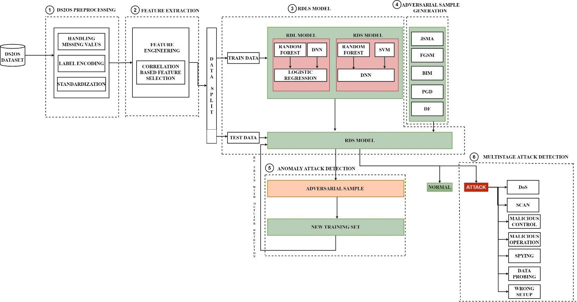

Slide 12
LIST OF MODULES
The list of modules involved in the entire process is as follows:
DS2OS Preprocessing
Feature Extraction
RDLS Model
Adversarial Sample Generation
Anomaly Attack Detection
Multistage attack detection

Slide 13
DS2OS Preprocessing:
While performing the first step of data preprocessing, null values were checked in the dataset, and label encoding was performed. Initially, an instance of the LabelEncoder class was created to encode categorical labels into numerical values. standardization of the feature variables for a machine learning model is conducted using the StandardScaler from scikit-learn.

Slide 14
Algorithm:
Input: DS2OS Dataset
Output: Pre-processed data
1. Load DS2OS Dataset using pandas read_csv.
2. Handle missing values using mean
3. Handle Unexpected entries by replacing specific strings with numerical values using a predefined dictionary mapping.
4. Convert all categorical features into numerical representations using Label encoding.
5. Standardize numerical features.

Slide 15

Feature Extraction:
The TimeStamp column was removed from the pre-processed data, resulting in 12 features selected for further processing.

Slide 16
Algorithm:
Input: Pre-processed data
Output: Feature extracted data
Unique features were identified after pre-processing.
Correlation between newly extracted features and target class were observed.
The newly generated feature that showed best correlation was chosen for further analysis.
The best five features ware further taken for model training .

Slide 17
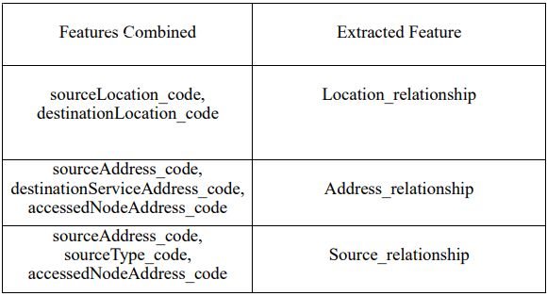
Feature Combination – Corresponding Extracted Feature

Slide 18
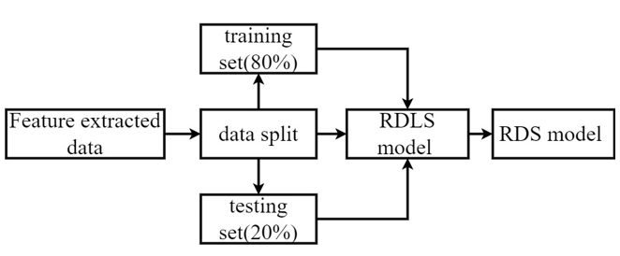
RDLS Model Training:
.
The dataset was then split into training and testing sets in an 80:20 ratio. Subsequently, Random Forest, SVM, DNN, and Logistic Regression models were trained and tested, followed by generating predictions from them.

Slide 19
Algorithm:
Input: Feature extracted data Output: RDS Model
Split the data into training (80%) and testing (20%) sets using an appropriate splitting method like train_test_split from scikit-learn.
Train RDLS model using training data.
Test the RDLS model using test data.
Evaluate the performance of both RDS and RDL model on the unseen test data using Accuracy, precision, recall and F1-score.

Slide 20
Adversarial Sample Generation:
Adversarial sample generation is the process of creating carefully crafted inputs that are designed to fool the deep learning model into making incorrect predictions. These adversarial examples can be used to test the robustness of the model and identify potential weaknesses.

Slide 21
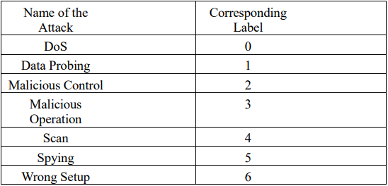
Adversarial Sample Generation:

Slide 22
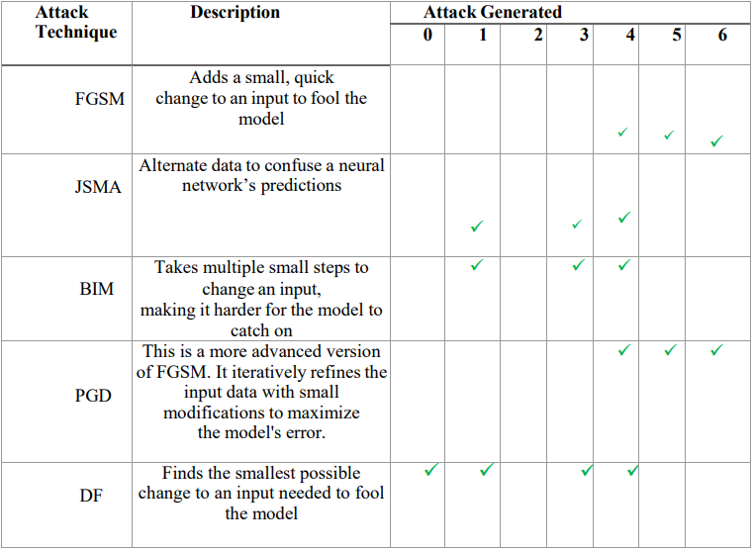
Attacks Description:

Slide 23
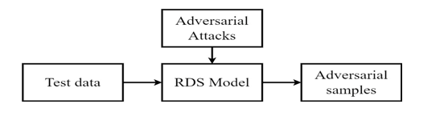
Adversarial Sample Generation:
This module is used for improving the robustness of deep learning models to adversarial attacks. This is done by training the model on a combination to learn to distinguish between legitimate and malicious inputs, making it more difficult to fool.

Slide 24
Algorithm:
Input: Test data
Output: Adversarial Samples
1. Adversarial sample generation:
Choose appropriate attack methods.
Generate perturbation based on the attack methods.
Apply perturbation to original input data to create adversarial example.
2. Test the RDS model with generated adversarial samples.

Slide 25
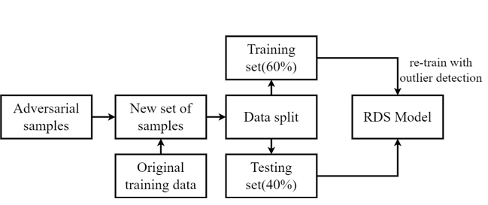
Anomaly Attack Detection:
When generating adversarial samples, there is a possibility of encountering unknown attacks, referred to as anomaly attacks, in addition to signature attacks. If anomaly attacks are detected, the model should be retrained using a new training set obtained from adversarial samples, employing outlier detection techniques to eliminate anomalous samples.

Slide 26
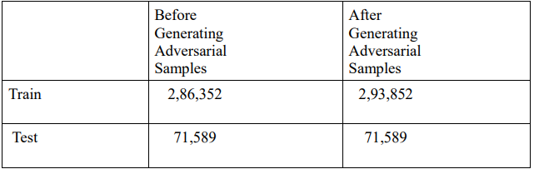
Train – Test Samples:

Slide 27
Algorithm:
Input: Adversarial samples
Output: Retrained RDS Model
Generate adversarial samples using attack methods.
Apply an outlier detection technique to identify anomaly attacks
New Training and Testing Set Construction:
Combine original training set and correctly classified adversarial samples.
Split the data into new train(60%) and test(40%) sets.
Retrain the model using the new training set.
Assess the retrained model's performance on a test set.

Slide 28
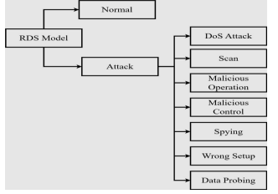
Multistage Attack Detection:
In this stage for model retraining, use new training data that includes both original data and adversarial samples. Compare the predictions from the retrained model with its original predictions to understand how adversarial inputs affect its performance. And a classification model is used to classify the seven different classes of attacks

Slide 29
Algorithm:
Input: Retrained RDS Model
Output: Classification of attacks
Combine the original clean training data with generated adversarial samples, creating a new training set.
Retrain Model: Train the model again on this new training set, incorporating the knowledge of adversarial examples.
Evaluation:
Predict Both Types: Make predictions on both normal data and unseen attack samples.
Monitor Performance: Evaluate the model's performance on each type of data to understand how retraining with adversarial examples impacts its ability to handle attacks.

Slide 30
IMPLEMENTATION DETAILS (100%)

Slide 31
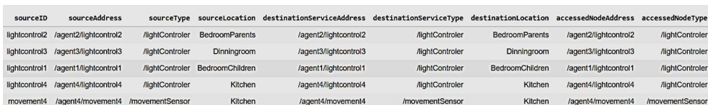
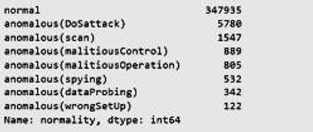
Sample Data:

Slide 32
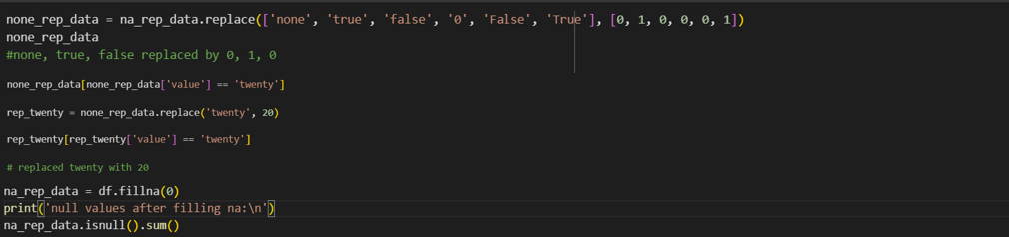
Pre-processing:

Slide 33
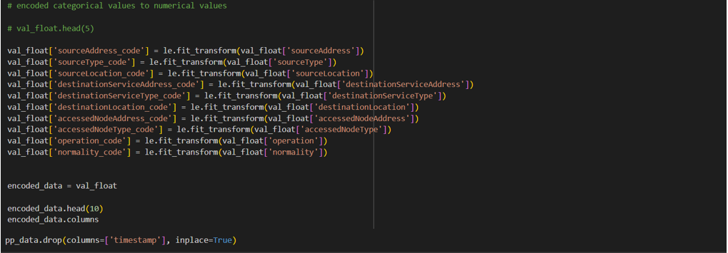
Pre-processing:

Slide 34
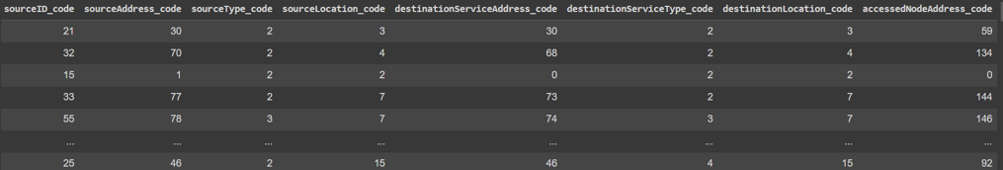
DS2OS preprocessed data:

Slide 35
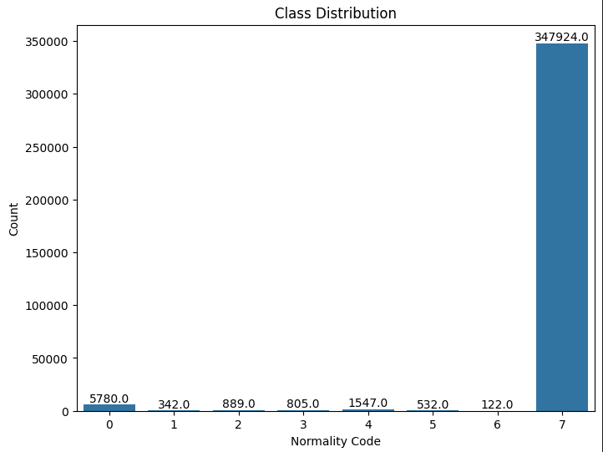

Slide 36
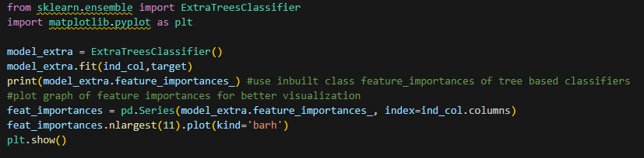
Feature Extraction:
Feature Importance:

Slide 37
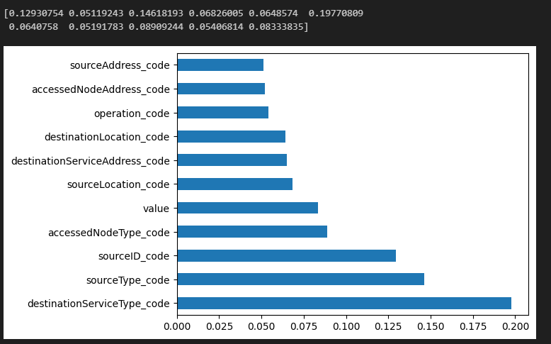
Feature Importance Graph:

Slide 38
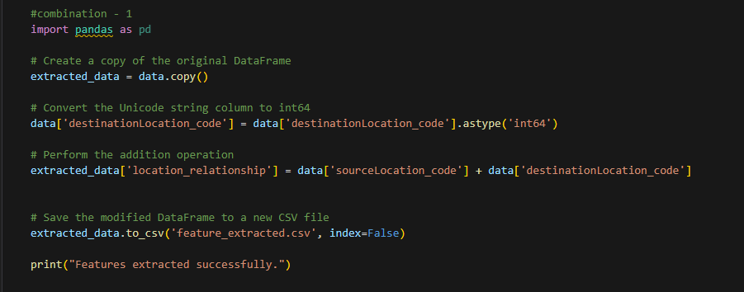
New Feature Extraction:

Slide 39
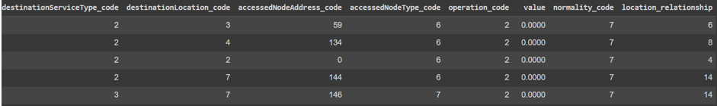
Sample of Extracted Feature :

Slide 40
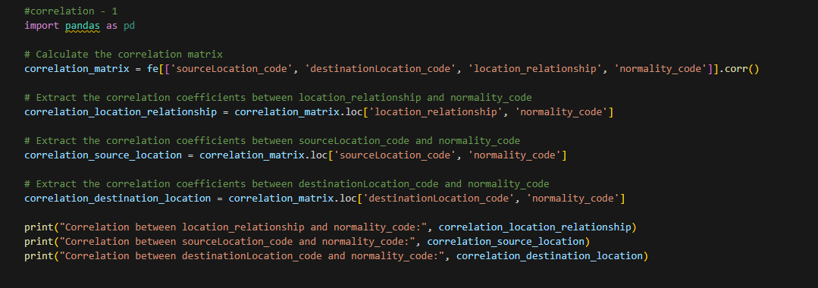
Correlation of Extracted Feature
Correlation Value - Extracted Feature and Target Class

Slide 41
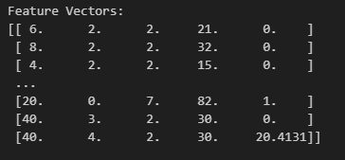

Feature Vectors :
Shapes of Train and Test Data :

Slide 42
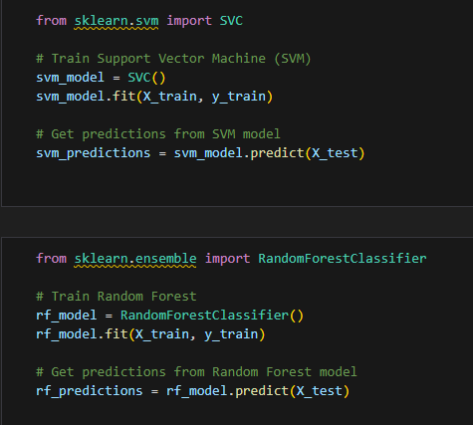
RDS (Random Forest, DNN, SVM) model:

Slide 43
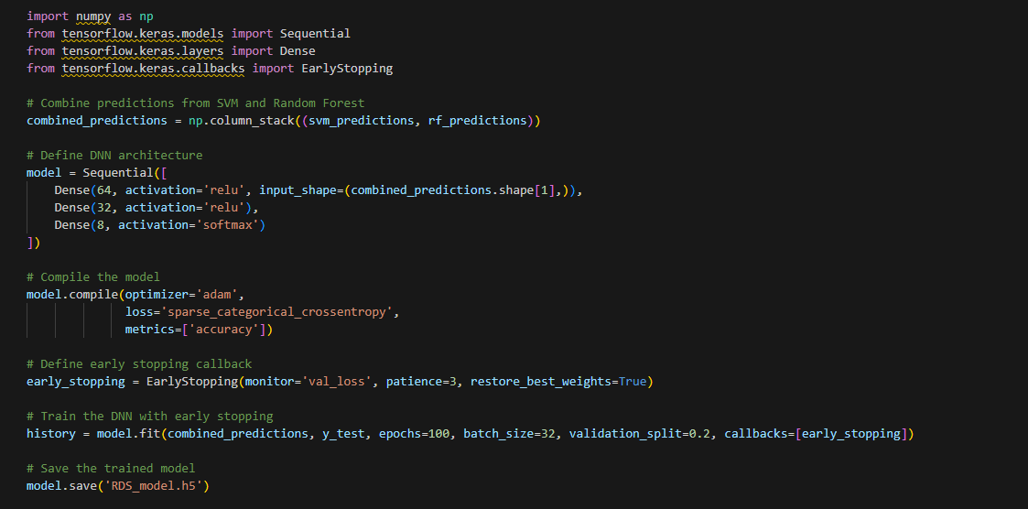
RDS (Random Forest, DNN, SVM) model:

Slide 44

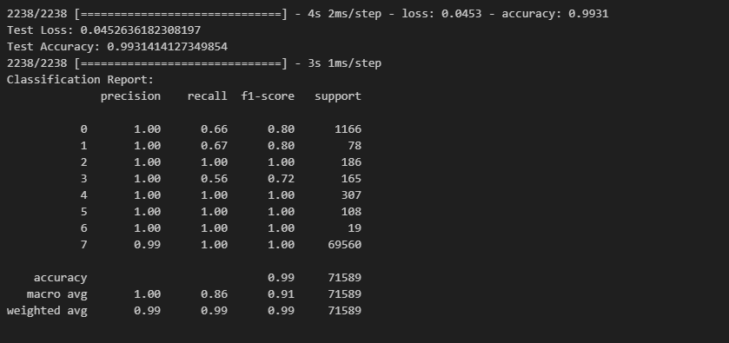
Training Accuracy for RDS Model :
Classification Report for RDS model :

Slide 45
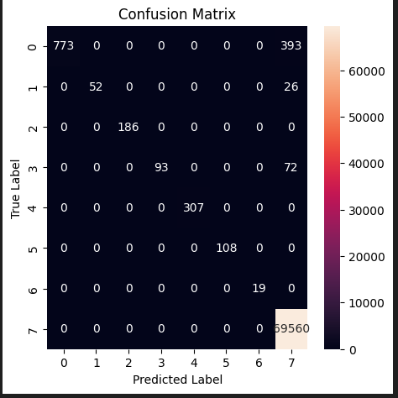
Confusion Matrix for RDS model:

Slide 46
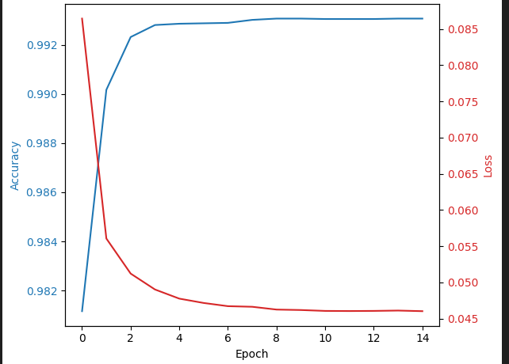
RDS Model Accuracy-Loss Graph

Slide 47
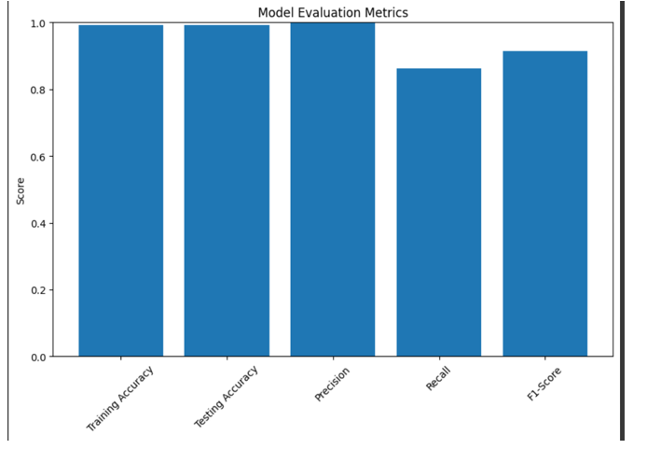
RDS Model Evaluation Metrics

Slide 48
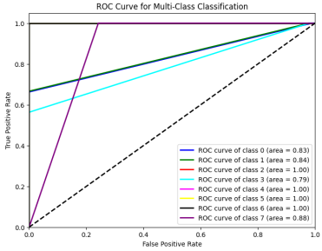
ROC Curve For Multi-class Classification:

Slide 49
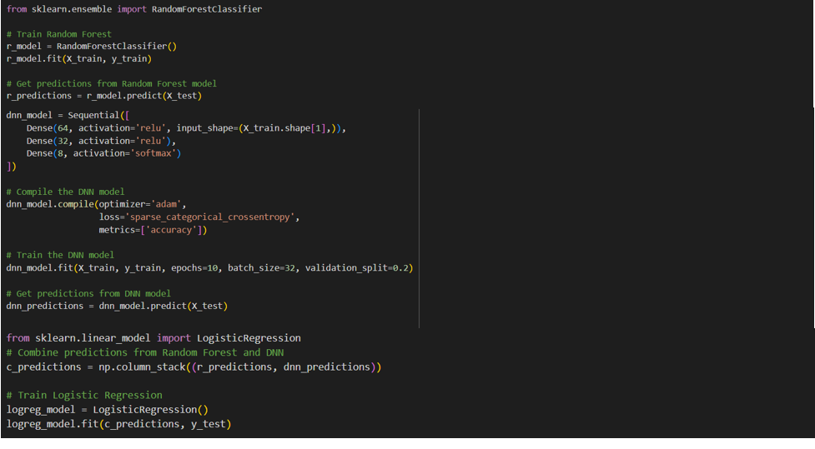
RDL (Random Forest, DNN, Logistic Regression) model:

Slide 50
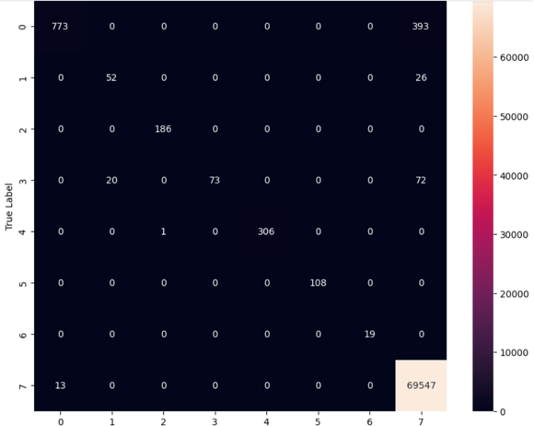
Confusion Matrix for RDL Model:

Slide 51
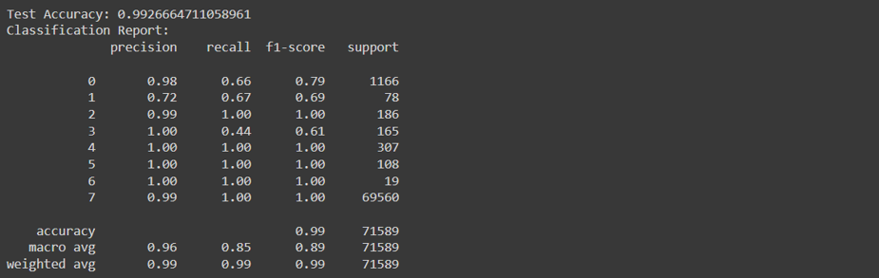
Classification Report for RDL Model

Slide 52
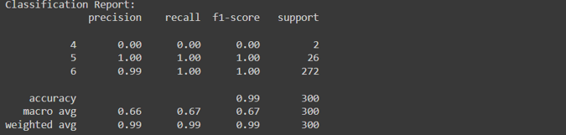
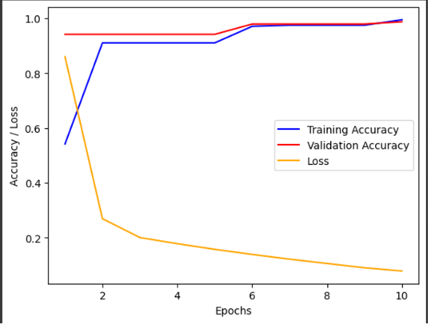
FGSM Classification Report:
Accuracy-Loss Graph for FGSM:

Slide 53
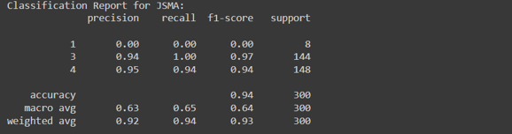
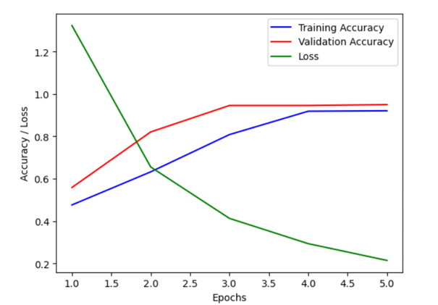
JSMA Classification Report:
Accuracy-Loss Graph for JSMA:

Slide 54
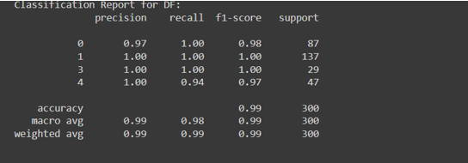
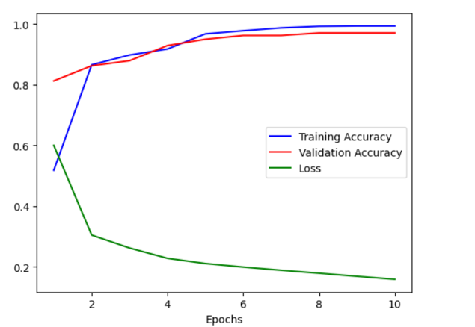
DF Classification Report:
Accuracy-Loss Graph for DF:

Slide 55
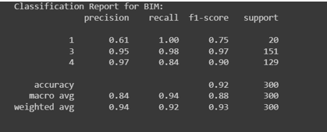
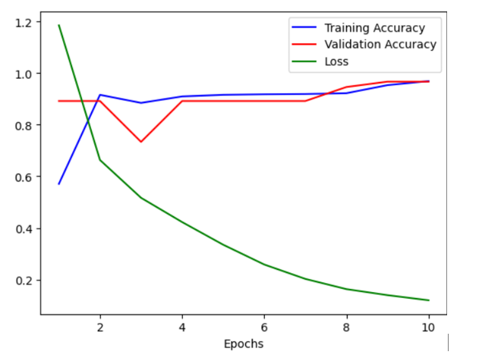
BIM Classification Report:
Accuracy-Loss Graph for BIM:

Slide 56
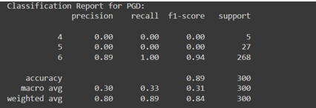
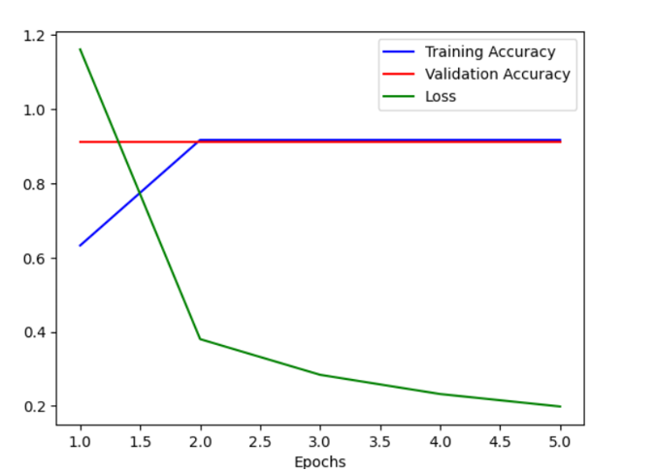
PGD Classification Report:
Accuracy-Loss Graph for PGD:

Slide 57
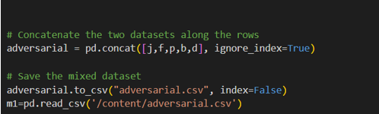
Concatenating Attack Samples:

Slide 58
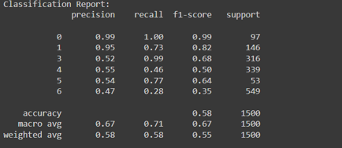
Classification Report of Adversarial Test:

Slide 59
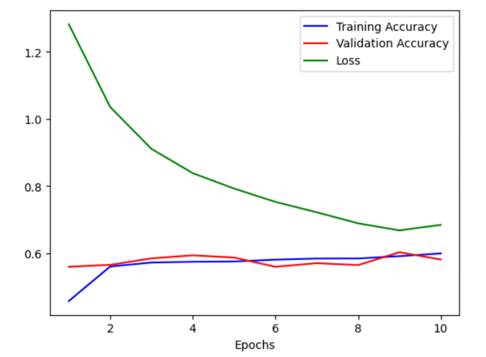
Accuracy-Loss Graph for Adversarial Samples:

Slide 60
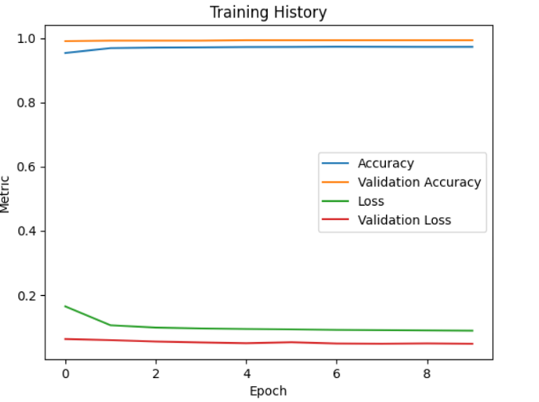
Training History of Re-trained Model:

Slide 61
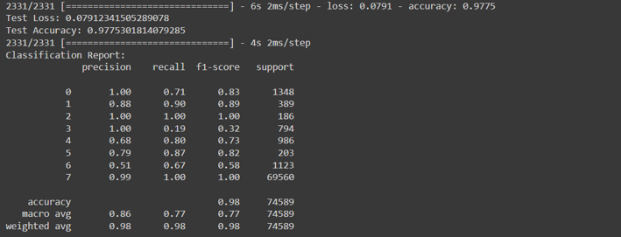
Re-training Accuracy:
Re-training Classification Report:

Slide 62
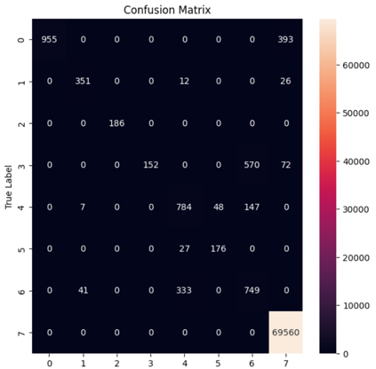
Re-training Confusion Matrix:

Slide 63
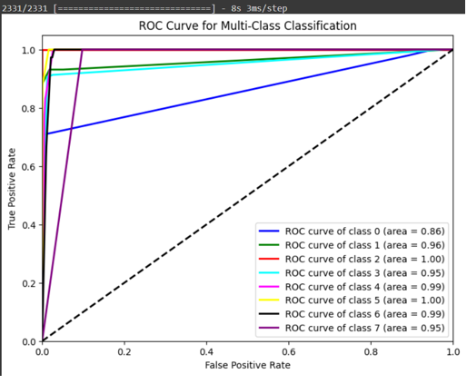
ROC Curve

Slide 64
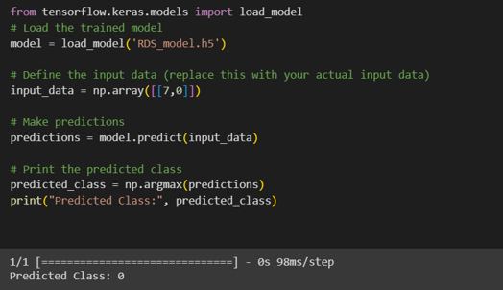
TEST CASES
Test Case – 1:

Slide 65
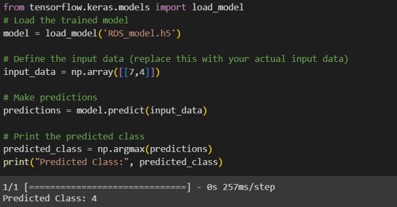
Test Case – 2 :

Slide 66

Test Cases:

Slide 67
PERFORMANCE METRICES
Accuracy: It represents the ratio of correctly predicted instances to total number of instances.
Formula: Accuracy = (TP+TN)/ (TP+FP+TN+FN).
Recall: Evaluates the ability of the model to capture all the actual positive instances in the data.
Formula: Recall =TP/ (TP+FN)
Precision: It measures the accuracy of positive predictions .
Formula: Precision = TP/ (TP+FP)
Confusion matrix : Provides insights into how well the model correctly classifies each class and where it makes mistakes.
F1 score: It is the harmonic mean of the precision and recall and provides a balance between the two.
Formula: F1 score = 2*(precision*recall) / (precision+recall)

Slide 68

Result Analysis:

Slide 69

Comparative Analysis:

Slide 70
CONCLUSION :
In conclusion, integrating adversarial training into deep learning models for intrusion detection in smart cities is essential for enhancing security. By retraining with hybrid model and exposing models to tricky scenarios, we're making them more robust against potential attacks. This approach helps ensure our systems can effectively detect threats, safeguarding the integrity of smart city infrastructure. As smart cities continue to evolve, refining these techniques will be crucial for staying ahead of emerging threats and maintaining the safety and functionality of urban environments.

Slide 71
FUTURE WORK :
Instead of detecting an intruder, detection systems can focus on identifying suspicious event and let the system administrator decide whether to start an investigation.
Development and implementation of adaptive threat modeling techniques within smart city environments. Adaptive threat modeling involves continuously analyzing emerging cyber threats, vulnerabilities, and potential system weaknesses to proactively identify and mitigate risks before they can 72 be exploited by attackers. By integrating adaptive threat modeling into cybersecurity strategies, smart cities can enhance their resilience against evolving cyber threats and ensure the ongoing security and reliability of critical infrastructure.
Can explore techniques for conducting adversarial training while preserving the privacy of sensitive data in IoT environment.

Slide 72
REFERENCES
E. Anthi, L. Williams, M. Słowińska, G. Theodorakopoulos and P. Burnap, "A Supervised Intrusion Detection System for Smart Home IoT Devices," in IEEE Internet of Things Journal, vol. 6, no. 5, pp. 9042-9053, Oct. 2019, doi: 10.1109/JIOT.2019.2926365.
Boukerche, Azzedine, and Rodolfo WL Coutinho. "Design guidelines for machine learning-based cybersecurity in internet of things." IEEE Network 35.1 (2020): 393-399.
Miyato, Takeru, et al. "Virtual adversarial training: a regularization method for supervised and semi-supervised learning." IEEE transactions on pattern analysis and machine intelligence 41.8 (2018): 1979-1993.
Z. Wang, "Deep Learning-Based Intrusion Detection With Adversaries," in IEEE Access, vol. 6, pp. 38367-38384, 2018, doi: 10.1109/ACCESS.2018.2854599.

Slide 73
REFERENCES
O. Ibitoye, O. Shafiq and A. Matrawy, "Analyzing Adversarial Attacks against Deep Learning for Intrusion Detection in IoT Networks," 2019 IEEE Global Communications Conference (GLOBECOM), Waikoloa, HI, USA, 2019, pp. 1-6, doi: 10.1109/GLOBECOM38437.2019.9014337.
R. Kumar Singh Gautam and E. A. Doegar, "An Ensemble Approach for Intrusion Detection System Using Machine Learning Algorithms," 2018 8th International Conference on Cloud Computing, Data Science & Engineering (Confluence), Noida, India, 2018, pp. 14-15, doi: 10.1109/CONFLUENCE.2018.8442693.
N. Papernot, P. McDaniel, S. Jha, M. Fredrikson, Z. B. Celik and A. Swami, "The Limitations of Deep Learning in Adversarial Settings," 2016 IEEE European Symposium on Security and Privacy (EuroS&P), Saarbruecken, Germany, 2016,pp. 372-387, doi: 10.1109/EuroSP.2016.36.
L. Nie et al., "Intrusion Detection for Secure Social Internet of Things Based on Collaborative Edge Computing: A Generative Adversarial Network-Based Approach," in IEEE Transactions on Computational Social Systems, vol. 9, no. 1, pp. 134-145, Feb. 2022, doi: 10.1109/TCSS.2021.3063538.

Slide 74
REFERENCES
M. N. Al-Andoli, S. C. Tan, K. S. Sim, P. Y. Goh and C. P. Lim, "A Framework for Robust Deep Learning Models Against Adversarial Attacks Based on a Protection Layer Approach," in IEEE Access, vol. 12, pp. 17522- 17540, 2024, doi: 10.1109/ACCESS.2024.3354699.
Hongling Jiang, Jinzhi Lin, Haiyan Kang, “FGMD: A robust detector against adversarial attacks in the IoT network”, Future Generation Computer Systems, Volume 132,2022, Pages 194-210, ISSN 0167-739X, https://doi.org/10.1016/j.future.2022.02.019
M. Liu, Z. Zhang, Y. Chen, J. Ge and N. Zhao, "Adversarial Attack and Defense on Deep Learning for Air Transportation Communication Jamming," in IEEE Transactions on Intelligent Transportation Systems, vol. 25, no. 1, pp. 973-986, Jan. 2024, doi: 10.1109/TITS.2023.3262347
.Mani, S., Sundan, B., Thangasamy, A., Govindaraj, L. (2022). A New Intrusion Detection and Prevention System Using a Hybrid Deep Neural Network in Cloud Environment. In: Pandian, A.P., Fernando, X., Haoxiang, W. (eds) Computer Networks, Big Data and IoT. Lecture Notes on Data Engineering and Communications Technologies, vol 117. Springer, Singapore. https://doi.org/10.1007/978-981-19-0898-9_73 .

Slide 75
REFERENCES
T. -T. -H. Le, R. W. Wardhani, D. S. C. Putranto, U. Jo and H. Kim, "Toward Enhanced Attack Detection and Explanation in Intrusion Detection SystemBased IoT Environment Data," in IEEE Access, vol. 11, pp. 131661-131676, 2023, doi: 10.1109/ACCESS.2023.3336678.
Maheswaran, N., Bose, S., Logeswari, G., Anitha, T. (2023). Hybrid Intrusion Detection System Using Machine Learning Algorithm. In: Khanna, A., Polkowski, Z., Castillo, O. (eds) Proceedings of Data Analytics and Management . Lecture Notes in Networks and Systems, vol 572. Springer, Singapore. https://doi.org/10.1007/978-981-19-7615-5_30
B. Natarajan, S. Bose, N. Maheswaran, G. Logeswari and T. Anitha, "A Survey: An Effective Utilization of Machine Learning Algorithms in IoT Based Intrusion Detection System," 2023 12th International Conference on Advanced Computing (ICoAC), Chennai, India, 2023, pp. 1-7, doi: 10.1109/ICoAC59537.2023.10249672.
E. Gelenbe and M. Nakip, "IoT Network Cybersecurity Assessment With the Associated Random Neural Network," in IEEE Access, vol. 11, pp. 85501- 85512, 2023, doi: 10.1109/ACCESS.2023.3297977.

Slide 76
REFERENCES
N. Maheswaran, S. Bose, S. Sonny, M. Araventh, G. Tharun and R. J, "Effective Intrusion Detection System using Hybrid Ensemble Method for Cloud Computing," 2023 Second International Conference on Advances in Computational Intelligence and Communication (ICACIC), Puducherry, India, 2023, pp. 1-5, doi:10.1109/ICACIC59454.2023.10435091.
B. Natarajan, S. Bose, N. Maheswaran, G. Logeswari and T. Anitha, "A Survey: An Effective Utilization of Machine Learning Algorithms in IoT Based Intrusion Detection System," 2023 12th International Conference on Advanced Computing (ICoAC), Chennai, India, 2023, pp. 1-7, doi: 10.1109/ICoAC59537.2023.10249672.
Xinwei Yuan, Shu Han, Wei Huang, Hongliang Ye, Xianglong Kong, Fan Zhang, A simple framework to enhance the adversarial robustness of deep learning-based intrusion detection system, Computers & Security, Volume 137, 2024, 103644, ISSN 0167-4048
Vitorino, J., Praça, I. & Maia, E. Towards adversarial realism and robust learning for IoT intrusion detection and classification. Ann. Telecommun. 78, 401–412 (2023).

Slide 77
REFERENCES
E. Nowroozi, Y. Mekdad, M. H. Berenjestanaki, M. Conti and A. E. Fergougui, "Demystifying the Transferability of Adversarial Attacks in Computer Networks," in IEEE Transactions on Network and Service Management, vol. 19, no. 3, pp. 3387-3400, Sept. 2022, doi: 10.1109/TNSM.2022.3164354.
Md. Mamunur Rashid, Joarder Kamruzzaman, Mohammad Mehedi Hassan, Tasadduq Imam, Santoso Wibowo, Steven Gordon, Giancarlo Fortino, Adversarial training for deep learning-based cyberattack detection in IoT-based smart city applications, Computers & Security, Volume 120, 2022, 102783, ISSN 0167-4048
Ryu, G., Choi, D. A hybrid adversarial training for deep learning model and denoising network resistant to adversarial examples. Appl Intell 53, 9174–9187 (2023).
Hongling Jiang, Jinzhi Lin, Haiyan Kang, FGMD: A robust detector against adversarial attacks in the IoT network, Future Generation Computer Systems, Volume 132, 2022, Pages 194-210, ISSN 0167-739X

Slide 78
Thank You

