Slide 1
Sentiment Analysis
CAPSTONE PROJECT
Presented By :
1.Student Name: PARNAM.HAARINI
2.College Name: ADITYA COLLEGE OF ENGINEERING
3.Department : ECE

Slide 2
OUTLINE
Problem Statement (Should not include solution)
Proposed System/Solution
System Development Approach (Technology Used)
Algorithm & Deployment
Result
Conclusion
Future Scope
References

Slide 3
Problem Statement
Example: Develop a sentiment analysis model to classify reviews as positive or negative
# Preprocessing the reviews text using techniques such as lower casting,removing stop words and lemmatization
# Use the trained model accurately predict the sentiment of new,unseen reviews

Slide 4
Proposed Solution
The proposed system aims to address the challenge of predicting the required restaurant review count at each hour to ensure a stable supply of food . This involves leveraging data analytics and machine learning techniques to forecast demand patterns accurately. The solution will consist of the following components:
Data Collection:
Gather historical data on restaurant review of the products including time, date, location, and other relevant factors.
Utilize real-time data sources, such as weather conditions, events, and holidays, to enhance prediction accuracy.
Data Preprocessing:
Clean and preprocess the collected data to handle missing values, outliers, and inconsistencies.
Feature engineering to extract relevant features from the data that might impact b restaurant food demand.
Machine Learning Algorithm:
Implement a machine learning algorithm, Naïve bayes classification(e.g., ARIMA, SARIMA, or LSTM), to predict the restaurant review of the food data historical patterns.
Consider incorporating other factors like weather conditions, day of the week, and special events to improve prediction accuracy.
Deployment:
Develop a user-friendly interface or application that provides real-time predictions for food counts at different hours.
Deploy the solution on a scalable and reliable platform, considering factors like server infrastructure, response time, and user accessibility.
Evaluation:
Assess the model's performance using appropriate metrics Accuracy score (MAE), train,testing the data(RMSE), or other relevant metrics.
Fine-tune the model based on feedback and continuous monitoring of prediction accuracy.
Result:

Slide 5
System Approach
The "System Approach" section outlines the overall strategy and methodology for developing and implementing the rental bike prediction system. Here's a suggested structure for this section:
System requirements:
The system with minimum capabile of widows 7 and i7 processor

Slide 6
Algorithm & Deployment
In the Algorithm section, describe the machine learning algorithm chosen for predicting Restaurant Reviews data. Here's an example structure for this section:
Algorithm Selection:
Provide a brief overview of the chosen algorithm (e.g., Naïve Bayes classifier ) and justify its selection based on the problem statement and data characteristics.
Data Input:
Specify the input features used by the algorithm, such as historical Restaurant reviews data, product manufacture date, day of the week, and any other relevant factors.
Training Process:
Explain how the algorithm is trained using historical data. Highlight any specific considerations or techniques employed, such as accuracy score or Tokenization techniques.
Prediction Process:
Detail how the trained algorithm makes predictions for future Restaurant reviews data.Discuss any real-time data inputs considered during the prediction phase.

Slide 7
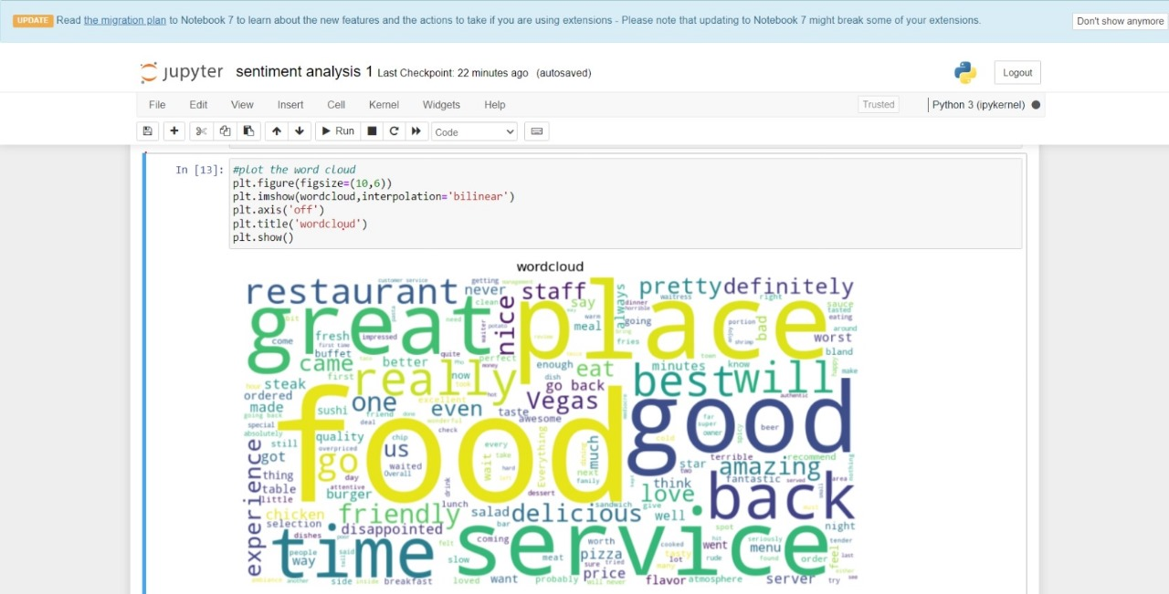
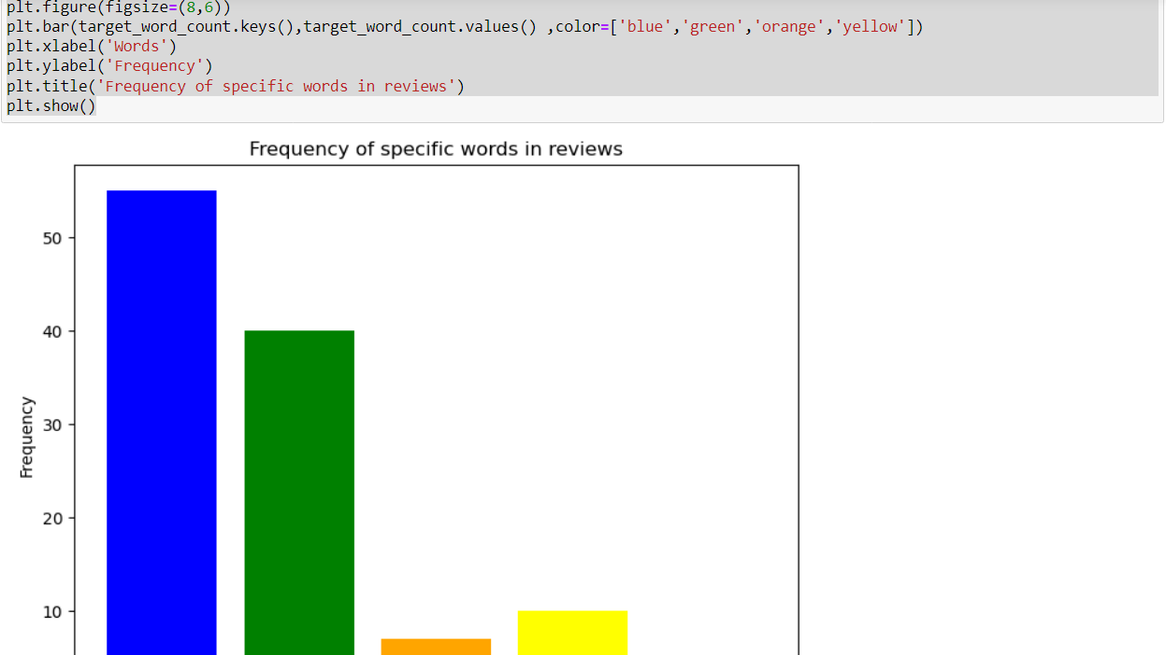
Result
Present the results of the machine learning model in terms of its accuracy and effectiveness in predicting reviews counts. Include visualizations and comparisons between predicted and actual counts to highlight the model's performance.

Slide 8
Conclusion
Summarize the findings and discuss the effectiveness of the proposed solution. Highlight any challenges encountered during the implementation and potential improvements. Emphasize the importance of accurate reviews data and predict data for ensuring a stable supply of revies data in urban areas.
Here we review the food and prices and the review of the people that are taken in the reataurant using Naïve Bayes classifier Algorithm we classify the data of the food and the reviews from the customers and we find the nearest accuracy score of the food that is purchased in the restaurant area
For this we use sentiment analysis techniques such as lemmatization ,tokenization,sentiment analysis like this we use some techniques and find the qccuracy score

Slide 9
Future scope
Discuss potential enhancements and expansions for the system. This could include incorporating additional data sources, optimizing the algorithm for better performance, and expanding the system to cover multiple cities or regions. Consider the integration of emerging technologies such as edge computing or advanced machine learning techniques.
We can use some sort of techniques and we can find the solution for the data what we have given very easily
We gain some knowledge about the algorithms based on them we can make the project very easily

Slide 10
References
List and cite relevant sources, research papers, and articles that were instrumental in developing the proposed solution. This could include academic papers on bike demand prediction, machine learning algorithms, and best practices in data preprocessing and model evaluation.
We have used Sentiment analysis techniques like stemming,Tokenization etc
We used Algorithms like Naïve Bayes classifier which can be used for doing sentiment analysis
We have collected data from online services,from Restaurants etc

Slide 11
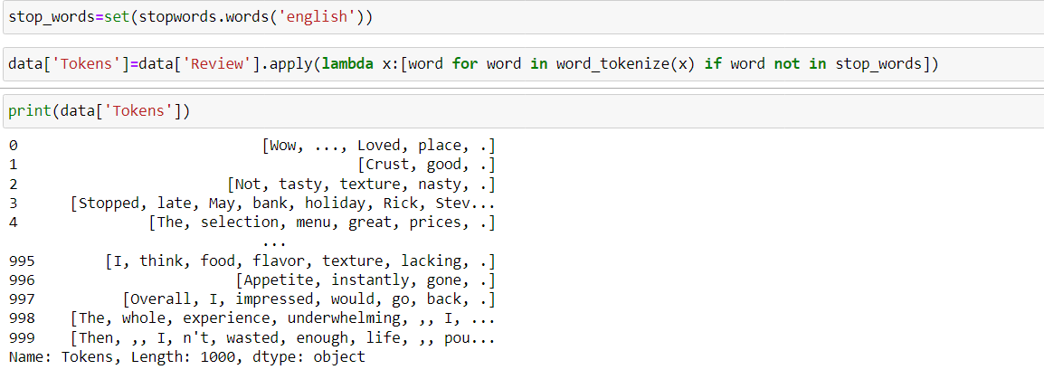
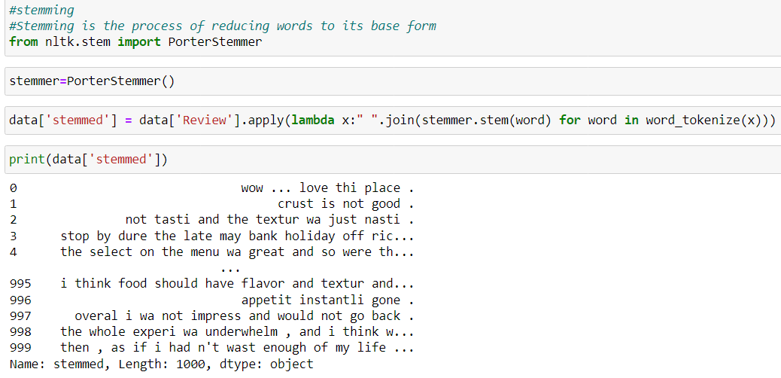
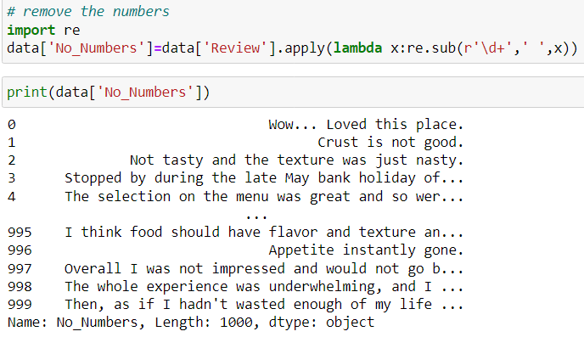
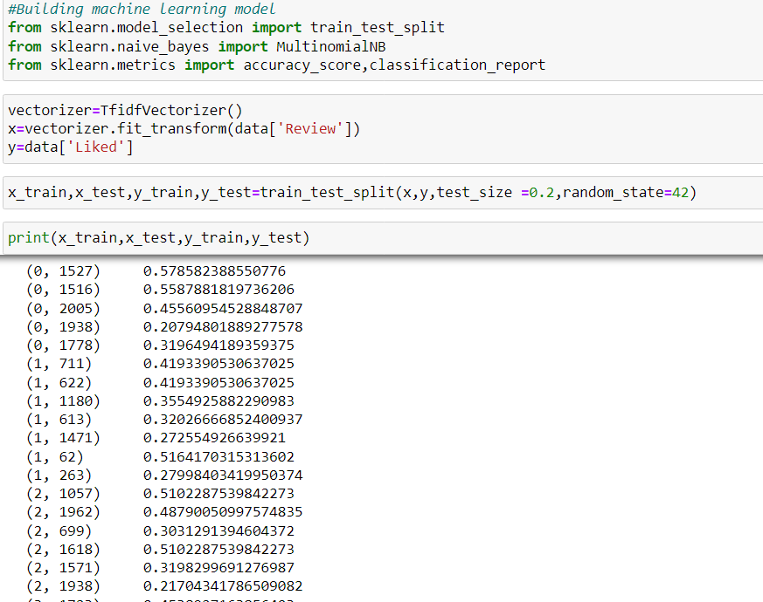
THANK YOU

