Slide 1

Advanced Security Access Control System
Batch Members: B10_HAARISH N (113222041053) • B10_NITHISH KL (113222041103) • B10_DHANUSH VAASAN D (113222041032)
Supervisor: Mrs. S. KAVITHA, Associate Professor
Date: 10-04-2026

Slide 2



Abstract
The CO-MAIN project transforms traditional reactive surveillance into a proactive, autonomous security framework using Computer Vision, deep learning, and multi-threaded software engineering.
Vision-as-a-Sensor
Real-Time Identification
Proactive Alerting
Existing camera infrastructure is repurposed as an intelligent sensor network — no badge readers or biometric scanners needed.
Personnel are identified continuously using deep face recognition. Entry into restricted zones is cross-referenced with Authority Ranks instantly.
Unlike passive CCTV recording, CO-MAIN generates instant security alerts when unauthorized individuals are detected in restricted zones.
CO-MAIN Project | Advanced Security Access Control System
2

Slide 3




Key Innovation — 4-Module Modular Architecture
The system is divided into four specialized, independently upgradable modules:
Orchestrator
Recognition Engine
main.py
recognition.py
Handles the GUI, application state, and coordinates data flow between hardware and intelligence modules.
The brain. Handles face detection, VGG-Face embedding generation, and person identification.
Spatial Tracker
Persistence Layer
room_detector.py
database.py
Maintains Object Permanence — tracks individuals across zones even when face is not visible.
Manages the SQLite database, stores embeddings, and maintains a high-performance RAM cache.
CO-MAIN Project | Advanced Security Access Control System
3

Slide 4
Objectives
Objective
Measurable Target / KPI
1
Design a real-time facial biometric identity monitoring system
30 FPS continuous monitoring
2
Continuously identify personnel in restricted zones via camera
4096-dim VGG-Face embeddings
3
Detect unauthorized individuals instantly with high accuracy
Cosine distance threshold: 0.60
4
Generate intelligent real-time security alerts on zone violation
<1 µs auth lookup via RAM cache
5
Prevent spoofing attacks using liveness detection
Photo / video replay protection
6
Maintain encrypted biometric data storage with audit logging
SQLite3 + Write-Ahead Logging
CO-MAIN Project | Advanced Security Access Control System
4

Slide 5
Literature Survey (Papers 1 – 2)
Sr. No
Paper Title
Year
Advantages
Disadvantages
1
"On Generating Identifiable Virtual Faces" – ACM Intl. Conf. on Multimedia
2023
Realistic synthetic faces via GANs; useful for privacy-preserving training datasets.
Limited to facial data; requires high computational resources.
2
Deep Learning Face Recognition: A Survey – IEEE TPAMI
2023
High accuracy using CNN models; robust feature extraction across many datasets.
Requires large datasets; high training complexity and long inference time.
CO-MAIN Project | Advanced Security Access Control System
5

Slide 6
Literature Survey (Papers 3 – 4)
Sr. No
Paper Title
Year
Advantages
Disadvantages
3
Presentation Attack Detection for Face Recognition – IEEE TBIOM
2022
Prevents photo/video spoofing attacks; significantly improves security posture.
Increases system complexity; additional processing overhead required.
4
Recent Advances in Face Recognition & Surveillance Systems (Survey)
2024
Improved accuracy with modern AI models; better scalability across environments.
High implementation cost; complex integration with existing infrastructure.
CO-MAIN Project | Advanced Security Access Control System
6

Slide 7
Existing System — Limitations & CO-MAIN Solutions
Problem
Existing System
CO-MAIN Fix
Manual CCTV monitoring — human fatigue & missed detections
Security guard watches screens
Autonomous AI monitoring at 30 FPS, zero fatigue
No continuous identity tracking — only access-gate control
Badge swipe at entry point only
Vision-as-a-Sensor: tracks entire movement path
No liveness detection — vulnerable to photo/video spoofing
Single-modality face recognition
Liveness detection integrated into pipeline
Real-time auth queries hit disk (~10 ms per check)
Database query on every frame
In-RAM cache lookup: <1 µs per authorization check
Crashes with multiple USB cameras (MSMF driver conflicts)
Single camera or sequential init
Staggered Start Protocol (2.5 s delay) + fallback
CO-MAIN Project | Advanced Security Access Control System
7

Slide 8
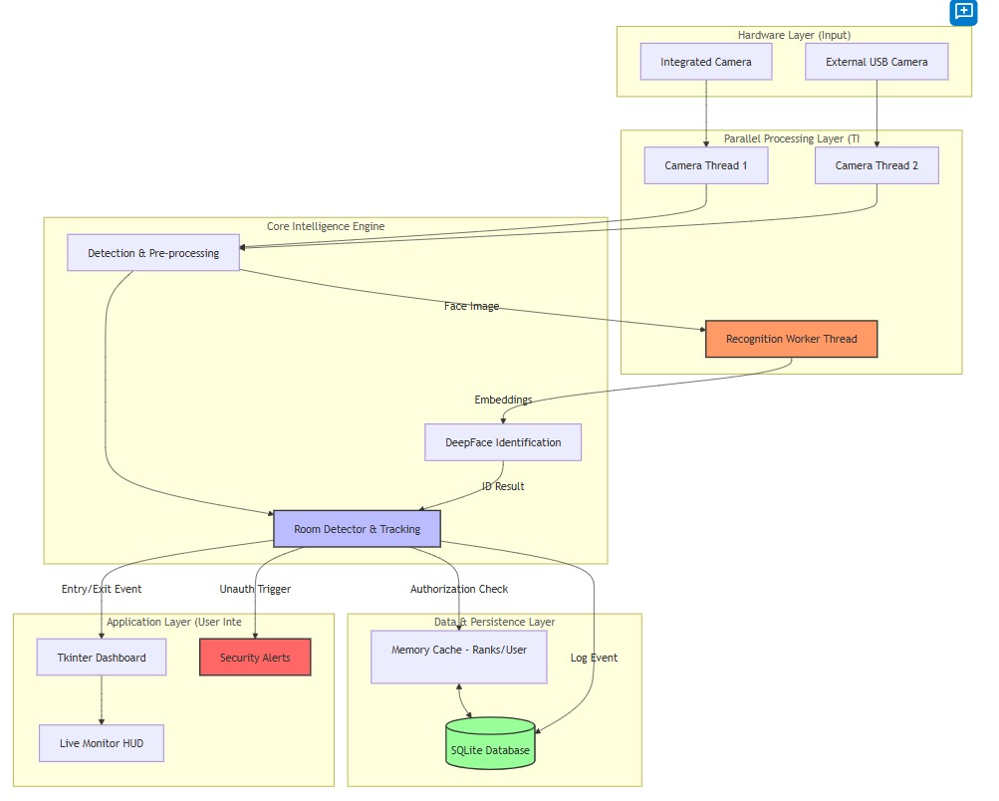
Proposed System Architecture
Recognition Engine
recognition.py
Persistence Layer
database.py
CO-MAIN Project | Advanced Security Access Control System
8

Slide 9
Multi-Camera Management & Threading Model
Problem: Opening multiple USB cameras simultaneously causes MSMF driver conflicts on Windows.
PRODUCERS — Camera Threads (one per camera)
Camera Thread 1
Polls hardware for latest frame
Camera Thread 2
Polls hardware for latest frame
Camera Thread 3
Polls hardware for latest frame
⏱ Staggered Start: 2.5 s delay between each camera init (MSMF fix)
THREAD-SAFE CAMERASLAB BUFFER
CameraSlot[1] · CameraSlot[2] · CameraSlot[3] — Each holds the latest frame from its camera thread
CONSUMER — GUI Main Loop (30 FPS)
GUI reads latest frame from each CameraSlot at 30 FPS — if one camera drops, others remain fluid
CO-MAIN Project | Advanced Security Access Control System
9

Slide 10
Face Recognition Pipeline — Two-Stage Identification
STAGE 1: Fast Detection
STAGE 2: Deep Identification (VGG-Face)
Live Camera
Frame
Grayscale
Downsample
Haar Cascade
Detection
Face Region
Cropped
VGG-Face
Embedding
Cosine Distance
Comparison
640×480 px
Saves ~40% CPU
Filters 99% of pixels
ROI passed to DNN
4096-dim vector
vs. all DB embeddings
Threshold Decision: Cosine Distance < 0.60
Tuned after testing — best balance between False Rejection and False Acceptance
✔ Distance < 0.60 → PERSON IDENTIFIED
(Name + Department displayed on screen)
✘ Distance ≥ 0.60 → UNKNOWN PERSON
(Security alert triggered immediately)
⚙ Recognition Worker Thread: recognize_face() runs in a background thread — UI continues at 30 FPS while AI processes. Zero lag.
CO-MAIN Project | Advanced Security Access Control System
10

Slide 11
Spatial Zone Detection — Room Tracking State Machine
CAMERA FIELD OF VIEW
Zone Transition Logic
ROOM 1
0% – 20%
HALLWAY
20% – 80%
ROOM 2
80% – 100%
ENTRY Event
Centroid moves from Hallway → Room 1 zone. System logs ENTERED_ROOM for Room 1.
EXIT Event
Object appears directly in Room 2 zone. System logs EXITED for Room 2.
Hysteresis
Centroid Tracking: Euclidean distance tracker maintains person identity across frames even when face is turned away.
Centroid must remain in a zone for N frames before transition is confirmed. Prevents 100 logs/sec jitter.
CO-MAIN Project | Advanced Security Access Control System
11

Slide 12
Security & Authorization Matrix — Authority Ranks
UNKNOWN / GUEST
Instant security alert generated on ANY zone entry. Flagged immediately.
RANK 1 — GENERAL
Access only to public zones and basic offices. Alert if enters lab or server room.
RANK 2 — STAFF
Access to labs, workshops, and standard personnel areas.
RANK 3 — ADMIN
Full clearance. All zones including server rooms and security junctions.
When ENTERED_ROOM event fires → system fetches person's rank from RAM cache → compares against room's allowed rank string → AUTHORIZED or ALERT
CO-MAIN Project | Advanced Security Access Control System
12

Slide 13
Database Architecture & High-Performance Caching
Table: users
Table: rooms
Table: access_logs
id
INT PK
id
INT PK
id
INT PK
name
TEXT
room_name
TEXT
person_name
TEXT
dept
TEXT
allowed_ranks
"1,2,3" string
room
TEXT
rank
INT (1/2/3)
timestamp
DATETIME
embedding
JSON (4096-D vector)
status
AUTHORIZED / UNAUTH
RAM Cache Performance Advantage
~10 ms
< 1 µs
10,000×
Without Cache
(disk query per frame)
faster
With RAM Cache
(Python dict lookup)
CO-MAIN Project | Advanced Security Access Control System
13

Slide 14
Proposed Working Procedure
System Initialization
Identity & Zone Check
1
Camera and embedded processor initialize. MultiCameraManager applies Staggered Start Protocol with 2.5 s delay between each camera.
4
Detected faces are matched via Cosine Distance (threshold 0.60). Simultaneously, RoomDetector tracks centroid positions across 3 zones.
Personnel Enrollment
Authorization Decision
2
Admin captures multiple facial images of authorized persons. VGG-Face generates 4096-D embedding, which is encrypted and stored in the database.
5
Person's Authority Rank is fetched from RAM cache (<1 µs) and compared to the room's allowed ranks. Decision: AUTHORIZED or ALERT.
Live Monitoring Starts
Logging & Alerting
3
All camera threads begin polling. Haar Cascade detects faces on grayscale downsampled frames at 30 FPS for efficiency.
6
All events are logged to access_logs table (WAL mode). Unauthorized entries trigger instant security alert on the GUI dashboard.
CO-MAIN Project | Advanced Security Access Control System
14

Slide 15



Novelty & Innovation
Continuous Monitoring vs. Access Control
Sub-Microsecond Authorization via RAM Cache
Traditional systems gate entry at doors. CO-MAIN monitors identity presence throughout the entire facility in real-time, detecting unauthorized movement anywhere in the building.
By loading the entire users and rooms tables into Python dicts at startup, authorization checks complete in <1 µs — enabling real-time 30 FPS monitoring without any frame stutter.
Anti-Spoofing with Liveness Detection
Software-Only Cost-Effective Solution
Integration of liveness detection with VGG-Face recognition prevents spoofing attacks using photographs or video replays — a critical gap in most face recognition deployments.
Entire system runs on standard Windows hardware with USB webcams — no specialized sensors, RFID readers, or proprietary hardware required. Fully open-stack implementation.
CO-MAIN Project | Advanced Security Access Control System
15

Slide 16





Advantages
Real-Time Identity Monitoring
Instant Security Alerts
Anti-Spoofing Protection
Continuous 30 FPS surveillance with face identification across all camera zones simultaneously.
Unauthorized or suspicious presence triggers immediate alert — no human monitoring required.
Liveness detection prevents photo and video replay attacks that defeat basic face recognition.
Reduces Human Dependency
Full Audit Trail
Scalable Architecture
Eliminates fatigue-related missed detections. System operates 24/7 with consistent accuracy.
Every access event is logged with person, room, timestamp, and status for compliance and review.
Modular design supports additional cameras, rooms, and AI models without full system rewrite.
CO-MAIN Project | Advanced Security Access Control System
16

Slide 17
Hardware Components
S.No
Hardware
Specification
Purpose
1
Computer / Laptop
Windows 10/11, Intel i5+ (min), 8 GB RAM
Core processing unit for all CV and AI workloads
2
USB Webcam
720p or above; multiple units supported
Camera input for real-time face capture and zone tracking
3
Display Monitor
Standard PC Monitor (1080p recommended)
GUI dashboard for live surveillance and alerts
4
Storage
Minimum 50 GB HDD/SSD
Database storage for embeddings and access logs
CO-MAIN Project | Advanced Security Access Control System
17

Slide 18
Software Components
S.No
Software
Category
Role in CO-MAIN
1
Python 3.x
Core Language
Primary programming language for all modules — recognition, tracking, GUI, and database management.
2
OpenCV (cv2)
Computer Vision
Real-time face detection via Haar Cascade, frame capture, grayscale processing, bounding box rendering.
3
DeepFace / VGG-Face
Deep Learning
Generates 4096-dimensional facial embeddings. Performs Cosine Distance comparison for identification.
4
SQLite3
Database
Persistent storage for user embeddings, room configs, and access logs. Write-Ahead Logging for concurrency.
5
Tkinter
GUI Framework
Dashboard, live surveillance view, user registration page, and alert notification system.
6
NumPy / dlib
Data Processing
Facial landmark detection, numerical vector operations, and embedding distance calculations.
CO-MAIN Project | Advanced Security Access Control System
18

Slide 19
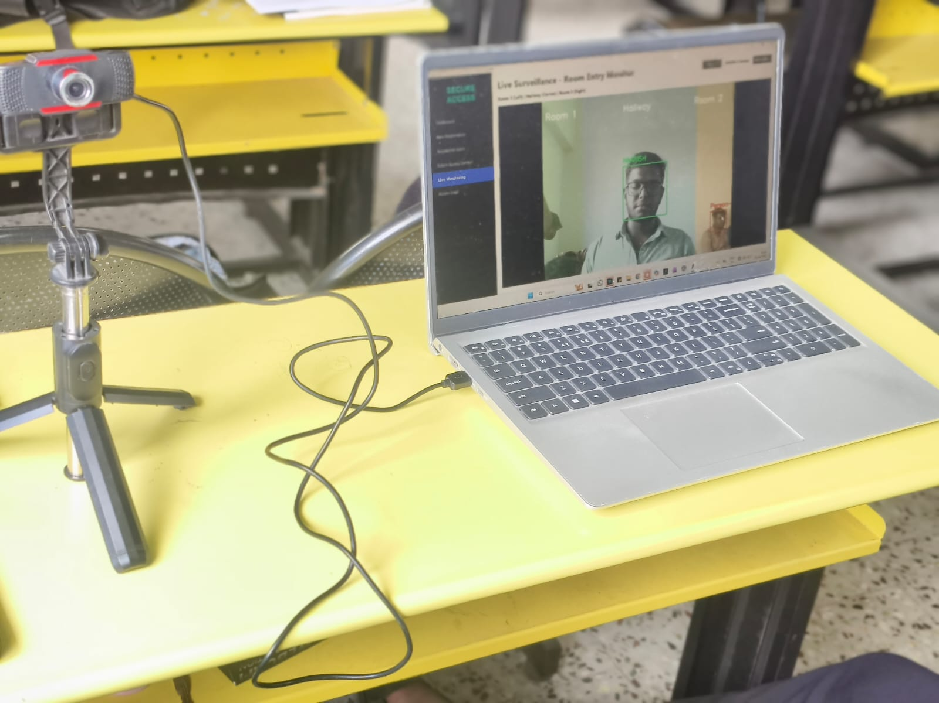
HARDWARE OUPUT
CO-MAIN Project | Advanced Security Access Control System
20

Slide 20
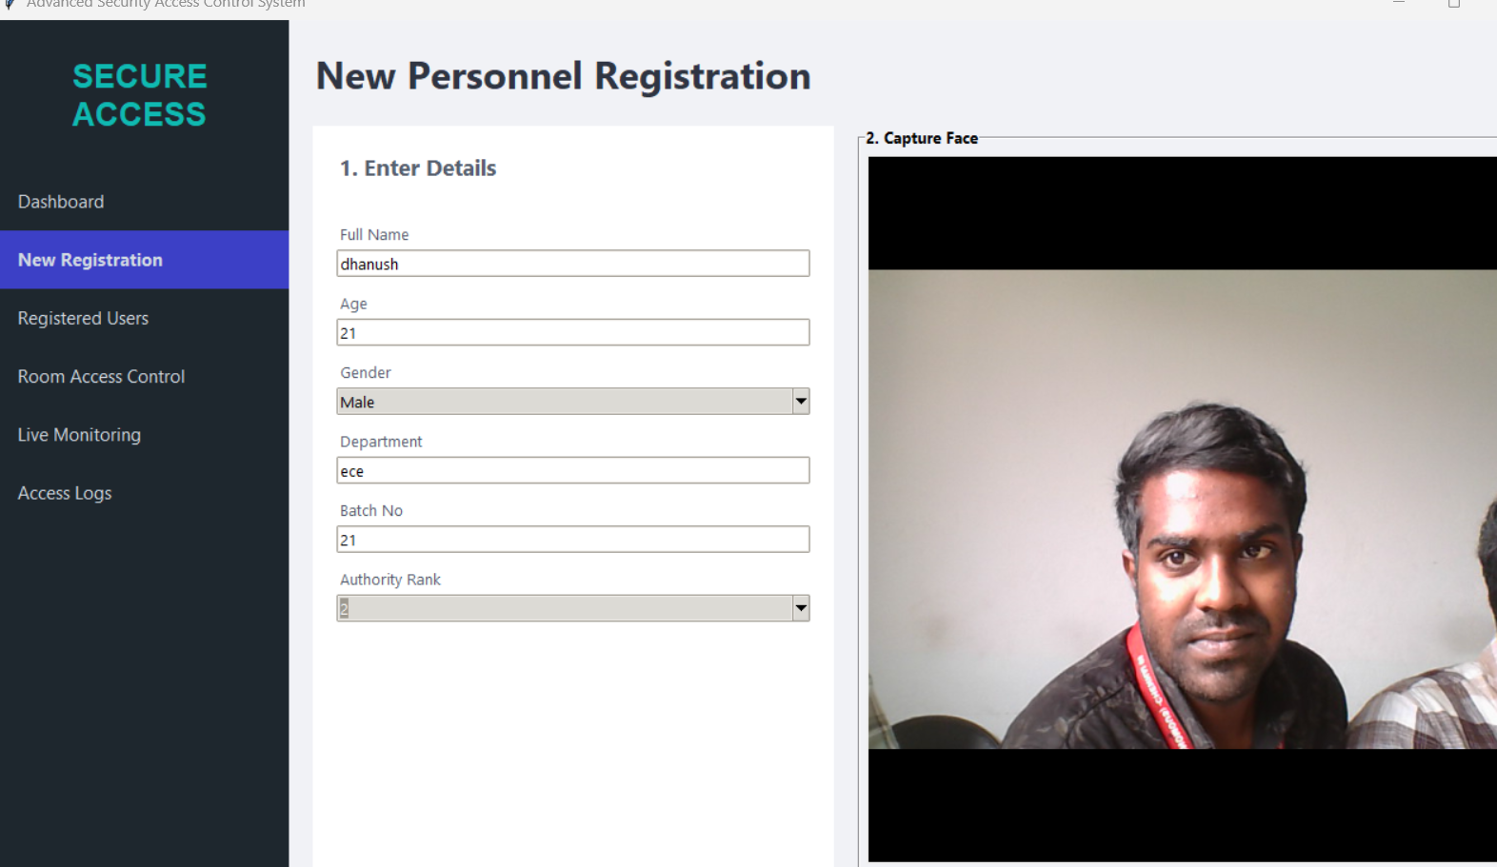
SOFTWARE OUTPUT
CO-MAIN Project | Advanced Security Access Control System
20

Slide 21
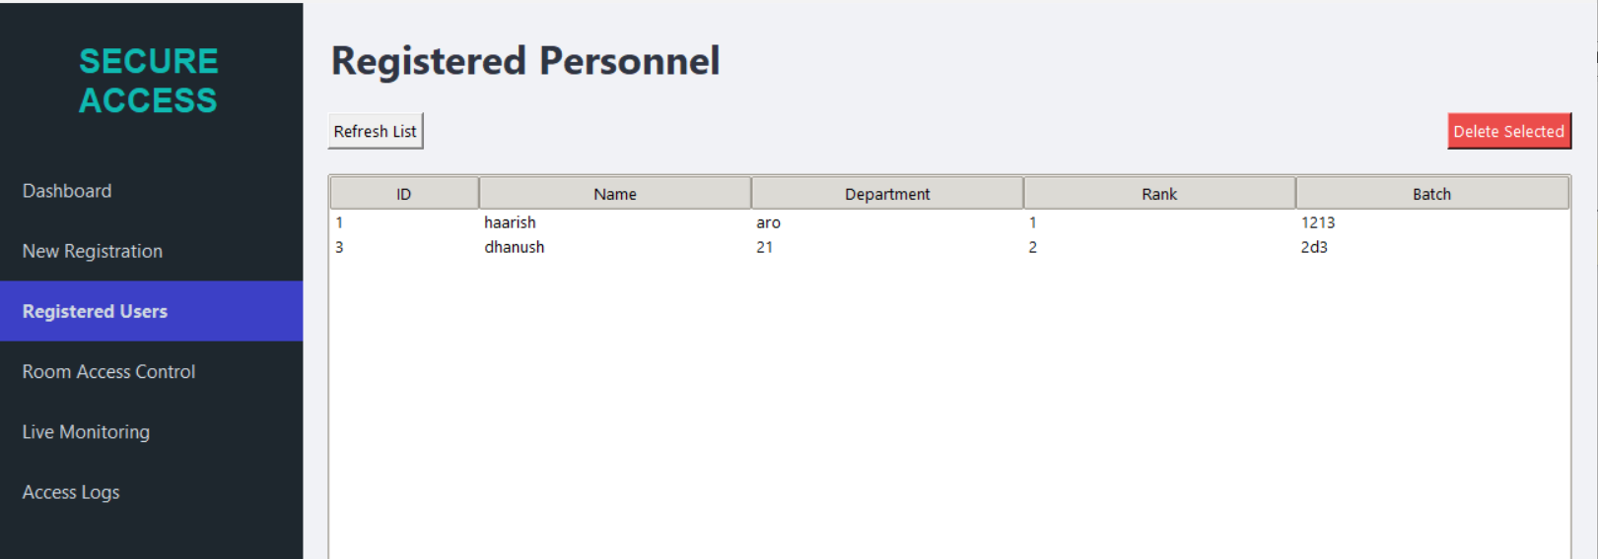

Slide 22
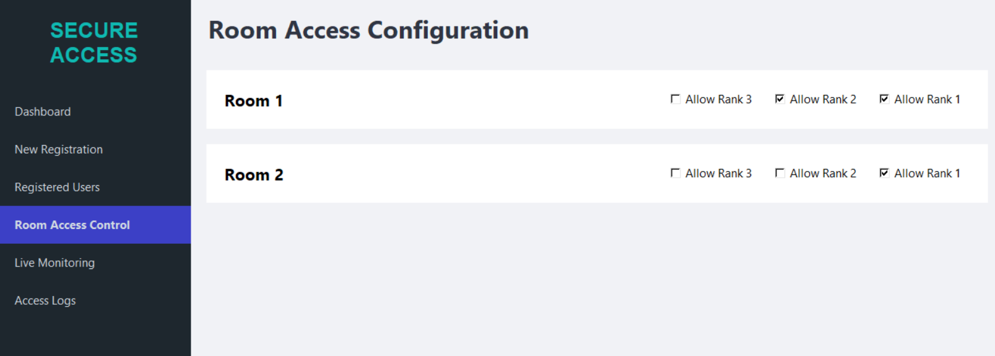

Slide 23
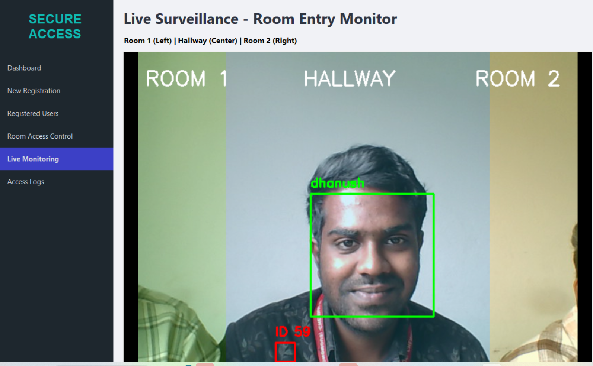

Slide 24
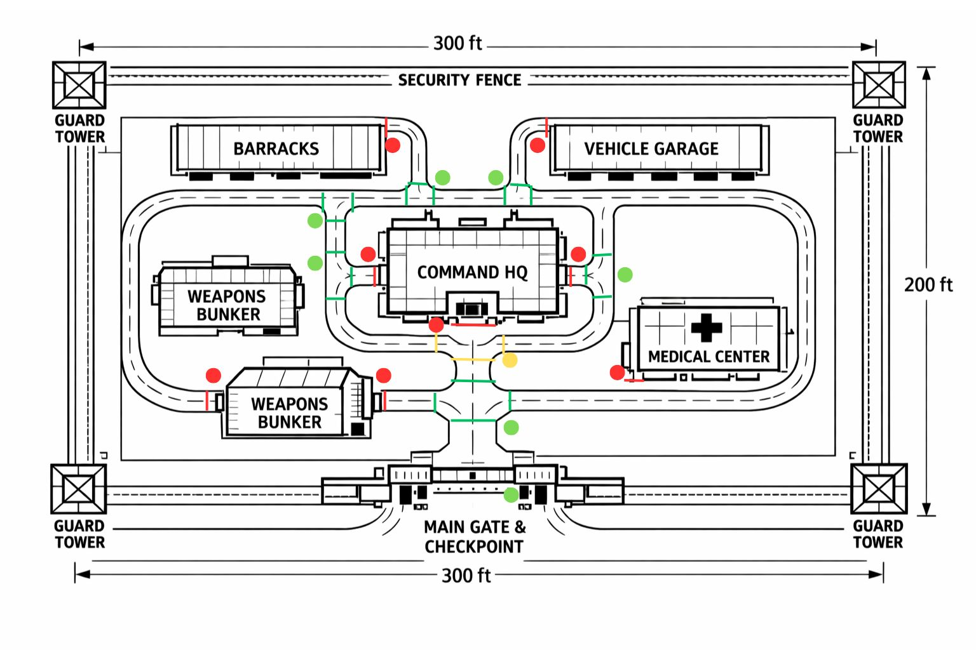
ROOM LAYOUT
CO-MAIN Project | Advanced Security Access Control System
20

Slide 25


Conclusion & Future Scope
Conclusion
Future Scope
Transforms passive CCTV surveillance into a proactive, autonomous security ecosystem.
Distributed GPU Processing
Run heavy VGG-Face inference on a GPU-accelerated server while lightweight camera nodes handle capture.
Solves real-world engineering challenges: multi-camera conflicts, real-time AI performance, and spatial tracking.
Anomaly Detection
Train models to detect suspicious behaviors: loitering, running in hallways, or unattended objects.
Provides continuous identity monitoring with intelligent zone-based alert generation.
Smart IoT Lock Integration
Scalable, software-only implementation on standard hardware with full encrypted audit logging.
Connect Authorization signal to IoT-enabled door locks for automatic physical access control.
CO-MAIN Project | Advanced Security Access Control System
19

Slide 26
References
[1] Y. Sun, X. Wang, and X. Tang, Deep learning face recognition: A survey, IEEE Trans. Pattern Analysis and Machine Intelligence, vol. 45, no. 3, pp. 2582-2606, 2023.
[2] R. Raghavendra, K. Raja, and C. Busch, Presentation attack detection for face recognition: A comprehensive survey, IEEE Trans. Biometrics, Behavior, and Identity Science, vol. 4, no. 3, pp. 367-388, 2022.
[3] M. Wang, W. Deng, and J. Hu, Deep face recognition: A survey, IEEE Trans. Neural Networks and Learning Systems, vol. 34, no. 1, pp. 1-18, 2023.
[4] H. Li, G. Hua, and X. Lin, Face recognition in the wild: A survey, IEEE Access, vol. 10, pp. 11421-11445, 2022.
[5] S. Z. Li, X. Zhu, and Z. Lei, Reliable face recognition for surveillance applications, IEEE Signal Processing Magazine, vol. 40, no. 2, pp. 89-102, 2023.
CO-MAIN Project | Advanced Security Access Control System
20

