Slide 1
Hobby Web Application Project
By Haaris Moghal

Slide 2
Introduction
Created a Full stack web application, with utilization of supporting tools and methodologies, covered during training.
Create a full-stack web application following the Enterprise Architecture Model, using:
Persistent layer - A managed database hosted locally or within the Cloud Provider (e.g. MySQL in GCP)
Business Layer - An application back-end developed using the language from your Programming Fundamentals module (e.g Spring)
Data Layer - A front-end developed using the language from your Front-End Web Technologies module (e.g. JavaScript)

Slide 3
Concept
Project objective:
To create a functional Web application
Focused on the MVP (Minimum Viable Product)
Project breakdown:
Key deliverables were split into user stories on my Kanban board.
Back-end application with full CRUD functionality
Testing
Git repository and management
Full supporting documentation including UML and ERD diagrams
Build Tool Maven
Project Management platform – Jira-Kanban Board
Fully integrated front end

Slide 4
Consultant Journey
Version Control System: Git – Project management. Pushing and Reverting.
Source Code Management: GitHub. See the progress of the project coming together.
Database management system – local:H2 and Google Cloud Platform (GCP)
Backend programming language – Spring
Testing – Junit, Mockito, Selenium and SonarQube.
Build tools – Maven. Using dependencies and building application.
Project Management platform – Jira/Kanban board

Slide 5
Continuous Integration
Git for version control
Used a Feature-branch model. (GitKraken)
Regular commits to ensure project safety.
Used Jira tags on most commits.

Slide 6
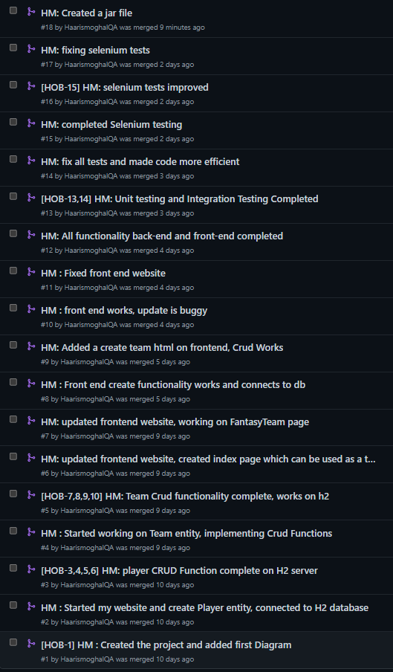
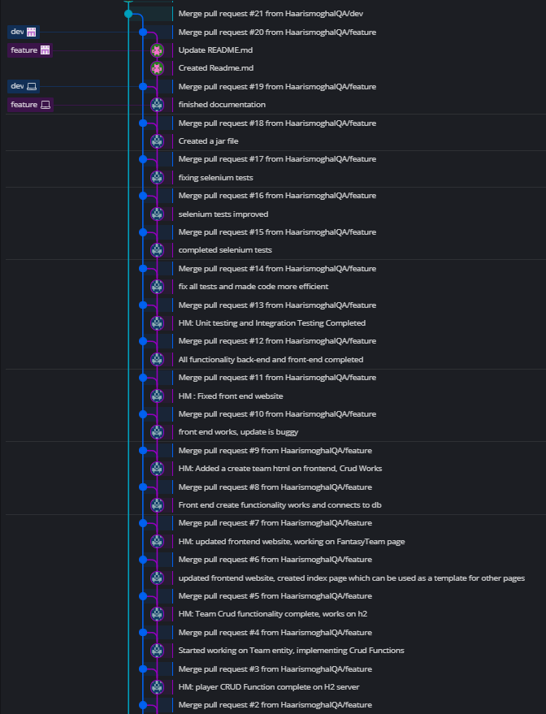
Continuous Integration
Added Jira Tags
On relevant
commits.

Slide 7
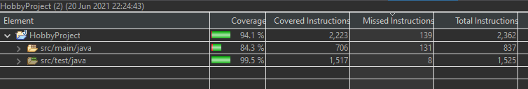
Testing unit
Managed to get 84.3% test coverage on src/main/java folder
Junit was used to test individual methods in each of the classes which were used. (Services and Controller)
Mockito was used to mock objects so that I can use to test the methods.

Slide 8
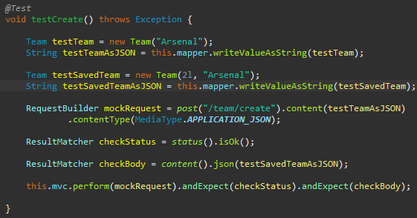
Testing- Mockito
Mockito was used along with Junit which allows you to create and configure mock objects
Mockito was used to mock objects so that I can use to test the methods.

Slide 9
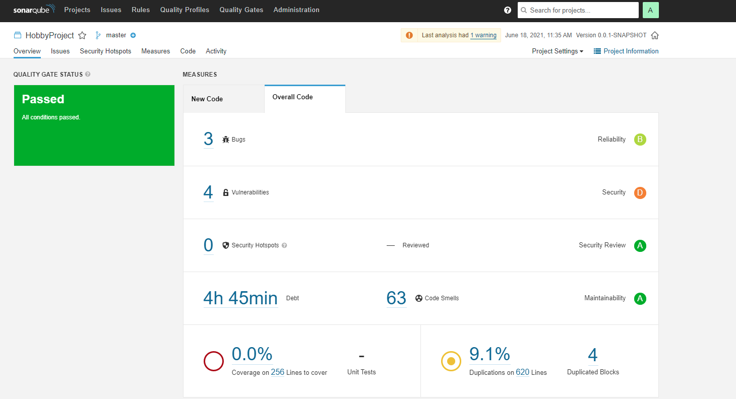
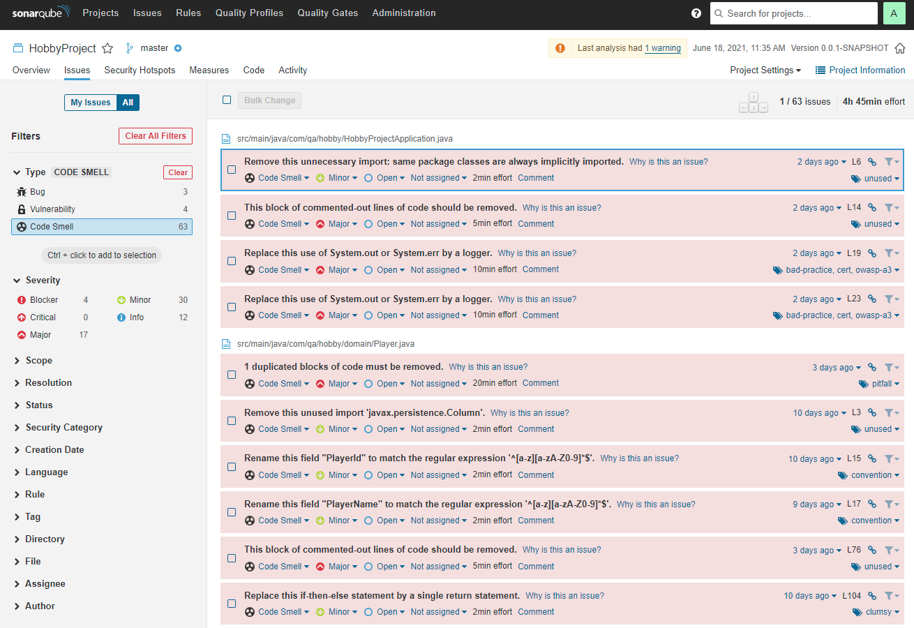
Testing - SonarQube

Slide 10
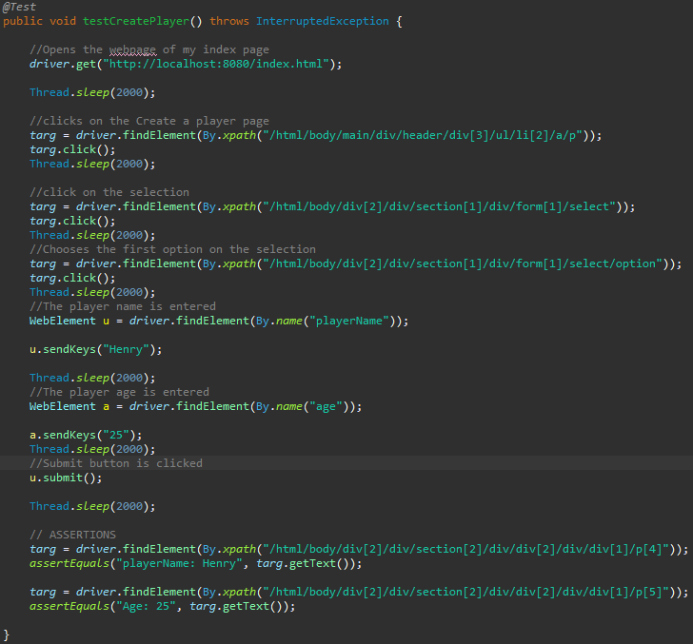
Testing - Selenium
Finding the target of each element
Able to submit a form using “submit()” method.
Used Assertion to double check if test worked/good practise.

Slide 11
Demonstration
User story 1: User is able to ADD a Team in the system SO THAT the User can create a team of players.
User story 2: User is able to ADD an Player in the system SO THAT the user can add players to there Team.
User story 3: User is able to Update a Team in the system SO THAT the User can change the name of the team.
User story 4: User can Delete a Player in the system SO THAT they can remove players from there team.

Slide 12
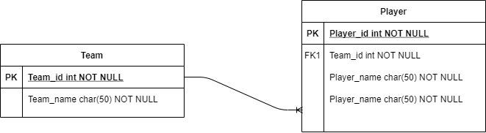
ERD – Entity Relationship Diagram
Before
After

Slide 13
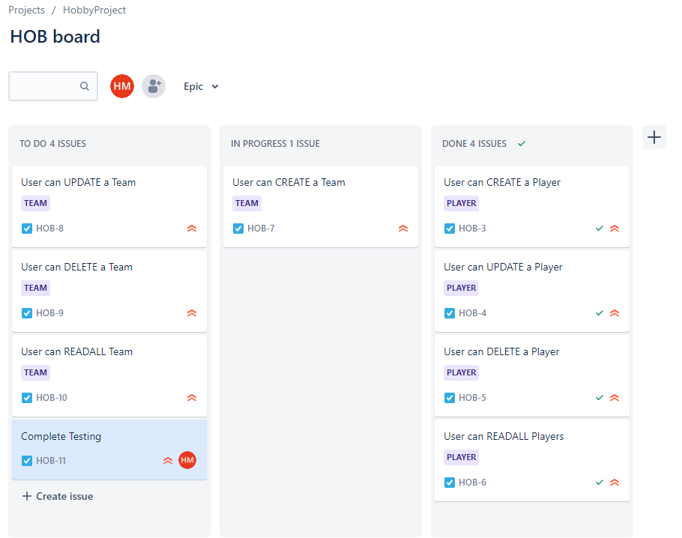
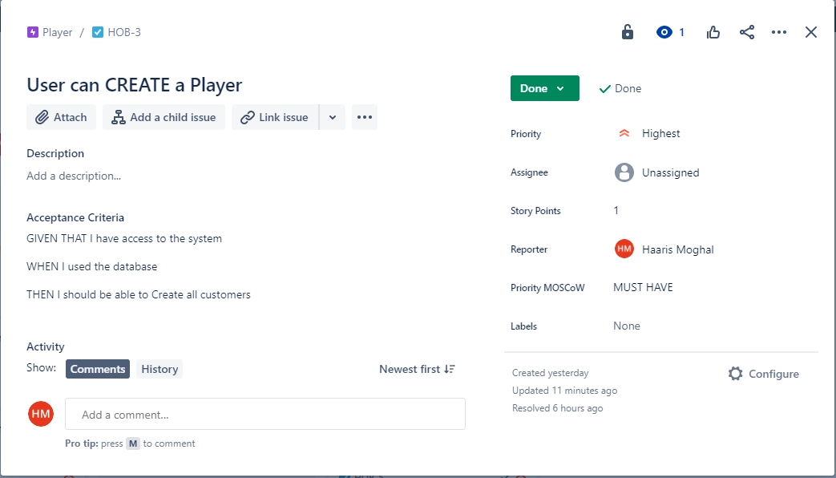
Jira – Kanban Board Week 1
Example of one the user stories.

Slide 14
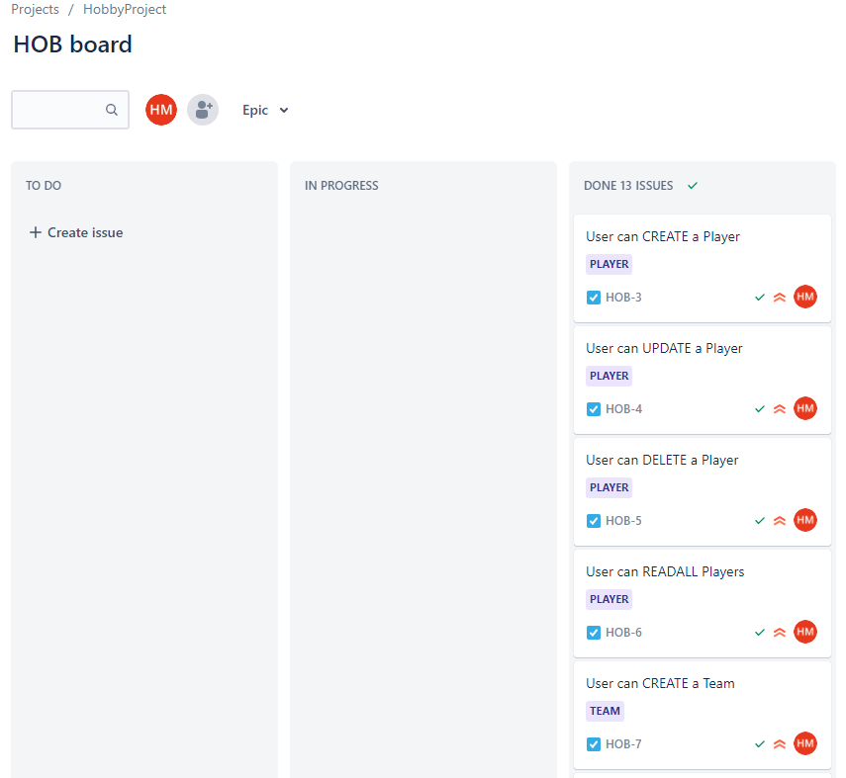
Jira – Kanban Board Week 2
All CRUD functions for Team and Players completed.
Unit, Integration and Selenium testing completed.

Slide 15
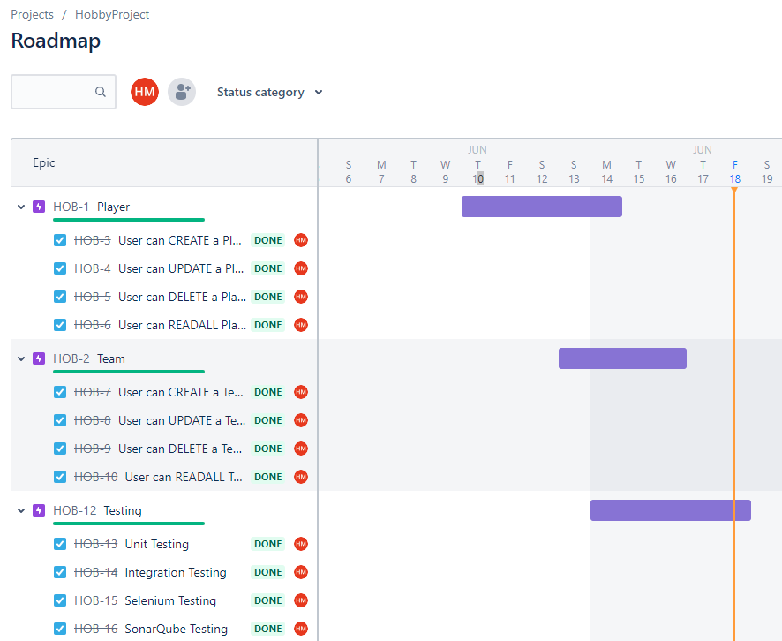
Jira Roadmap
All user stories completed.

Slide 16
Sprint review
I managed to complete the main functionality required according the deliverables:
CRUD functionality on the Front-end
CRUD functionality on the Back-end
Testing <80%
What got left behind:
All MVP has been met, nothing was left behind.
On front-end, About page (extra Web page) is not complete
On front-end, Login page (extra Web page) is not fully functional

Slide 17
Sprint retrospective
What went well?
I was able to meet all the user requirements
Version Control
Improvements?
SonarQube, fix all code smells and to be able to use unit coverage
Time management

Slide 18
Conclusion
Creating this Web application has improved my knowledge:
Back-end programming : Spring
Testing : Junit, Mockito, SonarQube and Selenium
Overall the aims project have been met:
Crud functionality
Testing
Using a database
Improvements?
More realistic with setting time frames of each sprints

Slide 19
Thank you for listening!

