Slide 1
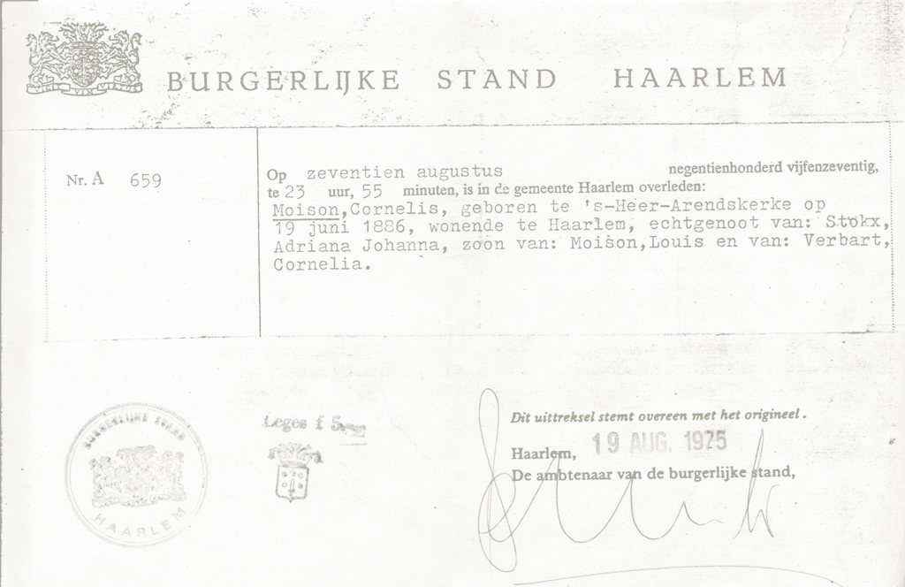


Proofs of being registered
Digital through Discipl

Slide 2
Providing proofs
It is a step preceding a broader use case with a corresponding universal transaction between for example a citizen and a housing corporation
T1
Register
Citizen
Housing corporation

Slide 3
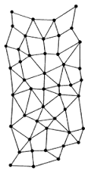
Providing proofs
Citizen claims (claim) data to be proofed, municipality attests claim (attest), housing corporation verifies attestation on claim (assert)
This is the same pattern as can be found in Self Sovereign Identity Platforms (SSIP)
Distributed Self Sovereign
Identity Platform
Standards (evolving):
DID – Decentralised IDentifier
W3C Verifiable Claims
Linked Data
Examples: Sovrin, uPort,
Techruption, Blockcerts
Now: providing proof
Later: Automatically and implicitely when registering birth / at municipality
Municipality
T0
Attestations
Attest
Claims
Assert
Claim
T1
Register
Citizen
Housing corporation

Slide 4

Providing Proofs
Citizen claims (claim) data to be proofed, municipality attests claim (attest), housing corporation verifies attestation on claim (assert)
Discipl is a new innovative architecture for society. Within this Discipl Core is an API for, amongst other functions, leveraging a distributed SSIP
Now: providing proof
Later: Automatically and implicitely when registering birth / at municipality
Municipality
T0
Attestations
Attest
Claims
Assert
Claim
T1
Register
Citizen
Housing corporation

Slide 5
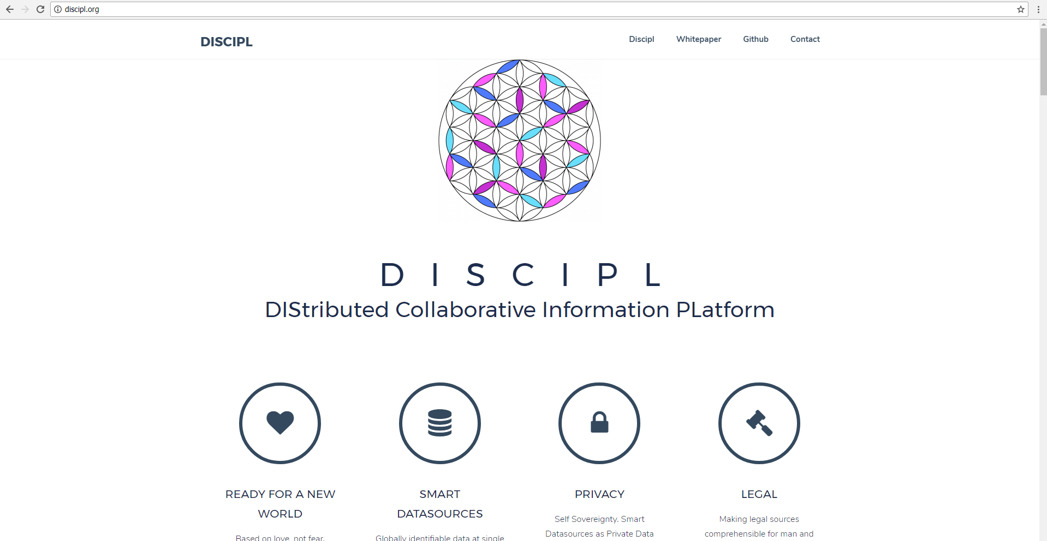
About Discipl

Slide 6
Discipl Core Context
WeQuest
Proofs of being registered – gemeente Haarlem
Logiesbelasting –
Gemeente Rotterdam
MoVo (ondernemersplein)
KvK
Discipl Core
GDI
Blockcerts / Blockchain
uPort / Ethereum
(Sovrin/) IOTA
Secure Scuttlebot
uPort / IPLD
Lokale private LD store

Slide 7
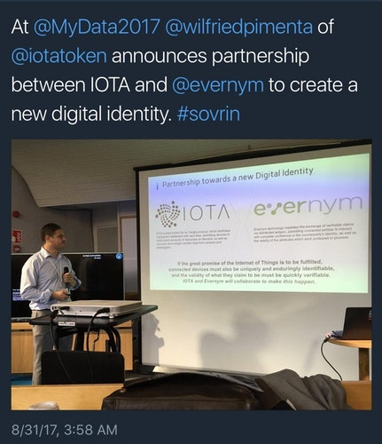
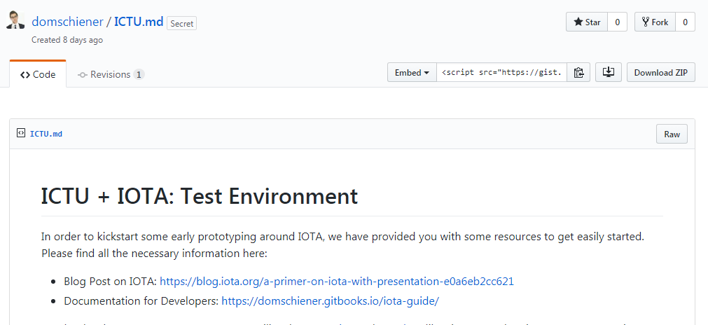
About IOTA
No blockchain but Tangle
No fees, no miner’s
Scalable: more nodes, more transactions: more throughput
Quantum safe

Slide 8
About IOTA
Masked Authenticated Messaging (MAM) Channels
Initiating party generates random adress under which an encrypted message is published referring to a next random adress (that can only be generated with the private key of the initiating party) and where the next message will be found.
Others need to get a reference to a message in the channel (within the Tangle) along with an appropiate key for decryption
Now still a beta release add on module, being verified by team of cryptologists september 2017

Slide 9
Proofs
Housing corporation subscribes to MAM channel of municipality (can be done at a later moment too).
Website for providing information out of central register, citizen claiming this information and attesting of these claims on MAM channel of municipality. Claim and attestation provided as QR code.
App for asserting (assert) of claim (through QR code scan)
Information itself is not put on a public distributed ledger platform, only the hash of the hash of it, and also in encrypted form

Slide 10

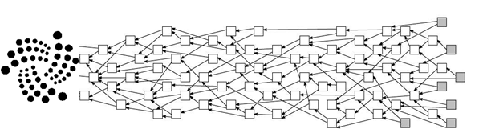
Proofs
Housing corporation
Citizen
Webapplication municipality Server side
Webapplication municipallity
Client side
Verification App
Presentatie Layer
Presentatie Layer
Presentatie Layer
Business Layer
Business Layer
Business Layer
Discipl Core API
Discipl Core API
Discipl Core API
Central BRP register through Stuf BG
Discipl IOTA Binding
Discipl Local LDStore Binding
Discipl IOTA Binding
MAM channel initiated by Municipality

Slide 11
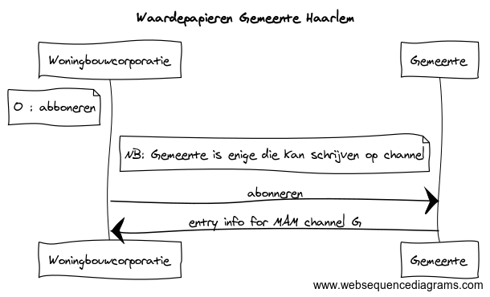
Step 0 : subscribe
Subscription can be realised in multiple ways. For better security a relying party like a housing corporation needs to identify itself in a secured session trough a website or even better: the verification-app.

Slide 12
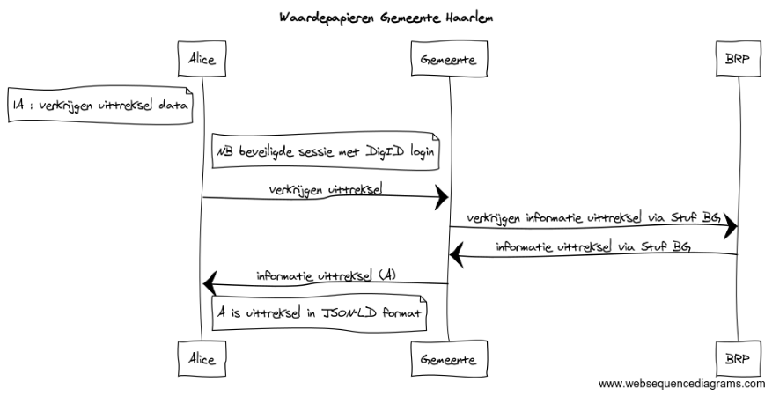
Step 1A : retrieving information
NB: Alice uses the client side of the webapplication of the municipality.
It could also be a smartphone App compatible with SSIP standards.
Signing takes place in the next step.

Slide 13
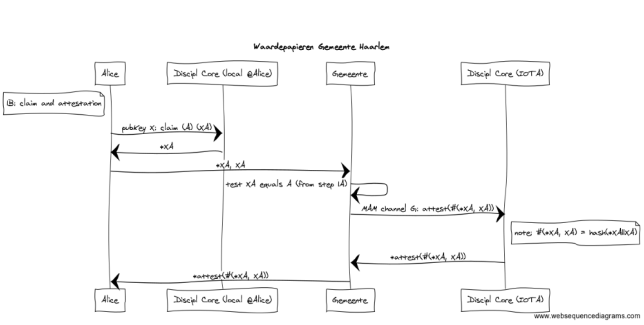
Step 1B : claim and attestation
Alice claims locally (temporarily) the information to be proved and doing so adds a secret code.
The municipality publishes the hash of information+secret on MAM channel. A reference to this message together with the information and secret is rendered in a QR code for Alice to keep safe (op paper or digitally). It might be easier and more safe for Alice to keep it in a dedicated App instead of fetched from the client side webapplication. In the end Discipl will probably allow for safely sharing claims throug a DLT, for example through MAM channels.

Slide 14
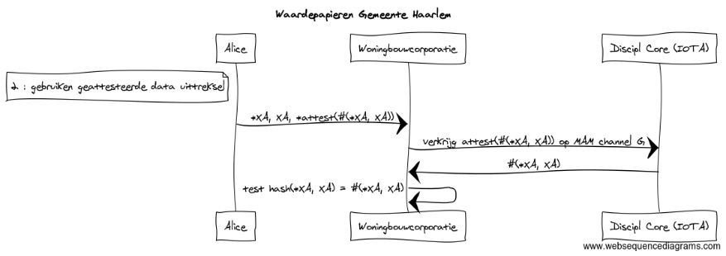
Step 2 : verification
The verification app supports subscription (step 0) and crawls the channel until the attestation claim referenced by Alice has been found. The App tests whether the hash of the information provided by Alice equals the hash in the attestation claim found on the channel.
The fact that the hash of information and secret exists in the channel in which only the municipality can add messages proves that the municipality earlier identified a person with the same information and knowledge of the same secret code (which is not being stored elsewhere than with that person.) as provided by the person now in contact with the housing corporation.

Slide 15
Security en Privacy
Open Source and GPLv3.0, Privacy By Design
No real information on the ledger, also not in encrypted form, only encrypted one way hashes
Non-transferability : attestations are linked to personal identifiable information as name and adres; these can not be altered and therefore used when keys of the citizen are stolen, or the citizen deliberately shares keys with others.
Issuer unlinkabillity : The municipality will not be aware of the verification the housing corporation performs.
Multi show unlinkabillity : the information claimed in this use case will alwyas be linkable by comparing information when housing corporations share this info (which is probably not permitted). There will never be a way to prevent this, but that's not different in the current situation. An attestation can be used only once by the citizen to make this more hard
Revocation : in the current situation the municipality will have to publish a revocation on the MAM channel. In the future when the claim is a real registration itself, the citizen publishes the revocation him/her selves (though that would mean he/she unregisters).
When the keys of the municipality are stolen the municipality can invalidate the whole channel when noticing a first fraudulent message by adding a kill-message together with revocations of fraudulent attestations and move to a new channel.
Revocation will be out of scope in the first demo.

Slide 16
Roadmap
Octobre 2017: Functional and technical design,
Proof of technology on IOTA Sandbox
2. December 2017: Demo website and App (without DigId en BRP)
3. 2018: Production version (with DigId en BRP)

Slide 17
Technical Design
Components ICTU / Discipl community with support IOTA Foundation :
1. Discipl Core (Claim(), Attest(), Assert())
2. Discipl Local binding
3. Discipl IOTA binding (with MAM support)
http://github.com/discipl/core
Components Municipality of Haarlem (development: Xurux):
1. Demo Website server/client side
2. Demo Verification App
http://github.com/Haarlem/Digitale-waardepapieren
(later in “App Store”: http://github.com/discipl/projects/waardepapieren)

