Slide 1

DANA-4820
MAHEEP KAUR
PREET MANN
HARPREET KAUR
MOHIT SAINI

Slide 2

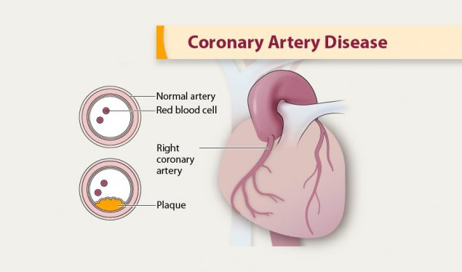
Why this dataset?
As per the statistics from the World Health Organisation,
Cardiovascular diseases (CVDs) are the leading cause of death globally.
An estimated 17.9 million people died from CVDs in 2019, representing 32% of all global deaths. Of these deaths, 85% were due to heart attack and stroke

Slide 3
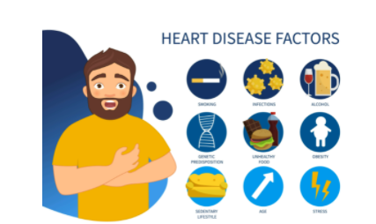
Project Overview
During the training phase, a classification model will be built using a number of independent factors such as male, age, cigsPerDay, totChol, sysBP, and glucose, as well as a dependent variable (TenYearCHD class). The purpose of the categorization is to determine if the patient has a 10-year risk of Coronary Heart Disease (CHD).

Slide 4

Methodology
We will try to predict whether a patient is likely to have a heart disease in 10 years based on the input parameters like gender, age, education, currentSmoker, cigsPerDay, BPMeds, prevalentStroke, prevalentHyp, diabetes, totChol, sysBP, diaBp, BMI, heartRate and glucose.

Slide 5
Description of Dataset
Variable Name | Data Type
male | Nominal-Categorical
age | Continuous-Numerical
education | Ordinal-Categorical
currentSmoker | Nominal-Categorical
cigsPerDay | Continuous-Numerical
BPMeds | Nominal-Categorical
prevalentStroke | Nominal-Categorical
prevalentHyp | Nominal-Categorical
diabetes | Nominal-Categorical
TenYearCHD | Nominal-Categorical
totChol | Continuous-Numerical
sysBP | Continuous-Numerical
diaBP | Continuous-Numerical
BMI | Continuous-Numerical
heartRate | Continuous-Numerical
glucose | Continuous-Numerical
Dataset Name - Heart Disease Prediction
Dataset Dimensions - 4238 rows and 16 columns
Response Variable - TenYearCHD
Predictors - male, age, education, currentSmoker, cigsPerDay, BPMeds, prevalentStroke, prevalentHyp, diabetes, totChol, sysBP, diaBp, BMI, heartRate and glucose

Slide 6
Description of Variables
male : male or female (Nominal)
age : age of the patient (Continuous)
currentSmoker : whether or not the patient is a current smoker (Nominal)
cigsPerDay : the number of cigarettes that the person smoked on average in one day (Continuous)
BPMeds : whether or not the patient was on blood pressure medication (Nominal)
prevalentStroke : whether or not the patient had previously had a stroke (Nominal)
prevalentHyp : whether or not the patient was Hypertension (Nominal)
diabetes : whether or not the patient had diabetes (Nominal)
totChol : total cholesterol level (Continuous)
sysBP : systolic blood pressure (Continuous)
diaBP : diastolic blood pressure (Continuous)
BMI : Body Mass Index (Continuous)
heartRate : heart rate (Continuous)
glucose : glucose level (Continuous)
TenYearCHD : 10 year risk of Coronary Heart Disease (CHD) (binary: 1 (Yes), 0 (No))
Education : education level (Ordinal)

Slide 7
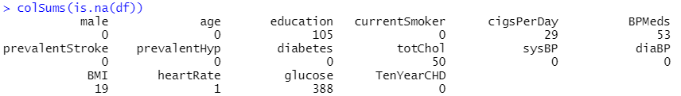
Data Cleaning and Manipulation
The dataset was analysed for any missing values.
The variables “bmi” , ”glucose”, ”heart rate” had missing values and the values were imputed with the median values.
The variables “education”, “cigsPerDay “ and “BPMeds” are categorical so, we dropped the missing values.
The name of variable “male” was changed to “gender” .
No duplicates were found in the dataset.

Slide 8
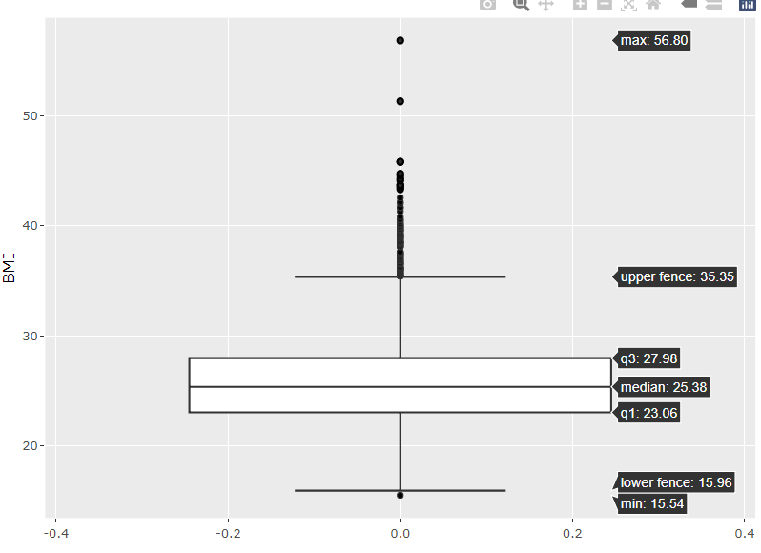
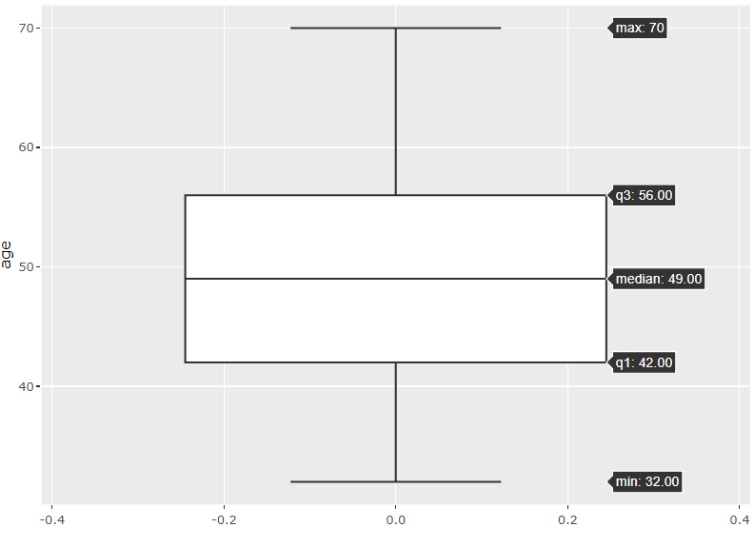
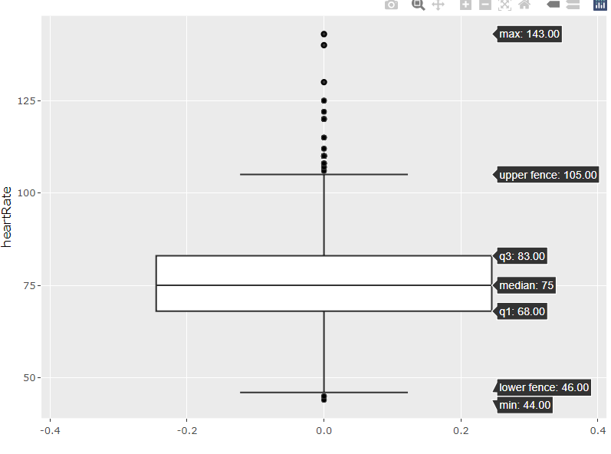
Outlier Detection
The numeric variables “bmi”, “age” and “heart rate” were analysed for any outliers by plotting boxplots.
The outliers for the variable “bmi” ,”heart rate” ,”glucose” were meaningful so we retained them in our further analysis.

Slide 9
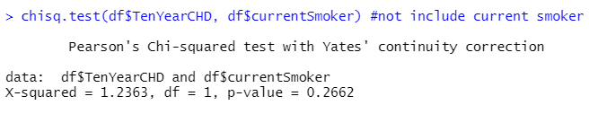
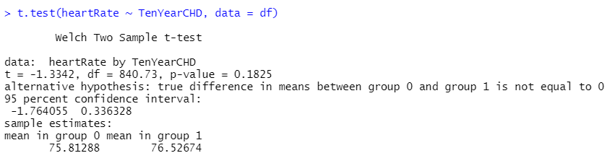
Initial Variable Selection:
We performed Chi-Square for categorical variables and T-test for numeric variables to check association.
Ho : There is no association between the two variables.
Ha : There is significant association between the two variables.
Results for Chi-Square:
We rejected null hypothesis for all the variables other than “current_smoker”.
Results for t-test:
Variances are equal for all other variables except heartRate.

Slide 10
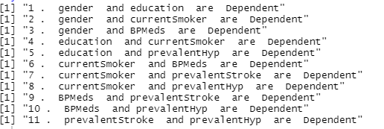
Correlation of categorical data :
We can observe that all of the below pairs of categorical data are dependent on each other :

Slide 11
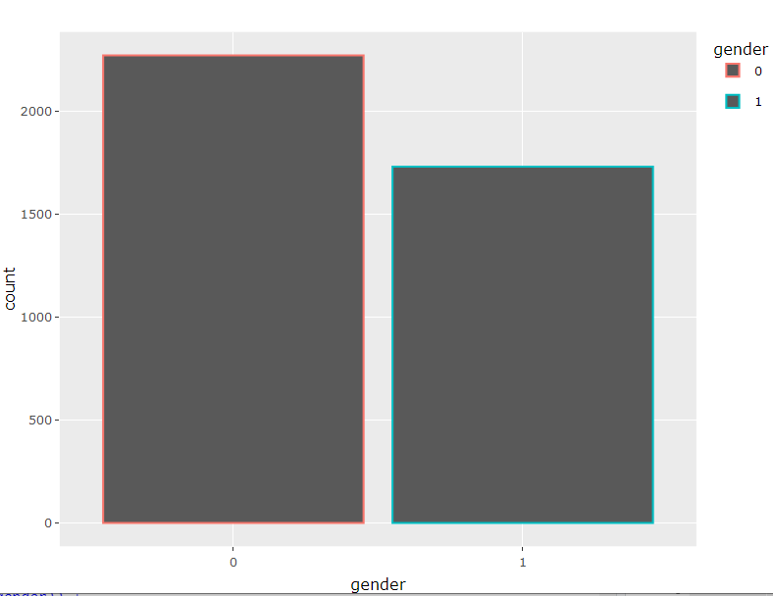
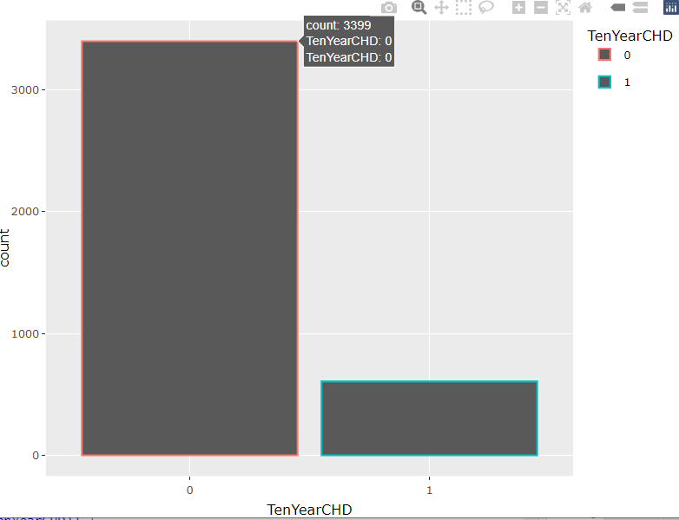
Descriptive Analysis of Variables
We can observe that the risk of having CHD was more in females which was 2273 and for males it was 1732.
The probability of people having CHD in 10 years is less than the count of people who will not have CHD.

Slide 12
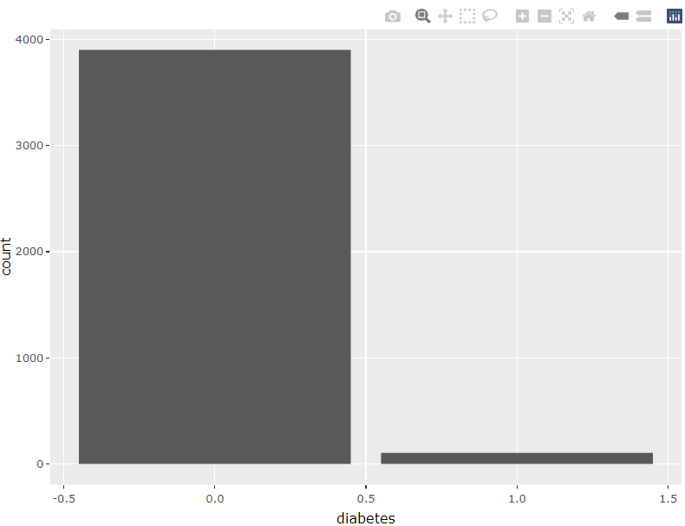
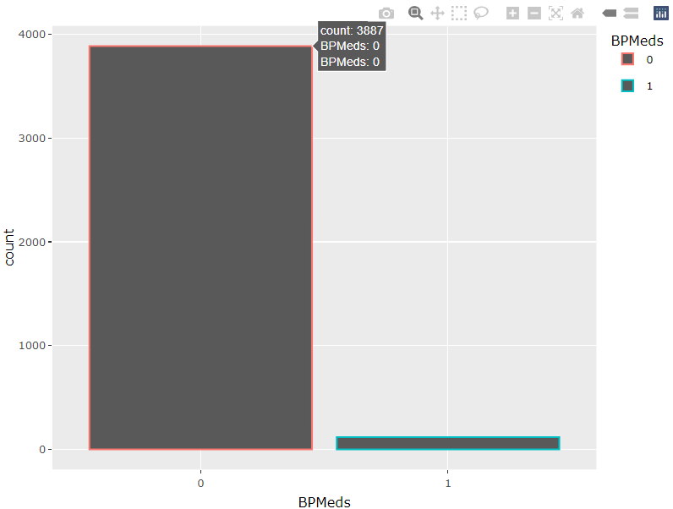
Descriptive Analysis of Variables
The count of people with no diabetes is very high than the count of people with diabetes.
Most of the people were not on blood pressure medications.

Slide 13
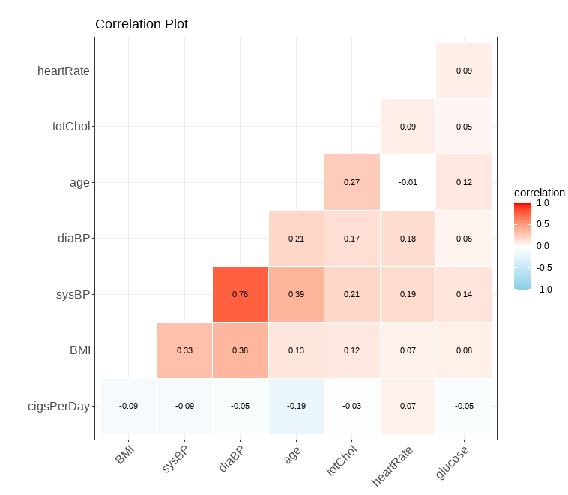
Correlation Plot
We plotted correlation plot for the numeric variables.
We can observe that:
diaBP is highly positively correlated with the sysBP.
diaBP and sysBP are positively correlated to the BMI.
Age is moderately positively correlated to sysBP.
Age is less positively correlated to the totChol.

Slide 14
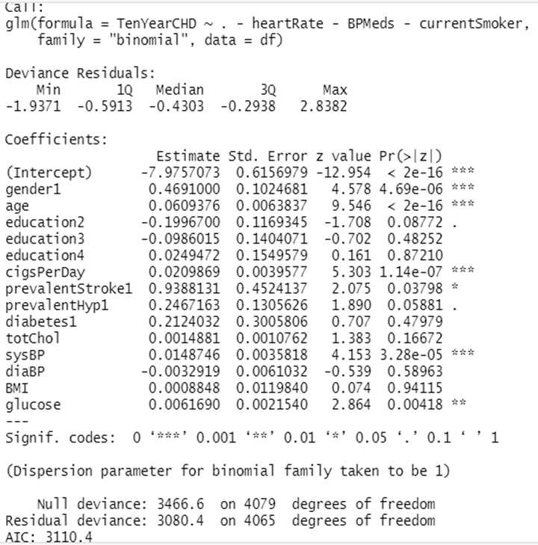
Building Logistic Model
We built the logistic regression model without the two variables “currentsmoker”,”BPMeds” and “heartRate” as these were not significant based upon our t-test, interaction and Chi Square test.
The summary concludes that the variables “gender”, “age”, “cigsPerDay”, “sysBP” and “glucose” are significant in the model as they have low p values which were < 0.05

Slide 15
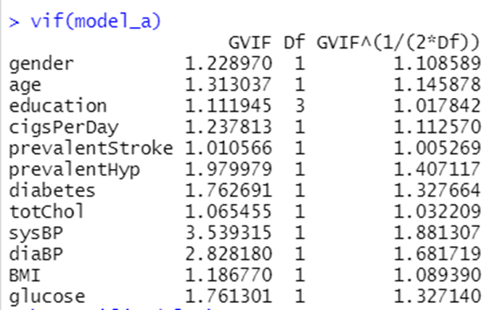
Multicollinearity
The model was subjected to multicollinearity using VIF and we observed that all the values were below threshold of 5. Hence, no multicollinearity was detected for the model.

Slide 16
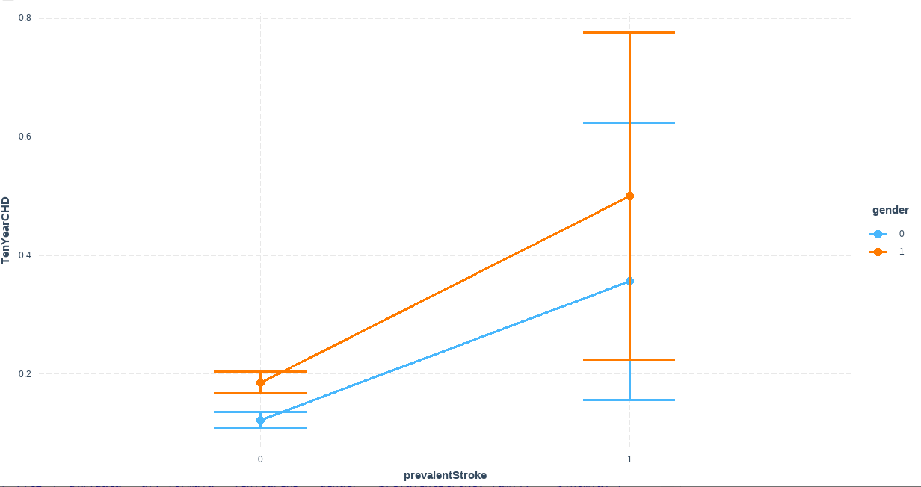
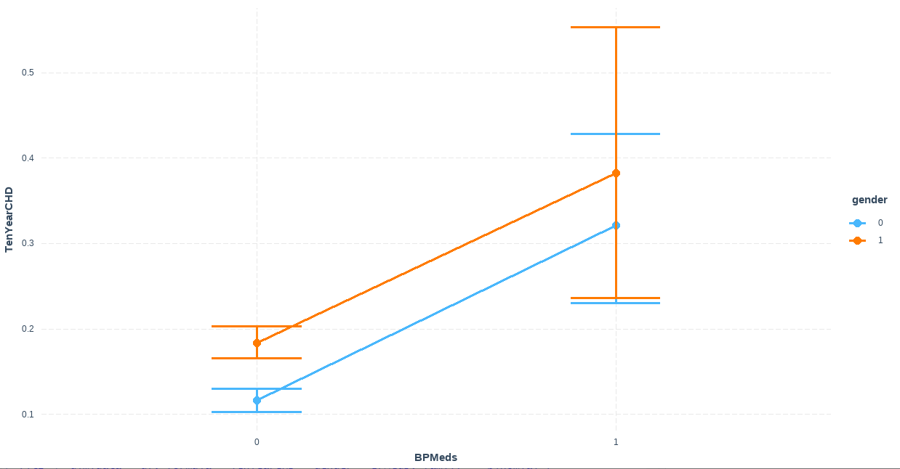
Interaction Plots
The lines for prevalentstr and gender are not parallel and will intersect at some point, thus there is interaction between them.
The lines for BPMeds and gender are parallel thus we consider there is no interaction between them.

Slide 17
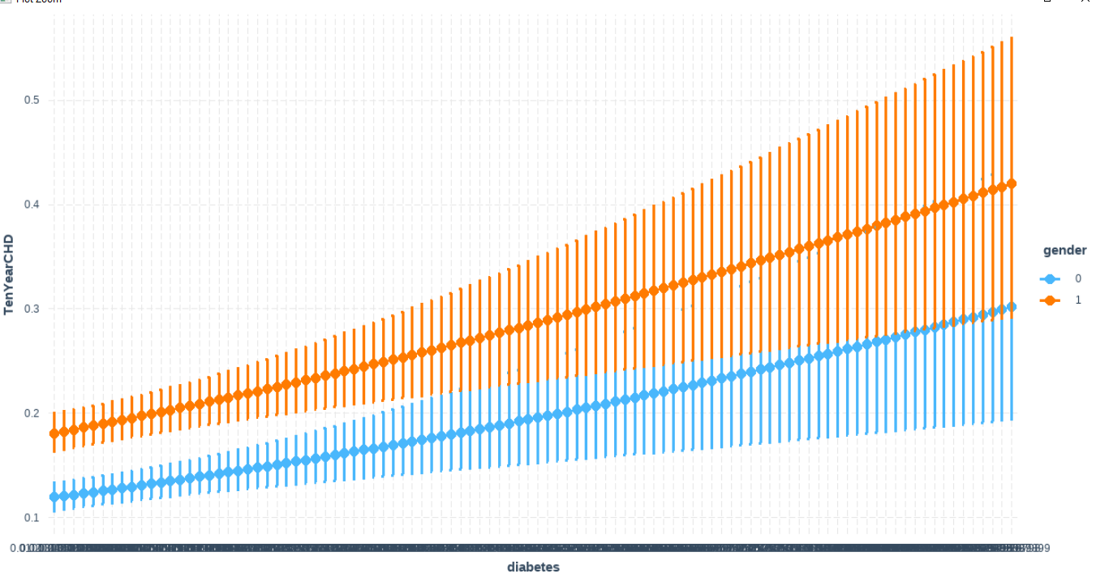
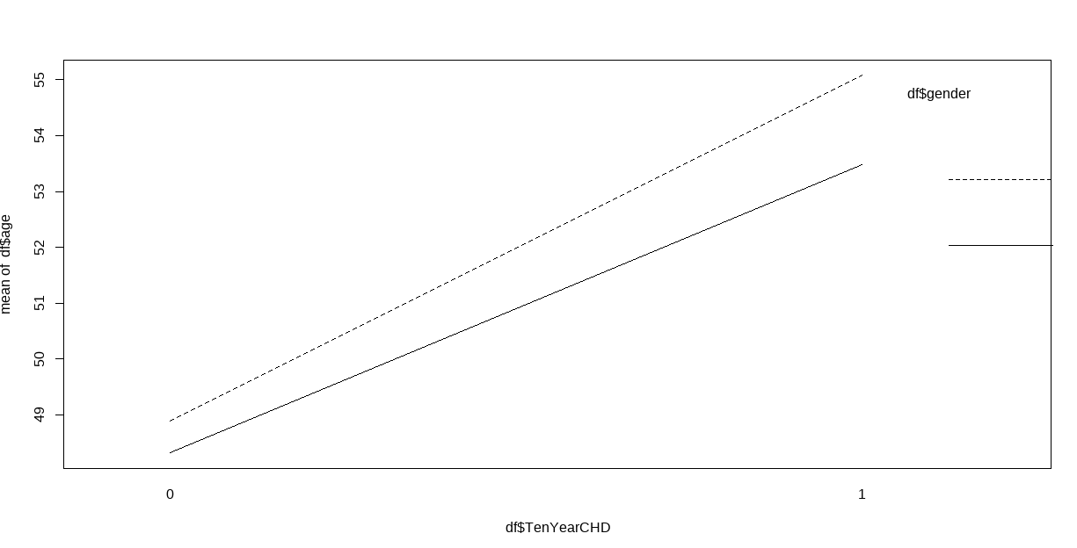
Interaction Plots
The lines for diabetes and gender are running parallel so there is no interaction between them.
The lines for TenYearCHD and gender are not parallel thus indicate there is interaction between them.

Slide 18
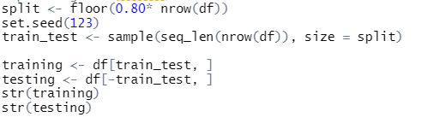
Test And Train Using 80-20% ratio
We splitted the dataset on a 80-20%ratio to develop our test and train data models. After splitting our test dataset have 816 records and training dataset had 3264 records with 16 features

Slide 19
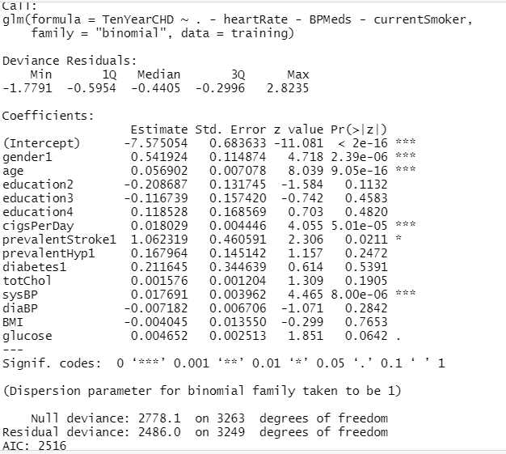
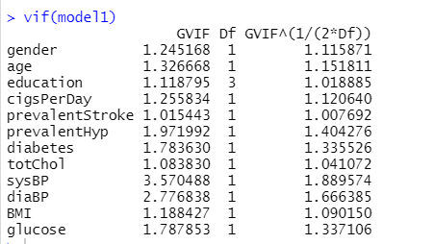
Building Model on Training Dataset
We ran our training model and the variables which were significant were found to be same and they were male (gender1) , age , cigsPerDay and sysBP. Moreover, vif is significant as it is less than 5

Slide 20
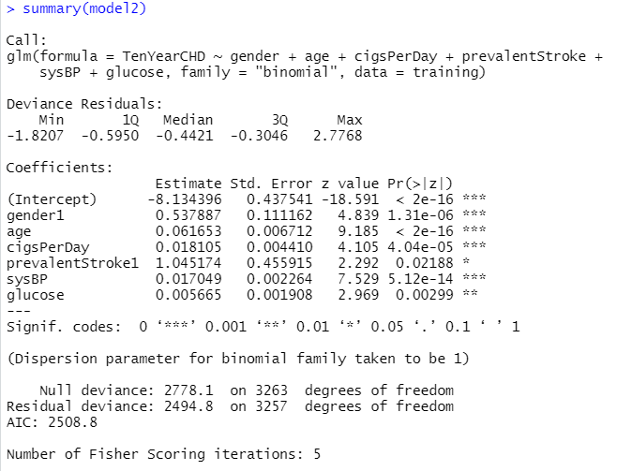
Backward Selection Method
We ran the Backward Elimination Method to remove the variables with the highest P-value one at a time, then ran the regression again until all of the variables have P-values less than 0.05. We found that the significant variables were found to be same as before which shows that our model is good fit with no multicollinearity.

Slide 21
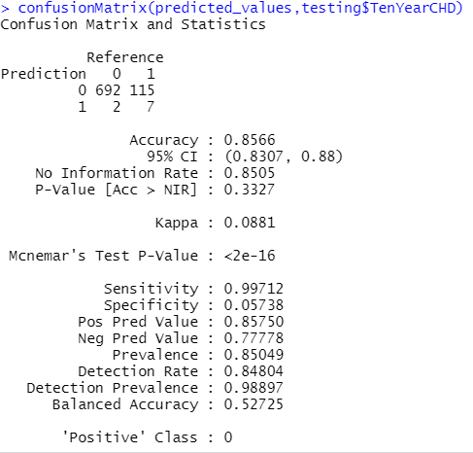
Accuracy, Specificity and Sensitivity
The accuracy of our model came out to be 86%.
The sensitivity of detecting the positive cases is 99% i.e people are likely to have heart diseases in 10 years and it is predicted by the model.
The specificity of detecting the negative case is 0.05%.

Slide 22
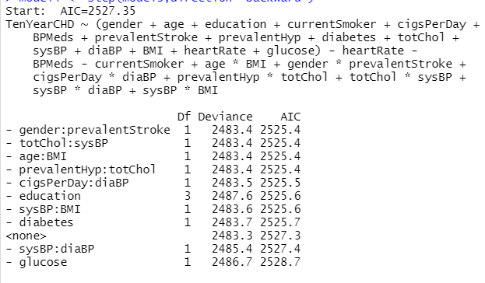
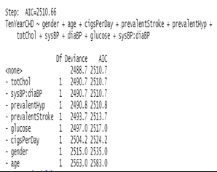
Building Model with Interaction terms
We had no interaction terms in our full model, so we introduced a few interaction terms to check if our model without interactions terms is good fit or not.
Final Result of backward selection is

Slide 23
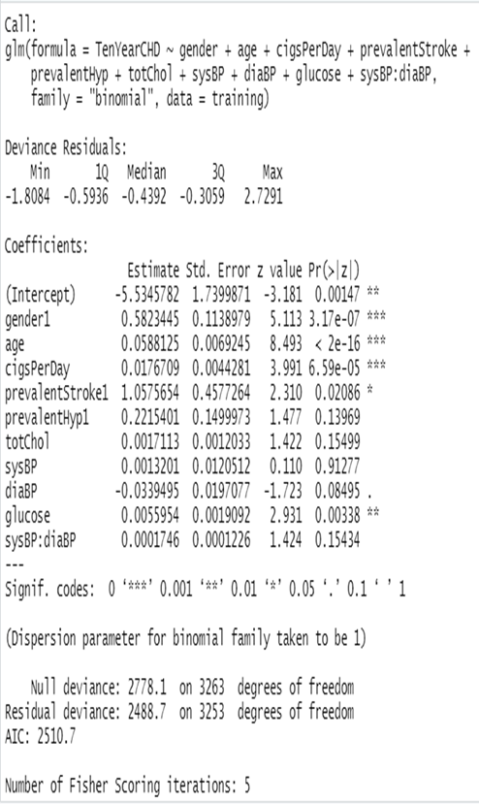
Backward Selection Model
We performed backward selection method to check for the most significant variables. We found that one of the interaction terms in the model

Slide 24
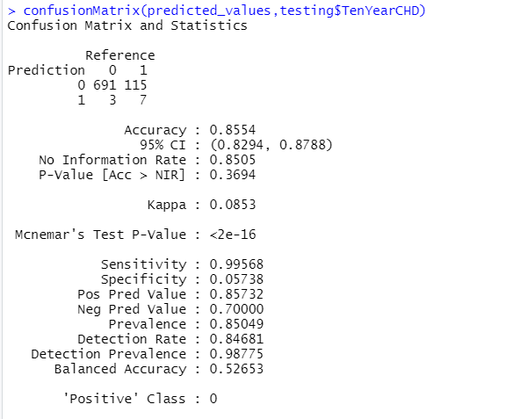
Prediction Accuracy
The accuracy of our model came out to be 85.54%.
The sensitivity of detecting the positive cases is 99% i.e people are likely to have heart diseases in 10 years and it is predicted by the model.
The specificity of detecting the negative case is 0.05%.

Slide 25
Comparing the Models
AIC is Akaike information criterion. Lower the AIC the better the model is. Hence it is cleared that model without interaction term has lower AIC value than With Interaction Term.
 | Without Interaction Term | With Interaction Term
AIC Value | 2508.87 | 2510.7

Slide 26
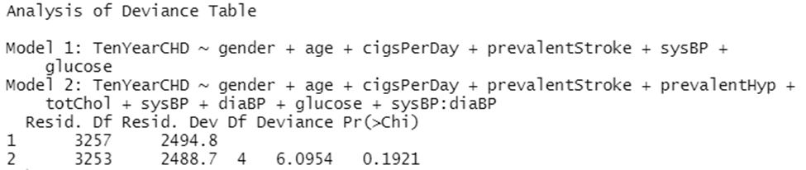
Comparing the Models
We did the Log-Likelihood test to check which model is a good fit.
Ho : The Reduced model is appropriate.
Ha: The full model is appropriate.
It shows that p-value is greater than 0.05 which means we accept null hypothesis says model without interaction terms is better.

Slide 27
COMPARING BOTH MODELS
 | WITHOUT INTERACTION | WITH INTERACTION
ACCURACY | 85.66% | 85.54%
SENSITIVITY | 99% | 99.5%
SPECIFICITY | 0.05 | 0.05
We can see that accuracy, sensitivity and specificity is somewhat similar in both models, so we decided to go with the model without interactions as the model is less complex.

Slide 28
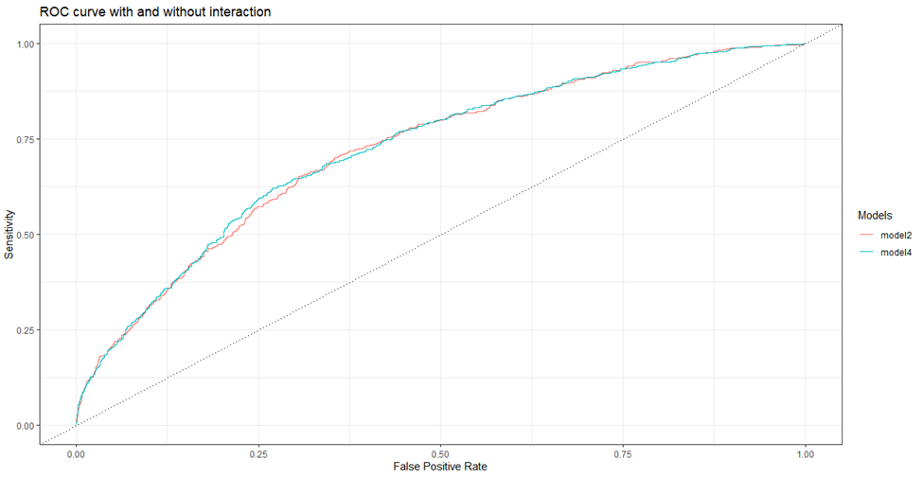
ROC Curve
Model2 – AUC value = 0.722
Model4- AUC Value = 0.724
From, plot it has been observed that AUC value is approximately same for both model which is 72%. So, we consider our model without interaction plot is better as it will be less complex in analysis.

Slide 29
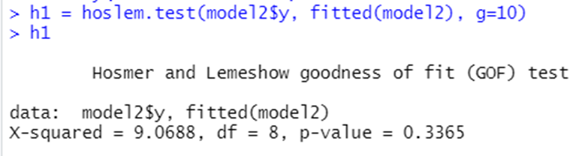
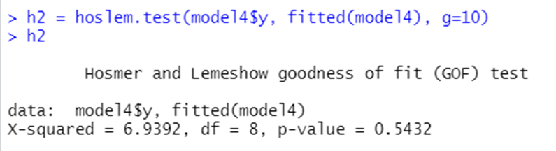
Hosmer and Lemeshow Goodness of Fit Test
Hosmer-Lemeshow Test to verify that if our model is a good fit or it lacks the appropriate level of fitness to be considered fruitful for predictions.
H0 : The model is good fit.
Ha : The model is not a good fit.
The p-value of both model is greater than 0.05, so we fail to reject null hypothesis which shows that our model is good fit to predict whether a patient has a 10-year risk of developing Coronary Heart Disease (CHD). Where model-2 is without interaction and Model-4 is with interaction.

Slide 30

Conclusion
As we have high values of sensitivity but low value of specificity this is because our data is imbalanced and our results of logistic regression concluded that our model without interaction terms is better fit than the model with interaction terms.
The model predicted with 86% accuracy. The model is more sensitive than specific.

Slide 31

Thank You!

