Slide 1
Denial of Service (DOS)

Slide 2
What is Denial of Service (DOS)?
Attack on Availability -DoS
DoS attack attempts to make a computer resource unavailable to its intended users
An attacker can send arbitrary input data to a program and make it hang and crash
It is believed that Regex performance is fast, but the truth is that the Regex worst case is exponential
If unsafe Regexes run on inputs which cannot be matched, then the Regex engine is stuck
Evaluating user-provided strings as regular expressions opens the door for Denial Of Service attacks. In the context of a web application, attackers can force the web server to spend all of its resources evaluating regular expressions thereby making the service inaccessible to genuine users.

Slide 3
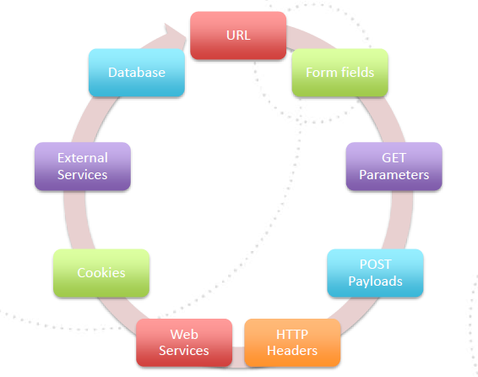
All Input is Evil

