Slide 1
CI-CD To DevOps
A path to cost effective software development

Slide 2
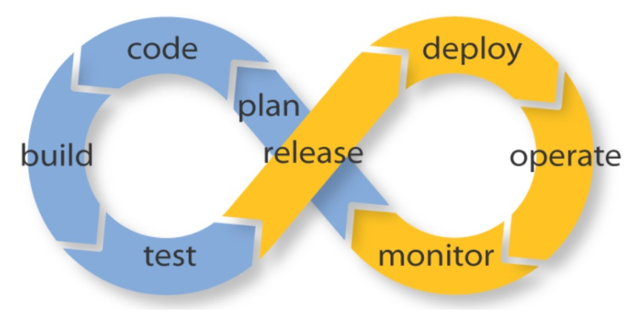
A complete development flow. How CI-CD fits into DevOps

Slide 3
WHATS HAPPENING OUT THERE!!
First it was Waterfall, next it was Agile, and now it's DevOps.
Historically, in the agile age, most companies would deploy/ship software in monthly, quarterly, bi-annual, or even annual.
Now, however, in the DevOps era, weekly, daily, and even multiple times a day is the norm.
Development teams have adapted to the shortened delivery cycles by embracing automation across their software delivery pipeline.
Most teams have automated processes to check in code and deploy to new environments.
Heavy focus on automating the testing process along the way.

Slide 4
WHAT IS CI??
Continuous integration focuses on blending the work products of individual developers together into a repository.
This is done several times each day, and the primary purpose is to enable early detection of integration bugs, which should eventually result in tighter cohesion and more development collaboration.
The aim of continuous delivery is to minimize the friction points that are inherent in the deployment or release processes.
Typically, the implementation involves automating each of the steps for build deployments such that a safe code release can be done—ideally—at any moment in time.

Slide 5
Is CI a tool or Process?
The term 'Continuous Integration' originated with Kent Beck's Extreme Programming development process, as one of its original twelve practices.
Continuous Integration is a practice that requires no particular tooling to deploy, we've found that it is useful to use a Continuous Integration server. The best known such server is Jenkins.
The goal of CI is to refine integration into a simple, easily-repeatable everyday development task that will serve to reduce overall build costs and reveal defects early in the cycle.
Success in CI will depend on changes to the culture of the development team so that there is incentive for readiness, frequent and iterative builds, and eagerness to deal with bugs when they are found much earlier.

Slide 6
Best Practices to Achieve CI
Maintain a Single Source Repository.
Automate the Build
Make Your Build Self-Testing
Everyone Commits To the Mainline Every Day
Every Commit Should Build the Mainline on an Integration Machine
Fix Broken Builds Immediately
Keep the Build Fast
Test in a Clone of the Production Environment
Make it Easy for Anyone to Get the Latest Executable
Everyone can see what's happening
Automate Deployment

Slide 7
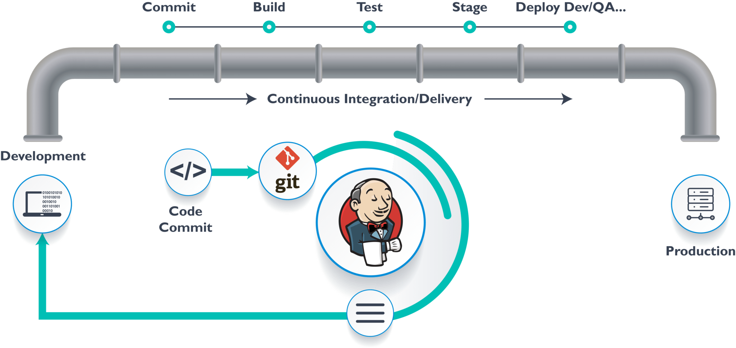
The Idea of a Pipeline
The idea behind a CI pipeline (also known as build pipeline or staged build) is that there are in fact multiple builds done in sequence.
Every change to your software goes through a complex process on its way to being released.
That process involves building the software, followed by the progress of these builds through multiple stages of testing and deployment.

Slide 8
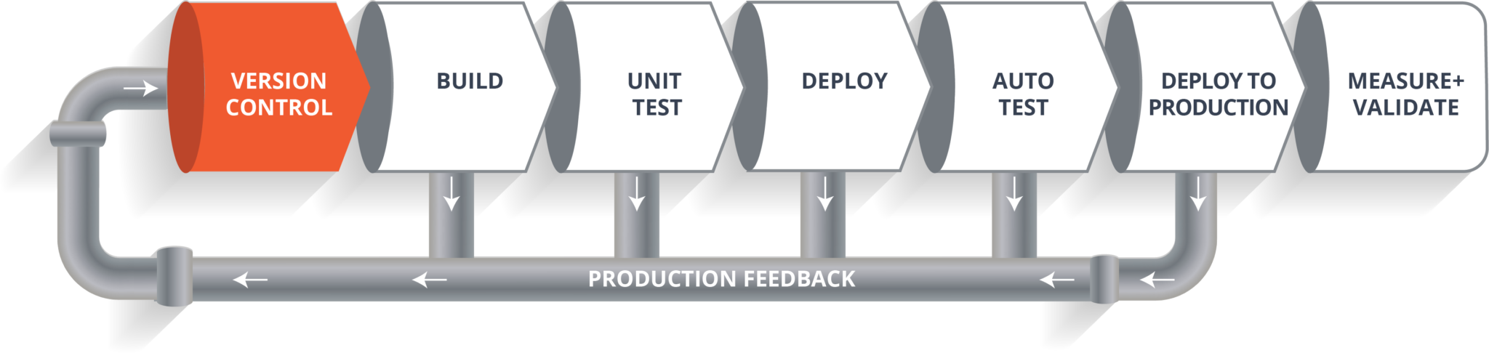
Stages Of an Automated Pipeline
CD depends centrally on a pipeline by which the team automates the testing and deployment processes. This pipeline is an automated system that executes a progressive set of test suites against the build. CD is highly automatable and easily configurable.
In each segment in the pipeline, the build may fail a critical test and alert the team. Otherwise, it continues on to the next test suite, and successive test passes will result in automatic promotion to the next segment in the pipeline. The last segment in the pipeline will deploy the build to an environment.
This is a comprehensive activity, since the build, the deployment, and the environment are all exercised and tested together. The result is a build that is deployable and verifiable in an actual production environment.

Slide 9
CD! Delivery vs Deployment
Continuous delivery is actually an extension of CI, in which the software delivery process is automated further to enable easy and confident deployments into production —at any time.
A mature continuous delivery process exhibits a codebase that is always deployable—on the spot. With CD, software release becomes a routine event without emotion or urgency.
Teams proceed with daily development tasks in the confidence that they can build a production-grade release—any old time they please—without elaborate orchestration or special late-game testing.
You achieve continuous delivery by continuously integrating the software done by the development team, building executables, and running automated tests on those executables to detect problems. Furthermore you push the executables into increasingly production-like environments to ensure the software will work in production. To do this you use a DeploymentPipeline.

Slide 10
To achieve continuous delivery you need:
a close, collaborative working relationship between everyone involved in delivery (often referred to as a DevOpsCulture).
extensive automation of all possible parts of the delivery process, usually using a DeploymentPipeline
You’re doing continuous delivery when:
Your software is deployable throughout its lifecycle.
Your team prioritizes keeping the software deployable over working on new features.
Anybody can get fast, automated feedback on the production readiness of their systems any time somebody makes a change to them.
You can perform push-button deployments of any version of the software to any environment on demand
The principal benefits of continuous delivery are:
Reduced Deployment Risk: since you are deploying smaller changes, there's less to go wrong and it's easier to fix should a problem appear.
Believable Progress: many folks track progress by tracking work done. If "done" means "developers declare it to be done" that's much less believable than if it's deployed into a production (or production-like) environment.
User Feedback: the biggest risk to any software effort is that you end up building something that isn't useful. The earlier and more frequently you get working software in front of real users, the quicker you get feedback to find out how valuable it really i

Slide 11
Deployment
Continuous Delivery is sometimes confused with Continuous Deployment. Continuous Deployment means that every change goes through the pipeline and automatically gets put into production, resulting in many production deployments every day. Continuous Delivery just means that you are able to do frequent deployments but may choose not to do it, usually due to businesses preferring a slower rate of deployment. In order to do Continuous Deployment you must be doing Continuous Delivery.
Continuous deployment extends continuous delivery so that the software build will automatically deploy if it passes all tests. In such a process, there is no need for a person to decide when and what goes into production. The last step in a CI/CD system will automatically deploy whatever build components/packages successfully exit the delivery pipeline. Such automatic deployments can be configured to quickly distribute components, features, and fixes to customers, and provide clarity on precisely what has is presently in production.

Slide 12
