Slide 1


SMART INDIA HACKATHON 2026
TITLE PAGE
Problem Statement ID – SIH26166
Problem Statement Title- Multi-modal, Sun angle and scale invariant image correspondence using Chandrayaan-2 optical images (OHRC, TMC and IIRS)
Theme - Space Technology
PS Category - Software
Team ID -
Team Name (Registered on portal) - PixOrb

Slide 2
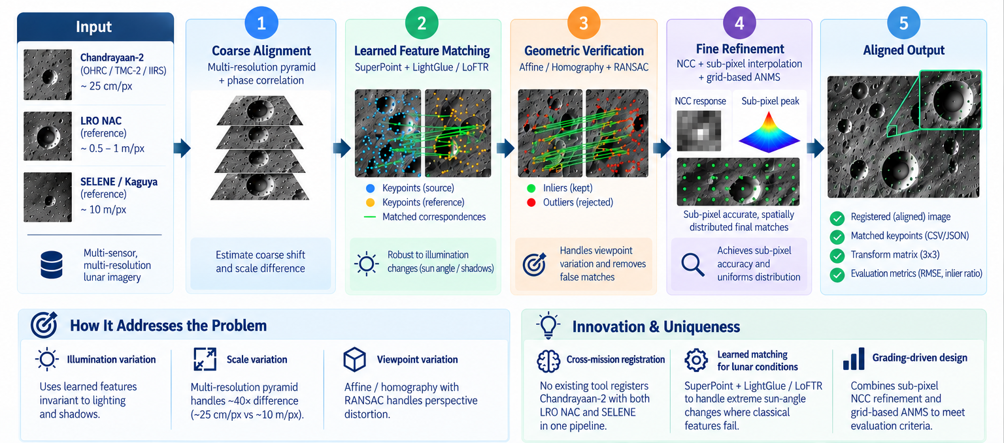
PROPOSED SOLUTION
PixOrb

Slide 3
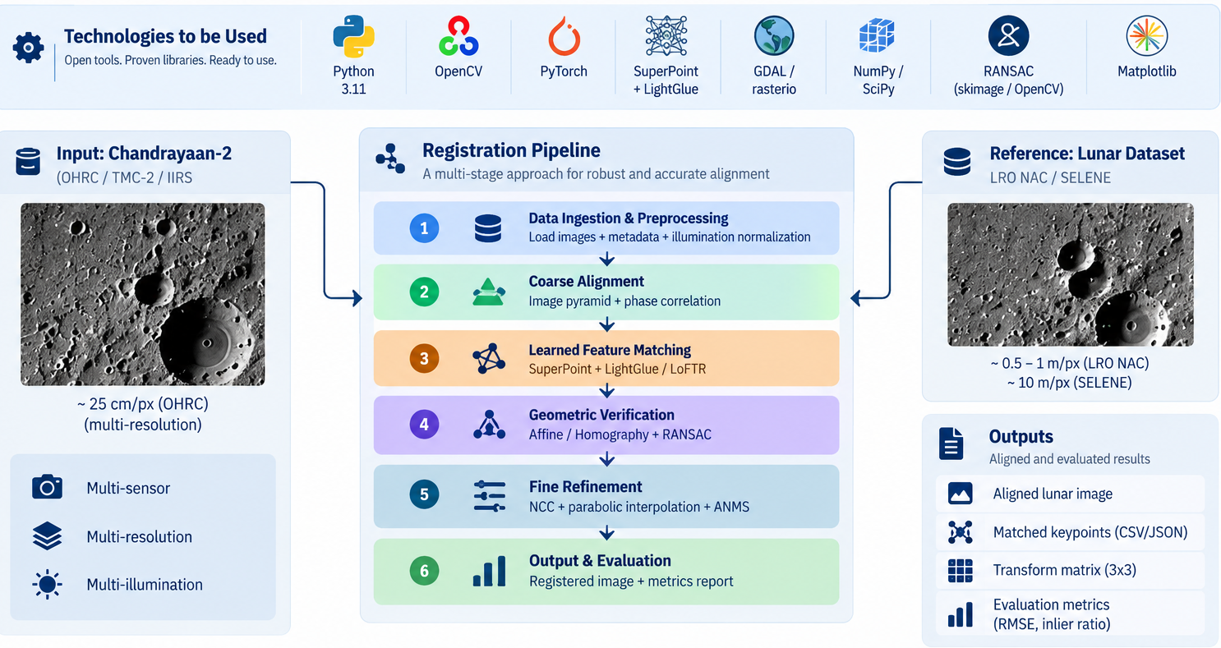
TECHNICAL APPROACH
PixOrb

Slide 4
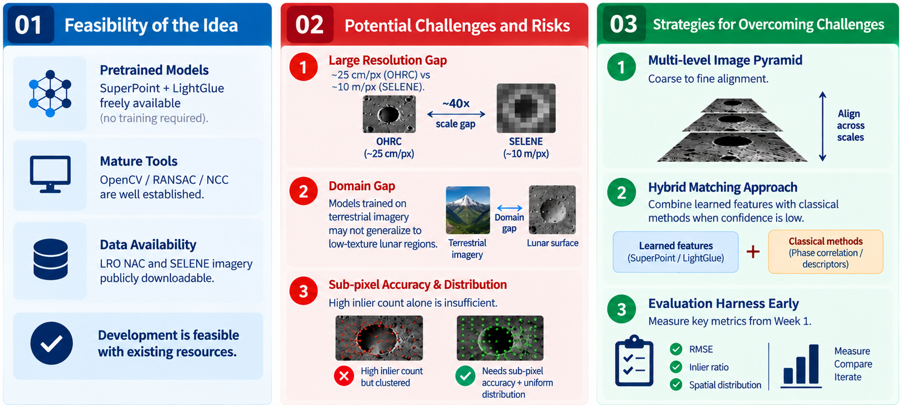
FEASIBILITY AND VIABILITY
PixOrb

Slide 5
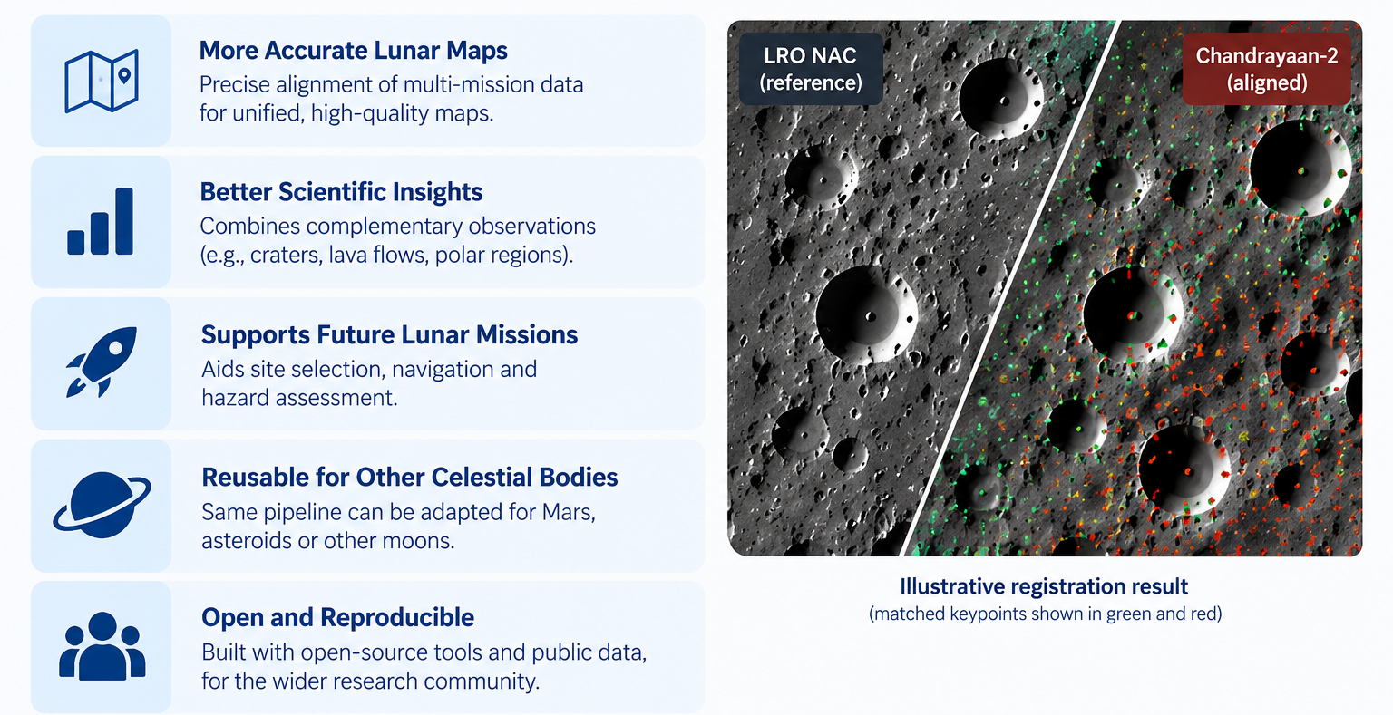
IMPACT AND BENEFITS
PixOrb

Slide 6
RESEARCH AND REFERENCES
PixOrb
01 | Mathematical Theory
Homography / affine transform estimation for planar image registration
RANSAC (Fischler & Bolles, 1981) — robust model fitting under outliers
Normalized cross-correlation + parabolic peak interpolation for sub-pixel localization
02 | Feature Matching Models
DeTone et al., “SuperPoint: Self-Supervised Interest Point Detection and Description,” CVPR 2018
Lindenberger et al., “LightGlue: Local Feature Matching at Light Speed,” ICCV 2023
03 | Datasets
Chandrayaan-2: OHRC / TMC-2 / IIRS — chmapbrowse.issdc.gov.in
LRO NAC: lroc.im-ldi.com/images/downloads/ · quickmap.lroc.im-ldi.com
SELENE (Kaguya): Lunar imagery archive
04 | Evaluation Benchmarks
RMSE: Inlier residuals post-transform
Inlier count and inlier ratio (inliers / candidate matches)
Benchmarked on held-out LRO NAC / SELENE pairs prior to official dataset release

