Slide 1
Multithreaded Log Analysis System
Finding errors, warnings and suspicious events in log files using threads
Team Deadlock_OS SP
2520030265 - Haasini Reddy B
2520030500 - M. Manasa
2520030285 - Arjun Tomar

Slide 2
Problem
Servers write every event into log files (logins, errors, warnings)
These files can have lakhs of lines, so reading them one by one is slow
We need a program that checks the log quickly and tells us how many errors, warnings and suspicious events there are
The program should use multiple threads and run on Ubuntu

Slide 3
How our program works
Read the log file
Divide it into equal parts, one part for each thread (a part always ends at the end of a line)
Each thread checks its own part and counts errors, warnings and suspicious lines
When a thread finishes, it adds its counts to the final total
Print the total and a few example lines

Slide 4
What we used
C language and pthread library (for threads)
gcc compiler on Ubuntu (WSL)
Mutex: a lock so only one thread updates the final total at a time
How we detect lines: the line contains "error", "warn", or words like "failed password", "invalid user", "unauthorized", "permission denied"

Slide 5
How to run
gcc -O2 -Wall -pthread log_analyzer.c -o log_analyzer
./log_analyzer sample.log 4
sample.log is the log file, 4 is the number of threads (optional, default is 4)

Slide 6
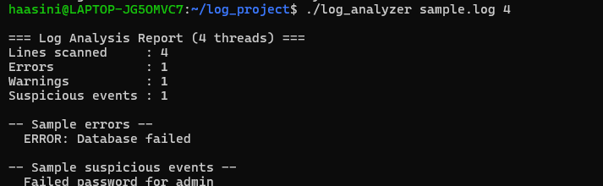
Output on a small log file
Log file has 4 lines
It found 1 error, 1 warning and 1 suspicious line (failed password)

Slide 7
Testing
What we tested | Result
Normal log file | Correct counts
Empty file | All counts are 0, no crash
File that does not exist | Shows an error message
Wrong number of threads (abc, 0) | Shows an error message
Big file (80,000 lines) with 1 thread and 8 threads | Same counts both times

Slide 8
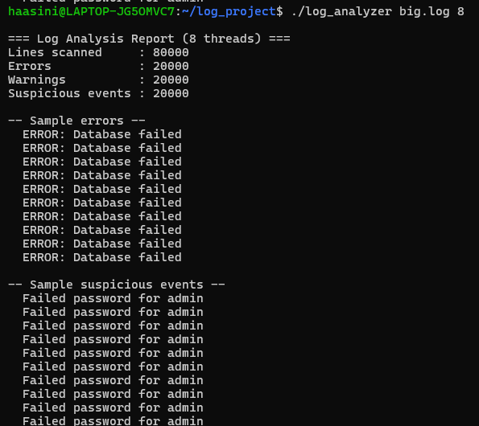
Output on a big file
File has 80,000 lines, run with 8 threads
Errors: 20,000 Warnings: 20,000 Suspicious: 20,000
We got the same numbers with 1 thread, so the threads are not missing or repeating any lines

Slide 9
Conclusion
The program checks a log file using many threads and gives correct counts
It works for normal, empty and big files
Next steps: handle very large files without loading all of it, and let the user choose the words to search for
Who did what
Haasini Reddy B: dividing the file and reading it
M. Manasa: threads and mutex
Arjun Tomar: testing and demo

