Slide 1
Estimating Aqueous Solubility Directly From Molecular Structure
Group Members:
Sahil Kumar (22114083)
Yash Joshi (22114108)
Shubham Kr. Verma (22114092)
Mohammed Haaziq Jamal (22114055)

Slide 2
Introduction
Background:
Aqueous solubility is a critical property in fields such as drug discovery, environmental chemistry, and material science.
It determines how well a substance dissolves in water, impacting bioavailability in pharmaceuticals and contaminant behavior in the environment.
Problem Statement: Traditional methods for experimentally determining solubility are time-consuming and expensive.
Solution: Developing a machine learning model to predict solubility directly from molecular structure using molecular descriptors.
Objective: Use regression models to estimate the solubility of molecules (logS) from a dataset of molecular descriptors.

Slide 3
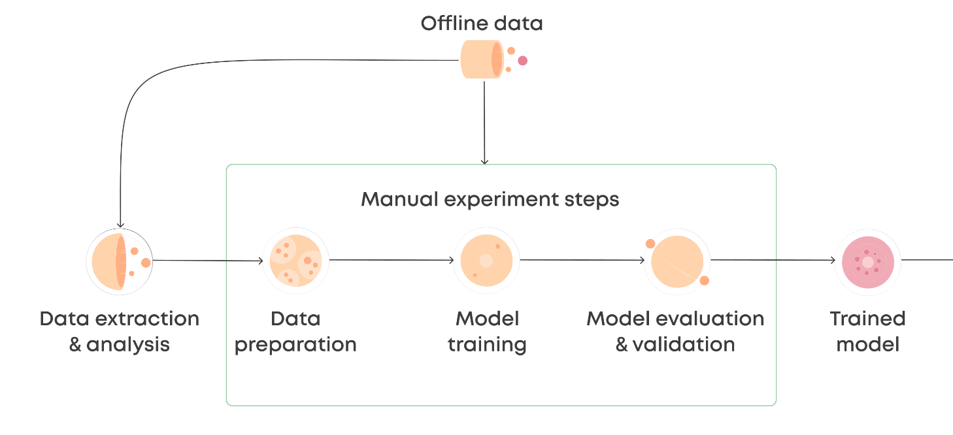
Followed Pipeline

Slide 4
Dataset Description
Dataset: delaney_solubility_with_descriptors.csv
Source: Sourced from published papers on solubility prediction.
Size: 1,144 molecules, each with 4 molecular descriptors.
Target Variable:
logS: Logarithm of solubility in mol/L.
The target is continuous and used for regression analysis.
Descriptors:
Molecular descriptors include MolLogP (octanol-water partition coefficient), MolWt (Molecular Weight), NumRotatableBonds, AromaticProportion, etc.

Slide 5
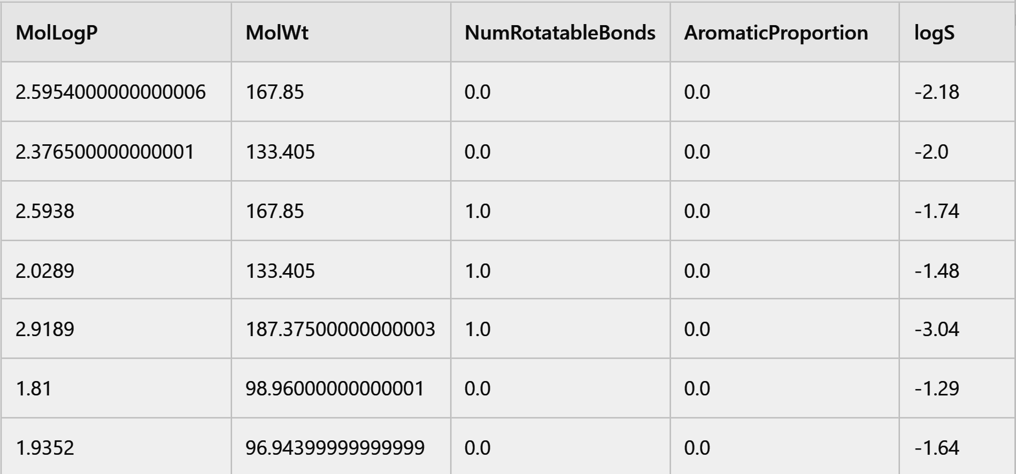
Sample rows from the dataset

Slide 6
Data Preprocessing
Preprocessing Steps:
1. Feature Scaling:
Applied StandardScaler to ensure all descriptors are on the same scale.
Scaling was important because models like SVR and Neural Networks are sensitive to feature magnitudes.
2. Train-Test Split:
Dataset split into 80% training (915 samples) and 20% testing (229 samples) for model evaluation.
Why Preprocessing Matters:
Standardization ensures no single feature dominates others during model training.
Proper train-test splitting avoids data leakage and ensures unbiased model performance.

Slide 7
Exploratory Data Analysis (EDA)
EDA Goals:
Understand relationships between molecular descriptors and solubility.
Identify patterns, correlations, and potential feature importance.
Key Observations:
Strong negative correlation between MolLogP and logS.
Moderate negative correlation between Molecular Weight (MolWt) and logS.
Weak correlations for other features, indicating that non-linear models may perform better.
Insights on Distributions:
Some features like MolWt are skewed, while others like Aromatic Proportion are binary.

Slide 8
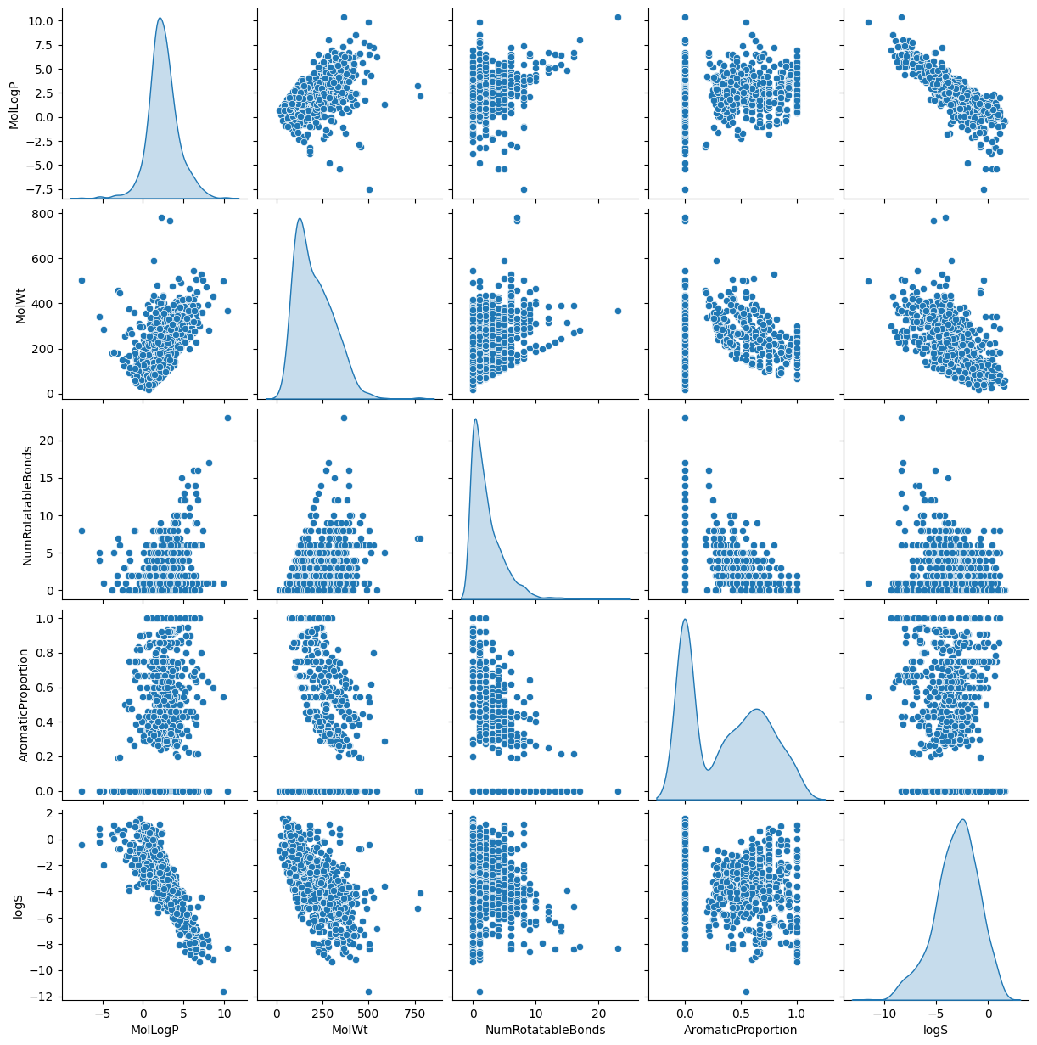
EDA Plots :

Slide 9
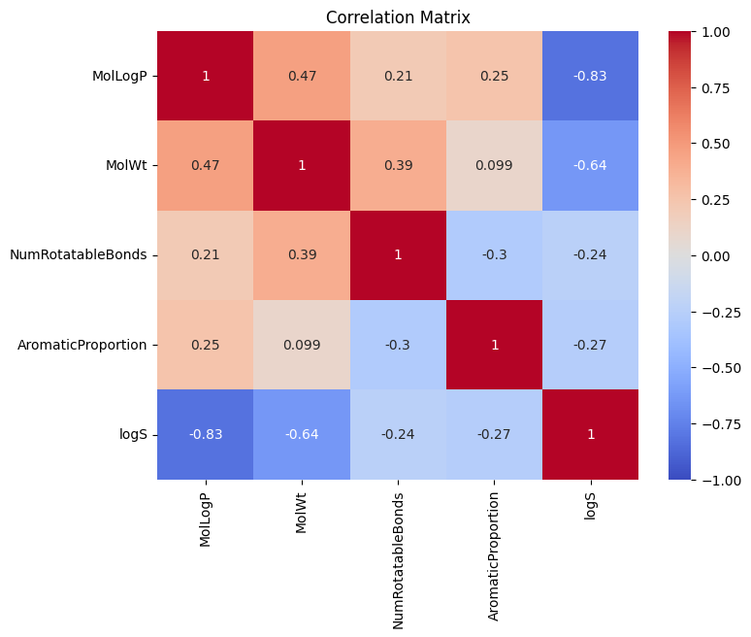
Correlation Matrix

Slide 10
Feature Insights – MolLogP vs logS
MolLogP (Partition Coefficient): A measure of a molecule’s hydrophobicity.
Observation:
Strong negative correlation (-0.828) between MolLogP and logS.
Hydrophobic molecules (higher MolLogP) tend to have lower solubility in water.
Key Takeaway:
MolLogP is a crucial predictor of solubility due to its large influence on the model.

Slide 11
Feature Insights – MolWt vs logS
Molecular Weight (MolWt): The sum of the atomic weights of all atoms in a molecule.
Observation:
Moderate negative correlation (-0.637) between MolWt and logS.
Larger molecules are generally less soluble.
Key Takeaway:
MolWt is another important feature, but the relationship is less strong than with MolLogP.

Slide 12
Feature Insights – NumRotatableBonds and AromaticProportion
NumRotatableBonds:
A weak negative correlation (-0.239) with logS.
Molecules with more rotatable bonds may have slightly lower solubility due to greater flexibility in structure.
AromaticProportion:
Weak binary correlation (-0.268) with logS.
Aromatic molecules (containing rings of atoms) do not show a clear linear relationship with solubility.

Slide 13
Data Distribution Insights
MolWt: Right-skewed distribution, with most molecules having a smaller weight but a few with very high molecular weights.
NumRotatableBonds: Discrete distribution due to the nature of the feature (whole numbers).
AromaticProportion: Binary feature, values are either 0 or 1.

Slide 14
Model Selection
Models Used:
Neural Network: Best suited for capturing non-linear relationships.
Random Forest & Gradient Boosting: Excellent for feature importance and handling mixed feature types.
Support Vector Regression: Effective for smaller datasets but sensitive to feature scaling.
Linear Models (Ridge, Lasso): Act as baseline models to compare against more complex models.
Why These Models?
Each model has distinct advantages: Neural Networks for non-linearity, Random Forest for feature importance, Gradient Boosting for reducing bias.
Evaluation Metrics:
RMSE (Root Mean Square Error): Measures the average error magnitude.
MAE (Mean Absolute Error): Measures the average absolute difference between predicted and actual values.
R² (Coefficient of Determination): Measures how well the model explains variance in the data.

Slide 15
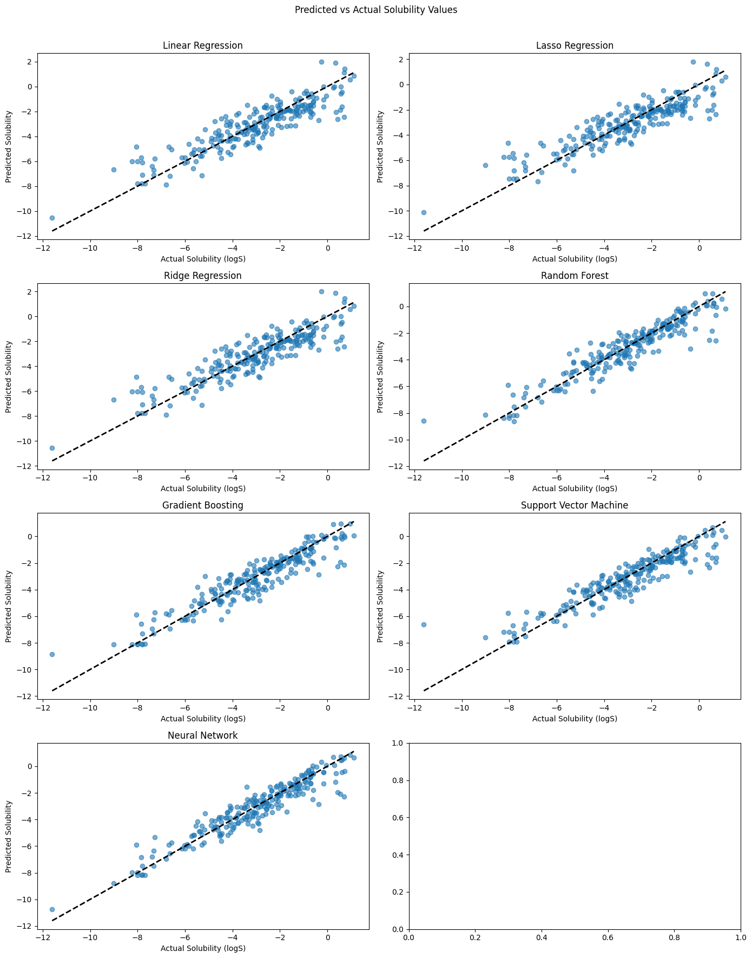
Model Performance – Neural Network
Neural Network Performance:
Best performance among all models with:
RMSE: Lowest (0.72)
MAE: Lowest (0.53)
R²: Highest (0.89)
Why Neural Network Performed Best:
Captures complex non-linear relationships between molecular descriptors and solubility.
Uses multiple layers of perceptrons, optimizing weights during training for accurate predictions.
Tuning: Manually tuned parameters like learning rate, batch size. and number of layers to find the best performing model .

Slide 16
Model Performance – Random Forest & Gradient Boosting
Random Forest Performance:
RMSE: 0.80
MAE: 0.58
R²: 0.86
Gradient Boosting Performance:
RMSE: 0.82
MAE: 0.60
R²: 0.86
Why Random Forest & Gradient Boosting Worked Well:
Its robust handling of non-linear patterns and minimal need for feature scaling made it work well.

Slide 17
Model Performance – Support Vector Regression(SVR) and Linear Models
SVR Performance:
RMSE: 0.88
MAE: 0.63
R²: 0.84
Linear Models (Ridge, Lasso):
Ridge:
RMSE: 1.01
MAE: 0.78
R²: 0.79
Lasso:
RMSE: 1.02
MAE: 0.80
R²: 0.78
Linear models couldn’t capture the complex relationships between molecular descriptors and logS, performing worse than non-linear models.

Slide 18
Hyperparameter Tuning
Purpose of Hyperparameter Tuning:
Optimize model performance by adjusting key parameters such as:
Number of trees in Random Forest and Gradient Boosting.
Regularization parameters in Ridge and Lasso.
Methods Used:
Grid Search and Randomized Search to find the optimal combination of hyperparameters.
Grid Search tested specific parameter combinations, while Randomized Search provided faster exploration of broader parameter spaces.
Key Tuned Hyperparameters:
Random Forest: Number of estimators, max depth.
Gradient Boosting: Learning rate, number of trees.
Results of Tuning:
Improvements in model metrics were modest. Each model showed comparable performance with RMSE values close to one another.

Slide 19
Outlier Detection
Why Detect Outliers:
Outliers can skew model performance, especially in sensitive models like Neural Networks.
Method:
Used Isolation Forest algorithm to detect outliers by isolating data points that differ significantly from the rest.
Impact on Dataset:
46 outliers removed from the original dataset.
Neural Network performance slightly decreased after outlier removal, suggesting a negative effect on overfitting.
Conclusion:
Outlier removal had a small but noticeable impact on model performance, indicating that most data points were consistent with expected solubility trends.

Slide 20
Output Visualization – Predicted vs Actual Solubility
Visualization Purpose:
Comparing the predicted solubility (logS) values against actual values for each model on the test set.
Best Model: Neural Network predictions closely matched actual solubility values, especially in the mid-range of solubility.
Other Models: Random Forest and Gradient Boosting also performed well but occasionally over- or under-predicted solubility for more extreme cases.

Slide 21
Learning Outcomes and Limitations
Learning Outcomes:
Successfully implemented regression models to predict aqueous solubility.
Neural Network proved most effective, highlighting the importance of non-linear modeling in chemical data.
Preprocessing and feature scaling were critical for SVR and Neural Network performance.
Limitations:
Dataset Size: Small dataset (1,144 samples) limits generalizability.
Feature Selection: Some molecular descriptors, like NumRotatableBonds, showed weak correlations, potentially adding noise to the model.
Synthetic Data Generation: Could not be applied due to the complexity of chemical structures.
Future Improvements:
Consider larger datasets for better model generalization.
Experiment with advanced deep learning architectures for more complex molecule representations.
Apply advanced tuning techniques like Bayesian optimization.

Slide 22
THANK YOU

