Slide 1

Project Title -Healthcare Analytics for Doctor Visits: Predicting Patient Utilization
[Student Name- PATHAN HABEEB KHAN
College Name- VIGNAN’S LARA INSTITUTE OF TECHNOLOGY & SCIENCE ]
AICTE STU ID: STU67dc0645388db1742472773

Slide 2

PROBLEM STATEMENT
Why do some people visit a doctor more often than others?"
In public and private healthcare systems, medical resource allocation, facility planning, and staffing rely heavily on understanding patient behaviors. By diagnosing the key drivers of physician visits—whether they stem from non-preventable demographic factors (like age and gender), socioeconomic baselines (such as family income), severe acute physical distress, or differences in systemic healthcare access—this project seeks to uncover actionable patterns that explain and predict patient demand.

Slide 3
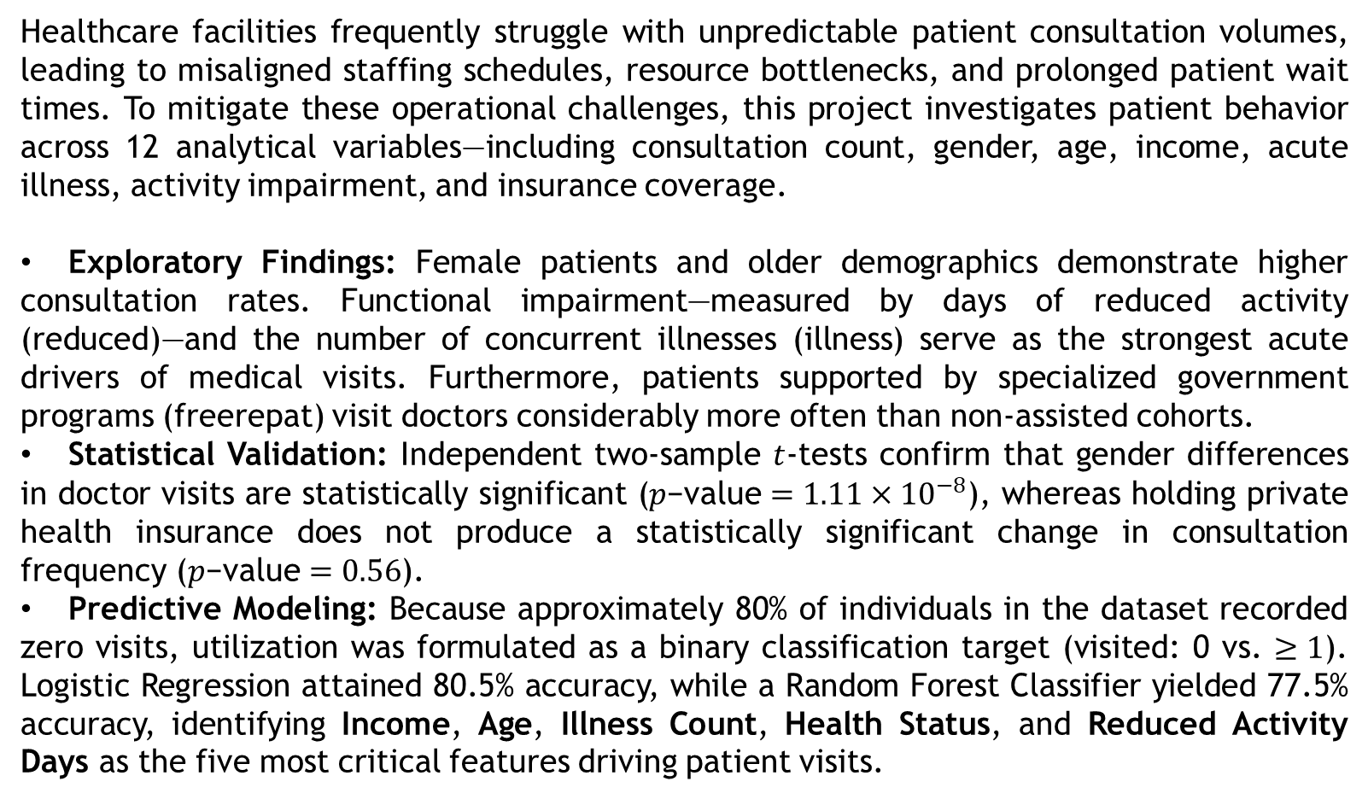
Project Description
Healthcare facilities frequently struggle with unpredictable patient consultation volumes, leading to misaligned staffing schedules, resource bottlenecks, and prolonged patient wait times. To mitigate these operational challenges, this project investigates patient behavior across 12 analytical variables—including consultation count, gender, age, income, acute illness, activity impairment, and insurance coverage.
Exploratory Findings: Female patients and older demographics demonstrate higher consultation rates. Functional impairment—measured by days of reduced activity (reduced)—and the number of concurrent illnesses (illness) serve as the strongest acute drivers of medical visits. Furthermore, patients supported by specialized government programs (freerepat) visit doctors considerably more often than non-assisted cohorts.
Statistical Validation: Independent two-sample $t$-tests confirm that gender differences in doctor visits are statistically significant ($p\text{−value}=1.11×{10}^{−8}$), whereas holding private health insurance does not produce a statistically significant change in consultation frequency ($p\text{−value}=0.56$).
Predictive Modeling: Because approximately 80% of individuals in the dataset recorded zero visits, utilization was formulated as a binary classification target (visited: 0 vs. $≥1$). Logistic Regression attained 80.5% accuracy, while a Random Forest Classifier yielded 77.5% accuracy, identifying Income, Age, Illness Count, Health Status, and Reduced Activity Days as the five most critical features driving patient visits.

Slide 4

WHO ARE THE END USERS?
Clinic Administrators & Operations Managers: To dynamically align physician and nursing shift schedules with expected patient volume surges, especially during periods of widespread acute illness.
Preventive Care Coordinators: To design targeted wellness check-ins, remote monitoring, and telemedicine consultations for elderly or chronically impaired patients, reducing emergency department crowding.
Government & Community Health Officials: To evaluate healthcare utilization patterns among state-assisted and low-income populations, ensuring medical resources and subsidies are distributed equitably.

Slide 5

Technology Used
Programming Language: Python
Data Manipulation & Cleaning: Pandas, NumPy
Statistical Hypothesis Testing: SciPy (scipy.stats.ttest_ind)
Machine Learning & Evaluation: Scikit-Learn (LogisticRegression, RandomForestClassifier, train_test_split, accuracy_score, precision_score, recall_score, classification_report)
Data Visualization: Matplotlib, Seaborn

Slide 6
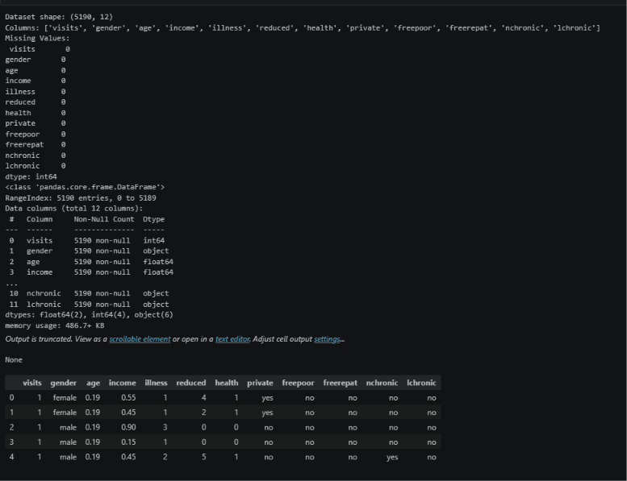
RESULTS

Slide 7
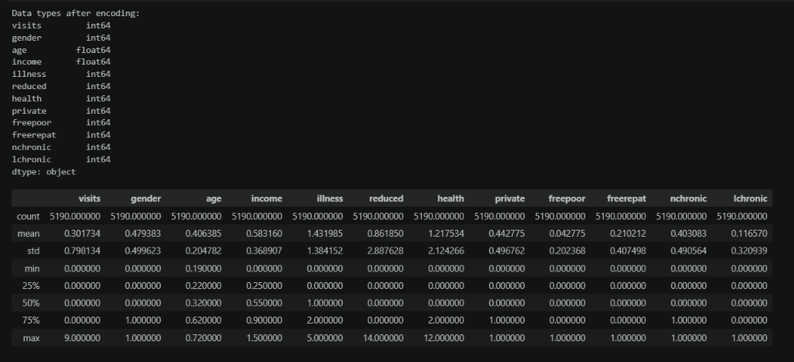
RESULTS

Slide 8
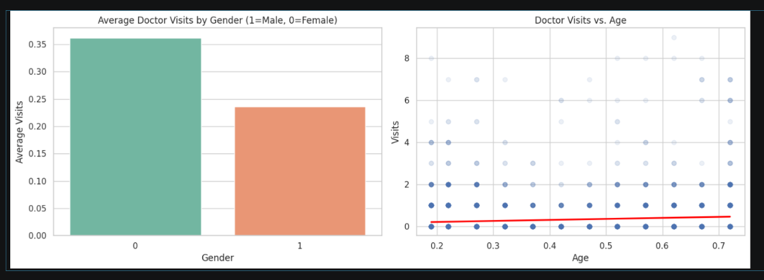
RESULTS
demo link

Slide 9
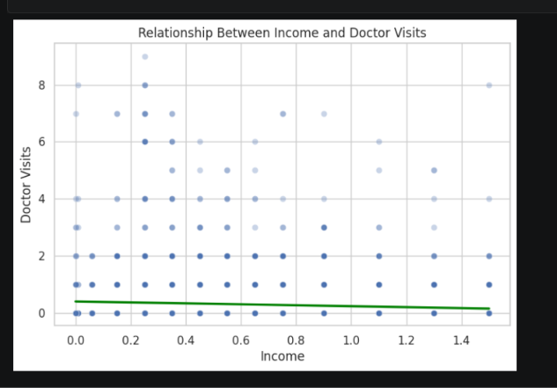
RESULTS
demo link

Slide 10
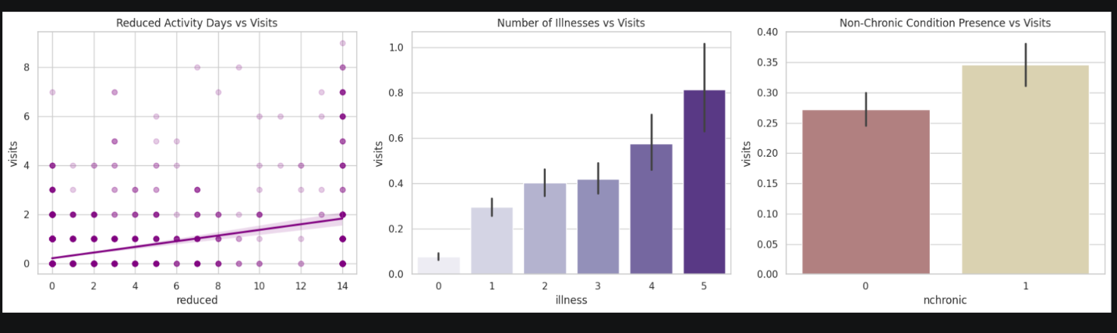
RESULTS
demo link

Slide 11
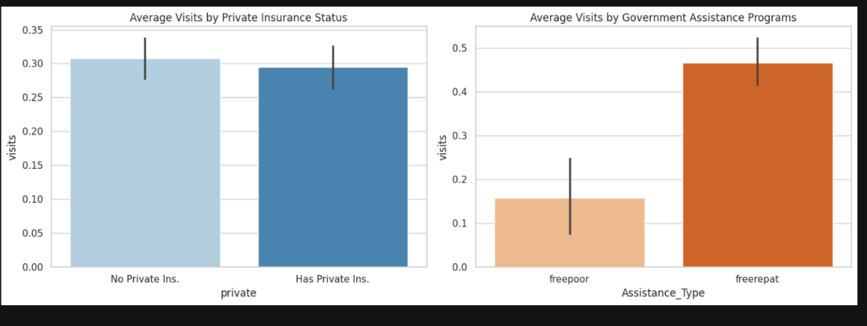
RESULTS
demo link

Slide 12
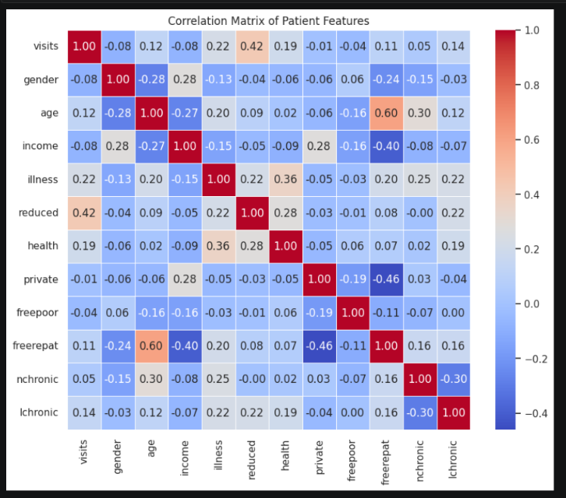
RESULTS
demo link

Slide 13
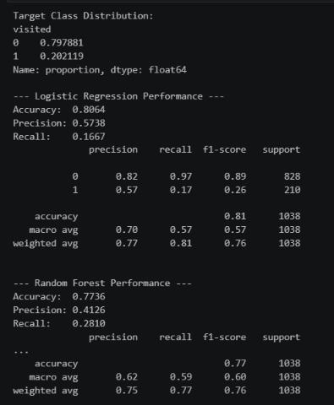
RESULTS
demo link

Slide 14
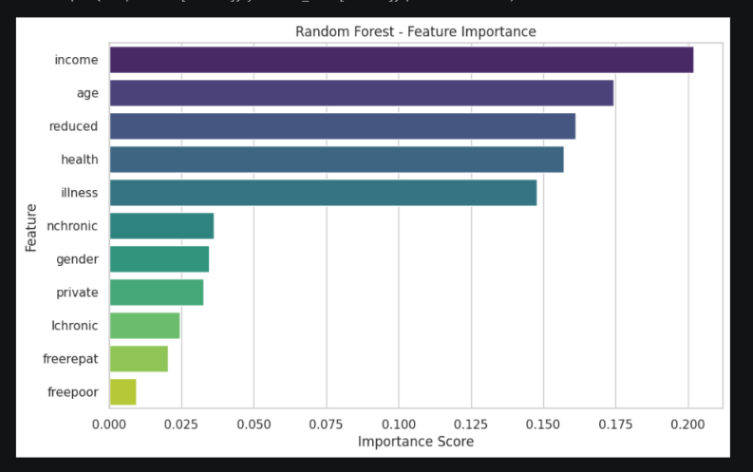
RESULTS
demo link

Slide 15
GitHub Link
https://github.com/Habeebkhan666/Healthcare_Analytics_for_Doctor_Visits_Predicting_Patient_Utilization.git

Slide 16

VOIS Course completion certificate -
Course name- Data Visualization

Slide 17
Thank you
.
.

